Slide 1

Department of Computer Science and Engineering
A Transformer-Based Framework for Domain-Sensitive Amharic–English Neural Machine Translation with Character-Aware Subword Encoding
PRESENTED BY
M.Sai Jyothi (22471A05H1)
D.Divya (22471A05F3)
D.Srujana Sankerthi (22471A05F0)
Under the Guidance of,
Syed Rizwana,_{B.Tech,M.Tech},
Department of Computer Science and Engineering,
Narasaraopeta Engineering College (Autonomous), Narasaraopet- 522 601.
Review No.1
Department of CSE

Slide 2
OUTLINE
Abstract
Introduction
Problem Statement
Literature Survey
Research Gaps
Objectives
Methodology
Block Diagram / Flow Diagram
Implementation
Results and Analysis
Conclusion & Future Scope
References
Question and Answers
Acknowledgements
Review No.
Department of CSE

Slide 3
ABSTRACT
• Developed a Transformer-based neural machine translation model for Amharic–English translation.
• Focused on religious text domain to ensure accurate meaning and style preservation.
• Used SentencePiece subword tokenization and character-aware Transformer to handle Amharic’s complex morphology.
• Trained on a cleaned Tanzil Amharic–English corpus for improved translation quality.
• Achieved a BLEU score of 59.03, outperforming baseline RNN with Attention model (26.08).
• Produced fluent, contextually accurate, and domain-sensitive translations.
• Provides a reproducible and scalable framework for low-resource language translation.
Review No.
Department of CSE

Slide 4
INTRODUCTION
Brief Introduction to the Project
• Designed a Transformer-based Amharic–English translation model for domain-specific texts.
• Aims to improve translation fluency and accuracy for low-resource languages.
Motivation Behind the Project
• Existing NMT systems struggle with Amharic’s complex morphology and limited data.
• Need for accurate and meaningful translation of religious texts.
Importance and Relevance
• Helps preserve and promote the Amharic language digitally.
• Useful for low-resource language research and real-world translation applications.
Review No.
Department of CSE

Slide 5
PROBLEM STATEMENT
• Accurate translation between Amharic and English remains challenging due to complex morphology and limited data.
• Existing NMT systems struggle with word segmentation, context preservation, and rare word handling.
• Most current models are not optimized for domain-specific or low-resource languages.
• The problem addressed is developing an effective Amharic–English translation model using Transformer architecture.
• Significance lies in improving translation fluency, accuracy, and applicability to real-world low-resource domains.
Review No.
Department of CSE

Slide 6
LITERATURE SURVEY
No | Title | Author | Journal Name & Year | Methodology Adapted | Key Findings | Gaps
1 | Neural Machine Translation by Jointly Learning to Align and Translate | Bahdanau | ICLR, 2015 — https://arxiv.org/abs/1409.0473 | RNN encoder–decoder with attention mechanism | Improved translation by aligning source and target words. | Sequential and slow for long sentences; limited context handling.
2 | Subword-Based Transformer for Amharic–English NMT | Gezmu et al. | arXiv, 2022 — https://arxiv.org/abs/2203.00567 | Transformer with subword tokenization (SentencePiece) | Reduced OOV issues and improved BLEU score for Amharic–English. | Limited domain adaptation; lacks character-level integration.
3 | Attention Is All You Need | Vaswani et al. | NeurIPS, 2017 — https://arxiv.org/abs/1706.03762 | Transformer with multi-head self-attention | Achieved better context understanding and parallel learning. | Requires large datasets and high computational resources.
4 | MorphoSeg: Morphologically-Aware Segmentation for Amharic NMT | Gezmu & Nürnberger | LREC, 2022 — https://aclanthology.org/2022.lrec-1.124.pdf | Morpheme-based segmentation integrated with NMT | Enhanced translation for morphologically rich Amharic. | Needs linguistic resources for segmentation.
Review No.
Department of CSE

Slide 7
LITRATURE SURVEY
No | Title | Author | Journal Name & Year | Methodology Adapted | Key Findings | Gaps
5 | Transformer-Based Amharic–English NMT with Character Embedding | Asefa & Assabie | IEEE Access, 2025 — https://ieeexplore.ieee.org/document/10813169 | Character-aware Transformer with combined regularization | Achieved higher BLEU and better fluency in low-resource setups. | Computationally heavy and complex to reproduce.
Summary of Relevant Literature
• Existing NMT models show strong results but struggle with low-resource and morphologically rich languages.
• Subword and morpheme-based tokenization methods improve translation by reducing OOV errors.
• Transformer architectures provide superior context understanding and fluency.
Review No.
Department of CSE

Slide 8
LITERATURE SURVEY
Key Findings and Relation to Project
• This project combines Transformer + SentencePiece + character awareness for Amharic–English NMT.
• Addresses identified gaps in morphology handling, domain adaptation, and dataset scarcity.
• Builds on proven methods while tailoring them for low-resource translation performance.
Review No.
Department of CSE

Slide 9
RESEARCH GAPS
• Limited work done on Amharic–English translation compared to other high-resource languages.
• Existing word-based and RNN-based models fail to handle Amharic’s morphological complexity.
• Lack of domain-specific translation systems for religious or specialized text.
• Insufficient parallel corpus and low-resource data availability.
• Current models show poor fluency and context retention in translations.
• Need for a domain-sensitive Transformer model combining subword and character-level encoding.
Review No.
Department of CSE

Slide 10
OBJECTIVES
To overcome the limitations of existing translation systems such as Google Translate in handling Amharic’s complex word morphology.
To design a Transformer-based Amharic–English model that produces contextually accurate and fluent translations.
To implement subword and character-level tokenization to reduce word-level errors and improve translation quality.
To achieve higher BLEU score and better performance for domain-specific (religious) text translation.
Review No.
Department of CSE

Slide 11
METHODOLOGY
Dataset: OPUS Tanzil corpus – 25,000 Amharic–English sentence pairs.
Preprocessing: Cleaning, normalization, and removal of malformed or duplicate pairs.
Tokenization: SentencePiece with 8,000 vocabulary size for each language.
Model: Transformer (2-layer encoder–decoder, 8 heads,518-FFN)
Training: Adam optimizer (lr=1e-4), 15 epochs, batch size 64, dropout=0.1.
  Training: 19,032 pairs (80%)
  Validation: 2,379 pairs (10%)
  Test: 2,379 pairs (10%)
Evaluation: BLEU-4 metric via SacreBLEU and qualitative translation analysis
Review No.
Department of CSE

Slide 12
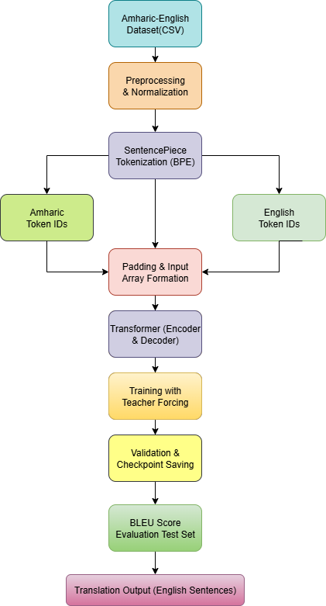
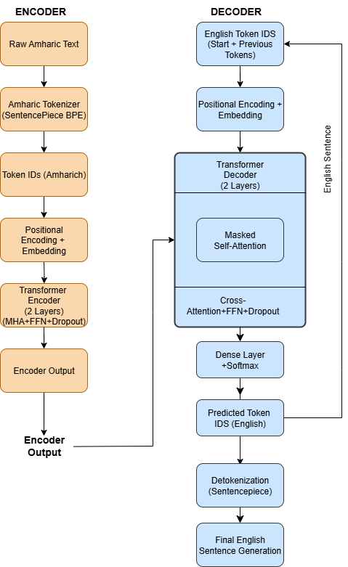
FLOW DIAGRAM
Workflow of proposed model Architecture of proposed model
Review No.
Department of CSE

Slide 13
IMPLEMENTATION
Software Specifications:
Programming Language: Python
Frameworks: TensorFlow, SentencePiece, NumPy, Matplotlib
Environment: Google Colab with GPU acceleration
Operating System: Windows 11
Libraries Used: SacreBLEU, Pandas, Transformers API
Hardware Specifications:
Processor: Intel Core i5
RAM: 8 GB or higher
GPU: NVIDIA Tesla T4 (provided by Colab)
Storage: 5 GB dataset and model files
Review No.
Department of CSE

Slide 14
IMPLEMENTATION
Implementation Steps:
– Loaded and preprocessed the OPUS Tanzil Amharic–English dataset.
– Applied SentencePiece subword tokenization (vocab size 8,000).
– Built Transformer architecture (2-layer Encoder–Decoder).
– Trained model for 15 epochs using Adam optimizer (lr = 1e-4).
– Evaluated translations using BLEU-4 metric (SacreBLEU).
Challenges Faced:
– Limited availability of clean Amharic–English parallel data.
– Morphological complexity caused token fragmentation.
– High GPU time and memory usage during training.
How Challenges Were Overcome:
– Used SentencePiece subword encoding to reduce OOV issues.
– Optimized model parameters for low-resource efficiency.
– Leveraged Google Colab GPU to speed up training and evaluation.
Review No.
Department of CSE

Slide 15
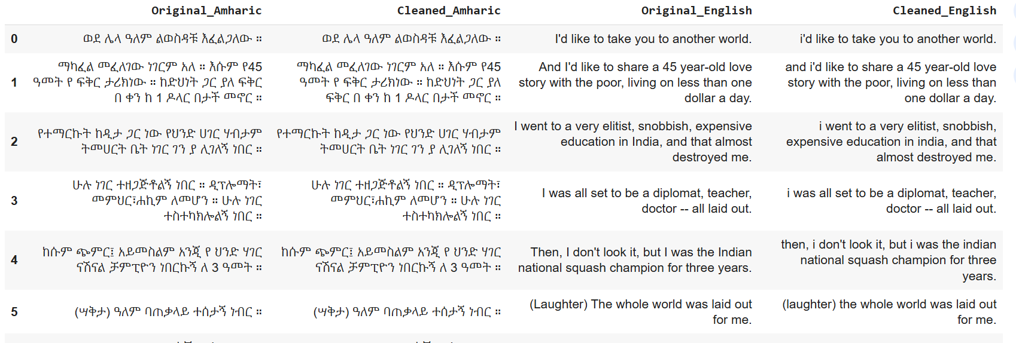
Before and After preprocessing
Review No.
Department of CSE

Slide 16
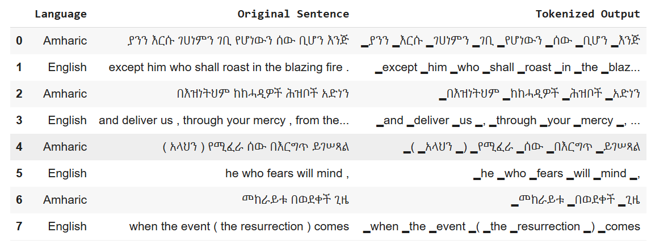
After Applying Tokenization

Slide 17
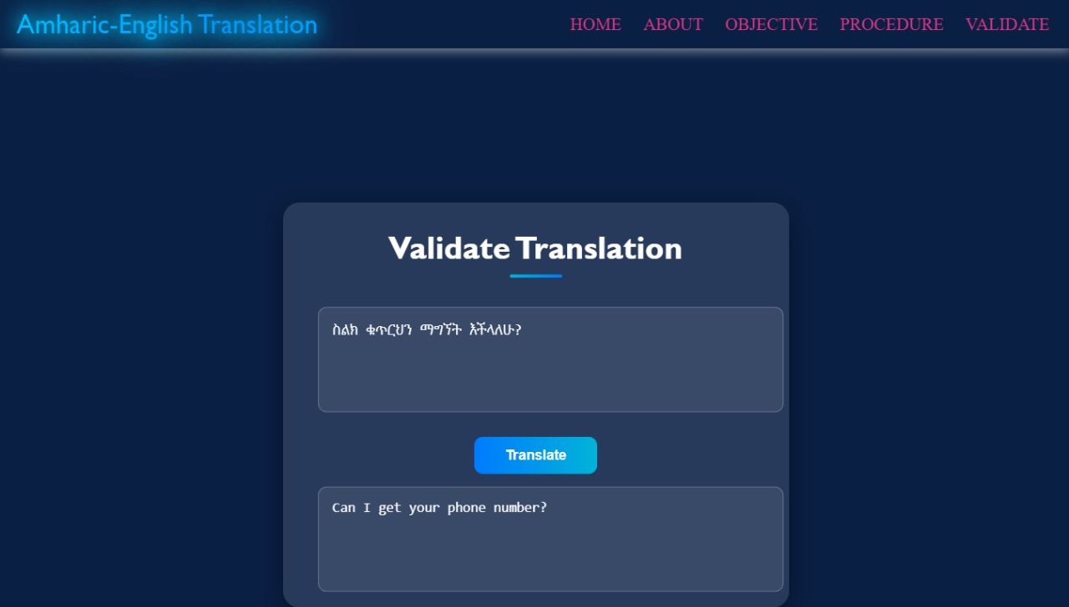

Slide 18
RESULTS & ANALYSIS
BLEU Score (Test): 59.03 – outperforming RNN baseline (26.08) and prior Transformer (40.59).
Validation Loss: 0.0605 after 15 epochs.
Convergence observed with minimal overfitting (Training vs Validation Loss stable).
SentencePiece effectively handled morphological variations.
Qualitative results confirmed accurate and fluent Amharic–English translations.
Review No.
Department of CSE

Slide 19
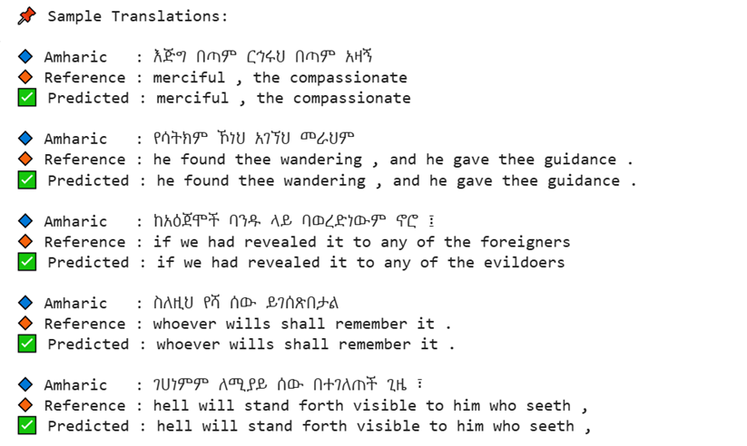
RESULTS & ANALYSIS
Sample Output obtained by Proposed Model
Review No.
Department of CSE

Slide 20
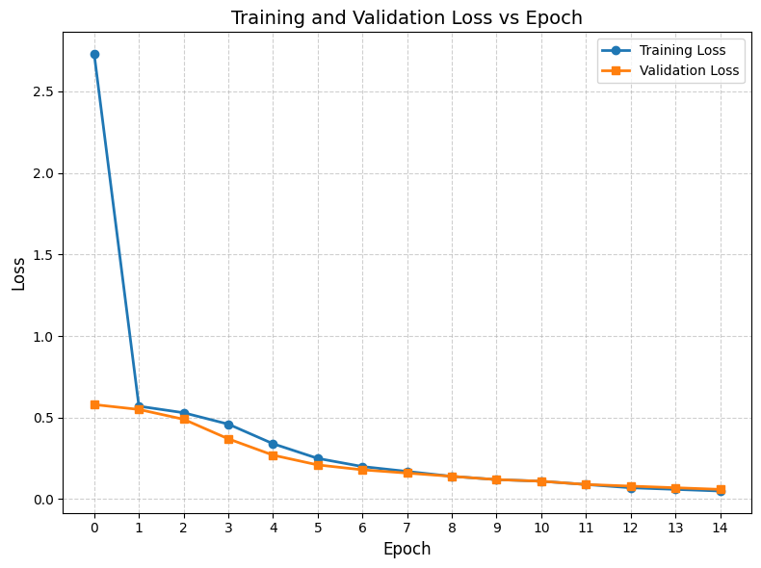
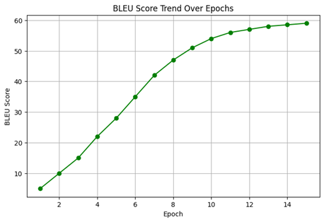

Slide 21
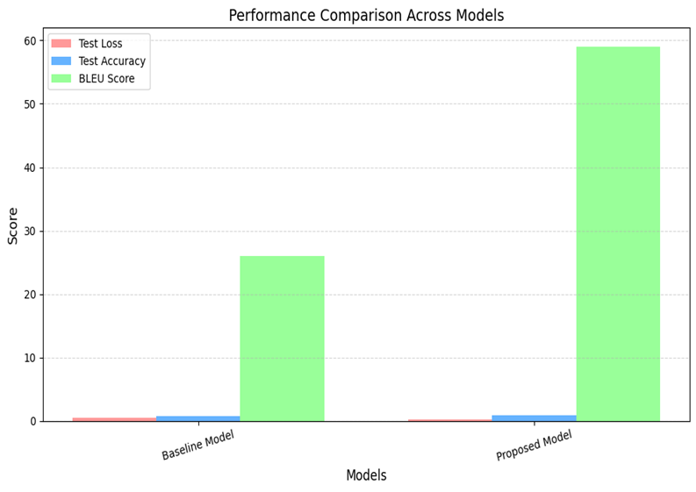
Review No.
Department of CSE

Slide 22
CONCLUSION and FUTURE SCOPE
Developed an effective Transformer-based NMT system for Amharic–English translation.
Achieved state-of-the-art BLEU performance through subword tokenization and domain adaptation.
Limitations:
Used greedy decoding; limited regularization techniques.
Future work:
Implement beam search, label smoothing, multilingual pretraining, and extend to other domains.
Explore transfer learning using multilingual pre-trained models.
Extend to other Semitic or African languages and non-religious domains.
Review No.
Department of CSE

Slide 23
REFERENCES
D. Bahdanau et al., “Neural machine translation by jointly learning to align and translate,” ICLR, 2015. https://arxiv.org/abs/1409.0473
T. Mikolov et al., “Efficient estimation of word representations in vector space,” arXiv, 2013. https://arxiv.org/abs/1301.3781
A. Vaswani et al., “Attention is all you need,” NeurIPS, 2017. https://papers.nips.cc/paper/2017/file/3f5ee243547dee91fbd053c1c4a845aa-Paper.pdf
G. Gezmu et al., “Subword-based transformer NMT models for Amharic-English,” arXiv, 2022. https://arxiv.org/abs/2203.00567
M. Artetxe and H. Schwenk, “Massively multilingual sentence embeddings for zero-shot cross-lingual transfer,” TACL, 2019. https://aclanthology.org/Q19-1042.pdf
Review No.
Department of CSE

Slide 24
REFERENCES
G. Gezmu and A. Nürnberg, “MorphoSeg: Morphologically-aware segmentation for Amharic NMT,” LREC, 2022. https://aclanthology.org/2022.lrec-1.124.pdf
B. Belay and Y. Assabie, “Improving Amharic–English machine translation using homophone normalization,” arXiv, 2023. https://arxiv.org/abs/2302.10934
Kudo and J. Richardson, “SentencePiece: Language-independent subword tokenizer,” EMNLP, 2018. https://aclanthology.org/D18-2012.pdf
S. Hochreiter and J. Schmidhuber, “Long short-term memory,” Neural Computation, 1997. https://www.bioinf.jku.at/publications/older/2604.pdf
Y. Zhang et al., “Character-level representations improve translation for morphologically rich languages,” ACL, 2020. https://aclanthology.org/2020.acl-main.430.pdf
Review No.
Department of CSE

Slide 25
REFERENCES
Y. Liu et al., “Multilingual denoising pre-training for NMT,” TACL, 2020. https://aclanthology.org/2020.tacl-1.47.pdf
H. Zhou et al., “Understanding dropout in deep learning,” NeurIPS, 2022. https://arxiv.org/abs/2205.13055
D. Variš and O. Bojar, “EWC for low-resource neural machine translation,” arXiv, 2023. https://arxiv.org/abs/2301.00251
T. Wolf et al., “Transformers: State-of-the-art NLP,” EMNLP Demos, 2020. https://aclanthology.org/2020.emnlp-demos.6.pdf
S. H. Asefa and Y. Assabie, “Transformer-based Amharic-to-English MT with character embedding,” IEEE Access, 2025. https://ieeexplore.ieee.org/document/10813169
Review No.
Department of CSE

Slide 26
QUESTIONS and ANSWERS
Thank you for the opportunity to present my project.
I would be happy to answer any questions or provide further details.
Review No.
Department of CSE

Slide 27
ACKNOWLEGEMENTS
THANK YOU!!!
Review No.
Department of CSE

