Slide 1
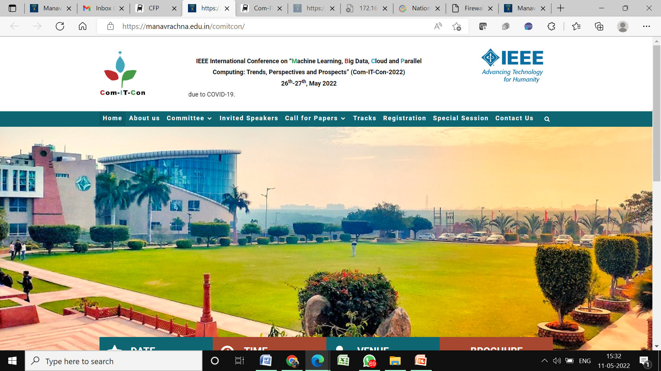
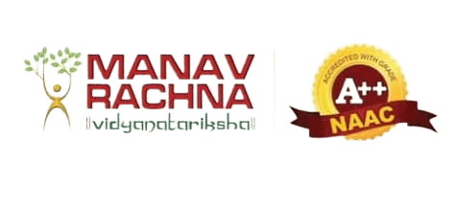
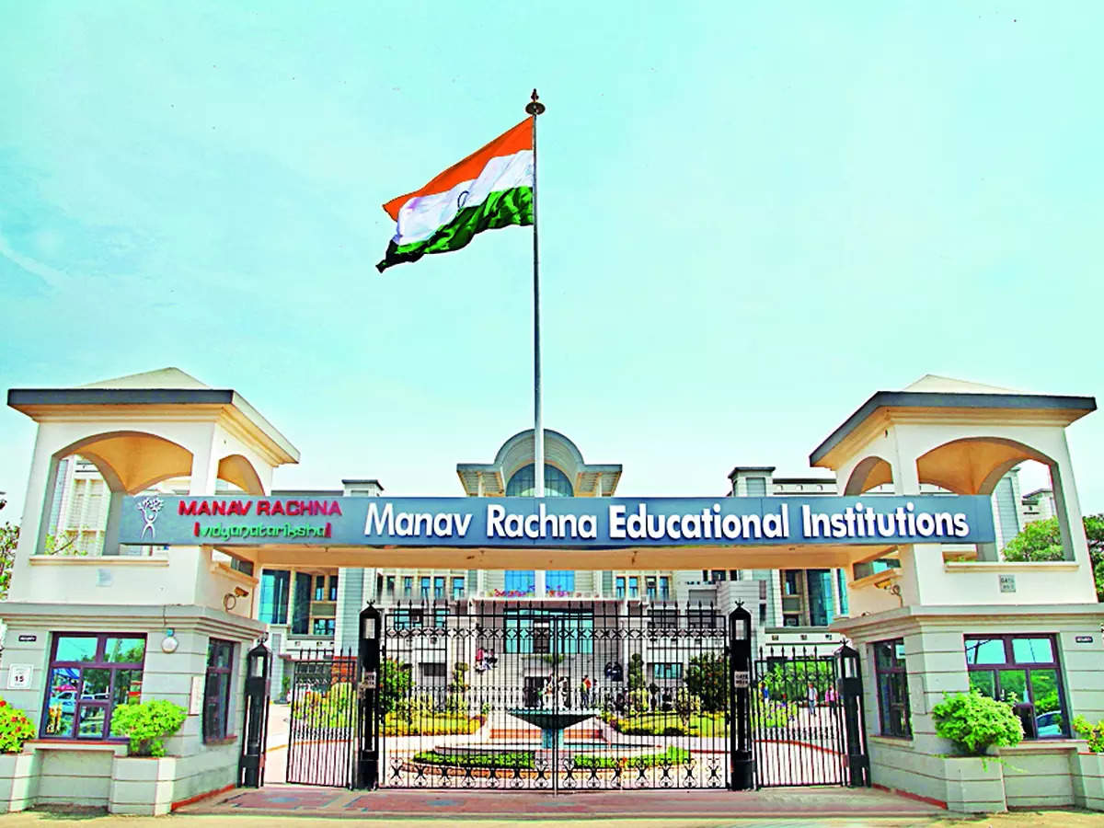
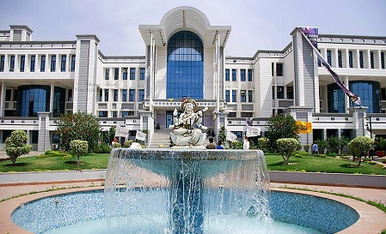
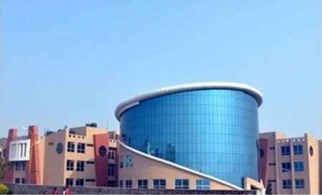
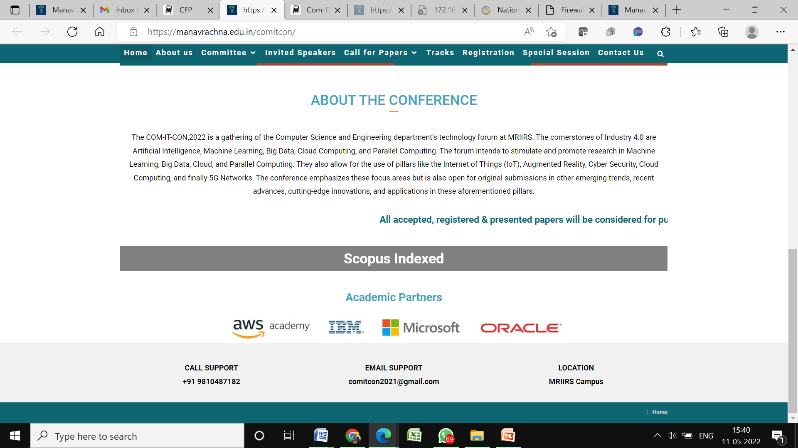
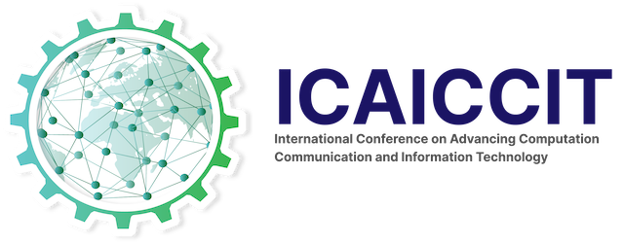

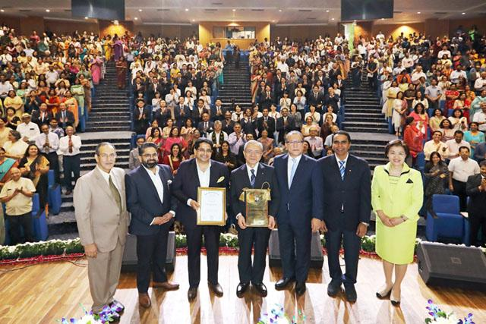
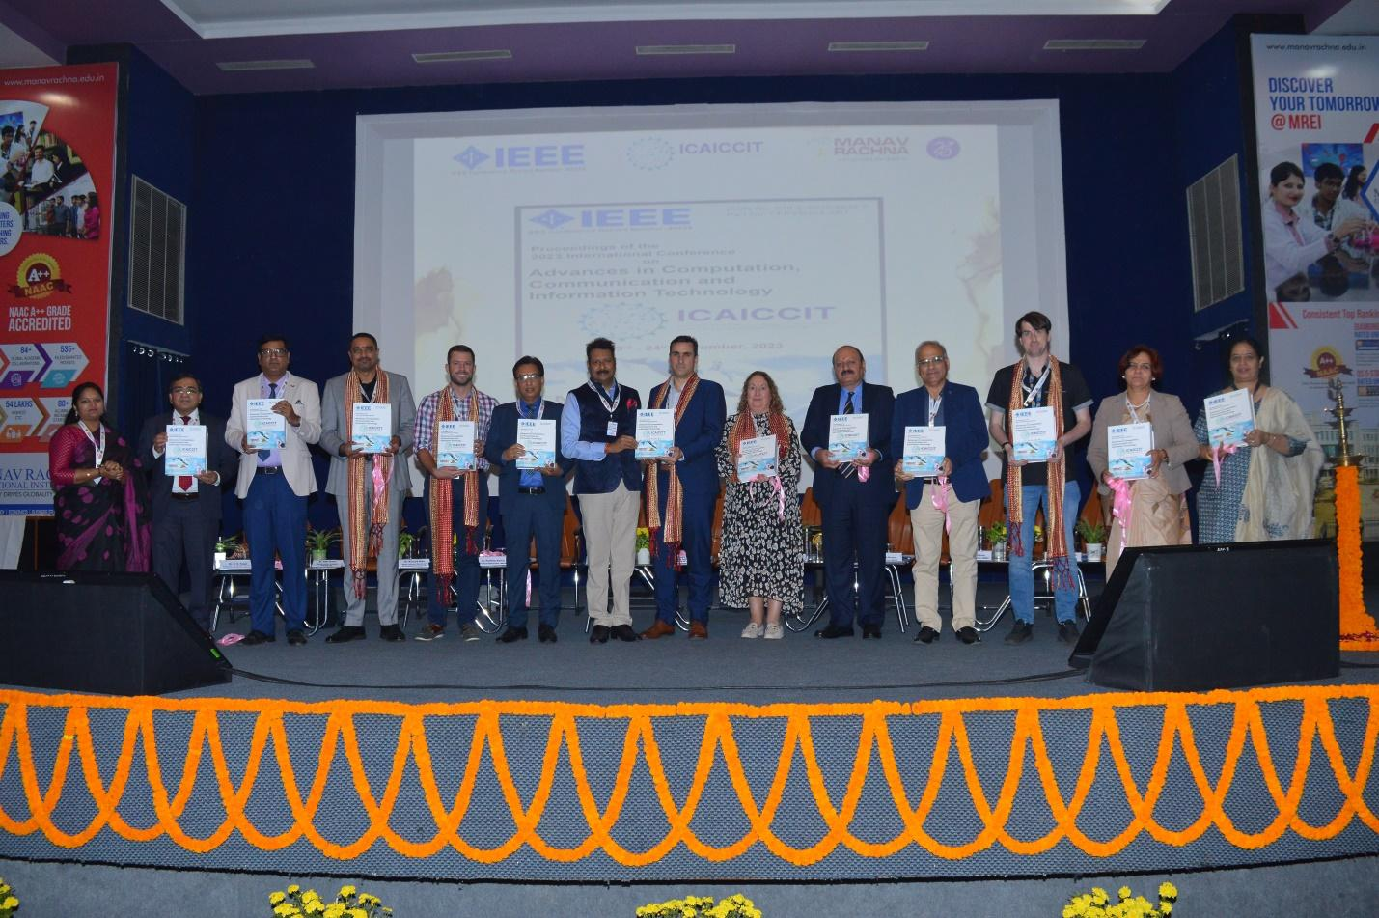
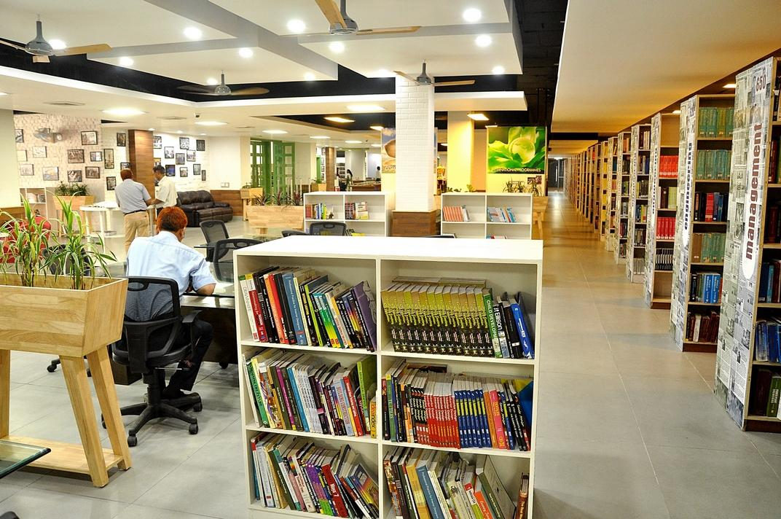
ICAICCIT-2025, 3rd International conference on Advances in Computing, Communication and Information Technology, technically Co-Sponsored by IEEE Delhi SECTION (IEEE record no # 68829)
on 31st Oct & 1st Nov. 2025

Slide 2
A Transformer-Based Framework for Domain-Sensitive Amharic-English Neural Machine Translation with Character-Aware Subword Encoding
Paper-ID -00477
Presented BY
Mallela Sai Jyothi
y
Rajeswari Makkena
Authors Name & Affiliation
Syed Rizwana
Dept. Of Computer Science and Engineering, NEC
Mallela Sai Jyothi
Dept. Of Computer Science and Engineering, NEC
Duddu Divya
Dept. Of Computer Science and Engineering, NEC
Dasari Srujana Sankeerthi
Dept. Of Computer Science and Engineering, NEC
V.Lakshmi
Dept. Of Computer Science and Engineering, GRIET
Yerraparu Sravani Devi
Dept. Of Computer Science and Engineering, GNITS

Slide 3
Contents
Introduction
Problem Statements
Objectives
Literature Review
Methodology
Result & Discussion
Conclusion & Future Scope
References

Slide 4
  Introduction
Neural Machine Translation (NMT) has transformed language translation through data-driven deep learning approaches.
The Transformer model introduced by Vaswani et al. (2017) replaced recurrence with attention, improving efficiency and scalability.
Amharic, a Semitic language, presents challenges due to rich morphology and limited bilingual data.
This project aims to address these issues through a domain-sensitive, character-aware Transformer architecture.

Slide 5
Problem Statement
Lack of high-quality Amharic–English parallel datasets.
Morphological complexity and agglutination lead to high out-of-vocabulary (OOV) rates.
General-purpose translators perform poorly on domain-specific texts such as religious literature.
Need for a low-resource, domain-sensitive translation system that preserves semantics and fluency.

Slide 6
Objectives
Develop a Transformer-based NMT system for Amharic–English translation in the religious domain.
Employ SentencePiece subword tokenization to mitigate OOV issues.
Utilize dropout regularization and early stopping to improve generalization.
Evaluate the model with BLEU metric and compare it to baseline architectures.

Slide 7
Literature Review
Subword and character-level models improve performance in low-resource NMT (Gezmu et al., 2022)
SentencePiece provides language-independent segmentation for morphologically rich languages.
Domain adaptation enhances fluency and semantic preservation in specialized texts.
Asefa & Assabie (2025) achieved BLEU 40.59; this work surpasses it with BLEU 59.03 using domain-specific techniques.

Slide 8
Methodology
Dataset: OPUS Tanzil corpus – 25,000 Amharic–English sentence pairs.
Preprocessing: Cleaning, normalization, and removal of malformed or duplicate pairs.
Tokenization: SentencePiece with 8,000 vocabulary size for each language.
Model: Transformer (2-layer encoder–decoder, 8 heads,518-FFN)
Training: Adam optimizer (lr=1e-4), 15 epochs, batch size 64, dropout=0.1.
  Training: 19,032 pairs (80%)
  Validation: 2,379 pairs (10%)
  Test: 2,379 pairs (10%)
Evaluation: BLEU-4 metric via SacreBLEU and qualitative translation analysis.

Slide 9
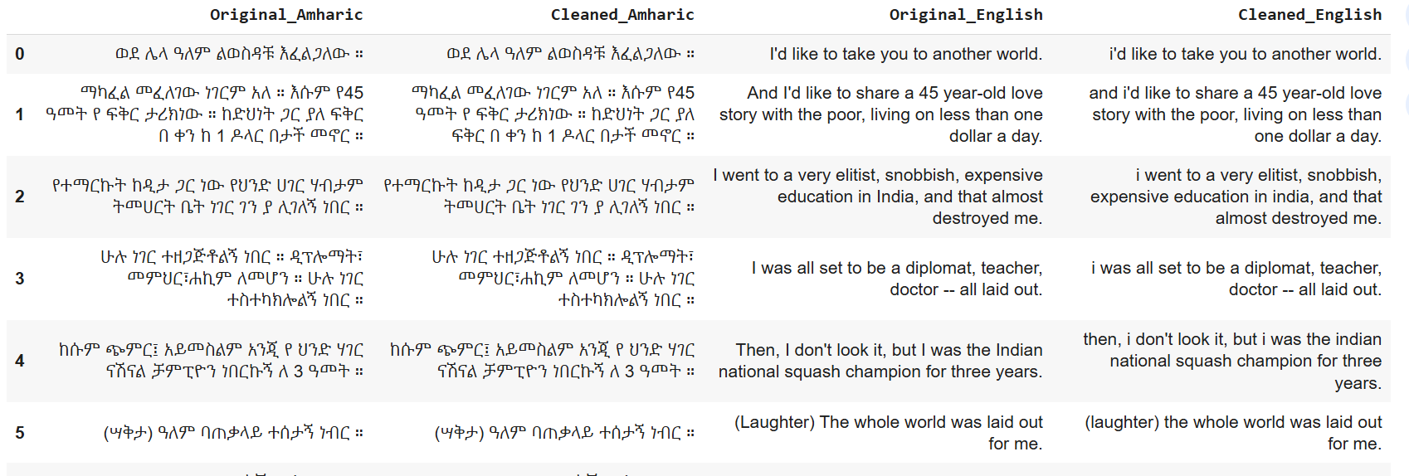
Before and After preprocessing

Slide 10
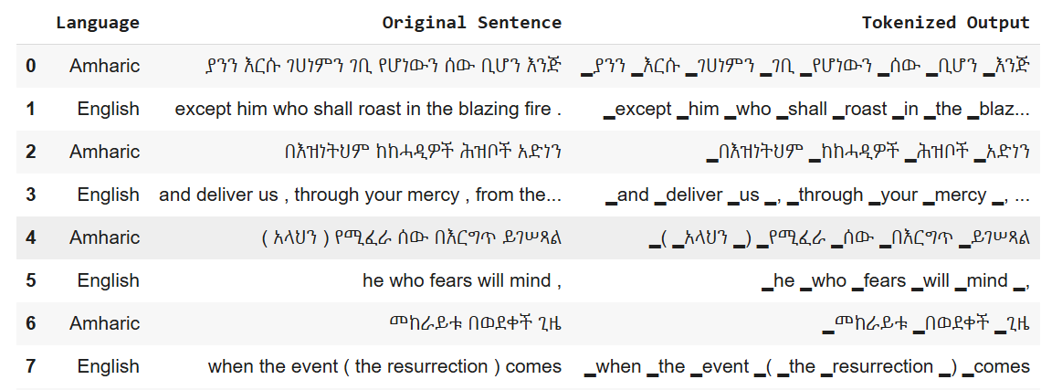
After Applying Tokenization

Slide 11
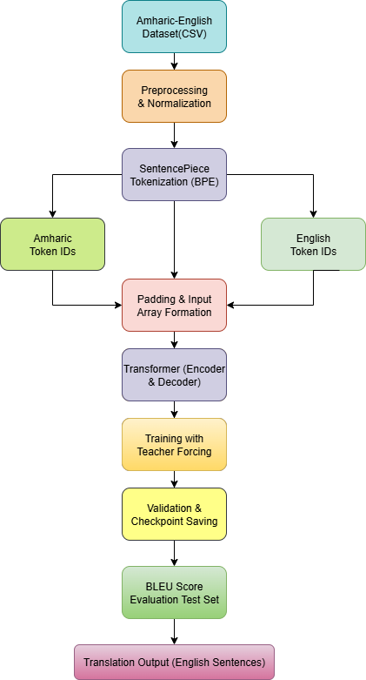
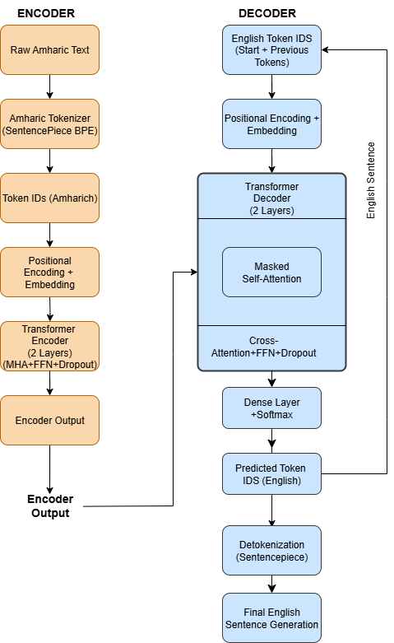
Workflow of proposed model Architecture of pro[posed model

Slide 12
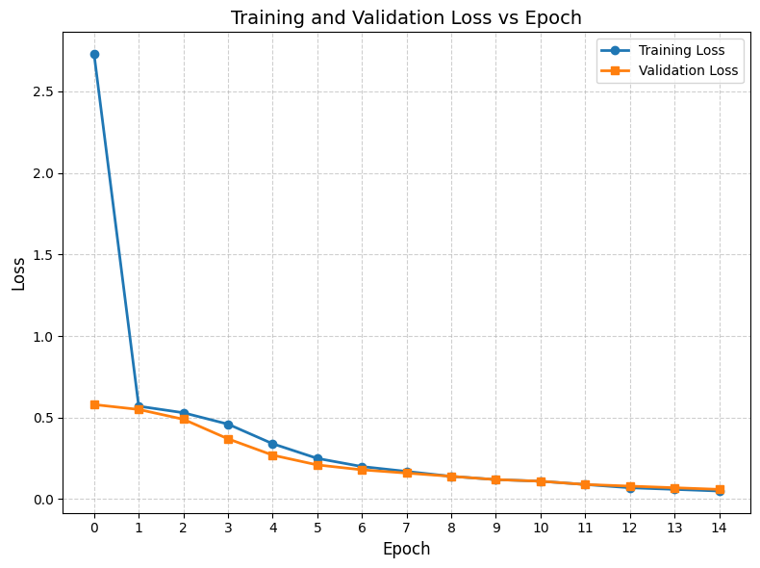
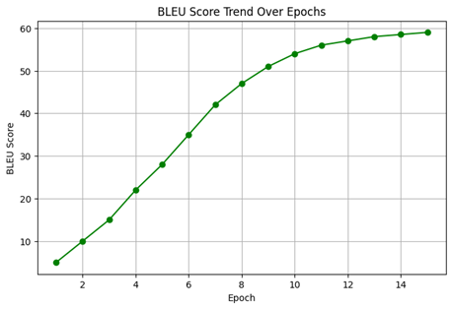

Slide 13
Results & Discussion
BLEU Score (Test): 59.03 – outperforming RNN baseline (26.08) and prior Transformer (40.59).
Validation Loss: 0.0605 after 15 epochs.
Convergence observed with minimal overfitting (Training vs Validation Loss stable).
SentencePiece effectively handled morphological variations.
Qualitative results confirmed accurate and fluent Amharic–English translations.

Slide 14
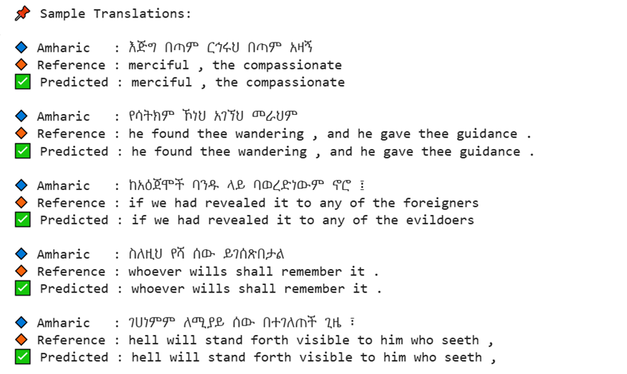
Sample Output obtained by Proposed Model

Slide 15
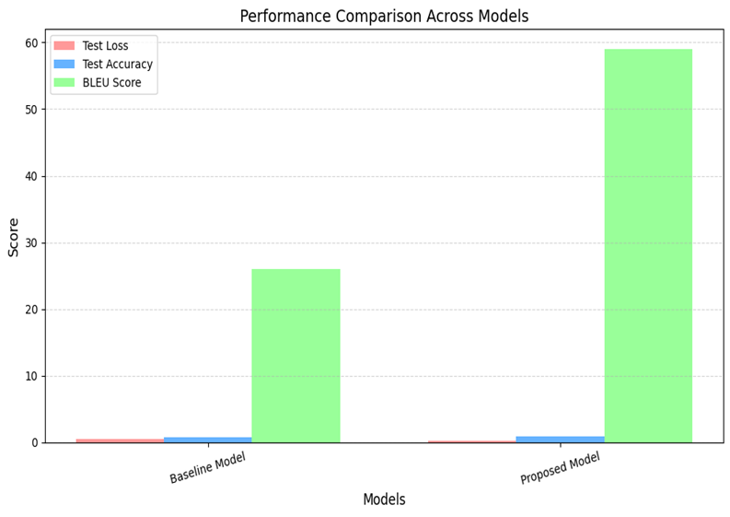

Slide 16
Conclusion & Future Scope
Developed an effective Transformer-based NMT system for Amharic–English translation.
Achieved state-of-the-art BLEU performance through subword tokenization and domain adaptation.
Limitations:
Used greedy decoding; limited regularization techniques.
Future work:
Implement beam search, label smoothing, multilingual pretraining, and extend to other domains.
Explore transfer learning using multilingual pre-trained models.
Extend to other Semitic or African languages and non-religious domains.

Slide 17
References
A. Vaswani et al., “Attention Is All You Need,” NeurIPS, 2017.
G. Gezmu et al., “Subword-Based Transformer NMT Models for Amharic–English,” arXiv, 2022.
B. Belay & Y. Assabie, “Improving Amharic–English Machine Translation,” arXiv, 2023.
S. H. Asefa & Y. Assabie, “Transformer-Based Amharic-to-English Machine Translation,” IEEE Access, 2025.
Tanzil Project: https://opus.nlpl.eu/Tanzil.php

Slide 18
THANK YOU!!

