Slide 1








Blockchain
[C3] Complex Proof of Storage
$$F^{(2)}$$
Storage Miners
[C1] Difficulties in Managing Multi-Version Files
$$F^{(1)}$$
$$F^{(3)}$$
[C2] Data Privacy Leakage
$$F^{(4)}$$
File (Version 4)

Slide 2
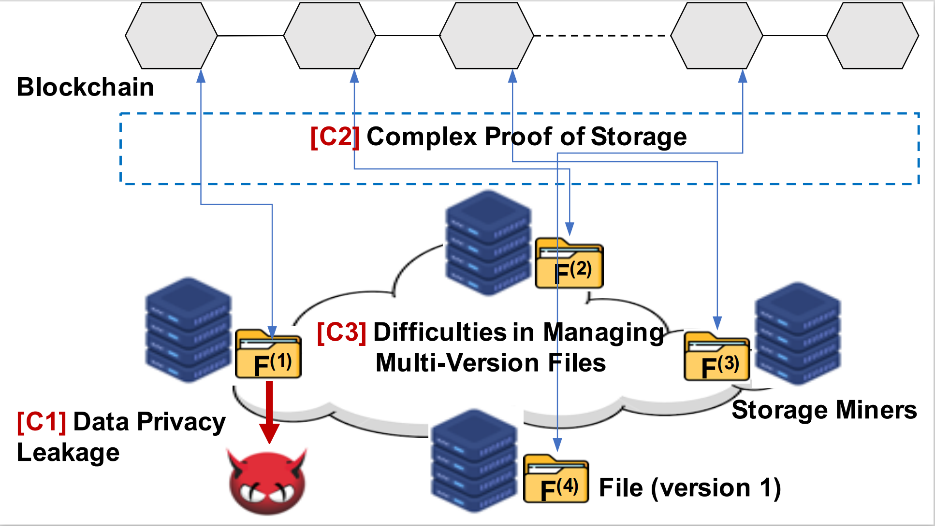

Slide 3








Client
SM
SC
RoM
ReM
RandomSelect
1.1 PoES.Setup
DSN.Put
Store file
Compute $π_{POS}$
1.2 PoES.Prove
Upload $π_{POS}$
Send challenge $c$
2.1 PoES.CycleProve
Compute $π_{POST}$
Upload $π_{POST}$
2.2 PoES.Verify
3.1 Rollup.Prepare
Send data
Fetch $\vec{π_{POST}}$
3.2 Rollup.Collect
3.3 Rollup.Aggregate
Compute $π_{ROLL}$
DSN.Get
Upload $π_{ROLL}$
4 Retrieve
Dec & Recover

Slide 4
Node Authentication
Consensus
Message Pool
Gateway
Public Service
Deal
Message
Deal
Message
Increment
[200LOC]
Upload&Retrieve
[300LOC]
Storage Miner
[1200LOC]
Retrieval Miner
[400LOC]
Enc&Dec
[400LOC]
Rollup Miner
[1050LOC]
Client
Miner
Notes:
Malware icon：通用标签（google搜索有很多素材）
画图的逻辑：通用性，简单化，阶梯型，电路图（不要直来直去，太乱），对齐（节省空白）

Slide 5
Ensure secure encrypted data storage, maintain data availability.
Secure
FileDES
High system scalability, decrease the hardware requirements.
Proof succinctness, only one proof submitted for a multi-version file.
Scalable
Succinct

Slide 6



Other client
Encrypt with pk
Get
Other client
Get
File owner
File owner
Plaintext Storage
Simple Encryption Storage

Slide 7







$${sk}_{1}$$
Share
…
RSA
$${sk}_{n}$$
Public file
$${pk}_{1}$$
Authenticate
User file
…
$${pk}_{n}$$
PRE
Private file

Slide 8








$$sk$$
DSN
$$pk$$
DSN
Encrypt
Encrypt
$$rk$$
$$sk$$
Re-Encrypt
Re-key Gen
Shared
$$pk$$
$$sk$$
$$rk$$
$$pk$$
Decrypt
Decrypt

Slide 9



Upload
$$sk$$
Upload
Encrypt
Generate
SDRG
Directly store
Re-generate when challenged
Re-generate when challenged
Time limit
$sk$ is not shared

Slide 10





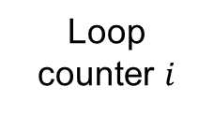
PoES.Prove
rt
Loop counter $i$
PoES.Prove
$$c_{i}$$
$$c$$
Generate new challenge
$π_{PoSt}$ at $i$
Challenge
Repeat $t$ times
PoES.CycleProve
File
Challenge $c$

Slide 11


rt
$$π_{PoS}$$
$$c$$
File
Challenge
PoES.Prove

Slide 12






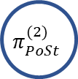







$$π_{PoSt}^{(1)}$$
$$π_{PoSt}^{(1)}$$
$$F^{(1)}$$
$$F^{(1)}$$
$$π_{PoSt}^{(2)}$$
$$π_{PoSt}^{(2)}$$
$$F^{(2)}$$
$$I^{(2)}$$
Aggregate
…
…
$$π_{PoSt}^{(n)}$$
$$π_{PoSt}^{(n)}$$
$$F^{(n)}$$
$$I^{(n)}$$

Slide 13












$$π_{PoSt}^{(1)}$$
Verify version 1
$$π_{PoSt}^{(1)}$$
$$F^{(1)}$$
$$F^{(1)}$$
+
$$π_{PoSt}^{(2)}$$
Verify version 2
$$π_{PoSt}^{(2)}$$
$$F^{(2)}$$
$$F^{(2)}$$
…
…
…
+
$$π_{PoSt}^{(n)}$$
Verify version n
$$π_{PoSt}^{(n)}$$
Verify version n
$$F^{(n)}$$
$$F^{(n)}$$
Verification of Multi-Version File in DSN
Verification of Multi-Version File with Deduplication

Slide 14











Zk-proof
Prev State Root
Post State Root
$$rt$$
$${rt}^{′}$$
Transaction1
Transaction2
…
Check
$$a_{0}$$
$$a_{1}$$
$$a_{2}$$
$$a_{3}$$
$$a_{0}^{′}$$
$$a_{1}^{′}$$
$$a_{2}^{′}$$
$$a_{3}^{′}$$
Account Data
Account Data

Slide 15
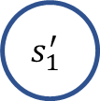


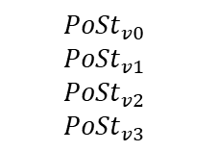





Zk-proof
Prev State Root
Post State Root
$$rt$$
$${rt}^{′}$$
$${PoSt}_{v0}$$
$${PoSt}_{v1}$$
$${PoSt}_{v2}$$
$${PoSt}_{v3}$$
Check
$$s_{0}$$
$$s_{1}$$
$$s_{2}$$
$$s_{3}$$
$$s_{0}^{′}$$
$$s_{1}^{′}$$
$$s_{2}^{′}$$
$$s_{3}^{′}$$
File Storage State
File Storage State

Slide 16











$$rt$$
$${rt}^{′}$$
Prev State Root
Post State Root
$${PoSt}_{v0}$$
$${PoSt}_{v1}$$
$${PoSt}_{v2}$$
$${PoSt}_{v3}$$
Submit
Zk-proof
Check
$$s_{0}$$
$$s_{1}$$
$$s_{2}$$
$$s_{3}$$
$$s_{0}^{′}$$
$$s_{1}^{′}$$
$$s_{2}^{′}$$
$$s_{3}^{′}$$
Multi-version file storage state
Multi-version file storage state

