Slide 1
Dynamic Programming

Slide 2
Broad Steps
Characterize the structure of an optimal solution.
Recursively define the value of an optimal solution.
Compute the value of an optimal solution, typically in a bottom-up fashion.
Construct an optimal solution from computed information.
NOTE:
Steps 1–3 : basis of a dynamic-programming solution
If we need only the value of an optimal solution, and not the solution itself, then we can omit step 4.
When we do perform step 4, we sometimes maintain additional information during step 3 so that we can easily construct an optimal solution.

Slide 3

Rod Cutting Problem
Given a rod of length n inches and a table of prices pi for I = 1, 2, …, n determine the maximum revenue rn obtainable by cutting up the rod and selling the pieces.
Note that if the price pn for a rod of length n is large enough, an optimal solution may require no cutting at all

Slide 4
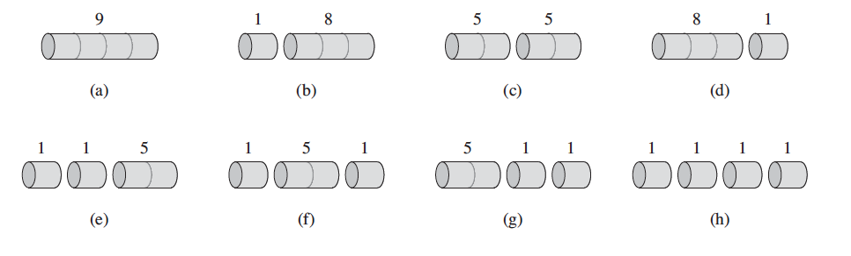


Pn – sell the rod without any cut; other n -1 arguments to max corres. To max revenue obtained by making an initial cut of the rod into two pieces of size i and n - i , for i = 1, 2, … n -1, and then optimally cutting up those pieces further, obtaining revenues ri and r<n-i>

Slide 5
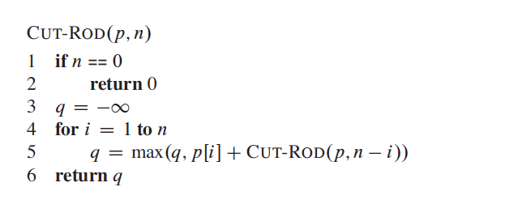
Recursive Alg.
How Ineffcient it is?

Slide 6
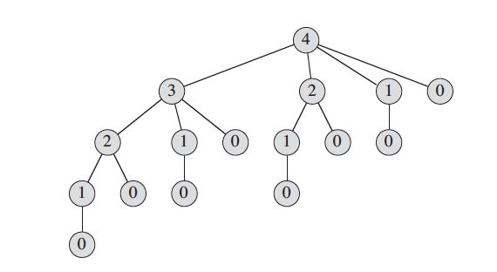

2**N --Exponential

Slide 7
Dynamic Programming Approach
Recursive solution is inefficient because it solves the same sub-problems repeatedly,
So arrange for each sub-problem to be solved only once, saving its solution.
If we need to refer to this subproblem’s solution again later, we can just look it -- MEMOIZATION
Space is increased

Slide 8
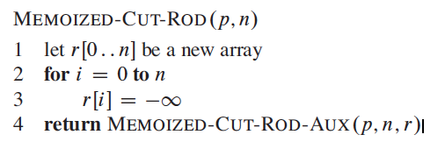
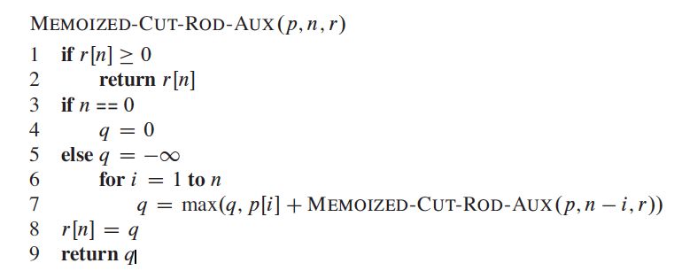
TOP DOWN WITH MEMOIZATION

Slide 9
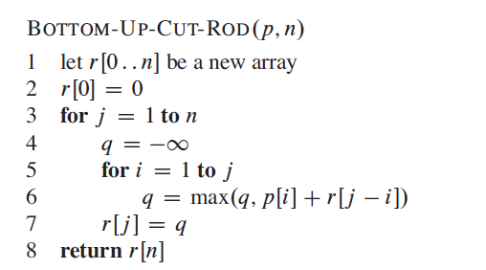
Bottom Up Method

Slide 10

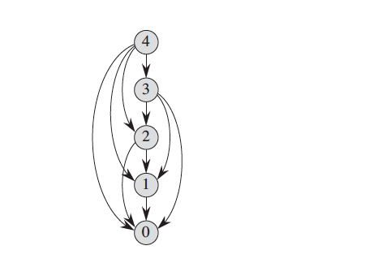
The vertex labels give the sizes of the corresponding sub-problems.
A directed edge (x,y) indicates that we need a solution to subproblem y when solving
subproblem x. -- Compare to the tree shown earlier

Slide 11
Complexity
Asymptotic same for both O(n^2)

Slide 12
Reconstructing a solution
The solutions to the rod-cutting problem return the value of an optimal solution, but they do not return an actual solution: a list of piece sizes.
We can extend the dynamic-programming approach to record not only the optimal value computed for each subproblem, but also a choice that led to the optimal value.
With this information, we can readily print an optimal solution.

Slide 13
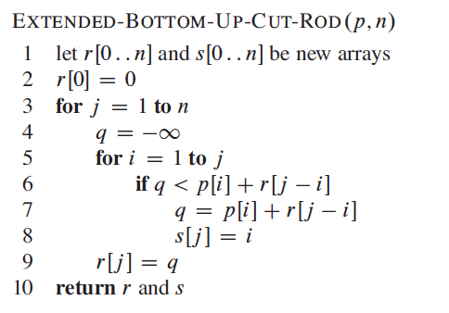

Slide 14
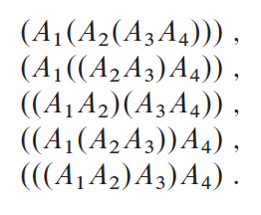
Matrix Multiplication
A1 x A2 x A3 x A4

Slide 15
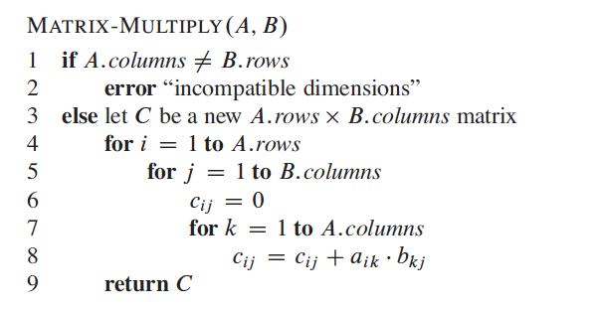
Matrix Multiplication

Slide 16

We are not actually multiplying the matrices
We are only setting the order of the multiplication

Slide 17
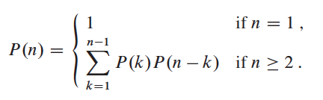
Number of Parenthesizations
Denote the number of alternative parenthesizations of a sequence of n matrices by P(n).
When n = 1, we have just one matrix and therefore only one way to fully parenthesize the matrix product.
When n >= 2, a fully parenthesized matrix product is the product of two fully parenthesized matrix subproducts, and the split between the two subproducts may occur between the kth and (k+1)st matrices for any k = 1, 2, …, n .
The recurrence is given below (You can see no. of solutions is exponential)

