Slide 1

Object Oriented Programming Concepts

Slide 2
Topics
Abstraction
Encapsulation
Inheritance
Polymorphism
Method Overloading
Method Overriding
Constructor execution sequence
Interfaces

Slide 3
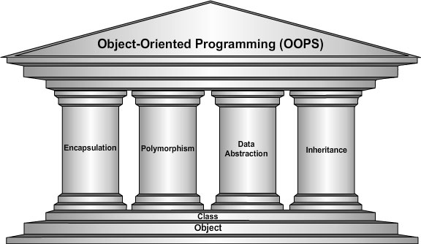
Four Pillars of OOP

Slide 4
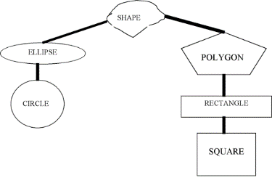
Abstraction
Centralize common characteristics
Reduce complexity
Increase coding efficiency
Eliminate duplicate code
Generalize behavior into conceptual classes
Provide a template for other classes

Slide 5
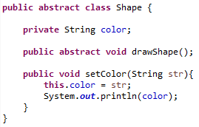
Abstract Keyword
Abstract classes and methods use the abstract modifier
Abstract classes cannot be instantiated!
An abstract method does not have a body
No braces or implementation
Terminated with semicolon
Abstract class can have both:
Abstract methods
Concrete methods

Slide 6
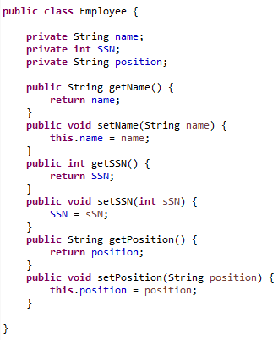
Encapsulation
Restriction of access to class members
Class members packaged into one component
Variables declared private to hide data
External classes retrieve data through public methods
Maintains boundaries between components
Separation of concerns

Slide 7
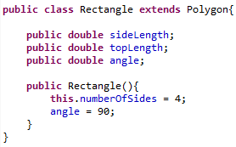
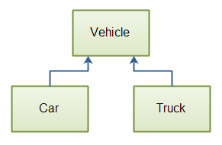
Inheritance
A class can inherit members from another class
A class can extend another class’s functionality
The class that extends another is called a sub-class
Also called child class
The class that is extended is the super-class
Also called parent class
Car IS A Vehicle
Truck IS A Vehicle

Slide 8
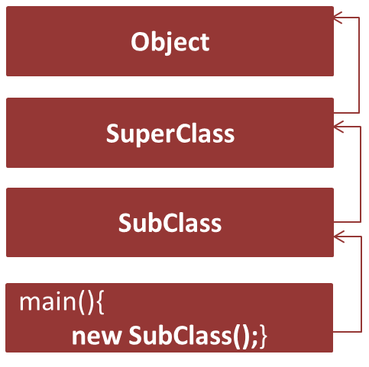

Constructor Execution
When an object is constructed, the JVM calls:
super( );
Calls the no-arg constructor of its parent
This continues to chain up the tree
When the Object constructor is called…

Slide 9


Polymorphism/Method Overriding
From Greek:
πολύς, polys, "many, much"
and μορφή, morphē, "form, shape”
A class can take many forms
Polymorphism is achieved through:
Subclasses
Method overriding
Methods in a subclass override a parent:
When the method signature is identical
When the method has the same parameters
Notes:
Method overriding is a type of “run-time polymorphism”

Slide 10

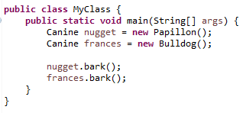
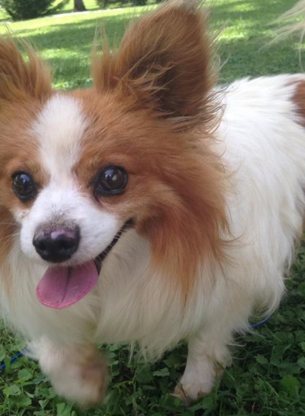

Polymorphism in Practice
Deep, intimidating bark!
Tiny, yappy bark!

Slide 11
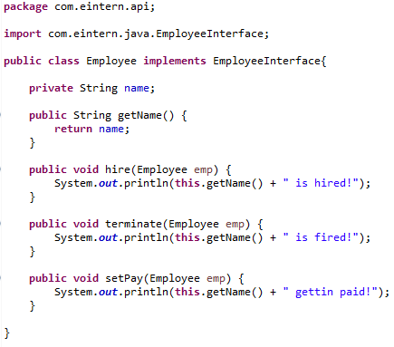
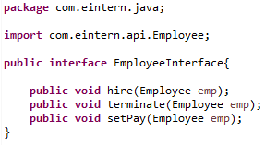
Interfaces
Interfaces are blank templates
Used to define class behavior
Enforce behavior from subclasses
Hide implementation details
Act as a contract for others to use your code
A class implements an interface

Slide 12
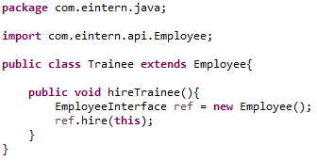
Interfaces
Anyone can use your code without understanding the complexity!
Why? Polymorphism!
Interfaces are used widely in:
Spring
Hibernate
EjB
WebServices
And many more frameworks!

Slide 13
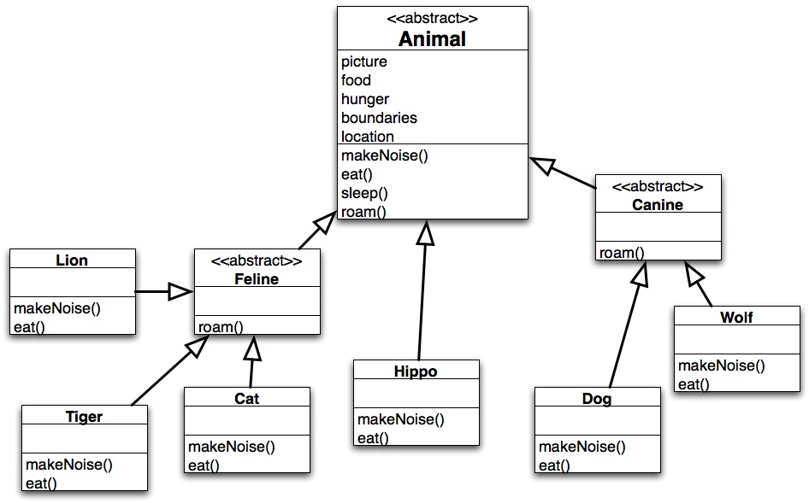
Assignment
Create the Animal
interface, Feline and Canine
abstract classes, and the
concrete animal classes.
Each should have a variable
and a method.
Create an object of each,
call all of the methods
for each object, and
observe the effects.

