Slide 1
PostgreSQL

Slide 2
What is PostgreSQL
PostgreSQL is an advanced, enterprise-class, and open-source relational database system.
PostgreSQL supports both SQL (relational) and JSON (non-relational) querying.
PostgreSQL is a highly stable database backed by more than 20 years of development by the open-source community.
PostgreSQL is used as a primary database for many web applications as well as mobile and analytics applications.

Slide 3
PostgreSQL Data Types
Boolean
Character types such as char, varchar, and text.
Numeric types such as integer and floating-point number.
Temporal types such as date, time, timestamp, and interval
UUID for storing Universally Unique Identifiers
Array for storing array strings, numbers, etc.
JSON stores JSON data
hstore stores key-value pair
Special types such as network address and geometric data.

Slide 4
PostgreSQL Sequences
A sequence in PostgreSQL is a user-defined schema-bound object that generates a sequence of integers based on a specified specification.

Slide 5
Creating Sequence example
CREATE SEQUENCE mysequence
INCREMENT 5
START 100;
To get the next value from the sequence to you use the nextval() function:
SELECT nextval('mysequence');

Slide 6
PostgreSQL SERIAL
When creating a new table, the sequence can be created through the SERIAL pseudo-type as follows:
CREATE TABLE fruits(
id SERIAL PRIMARY KEY,
name VARCHAR NOT NULL );
INSERT INTO fruits(name) VALUES('Orange');

Slide 7
PostgreSQL SERIAL
By assigning the SERIAL pseudo-type to the id column, PostgreSQL performs the following:
First, create a sequence object and set the next value generated by the sequence as the default value for the column.
Second, add a NOT NULL constraint to the id column because a sequence always generates an integer, which is a non-null value.
Third, assign the owner of the sequence to the id column; as a result, the sequence object is deleted when the id column or table is dropped

Slide 8
PostgreSQL Identity Column
PostgreSQL version 10 introduced a new constraint GENERATED AS IDENTITY that allows you to automatically assign a unique number to a column.
The GENERATED AS IDENTITY constraint is the SQL standard-conforming variant of the good old SERIAL column.

Slide 9
PostgreSQL Identity Column
CREATE TABLE color (
color_id INT GENERATED BY DEFAULT AS IDENTITY (START WITH 10 INCREMENT BY 10), color_name VARCHAR NOT NULL );

Slide 10
PostgreSQL CREATE TABLE
CREATE TABLE [IF NOT EXISTS] table_name (
column1 datatype(length) column_contraint,
column2 datatype(length) column_contraint,
column3 datatype(length) column_contraint,
table_constraints
);

Slide 11
Constraints
PostgreSQL includes the following column constraints:
NOT NULL – ensures that values in a column cannot be NULL.
UNIQUE – ensures the values in a column unique across the rows within the same table.
PRIMARY KEY – a primary key column uniquely identify rows in a table. A table can have one and only one primary key. The primary key constraint allows you to define the primary key of a table.
CHECK – a CHECK constraint ensures the data must satisfy a Boolean expression.
FOREIGN KEY – ensures values in a column or a group of columns from a table exists in a column or group of columns in another table. Unlike the primary key, a table can have many foreign keys.

Slide 12
Constraints
CREATE TABLE employees (
id SERIAL PRIMARY KEY,
first_name VARCHAR (50),
last_name VARCHAR (50),
birth_date DATE CHECK (birth_date > '1900-01-01'), joined_date DATE CHECK (joined_date > birth_date), salary numeric CHECK(salary > 0)
);

Slide 13
PostgreSQL CREATE TABLE
CREATE TABLE accounts (
user_id serial PRIMARY KEY,
username VARCHAR ( 50 ) UNIQUE NOT NULL,
password VARCHAR ( 50 ) NOT NULL,
email VARCHAR ( 255 ) UNIQUE NOT NULL,
created_on TIMESTAMP NOT NULL,
last_login TIMESTAMP
);
CREATE TABLE roles(
role_id serial PRIMARY KEY,
role_name VARCHAR (255) UNIQUE NOT NULL
);

Slide 14
PostgreSQL CREATE TABLE
CREATE TABLE account_roles (
user_id INT NOT NULL,
role_id INT NOT NULL,
grant_date TIMESTAMP,
PRIMARY KEY (user_id, role_id),
FOREIGN KEY (role_id)
REFERENCES roles (role_id),
FOREIGN KEY (user_id)
REFERENCES accounts (user_id)
);

Slide 15
PostgreSQL ALTER TABLE
To change the structure of an existing table, you use PostgreSQL ALTER TABLE statement.
ALTER TABLE table_name action

Slide 16
PostgreSQL ALTER TABLE
To add a new column to a table, you use ALTER TABLE ADD COLUMN statement:
ALTER TABLE table_name
ADD COLUMN column_name datatype column_constraint;
To drop a column from a table, you use ALTER TABLE DROP COLUMN statement:
ALTER TABLE table_name
DROP COLUMN column_name;
To rename a column, you use the ALTER TABLE RENAME COLUMN TO statement:
ALTER TABLE table_name
RENAME COLUMN column_name TO new_column_name;
To rename an existing table, you use the ALTER TABLE statement as follows:
ALTER TABLE table_name RENAME TO new_table_name;

Slide 17
PostgreSQL DROP TABLE
DROP TABLE [IF EXISTS] table_name
[CASCADE | RESTRICT];
In case the table that you want to remove is used in other objects such as views, triggers, functions, and stored procedures, the DROP TABLE cannot remove the table.
In this case, you have two options:
The CASCADE option allows you to remove the table and its dependent objects.
The RESTRICT option rejects the removal if there is any object depends on the table. The RESTRICT option is the default if you don’t explicitly specify it in the DROP TABLE statement.

Slide 18
PostgreSQL TRUNCATE TABLE
To remove all data from a table, you use the DELETE statement.
However, when you use the DELETE statement to delete all data from a table that has a lot of data, it is not efficient.
In this case, you need to use the TRUNCATE TABLE statement:
TRUNCATE TABLE table_name;

Slide 19
Querying Data

Slide 20
PostgreSQL SELECT
One of the most common tasks, when you work with the database, is to query data from tables by using the SELECT statement.
The SELECT statement is one of the most complex statements in PostgreSQL.
It has many clauses that you can use to form a flexible query.
SELECT
select_list
FROM
table_name;

Slide 21
PostgreSQL SELECT
Using PostgreSQL SELECT statement to query data from one column
SELECT first_name FROM customer;
Using PostgreSQL SELECT statement to query data from multiple columns
SELECT first_name, last_name, email FROM customer;
Using PostgreSQL SELECT statement to query data from all columns of a table
SELECT * FROM customer;

Slide 22
PostgreSQL Column Alias
A column alias allows you to assign a column or an expression in the select list of a SELECT statement a temporary name.
The column alias exists temporarily during the execution of the query.
SELECT first_name, last_name surname FROM customer;
SELECT first_name || ' ' || last_name AS full_name FROM customer;

Slide 23
PostgreSQL ORDER BY
When you query data from a table, the SELECT statement returns rows in an unspecified order.
To sort the rows of the result set, you use the ORDER BY clause in the SELECT statement.
The ORDER BY clause allows you to sort rows returned by a SELECT clause in ascending or descending order based on a sort expression.

Slide 24
PostgreSQL ORDER BY
SELECT
first_name, last_name FROM customer
ORDER BY
first_name ASC;
SELECT
first_name, last_name FROM customer
ORDER BY
last_name DESC;
SELECT
first_name, last_name FROM customer
ORDER BY
first_name ASC,
last_name DESC;

Slide 25
PostgreSQL SELECT DISTINCT
The DISTINCT clause is used in the SELECT statement to remove duplicate rows from a result set.
The DISTINCT clause keeps one row for each group of duplicates.
The DISTINCT clause can be applied to one or more columns in the select list of the SELECT statement.
SELECT
DISTINCT column1
FROM
table_name;

Slide 26
PostgreSQL WHERE
The SELECT statement returns all rows from one or more columns in a table.
To select rows that satisfy a specified condition, you use a WHERE clause.
The WHERE clause appears right after the FROM clause of the SELECT statement.
The WHERE clause uses the condition to filter the rows returned from the SELECT clause.
The condition must evaluate to true, false, or unknown.
It can be a boolean expression or a combination of boolean expressions using the AND and OR operators.
The query returns only rows that satisfy the condition in the WHERE clause. In other words, only rows that cause the condition evaluates to true will be included in the result set.

Slide 27
PostgreSQL WHERE
SELECT last_name, first_name FROM customer
WHERE first_name = 'Jamie';
SELECT last_name, first_name FROM customer
WHERE first_name = 'Jamie‘ AND last_name = 'Rice';
SELECT last_name, first_name FROM customer
WHERE first_name = 'Jamie‘ OR last_name = 'Rice';
SELECT first_name,last_name FROM customer
WHERE first_name IN ('Ann','Anne','Annie');
SELECT first_name,last_name FROM customer
WHERE first_name LIKE 'Ann%';
SELECT first_name,LENGTH(first_name) name_length FROM customer WHERE first_name LIKE 'A%' AND
LENGTH(first_name) BETWEEN 3 AND 5

Slide 28
PostgreSQL IS NULL
In the database world, NULL means missing information or not applicable.
NULL is not a value, therefore, you cannot compare it with any other values like numbers or strings.
The comparison of NULL with a value will always result in NULL, which means an unknown result.
SELECT
id, first_name, last_name, email, phone
FROM
contacts
WHERE
phone IS NULL;

Slide 29
PostgreSQL Table Aliases
Table aliases temporarily assign tables new names during the execution of a query.
table_name AS alias_name;
SELECT
c.customer_id, first_name,amount,payment_date
FROM
customer c
INNER JOIN payment p
ON p.customer_id = c.customer_id
ORDER BY
payment_date DESC;

Slide 30
PostgreSQL Joins
PostgreSQL join is used to combine columns from one (self-join) or more tables based on the values of the common columns between related tables.
The common columns are typically the primary key columns of the first table and foreign key columns of the second table.
PostgreSQL supports inner join, left join, right join, full outer join, cross join, natural join, and a special kind of join called self-join.

Slide 31
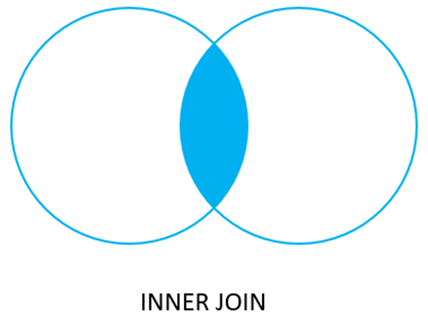
PostgreSQL INNER JOIN
For each row in the table A, inner join compares the value in the pka column with the value in the fka column of every row in the table B:
If these values are equal, the inner join creates a new row that contains all columns of both tables and adds it to the result set.
In case these values are not equal, the inner join just ignores them and moves to the next row.

Slide 32
PostgreSQL INNER JOIN
SELECT
customer.customer_id,
first_name,
last_name,
amount,
payment_date
FROM
customer
INNER JOIN payment
ON payment.customer_id = customer.customer_id
ORDER BY payment_date;

Slide 33
PostgreSQL LEFT JOIN
The LEFT JOIN clause starts selecting data from the left table.
For each row in the left table, it compares the value in the pka column with the value of each row in the fka column in the right table.
If these values are equal, the left join clause creates a new row that contains columns that appear in the SELECT clause and adds this row to the result set.
In case these values are not equal, the left join clause also creates a new row that contains columns that appear in the SELECT clause. In addition, it fills the columns that come from the right table with NULL.

Slide 34
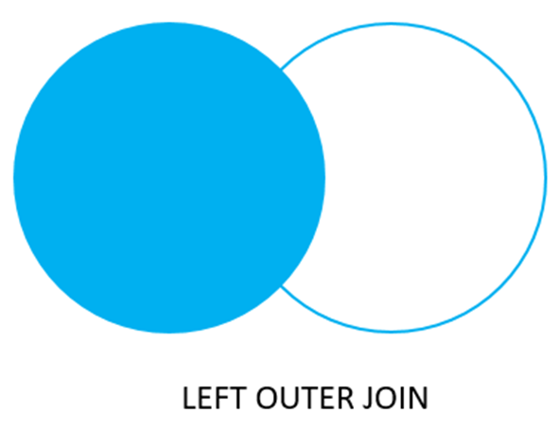
PostgreSQL LEFT JOIN
SELECT
film.film_id,
title,
inventory_id
FROM
film
LEFT JOIN inventory
ON inventory.film_id = film.film_id
ORDER BY title;

Slide 35
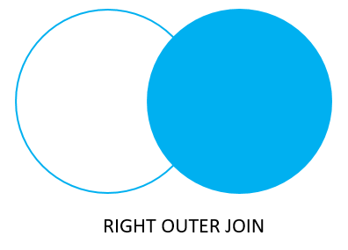
PostgreSQL right join
The right join is a reversed version of the left join.
The right join starts selecting data from the right table

Slide 36
PostgreSQL Self-Join
A self-join is a regular join that joins a table to itself.
In practice, you typically use a self-join to query hierarchical data or to compare rows within the same table.

Slide 37

PostgreSQL FULL OUTER JOIN
The full outer join combines the results of both left join and right join.
If the rows in the joined table do not match, the full outer join sets NULL values for every column of the table that does not have the matching row.
If a row from one table matches a row in another table, the result row will contain columns populated from columns of rows from both tables

Slide 38
PostgreSQL Cross Join
A CROSS JOIN clause allows you to produce a Cartesian Product of rows in two or more tables.
Suppose you have to perform a CROSS JOIN of two tables T1 and T2.
If T1 has n rows and T2 has m rows, the result set will have nxm rows. For example, the T1 has 1,000 rows and T2 has 1,000 rows, the result set will have 1,000 x 1,000 = 1,000,000 rows.
USE CASE: Maybe you want a table that contains a row for every minute in the day, and you want to use it to verify that a procedure has executed each minute, so you might cross three tables:
Select hour, minute from hours CROSS JOIN minutes

Slide 39
Set Operators
Set operators are different from joins.
Instead of combining columns of two tables, set operators combine the rows of different result sets.
Essentially, set operators perform some kind of (set) operation on two different queries.

Slide 40
Some Set Operators
UNION [ALL]
UNION does not keep duplicates, but UNION ALL will
INTERSECT
Only returns records in common between the queries
MINUS
Removes from the first result set any rows that appear in the second result set and returns what remains
EXCEPT
Same as MINUS, but for SQLServer instead of Oracle

Slide 41
PostgreSQL GROUP BY
The GROUP BY clause divides the rows returned from the SELECT statement into groups.
For each group, you can apply an aggregate function e.g., SUM() to calculate the sum of items or COUNT() to get the number of items in the groups.
SELECT customer_id FROM payment GROUP BY customer_id;
The GROUP BY clause is useful when it is used in conjunction with an aggregate function.
SELECT customer_id, SUM (amount) FROM payment GROUP BY
customer_id;

Slide 42
PostgreSQL HAVING
The HAVING clause specifies a search condition for a group or an aggregate.
The HAVING clause is often used with the GROUP BY clause to filter groups or aggregates based on a specified condition.
SELECT store_id,COUNT (customer_id)
FROM customer
GROUP BY store_id
HAVING COUNT (customer_id) > 300;

Slide 43
PostgreSQL Subquery
A subquery is a query nested inside another query such as SELECT, INSERT, DELETE and UPDATE.
To construct a subquery, we put the second query in brackets and use it in the WHERE clause as an expression:
SELECT film_id,title,rental_rate
FROM film
WHERE rental_rate > (
SELECT AVG (rental_rate)
FROM film
);

Slide 44
PostgreSQL Subquery
The query inside the brackets is called a subquery or an inner query.
The query that contains the subquery is known as an outer query.
PostgreSQL executes the query that contains a subquery in the following sequence:
First, executes the subquery.
Second, gets the result and passes it to the outer query.
Third, executes the outer query.

Slide 45
PostgreSQL subquery with IN operator
A subquery can return zero or more rows.
To use this subquery, you use the IN operator in the WHERE clause.
SELECT film_id, title FROM film
WHERE film_id IN (
SELECT inventory.film_id FROM rental
INNER JOIN inventory ON inventory.inventory_id = rental.inventory_id
WHERE return_date BETWEEN '2005-05-29‘ AND '2005-05-30'
);

Slide 46
PostgreSQL Views
A view is named query that provides another way to present data in the database tables.
A view is defined based on one or more tables which are known as base tables.
When you create a view, you basically create a query and assign it a name, therefore a view is useful for wrapping a commonly used complex query.

Slide 47
Creating PostgreSQL Views
To create a view, we use CREATE VIEW statement.
CREATE VIEW view_name AS query;
To remove an existing view in PostgreSQL, you use DROP VIEW statement as follows:
DROP VIEW [ IF EXISTS ] view_name;

Slide 48
Creating PostgreSQL Views
CREATE VIEW customer_master AS
SELECT cu.customer_id AS id,
cu.first_name || ' ' || cu.last_name AS name,
a.address, a.postal_code AS "zip code",
a.phone, city.city, country.country,
CASE
WHEN cu.activebool THEN 'active'
ELSE ''
END AS notes,
cu.store_id AS sid
FROM customer cu
INNER JOIN address a USING (address_id)
INNER JOIN city USING (city_id)
INNER JOIN country USING (country_id);
whenever you need to get a complete customer data, you just query it from the view by executing the following simple SELECT statement:
SELECT * FROM customer_master;

Slide 49
PostgreSQL Indexes
PostgreSQL indexes are effective tools to enhance database performance.
Indexes help the database server find specific rows much faster than it could do without indexes.
However, indexes add write and storage overheads to the database system, therefore, using them appropriately is very important.
PostgreSQL CREATE INDEX
To create an index for the values in the phone column of the address table, you use the following statement:
CREATE INDEX idx_address_phone ON address(phone);
PostgreSQL DROP INDEX
DROP INDEX idx_actor_first_name;

Slide 50
Types of Indexes
Indexes can be categorized into two types:
clustered
non-clustered.
Clustered indexes alter the order in which the records are physically stored on disk. Thus only one clustered index can be created on a given table.
Non-clustered indexes specify a logical ordering of rows but do not affect the physical ordering, so there may be more than one non-clustered index in a table.

Slide 51
Aggregate Functions
An aggregate function allows you to perform a calculation on a set of values to return a single scalar value.
We often use aggregate functions with the GROUP BY and HAVING clauses of the SELECT statement.
The following are the most commonly used SQL aggregate functions:
AVG – calculates the average of a set of values.
COUNT – counts rows in a specified table or view.
MIN – gets the minimum value in a set of values.
MAX – gets the maximum value in a set of values.
SUM – calculates the sum of values.

Slide 52
Scalar Functions
Scalar functions are the built-in functions in SQL, and whatever be the input provided to the scalar functions, the output returned by these functions will always be a single value.
In SQL, each record is operated independently by the scalar functions.
In SQL, each record is operated independently by the scalar functions.
Some of the commonly used scalar functions in SQL includes:
UCASE() or upper()
LCASE() or lower()
LENGTH()
ROUND()
NOW()
FORMAT()

