Slide 1
MySQL Basics

Slide 2
MySQL Data Types
A database table contains multiple columns with specific data types such as numeric or string.
MySQL provides more data types other than just numeric and string.
Each data type in MySQL can be determined by the following characteristics:
  The kind of values it represents.
  The space that takes up and whether the values are a fixed-length or variable length.
  The values of the data type can be indexed or not.
  How MySQL compares the values of a specific data type.

Slide 3
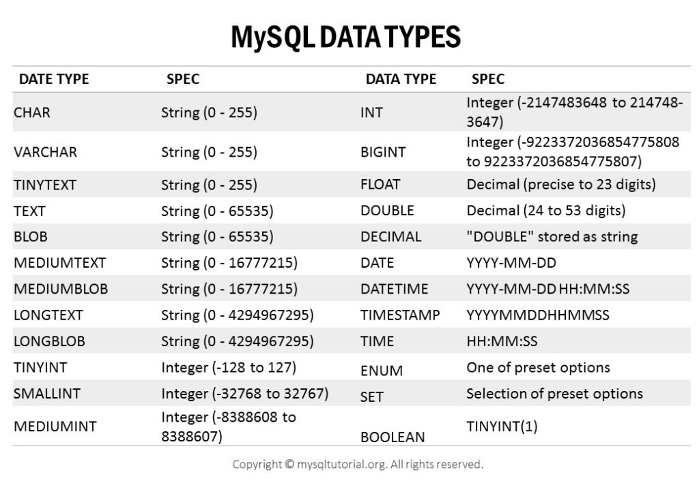
MySQL Data Types

Slide 4
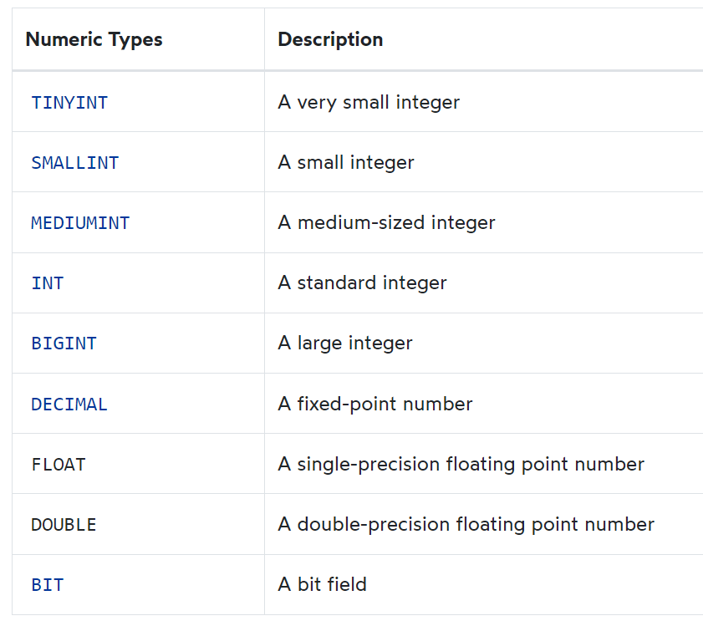
MySQL numeric data types

Slide 5
MySQL Boolean data type
MySQL does not have the built-in BOOLEAN or BOOL data type.
To represent boolean values, MySQL uses the smallest integer type which is TINYINT(1).
In other words, BOOLEAN and BOOL are synonyms for TINYINT(1).

Slide 6

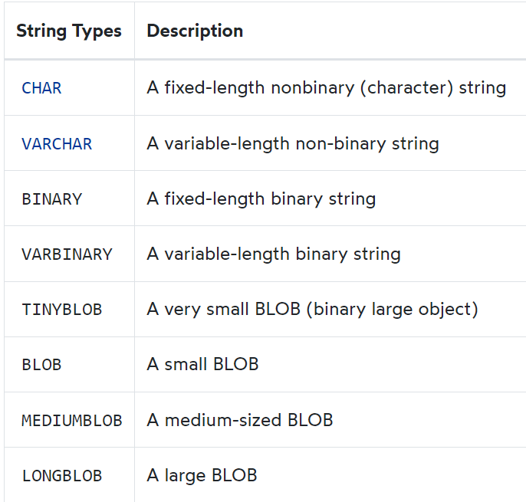
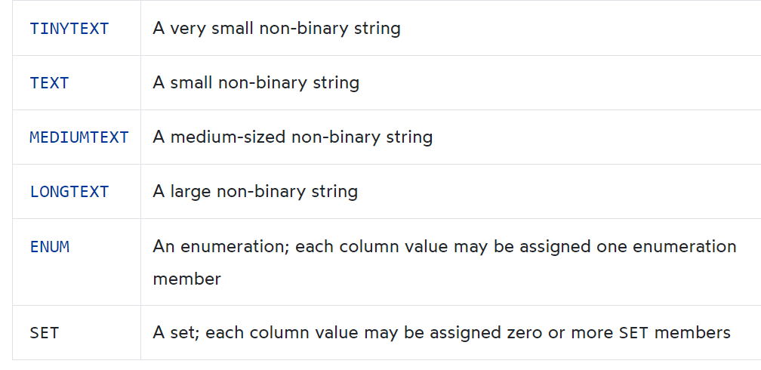
MySQL String data types

Slide 7
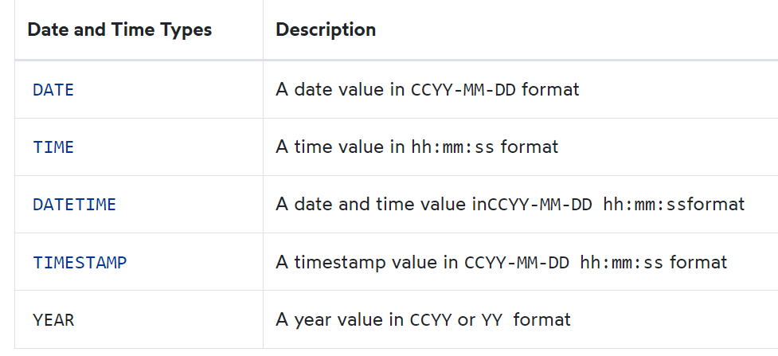
MySQL date and time data types

Slide 8
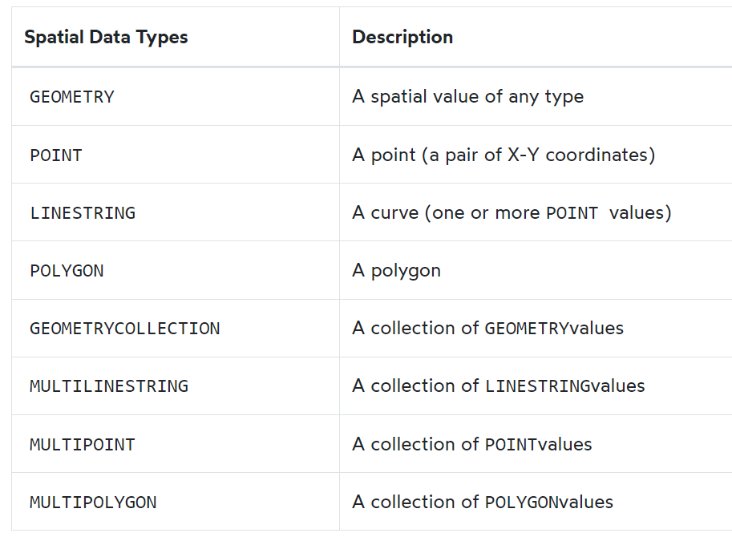
MySQL spatial data types

Slide 9
JSON data type
MySQL supported a native JSON data type since version 5.7.8 that allows you to store and manage JSON documents more effectively.
The native JSON data type provides automatic validation of JSON documents and optimal storage format.

Slide 10
MANAGING TABLES

Slide 11
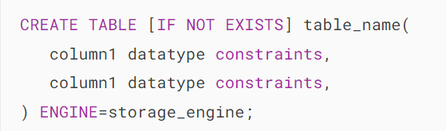
MySQL CREATE TABLE
The CREATE TABLE statement allows you to create a new table in a database.
  table_name: This is the name of the table that you want to create.
  column1, column2, etc.: The names of the columns in the table.
  datatype: the data of each column such as INT, VARCHAR, DATE, etc.
  constraints: These are optional constraints such as NOT NULL, UNIQUE, PRIMARY KEY, and FOREIGN KEY.
  If you create a table with a name that already exists in the database, you’ll get an error. To avoid the error, you can use the IF NOT EXISTS option.
  In MySQL, each table has a storage engine such as InnoDB or MyISAM. The ENGINE clause allows you to specify the storage engine of the table.
  If you don’t explicitly specify a storage engine, MySQL will use the default storage engine which is InnoDB.

Slide 12
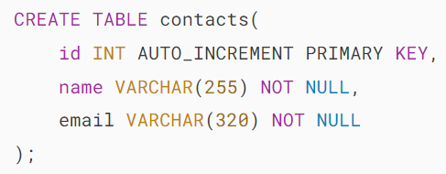

MySQL AUTO_INCREMENT
In MySQL, you use the AUTO_INCREMENT attribute to automatically generate unique numbers for a column each time you insert a new row into the table.
Typically, you use the AUTO_INCREMENT attribute for the primary key to ensure each row has a unique identifier.

Slide 13
MySQL AUTO_INCREMENT
Retrieving the last auto-increment value
To get the AUTO_INCREMENT value that MySQL generated for the most recent insert, you use the LAST_INSERT_ID() function:
SELECT LAST_INSERT_ID();
Resetting the current auto-increment value
To reset the AUTO_INCREMENT value, you use the ALTER TABLE statement. For example, the following statement reset the current auto-increment value to 1:
ALTER TABLE contacts AUTO_INCREMENT = 1;

Slide 14
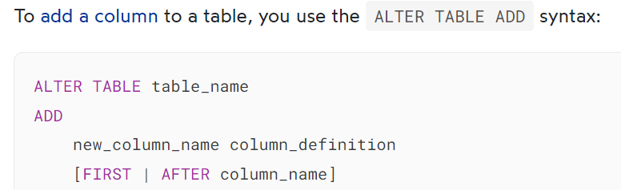
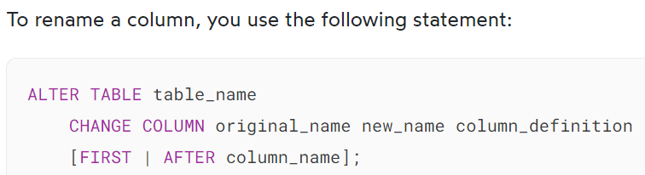
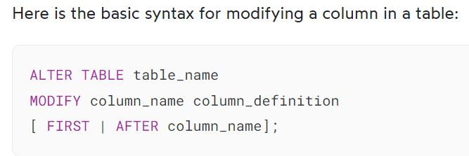



MySQL ALTER TABLE

Slide 15

MySQL DROP TABLE
To remove existing tables, you use the MySQL DROP TABLE statement.
Here is the basic syntax of the DROP TABLE statement:
The DROP TABLE statement removes a table and its data permanently from the database. In MySQL, you can also remove multiple tables using a single DROP TABLE statement, each table is separated by a comma (,).
The TEMPORARY option allows you to remove temporary tables only. It ensures that you do not accidentally remove non-temporary tables.
The IF EXISTS option conditionally drop a table only if it exists. If you drop a non-existing table with the IF EXISTS option, MySQL generates a NOTE, which can be retrieved using the SHOW WARNINGS statement.

Slide 16
MYSQL CONSTRAINTS

Slide 17
MySQL Primary Key
A primary key is a column or a set of columns that uniquely identifies each row in the table. The primary key follows these rules:
A primary key must contain unique values. If the primary key consists of multiple columns, the combination of values in these columns must be unique.
A primary key column cannot have NULL values. Any attempt to insert or update NULL to primary key columns will result in an error. Note that MySQL implicitly adds a NOT NULL constraint to primary key columns.
A table can have one an only one primary key.
A primary key column often has the AUTO_INCREMENT attribute that automatically generates a sequential integer whenever you insert a new row into the table.

Slide 18
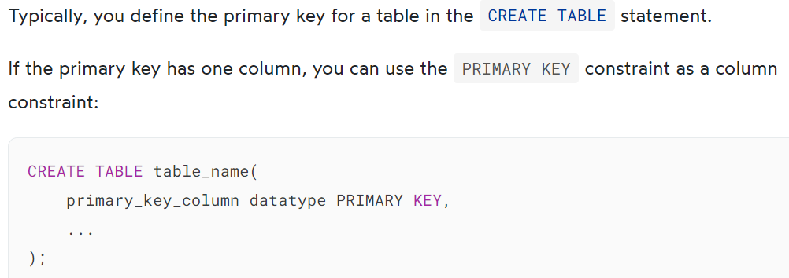
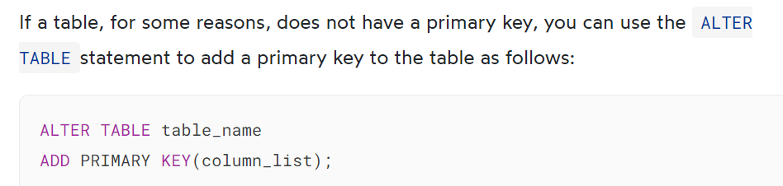
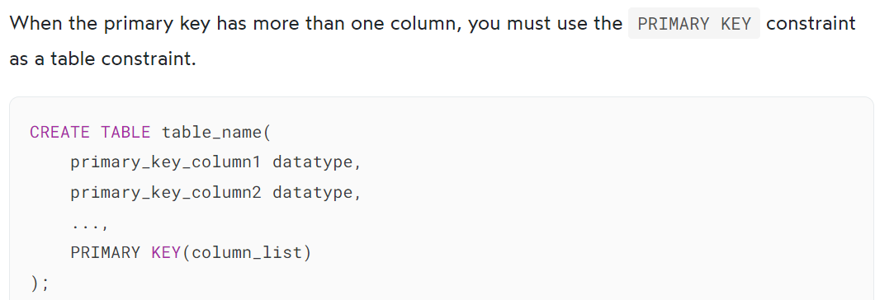
MySQL Primary Key

Slide 19
MySQL Foreign Key
A foreign key is a column or group of columns in a table that links to a column or group of columns in another table.
The foreign key places constraints on data in the related tables, which allows MySQL to maintain referential integrity.
Typically, the foreign key columns of the child table often refer to the primary key columns of the parent table.
A table can have more than one foreign key where each foreign key references a primary key of the different parent tables.
Once a foreign key constraint is in place, the foreign key columns from the child table must have the corresponding row in the parent key columns of the parent table, or values in these foreign key columns must be NULL

Slide 20
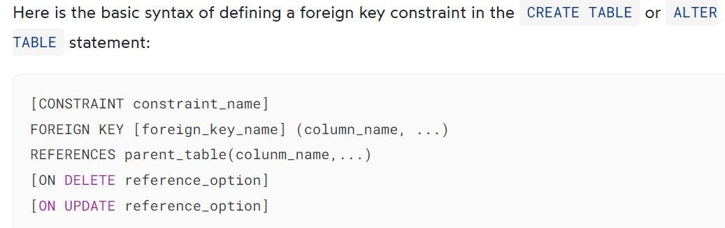
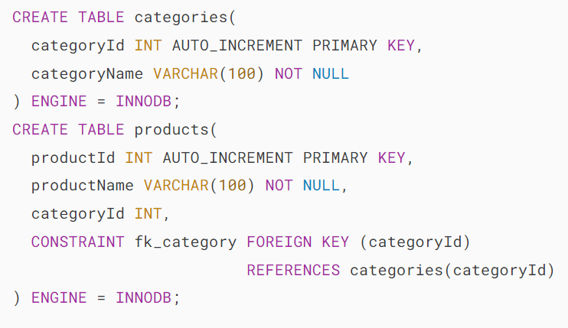
MySQL Foreign Key

Slide 21
MySQL Foreign Key
Finally, specify how the foreign key maintains the referential integrity between the child and parent tables by using the ON DELETE and ON UPDATE clauses.
The reference_option determines the action that MySQL will take when values in the parent key columns are deleted (ON DELETE) or updated (ON UPDATE).
MySQL has five reference options: CASCADE, SET NULL, NO ACTION, RESTRICT, and SET DEFAULT.
  CASCADE: if a row from the parent table is deleted or updated, the values of the matching rows in the child table are automatically deleted or updated.
  SET NULL: if a row from the parent table is deleted or updated, the values of the foreign key column (or columns) in the child table are set to NULL.
  RESTRICT: if a row from the parent table has a matching row in the child table, MySQL rejects deleting or updating rows in the parent table.
  NO ACTION: is the same as RESTRICT.
  SET DEFAULT: is recognized by the MySQL parser. However, this action is rejected by both InnoDB and NDB tables.
In fact, MySQL fully supports three actions: RESTRICT, CASCADE and SET NULL.
If you don’t specify the ON DELETE and ON UPDATE clause, the default action is RESTRICT

Slide 22

MySQL Foreign Key

Slide 23
MySQL Disable Foreign Key Checks
Sometimes, it is very useful to disable foreign key checks. For example, you can load data to the parent and child tables in any order with the foreign key constraint check disabled. If you don’t disable foreign key checks, you have to load data into the parent tables first and then the child tables in sequence, which can be tedious.
Another scenario that you want to disable the foreign key check is when you want to drop a table. Unless you disable the foreign key checks, you cannot drop a table referenced by a foreign key constraint.
To disable foreign key checks, you set the foreign_key_checks variable to zero as follows:
SET foreign_key_checks = 0;

Slide 24
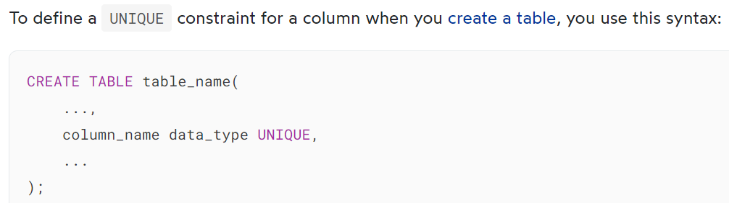
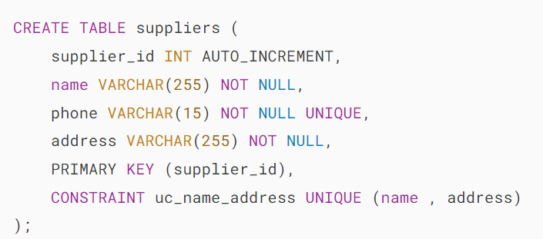
MySQL UNIQUE Constraint
A UNIQUE constraint is an integrity constraint that ensures values in a column or group of columns to be unique.
A UNIQUE constraint can be either a column constraint or a table constraint.

Slide 25
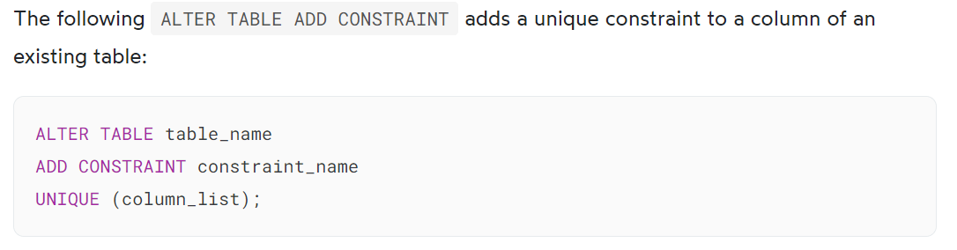
MySQL UNIQUE constraints
When you define a unique constraint, MySQL creates a corresponding UNIQUE index and uses this index to enforce the rule.

Slide 26
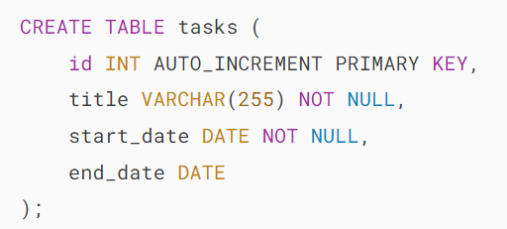
MySQL NOT NULL Constraint
A NOT NULL constraint ensures that values stored in a column are not NULL.
The syntax for defining a NOT NULL constraint is as follows:
column_name data_type NOT NULL;

Slide 27
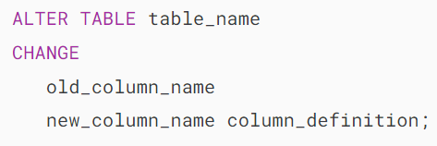
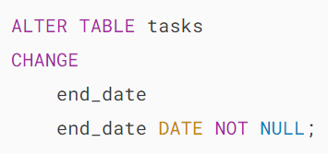
MySQL NOT NULL Constraint
Typically, you add NOT NULL constraints to columns when you create
the table.
However, you may want to add a NOT NULL constraint to a column of an existing table. In this case, you use the following steps:
  First, check the current values of the column if there are any NULL values.
  Second, update the NULL to non-NULL.
  Third, modify the column with a NOT NULL constraint.

Slide 28
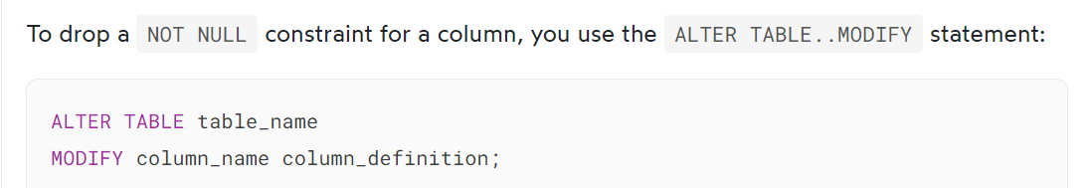

MySQL NOT NULL Constraint

Slide 29
MySQL DEFAULT
MySQL DEFAULT constraint allows you to specify a default value for a column.
column_name data_type DEFAULT default_value;
The default_value must be a literal constant, e.g., a number or a string. It cannot be a function or an expression. However, MySQL allows you to set the current date and time (CURRENT_TIMESTAMP) to the TIMESTAMP and DATETIME columns.
When you define a column without the NOT NULL constraint, the column will implicitly take NULL as the default value.
If a column has a DEFAULT constraint and the INSERT or UPDATE statement doesn’t provide the value for that column, MySQL will use the default value specified in the DEFAULT constraint.
Typically, you set the DEFAULT constraints for columns when you create the table. MySQL also allows you to add default constraints to the columns of existing tables.
If you don’t want to use default values for columns, you can remove the default constraints.

Slide 30
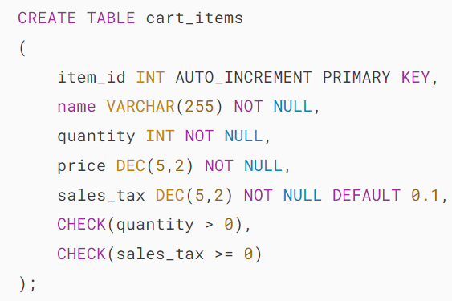
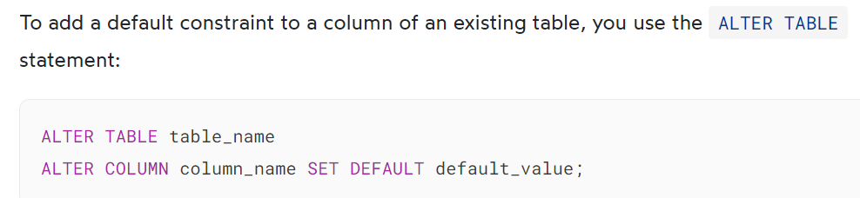



MySQL DEFAULT

Slide 31
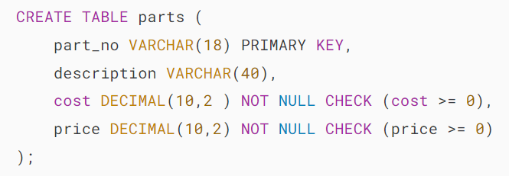
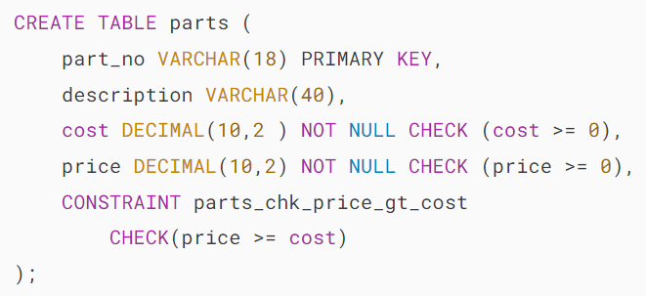
MySQL CHECK Constraint
Using MySQL CHECK constraint as a column constraint example
Using MySQL CHECK constraint as a table constraint example

Slide 32
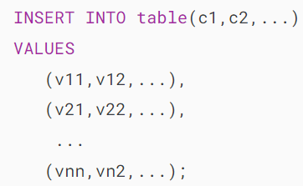
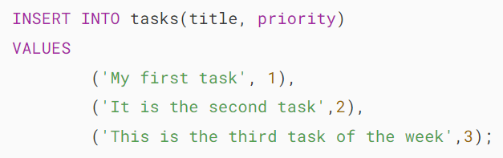
MySQL Insert
The INSERT statement allows you to insert one or more rows into a table. The following illustrates the syntax of the INSERT statement:
INSERT INTO table(c1,c2,...) VALUES (v1,v2,...);

Slide 33
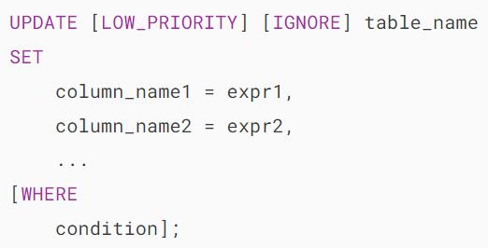
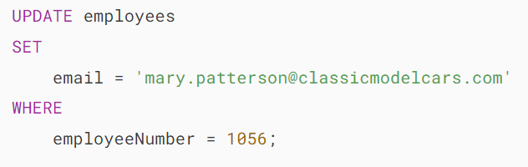
MySQL UPDATE
The UPDATE statement updates data in a table. It allows you to change the values in one or more columns of a single row or multiple rows.

Slide 34


MySQL DELETE
To delete data from a table, you use the MySQL DELETE statement.

