Slide 1
QUERYING DATA

Slide 2
MySQL SELECT FROM
The SELECT statement allows you to select data from one or more tables.
SELECT select_list FROM table_name;

Slide 3
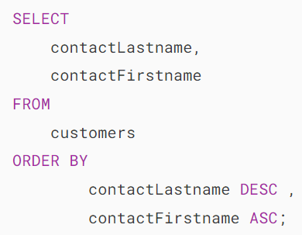
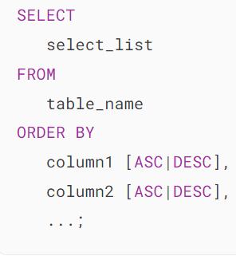
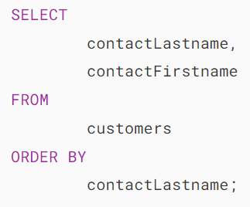
MySQL ORDER BY
When you use the SELECT statement to query data from a table, the order of rows in the result set is unspecified.
To sort the rows in the result set, you add the ORDER BY clause to the SELECT statement.

Slide 4
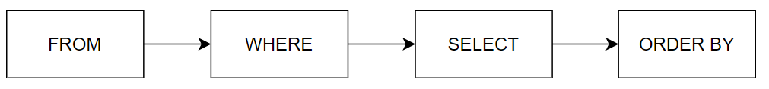
MySQL WHERE
The WHERE clause allows you to specify a search condition for the rows returned by a query.
SELECT select_list FROM table_name WHERE search_condition;
The search_condition is a combination of one or more expressions using the logical operator AND, OR and NOT.
Besides the SELECT statement, you can use the WHERE clause in the UPDATE or DELETE statement to specify which rows to update or delete.
When executing a SELECT statement with a WHERE clause, MySQL evaluates the WHERE clause after the FROM clause and before the SELECT and ORDER BY clauses:

Slide 5
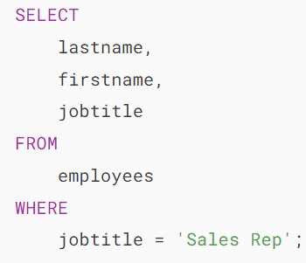
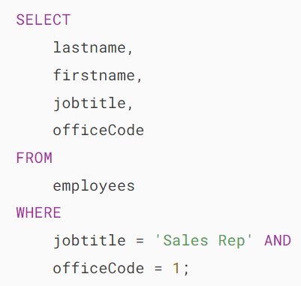
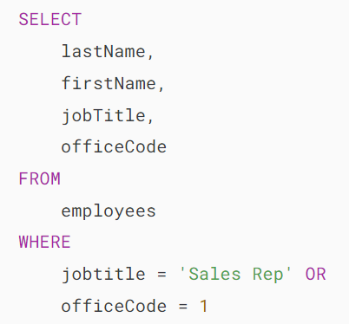
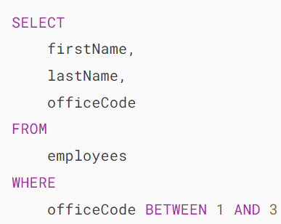
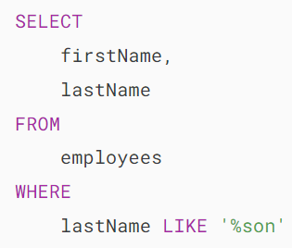
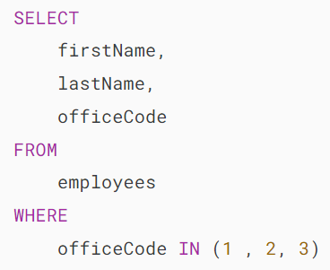
MySQL WHERE

Slide 6
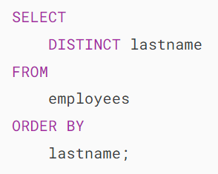
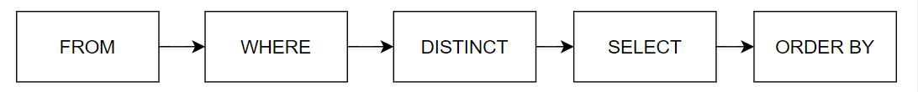
MySQL DISTINCT
When querying data from a table, you may get duplicate rows.
To remove these duplicate rows, you use the DISTINCT clause in the SELECT statement.
When executing the SELECT statement with the DISTINCT clause, MySQL evaluates the DISTINCT clause after the FROM, WHERE, and SELECT clause and before the ORDER BY clause

Slide 7
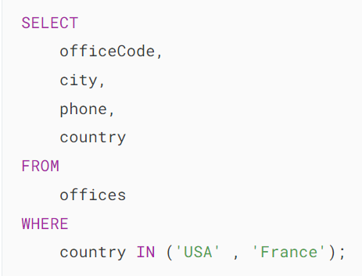
MySQL IN
The IN operator allows you to determine if a value matches any value in a list of values.
value IN (value1, value2, value3,...)

Slide 8
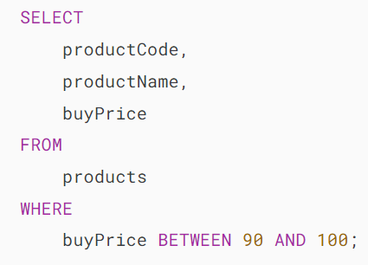
MySQL BETWEEN
The BETWEEN operator is a logical operator that specifies whether a value is in a range or not.
value BETWEEN low AND high;

Slide 9
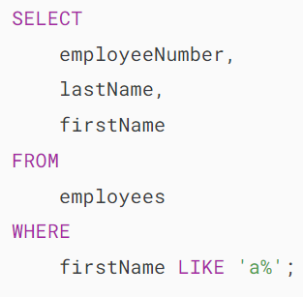
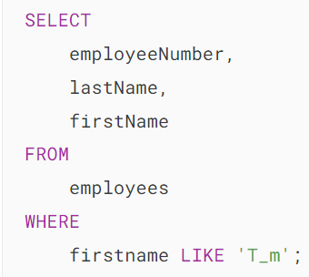
MySQL LIKE
The LIKE operator is a logical operator that tests whether a string contains a specified pattern or not.
MySQL provides two wildcard characters for constructing patterns: Percentage % and underscore _ .
The percentage ( % ) wildcard matches any string of zero or more characters.
The underscore ( _ ) wildcard matches any single character.

Slide 10
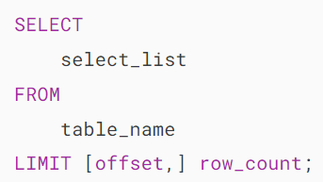
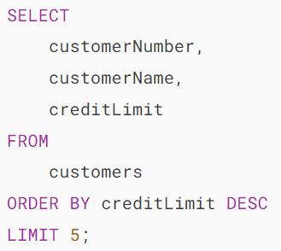
MySQL LIMIT
The LIMIT clause is used in the SELECT statement to constrain the number of rows to return. The LIMIT clause accepts one or two arguments. The values of both arguments must be zero or positive integers.

Slide 11
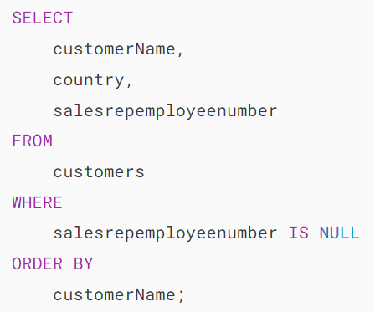
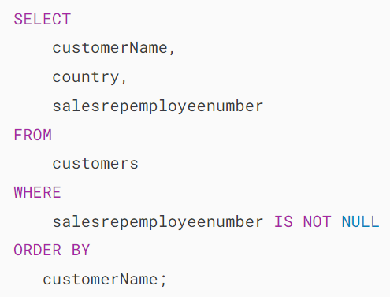
MySQL IS NULL
To test whether a value is NULL or not, you use the IS NULL operator.

Slide 12
MySQL Aliases
MySQL uses aliases to assign temporary names to columns or tables in a query.
MySQL supports two kinds of aliases: column aliases and table aliases.

Slide 13
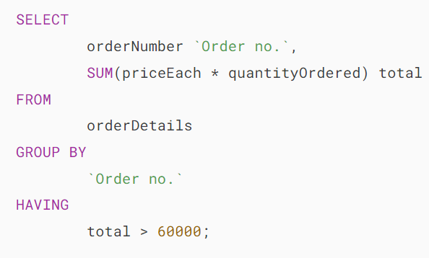
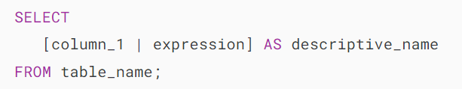
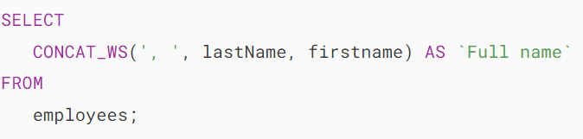
Column aliases
In MySQL, you use column aliases to assign a temporary name to a column in the query’s result set.

Slide 14
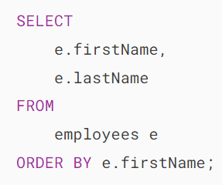
Table aliases
Similar to column aliases, you can assign a temporary name to a table in a query using a table alias.

Slide 15
MySQL Join

Slide 16
MySQL Join
A join is a method of linking data between one (self-join) or more tables based on the values of the common column between the tables.
MySQL supports the following types of joins:
Inner join
Left join
Right join
Cross join
To join tables, you use the cross join, inner join, left join, or right join clause. The join clause is used in the SELECT statement appeared after the FROM clause.

Slide 17
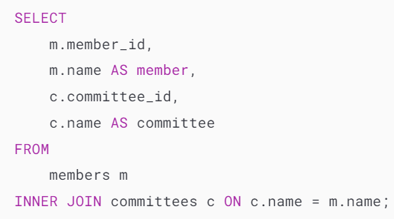
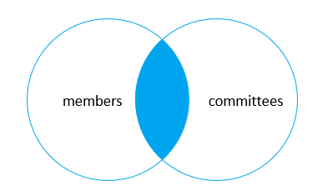
MySQL INNER JOIN clause
The inner join clause joins two tables based on a condition which is known as a join predicate.
The inner join clause compares each row from the first table with every row from the second table.
If values from both rows satisfy the join condition, the inner join clause creates a new row whose column contains all columns of the two rows from both tables and includes this new row in the result set. In other words, the inner join clause includes only matching rows from both tables.
If the join condition uses the equality operator (=) and the column names in both tables used for matching are the same, and you can use the USING clause instead

Slide 18
MySQL LEFT JOIN clause
The left join selects data starting from the left table. For each row in the left table, the left join compares with every row in the right table.
If the values in the two rows satisfy the join condition, the left join clause creates a new row whose columns contain all columns of the rows in both tables and includes this row in the result set.
If the values in the two rows are not matched, the left join clause still creates a new row whose columns contain columns of the row in the left table and NULL for columns of the row in the right table.
In other words, the left join selects all data from the left table whether there are matching rows exist in the right table or not.
In case there are no matching rows from the right table found, the left join uses NULLs for columns of the row from the right table in the result set.

Slide 19
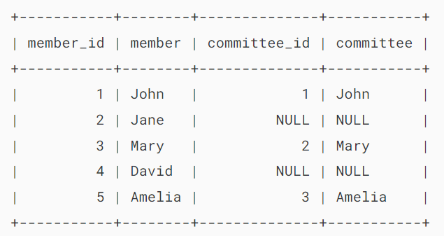
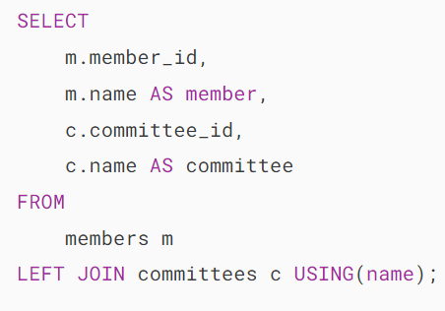
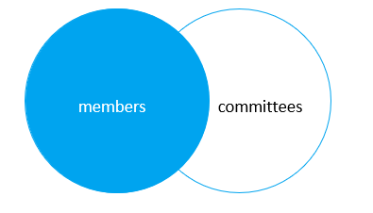
MySQL LEFT JOIN clause

Slide 20
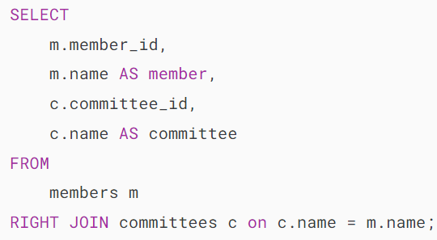
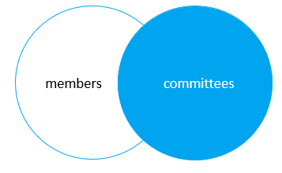
MySQL RIGHT JOIN clause
The right join clause selects all rows from the right table and matches rows in the left table.
If a row from the right table does not have matching rows from the left table, the column of the left table will have NULL in the final result set.

Slide 21
MySQL CROSS JOIN clause
The cross join makes a Cartesian product of rows from the joined tables.
The cross join combines each row from the first table with every row from the right table to make the result set.

Slide 22
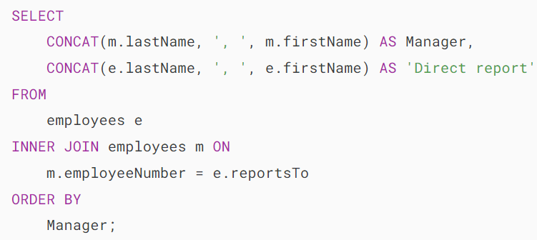
MySQL Self Join
A self join allows you to join a table to itself.
Since MySQL does not have specific self join syntax, you need to perform a self join via a regular join such as left join or inner join.

Slide 23
MySQL GROUP BY
The GROUP BY clause groups a set of rows into a set of summary rows based on column values or expressions. It returns one row for each group and reduces the number of rows in the result set.
The GROUP BY clause is an optional part of the SELECT statement.
MySQL evaluates the GROUP BY clause after the FROM and WHERE clauses but before the HAVING, SELECT, DISTINCT, ORDER BY and LIMIT clauses:
In practice, you often use the GROUP BY clause with aggregate functions such as SUM, AVG, MAX, MIN, and COUNT. The aggregate function that appears in the SELECT clause provides the information for each group.

Slide 24
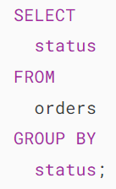
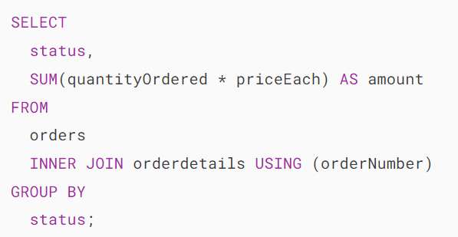
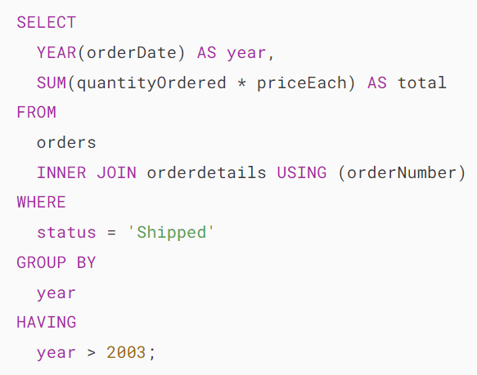
MySQL GROUP BY

Slide 25
MySQL HAVING
The HAVING clause is used in conjunction with the GROUP BY clause to filter the groups based on a specified condition.
The HAVING clause allows you to apply a condition to the groups returned by the GROUP BY clause and only include groups that meet the specified condition.
The HAVING clause evaluates each group returned by the GROUP BY clause. If the result is true (1), it includes the group in the result set.
The HAVING clause applies the condition to groups of rows, while the WHERE clause applies the condition to individual rows
If you omit the GROUP BY clause, the HAVING clause behaves like the WHERE clause.
MySQL evaluates the HAVING clause after the FROM, WHERE, SELECT and GROUP BY clauses, but before DISTINCT, SELECT, ORDER BY, and LIMIT clauses:

Slide 26
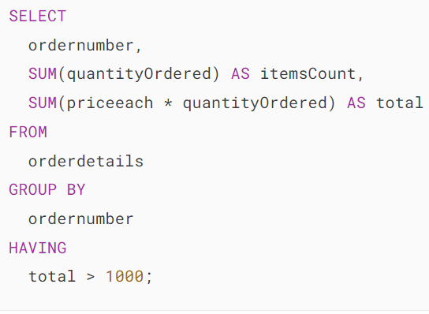
MySQL HAVING

Slide 27
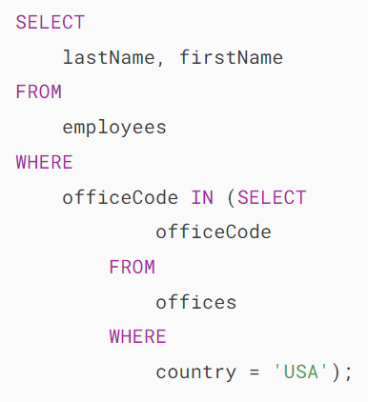
MySQL Subquery
A MySQL subquery is a query nested within another query such as SELECT, INSERT, UPDATE or DELETE. Also, a subquery can be nested within another subquery.
A MySQL subquery is called an inner query while the query that contains the subquery is called an outer query. A subquery can be used anywhere that expression is used and must be closed in parentheses.

Slide 28
MySQL UNION
MySQL UNION operator allows you to combine two or more result sets of queries into a single result set.
To combine result set of two or more queries using the UNION operator, these are the basic rules that you must follow:
First, the number and the orders of columns that appear in all SELECT statements must be the same.
Second, the data types of columns must be the same or compatible.
By default, the UNION operator removes duplicate rows even if you don’t specify the DISTINCT operator explicitly.

Slide 29
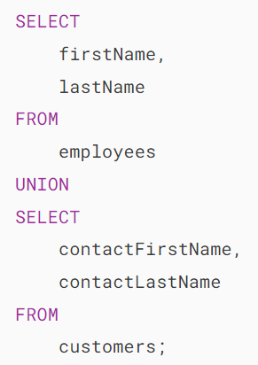
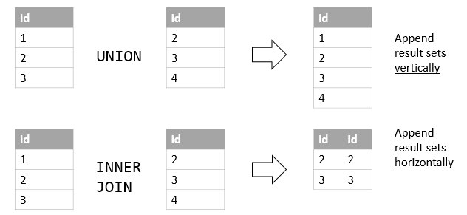
UNION vs. JOIN
A JOIN combines result sets horizontally, a UNION appends result set vertically.

Slide 30
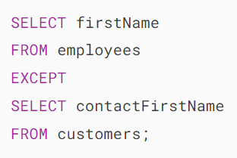
MySQL EXCEPT
The MySQL EXCEPT operator allows you to retrieve rows from one query that do not appear in another query.
The following query uses the EXCEPT operator to find the first names that appear in the customers table but do not appear in the employees table:

Slide 31
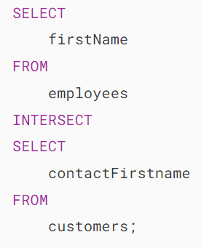
MySQL INTERSECT
The INTERSECT operator is a set operator that returns the common rows of two or more queries.
The INTERSECT operator compares the result sets of two queries and returns the common rows.
The following query uses the INTERSECT operator to find the common first names of customers and employees

