Slide 1
MySQL Advance

Slide 2
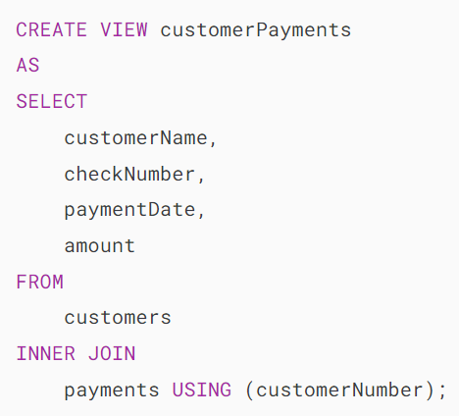

MySQL Views
A view is a virtual table based on the result-set of an SQL statement.
A view contains rows and columns, just like a real table.
The fields in a view are fields from one or more real tables in the database.
By definition, a view is a named query stored in the database catalog.
To create a new view you use the CREATE VIEW statement.
Once you execute the CREATE VIEW statement, MySQL creates the view and stores it in the database.
Now, you can reference the view as a table in SQL statements.

Slide 3
Advantages of MySQL Views
Simplify complex query
Make the business logic consistent
Add extra security layers
Enable backward compatibility

Slide 4
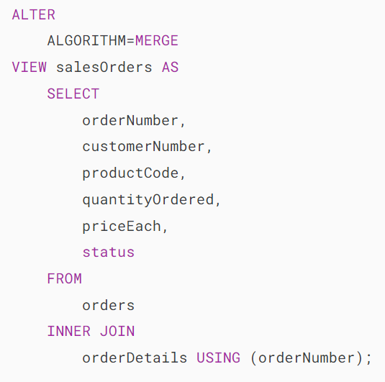
MySQL ALTER VIEW
The MySQL ALTER VIEW statement changes the definition of an existing view.

Slide 5

MySQL DROP VIEW
The DROP VIEW statement deletes a view completely from the database.

Slide 6
MySQL Index
MySQL uses indexes to rapidly locate rows with specific column values.
Without an index, MySQL must scan the entire table to find the relevant rows.
The larger the table, the slower the search becomes.
An index is a data structure such as a B-Tree that improves the speed of data retrieval on a table at the cost of additional writes and storage to maintain it.
The query optimizer may use indexes to quickly locate data without having to scan every row in a table for a given query.

Slide 7
MySQL INDEX
When you create a table with a primary key or unique key, MySQL automatically creates a special index named PRIMARY. This index is called the clustered index.
The PRIMARY index is special because the index itself is stored together with the data in the same table. The clustered index enforces the order of rows in the table.
Other indexes other than the PRIMARY index are called secondary indexes or non-clustered indexes.

Slide 8


MySQL CREATE INDEX
To add an index for a column or a set of columns, you use the CREATE INDEX statement.

Slide 9
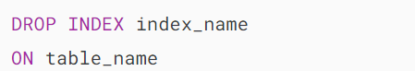

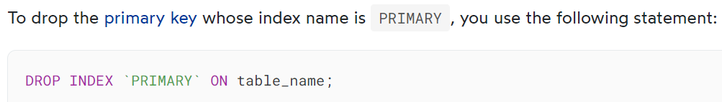
MySQL DROP INDEX
To delete an existing index from a table, you use the DROP INDEX statement as follows.

Slide 10
MySQL Stored Procedures & Triggers

Slide 11
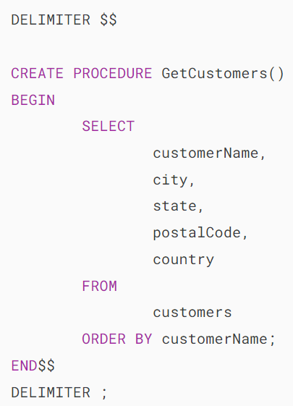

MySQL Stored Procedures
A stored procedure is a set of declarative SQL statements stored within the MySQL Server.
After saving the stored procedure, you can invoke it by using the CALL statement.

Slide 12

MySQL Delimiter
A MySQL client program, such as MySQL Workbench or the mysql program, uses the default delimiter (;) to separate statements and execute each separately.
However, a stored procedure consists of multiple statements separated by a semicolon (;).
If you use a MySQL client program to define a stored procedure that contains semicolons, the MySQL client program will not treat the entire stored procedure as a single statement; instead, it will recognize it as multiple statements.
Therefore, it is necessary to temporarily redefine the delimiter so that you can pass the entire stored procedure to the server as a single statement.
To redefine the default delimiter, you use the DELIMITER command

Slide 13
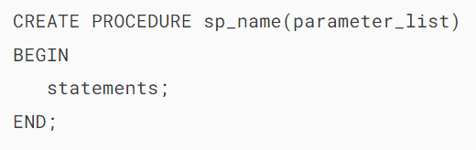
MySQL CREATE PROCEDURE
To create a stored procedure, you use the CREATE PROCEDURE statement.
First, define the name of the stored procedure sp_name after the CREATE PROCEDURE keywords.
Second, specify the parameter list (parameter_list) inside the parentheses followed by the stored procedure’s name. If the stored procedure has no parameters, you can use an empty parentheses ().
Third, write the stored procedure body that consists of one or more valid SQL statements between the BEGIN and END block.

Slide 14
MySQL Stored Procedure Parameters
Typically, stored procedures have parameters, making them more useful and reusable.
A parameter in a stored procedure has one of three modes: IN, OUT, or INOUT.

Slide 15
IN parameters
IN is the default mode.
When defining an IN parameter in a stored procedure, the calling program must pass an argument to the stored procedure.
Additionally, the value of an IN parameter is protected.
This means that even if you change the value of the IN parameter inside the stored procedure, its original value remains unchanged after the stored procedure ends. In other words, the stored procedure works only on the copy of the IN parameter.

Slide 16
OUT parameters
The value of an OUT parameter can be modified within the stored procedure, and its updated value is then passed back to the calling program.

Slide 17
INOUT parameters
An INOUT parameter is a combination of IN and OUT parameters.
This means that the calling program may pass the argument, and the stored procedure can modify the INOUT parameter and pass the new value back to the calling program.

Slide 18
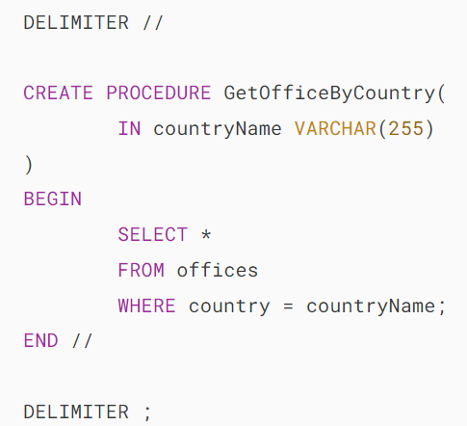
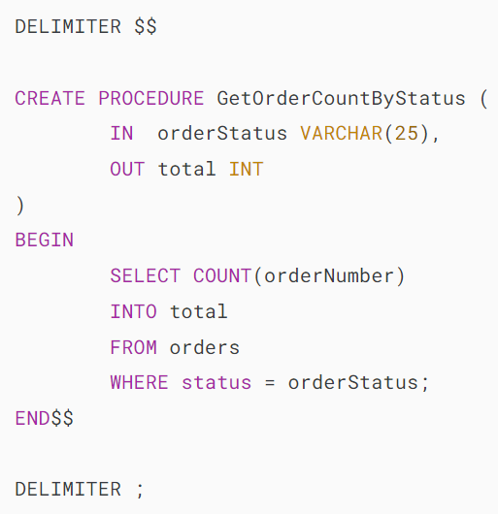
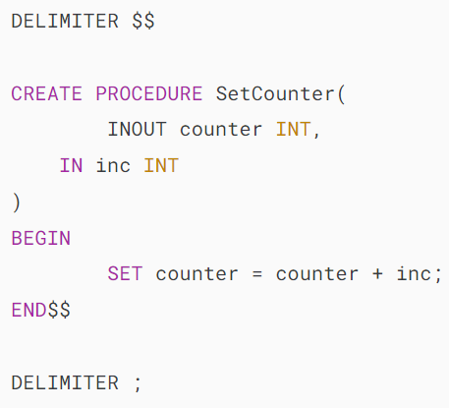
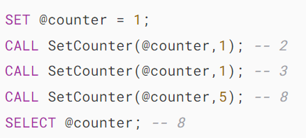


Examples

Slide 19

MySQL DROP PROCEDURE

Slide 20

MySQL Stored Procedure Variables
A variable is a named data object whose value can change during the execution of a stored procedure.
Typically, you use variables to hold immediate results. These variables are local to the stored procedure.
Before using a variable, you need to declare it.
To declare a variable inside a stored procedure, you use the DECLARE statement

Slide 21


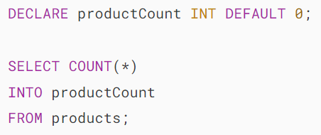
Assigning variables
To assign a variable a value, you use the SET statement

Slide 22
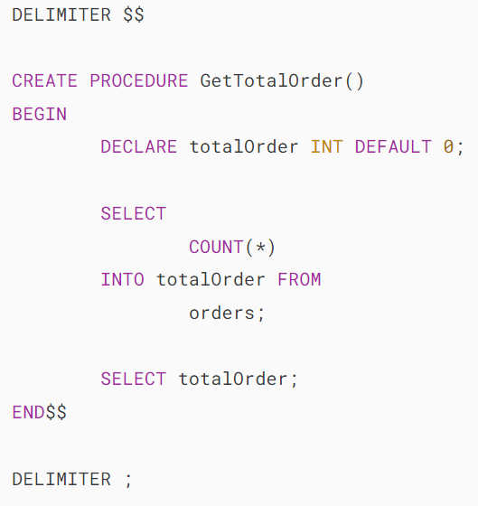
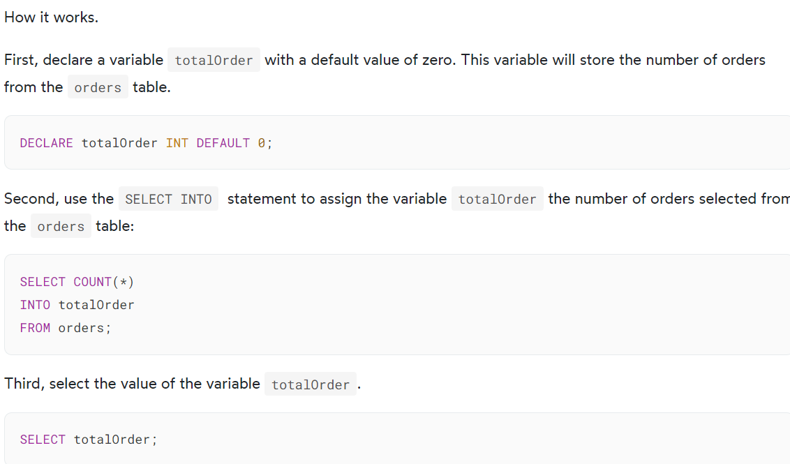
Assigning variables

Slide 23
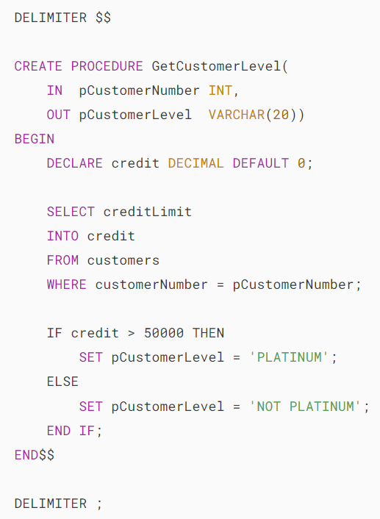
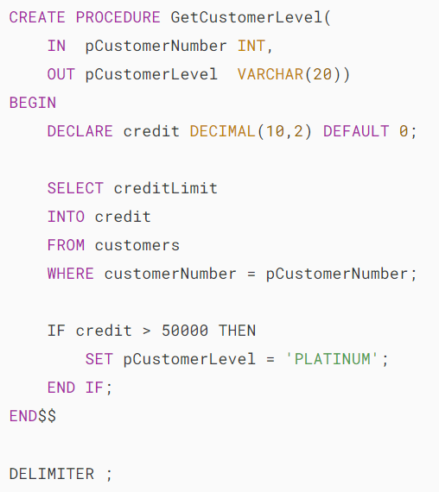
MySQL IF Statement

Slide 24
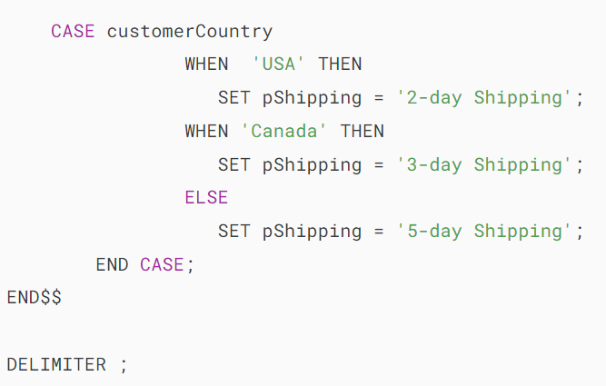
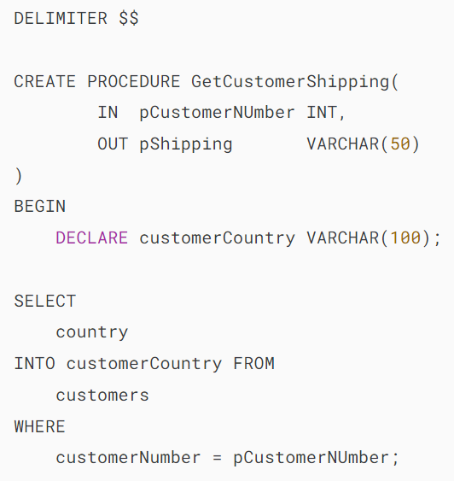
MySQL CASE Statement

Slide 25
MySQL LOOP

Slide 26
MySQL WHILE Loop

Slide 27
MySQL Triggers

Slide 28
MySQL Triggers

Slide 29
MySQL Triggers
In MySQL, a trigger is a stored program invoked automatically in response to an event such as insert, update, or delete that occurs in the associated table.
MySQL supports triggers that are invoked in response to the INSERT, UPDATE or DELETE event.
The SQL standard defines two types of triggers: row-level triggers and statement-level triggers.
A row-level trigger is activated for each row that is inserted, updated, or deleted. For example, if a table has 100 rows inserted, updated, or deleted, the trigger is automatically invoked 100 times for the 100 rows affected.
A statement-level trigger is executed once for each transaction regardless of how many rows are inserted, updated, or deleted.
MySQL supports only row-level triggers. It doesn’t support statement-level triggers.

Slide 30
MySQL Triggers
Advantages of triggers
Triggers provide another way to check the integrity of data.
Triggers handle errors from the database layer.
Triggers give an alternative way to run scheduled tasks. By using triggers, you don’t have to wait for the scheduled events to run because the triggers are invoked automatically before or after a change is made to the data in a table.
Triggers can be useful for auditing the data changes in tables.
Disadvantages of triggers
Triggers can only provide extended validations, not all validations. For simple validations, you can use the NOT NULL, UNIQUE, CHECK and FOREIGN KEY constraints.
Triggers can be difficult to troubleshoot because they execute automatically in the database, which may not be visible to the client applications.
Triggers may increase the overhead of the MySQL server.

Slide 31
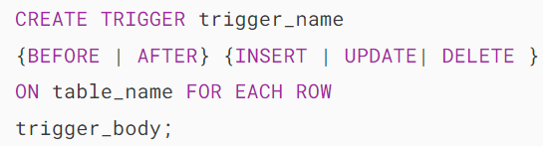
Create Trigger in MySQL
The CREATE TRIGGER statement creates a new trigger.
The trigger body can access the values of the column being affected by the DML statement.
To distinguish between the value of the columns BEFORE and AFTER the DML has fired, you use the NEW and OLD modifiers.

Slide 32
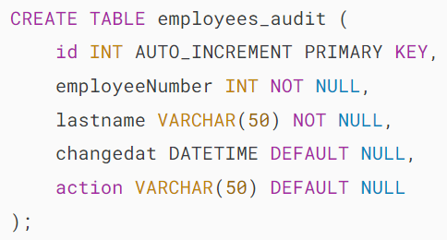
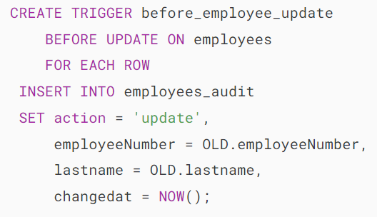
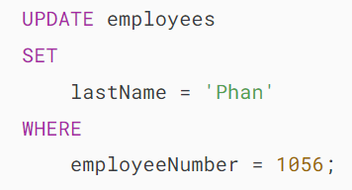

Create Trigger in MySQL

Slide 33


MySQL DROP TRIGGER

Slide 34
MySQL Stored Function

Slide 35
MySQL Stored Function
A stored function is a specialized type of stored program designed to return a single value. Typically, you use stored functions to encapsulate common formulas or business rules, making them reusable across SQL statements or other stored programs.
Unlike a stored procedure, you can use a stored function in SQL statements wherever you use an expression. This enhances the readability and maintainability of the procedural code.
To create a stored function, you use the CREATE FUNCTION statement.

Slide 36
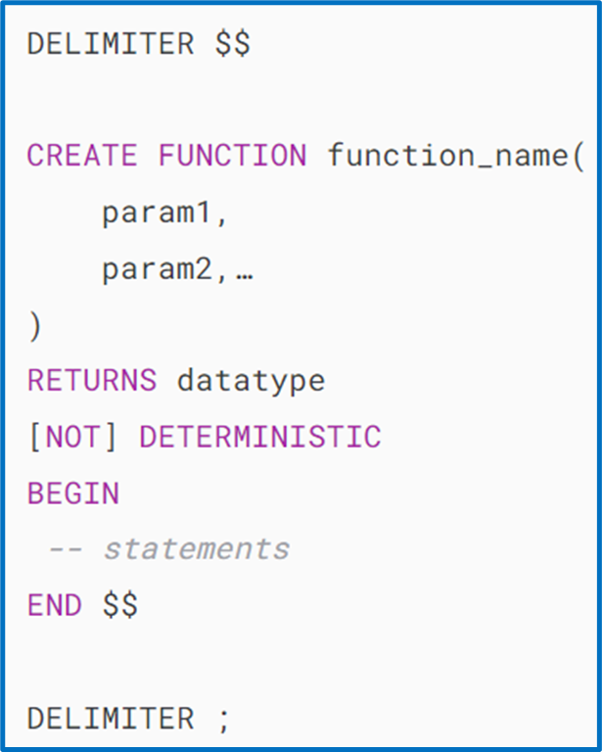
MySQL Stored Function
Specify the name of the stored function that you want to create after CREATE FUNCTION keywords.
List all parameters of the stored function inside the parentheses followed by the function name.
By default, stored functions consider all parameters as IN parameters. You cannot specify IN , OUT or INOUT modifiers to parameters
Specify the data type of the return value in the RETURNS statement, which can be any valid MySQL data types.
Determine whether a function is deterministic or not using the DETERMINISTIC keyword.
A deterministic function always returns the same result for the same input parameters, while a non-deterministic function produces different results for the same input parameters.
If you don’t use DETERMINISTIC or NOT DETERMINISTIC, MySQL defaults to the NOT DETERMINISTIC option.
Write the code in the body of the stored function in the BEGIN...END block.
Inside the body section, you need to include at least one RETURN statement. The RETURN statement sends a value to the calling programs.
Upon reaching the RETURN statement, the stored function terminates the execution of the stored function immediately.

Slide 37

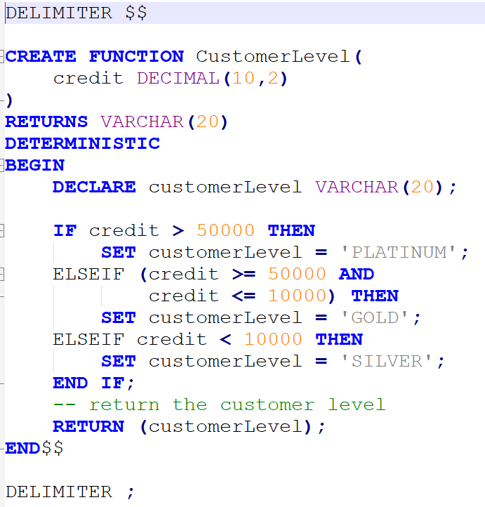
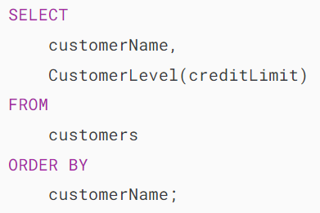
MySQL CREATE FUNCTION

Slide 38

MySQL DROP FUNCTION
The DROP FUNCTION statement drops a stored function.

