Slide 1

Banglore eatery Zomato
By shiva sai karne
1099134
.

Slide 2
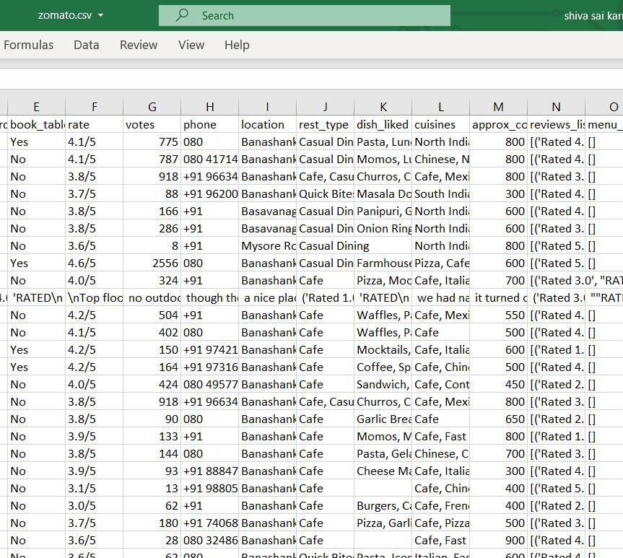
Data set:
https://www.kaggle.com/himanshupoddar/zomato-bangalore-restaurants#zomato.csv

Slide 3
Problem statements
MapReduce:
Out of all restaurants in Bangalore finding out who hold overall rating of 5.
Hive:
Out of all restaurants find out the different type of meal they had that is listing out whether they had delivery or dine-out where the rating is above 4.

Slide 4
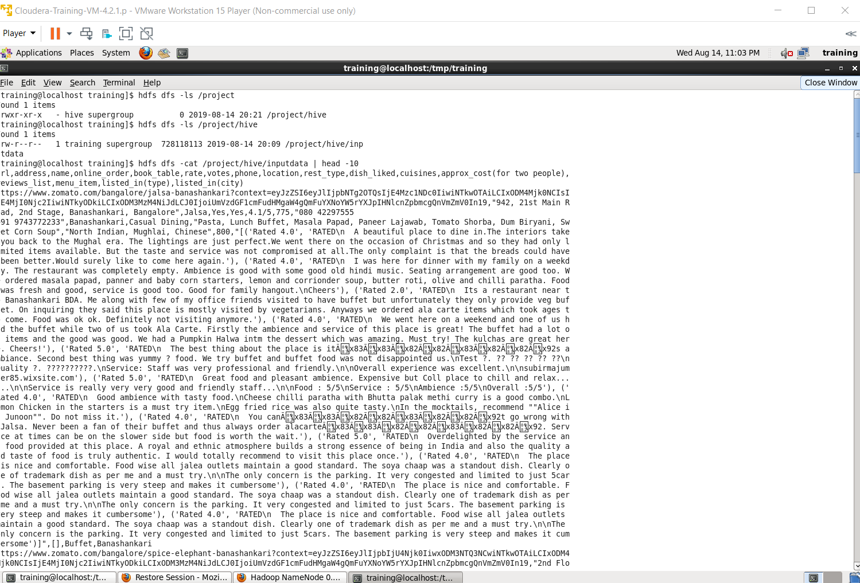
Preparing data and uploading to HDFS

Slide 5
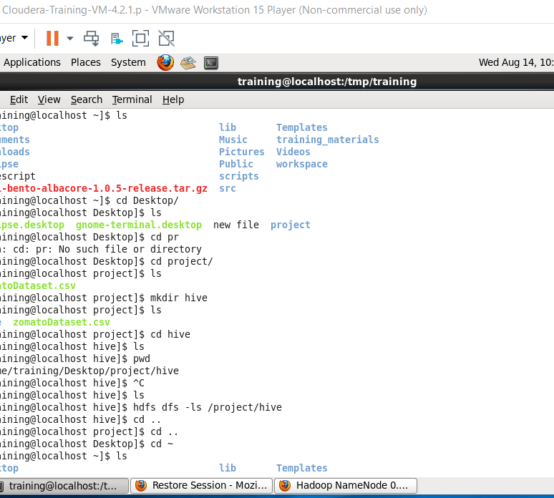
Using Hive:

Slide 6
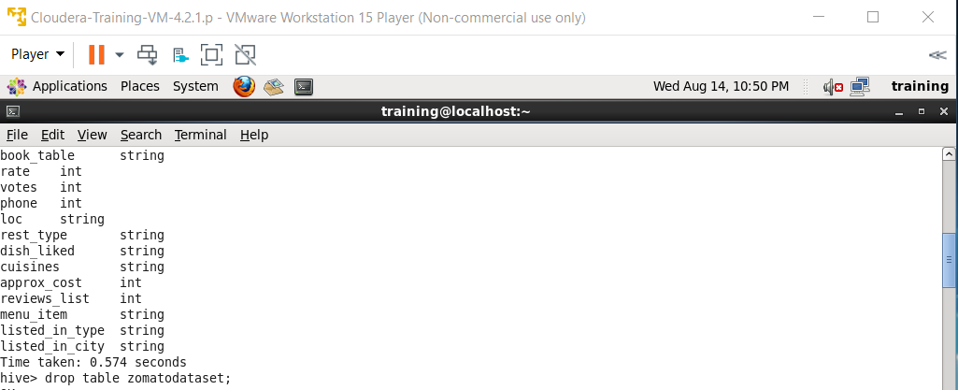
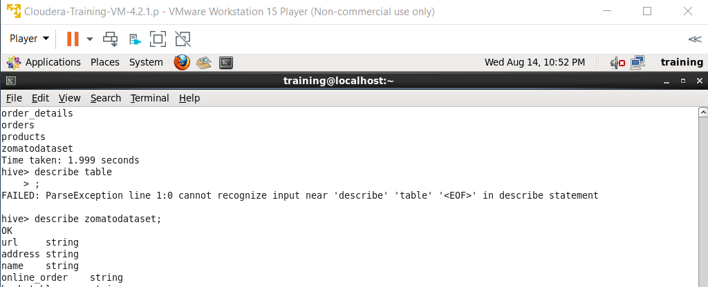
hive

Slide 7
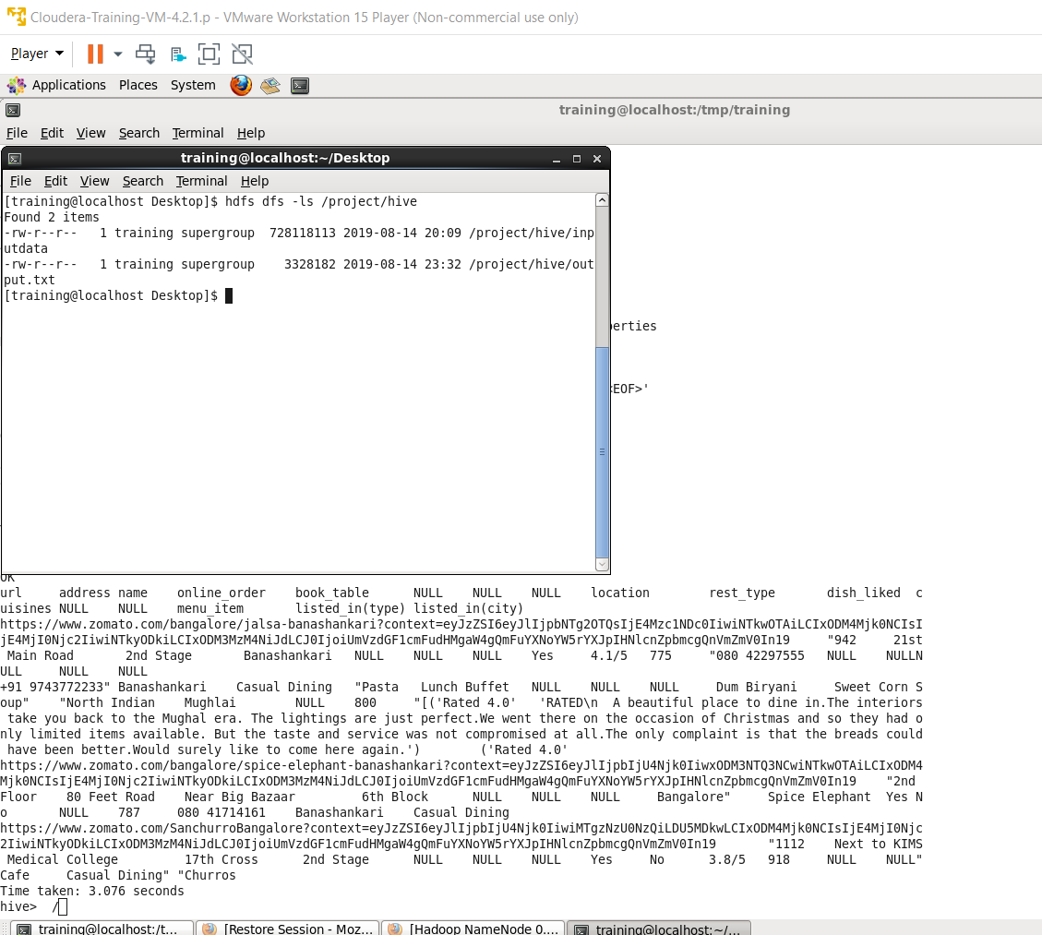
Hive output

Slide 8
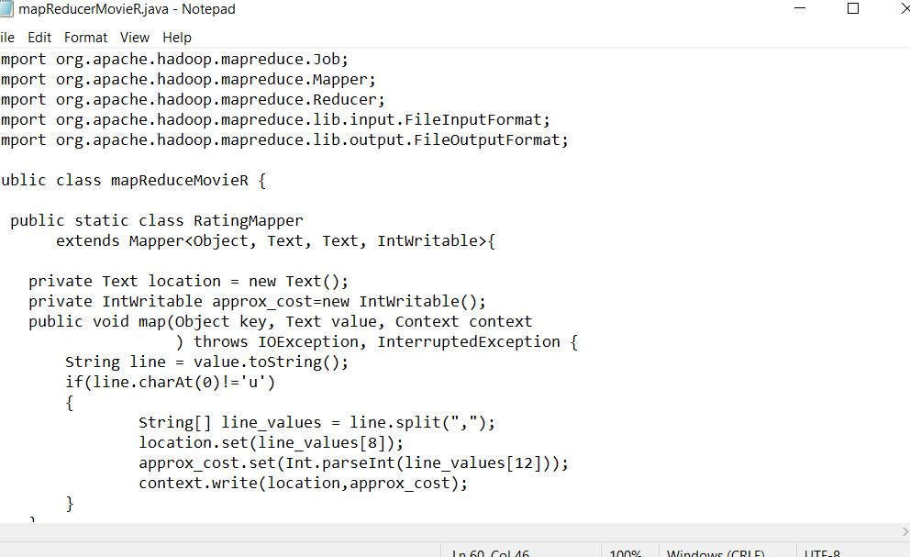
mapreduce
Java script

Slide 9
thankyou

