Slide 1
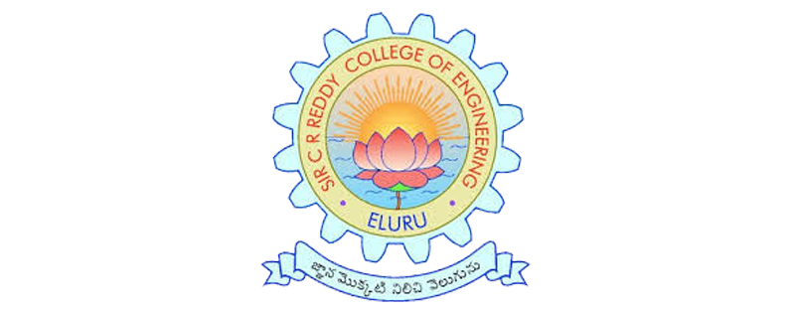
SIR CR REDDY COLLEGE OF ENGINEERING
DEPARTMENT OF INFORMATION TECHNOLOGY
PROJECT TITLE:
Design of a Transfer Learning-Based Deep Learning Model for Domain-Adaptive Classification
Batch No.: B14
Project Members:
T. Hemanth Kumar (22B81A12C1)
M. Sai Karthik (22B81A1284)
M. Manoj (22B81A1272)
L. Naga Sai (22B81A1271)
Guided By:
Mr. G. Pavan, Asst. Professor

Slide 2

Table of Contents
Abstract
Literature Review
Problem Statement
Proposed Methodology
System Architecture
Advantages
Conclusion

Slide 3

Abstract
This project proposes a transfer learning–based deep learning model to improve classification performance across different domains. Pre-trained deep learning models are used to extract meaningful features and reduce the need for large labeled datasets. Domain adaptation techniques help minimize the differences between source and target data distributions. Experimental results show that the proposed model achieves better accuracy compared to traditional deep learning approaches.

Slide 4
Literature Review
S. No. | Author(s) & Year | Algorithm(s) Used | Accuracy (Approx.) | Advantage | Disadvantage
1 | Pan & Yang (2019) | Transfer Learning Framework | – | Established theoretical foundation for transfer learning | No deep learning or experimental results
2 | Yosinski et al. (2020) | CNN Feature Transfer | 88% | Demonstrated layer-wise feature transferability | Limited to CNN architectures
3 | Long et al. (2022) | Deep Adaptation Network (MMD) | 89% | Effectively minimizes domain discrepancy | Sensitive to kernel selection
4 | Ganin et al. (2023) | DANN (Domain-Adversarial NN) | 90% | Learns domain-invariant features automatically | Training instability due to adversarial loss
5 | He et al. (2024) | ResNet + Transfer Learning | 92% | Deep residual learning improves accuracy | High computational complexity

Slide 5

Problem Statement
Traditional Deep Learning models fail when test data is different from training data. There is a need for a model that can adapt knowledge from one domain to another. We have to make the Deep Learning model perform Domain Adaptive Classification of a new training data using Transfer Learning.

Slide 6
Proposed Methodology
Adversarial Training Method:
• The Adversarial Training Method consists of two processes:
1. Feature Extraction: Takes input data and converts it into features regardless of whether the feature comes from the source or target domain.
2. Domain Discriminator: This discriminator tries to identify if a feature comes from the source or target domain.
• This way this method forces the deep learning model to learn of domain-invariant representations of data.
Discrepancy-Based Loss:
The model incorporates Maximum Mean Discrepancy (MMD) loss. This quantitatively measures the statistical distance between the feature distributions of the two domains and minimizes it during training to bridge the distributional gap.

Slide 7
Hybrid Loss Function:
  A unique combined loss function is proposed that balances two elements:
Cross-Entropy Loss for classification accuracy on the labeled source data.
Domain Discrepancy Loss for alignment between domains.
Layer-Specific Fine-Tuning:
  Rather than a naive transfer, the method involves freezing early layers to preserve generic features (edges, textures) while selectively unfreezing and fine-tuning later, more task-specific layers for adaptation.

Slide 8
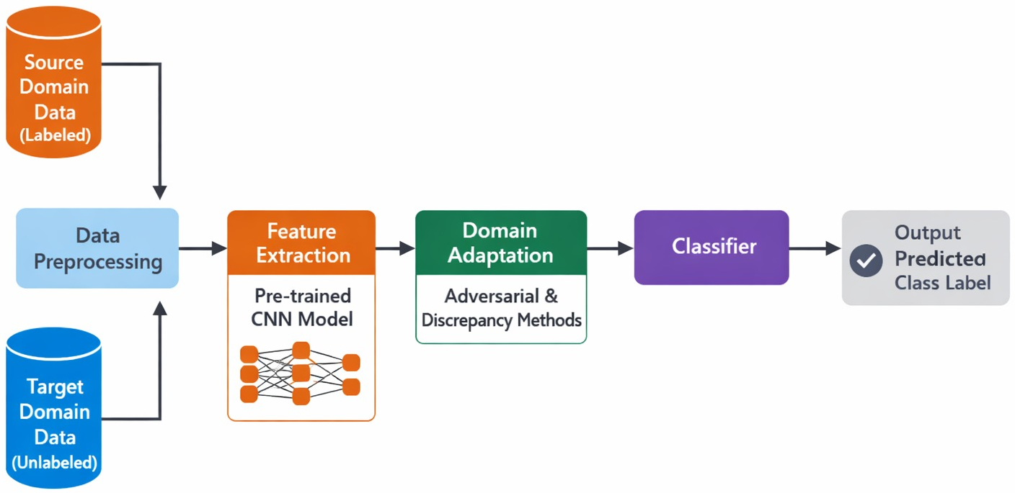
System Architecture

Slide 9
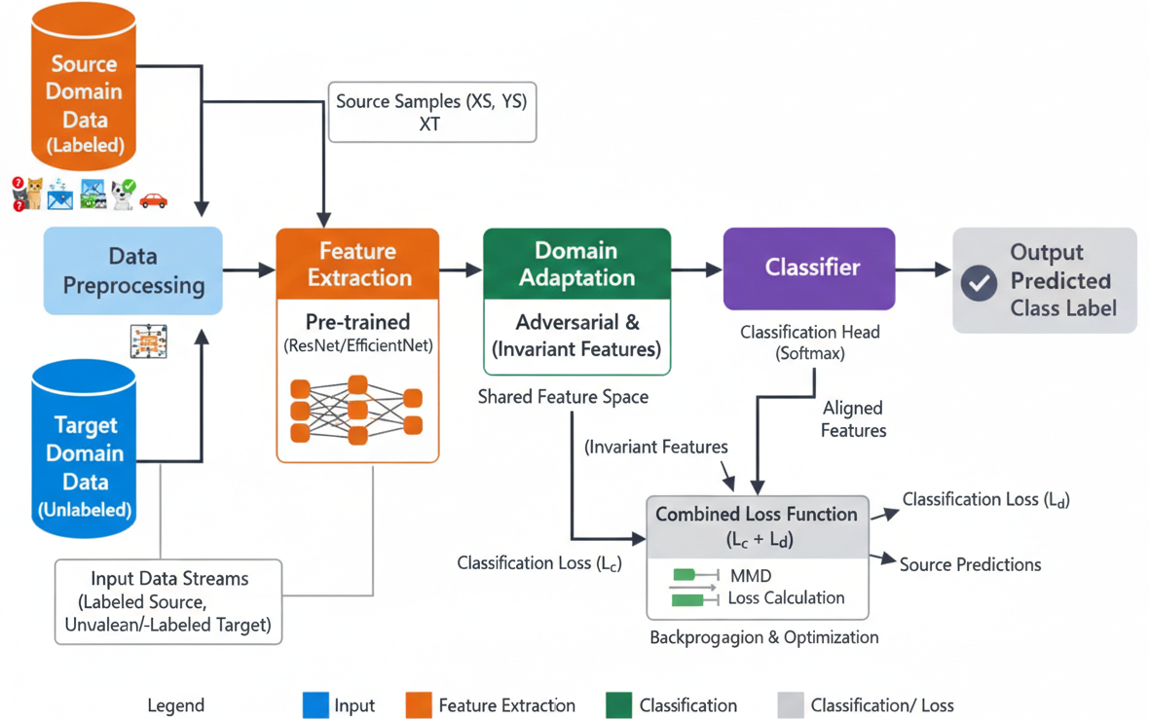
System Architecture

Slide 10
Source Domain Data: Provides labeled data used to train the classification model.
Target Domain Data: Provides unlabeled data or limited labeled data for domain adaptation.
Preprocessing Module : Prepare input data in a format suitable for deep learning model.
CNN Feature Extractor: Extracts high-level features using a pre-trained deep learning Network.
Domain Adaptation Module: Minimizes the difference between source and target domain features.
Classifier Module: Predicts the class labels based on learned features.
Output Layer: Displays the final classification result.

Slide 11
Advantages
  Cost Effective
  • This project makes the Deep Learning Model Cost effective as we would be working on fine-tuning the existing Deep learning model.
  Effective Resource Management
  • This project makes the Deep Learning Model use the existing model by fine-tuning it as we not be need to make a model from scratch.
  Reduces Overall Manpower
  • It would be working on fine-tuning the existing Deep learning model.

Slide 12
Conclusion
This project focuses on domain-adaptive classification by means of Transfer learning using a pre-trained Deep Learning model to improve classification accuracy with reduced training effort for real-world applications and data distribution changes.

Slide 13

THANK YOU

