Slide 1
Redesigned College Canteen Menu & Financial Feasibility Report
Prepared by: Sai Karthik Nidamarthi — Date: 21 Sep 2025

Slide 2
Purpose / Objective
Redesign canteen menu to balance student affordability, variety, health, and profitability.
Create a scalable, hygienic, and digital-first canteen model for the college.
Provide CA-ready financials and CEO-ready strategy with operational controls.

Slide 3
Market / Student Insights
Student affordability band: ₹10 – ₹300 (majority sales in ₹20–₹100).
Trending items: Maggi, Fries, Cold Coffee, Biryani, Wraps, Healthy bowls.
Demand for quick service, hygienic food, and cashless payments.

Slide 4
Menu Segmentation (Price Range ₹10–₹300)
Category | Price Band | Sample Items
Snacks | ₹10 – 50 | Samosa, Veg Puff, Pakoda, Maggi, Fries
Breakfast | ₹20 – 80 | Idli, Dosa, Upma, Sandwich, Paratha
Main Meals | ₹60 – 300 | Veg/Non-Veg Thali, Biryani, Curry + Rice
Fast Food | ₹40 – 120 | Burgers, Wraps, Noodles, Pasta, Pizza
Healthy Corner | ₹20 – 100 | Fruit Bowl, Salads, Boiled Eggs
Beverages | ₹10 – 80 | Tea, Coffee, Cold Coffee, Milkshakes
Desserts | ₹20 – 150 | Gulab Jamun, Ice cream, Brownie, Donut
Premium Specials | ₹150 – 300 | Special Thali, Large Pizza, Group Combos

Slide 5
Sample Redesigned Menu
Item | Category | Price (₹)
Samosa (2 pcs) | Snacks | 15
Veg Puff | Snacks | 20
French Fries | Snacks | 50
Idli (3+chutney) | Breakfast | 25
Masala Dosa | Breakfast | 50
Veg Thali | Main Meals | 80
Chicken Curry + Rice | Main Meals | 120
Chicken Biryani | Main Meals | 180
Veg Burger | Fast Food | 50
Chicken Roll | Fast Food | 80
Fruit Bowl | Healthy | 40
Cold Coffee | Beverages | 40
Special Non-Veg Thali | Premium | 220
Combo (Burger+Fries+Coke) | Combo | 200

Slide 6
Costing & Margin Examples
Item | Prod. Cost (₹) | Selling Price (₹) | Margin %
Samosa (2 pcs) | 8 | 15 | 47%
Chicken Biryani | 100 | 180 | 44%
Milkshake | 30 | 60 | 50%
Chicken Roll | 50 | 80 | 37.5%

Slide 7
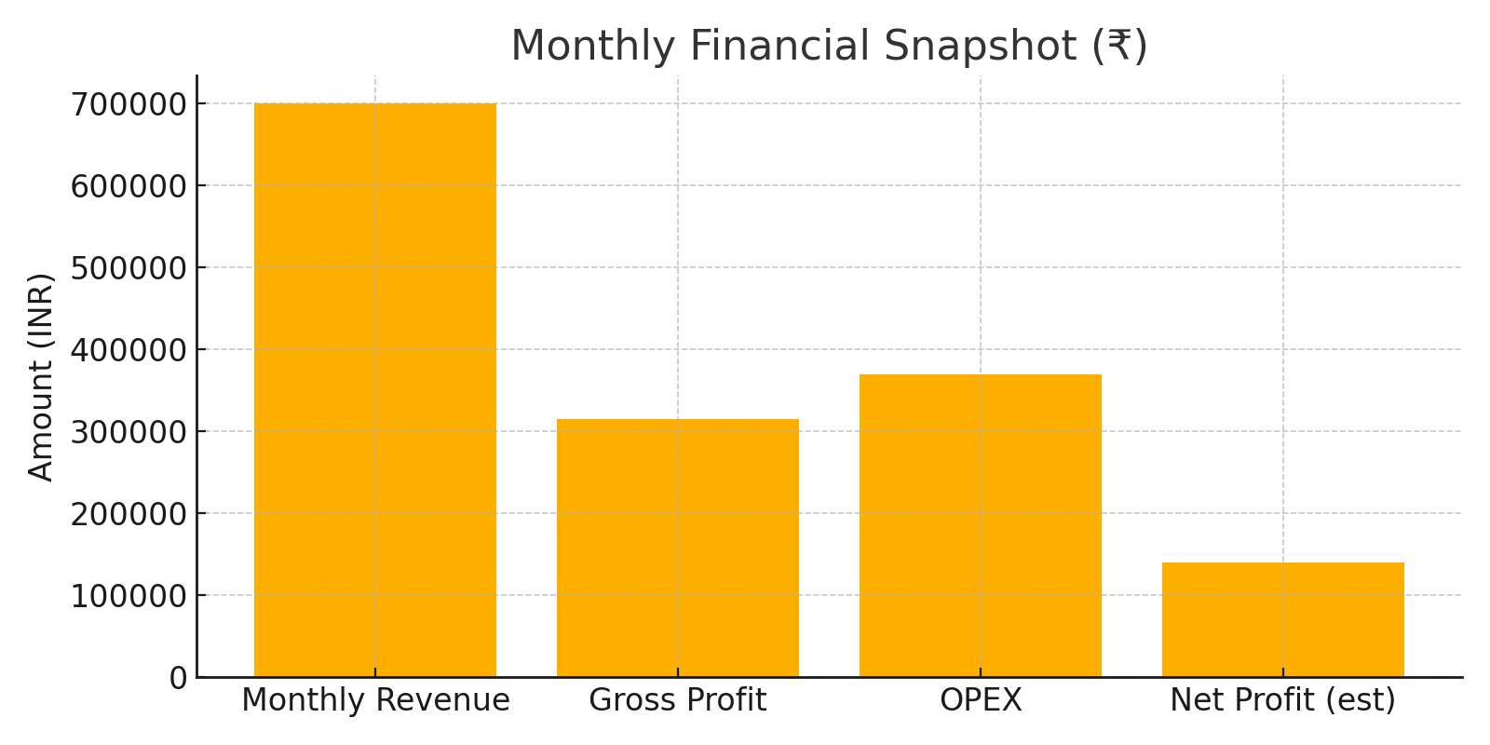
Financial Forecast & Revenue Model
Daily Sales Projection: 300 students/day × Avg Ticket ₹90 = ₹27,000
Monthly (26 days) ≈ ₹7,02,000
Gross Margin ≈ 45% → Gross Profit ≈ ₹3.15 Lakh
OPEX ≈ ₹3.7 Lakh/month → Net Profit ≈ ₹1.3–1.5 Lakh/month
Payback Period ≈ 10–12 months

Slide 8
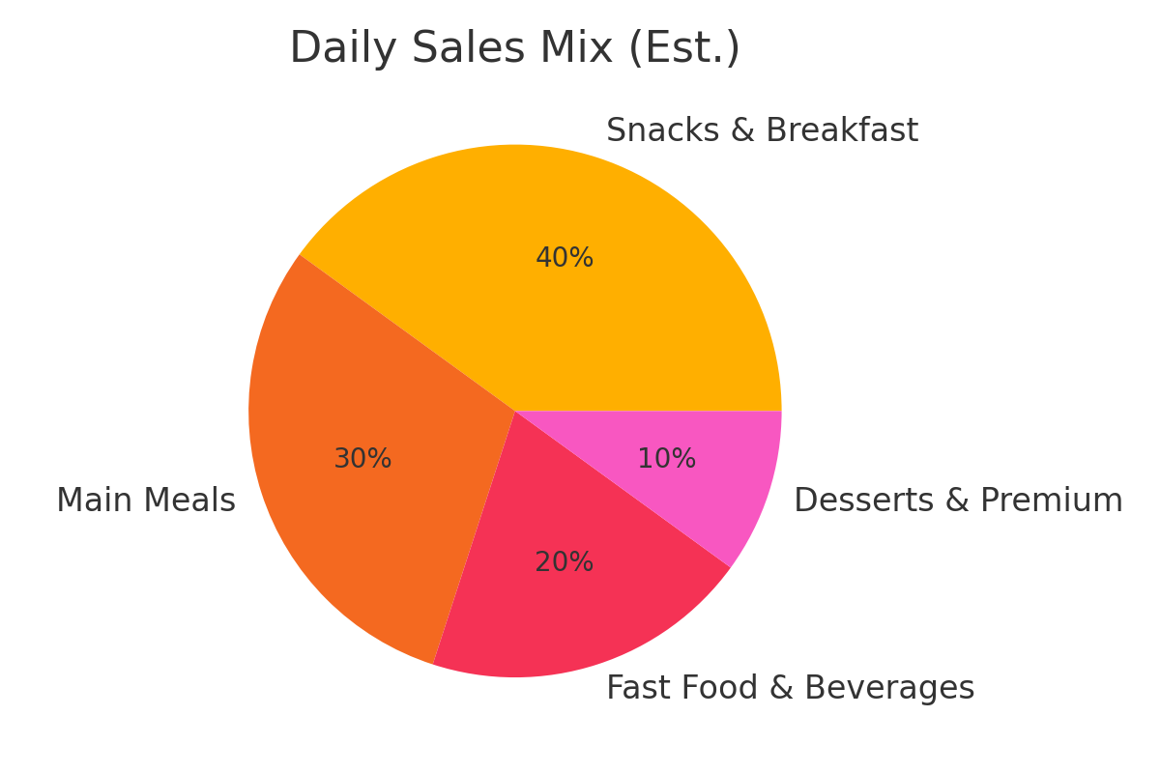
Daily Sales Mix (Estimated)
Estimated percentage split of daily sales by category.

Slide 9
Investment Requirement
Component | Details | Estimated Cost (₹)
Kitchen Setup | Cooking range, fryers, ovens, refrigerators | 6,00,000
Storage & Warehouse | Cold storage, dry racks | 2,00,000
Service Setup | Counters, POS, furnishing | 2,00,000
Licenses & Compliance | FSSAI, safety | 50,000
Working Capital (1 month) | Raw material buffer, salaries | 2,50,000
Logistics | Supplier tie-ups, transport | 1,50,000
Total |  | 14,50,000

Slide 10
Operational Controls & Plan-B
Daily monitoring (morning inventory, midday sales review, evening wastage audit).
Waste control: FIFO, portion control, batch cooking, end-of-day discounts or donation.
Plan-B for low sales: Student specials, reduced production, loyalty programs.
Plan-B for ops issues: standby staff, backup vendors, spare equipment, generator.

Slide 11
Staffing Plan & Space Requirement
Role | Count | Salary Range (₹/month)
Head Cook | 1 | ₹20,000–25,000
Assistant Cooks | 2 | ₹15,000 each
Snack Counter Staff | 2 | ₹12,000 each
Cashier | 1 | ₹15,000
Helpers | 2 | ₹10,000 each
Total Staff (full ops) | 8 | ₹1,10,000–1,20,000/month

Slide 12
Risk & Compliance
Maintain 10–15% pricing buffer for raw material inflation.
FSSAI certification, quarterly hygiene audits, staff training.
Digital payments (UPI/POS) for transparency and daily reconciliation.

Slide 13
Closing / Call to Action
Approve redesigned menu and initial investment of ~₹14.5 Lakh.
Authorize procurement and POS setup; enable prepaid student wallet.
Start pilot for 1 month and review sales data; scale based on results.

