Slide 1




DATABASE MANAGEMENT SYSTEMS
TERM PROJECT – SPRING 2021

Slide 2
Group Members:
Sai Karun Sandugula(101691752)
Revanth keshaboina(101697266)
Mahaveer Sai Marapally(101698112)
Akshay Kumar Erati(101699139)
Kalyan Bankiti(101680324)

Slide 3
HOSPITAL MANAGEMENT SYSTEM

Slide 4
PURPOSE :
The main purpose of “HOSPITAL MANAGEMENT SYSTEM” database is to easily maintain the information of doctor , patient ,room ,bill payment. It Includes electronic business intelligent like revenue cycle management and health records.
The main purpose of the project is to store and retrieve the data of doctor and patient when ever required.

Slide 5
Entities :
Physician
Patient
Nurses
medicines
Pharmacy
Medical_receipts
Medical Branches
Wards
Schedules
10. Admin

Slide 6
Physician
The physician entity consists of the physician id, physician name department of the physician, contact information, working hours. Using this, the database can retrieve the information easily depending upon the medical–branches the physicians work in.
Patient
The patient’s entity contains the information about the patient such as patient registration id, patient medical info, and patient personal information which gives easy access to the physicians
Nurses
The Nurse entity has information about the nurses working in the hospital, like their id, nurse working hours, contact information, their department. Using this the database will be able to get the desired information about the nurse and assigned tasks as well.
.

Slide 7
Medicines
Medicine’s entity will include the different types of medicines prescribed by the physician. It will include the patient id (to whom the medicine has been prescribed), medicine name and medicine id.
Pharmacy
The pharmacy will have the details of the medicines such as medicine id, bill id , and medicine price to keep a record of the medicines given to the patients.
Medical_receipts
The billing entity consists of the information about the patient’s bill which includes bill id, information of the medicines. This will keep track of the patients and their prescriptions.
.

Slide 8
Medicalbranches
The department entity contains information about the different medicalbranches like accident and emergency, discharge lounge, anesthetics, diagnostic imaging, critical care, etc. This will help in the precise categorization of the information for easy information access.
Wards
Different wards will be assigned to the patients depending upon the treatment. Wards will include types such as ICU, Diagnostic imaging, Discharge lounge etc.
Schedules
The Schedules entity includes the Schedule details scheduled between the patient and the physician. It will include details such as patient id, Schedule id, Schedule time, Schedule date.
.

Slide 9
Admin
Admin is the controller of the database system which has been designed. It has the authority to keep track of the tasks that are being processed in the database.
.

Slide 10
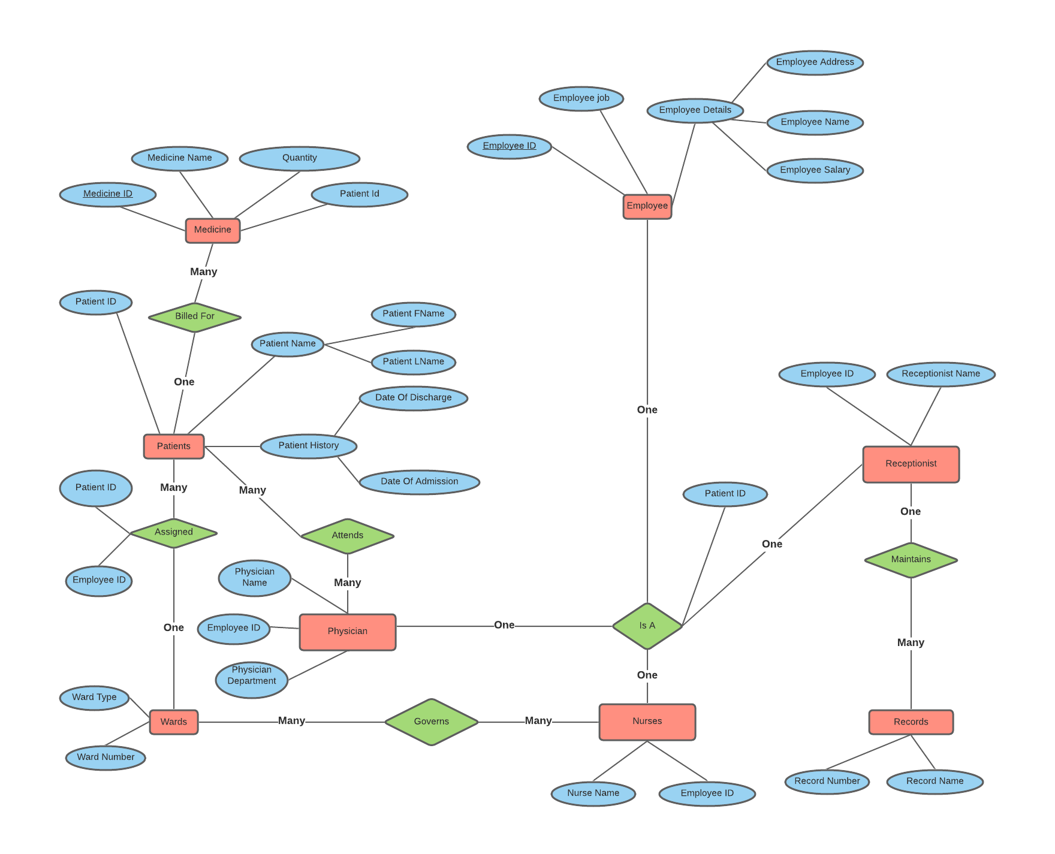
Entity Relationship Diagram -

Slide 11
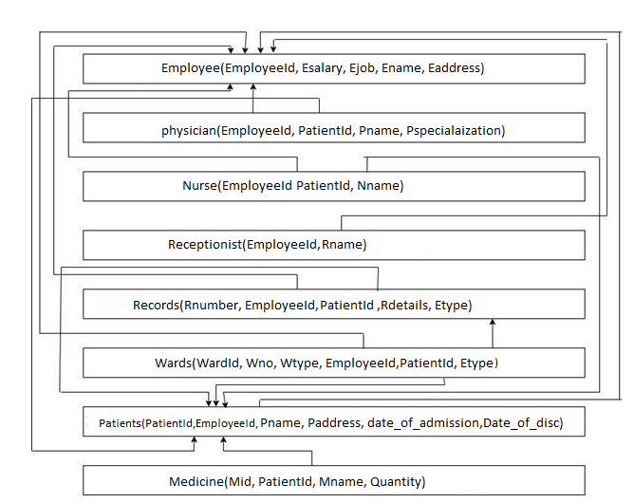
Relational Diagram -

Slide 12
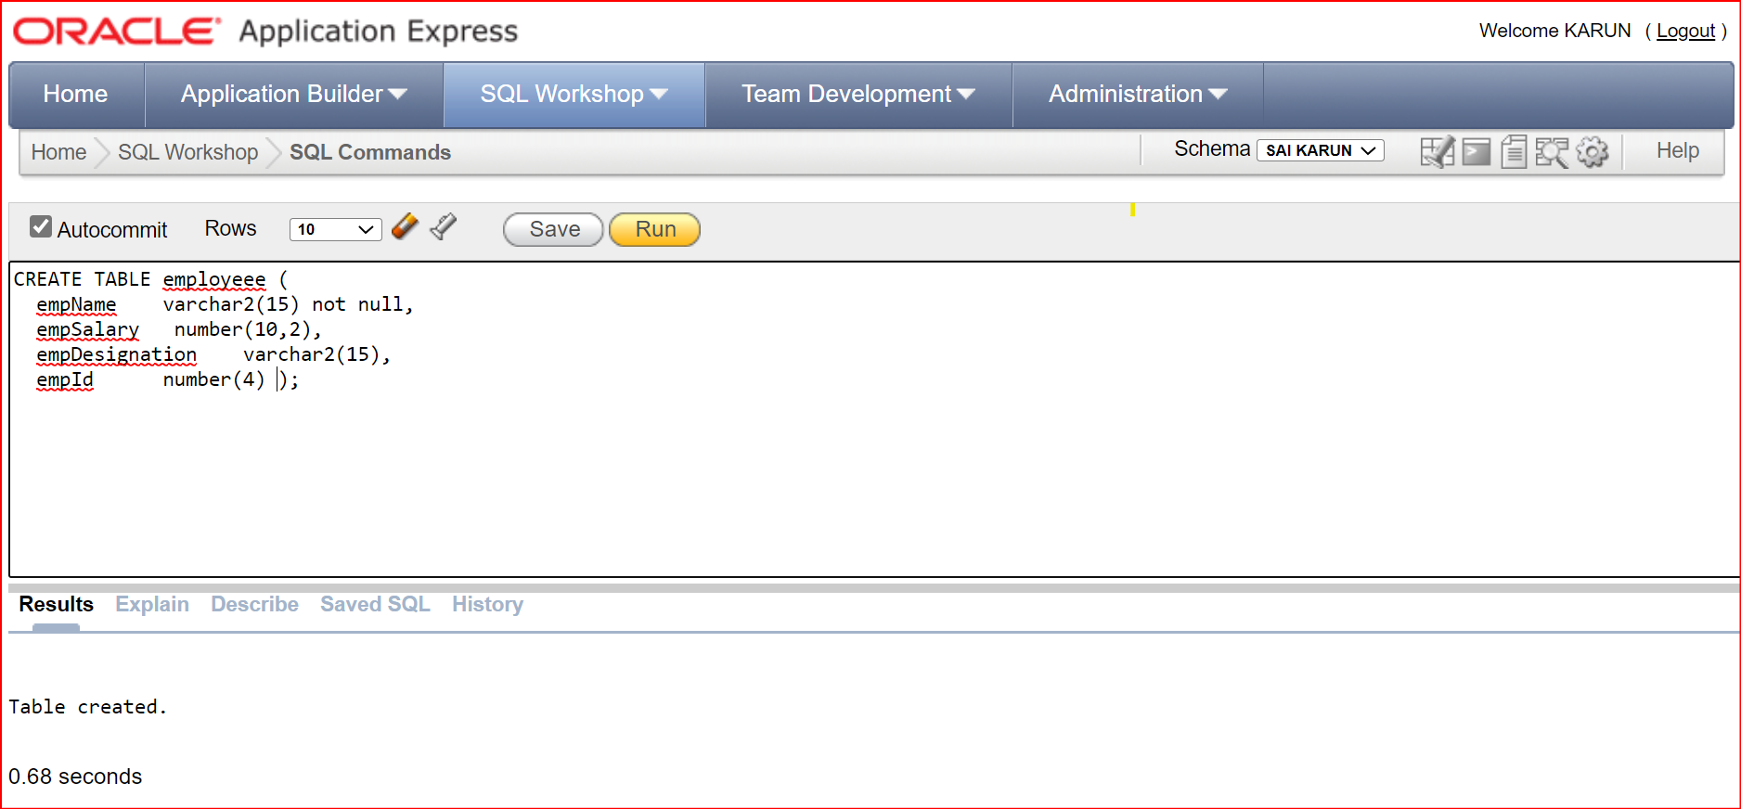
SQL QUERIES -
Create Query for Employee Table

Slide 13
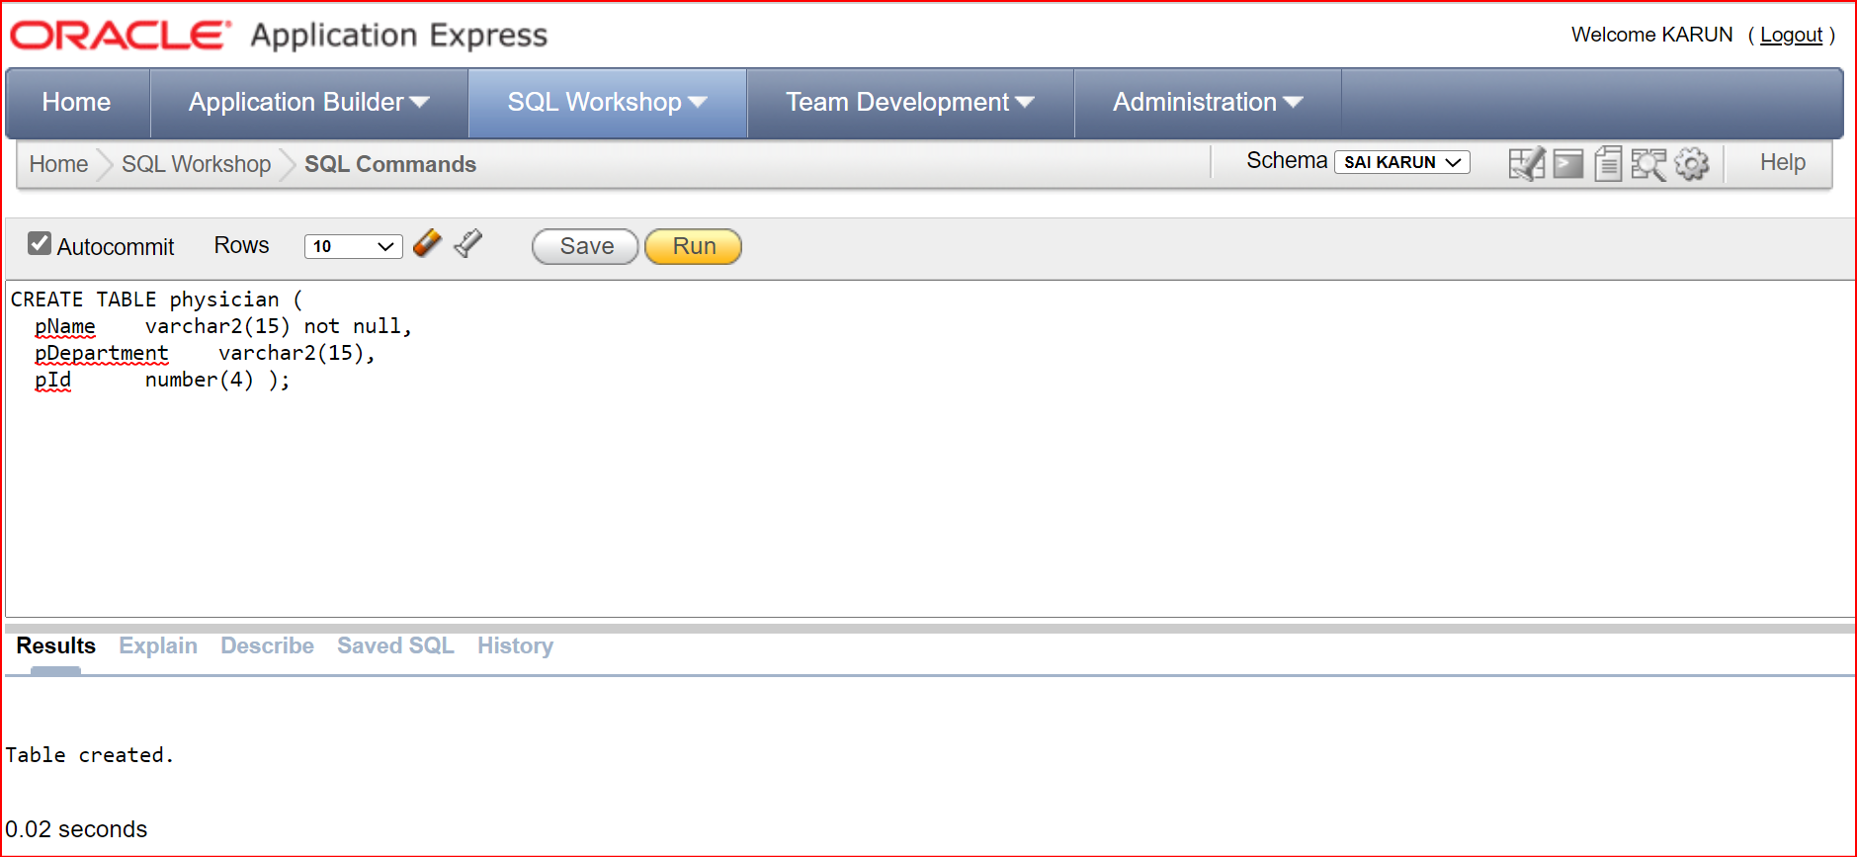
SQL QUERIES -
Create Query for Physician Table

Slide 14
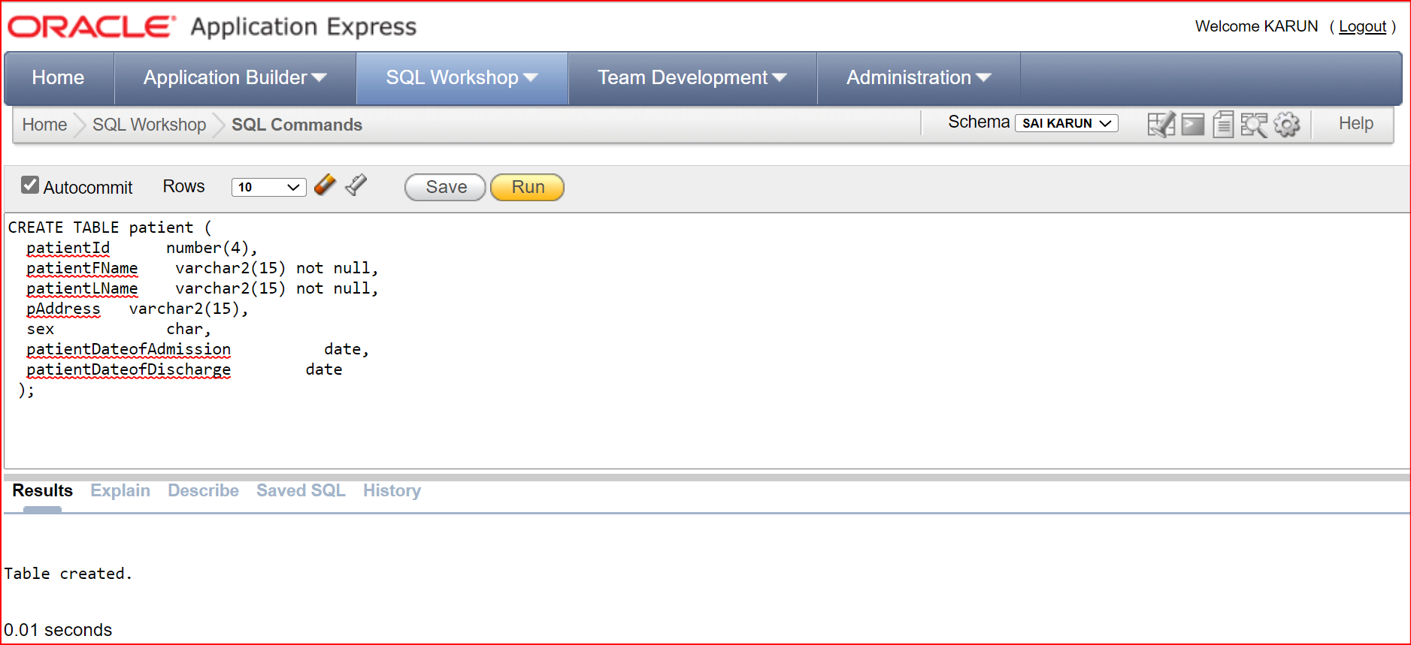
SQL QUERIES -
Create Query for Patient Table

Slide 15
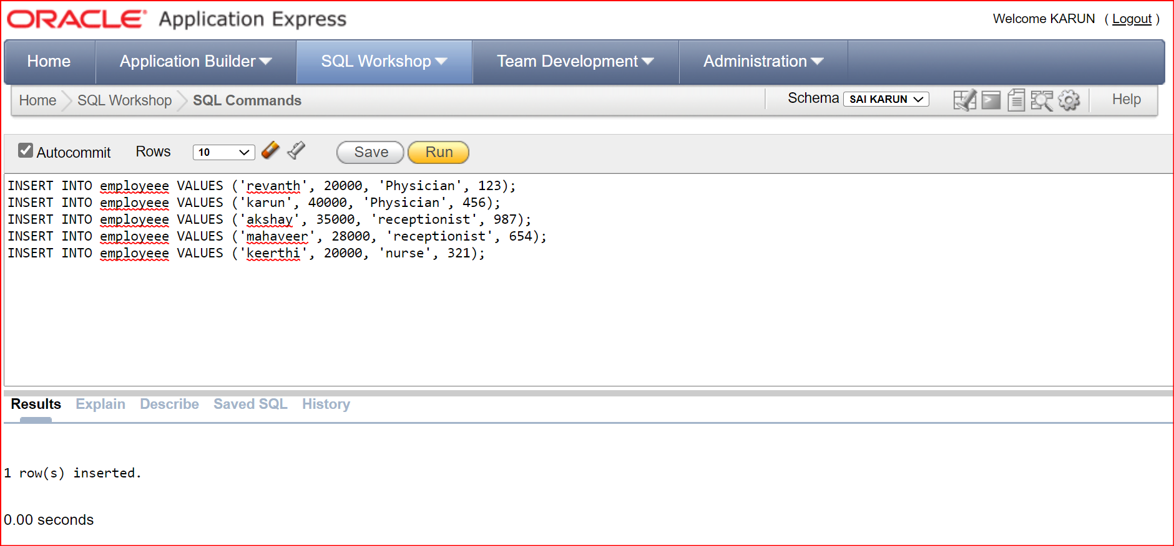
SQL QUERIES -
Insert Queries for Employee Table

Slide 16
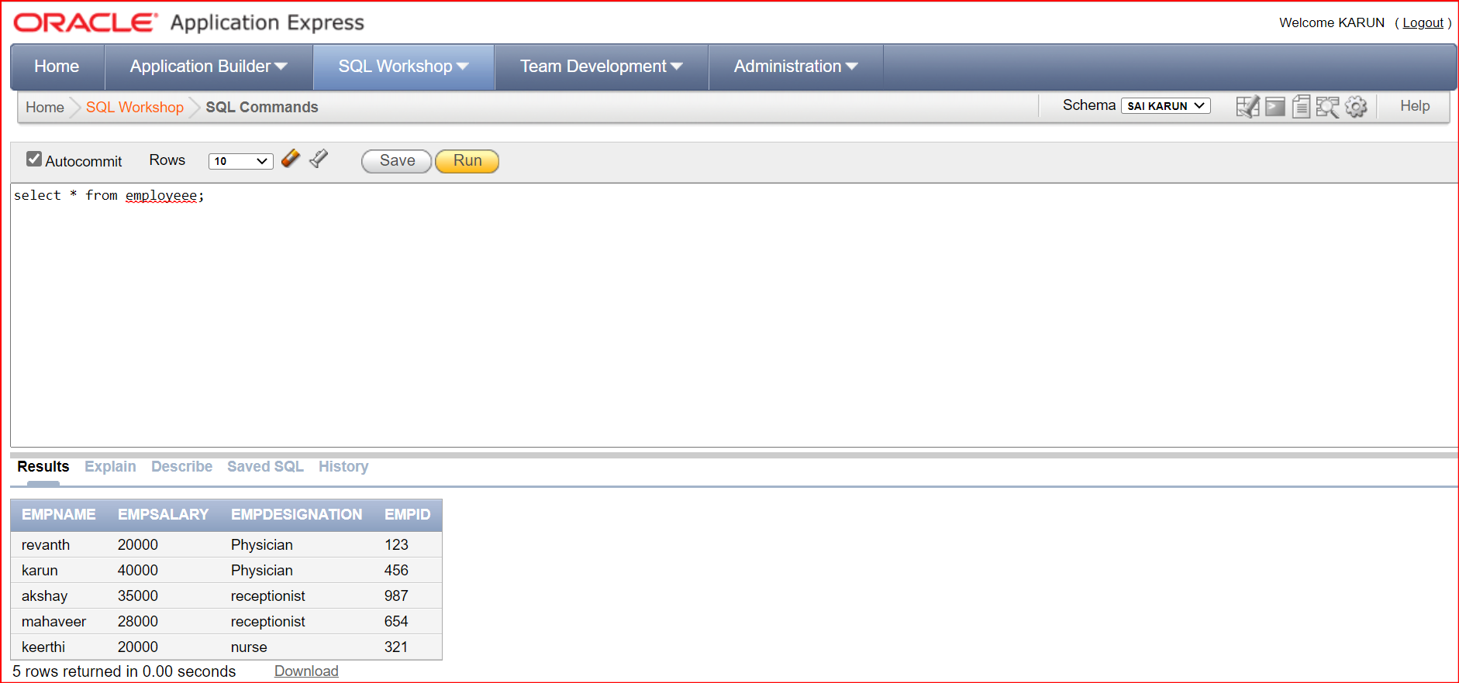
SQL QUERIES -
Employee Table

Slide 17
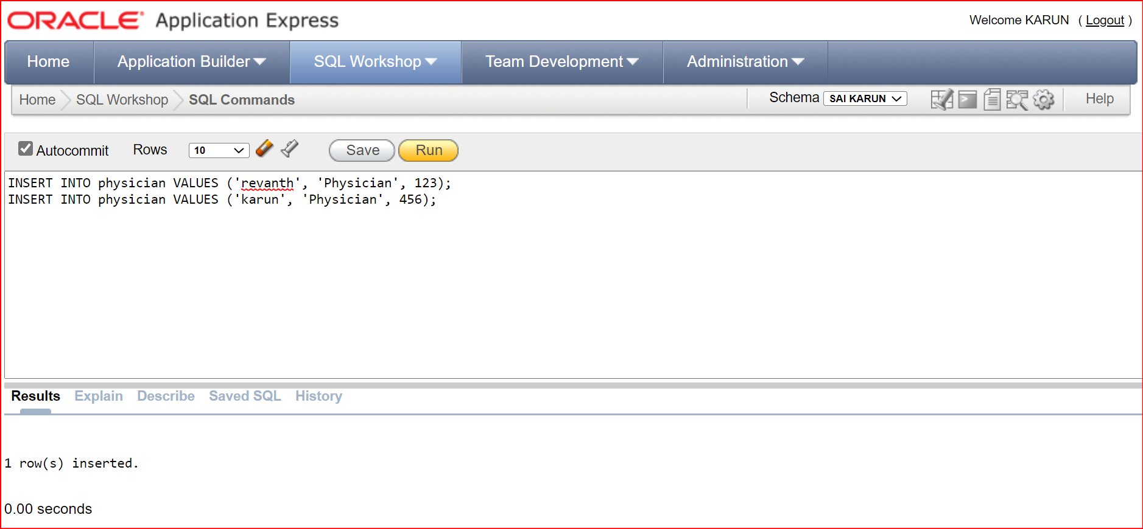
SQL QUERIES -
Insert Queries for Physician Table

Slide 18
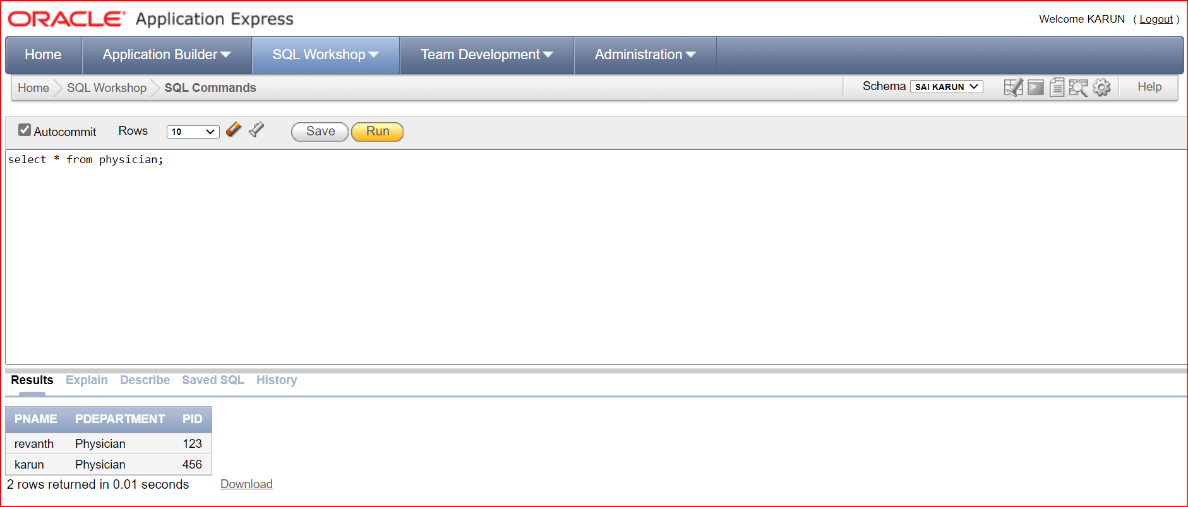
SQL QUERIES -
Physician Table

Slide 19
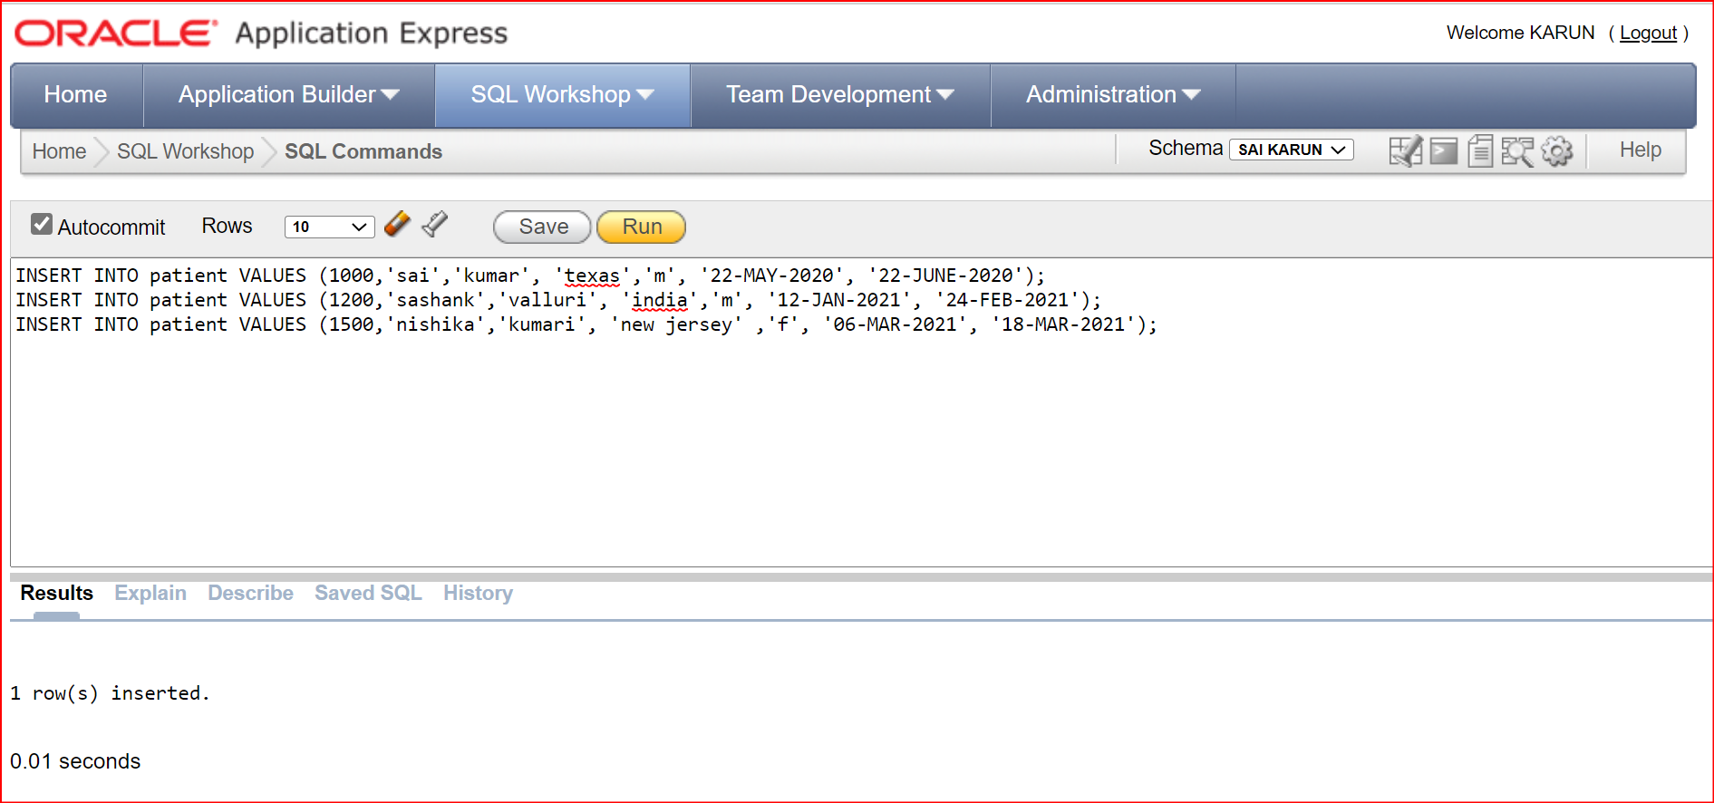
SQL QUERIES -
Insert Queries for Patient Table

Slide 20
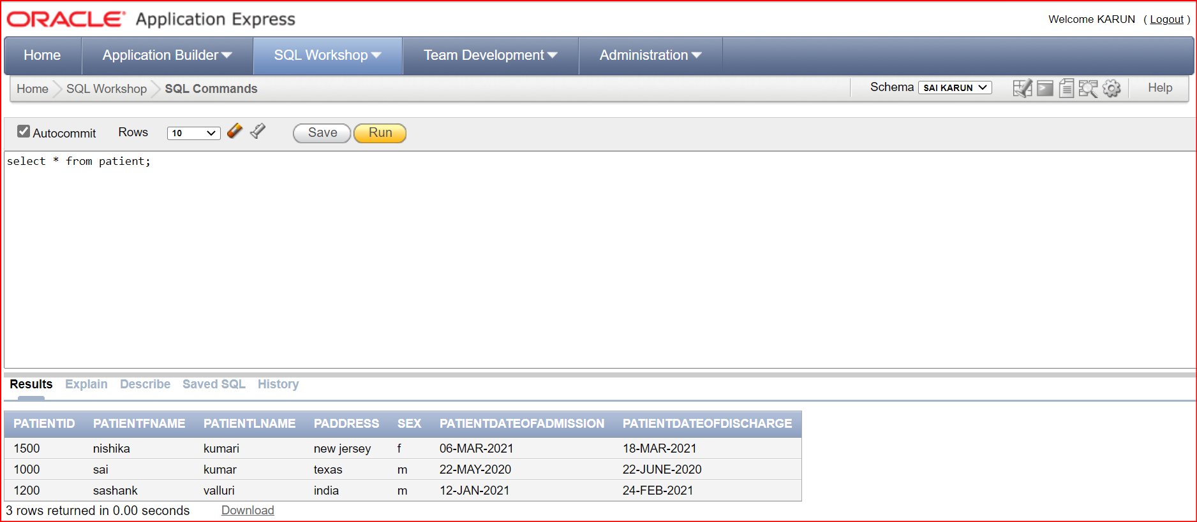
SQL QUERIES -
Patient Table

Slide 21
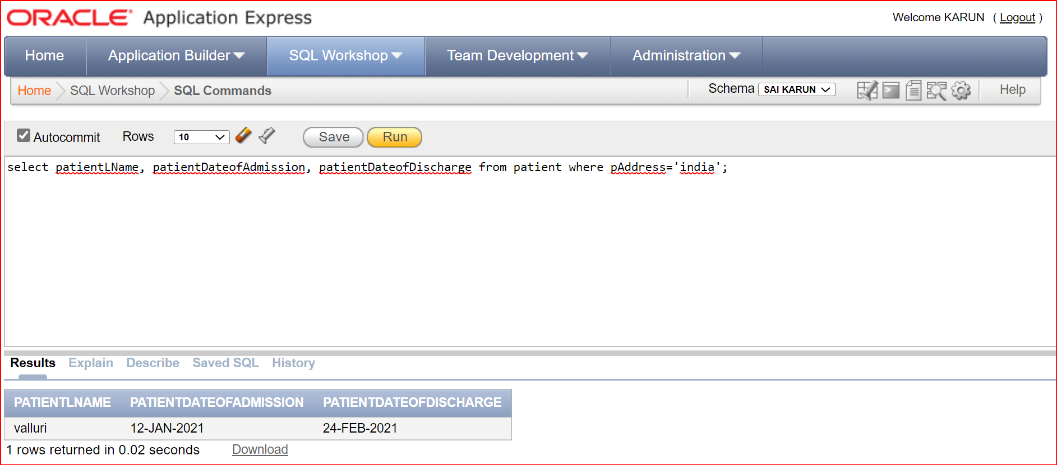
SQL QUERIES -
List the last name, date of admission and date of discharge of patients who are from India.

Slide 22
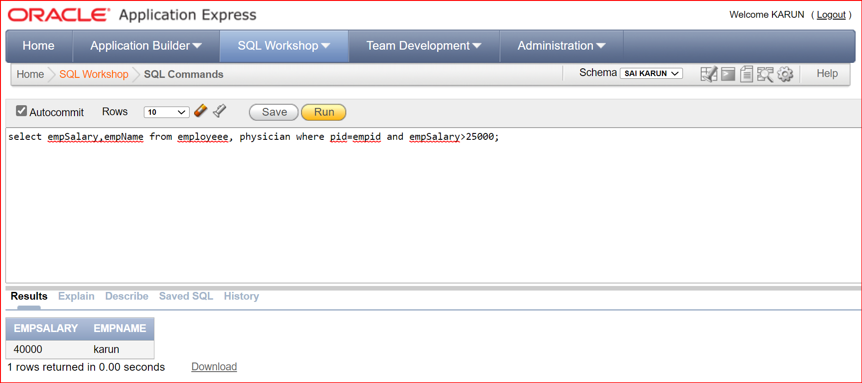
SQL QUERIES -
2. Retrieve the name and salary of employees using physician id whose salary is above 25000.

Slide 23
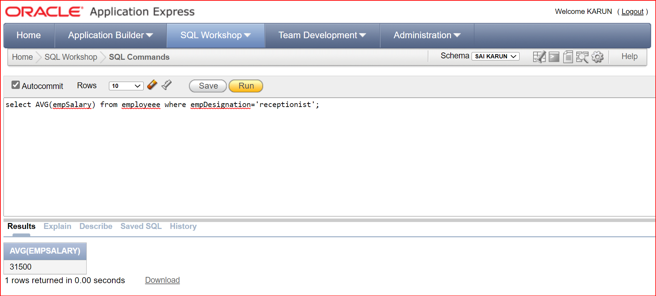
SQL QUERIES -
3. List the average salary of employees who works as receptionists.

Slide 24
Thank you!

