Slide 1
Comparative Analysis of Text Classification Models on AG's News Dataset
Sai Priya Kasturi

Slide 2
Agenda
Introduction
Challenges
Data Description
Data Preprocessing
Exploratory Data Analysis(EDA)
Training and Evaluation
Results
Conclusion

Slide 3
Introduction
Text Classification:
A Fundamental task in Natural Language Processing (NLP)
Aims to automate news article categorization.
Essential in sentiment analysis, market research, and social media.
Vital for information retrieval in search engines and recommendation systems.
Objective:
Develop and compare text classification models.
Identify the most efficient model for news categorization.

Slide 4
Challenges
Data Preprocessing and Feature Extraction:
Challenge: Extracting features from unstructured, mixed-media news content.
Gap Addressed: Explore preprocessing techniques to optimize model performance.
Model Selection and Optimization:
Challenge: Selecting and fine-tuning the right model for diverse news datasets.
Gap Addressed: Compare models to determine effectiveness in news classification.

Slide 5
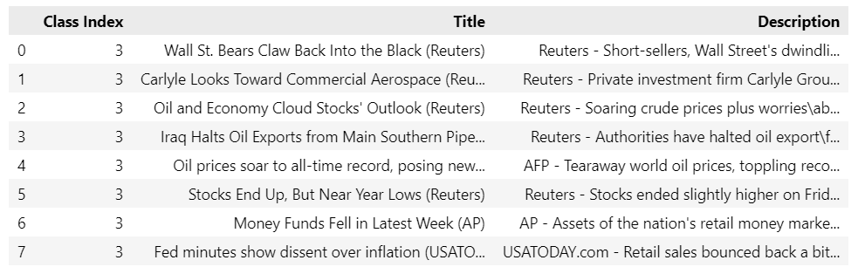
Data
Compiled from over 1 million news articles
Gathered from 2,000+ news sources by ComeToMyHead
Divided into 4 main classes: World, Sports, Business, Science/Tech
Source: Kaggle

Slide 6
Data Preprocessing
Data Cleaning:
Converting to Lowercase and removes all the special characters and punctuation
Before– “Oil prices soar to all-time record, posing new menace to economy (AFP) “
After- "oil prices soar to alltime record posing new menace to economy afp“
Tokenization:
Split the text into individual words using Natural Language Toolkit (NLTK).
After - ["oil", "prices", "soar", "to", "alltime", "record", "posing", "new", "menace", "to", "economy", "afp"]

Slide 7
Data Preprocessing Continued
Lemmatization:
Reducing words to their base form, considering grammatical roles
["oil", "price", "soar", "to", "alltime", "record", "pose", "new", "menace", "to", "economy", "afp"]
Stop Word Removal:
Eliminating common words that do not contribute to meaning
Before - ["oil", "price", "soar", "to", "alltime", "record", "pose", "new", "menace", "to", "economy", "afp"]
After- ["oil", "price", "soar", "alltime", "record", "pose", "menace", "new" ,"economy", "afp"]

Slide 8
Data Preprocessing Continued
TF-IDF Vectorization:
Transformed the text into a vector of numerical features using TF-IDF.
This helps to quantify the importance of each word in the document and across the entire dataset.
TF(x) = (Number of times word x appears in a document)/(Total number of words in the document)
IDF(x) = log_e(Total number of documents/ Number of documents with word x in it)
Before:
["oil", "price", "soar", "alltime", "record", "pose", "menace", "new" ,"economy", "afp"]
After:
[0.5, 0.7, 0.6, 0.9, 0.8, 0.2, 0.1, 0.3, 0.4, 0.05 ]

Slide 9
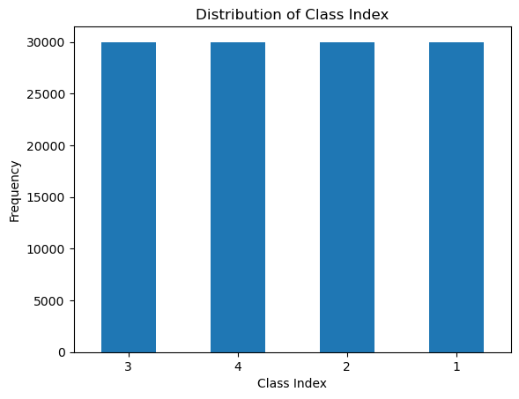
EDA - Class Distribution
Shows a balanced distribution across four class indices in the dataset.
ensuring that model performance is not skewed by an overrepresentation of any single class.

Slide 10
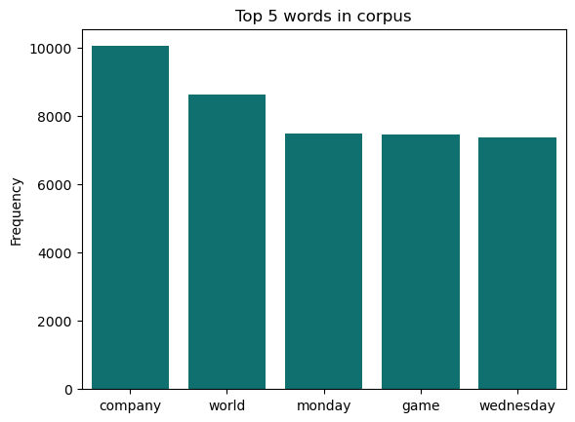
EDA - Word Frequency
Indicates 'company' and 'world' as the most common, followed by 'monday', 'game', and 'wednesday’.

Slide 11
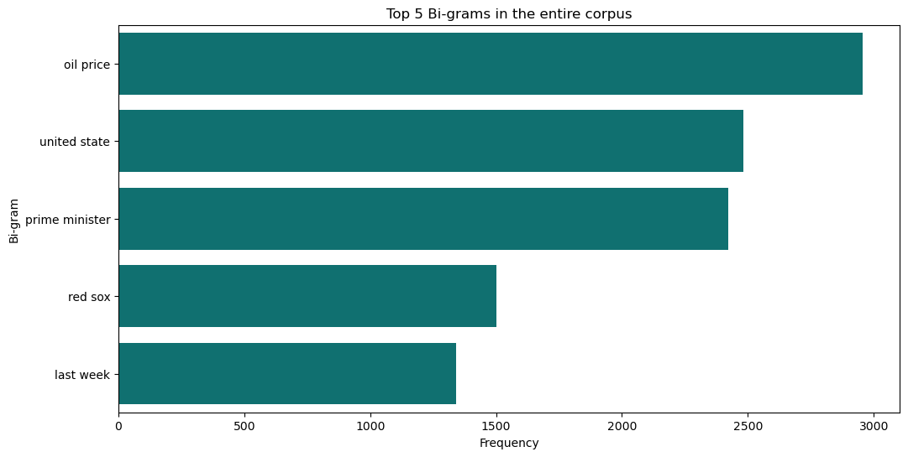
EDA - Bigram Analysis
Indicates the most frequently occurring word pairs
'oil price', 'united state', and 'prime minister'—highlight economic and political discourse, while 'red sox' indicate sports coverage and 'last week' time-specific reporting.

Slide 12
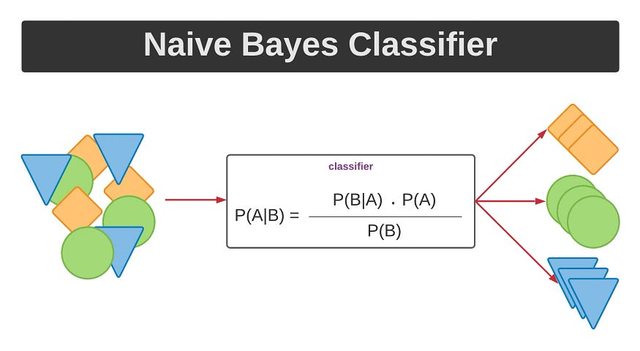
Naive Bayes Classifier
Description: Probabilistic model based on the Bayes theorem.
Strengths: Efficient, easy to interpret, works well with small datasets.
Weaknesses: Assumes independence of features, may not be accurate for complex datasets.
Source: medium.com

Slide 13
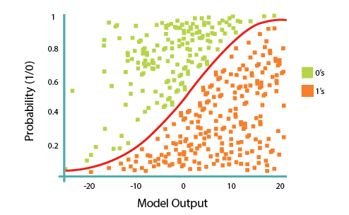
Logistic Regression
Description: Statistical model that predicts the probability of an event based on its features.
Strengths: Interpretable coefficients, robust to outliers, works well with large datasets.
Weaknesses: May not capture non-linear relationships between features.
Source: developer.ibm.com

Slide 14
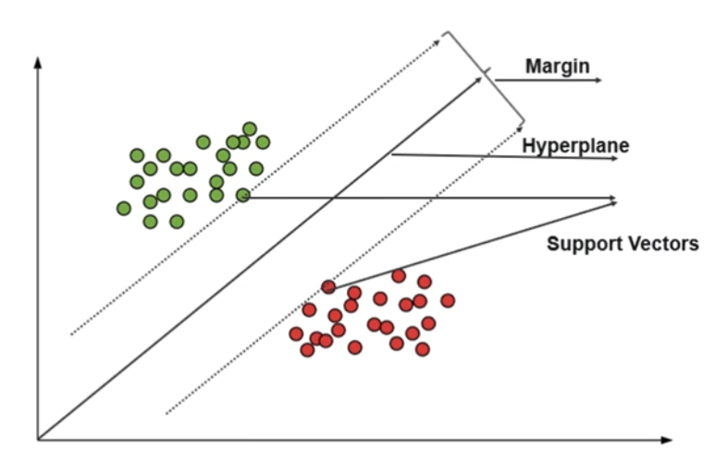
Support Vector Machine
Description: Algorithm that finds the best hyperplane to separate data points into different classes.
Strengths: Effective for high-dimensional data, good at handling non-linear relationships.
Weaknesses: Can be computationally expensive, prone to overfitting, black-box model.
Source: edureka.com

Slide 15
Training & Evaluation
Training Process:
Data Split: Divided the dataset into training (80%), and testing (20%) sets.
Feature Engineering: Applied preprocessing techniques like tokenization, lemmatization, and TF-IDF vectorization.
Model Training: Trained each machine learning model on the training data.
Final Evaluation: Evaluated the performance of each model on the unseen testing set.
Evaluation Metrics:
Accuracy: Proportion of correctly classified examples.
Precision: Proportion of positive predictions that are actually correct.
Recall: Proportion of actual positives that are correctly identified.
F1-score: Harmonic mean of precision and recall, balances both metrics.

Slide 16
Results
Model | Accuracy | Precision | Recall | F1-Score
Naive Bayes | 0.9046 | 0.9044 | 0.9046 | 0.9043
Logistic Regression | 0.9123 | 0.9122 | 0.9123 | 0.9121
Support Vector Machines (SVM) | 0.9185 | 0.9186 | 0.9185 | 0.9183
All three machine learning models achieved high performance on the AG’s News Dataset.
SVM outperformed Naive Bayes and Logistic Regression across all metrics.

Slide 17
Conclusion
Summary of Findings:
All three models achieved high accuracy (above 90%).
SVM emerged as the champion, outperforming others on all metrics.
SVM's ability to handle complex relationships and high-dimensional data secured its victory.
The Future Holds:
Delving deeper into SVM's potential with different kernel functions.
Crafting even better tools through advanced feature engineering.
Expanding our reach to conquer new text classification challenges.

Slide 18


