Slide 1
Contour and Texture Analysis for Image Segmentation
Author : J. Malik, S. Belongie, T. Leung and J. Shi (2001)
Presented by : Saikat Kumar Das (SMT2017016)

Slide 2
Introduction
The proposed method provides an algorithm for segmenting grayscale images into disjoint regions based on contour and texture analysis
The work discusses the limitations of prior methods in addressing the pitfalls of using edge detection and local window based contour analysis
Though Edge detection based contour analysis can work for untextured images but in presence of textured regions produces ‘tangle web of contours’
Using histogram of linear filter output based on local window tends to classify boundaries as a segment of their own with thin strip-like region
The authors proposed a method of segmentation that can generalize well to untextured and textured (both regular and stochastic; scale invariant) images

Slide 3
Objective
The authors provide a list desired traits of an image segmentation framework –
Can deal with general images – textured and untextured
Can identify boundaries by brightness step as well as lines
Can work with regular, stochastic or intermediate seamlessly in scale-invariant manner
Contours are analyzed in proposed intervening contour framework
Texture analysis is performed using textons
These two cues are combined by gating with a texturedness measure
Normalized cut framework is proposed for partitioning the image into disjoint segments

Slide 4

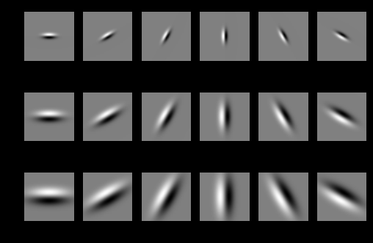
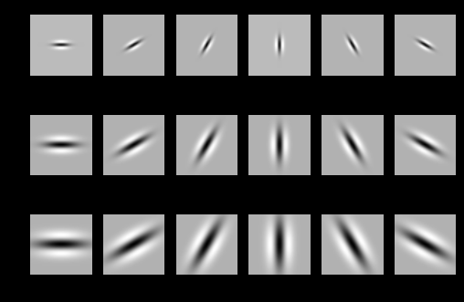
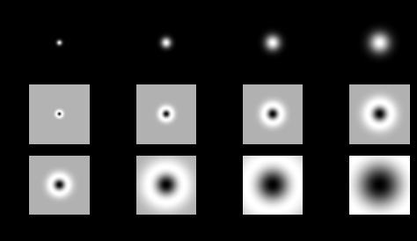

Method
Oriented filterbank consisting of rotated copies of Gaussian Derivative and its Hilbert transform are used
The collection of responses of convolving the image with this filterbank $(I∗f_{i})$, is referred to as the ‘hypercolumn transfer’ of the image

Slide 5
Method contd.
Authors propose to address the representation of textures as distinct high dimensional filter response vector instead of redundantly representing every pixel by collection of filterbank resopnses
Each pixel is a N dimensional vector of filter responses
These vectors are clustered using K-means algorithm and are called textons
Textons are assemblies of outputs that are characteristics of the local image structure present in the image

Slide 6
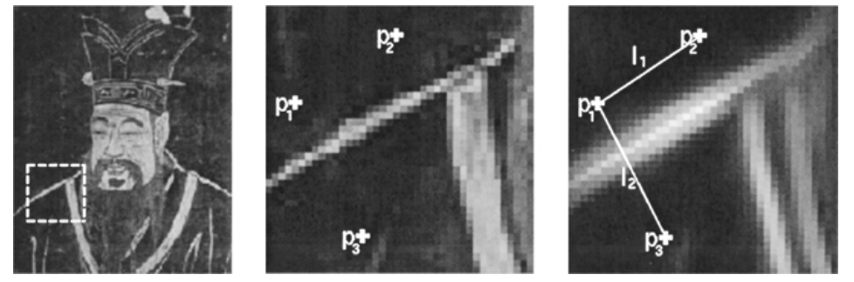

Method contd.
Contours are analyzed using Intervening Contour framework
Orientation energy (OE) along the line joining two pixel indicates whether they belong to same segment or not (p1 and p2 are from segment but not p3)
Normalized cuts is used to segment the image iteratively

Slide 7


Method contd.
Normalized cut framework is proposed for partitioning the image into disjoint segments
The cue integration is done using product of weights of each of the cue in such way that each cue is gated to be harmless in locations where the other cue should be operating
Defining the weights and computing the segmentation is done in an iterative manner

Slide 8
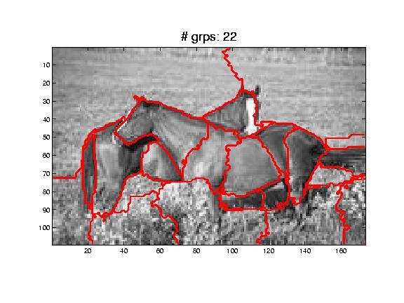
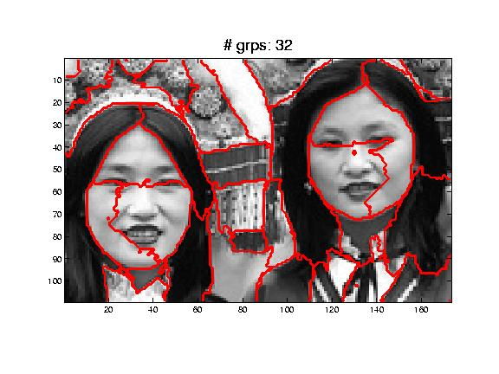
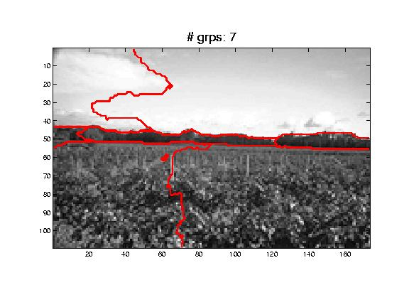
Resources
More than 1000 natural images from commercially available Corel Stock Photos Database is used to generate the results
Results of the method are available in https://www2.eecs.berkeley.edu/Research/Projects/CS/vision/grouping/ncuts_results.html

Slide 9
Quantification of Results
Results of the proposed methods were not analyzed with any quantitative measure due to unavailability of ground truth data for segmentation at the time of research
However, this research originally inspired the widely popular BSDS500 dataset for image segmentation with human annotated segmentation ground truth in ICCV 2001 publication “A Database of Human Segmented Natural Images and its Application to Evaluating Segmentation Algorithms and Measuring Ecological Statistics”
This dataset can be used for quantitative analysis of the proposed work

Slide 10
Thank you

