Slide 1
Sentiment Detection Case Study
BATCH 2 | TEAM 1
Version 1.0
26-OCT-2022
Design Center of Excellence

Slide 2
AGENDA
Objective
Clean data
EDA Insights
Model results
Conclusion

Slide 3
01
Objective

Slide 4
Objective
Understand the general sentiment of the customers based on the online reviews and provide insights to improve their service.

Slide 5
02
Clean Data

Slide 6
Clean Data
Lemmatization
Remove Special Characters
Remove Stop Words
Remove blank reviews

Slide 7
03
EDA Insights

Slide 8
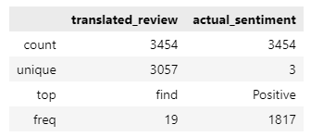
General Information of the data

Slide 9
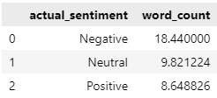
Average word count per type of review

Slide 10
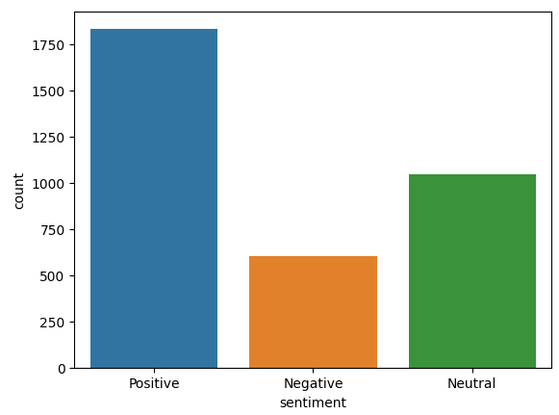
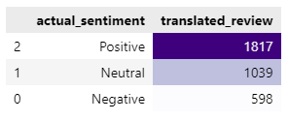
Count of reviews
The majority of reviews are positive, while there are few negative reviews.

Slide 11
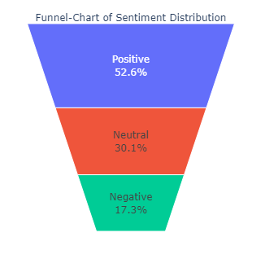
Sentiment Distribution

Slide 12
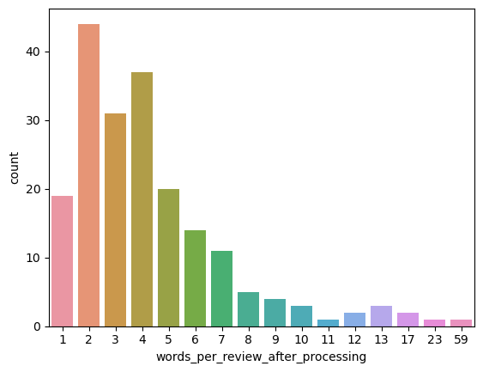
Words Per Review

Slide 13
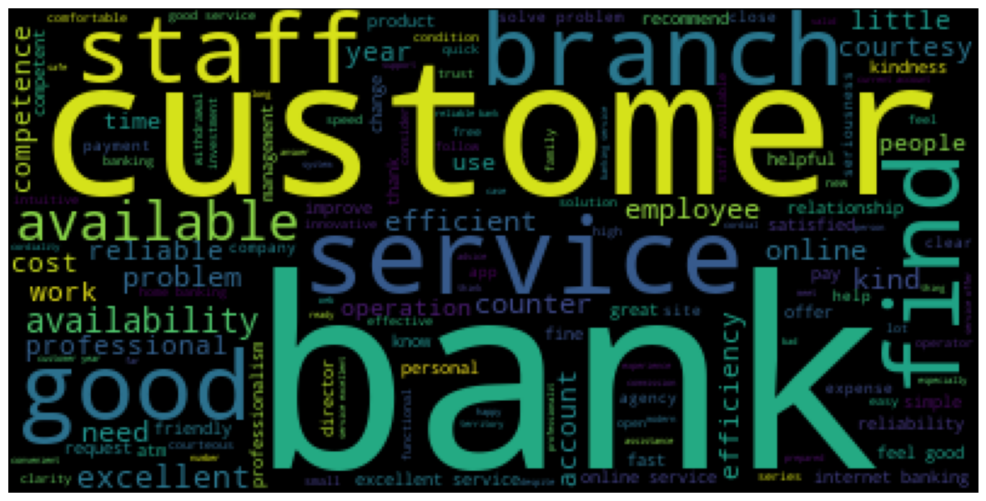
Word cloud from all reviews
The word cloud provides clear insights about the frequency of word usage in reviews, allowing us to identify the most commonly used words and those that appear less frequently.

Slide 14
04
Model results

Slide 15
Models used
Vectorizer used:
TF-IDF Vectorizer
Count Vectorizer
Logistic Regression
Ridge Classifier
Decision Tree
Pre-trained models:
RoBERTa
TextBlob

Slide 16
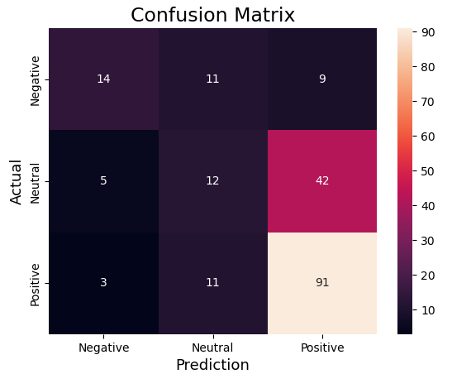
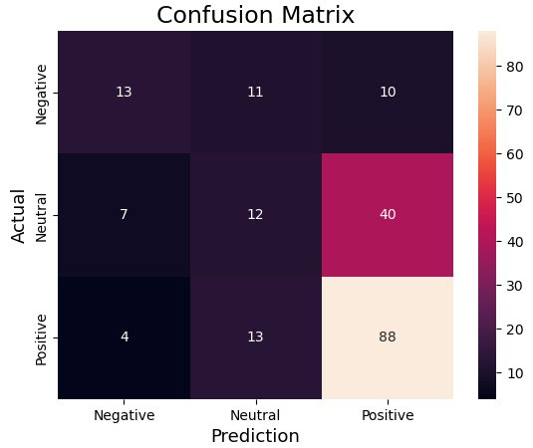
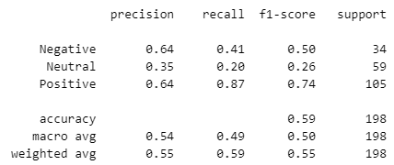
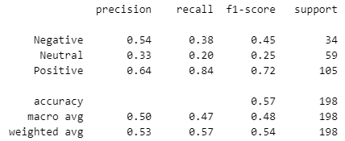
Logistic Regression
On TF-IDF Vectorized data
On Count Vectorized data

Slide 17
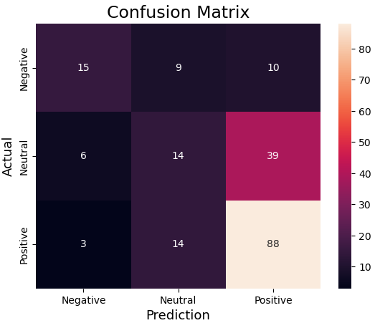

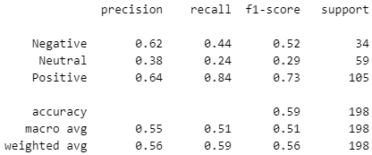
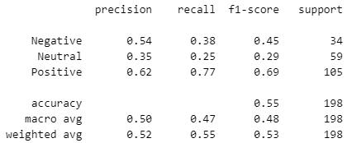
Ridge Classifier
On TF-IDF Vectorized data
On Count Vectorized data

Slide 18
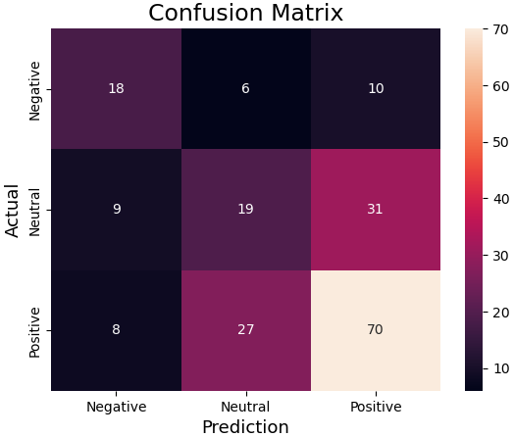
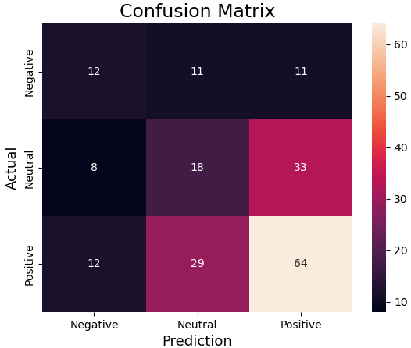
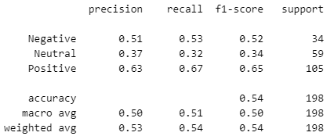
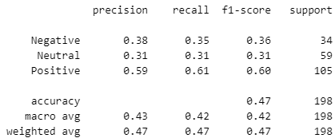
Decision Tree
On TF-IDF Vectorized data
On Count Vectorized data

Slide 19
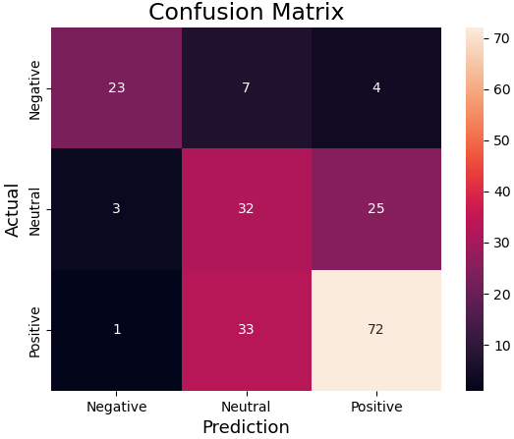
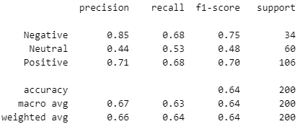
RoBERTa
Pre-trained model (cardiffnlp/twitter-roberta-base-sentiment-latest)

Slide 20
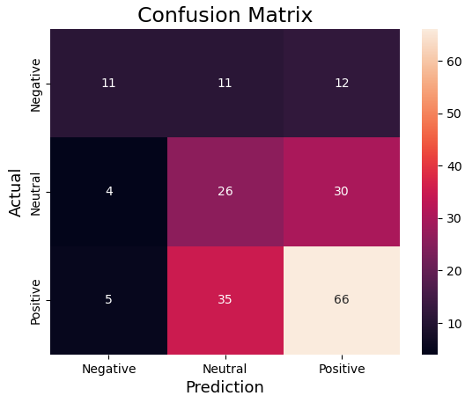
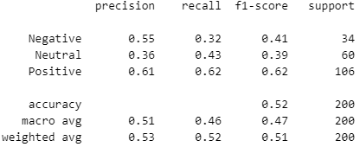
TextBlob
Pre-trained model

Slide 21
05
Conclusion

Slide 22
Conclusion
Overall NLP model is predicting the reviews by giving them tags like positive, negative or neutral. There are several models for this sentiment analysis. We have used vectorization models to vectorize the data and then feeding it to classifier models. We have used 3 classifier models: Logistic Regression, Ridge Classifier and Decision Tree. We have also used 2 pre-trained models: RoBERTa and TextBlob. From the results we can see RoBERTa is giving better results and accuracy.

Slide 23
Thank you !

