Slide 1




SMART INDIA HACKATHON 2026
HASTAKALA
  Problem Statement ID – SIH26090
  Problem Statement Title - AI-Driven Market Linkage and Smart Cataloging Mobile Application for Marginalized Artisans.
  Theme- Heritage & Culture
  PS Category- Software
  Team ID- T5
  Team Name (Registered on portal) – Mind Forge

Slide 2
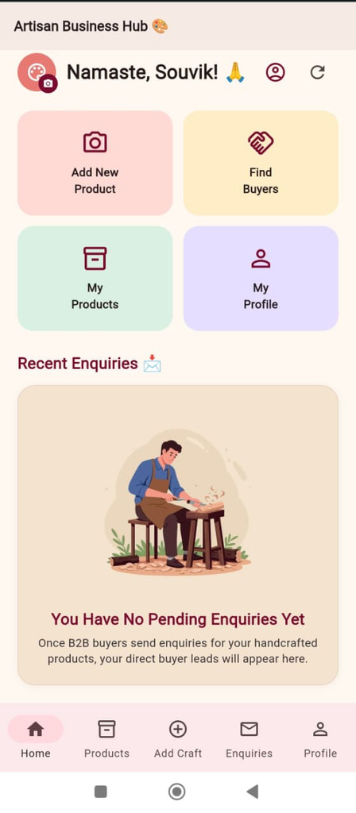


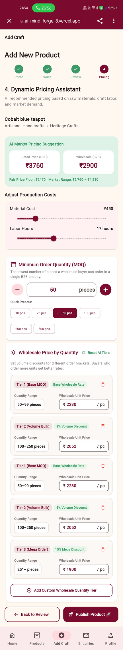
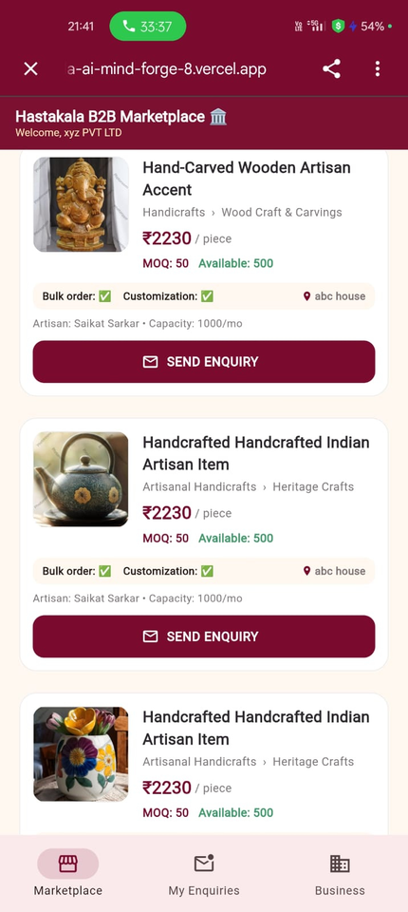
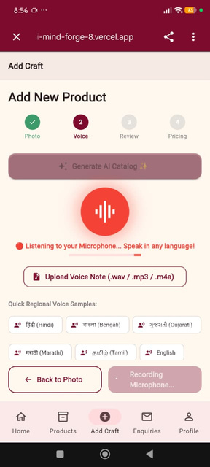
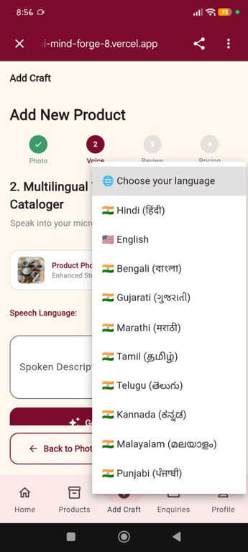
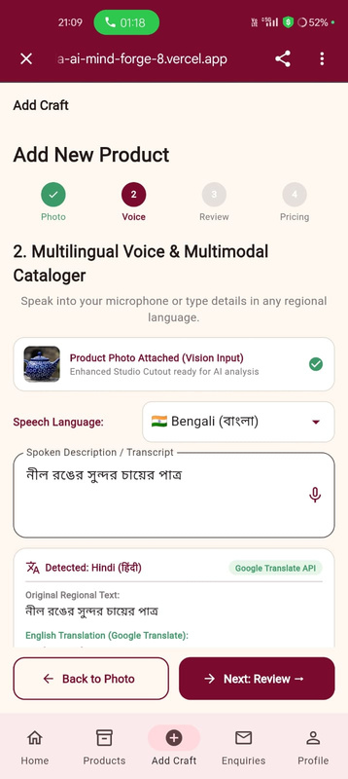
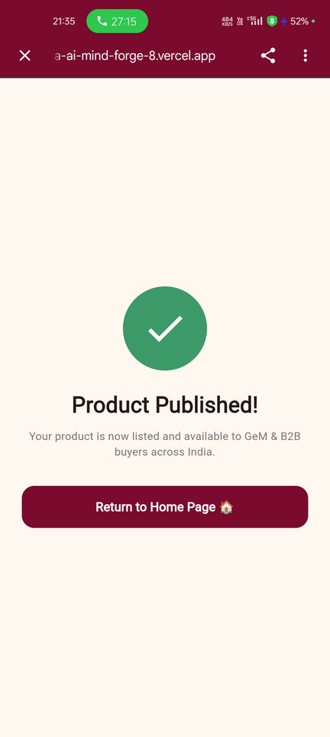
HASTAKALA
Mind Forge
Hastakala is an AI-powered business manager and B2B marketplace platform designed to empower traditional Indian artisans by eliminating exploitative middlemen. It works by :-
  Vernacular Multimodal AI
  Fair dynamic pricing
  Direct wholesale buyer connections
Why Hastakala is better ?
@SIH Idea submission
2
Notes:
2

Slide 3



















TECHNICAL APPROACH
Mind Forge
Technology Stack
Artisan Workflow Implementation
Frontend
Backend API
Click Pictures
Register / Login
Add New Product
Choose your Language
Database
AI Models & External APIs
Describe by Voice
Set up dynamic pricing
Review Cataloge
Deployment & Hosting
Accept / Reject order enquiries
Publish Product
3
@SIH Idea submission
3
Notes:
3

Slide 4





FEASIBILITY AND VIABILITY
Mind Forge
Feasibility of the Idea
Challenges & Overcome Strategies
Technical
Built on lightweight Flutter and FastAPI using existing speech and vision models, ensuring minimal infrastructure overhead.
  Rural Connectivity
Challenge: Weak networks fail photo uploads and cloud AI processing.
Solution: Queue drafts offline; auto-upload background data when reconnected.
Operational
Enables artisans to catalog products via vernacular voice notes and photos, bypassing text and digital literacy barriers.
  Workshop Speech Recognition
Challenge: Ambient noise and dialects mess up voice inputs.
Solution: Use on-app noise filtering, save previous voice inputs, and do instant audio previews.
  Digital Literacy
Economic
Taps into the ethical sourcing market by removing middlemen and establishing transparent wholesale margins.
Challenge: Low tech literacy creates problematic navigation and pricing errors.
Solution: Use voice/icon UI and a visual tutorial website or in app video to understand basic app workflow .
  Quality Verification
Challenge: Remote buyers cannot verify physical craftsmanship quality.
Solution: Add star ratings systems, trusted artisans badges, product reviews and translated feedback .
@SIH Idea submission
4
Notes:
4

Slide 5




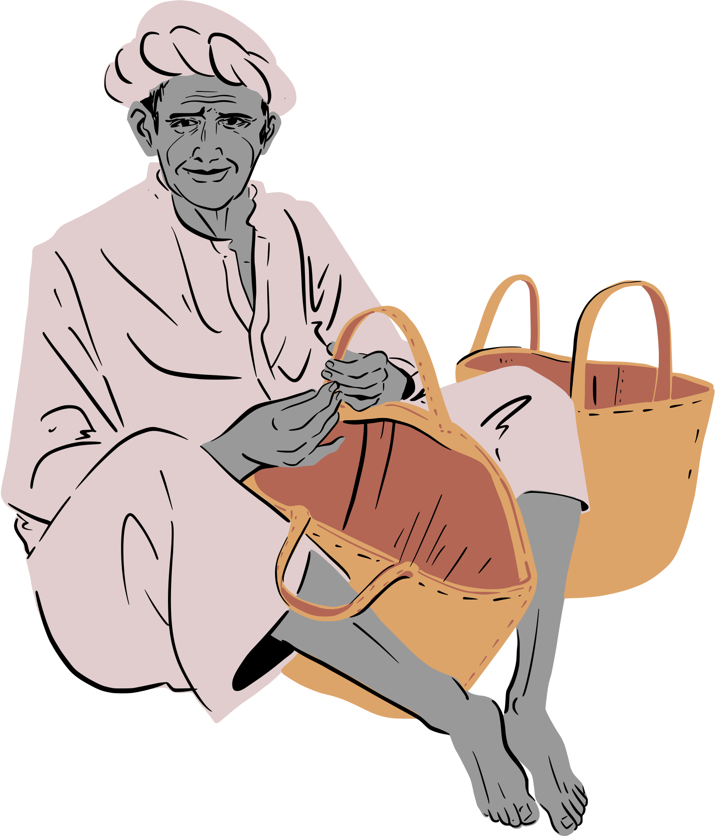


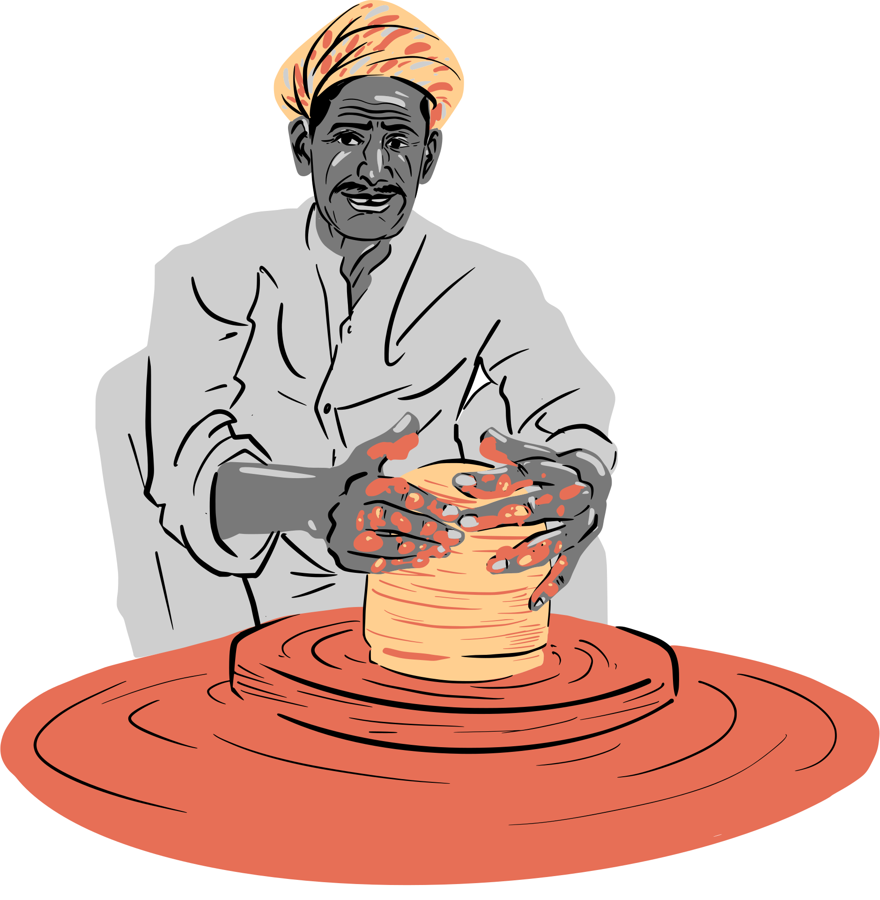
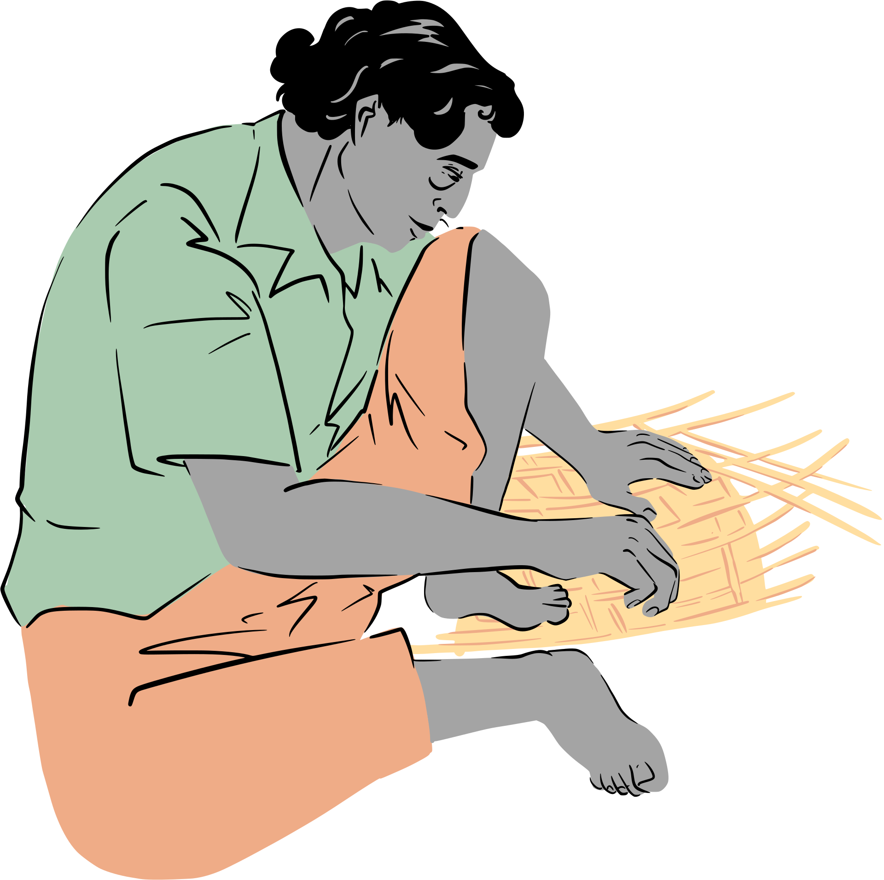
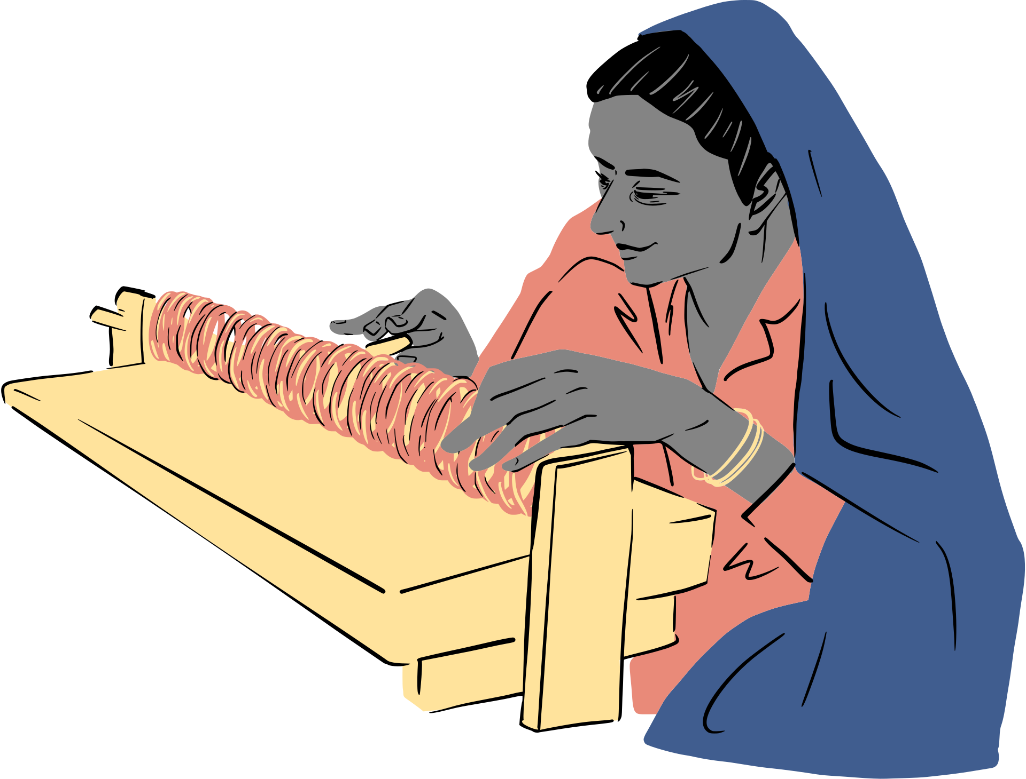


IMPACT AND BENEFITS
Mind Forge
Potential Impact on Target Audience:
365 Days Digital Presence:
Transitions artisans replacing seasonal physical fairs with continuous, year-round online access to e-commerce B2B clients/customers.
Target Income Growth:
Designed to scale annual artisan revenues by around 1.5x times their original annual income through optimized online market access.
Benefits of the Solution:
Preservation of Heritage & Crafts:
Directly supports National initiatives of onboarding rural artisans into the modern digital economy by expanding market reach beyond local geographic limitations.
Environmental & Operational Efficiency:
Lowers the travel and physical transport energy costs associated with relying solely on physical exhibition venues. Lightweight server architecture minimize requirements for low-connectivity regions.
@SIH Idea submission
5
Notes:
5

Slide 6

RESEARCH AND REFERENCES
Mind Forge
REFERENCES
Ministry of Textiles, "Annual Report of Handlooms and Handicrafts," Govt. of India, New Delhi, 2023–2024.
https://www.texmin.gov.in/static/uploads/2025/12/c865d599cae0c357c02d247a8a82d24e.pdf
G. DeepMind, "Gemini 1.5 Flash Vision Multimodal Model Specifications," Google AI Research, 2024.
https://medium.com/google-cloud/multimodality-with-gemini-1-5-flash-technical-details-and-use-cases-84e8440625b6
"Bhashini: National Language Translation Mission Blueprint," Ministry of Electronics and IT, Govt. of India, 2023.
https://righttoinformation.wiki/bhashini
E. R. Davies, "Computer Vision: Basis for Pillow RGB aspect ratio & dominant color extraction algorithms.
https://www.perlego.com/book/1831191/computer-vision-principles-algorithms-applications-learning-pdf
S. Ramírez, "FastAPI: Modern, Fast Web Framework for Python," Open Source Software, 2024.
https://fastapi.tiangolo.com/
Google Flutter Team, "Flutter Web Engine Architecture & SharedPreferences Storage," Google Developers, 2024.
https://docs.flutter.dev/platform-integration/web
@SIH Idea submission
6
Notes:
6

