Slide 1
MVC(Model-View-Controller)
ASP.NET MVC is a web development framework from Microsoft that is based on the Model-View-Controller (MVC) architectural design pattern
.
M MODEL
V VIEW
C CONTROL

Slide 2
mvc
Asp.net mvc is a new design pattern which is used for developing website ,with a support of html ,javascript,css and dotnet language.
This is not a replacement for asp.net Web Forms.
This is just option for developing the websites with the support of mvc design pattern.

Slide 3
advantages
Separation of the concern which means that we can decouple the things and we can concentrate on our requirement in a proper manner.
We can just try to separate the business logic,userinterface,and Dataaccesslayer

Slide 4
ADVANTAGES OF MVC
BETER SEPARATION
TESTABILITY
NO VIEWSTATE
RAZER VIEW ENGINE(Light weight)

Slide 5
Drawbacks of asp.net
ASP.NET websites depend on a page-based approach where each page on the website is represented in the form of a physical file (called a Web Form) and is accessible using that file’s name
Heavy object(event driven programming)
Depends on events (page_load ,pre_init)
View state has to be maintained
Test driven development is not possible

Slide 6
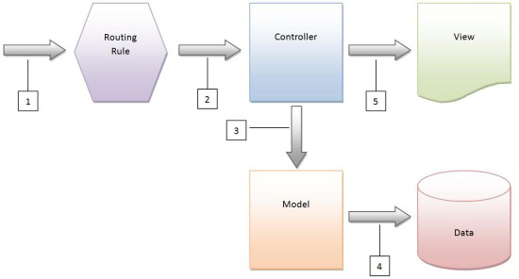
mvc process flow

Slide 7
Process of mvc
Step1:We can always give the request to the controller
Step2:controller takes the input and it can provide the result directly
Step3:controller can interact with the model and provide the particular model information to the view
Step4:Inorder to render the information view can interact with the model and view renders the final output

Slide 8
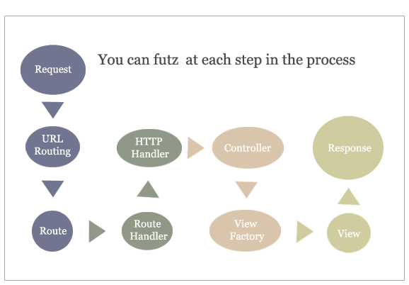
Complete flow of mvc

Slide 9
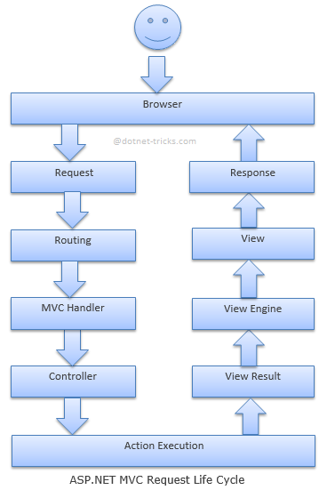
Mvc request life cycle

Slide 10
Mvc Handler
The routing engine returns a 404 HTTP status code if the patterns is not found in the Route Table.
The MvcHandler is responsible for initiating the real processing inside ASP.NET MVC.
MVC handler implements IHttpHandler interface and further process the request by using ProcessRequest method

Slide 11
Step-1
Asp.net Routing is the first step in MVC request cycle.
MVC requests are mapped to route tables for which controller and action to be invoked.
So if the request is the first request the first thing is to fill the route table with routes collection.
This filling of route table happens in the global.asax file.
When a matching pattern found in the Route Table, the Routing engine forwards the request to the corresponding IRouteHandler for that request.

Slide 12
Process Request
The ProcessRequest() method is responsible for processing the request and generating the response.
So in asp.net application it is simple, you request for a page in the url like http://mysite1\default.aspx and then it search for that page on the disk and execute the processrequest method and generate the response.

Slide 13
However in MVC application it doesn’t work in that way.
There is no physical page exist for a particular request. All the requests are routed to a special class called Controller.
The controller is responsible for generating the response and sending the content back to the browser.

Slide 14
controller
MvcHandler uses the IControllerFactory instance and tries to get a IController instance.
If successful, the Execute method is called. The IControllerFactory could be the default controller factory or a custom factory initialized at the Application_Start event

Slide 15
Action Execution
Once the controller has been instantiated, Controller's ActionInvoker determines which specific action to invoke on the controller.
Action to be execute is chosen based on attributes ActionNameSelectorAttribute (by default method which have the same name as the action is chosen) and ActionMethodSelectorAttribute(If more than one method found, the correct one is chosen with the help of this attribute)

Slide 16
View Result
The action method receives user input, prepares the appropriate response data, and then executes the result by returning a result type.
The result type can be ViewResult, RedirectToRouteResult, RedirectResult, ContentResult, JsonResult, FileResult, and EmptyResult.

Slide 17
View Engine
It is handled by IViewEngine interface of the view engine. By default Asp.Net MVC uses WebForm and Razor view engines.
You can also register your own custom view engine to your Asp.Net MVC application

Slide 18
view
The most important Action Result is the ViewResult, which renders and returns an HTML page to the browser by using the current view engine

Slide 19
Asp.Net Web Forms | Asp.Net MVC
Asp.Net Web Form follow a traditional event driven development model. | Asp.Net MVC is a lightweight and follow MVC (Model, View, Controller) pattern based development model.
Asp.Net Web Form has server controls. | Asp.Net MVC has html helpers.
Asp.Net Web Form supports view state for state management at client side. | Asp.Net MVC does not support view state.
Asp.Net Web Form has file-based URLs | Asp.Net MVC has route-based URLs means URLs are divided into controllers and actions .

Slide 20
Asp.Net Web Form follows Web Forms Syntax | Asp.Net MVC follow customizable syntax (Razor as default)
In Asp.Net Web Form, Web Forms(ASPX) i.e. views are tightly coupled to Code behind(ASPX.CS) i.e. logic. | In Asp.Net MVC, Views and logic are kept separately.
Asp.Net Web Form has Master Pages for consistent look and feels. | Asp.Net MVC has Layouts for consistent look and feels.
Asp.Net Web Form has User Controls for code re-usability. | Asp.Net MVC has Partial Views for code re-usability.
Asp.Net Web Form is not Open Source. | Asp.Net Web MVC is an Open Source.

Slide 21
ASP.NET MVC 3 Overview
Expressive Views including the new Razor View Engine!
NET 4 Data Annotation Support!
Streamlined validation with improved Model validation!
Rich JavaScript support with unobtrusive JavaScript, jQuery Validation, and JSON binding!

Slide 22
Razor View Engine
Razor is the first major update to rendering HTML
The default view engine used in MVC 1 and 2 was commonly called the Web Forms View Engine, because it uses the same ASPX/ASCX/MASTER fi les and syntax used in Web Forms.
The Razor syntax is easier to type, and easier to read. Razor doesn’t have the XML-like heavy syntax of the Web Forms view engine.
Razor also simplifies markup with an improvement on the Master Pages concept — called Layouts — that is both more flexible and requires less code.

Slide 23
NET 4 Data Annotation Support
NET 4 System.ComponentModel.DataAnnotations Display attribute is.
ValidationAttribute was enhanced in .NET 4 to better work with the validation context for the entire model,

Slide 24
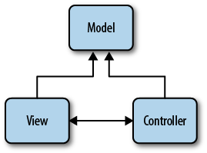
MVC

Slide 25
The Model
The model represents core business logic and data.
Models encapsulate the properties and behavior of a domain entity and expose properties that describe the entity.

Slide 26
The View
The view is responsible for transforming a model or models into a visual representation.
model might be visualized in HTML, PDF, XML, or perhaps even in a spreadsheet.
views should concentrate only on displaying data
should not contain any business logic themselves
Business logic stays in the model, which should provide the view with everything it needs.

Slide 27
The controller
The controller, as the name implies, controls the application logic and acts as the coordinator between the view and the model. Controllers receive input from users via the view,
then work with the model to perform specific actions, passing the results back to the view.

Slide 28
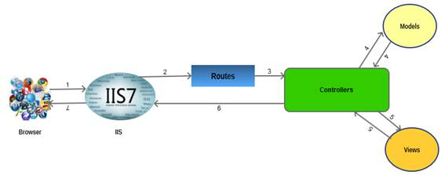
Process of mvc

Slide 29
Asp.net mvc3 feature
The Razor view engine.
Support for .NET 4 Data Annotations.
Improved model validation
Greater control and flexibility with support for dependency resolution and global action filters.
Better JavaScript support with unobtrusive JavaScript, jQuery Validation, and JSON binding.
Use of NuGet to deliver software and manage dependencies throughout the platform.

Slide 30
Asp.net mvc4 feature
ASP.NET Web API.
Enhancements to default project templates.
Mobile project template using jQuery Mobile.
Display Modes.
Task support for Asynchronous Controllers.
Bundling and minification.

Slide 31
The architecture is self explanatory.
The browser (as usual) sends a request to IIS, IIS searches for the route defined in MVC application and passes the request to the controller as per route, the controller communicates with the model and passes the populated model (entity) to View (front end), Views are populated with model properties, and are rendered on the browser, passing the response to browser through IIS via controllers which invoked the particular View.

Slide 32
Default route
Imagine that you enter the following URL into your web browser's address bar:
/Home/Index/3
The Default route maps this URL to the following parameters:
controller = Home
action = Index
id = 3
When you request the URL /Home/Index/3, the following code is executed:

Slide 33
Home controller class with string parameter
using System.Web.Mvc; namespace MvcApplication1.Controllers
{
[HandleError]
public class HomeController : Controller {
public ActionResult Index(string id)
{
return View();
}
}

Slide 34
Home controller class with out string parameter
MvcApplication1.Controllers { [HandleError] public class HomeController : Controller {
public ActionResult Index()
{
return View();
}
}
}
The Index() method in Listing 3 does not accept any parameters.
The URL /Home will cause this Index() method to be called.
The URL /Home/Index/3 also invokes this method (the Id is ignored).

Slide 35
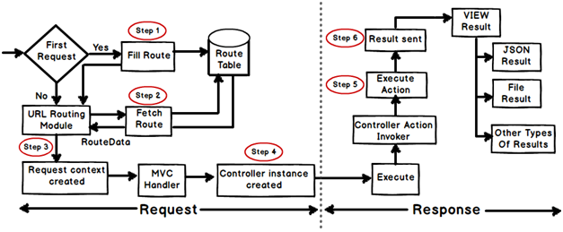
Routing

Slide 36
Creating Response object: - The request object creation has four major steps. Below is the detail explanation of the same.
Step 1 Fill route: - MVC requests are mapped to route tables which in turn specify which controller and action to be invoked.
So if the request is the first request the first thing is to fill the route table with routes collection.
This filling of route table happens in the global.asax file.

Slide 37
Step 2 Fetch route:- Depending on the URL sent "UrlRoutingModule" searches the route table to create "RouteData" object which has the details of which controller and action to invoke.
Step 3 Request context created: - The "RouteData" object is used to create the "RequestContext" object.
Step 4 Controller instance created: - This request object is sent to "MvcHandler" instance to create the controller class instance.
Once the controller class object is created it calls the "Execute" method of the controller class.

Slide 38
Creating Response object: - This phase has two steps executing the action and finally sending the response as a result to the view.
Step 5 Execute Action: - The "ControllerActionInvoker" determines which action to executed and executes the action.
Step 6 Result sent: - The action method executes and creates the type of result which can be a view result , file result , JSON result etc.

Slide 39
Project Templates
Empty
The Empty template creates a bare-bones ASP.NET MVC 4 application with the appropriate folder structure
that includes references to the ASP.NET MVC assemblies .
The template also includes a default view layout and generates a Global.asax file
that includes the standard configuration code that most ASP.NET MVC applications will need.

Slide 40
BASIC
The Basic template creates a folder structure that follows ASP.NET MVC 4 conventions
Includes references to the ASP.NET MVC assemblies and script folders and content(themes and css) .
This template represents the bare minimum that you’ll need to begin creating an ASP.NET MVC4 project,
But no more—you’ll have to do all the work from here!

Slide 41
Internet Application
The Internet Application template picks up where the Empty template leaves off,
Extending the Empty template to include a simple default controller (HomeController), an AccountController with all the logic required for users to registerand log in to the website, and default views for both of these controllers.

Slide 42
Intranet Application
The Intranet Application template is much like the Internet Application template,
Except that it is preconfigured to use Windows-based authentication, which is desirable in intranet scenarios.

Slide 43
Mobile Application
The Mobile Application template is another variation of the Internet Application
template. This template, however, is optimized for mobile devices and includes the
jQuery Mobile JavaScript framework and views that apply the HTML that works
best with jQuery Mobile.

Slide 44
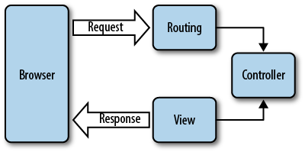
ROUTING

Slide 45
Configuring Routes
ASP.NET MVC routes are responsible for determining which controller method (otherwise known as a controller action) to execute for a given URL.
They consist of the following properties:
Unique name
A name may be used as a specific reference to a given route
URL pattern
A simple pattern syntax that parses matching URLs into meaningful segments
Defaults
An optional set of default values for the segments defined in the URL pattern
Constraints
A set of constraints to apply against the URL pattern to more narrowly define the URLs that it matches

Slide 46
ROUTING
The default ASP.NET MVC project templates add a generic route that uses the following
URL convention to break the URL for a given request into three named segments,
wrapped with brackets ({}): “controller”, “action”, and “id”:
{controller}/{action}/{id}
This route pattern is registered via a call to the MapRoute() extension method that runs
during application startup (located in App_Start/RouteConfig.cs

Slide 47
RouteConfig
public class RouteConfig
{
public static void RegisterRoutes(RouteCollection routes)
{
routes.IgnoreRoute("{resource}.axd/{*pathInfo}");
routes.MapRoute(
name: "Default",
url: "{controller}/{action}/{id}",
defaults: new { controller = "Home", action = "Index", id = UrlParameter.Optional }
);
}
}

Slide 48
HomeController
Home controller responsible for the “Home page” at the root of the website ,as well as an “about page “and a “contact page”
AccountController:Responsible for account-related requests, such as login and account registration
For instance, the HomeController class we just looked at contains three actions: Index, About, and Contact.
Thus, given the default route pattern {controller}/{action}/{id},
when a request is made to the URL /Home/About, the routing framework determines
that it is the About() method of the HomeController class that should process therequest.
The ASP.NET MVC Framework then creates a new instance of the HomeController class and executes its About() method.

Slide 49
In this case, the About() method is pretty simple: it passes data to the view via the ViewBag property (more on that later),
then tells the ASP.NET MVC Framework to display the view named “About” by calling the View() method, which returns an ActionResult of type ViewResult.

Slide 50
Homecontroller code
namespace Ebuy.Website.Controllers
{
public class HomeController : Controller
{
public ActionResult Index()
{
ViewBag.Message = "Your app description page.";
return View();
}
public ActionResult About()
{
ViewBag.Message = "Your quintessential app description page.";
return View();
}

Slide 51
public ActionResult Contact()
{
ViewBag.Message = "Your quintessential contact page.";
return View();
}
}
}

Slide 52
that every controller action needs to return an ActionResult,
System.Web.Mvc.Controller base class provides, such as:
Content()
Returns a ContentResult that renders arbitrary text, e.g., “Hello, world!”
File()
Returns a FileResult that renders the contents of a file, e.g., a PDF.
HttpNotFound()
Returns an HttpNotFoundResult that renders a 404 HTTP status code response.

Slide 53
Unobtrusive java script
Unobtrusive JavaScript makes a lot of sense when you consider that your html document is just that

Slide 54
JavaScript():: Returns a JavaScriptResult
that renders JavaScript, e.g., “function hello() { alert(Hello, World!); }”.
Json()
Returns a JsonResult that serializes an object and renders it in JavaScript Object
Notation (JSON) format, e.g., “{ “Message”: Hello, World! }”.
PartialView()
Returns a PartialViewResult that renders only the content of a view (i.e., a view without its layout).

Slide 55
Redirect()
Returns a RedirectResult that renders a 302 (temporary) status code to redirect
the user to a given URL, e.g., “302 http://www.ebuy.com/auctions/recent”. This
method has a sibling, RedirectPermanent(), that also returns a RedirectResult, but
uses HTTP status code 301 to indicate a permanent redirect rather than a temporary one.

Slide 56
View()
Returns a ViewResult that renders a view.
As you can tell from this list, the framework provides an action result for just about
any situation you need to support, and, if it doesn’t, you are free to create your own!

Slide 57
Razor!
Razor is a markup syntax for adding server-based code to web pages
Razor has the power of traditional ASP.NET markup, but is easier to learn, and easier to use
Razor is a server side markup syntax much like ASP and PHP
Razor supports C# and Visual Basic programming languages

Slide 58
Main Razor Syntax Rules for C#
Razor code blocks are enclosed in @{ ... }
Inline expressions (variables and functions) start with @
Code statements end with semicolon
Variables are declared with the var keyword
Strings are enclosed with quotation marks
C# code is case sensitive
C# files have the extension .cshtml

Slide 59
html>
<body>
<!-- Single statement block -->
@{ var myMessage ="Hello World"; }
<!-- Inline expression or variable -->
<p>The value of myMessage is: @myMessage</p>
<!--Multi-statement block -->
@{
var greeting = "Welcome to our site!";
var weekDay = DateTime.Now.DayOfWeek;
var greetingMessage = greeting + " Here in Huston it is: " + weekDay;
}

Slide 60
Razor’s
Razor’s intelligent parser allows developers to be more expressive with their logic and
make easier transitions between code and markup. Though Razor’s syntax might be
different from other markup syntaxes (such as the Web Forms syntax), it’s ultimately
working toward the same goal: rendering HTML.

Slide 61
Examples of common scenarios implemented in both Razor markup and Web Forms markup.
Here is an if/else statement using Web Forms syntax:
<% if(User.IsAuthenticated) { %>
<span>Hello, <%: User.Username %>!</span>
<% } %>
<% else { %>
<span>Please <%: Html.ActionLink("log in") %></span>
<% } %>
and using Razor syntax:
@if(User.IsAuthenticated) {
<span>Hello, @User.Username!</span>
} else {
<span>Please @Html.ActionLink("log in")</span>
}
>

Slide 62
Here is a foreach loop using Web Forms syntax:
<ul>
<% foreach( var auction in auctions) { %>
<li><a href="<%: auction.Href %>"><%: auction.Title %></a></li>
<% } %>
</ul>

Slide 63
Here is a foreach loop using Razor’s Forms syntax:
<ul>
@foreach( var auction in auctions) {
<li><a href="@auction.Href">@auction.Title</a></li>
}
</ul>

Slide 64
Razor Helpers
ASP.NET helpers are components that can be accessed by single lines of Razor code.
You can build your own helpers using Razor syntax, or use built-in ASP.NET helpers.
Below is a short description of some useful Razor helpers:
Web Grid
Web Graphics
Google Analytics
Facebook Integration
Twitter Integration
Sending Email
Validation

Slide 65
Converting Data Types
Method | Description | Example
AsInt() IsInt() | Converts a string to an integer. | if (myString.IsInt()) {myInt=myString.AsInt();}
AsFloat() IsFloat() | Converts a string to a floating-point number. | if (myString.IsFloat()) {myFloat=myString.AsFloat();}
AsDecimal() IsDecimal() | Converts a string to a decimal number. | if (myString.IsDecimal()) {myDec=myString.AsDecimal();}
AsDateTime() IsDateTime() | Converts a string to an ASP.NET DateTime type. | myString="10/10/2012"; myDate=myString.AsDateTime();

Slide 66
folders
The Controllers Folder contains the controller classes responsible for handling user input and responses.
MVC requires the name of all controllers to end with "Controller".
In our example, Visual Web Developer has created the following files: HomeController.cs (for the Home and About pages) and AccountController.cs (For the Log On pages):

Slide 67
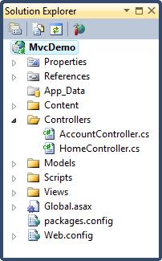

Slide 68
Web servers will normally map incoming URL requests directly to disk files on the server. For example: a URL request like "http://www.w3schools.com/default.asp" will map directly to the file "default.asp" at the root directory of the server.
The MVC framework maps differently. MVC maps URLs to methods. These methods are in classes called "Controllers".
Controllers are responsible for processing incoming requests, handling input, saving data, and sending a response to send back to the client.

Slide 69
The Home controller
The controller file in our application HomeController.cs, defines the two controls Index and About.
using System; using System.Collections.Generic; using System.Linq; using System.Web; using System.Web.Mvc; namespace MvcDemo.Controllers { public class HomeController : Controller { public ActionResult Index() {return View();} public ActionResult About() {return View();} } }

Slide 70
The Controller Views
The files Index.cshtml and About.cshtml in the Views folder defines the ActionResult views Index() and About() in the controller.

Slide 71
The Views Folder
The Views folder stores the files (HTML files) related to the display of the application (the user interfaces). These files may have the extensions html, asp, aspx, cshtml, and vbhtml, depending on the language content.
The Views folder contains one folder for each controller.
Visual Web Developer has created an Account folder, a Home folder, and a Shared folder (inside the Views folder).
The Account folder contains pages for registering and logging in to user accounts.
The Home folder is used for storing application pages like the home page and the about page.
The Shared folder is used to store views shared between controllers (master pages and layout pages).

Slide 72
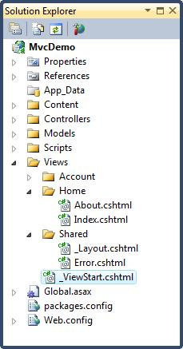
View folder

Slide 73
Disadvantages of mvc
Rapid application development is not possible
No drag and drop
No server controls

Slide 74
What are Action Filters
If we need to apply some specific logic before or after action methods then we use action filters.
We can apply these action filters to a Controller or a specific Controller action.
Action filters are basically custom classes that provide a way for adding pre-action or post-action behavior to Controller actions.

Slide 75
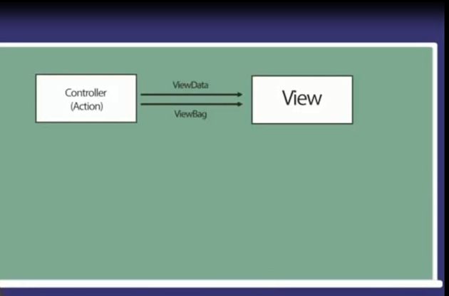
View Data and view bag

Slide 76
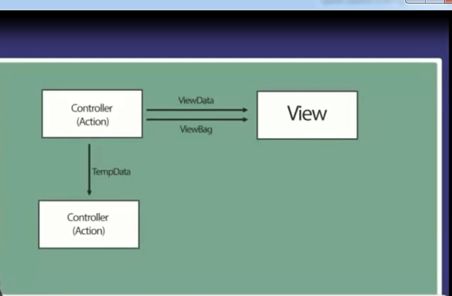
Temp

Slide 77
ViewData and ViewBag
ViewData, ViewBag and TempData to pass data from controller to view
View data is return as object which is based on viewdata dictionary .
Whenever we use a viewdata we use a like arryalist structure for accessing the information .
ViewData if I use it we have to typecast to extract the value.
ViewBag is similar to ViewData it performance the same functionality but the way comes the differences
ViewBag c-sharp4.0 dynamic expressions as a result its capability to trace out what type of value it is at the runtime we do not perform explicit type casting for the ViewBag
Helps to maintain data when you move from controller to view.

Slide 78
tempdata
Tempdata is used to passing the in formation to the one action to the subsequent action
whenever you have a such a requirement such that the data of one particular controller action you want to pass to the other controller action we can take the support of tempdata
Tempdata can access through view
Once the page getting loaded the information will not be existed from the TempData

Slide 79
session
Whenever we have a requirement such that a value what you have, you wanted to access across multiple controller actions and multiple views instead of using Viewdata,viewbag,tempdata,we can support of session

Slide 80
Difference in viewdata and viewbag
ViewData is a dictionary of objects that is derived from ViewDataDictionary class and accessible using strings as keys.
ViewBag is a dynamic property that takes advantage of the new dynamic features in C# 4.0.
ViewData requires typecasting for complex data type and check for null values to avoid error.
ViewBag doesn’t require typecasting for complex data type.

Slide 81
Html helper class
An HTML Helper is just a method that returns a string.
The string can represent any type of content that you want.
For example, you can use HTML Helpers to render standard HTML tags like HTML <input> and <img> tags.

Slide 82
Html helper
Html.ActionLink()
Html.BeginForm()
Html.CheckBox()
Html.DropDownList()
Html.EndForm()
Html.Hidden()
Html.ListBox()
Html.Password()
Html.RadioButton()
Html.TextArea()
Html.TextBox()

Slide 83
Html.BeginForm()
The Html.BeginForm() Helper method is used to create the opening and closing HTML <form> tags. Notice that the Html.BeginForm() method is called within a using statement.
The using statement ensures that the <form> tag gets closed at the end of the using block.
If you prefer, instead of creating a using block, you can call the Html.EndForm() Helper method to close the <form> tag.
Use whichever approach to creating an opening and closing <form> tag that seems most intuitive to you.

Slide 84
Html.TextBox()
The Html.TextBox() Helper methods are used in Listing 1 to render HTML <input> tags.
If you select view source in your browser then you see the HTML source in Listing 2. Notice that the source contains standard HTML tags.
IMPORTANT: notice that the Html.TextBox()-HTML Helper is rendered with <%= %> tags instead of <% %> tags. If you don't include the equal sign, then nothing gets rendered to the browser.

Slide 85
Actionresult and its types
Action result is a base class or abstract class for all the specific implementation of action result
Its is an abstract class and has several subtypes
Subtype of Action Result
view Result
Used to return a view render html in browser
Partialviewresult
Returns a specified partial view

Slide 86
Redirectresult()
Perform an http redirection to a specified url
RedirectToRouteResult()
Perform an http redirection to a another action method that is determined by the route engine
EmptyResult
Used when action method returns void
JSON Result
Returns a JSON result Which serializes an object in json format

Slide 87
Content View
Content Result
Write contents to the response stream without requiring a view
ViewResult
Returns a specified view
JavaScript Result
Returns a piece of JavaScript code that can be execute on the client
HttpNotFoundResult
This object indicate that the requested resources can not be found

Slide 88
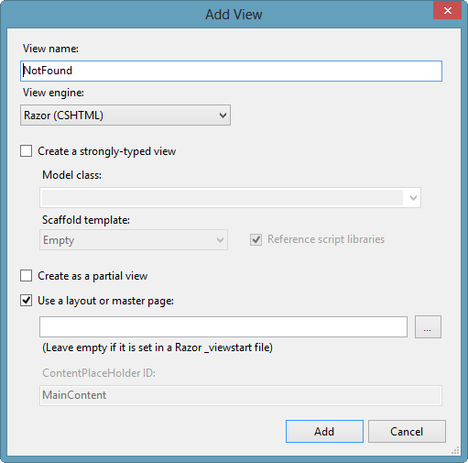
View engine

Slide 89
View engine
View engines provide a specific syntax to work with server-side elements and process the view to render the HTML in the browser.
ASP.NET MVC 4 includes two view engines:
The original ASPX view engine, which works similarly to the syntax in Web Forms applications
Razor view engine, which uses a simpler and compact syntax that is very easy to use.

Slide 90
In the “View name” text box, enter the name of the view. Generally, you’ll want to give the view the same name as the action method that triggered it.
Sometimes, though, you’ll want the view to have a different name from that of the action method. In this case,
the action method must specify the name of the view as follows: return View(name-of-view);

Slide 91
Different ways for sending data from controller to view
1)ViewBag or ViewData
2)Dyanamic Type
3)Strongly Typed View
Advantages of strongly typed view
Intellisense support
Compile time checking

Slide 92
strongly-typed view
Create a strongly-typed view:
When you associate a view model to a view, the view
become a strongly typed view.
Check this box if you want to make your view a strongly typed
view, which is a view that receives a known type of “model” object as a parameter from the
controller action method.
Using strongly typed views has several advantages, such as:
IntelliSense: Visual Studio will be capable of displaying IntelliSense using the Model property based on the view model class.
This allows the view page to access properties on
the model object, call methods, and so forth.

Slide 93
Automatic scaffolding
Automatic scaffolding: Selecting this option instructs Visual Studio to create a view with
a <form> tag that includes all the fields and validation options based on the properties defined in the view model class.

Slide 94
Compile-time type checking
Compile-time type checking: The compiler is able to detect problems with data type handling in the view because it knows the view model class and its properties.
For example,
if the view page tries to access a property that doesn’t exist on the model object, you'll get a compiler error rather than a runtime error. This is a good thing, because it helps you fix problems in your code more easily.

Slide 95
Create as a partial view
Create as a partial view: Check this box to define the view as a partial view, which is a chunk
of HTML that can be reused in other views. For example, a partial view can contain the logic to
display a chart based on a set of data. This chart then can be placed in different views, but the
logic remains centralized in a single partial view. This means that if you modify the chart type,
for example, from a bar chart to a pie chart, all views having the same chart will be displayed
as a pie chart.

Slide 96
Use a layout or master page
: Checking this box allows you to define a view that serves as a
general layout with elements such as a logo, a top menu, and a footer that will be the same
across all views that use it. This is a good way to give your web site a consistent look and feel.
Also, changes that you make in this shared view apply to all views that use it, which is much
easier than having to make the changes in each individual view. In Razor, there is a default
layout view called _ViewStart.cshtml (or _ViewStart.vbhtml if your server-side language is
VB.NET). The _ViewStart.cshtml view is used if you selected the check box “Use a layout or
master page” and left the layout input box empty

Slide 97
Action methods
The controller exposes action methods
Controller can include as many action methods as needed .
Action Methods have one-to –one mapping with user interactions

Slide 98
Action selectors
Action selectors is the attribute that can be applied to the action methods
It helps to route engine to select the correct action method to handle a particular request
Action selector attribute
ActionName
NonAction
Actionverbs

Slide 99
actionname
Actionname allows us to specify different action name than the method name
Public class StudentController:Controller
{
[ActionName("List")]
public ActionResult Index()
{
ViewBag.Message = “Asp.net";
return View();
}
}

Slide 100
nonaction
Nonaction method used to another way to restrict access to method in a controller by making them private.
Nonaction selector attribute indicate that a public method of a controller is not an action method
But it is a bad design for implementing nonaction method attribute

Slide 101
nonAction
Public class StudentController:Controller
{
[NonAction]
public ActionResult Details()
{
ViewBag.Message = “Asp.net";
return View();
}
}

Slide 102
Action verbs
The action verb selectors is used when you want to control the selection of an action method based on Http request method
For example
We can define two different action method with the same name but one action method responds to an Http Get request and another action method Http post request

Slide 103
Different action verbs
HTTP GET(to retrieve information from the user)
HTTP POST(to create a new resources)
HTTP DELETE(to delete an existing resources)
HTTP PUT(to update an existing resources)
HTTP OPTION
HTTP PATCH(to full or partial update the resources)

Slide 104
Data annotation
It is a library in DotNet framework
It resides in assembly System.componentmodel.DataAnnotations
Data annotations contains validation attributes to enforce validation rules
Data annotations allow us to describe the rules we want applied to our model properties

Slide 105
Attributes of dataannotations
Required
Indicate that the property is a required field
DisplayName
Defines the text we want to used on form fields and validation message
StringthLength
Defines maximum length for string field
Range
Gives a maximum and minimum value for a numeric field
Scaffold
Allows hiding fields from editor forms

Slide 106
Id,empname validation
[Key]
public int Id { get; set; }
[DisplayName("EmployeeName")]
[Required (ErrorMessage="EmpName is Required")]
[StringLength(35,MinimumLength=4)]
public string Name { get; set; }
[Required(ErrorMessage="EmployeeAddress Is required ")]
[StringLength (300)]
public string Address { get; set; }

Slide 107
Salary validation
[Required (ErrorMessage="Salary field is required")]
[Range(3000,10000,ErrorMessage="Salary should be between 3000 and 10000")]
public decimal Salary { get; set; }

Slide 108
email
[Required(ErrorMessage="please give your Emailaddress")]
[DataType(DataType.EmailAddress)]
[DisplayName("EmailAddress")]
[MaxLength(50)]
[RegularExpression(@"[a-z0-9,_%+-]+@[a-z,0-9.-]+\.[a-z]{2,4}",ErrorMessage="Please Enter Correct Email Address")]
public string Email { get; set; }

Slide 109
Action filters
Action filters are attribute that can be applied either on a controller action method or on a controller
When applied at the controller level,they are applicable for all actions with in that controller
Action filters allow us to add pre and post processing logic to an action methods
They allow us to modify the way in which an action is executed

Slide 110
Type of action filters
Authorize
ChildActionOnly
HandleError
OutputCache
Require Https
validateInput
validateAniforgeryToken

Slide 111
Repository
The repository mediates between the data source layer and business layers of the application
Repository queries the data source for the data ,maps the data from the data source to a business entity
Repository persists changes in the business entity to the data source
A repository separates the business logic from the interactions with the underlying datasource or web service.

Slide 112
Repository
Repository is centralized the data logic or web service logic
Repository provides a substitution point for the unit test
It is provides a flexible architecture that can be adapted as the overall design of the application evolves

Slide 113
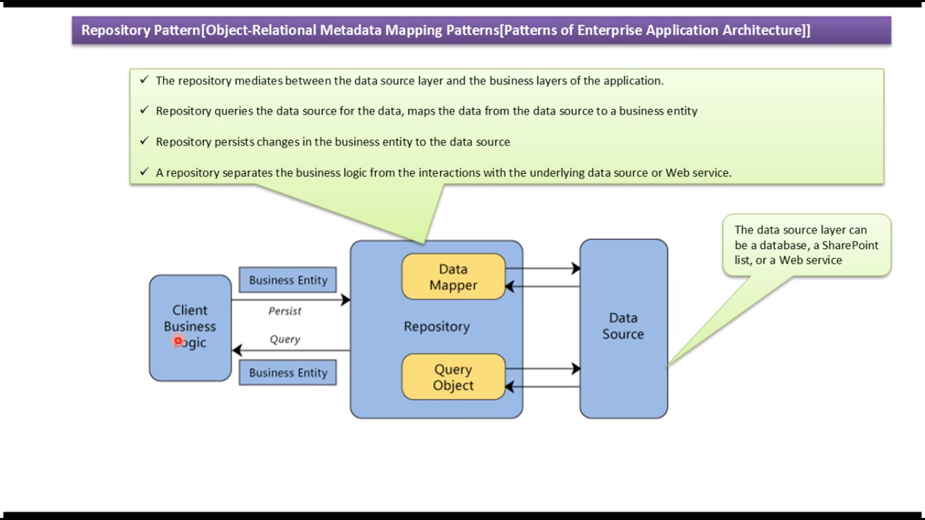
Repository design pattern

Slide 114
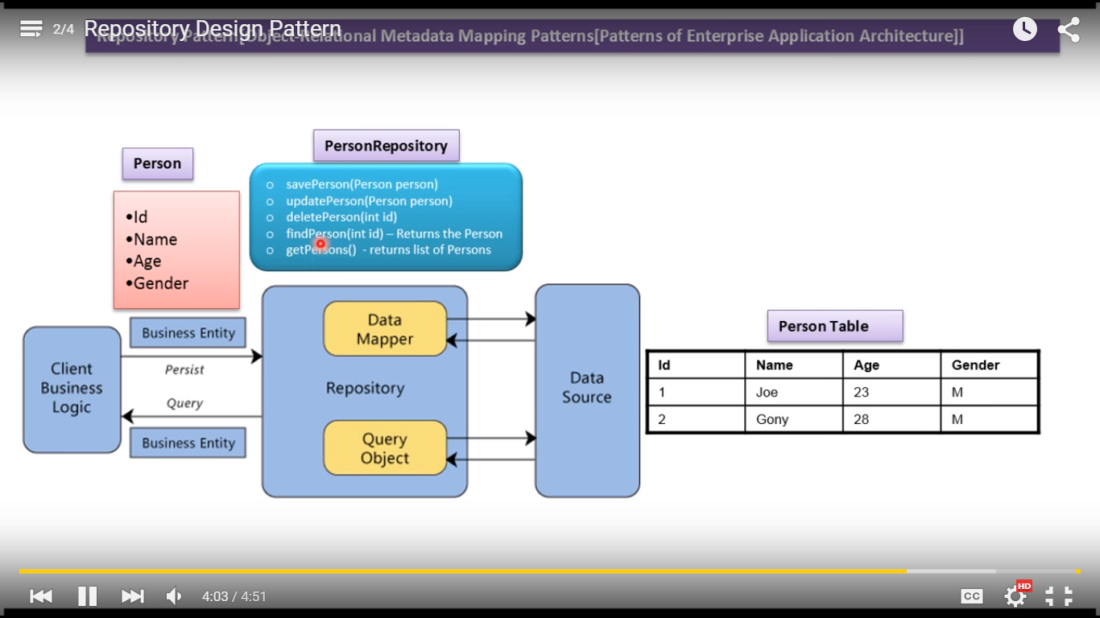
Repository

Slide 115
The repository layer isolates Business layer from the Data Access Layer.
The Repository contains Data Mapper entity.
This entity can be used as a model entity for providing schema of the data for performing CRUD operations, by using the CRUD operations defined in the repository.
The Business layer performs Data Access using repository layer. If the application makes use of WCF/Web services for data access, then repository can be used to isolate these service references from the Business layer.

Slide 116
In MVC, it is important to think of the repository pattern so that if the Model layers needs some breaking changes, then it should have minimum or no maintenance impact on the controller layer.
In MVC, finally the Controller is responsible for exposing data to the View or accessing Http posted data from View and send it further to the Model.
So here, if the Controller has tight-coupling dependency on the Model, then any change in the Model will impact the Controller and hence sometimes the View too.
In this case, we can use the Repository pattern as shown in the following diagram:

Slide 117
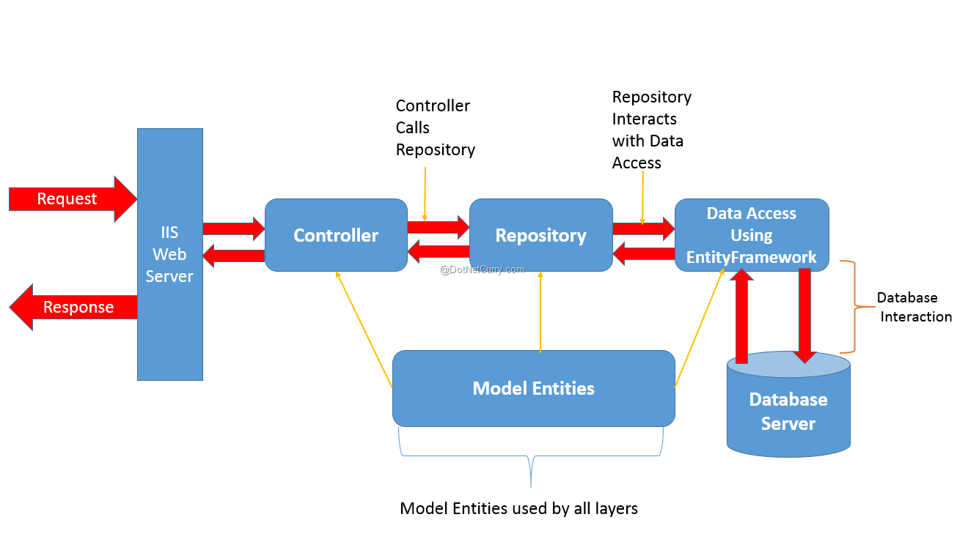

Slide 118
The above diagram explains the repository process flow. When using EntityFramework in MVC,
we have Model Entities available which can be used by all layers of the application.
Once the Web Server passed the request to Controller for Actions (e.g. Read/Write), the Controller calls repository and passes the Model Entity to it.

Slide 119
It is recommended that the Controller should use Dependency Injection to instantiate the Repository and call methods from it.
The Repository further passes the Model Entity to Data Access implemented using Entity Framework for performing operation requested by the Controller.

Slide 120
Here Repository must also use Dependency Injection to instantiate the DbContext of Entity Framework. To implement Dependency Injection, any DI framework can be used e.g. Unity, Ninject, etc.

