Slide 1
Chapter 18: Data Analysis and Mining

Slide 2
Chapter 18: Data Analysis and Mining
Decision Support Systems
Data Analysis and OLAP
Data Warehousing
Data Mining

Slide 3
Decision Support Systems
Decision-support systems are used to make business decisions, often based on data collected by on-line transaction-processing systems.
Examples of business decisions:
  What items to stock?
  What insurance premium to change?
  To whom to send advertisements?
Examples of data used for making decisions
  Retail sales transaction details
  Customer profiles (income, age, gender, etc.)

Slide 4
Decision-Support Systems: Overview
Data analysis tasks are simplified by specialized tools and SQL extensions
  Example tasks
    For each product category and each region, what were the total sales in the last quarter and how do they compare with the same quarter last year
    As above, for each product category and each customer category
Statistical analysis packages (e.g., : S++) can be interfaced with databases
  Statistical analysis is a large field, but not covered here
Data mining seeks to discover knowledge automatically in the form of statistical rules and patterns from large databases.
A data warehouse archives information gathered from multiple sources, and stores it under a unified schema, at a single site.
  Important for large businesses that generate data from multiple divisions, possibly at multiple sites
  Data may also be purchased externally

Slide 5
Data Analysis and OLAP
Online Analytical Processing (OLAP)
  Interactive analysis of data, allowing data to be summarized and viewed in different ways in an online fashion (with negligible delay)
Data that can be modeled as dimension attributes and measure attributes are called multidimensional data.
  Measure attributes
    measure some value
    can be aggregated upon
    e.g. the attribute number of the sales relation
  Dimension attributes
    define the dimensions on which measure attributes (or aggregates thereof) are viewed
    e.g. the attributes item_name, color, and size of the sales relation

Slide 6
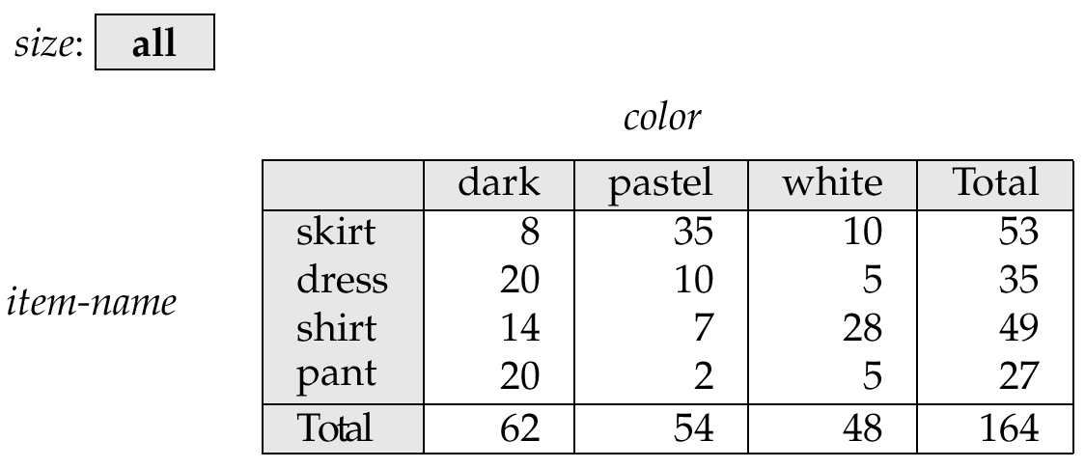
Cross Tabulation of sales by item-name and color
The table above is an example of a cross-tabulation (cross-tab), also referred to as a pivot-table.
  Values for one of the dimension attributes form the row headers
  Values for another dimension attribute form the column headers
  Other dimension attributes are listed on top
  Values in individual cells are (aggregates of) the values of the
  dimension attributes that specify the cell.

Slide 7
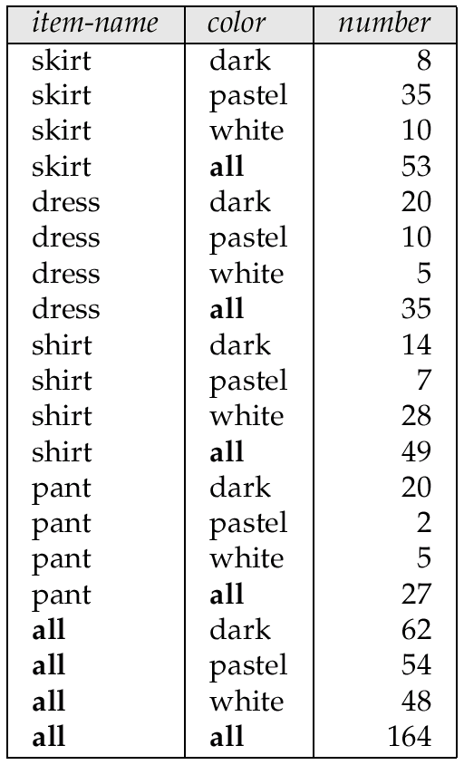
Relational Representation of Cross-tabs
Cross-tabs can be represented as relations
  We use the value all is used to represent aggregates
  The SQL:1999 standard actually uses null values in place of all despite confusion with regular null values

Slide 8
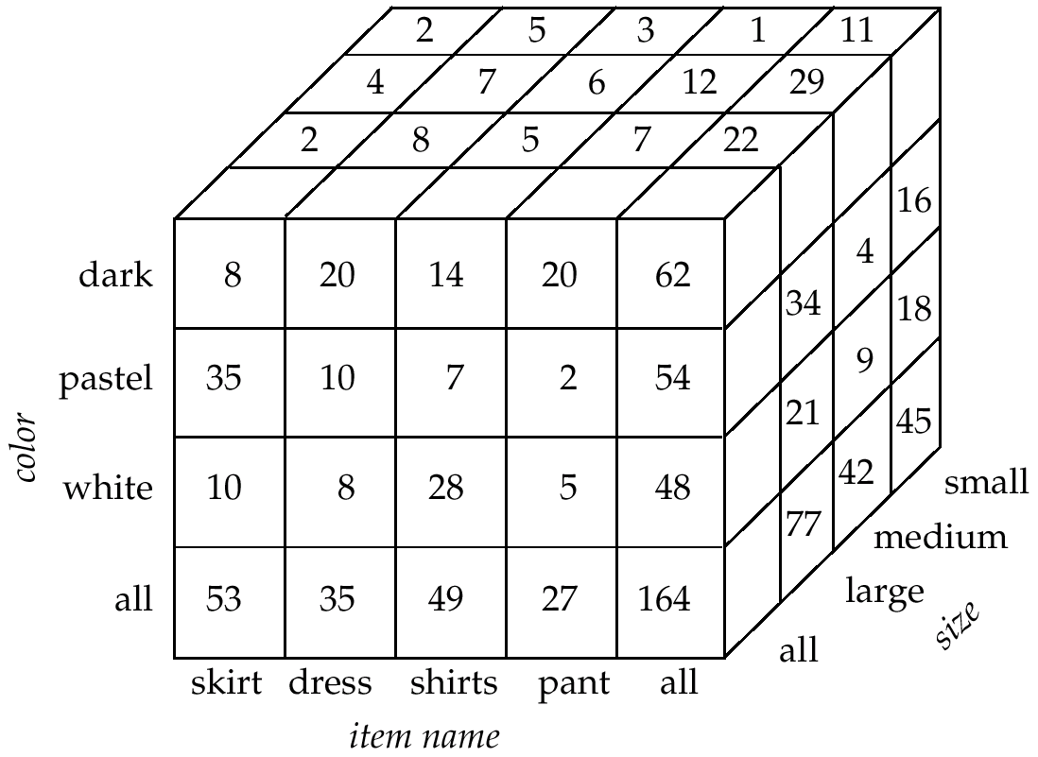
Data Cube
A data cube is a multidimensional generalization of a cross-tab
Can have n dimensions; we show 3 below
Cross-tabs can be used as views on a data cube

Slide 9
Online Analytical Processing
Pivoting: changing the dimensions used in a cross-tab is called
Slicing: creating a cross-tab for fixed values only
  Sometimes called dicing, particularly when values for multiple dimensions are fixed.
Rollup: moving from finer-granularity data to a coarser granularity
Drill down: The opposite operation - that of moving from coarser-granularity data to finer-granularity data

Slide 10

Hierarchies on Dimensions
Hierarchy on dimension attributes: lets dimensions to be viewed at different levels of detail
  E.g. the dimension DateTime can be used to aggregate by hour of day, date, day of week, month, quarter or year

Slide 11
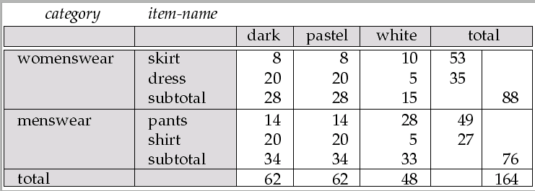
Cross Tabulation With Hierarchy
Cross-tabs can be easily extended to deal with hierarchies
  Can drill down or roll up on a hierarchy

Slide 12
OLAP Implementation
The earliest OLAP systems used multidimensional arrays in memory to store data cubes, and are referred to as multidimensional OLAP (MOLAP) systems.
OLAP implementations using only relational database features are called relational OLAP (ROLAP) systems
Hybrid systems, which store some summaries in memory and store the base data and other summaries in a relational database, are called hybrid OLAP (HOLAP) systems.

Slide 13
OLAP Implementation (Cont.)
Early OLAP systems precomputed all possible aggregates in order to provide online response
  Space and time requirements for doing so can be very high
    2^{n} combinations of group by
  It suffices to precompute some aggregates, and compute others on demand from one of the precomputed aggregates
    Can compute aggregate on (item-name, color) from an aggregate on (item-name, color, size)
      For all but a few “non-decomposable” aggregates such as median
      is cheaper than computing it from scratch
Several optimizations available for computing multiple aggregates
  Can compute aggregate on (item-name, color) from an aggregate on
  (item-name, color, size)
  Can compute aggregates on (item-name, color, size),
  (item-name, color) and (item-name) using a single sorting
  of the base data

Slide 14
Extended Aggregation in SQL:1999
The cube operation computes union of group by’s on every subset of the specified attributes
E.g. consider the query
select item-name, color, size, sum(number)
from sales
group by cube(item-name, color, size)
This computes the union of eight different groupings of the sales relation:
{ (item-name, color, size), (item-name, color),
(item-name, size), (color, size),
(item-name), (color),
(size), ( ) }
where ( ) denotes an empty group by list.
For each grouping, the result contains the null value
for attributes not present in the grouping.

Slide 15
Extended Aggregation (Cont.)
Relational representation of cross-tab that we saw earlier, but with null in place of all, can be computed by
select item-name, color, sum(number)
from sales
group by cube(item-name, color)
The function grouping() can be applied on an attribute
  Returns 1 if the value is a null value representing all, and returns 0 in all other cases.
select item-name, color, size, sum(number),
grouping(item-name) as item-name-flag,
grouping(color) as color-flag,
grouping(size) as size-flag,
from sales
group by cube(item-name, color, size)
Can use the function decode() in the select clause to replace
such nulls by a value such as all
  E.g. replace item-name in first query by
  decode( grouping(item-name), 1, ‘all’, item-name)

Slide 16
Extended Aggregation (Cont.)
The rollup construct generates union on every prefix of specified list of attributes
E.g.
select item-name, color, size, sum(number)
from sales
group by rollup(item-name, color, size)
  Generates union of four groupings:
{ (item-name, color, size), (item-name, color), (item-name), ( ) }
Rollup can be used to generate aggregates at multiple levels of a
hierarchy.
E.g., suppose table itemcategory(item-name, category) gives the category of each item. Then
select category, item-name, sum(number)
from sales, itemcategory
where sales.item-name = itemcategory.item-name
group by rollup(category, item-name)
would give a hierarchical summary by item-name and by category.

Slide 17
Extended Aggregation (Cont.)
Multiple rollups and cubes can be used in a single group by clause
  Each generates set of group by lists, cross product of sets gives overall set of group by lists
E.g.,
select item-name, color, size, sum(number)
from sales
group by rollup(item-name), rollup(color, size)
generates the groupings
{item-name, ()} X {(color, size), (color), ()}
= { (item-name, color, size), (item-name, color), (item-name),
(color, size), (color), ( ) }

Slide 18
Ranking
Ranking is done in conjunction with an order by specification.
Given a relation student-marks(student-id, marks) find the rank of each student.
select student-id, rank( ) over (order by marks desc) as s-rank
from student-marks
An extra order by clause is needed to get them in sorted order
select student-id, rank ( ) over (order by marks desc) as s-rank
from student-marks
order by s-rank
Ranking may leave gaps: e.g. if 2 students have the same top mark, both have rank 1, and the next rank is 3
  dense_rank does not leave gaps, so next dense rank would be 2

Slide 19
Ranking (Cont.)
Ranking can be done within partition of the data.
“Find the rank of students within each section.”
select student-id, section,
rank ( ) over (partition by section order by marks desc)
as sec-rank
from student-marks, student-section
where student-marks.student-id = student-section.student-id
order by section, sec-rank
Multiple rank clauses can occur in a single select clause
Ranking is done after applying group by clause/aggregation

Slide 20
Ranking (Cont.)
Other ranking functions:
  percent_rank (within partition, if partitioning is done)
  cume_dist (cumulative distribution)
    fraction of tuples with preceding values
  row_number (non-deterministic in presence of duplicates)
SQL:1999 permits the user to specify nulls first or nulls last
select student-id,
rank ( ) over (order by marks desc nulls last) as s-rank
from student-marks

Slide 21
Ranking (Cont.)
For a given constant n, the ranking the function ntile(n) takes the tuples in each partition in the specified order, and divides them into n buckets with equal numbers of tuples.
E.g.:
select threetile, sum(salary)
from (
select salary, ntile(3) over (order by salary) as threetile
from employee) as s
group by threetile

Slide 22
Windowing
Used to smooth out random variations.
E.g.: moving average: “Given sales values for each date, calculate for each date the average of the sales on that day, the previous day, and the next day”
Window specification in SQL:
  Given relation sales(date, value)
select date, sum(value) over
(order by date between rows 1 preceding and 1 following)
from sales
Examples of other window specifications:
  between rows unbounded preceding and current
  rows unbounded preceding
  range between 10 preceding and current row
    All rows with values between current row value –10 to current value
  range interval 10 day preceding
    Not including current row

Slide 23
Windowing (Cont.)
Can do windowing within partitions
E.g. Given a relation transaction (account-number, date-time, value), where value is positive for a deposit and negative for a withdrawal
  “Find total balance of each account after each transaction on the account”
  select account-number, date-time,
  sum (value ) over
  (partition by account-number
  order by date-time
  rows unbounded preceding)
  as balance
  from transaction
  order by account-number, date-time

Slide 24
Data Warehousing
Data sources often store only current data, not historical data
Corporate decision making requires a unified view of all organizational data, including historical data
A data warehouse is a repository (archive) of information gathered from multiple sources, stored under a unified schema, at a single site
  Greatly simplifies querying, permits study of historical trends
  Shifts decision support query load away from transaction processing systems

Slide 25
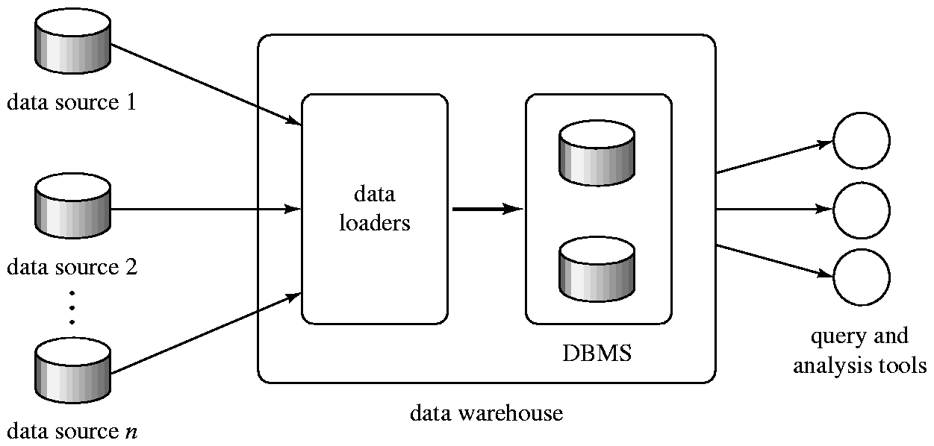
Data Warehousing

Slide 26
Design Issues
When and how to gather data
  Source driven architecture: data sources transmit new information to warehouse, either continuously or periodically (e.g. at night)
  Destination driven architecture: warehouse periodically requests new information from data sources
  Keeping warehouse exactly synchronized with data sources (e.g. using two-phase commit) is too expensive
    Usually OK to have slightly out-of-date data at warehouse
    Data/updates are periodically downloaded form online transaction processing (OLTP) systems.
What schema to use
  Schema integration

Slide 27
More Warehouse Design Issues
Data cleansing
  E.g. correct mistakes in addresses (misspellings, zip code errors)
  Merge address lists from different sources and purge duplicates
How to propagate updates
  Warehouse schema may be a (materialized) view of schema from data sources
What data to summarize
  Raw data may be too large to store on-line
  Aggregate values (totals/subtotals) often suffice
  Queries on raw data can often be transformed by query optimizer to use aggregate values

Slide 28
Warehouse Schemas
Dimension values are usually encoded using small integers and mapped to full values via dimension tables
Resultant schema is called a star schema
  More complicated schema structures
    Snowflake schema: multiple levels of dimension tables
    Constellation: multiple fact tables

Slide 29
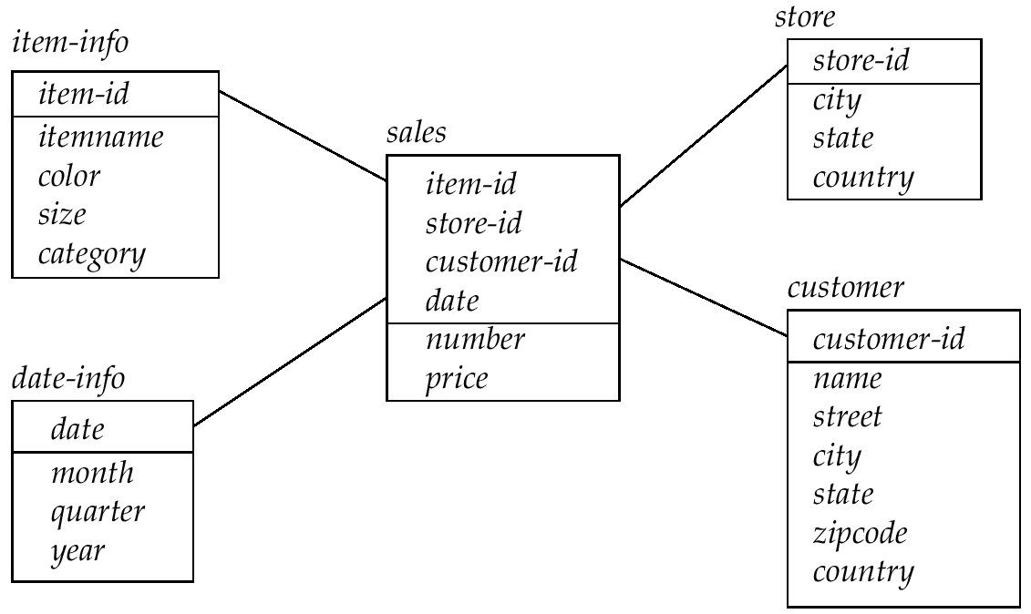
Data Warehouse Schema

Slide 30
Data Mining
Data mining is the process of semi-automatically analyzing large databases to find useful patterns
Prediction based on past history
  Predict if a credit card applicant poses a good credit risk, based on some attributes (income, job type, age, ..) and past history
  Predict if a pattern of phone calling card usage is likely to be fraudulent
Some examples of prediction mechanisms:
  Classification
    Given a new item whose class is unknown, predict to which class it belongs
  Regression formulae
    Given a set of mappings for an unknown function, predict the function result for a new parameter value

Slide 31
Data Mining (Cont.)
Descriptive Patterns
  Associations
    Find books that are often bought by “similar” customers. If a new such customer buys one such book, suggest the others too.
  Associations may be used as a first step in detecting causation
    E.g. association between exposure to chemical X and cancer,
  Clusters
    E.g. typhoid cases were clustered in an area surrounding a contaminated well
    Detection of clusters remains important in detecting epidemics

Slide 32
Classification Rules
Classification rules help assign new objects to classes.
  E.g., given a new automobile insurance applicant, should he or she be classified as low risk, medium risk or high risk?
Classification rules for above example could use a variety of data, such as educational level, salary, age, etc.
  ∀ person P, P.degree = masters and P.income > 75,000
    ⇒ P.credit = excellent
  ∀ person P, P.degree = bachelors and
  (P.income ≥ 25,000 and P.income ≤ 75,000)
  ⇒ P.credit = good
Rules are not necessarily exact: there may be some misclassifications
Classification rules can be shown compactly as a decision tree.

Slide 33
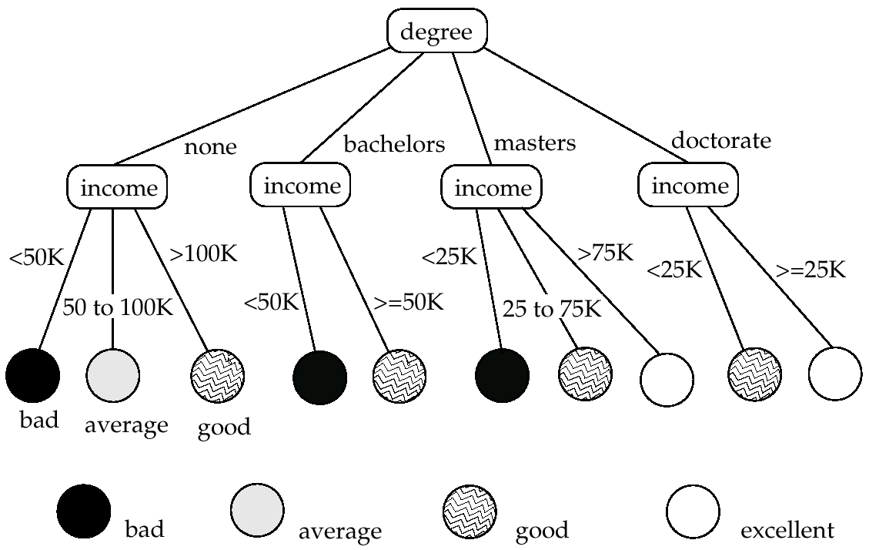
Decision Tree

Slide 34
Construction of Decision Trees
Training set: a data sample in which the classification is already known.
Greedy top down generation of decision trees.
  Each internal node of the tree partitions the data into groups based on a partitioning attribute, and a partitioning condition for the node
  Leaf node:
    all (or most) of the items at the node belong to the same class, or
    all attributes have been considered, and no further partitioning is possible.

Slide 35
Best Splits
Pick best attributes and conditions on which to partition
The purity of a set S of training instances can be measured quantitatively in several ways.
  Notation: number of classes = k, number of instances = |S|,
  fraction of instances in class i = p_{i}.
The Gini measure of purity is defined as
[
Gini (S) = 1 - ∑
  When all instances are in a single class, the Gini value is 0
  It reaches its maximum (of 1 –1 /k) if each class the same number of instances.
k
p²_{i}
i- 1

Slide 36
Best Splits (Cont.)
Another measure of purity is the entropy measure, which is defined as
entropy (S) = – ∑
When a set S is split into multiple sets Si, I=1, 2, …, r, we can measure the purity of the resultant set of sets as:
purity(S₁, S₂, ….., S_{r}) = ∑
The information gain due to particular split of S into S_{i}, i = 1, 2, …., r
Information-gain (S, {S₁, S₂, …., S_{r}) = purity(S ) – purity (S₁, S₂, … S_{r})
k
p_{i}log₂ p_{i}
i- 1
r
|S_{i}|
|S|
purity (S_{i})
i= 1

Slide 37
Best Splits (Cont.)
Measure of “cost” of a split:
Information-content (S, {S₁, S₂, ….., S_{r}})) = – ∑
Information-gain ratio = Information-gain (S, {S₁, S₂, ……, S_{r}})
Information-content (S, {S₁, S₂, ….., S_{r}})
The best split is the one that gives the maximum information gain ratio
r
|S_{i}|
|S|
|S_{i}|
|S|
log₂
i- 1

Slide 38
Finding Best Splits
Categorical attributes (with no meaningful order):
  Multi-way split, one child for each value
  Binary split: try all possible breakup of values into two sets, and pick the best
Continuous-valued attributes (can be sorted in a meaningful order)
  Binary split:
    Sort values, try each as a split point
      E.g. if values are 1, 10, 15, 25, split at ≤1, ≤ 10, ≤ 15
    Pick the value that gives best split
  Multi-way split:
    A series of binary splits on the same attribute has roughly equivalent effect

Slide 39
Decision-Tree Construction Algorithm
  Procedure GrowTree (S )
  Partition (S );
  Procedure Partition (S)
  if ( purity (S ) > δ_{p} or |S| < δ_{s} ) then
  return;
  for each attribute A
  evaluate splits on attribute A;
  Use best split found (across all attributes) to partition
  S into S₁, S₂, …., S_{r},
  for i = 1, 2, ….., r
  Partition (S_{i} );

Slide 40
Other Types of Classifiers
Neural net classifiers are studied in artificial intelligence and are not covered here
Bayesian classifiers use Bayes theorem, which says
p (c_{j} | d ) = p (d | c_{j} ) p (c_{j} )
p ( d )
where
p (c_{j} | d ) = probability of instance d being in class c_{j},
p (d | c_{j} ) = probability of generating instance d given class c_{j},
p (c_{j} ) = probability of occurrence of class c_{j}, and
p (d ) = probability of instance d occuring

Slide 41
Naïve Bayesian Classifiers
Bayesian classifiers require
  computation of p (d | c_{j} )
  precomputation of p (c_{j} )
  p (d ) can be ignored since it is the same for all classes
To simplify the task, naïve Bayesian classifiers assume attributes have independent distributions, and thereby estimate
p (d | c_{j}) = p (d₁ | c_{j} ) * p (d₂ | c_{j} ) * ….* (p (d_{n} | c_{j} )
  Each of the p (d_{i} | c_{j} ) can be estimated from a histogram on d_{i} values for each class c_{j}
    the histogram is computed from the training instances
  Histograms on multiple attributes are more expensive to compute and store

Slide 42
Regression
Regression deals with the prediction of a value, rather than a class.
  Given values for a set of variables, X₁, X₂, …, X_{n}, we wish to predict the value of a variable Y.
One way is to infer coefficients a₀, a₁, a₁, …, a_{n} such that
Y = a₀ + a₁ * X₁ + a₂ * X₂ + … + a_{n} * X_{n}
Finding such a linear polynomial is called linear regression.
  In general, the process of finding a curve that fits the data is also called curve fitting.
The fit may only be approximate
  because of noise in the data, or
  because the relationship is not exactly a polynomial
Regression aims to find coefficients that give the best possible fit.

Slide 43
Association Rules
Retail shops are often interested in associations between different items that people buy.
  Someone who buys bread is quite likely also to buy milk
  A person who bought the book Database System Concepts is quite likely also to buy the book Operating System Concepts.
Associations information can be used in several ways.
  E.g. when a customer buys a particular book, an online shop may suggest associated books.
Association rules:
bread ⇒ milk DB-Concepts, OS-Concepts ⇒ Networks
  Left hand side: antecedent, right hand side: consequent
  An association rule must have an associated population; the population consists of a set of instances
    E.g. each transaction (sale) at a shop is an instance, and the set of all transactions is the population

Slide 44
Association Rules (Cont.)
Rules have an associated support, as well as an associated confidence.
Support is a measure of what fraction of the population satisfies both the antecedent and the consequent of the rule.
  E.g. suppose only 0.001 percent of all purchases include milk and screwdrivers. The support for the rule is milk ⇒ screwdrivers is low.
Confidence is a measure of how often the consequent is true when the antecedent is true.
  E.g. the rule bread ⇒ milk has a confidence of 80 percent if 80 percent of the purchases that include bread also include milk.

Slide 45
Finding Association Rules
We are generally only interested in association rules with reasonably high support (e.g. support of 2% or greater)
Naïve algorithm
  Consider all possible sets of relevant items.
  For each set find its support (i.e. count how many transactions purchase all items in the set).
    Large itemsets: sets with sufficiently high support
  Use large itemsets to generate association rules.
    From itemset A generate the rule A - {b } ⇒b for each b ∈ A.
      Support of rule = support (A).
      Confidence of rule = support (A ) / support (A - {b })

Slide 46
Finding Support
Determine support of itemsets via a single pass on set of transactions
  Large itemsets: sets with a high count at the end of the pass
If memory not enough to hold all counts for all itemsets use multiple passes, considering only some itemsets in each pass.
Optimization: Once an itemset is eliminated because its count (support) is too small none of its supersets needs to be considered.
The a priori technique to find large itemsets:
  Pass 1: count support of all sets with just 1 item. Eliminate those items with low support
  Pass i: candidates: every set of i items such that all its i-1 item subsets are large
    Count support of all candidates
    Stop if there are no candidates

Slide 47
Other Types of Associations
Basic association rules have several limitations
Deviations from the expected probability are more interesting
  E.g. if many people purchase bread, and many people purchase cereal, quite a few would be expected to purchase both
  We are interested in positive as well as negative correlations between sets of items
    Positive correlation: co-occurrence is higher than predicted
    Negative correlation: co-occurrence is lower than predicted
Sequence associations / correlations
  E.g. whenever bonds go up, stock prices go down in 2 days
Deviations from temporal patterns
  E.g. deviation from a steady growth
  E.g. sales of winter wear go down in summer
    Not surprising, part of a known pattern.
    Look for deviation from value predicted using past patterns

Slide 48
Clustering
Clustering: Intuitively, finding clusters of points in the given data such that similar points lie in the same cluster
Can be formalized using distance metrics in several ways
  Group points into k sets (for a given k) such that the average distance of points from the centroid of their assigned group is minimized
    Centroid: point defined by taking average of coordinates in each dimension.
  Another metric: minimize average distance between every pair of points in a cluster
Has been studied extensively in statistics, but on small data sets
  Data mining systems aim at clustering techniques that can handle very large data sets
  E.g. the Birch clustering algorithm (more shortly)

Slide 49
Hierarchical Clustering
Example from biological classification
  (the word classification here does not mean a prediction mechanism)
  chordata
  mammalia reptilia
  leopards humans snakes crocodiles
Other examples: Internet directory systems (e.g. Yahoo, more on this later)
Agglomerative clustering algorithms
  Build small clusters, then cluster small clusters into bigger clusters, and so on
Divisive clustering algorithms
  Start with all items in a single cluster, repeatedly refine (break) clusters into smaller ones

Slide 50
Clustering Algorithms
Clustering algorithms have been designed to handle very large datasets
E.g. the Birch algorithm
  Main idea: use an in-memory R-tree to store points that are being clustered
  Insert points one at a time into the R-tree, merging a new point with an existing cluster if is less than some δ distance away
  If there are more leaf nodes than fit in memory, merge existing clusters that are close to each other
  At the end of first pass we get a large number of clusters at the leaves of the R-tree
    Merge clusters to reduce the number of clusters

Slide 51
Collaborative Filtering
Goal: predict what movies/books/… a person may be interested in, on the basis of
  Past preferences of the person
  Other people with similar past preferences
  The preferences of such people for a new movie/book/…
One approach based on repeated clustering
  Cluster people on the basis of preferences for movies
  Then cluster movies on the basis of being liked by the same clusters of people
  Again cluster people based on their preferences for (the newly created clusters of) movies
  Repeat above till equilibrium
Above problem is an instance of collaborative filtering, where users collaborate in the task of filtering information to find information of interest

Slide 52
Other Types of Mining
Text mining: application of data mining to textual documents
  cluster Web pages to find related pages
  cluster pages a user has visited to organize their visit history
  classify Web pages automatically into a Web directory
Data visualization systems help users examine large volumes of data and detect patterns visually
  Can visually encode large amounts of information on a single screen
  Humans are very good a detecting visual patterns

