Slide 1
NETWORK FLOW

Slide 2
Usage Places
Network | Vertex | Edges | Flow
communication | telephone exchanges computers, satellites | cables, fiber optics, microwave relays | voice, video, packets
circuits | gates, registers, processors | wires | current
mechanical | Joints | rods, beams, springs | heat, energy
hydraulic | reservoirs, pumping stations, lakes | pipelines | fluid, oil
financial | stocks, currency | transactions | money
transportation | airports, rail yards, street intersections | highways, railways, airway routes | freight, vehicles, passengers
chemical | sites | bonds | energy

Slide 3
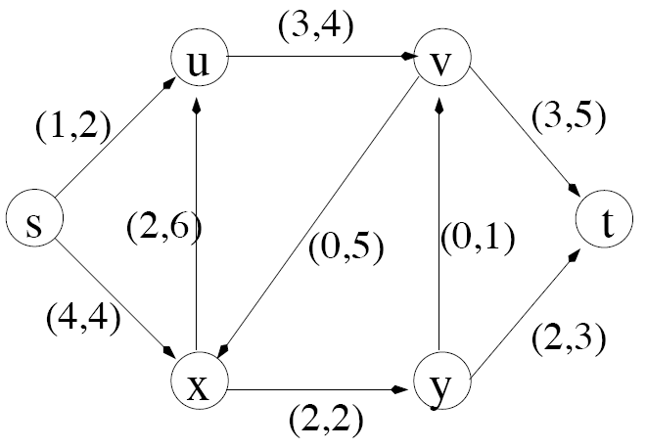
Example Graph
-
Sink node
Source node
Actual flow through this edge
Max. capacity of edge

Slide 4
Simplified Model
The network is modeled simply as
a directed graph G = (V,E) with
non-negative capacity on each edge,
a single source node, s, and
a single sink node, t

Slide 5
Some assumptions…
We will simplify our discussion by assuming the following:
No edge enters s, the source
No edge leaves t, the sink
At least one edge is incident to each node
All capacities are integers

Slide 6
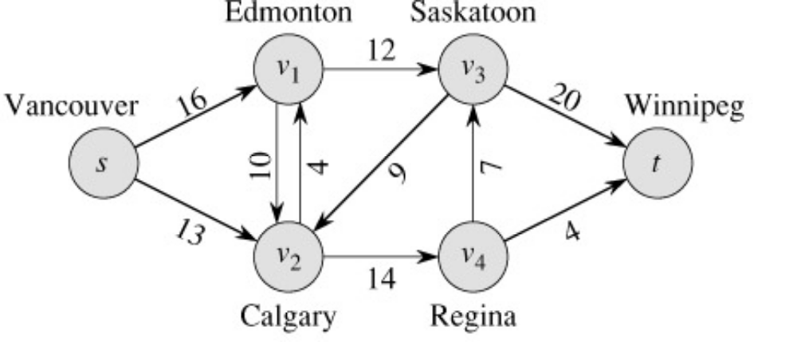
What is Network Flow?
Each edge (u,v) has a nonnegative capacity c(u,v).
If (u,v) is not in E, assume c(u,v)=0.
We have a source s, and a sink t.
Assume that every vertex v in V is on some path from s to t.
c(s,v₁)=16; c(v₁,s)=0; c(v₂,v₃)=0

Slide 7
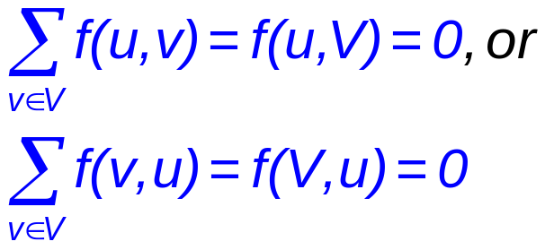
Formalization
Flow network – G=(V,E)
  Directed, each edge has capacity c(u,v) ≥ 0
  Two special vertices: source s, and sink t
  For any other vertex v, there is a path s→…→v→…→t
Flow – f : V × V → R
  Capacity constraint: ∀u,v ∈ V: f(u,v) ≤ c(u,v)
  Skew symmetry: ∀u,v ∈ V: f(u,v) = –f(v,u)
  Flow conservation: ∀u ∈ V – {s, t}:

Slide 8
Flow in a Flow Network
  A flow in the network is an integer-valued function f defined on the edges of G satisfying 0 ≤ f(i,j) ≤ c(i,j) for every edge (i,j) in E.

Slide 9
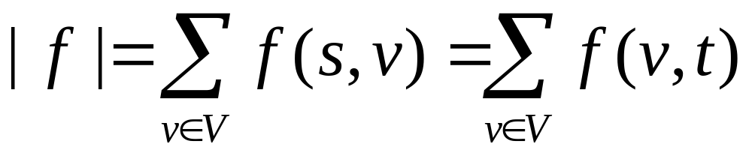
The Value of a Flow
The value of a flow is given by
This it the total flow leaving s = the total flow arriving in t

Slide 10
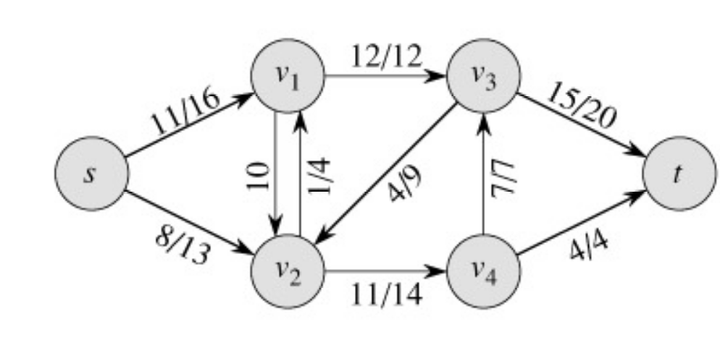
Example:
|f| = f(s, v₁) + f(s, v₂) + f(s, v₃) + f(s, v₄) + f(s, t) =
11 + 8 + 0 + 0 + 0 = 19
|f|= f(s, t) + f(v₁, t) + f(v₂, t) + f(v₃, t) + f(v₄, t) =
0 + 0 + 0 + 15 + 4 = 19

Slide 11
Example of a Flow
flow
capacity
0
0
f(v₂, v₁) = 1, c(v₂, v₁) = 4.
f(v₁, v₂) = -1, c(v₁, v₂) = 10.
f(v3, s) + f(v3, v1) + f(v3, v2) + f(v3, v4) + f(v3, t) =
0 + (-12) + 4 + (-7) + 15 = 0

Slide 12
A flow in a network
We assume that there is only flow in one direction at a time.
Sending 7 trucks from Edmonton to Calgary and 3 trucks from Calgary to Edmonton has the same net effect as sending 4 trucks from Edmonton to Calgary.

Slide 13
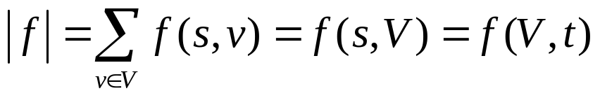
Maximum flow
What do we want to maximize?
  Value of the flow f:
a
13
b
15
8
19
10
10
13
t
s
4
2
9
5
6
5
3
14
c
11
d
3
8

Slide 14
Some Lemmas:
Prove that, f(s,V)=f(V,t) [pg-649]
[Lemma26.2] Prove that, |f+f′|=|f|+|f′|
Lemma: 26.3
Lemma 26.4 |f′| = |f| + |f_{p}| ≥|f|
Lemma: 26.5 |f| = f(S,T)
Lemma: 26.6 |f| ≤ c(S,T)

Slide 15
Cuts
A cut is a partition of V into S and T = V – S, such that s ∈ S and t ∈ T
The net flow (f(S,T)) through the cut is the sum of flows f(u,v), where s ∈ S and t ∈ T
  Includes negative flows back from T to S
The capacity (c(S,T)) of the cut is the sum of capacities c(u,v), where s ∈ S and t ∈ T
  The sum of positive capacities
Minimum cut – a cut with the smallest capacity of all cuts.
  |f|= f(S,T) i.e. the value of a max flow is equal to the capacity of a min cut.
a
8/13
b
10/15
13/19
s
10
9
5/5
t
2/4
6/14
c
8/11
d
3/3
Cut capacity = 24
Min Cut capacity = 21

Slide 16
Max Flow Network
_G = (V, E, s, t, u) _(V, E) = directed graph, no parallel arcs.
_Two distinguished nodes: s = source, t = sink.
_u(e) = capacity of arc e.
2
9
5
10
4
15
15
10
s
5
3
8
6
10
t
4
6
15
10
15
4
30
7
MAX FLOW: find s-t flow that maximizes net flow out of the source.

Slide 17
Cuts of Flow Networks
A cut in a network is a partition of V into S and T=V-S so that s is in S and t is in T.
2
9
5
10
4
15
15
10
s
5
3
8
6
10
t
4
6
15
10
15
Capacity = 30
4
30
7

Slide 18

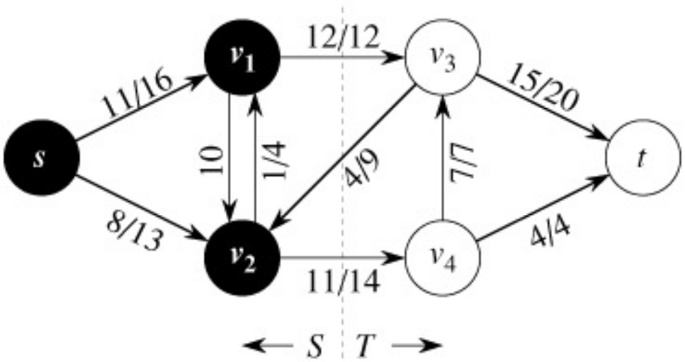
The Net Flow Through a Cut(S,T)
The value of any flow f in a flow network G is bounded from above by the capacity of any cut of G.
S
T
f(S,T) = 12 – 4 + 11 = 19

Slide 19
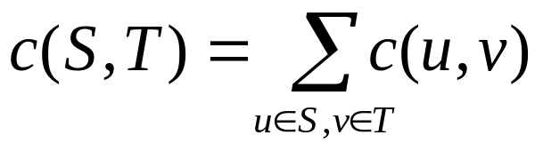
The Capacity of Cut(S,T)
c(S,T)= 12+ 14 = 26
CSC373 Algorithm Design and Analysis Announcements

Slide 20
Maxflow-Mincut Theorem
Max-flow min-cut theorem:
  If f is the flow in G, the following conditions are equivalent:
    1. f is a maximum flow in G
    2. The residual network G_{f} contains no augmenting paths
    3. |f| = c(S,T) for some cut (S,T) of G

Slide 21
Methods
Max-Flow Min-Cut Theorem
  The Ford-Fulkerson Method
  Preflow-Push Method

Slide 22
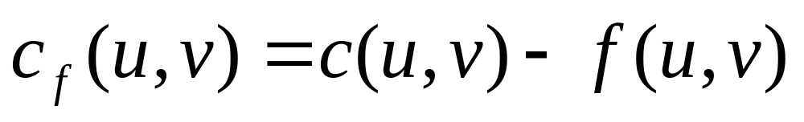
The Ford-Fulkerson Method
Try to improve the flow, until we reach the maximum.
The residual capacity of the network with a flow f is given by:
Always nonnegative (why?)

Slide 23
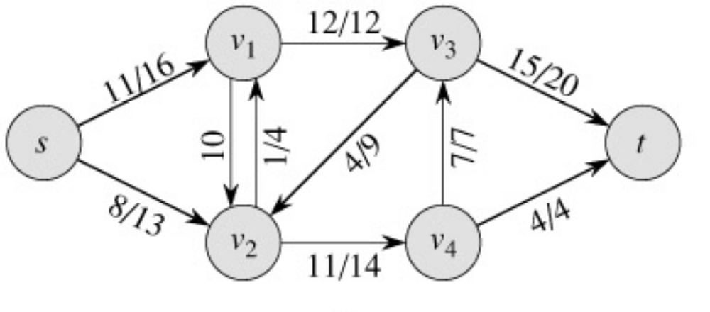
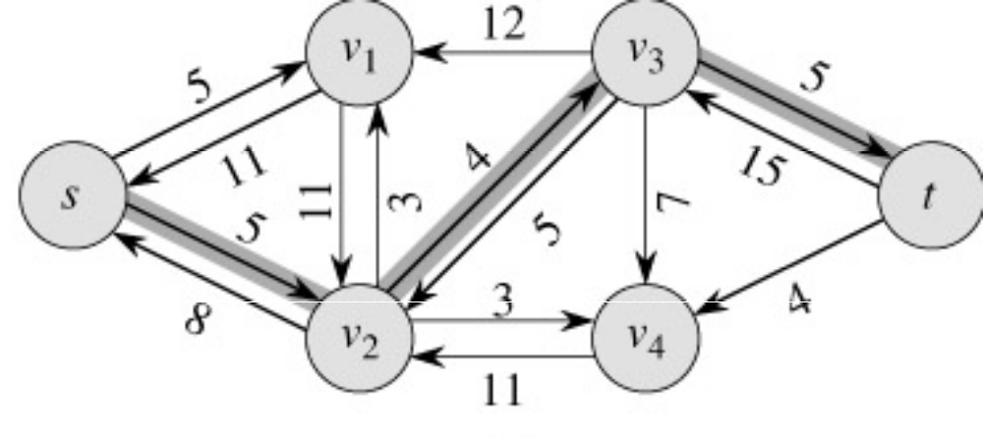
Example of residual capacities
Network:
Residual Network:
Augmenting path

Slide 24
The residual network
The edges of the residual network are the edges on which the residual capacity is positive.

Slide 25
Why do we need residual networks?
Residual networks allow us to reverse flows if necessary.
If we have taken a bad path then residual networks allow one to detect the condition and reverse the flow.
A bad path is one which overlaps with too many other paths.

Slide 26
Example
a
Source
1
1
Destination
1
1
1
b
Paths source, a, destinations and source, b destination gives a flow of 2 units.
Path source, a, b, destination overlaps with both the optimal paths.
If we initially choose source, a, b, destination as our path, then no greedy strategy will be able to augment the network flow any further (unless we use residual edges which allows recovery)
Verify how we recover in spite of the initial bad choice, if we use the residual network to augment flows.

Slide 27
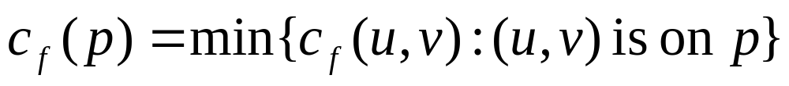
Augmenting Paths
An augmenting path p is a simple path from s to t on the residual network.
We can put more flow from s to t through p.
We call the maximum capacity by which we can increase the flow on p the residual capacity of p.

Slide 28
Augmenting Paths - example
The residual capacity of p = 4.
Can improve the flow along p by 4.

Slide 29
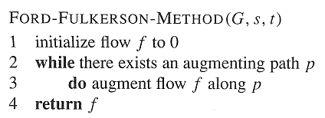
Ford-Fulkerson Method

Slide 30
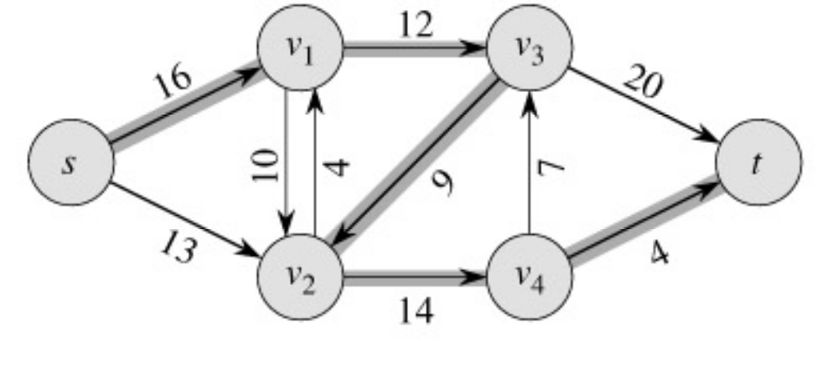
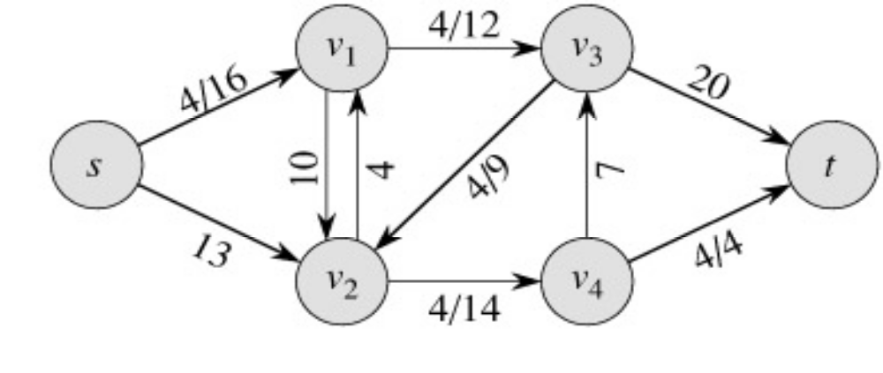
Example
augmenting path
Original Network
Resulting Flow =4
CSC373 Algorithm Design and Analysis Announcements

Slide 31
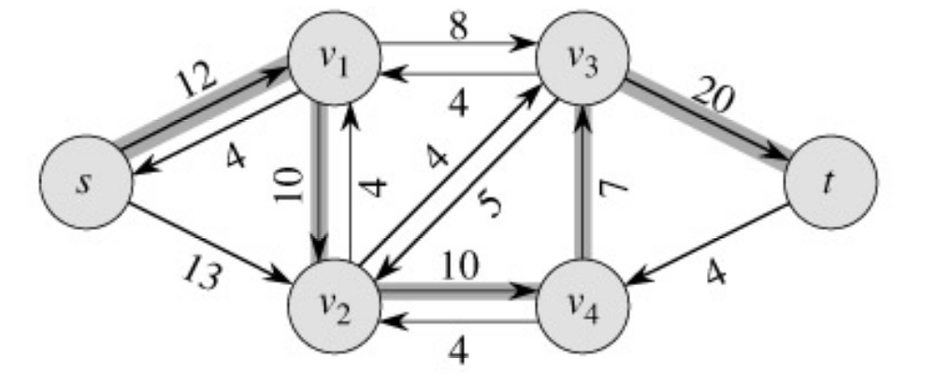
Example
Resulting
Flow = 4
augmenting path
Residual Network

Slide 32
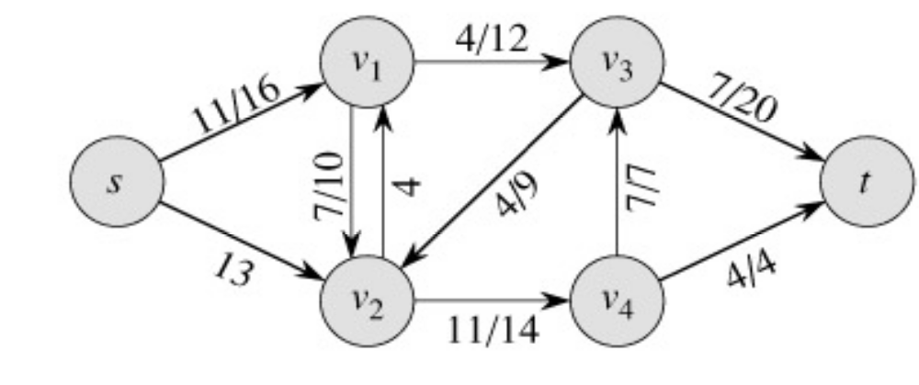
Example
Residual Network
Resulting Flow =11

Slide 33
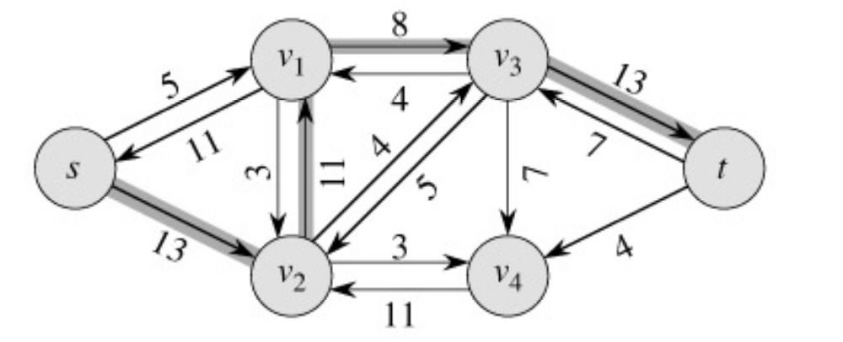
Example
Resulting
Flow =11
augmenting path
Residual Network

Slide 34
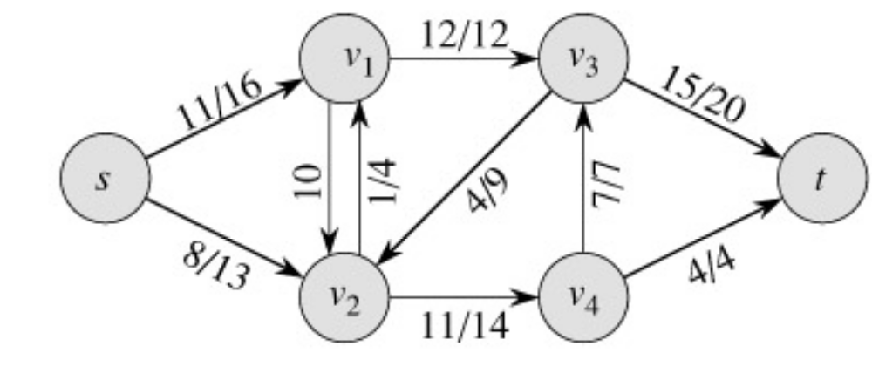
Example
Residual Network
Resulting
Flow =19

Slide 35
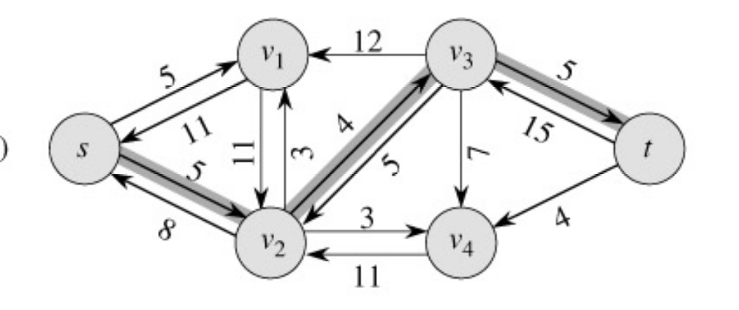
Example
Resulting
Flow = 19
augmenting path
Residual Network

Slide 36
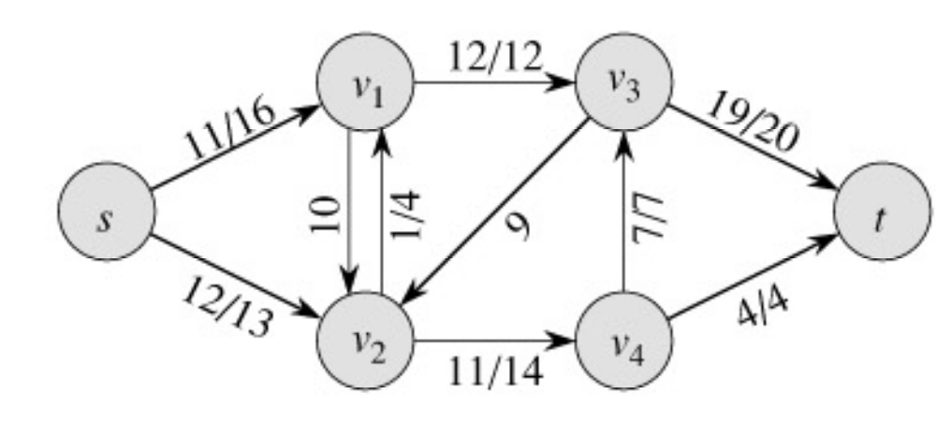
Example
Residual Network
Resulting
Flow = 23

Slide 37
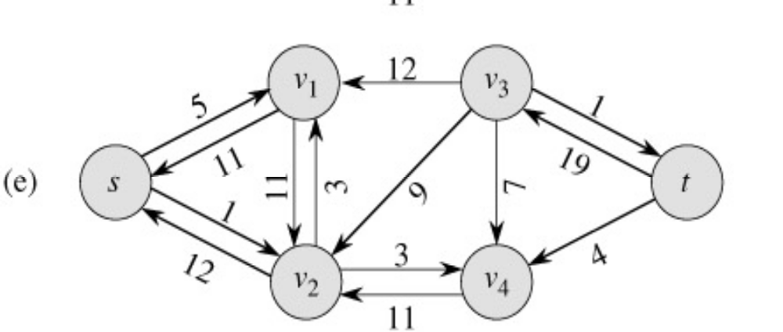
Example
Resulting
Flow = 23
No augmenting path:
Maxflow=23
Residual Network
  The residual network Gf contains no
  augmented paths. So f is a maximum
  flow in G.

Slide 38
Ford-Fulkerson method, with details
Ford-Fulkerson(G,s,t)
1 for each edge (u,v)∈G.E do
2 f(u,v) = f(v,u) = 0
3 while ∃ path p from s to t in residual network G_{f} do
4 c_{f} = min{c_{f}(u,v): (u,v)∈p}
5 for each edge (u,v) in p do
6 f(u,v) = f(u,v) + c_{f}
7 f(v,u) = -f(u,v)
8 return f
The algorithms based on this method differ in how they choose p in step 3.

Slide 39
Time Analysis I
A complete analysis establishing which specific method is best is a complex task, however, because their running times depend on
  The number of augmenting paths needed to find a maxflow
  The time needed to find each augmenting path

Slide 40
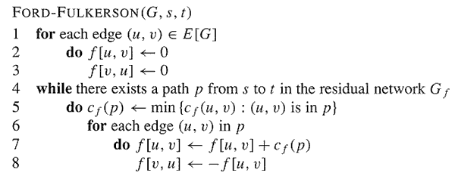
Analysis
O(E)
O(E)

Slide 41
Analysis
If capacities are all integer, then each augmenting path raises |f| by ≥ 1.
If max flow is f*, then need ≤ |f*| iterations
  So time is O(E|f*|).
Note that this running time is not polynomial in input size. It depends on |f*|, which is not a function of |V| or |E|.
If capacities are rational, can scale them to integers.
If irrational, FORD-FULKERSON might never terminate!

Slide 42
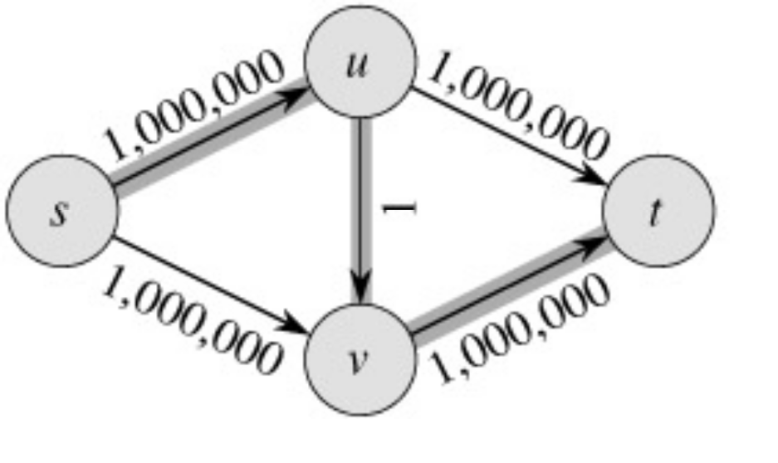
The basic Ford-Fulkerson Algorithm
With time O ( E |f*|), the algorithm is not polynomial.
This problem is real: Ford-Fulkerson may perform very badly if we are unlucky:
|f*|=2,000,000

Slide 43
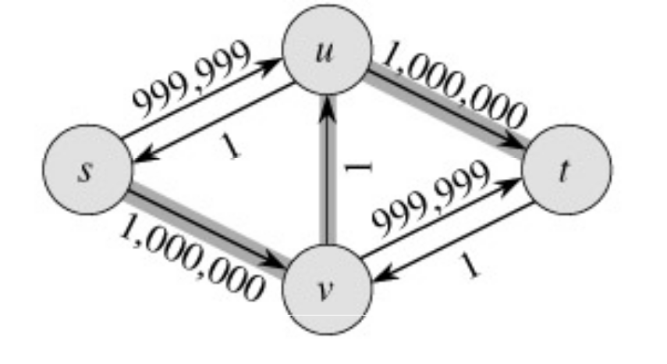
Run Ford-Fulkerson on this example
Augmenting Path
Residual Network

Slide 44
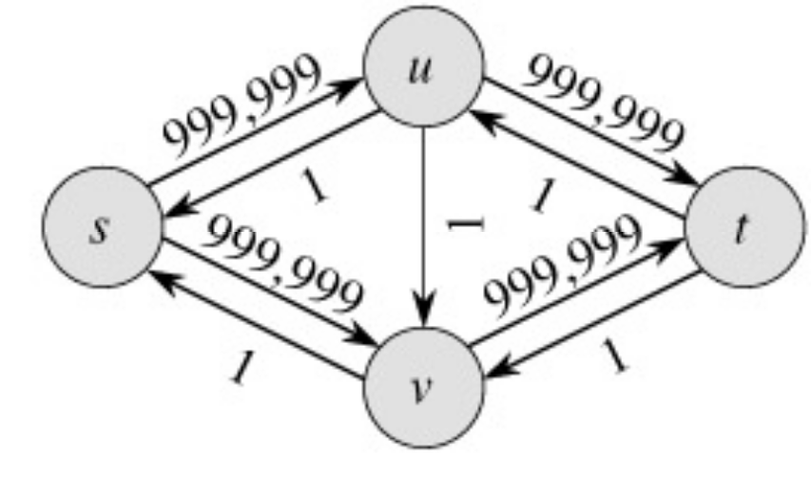
Run Ford-Fulkerson on this example
Augmenting Path
Residual Network

Slide 45

Run Ford-Fulkerson on this example
Repeat 999,999 more times…

Slide 46
The Edmonds-Karp Algorithm
A small fix to the Ford-Fulkerson algorithm makes it work in polynomial time.
Specify how to compute the path in line 4.

Slide 47
The Edmonds-Karp Algorithm
Compute the path in line 4 using breadth-first search on residual network.
The augmenting path p is the shortest path from s to t in the residual network (treating all edge weights as 1).
Runs in time O(V E²).

Slide 48
The Edmonds-Karp Algorithm - example
Edmonds-Karp’s algorithm runs only 2 iterations on this graph.

Slide 49
Time Complexity
Let, total number of flow augmentations performed by Edmonds-Karp algorithm is O(VE)
BFS to find the augmented path – O(E)
So, Total running time is O(VE²)

Slide 50
Thm: Total number of flow augmentations is O(VE)
Proof:
  Critical the first time: (u,v) on an augmenting path
  c_{f}(p)=c_{f}(u,v)
  At least 1 edge in an augmented path must be critical
  δ_{f}(s,v)= δ_{f} (s,u)+1
  Disappears from the residual network
  Reappears on the network: (v,u) has to be on an augmenting path
  Let f´ is the flow in G when this event occurs then
    δ_{f ´} (s,u) = δ_{f ´} (s,v)+1
    But δ_{f} (s,v) ≤ δ_{f ´} (s,v) [by lemma 26.8]
    So, δ_{f ´} (s,u) = δ_{f ´} (s,v)+1 ≥ δ_{f} (s,v) + 1 = δ_{f} (s,u)+2
  So in-between these events the distance from “s” to “u” increased by at least 2.
  Initially, distance from “s” to “u” is at least 0
  Until “u” becomes unreachable from the source (if ever), its distance is at most |V|-2. (reason, “s”, “u”, “t” can’t in between “s” to “u”s shortest path)
  So (u,v) can become critical at most (|V|-2)/2 times.
  There are O(E) pairs of vertices.
  So during entire execution is (|V|)/2-1 x E = O(VE)

Slide 51
Conditions
If f is a flow in a flow network G=(V,E), with source s and sink t, then the following conditions are equivalent:
  f is a maximum flow in G.
  The residual network G_{f} contains no augmented paths.
  |f| = c(S,T) for some cut (S,T) (a min-cut).
It is a flow since there is no augmented paths It is maximum since the sink is not reachable from the source

Slide 52
Push Relabel Algorithm

Slide 53
Defects of Augmenting Path Algorithm
Sending flow along a path requires O(V) complexity.
1
1
1
2
∝
∝
∝
1
1
∝
.
.
.
Since there are n separate paths, we need to push flow through n paths separately.
1
1
Every time complexity is O(V)
n

Slide 54
How about if we push flow through edges separately without caring about flow conversation?
If there is excess flow at a node, then the excess is sent to downstream nodes.
Finally, all excess flow is routed back to the source, so that flow conservation is maintained.
1
1
1
2
∝
∝
∝
∝
1
1
.
.
.
1
1
n

Slide 55
Generic Pre-flow Push Algorithm
Augmenting path algorithms maintain feasibility at every stage, and gradually strive towards optimality
Pre-flow push algorithm initially pushes the maximum possible amount of flow, and strives towards feasibility.
Initially, flow in every edge originating from the source is set to the link capacity.

Slide 56
Set distance label of source node s, d(s)=V
A node (which is not source nor destination), with excess flow is called an active node.
If a node has excess flow, send the flow along an admissible edge (end node of an admissible edge has less distance than the source node of the edge, and hence is closer to the destination).
Let the excess flow at a node u be e(u).
Let the capacity of admissible edge (u, v) in residual graph be r_{uv}
Then flow routed along (u, v) is min(e(u), r_{uv} )

Slide 57
If a node u with excess flow does not have an admissible edge in the residual network, then it is relabelled: d(u) is upgraded to d(v) + 1, where v is the node with minimum distance label amongst all nodes which have edges from u in the residual network.
The algorithm terminates when there are no active nodes.

Slide 58
Intuition
Edges are like water pipes
Nodes are joints
Distance is like height from the ground.
Destination is at the ground.
Initially source is at the heighest level and sends water to all adjacent nodes.
Whenever a node has accumulated water, it sends water to nodes at lower label.
So water moves towards the destination.

Slide 59
Sometimes water gets locally trapped as all neighboring nodes are at a greater height (no admissible arc).
Then, the node label is raised (relabelling).

Slide 60
Preflow push
Algorithm maintains preflow: some flow out of s which doesn’t reach t
Vertices have height
Flow is pushed to lower vertex
Vertices sometimes are lifted

Slide 61
Preflow
Function f: V * V → R
  Skew symmetry: f(u,v) = - f(v,u)
  Capacity constraints: f(u,v) ≤ c(u,v)
  Notation: f(V,u)
  For all u, except s: f(V,u) ≥ 0 (excess flow)
  u is overflowing when f(V,u) > 0.
  Maintain: e(u) = f(V,u).

Slide 62
Height function
h: V → N:
  h(s) = n
  h(t) = 0
  For all (u,v) in E_{f} (residual network):
  h(u) ≤ h(v)+1

Slide 63
Initialize
Set height function h
  h(s) = n
  h(t) = 0
  h(v) = 0 for all v except s
For each edge (s,u)
  f(s,u) = c(s,u); f(u,s) = - c(s,u)
  e[u] = c(s,u);
Do not change
Initial preflow

Slide 64
Basic operation 1: Push
Suppose e(u)>0, c_{f}(u,v)>0, and
h[u]= h[v]+1
Push as much flow across (u,v) as possible
  r = min (e[u], c_{f}(u,v))
  f(u,v) = f(u,v) + r;
  f(v,u) = - f(u,v);
  e[u] = e[u] - r;
  e[v] = e[v] + r.

Slide 65
Basic operation 2: Lift
When no push can be done from overflowing vertex (except s,t)
Suppose e[u]>0, and for all (u,v) in E_{f} : h[u] ≤ h[v], u ≠ s, u ≠ t
Set h[u] = 1 + min {h[v] | (u,v) in E_{f}}

Slide 66
Preflow push algorithm
Initialize
While push or lift operation possible do
  Select an applicable push or lift operation and perform it
To do: correctness proof and time analysis

Slide 67
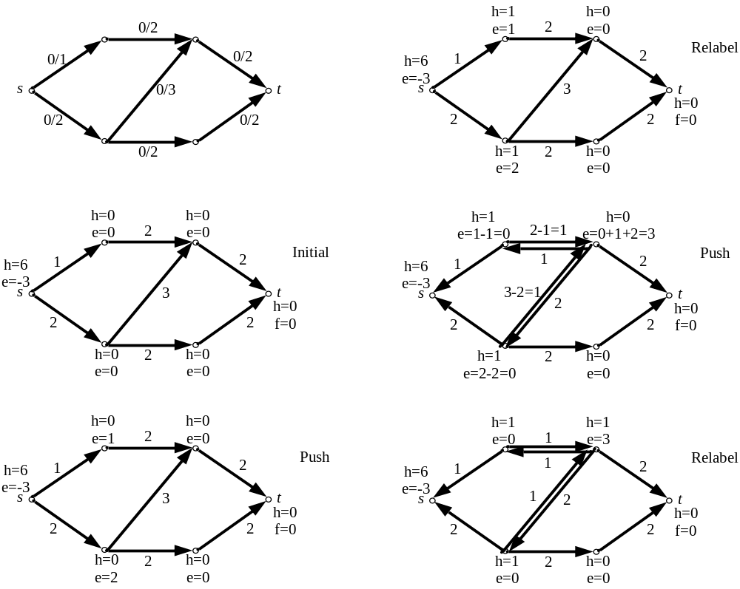
Push-Relabel Algorithm Example

Slide 68
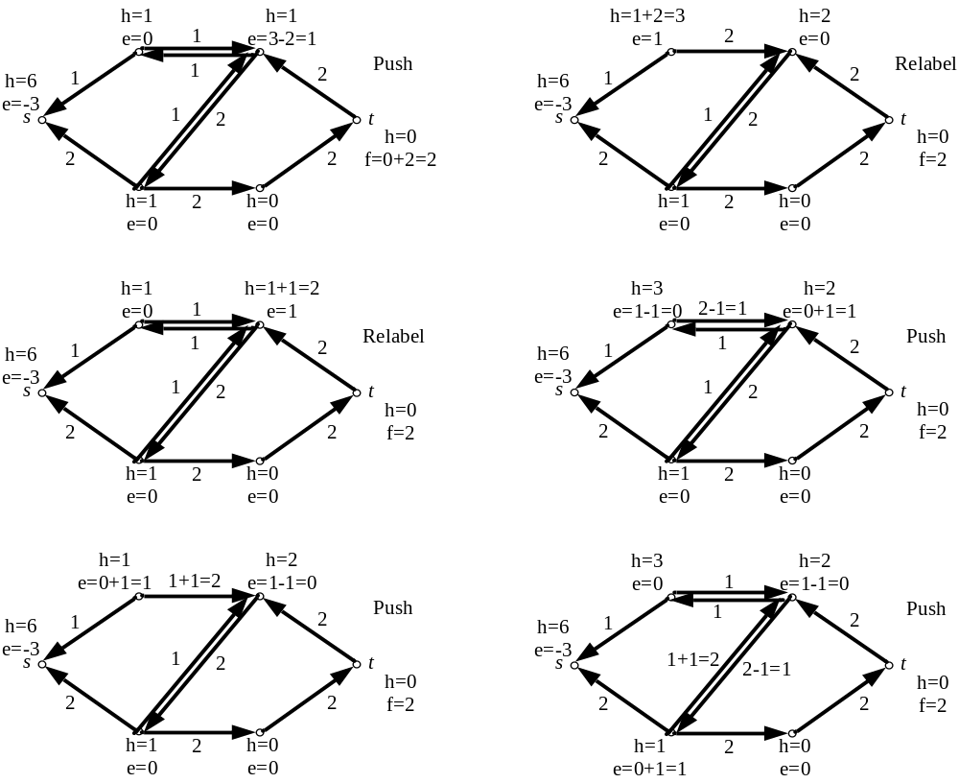
Push-Relabel Algorithm Example

Slide 69
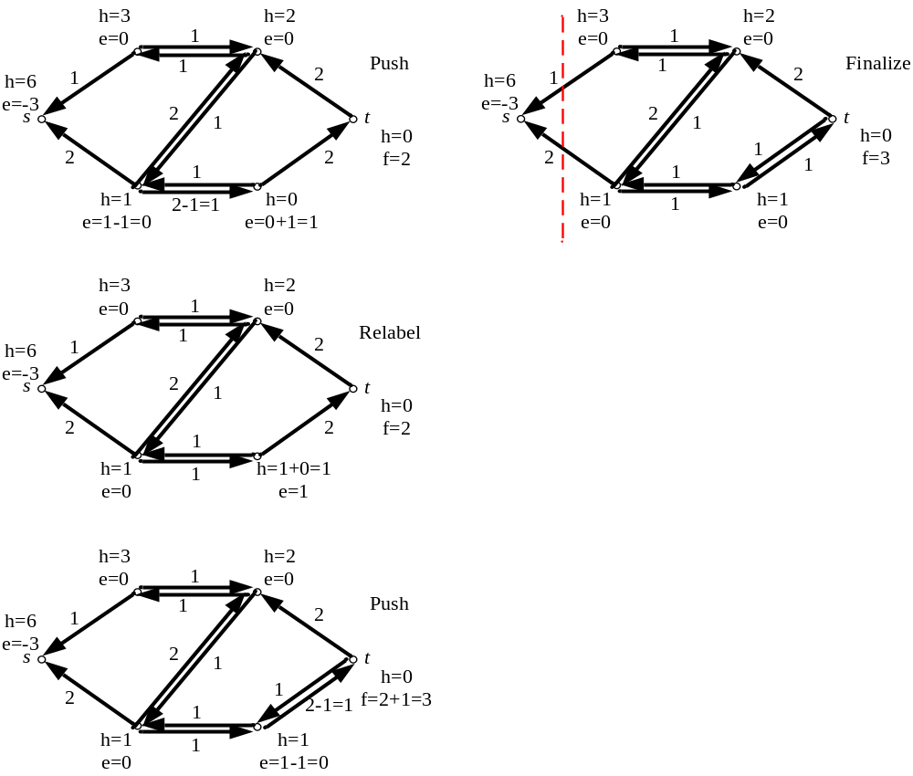
Push-Relabel Algorithm Example

Slide 70
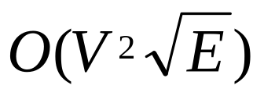
Push-Relabel Algorithm Analysis
The algorithm complexity is bounded to O(V²E)
Improved algorithms using highest-level selection rule and FIFO-rule (queue based selection rule) can reduce the complexity to
Optimizing the program by using bucket data structure based on any of the improved algorithms can yield O(VE)

Slide 71
Lemmas / Invariants
Lemma 26.13 –
Lemma 26.14 – After a nonsaturated push from u to v, the vertex u is no longer overflowing.
Lemma 26.15 - If there is an overflowing vertex (except t), then a lift or push operation is possible
Lemma 26.16 - The height of a vertex never decreases
When a lift operation is done, the height increases by at least one.
h remains a height function during the algorithm

