Slide 1
CSE301 –
Advanced Algorithm Design & Analysis
Topic - Matching
Notes:
ok

Slide 2
Today
Bipartite Matching
  Using Maximum Flow
  Without using maximum flow
Notes:
ok

Slide 3
Matchings
Matching: A set of edges with no shared end-points.
unsaturated vertex
All other vertices are saturated
Notes:
ok

Slide 4
Perfect Matching
A matching is perfect if all vertices are saturated
Notes:
ok

Slide 5
Bipartite Matching Problems
Underlying graph is bipartite
Of special interest
An edge between x and y means that student x doesn’t have a problem with sitting at y
Set of students
Set of desks
Notes:
ok

Slide 6
Maximum vs. Maximal Matching
A matching is maximal if it can not be enlarged by adding an edge
A maximum matching is a matching of maximum size (among all matchings in the graph)
Notes:
ok

Slide 7
Maximal Matching Algorithm
Can you come up with one?
  Easy but not very interesting
  Usually we are more interested in maximum matchings
    (sit as many students as possible)
Notes:
ok

Slide 8
Finding a Maximum
Matching
Using a Network Flow algorithm

Slide 9
Ford - Fulkerson Algorithm – 1
sink
Constructing a flow network out of a bipartite graph.
Each edge has capacity of 1.
1
2
3
4
5
6
a
b
c
d
e
f
source

Slide 10
Ford - Fulkerson Algorithm – 2
sink
Increasing the flow by 1.
1
2
3
4
5
6
a
b
c
d
e
f
source

Slide 11
Ford - Fulkerson Algorithm – 3
sink
Increasing the flow by 1.
1
2
3
4
5
6
a
b
c
d
e
f
source

Slide 12
Ford - Fulkerson Algorithm – 4
sink
Increasing the flow by 1.
1
2
3
4
5
6
a
b
c
d
e
f
source

Slide 13
Ford - Fulkerson Algorithm – 5
sink
Increasing the flow by 1.
1
2
3
4
5
6
a
b
c
d
e
f
source

Slide 14
Ford - Fulkerson Algorithm – 6
sink
Increasing the flow by 1.
1
2
3
4
5
6
a
b
c
d
e
f
source

Slide 15
Ford - Fulkerson Algorithm – 7
sink
Augmenting flow along the augmenting path.
1
2
3
4
5
6
a
b
c
d
e
f
source

Slide 16
Ford - Fulkerson Algorithm – 8
sink
Maximum flow found!
Thus maximum matching
found.
1
2
3
4
5
6
a
b
c
d
e
f
source

Slide 17
Finding a Maximum
Matching
By using an alternating tree

Slide 18
Maximum Matchings
To understand maximum matchings, we’ll use “alternating path” concept
Notes:
ok

Slide 19
Matched Vertex and Unmatched Vertex
Let M be a matching in a graph G=(V,E)
Matched Vertex:
  A vertex v is a matched vertex (with respect to the matching M) if v is an endpoint of an edge in M
Unmatched Vertex:
  A vertex v is a unmatched vertex (with respect to the matching M) if v is not an endpoint of an edge in M
Matching Edge:
  If e∈ M
Untamed Edge:
  If e ∉ M
Notes:
ok

Slide 20
Alternating Paths
Let M be a matching of G = (V,E).
  M-alternating path is a simple path that alternates between edges in M and edges not in M.
  an alternating path is an augmenting path if its end points are free
  Augmented path’s length is always odd.
If G contains an augmenting path P (with respect to M), then we can obtain a larger matching by removing from M the matching edges in P and adding to M the non-matching edges.
Notes:
ok

Slide 21
Alternating Path
Alternating between matching and non-matching edges.
a
b
c
d
e
f
g
h
i
j
i-d-h-e: alternating path
a-f-b-h-d-i: alternating path starts and ends with free vertices
f-b-h-e: not alternating path
e-j: alternating path starts and ends with free vertices
Notes:
ok

Slide 22
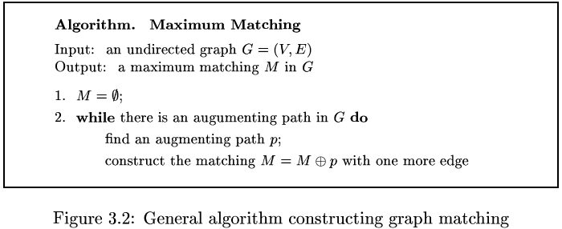
An algorithm to compute a maximum matching
But how can we find an M-augmenting path efficiently? How do we know when there is none?
We need to learn more about properties of matchings. We will focus on bipartite graphs.
Notes:
ok

Slide 23
Bipartite graph matching
The bipartiteness of a graph can be tested using a standard graph search algorithm (by coloring)
Bipartite graph does not contain any cycle of odd length.

Slide 24
Augmenting path for Bipartite graph
Start from each unmatched vertex v₀.
Try to find out whether an augmenting path starts from the vertex v₀.
Use BFS from the vertex v₀.
Two types of vertices depending upon their distance to the vertex v₀ in the search tree.
  Odd level vertex w.
    Tries to extend the augmenting path by adding a matching edge. (if w is matched). In this case, it only record the one that matches w in M and ignores the others.
    Or, concludes with an augmented path. (if w is unmatched)
  Even level vertex v –
    tries to extend the augmenting path by adding an untamed edge.
    Try to use all unvisited neighbors of the current vertex using BFS.

Slide 25
Data structures for the algorithm
Lev(v) – distance from the starting node
dad(v) – parent of the node v
If lev(v) is odd, then edge[dad(v),v] is an untamed edge
If lev(v) is even, then v is the unique child of its father dad(v) and edge [dad(v),v] is a matched edge.

Slide 26
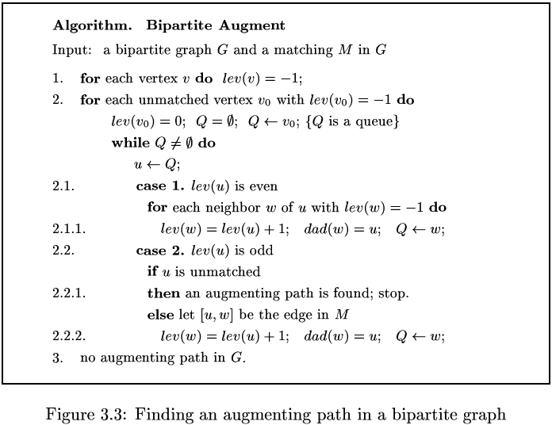
Maximum Bipartite Matching

Slide 27
Maximum matching
Beginning with matching M.
x0 = 2 unmatched in M,
set S = {2} and T = {∅}
X
1
2
3
4
5
6
7
Y
a
b
c
d
e
f
g
H
2

Slide 28
Maximum matching
N(S) = {b, c}, with N(S) ≠ T
chose b which is in N(S) but not in T.
4) y = b is matched. S = {1,2}, T = {b}.
X
1
2
3
4
5
6
7
Y
a
b
c
d
e
f
g
1
b
H
2

Slide 29
Maximum matching
N(S) = {b, c}, with N(S) ≠ T
chose y = c which is in N(S) but not in T.
4) S = {1, 2, 3} and T ={b,c}
X
1
2
3
4
5
6
7
Y
a
b
c
d
e
f
g
1
3
b
c
H
2

Slide 30
Maximum matching
N(S) = {a,b,c,d,e,f}, y = a which is in N(S) but not in T.
X
1
2
3
4
5
6
7
Y
a
b
c
d
e
f
g
a
1
3
b
c
H
2

Slide 31
Maximum matching
4) Augment path P from 2 to a
X
1
2
3
4
5
6
7
Y
a
b
c
d
e
f
g
a
1
3
b
c
H
2

Slide 32
Maximum matching
x0 = 4 is unmatched in M.
Set S = {4} and T = ∅.
X
1
2
3
4
5
6
7
Y
a
b
c
d
e
f
g
H
4

Slide 33
Maximum matching
N(S) = {b,c,d,g} ≠ T,
y = b which is in N(S) but not in T.
4) S = {1,4} and T = {b}
X
1
2
3
4
5
6
7
Y
a
b
c
d
e
f
g
1
b
H
4

Slide 34
Maximum matching
N(S) = {b,c,d,g} ≠ T,
y = c which is in N(S) but not in T.
4) S = {1,2,4} and T = {b,c}
X
1
2
3
4
5
6
7
Y
a
b
c
d
e
f
g
1
2
b
c
H
4

Slide 35
Maximum matching
N(S) = {b,c,d,g} ≠ T,
y = d which is in N(S) but not in T.
S = {1,2,4,5} and
T = {b,c,d}
X
1
2
3
4
5
6
7
Y
a
b
c
d
e
f
g
1
2
5
b
c
d
H
4

Slide 36
Maximum matching
N(S) = {b,c,d,g} ≠ T,
y = d which is in N(S) but not in T.
S = {1,2,4,5,6} and
T = {b,c,d,g}
X
1
2
3
4
5
6
7
Y
a
b
c
d
e
f
g
1
2
5
6
b
c
d
g
H
4

Slide 37
Maximum matching
N(S) = {b,c,d,f,g} ≠ T,
y = f which is in N(S) but not in T.
X
1
2
3
4
5
6
7
Y
a
b
c
d
e
f
g
f
1
2
5
6
b
c
d
g
H
4

Slide 38
Maximum matching
4) f unmatched: augment along path P from 4 to 2.
X
1
2
3
4
5
6
7
Y
a
b
c
d
e
f
g
f
1
2
5
6
b
c
d
g
H
4

Slide 39
Maximum matching
2) Vertex 7 is unmatched. Set S = {7} and T = ∅.
X
1
2
3
4
5
6
7
Y
a
b
c
d
e
f
g
H
7

Slide 40
Maximum matching
N(S) = {b,c} ≠ T.
y = b which is in N(S) but not in T.
b is matched.
S = {1,7} and T = {b}
X
1
2
3
4
5
6
7
Y
a
b
c
d
e
f
g
1
b
H
7

Slide 41
Maximum matching
N(S) = {b,c} ≠ T.
y = c which is in N(S) but not in T.
S = {1,2,7} and T = {b,c}
X
1
2
3
4
5
6
7
Y
a
b
c
d
e
f
g
1
2
b
c
H
7

Slide 42
Maximum matching
N(S) = {b,c} = T. algorithm stops because |N(S)| < |S|
with Hall‘s marriage theorem there is no matching in G with which every vertex in X is matched.
X
1
2
3
4
5
6
7
Y
a
b
c
d
e
f
g
1
2
b
c
H
7

Slide 43
Time Complexity of bipartite matching
O(nm)

Slide 44
General Graph Matching
All known algorithms for GRAPH MATCHING problem on general graphs are based on Theorem 3.1.1 and the algorithm Maximum-Matching.

Slide 45
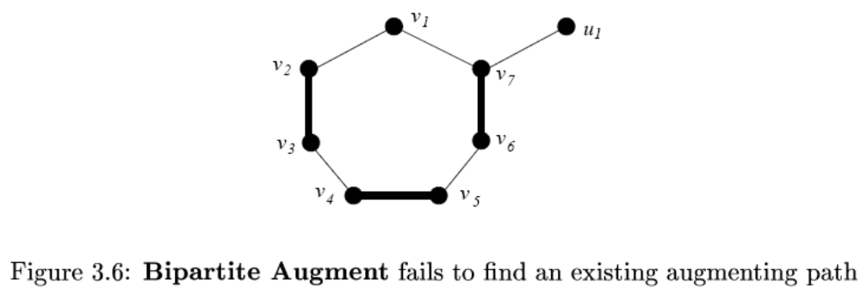
Bipartite Augmentation is not Suitable
Let, v₁ be the starting point. Then v₁ be the root of T(v₁).
v₂ and v₇ are the level 1 vertices.
v₃ and v₆ are the unique children which are in level 2.
v₄ and v₅ are the level 3 vertices
The process gets stuck
T(u₁) contains a single vertex u₁ since only neighbor v₇ of u₁ has been visited.
But there exists an augmenting path {v₁, v₂, v₃, v₄, v₅, v₆, v₇, u₁}
The main problem is odd length cycle which does not exist in a bipartite graph.

