Slide 1
CSE 301
Combinatorial Optimization
Fibonacci Heap

Slide 2
Fibonacci Heap
Heaps
Operation
Linked List
Binary
Binomial
Fibonacci †
Relaxed
make-heap
1
1
1
1
1
insert
1
log N
log N
1
1
find-min
N
1
log N
1
1
delete-min
N
log N
log N
log N
log N
union
1
N
log N
1
1
decrease-key
1
log N
log N
1
1
delete
N
log N
log N
log N
log N
is-empty
1
1
1
1
1
this time
† amortized

Slide 3
Unordered Binomial Heap
Unordered Binomial Trees: similar to a Binomial Tree.
  The Unordered Binomial Tree U₀ consists of a single node.
  An Unordered Binomial Tree U_{k} consists of two Unordered Binomial Trees U_{k-1} for which the root of one is made into any child of the root of the other.
  Lemma 19.1 holds, with 4 replaced by 4’ For the Unordered Binomial Tree U_{k}, the root has degree k, which is greater than that of any other node. The children of the root are roots of subtrees U₀, U₁, …, U_{k-1}, in some order.

Slide 4
Fibonacci Heap
Fibonacci Heap: a collection of min-heap-ordered trees (not constrained to be binomial trees).
Each node x, besides containing
  a parent pointer p[x], contains a pointer,
  child[x], that points to one of its children, linked as a doubly linked list, with left and right pointers.
  degree[x] contains the number of children in the child list of x.
  mark[x] indicates whether x has lost a child since the last time x was made a child of another node. Start unmarked. False for now.

Slide 5
Fibonacci heap: detailed figure
7
2
19
11
13
45
8
24
15
36
21
83
52
79
Notes:
Zeiger, die auf NULL zeigen, sind nicht dargestellt!

Slide 6
Fibonacci heap: simplified figure
7
2
19
11
13
45
8
24
15
36
21
83
52
79
Notes:
Bäume werden wie gewohnt dargestellt. Zeiger zu Geschwisterknoten werden nur in der Wurzelliste gezeigt.

Slide 7

Fibonacci Heap
There is a pointer min[H] which points to the root of the tree containing the minimum key (the minimum node). This is the pointer through which you access the heap H.
The number of nodes in H is kept in n[H].
Since we are going to use Amortized Analysis, we need to decide on the method. The Potential Method is chosen, with function:
Where t(H) is the number of trees in the root list of H, and m(H) is the number of marked nodes in H.

Slide 8
Fibonacci Heaps: Potential Function
Key quantities.
  Degree[x] = degree of node x.
  Mark[x] = mark of node x (black or gray).
  t(H) = # trees.
  m(H) = # marked nodes.
  Φ(H) = t(H) + 2m(H) = potential function.
t(H) = 5, m(H) = 3
Φ(H) = 11
degree = 3
min
17
24
23
7
3
30
26
46
18
52
41
35
44
H
39
Notes:
nodes only change mark in Decrease-Key Can basically ignore marks until then.

Slide 9
Fibonacci Heap: Potential Function
The potential of a set of Fibonacci Heaps is the sum of the individual potentials: a unit of potential can pay for any single constant cost operation.
Begin an application with NO Fibonacci Heaps, so the initial potential is 0. After that, the potential is always nonnegative. Recall the relationship between amortized cost and actual cost:
We get an upper bound on the actual cost for a sequence of n operations.

Slide 10

Fibonacci Heap: MakeHeap
Make-Fib-Heap:
Allocates and returns a Fibonacci Heap Object H.
n[H] = 0.
min[H] = NIL.
there are no trees in H, so t(H) = 0, m(H) = 0.
Amortized cost of Make-Fib-Heap: O(1).

Slide 11
Fibonacci Heaps: Insert
Insert.
  Create a new singleton tree.
  Add to left of min pointer.
  Update min pointer.
Insert 21
21
min
17
24
23
7
3
30
26
46
18
52
41
35
44
H
39

Slide 12
Fibonacci Heaps: Insert
Insert.
  Create a new singleton tree.
  Add to left of min pointer.
  Update min pointer.
Insert 21
min
17
24
23
7
21
3
30
26
46
18
52
41
35
44
H
39

Slide 13
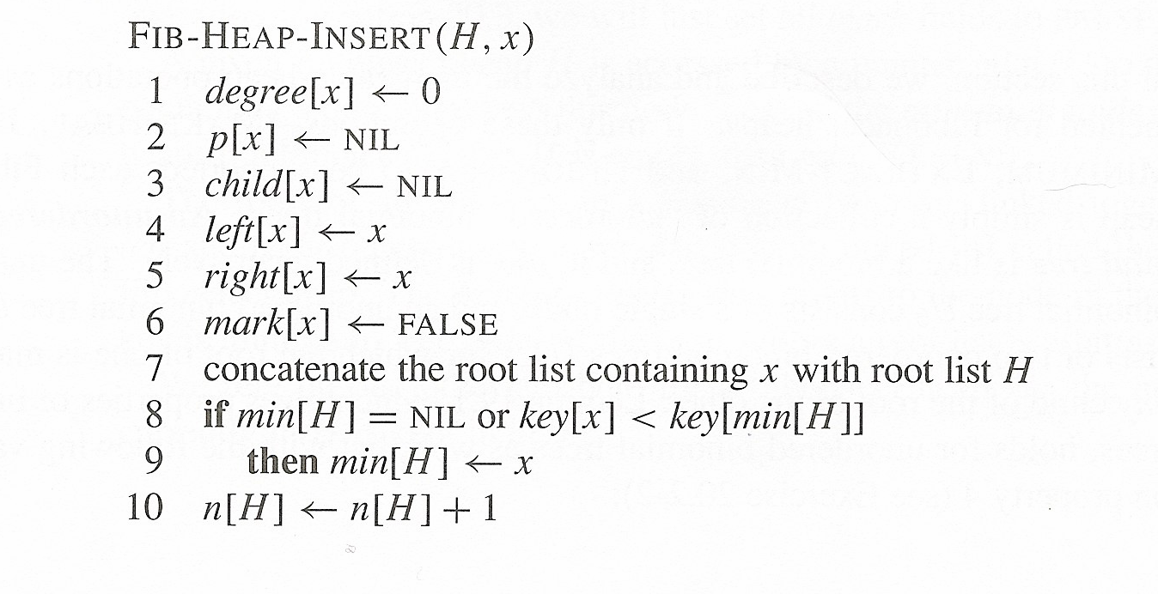
Fibonacci Heap: Insert

Slide 14
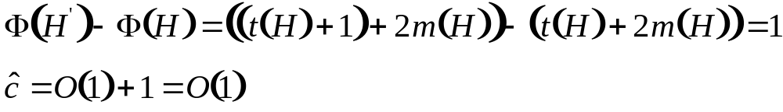
Fibonacci Heap: Insert
Fib-Heap-Insert(H, x):
Actual Cost:
  node H allocated, key[x] filled.
  Lines 1-7 cost O(1), and x is thus a single-node min-heap-ordered-tree (an unordered binomial tree) in the Fibonacci heap.
  The remaining lines are also O(1) - which is then the actual cost.
Amortized Cost:
  To obtain the amortized cost we must compute the change in potential.
  If we denote the new heap by H’, we have
    t(H’) = t(H) + 1,
    m(H’) = m(H). The change in potential is:

Slide 15
Fibonacci Heap: FindMinimum
FindMinimum(H):
Just follow the pointer in the H structure.
Cost:
  Actual Cost:O(1)
  Amortized Cost: O(1)
    the potential does not change since the heap does not change.

Slide 16
Fibonacci Heaps: Union
Union.
  Concatenate two Fibonacci heaps.
  Root lists are circular, doubly linked lists.
min
min
23
24
17
7
3
21
H'
H''
30
26
46
18
52
41
35
44
39

Slide 17
Fibonacci Heaps: Union
Union.
  Concatenate two Fibonacci heaps.
  Root lists are circular, doubly linked lists.
min
23
24
17
7
3
21
H'
H''
30
26
46
18
52
41
35
44
39

Slide 18
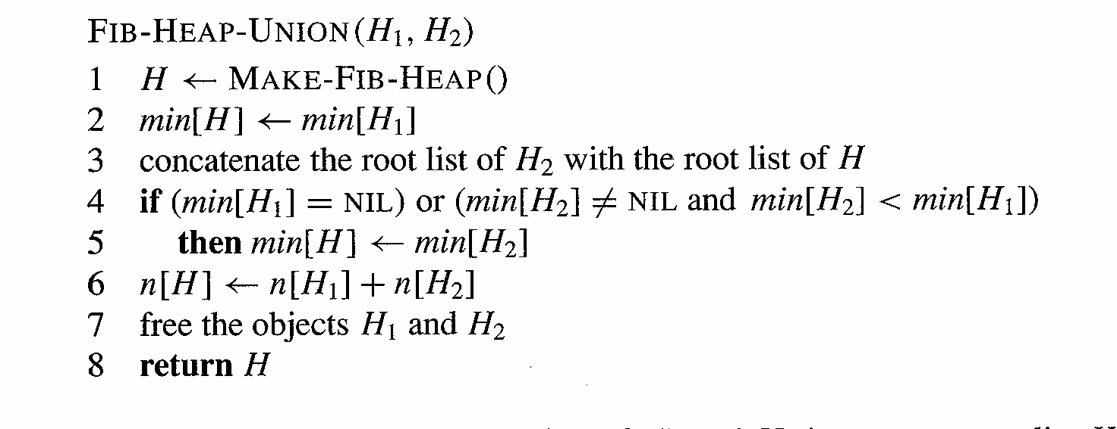
Fibonacci Heap: Union

Slide 19
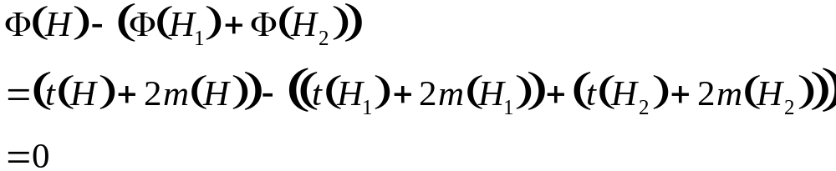
Fibonacci Heap: Union
Fib-Heap-Union:
The actual cost is clearly O(1), since the number of assignments, allocations, etc., is constant.
The change in potential is given by:
So that the amortized cost is also O(1).

Slide 20
Fibonacci Heaps: Extract Min
Delete min.
  Delete min and concatenate its children into root list.
  Consolidate trees so that no two roots have same degree.
min
7
24
23
17
3
30
26
46
18
52
41
35
39
44

Slide 21
Fibonacci Heaps: Extract Min
Delete min.
  Delete min and concatenate its children into root list.
  Consolidate trees so that no two roots have same degree.
current
min
7
24
23
17
18
52
41
30
26
46
39
44
35

Slide 22
Fibonacci Heaps: Extract Min
Delete min.
  Delete min and concatenate its children into root list.
  Consolidate trees so that no two roots have same degree.
0
1
2
3
current
min
7
24
23
17
18
52
41
30
26
46
39
44
35

Slide 23
Fibonacci Heaps: Extract Min
Delete min.
  Delete min and concatenate its children into root list.
  Consolidate trees so that no two roots have same degree.
0
1
2
3
current
min
7
24
23
17
18
52
41
30
26
46
39
44
35

Slide 24
Fibonacci Heaps: Extract Min
Delete min.
  Delete min and concatenate its children into root list.
  Consolidate trees so that no two roots have same degree.
0
1
2
3
min
7
24
23
17
18
52
41
30
26
46
39
44
current
35

Slide 25
Fibonacci Heaps: Extract Min
Delete min.
  Delete min and concatenate its children into root list.
  Consolidate trees so that no two roots have same degree.
0
1
2
3
min
7
24
23
17
18
52
41
30
26
46
39
44
current
35
Merge 17 and 23 trees.

Slide 26
Fibonacci Heaps: Extract Min
Delete min.
  Delete min and concatenate its children into root list.
  Consolidate trees so that no two roots have same degree.
0
1
2
3
current
min
7
24
17
18
52
41
30
26
46
23
39
44
35
Merge 7 and 17 trees.

Slide 27
Fibonacci Heaps: Extract Min
Delete min.
  Delete min and concatenate its children into root list.
  Consolidate trees so that no two roots have same degree.
0
1
2
3
min
current
24
7
18
52
41
26
46
17
30
39
44
35
23
Merge 7 and 24 trees.

Slide 28
Fibonacci Heaps: Extract Min
Delete min.
  Delete min and concatenate its children into root list.
  Consolidate trees so that no two roots have same degree.
0
1
2
3
min
current
7
18
52
41
24
17
30
39
44
26
46
23
35

Slide 29
Fibonacci Heaps: Extract Min
Delete min.
  Delete min and concatenate its children into root list.
  Consolidate trees so that no two roots have same degree.
0
1
2
3
min
current
7
18
52
41
24
17
30
39
44
26
46
23
35

Slide 30
Fibonacci Heaps: Extract Min
Delete min.
  Delete min and concatenate its children into root list.
  Consolidate trees so that no two roots have same degree.
0
1
2
3
min
current
7
18
52
41
24
17
30
39
44
26
46
23
35

Slide 31
Fibonacci Heaps: Extract Min
Delete min.
  Delete min and concatenate its children into root list.
  Consolidate trees so that no two roots have same degree.
0
1
2
3
min
current
7
18
52
41
24
17
30
39
44
26
46
23
Merge 41 and 18 trees.
35

Slide 32
Fibonacci Heaps: Extract Min
Delete min.
  Delete min and concatenate its children into root list.
  Consolidate trees so that no two roots have same degree.
0
1
2
3
min
current
7
52
18
24
17
30
41
39
26
46
23
44
35

Slide 33
Fibonacci Heaps: Extract Min
Delete min.
  Delete min and concatenate its children into root list.
  Consolidate trees so that no two roots have same degree.
0
1
2
3
min
current
7
52
18
24
17
30
41
39
26
46
23
44
35

Slide 34
Fibonacci Heaps: Extract Min
Extract min.
  Delete min and concatenate its children into root list.
  Consolidate trees so that no two roots have same degree.
min
7
52
18
24
17
30
41
39
26
46
23
44
Stop.
35

Slide 35
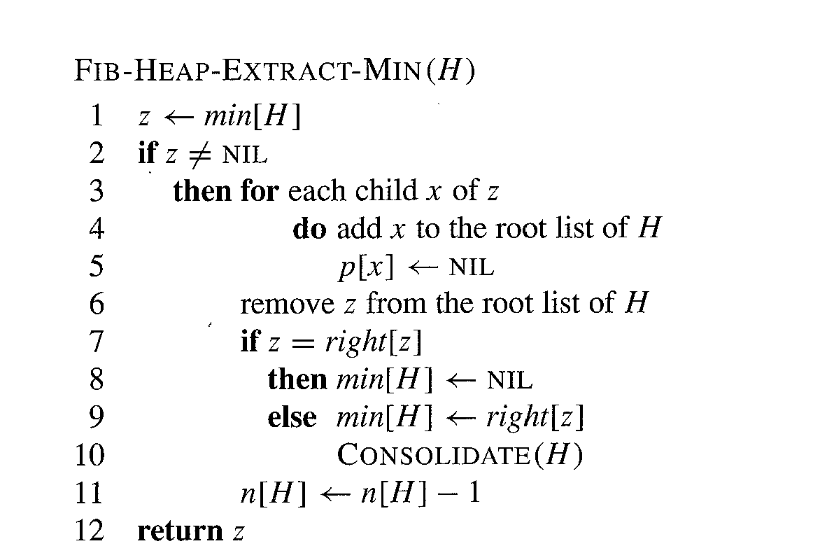
Fibonacci Heap: Extract-Min

Slide 36
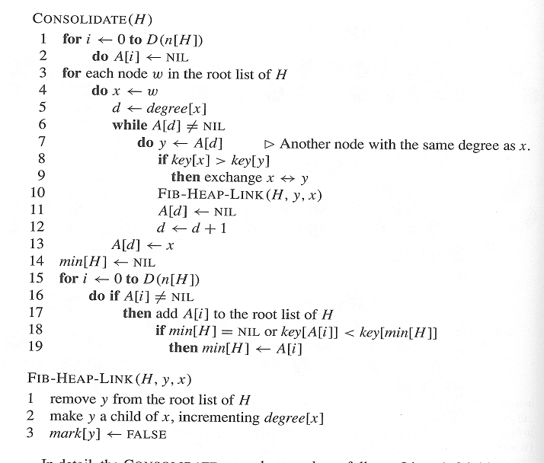
Fibonacci Heap: Consolidate

Slide 37
Fibonacci Heap: Extract Min
D(n):
  denotes the highest possible degree for a node in an n-node Fibonacci Heap H.
Actual cost:
  O(D(n)) for the lines of Fib-Heap-Extract-Min before and after the call to Consolidate.
  O(D(n)) for the lines 1-2 and 14 through 19 of Consolidate.

Slide 38
Fibonacci Heap: Extract Min
The loop from 3 through 13:
Size of root list at call of Consolidate:
  D(n) + t(H) – 1
  = max number of children of node removed + number of nodes on old root list - one removed.
The for loop (L. 3) goes through them only once.
Each time through while loop either a root is inserted into the array, or it is linked to another, possibly repeating the linking with an existing tree. The total number of linkings cannot exceed D(n) + t(H) - 1
For loop, actual work: O(D(n) + t(H))

Slide 39
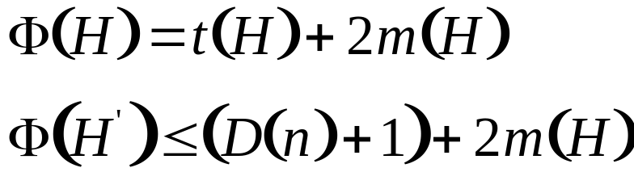
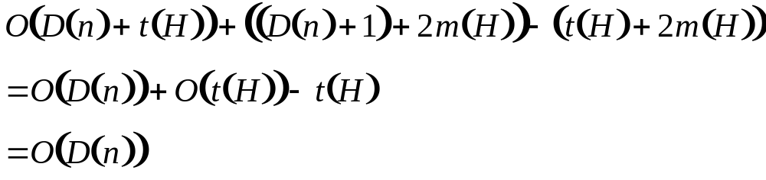
Fibonacci Heap: Extract Min
Amortized work: let H denote the heap before the extraction, with H’ denoting it after it. The Potential Function has values
Since at most D(n) + 1 roots remain, and no nodes become marked during the operation. The amortized cost is thus bounded above by

Slide 40

Fibonacci Heap: Extract Min
The non-obvious part comes from the dropping of the O(t(H)) - t(H) term.
  The O(t(H)) term comes from a count on the maximum size of the root-list. There will be a constant, say c₀, such that the actual cost of the operation will be bounded above by
    c₀(D(n) + t(H)) = c₀D(n) +c₀t(H).
We can rescale the units of potential so that
Making the term O(t(H)) - c₀t(H) disappear exactly.

Slide 41
Fibonacci Heaps: Delete Min Analysis
Is amortized cost of O(D(n)) good?
  Yes, if only Insert, Delete-min, and Union operations supported.
    in this case, Fibonacci heap contains only binomial trees since we only merge trees of equal root degree
    this implies D(n) ≤ ⎣log₂ N⎦
  Yes, if we support Decrease-key in clever way.
    we'll show that D(n) ≤ ⎣log_{φ} N⎦, where φ is golden ratio
    φ² = 1 + φ
    φ = (1 + √5) / 2 = 1.618…
    limiting ratio between successive Fibonacci numbers!

Slide 42

Fibonacci Heap
Up to this moment, no operation altered the Binomial Tree nature of the Fibonacci Heap, and thus all the bounds are correct, as far as we go. We still want to decrease a key and remove a node. These operations will introduce some changes, so the trees will no longer be binomial, but we will show that they are “close enough” to binomial to still satisfy the crucial condition .

Slide 43
Fibonacci Heaps: Decrease Key
Decrease key of element x to k.
  Case 0: min-heap property not violated.
    decrease key of x to k
    change heap min pointer if necessary
min
7
18
38
24
17
23
21
39
41
26
46
45
30
52
Decrease 46 to 45.
35
88
72

Slide 44
Fibonacci Heaps: Decrease Key
Decrease key of element x to k.
  Case 1: parent of x is unmarked.
    decrease key of x to k
    cut off link between x and its parent
    mark parent
    add tree rooted at x to root list, updating heap min pointer
min
7
18
38
24
17
23
21
39
41
26
45
15
30
52
Decrease 45 to 15.
35
88
72

Slide 45
Fibonacci Heaps: Decrease Key
Decrease key of element x to k.
  Case 1: parent of x is unmarked.
    decrease key of x to k
    cut off link between x and its parent
    mark parent
    add tree rooted at x to root list, updating heap min pointer
min
7
18
38
24
24
17
23
21
39
41
26
15
30
52
Decrease 45 to 15.
35
88
72

Slide 46
Fibonacci Heaps: Decrease Key
Decrease key of element x to k.
  Case 1: parent of x is unmarked.
    decrease key of x to k
    cut off link between x and its parent
    mark parent
    add tree rooted at x to root list, updating heap min pointer
min
15
7
18
38
72
24
24
17
23
21
39
41
26
30
52
Decrease 45 to 15.
35
88

Slide 47
Fibonacci Heaps: Decrease Key
Decrease key of element x to k.
  Case 2: parent of x is marked.
    decrease key of x to k
    cut off link between x and its parent p[x], and add x to root list
    cut off link between p[x] and p[p[x]], add p[x] to root list
      If p[p[x]] unmarked, then mark it.
      If p[p[x]] marked, cut off p[p[x]], unmark, and repeat.
min
15
7
18
38
72
24
24
17
23
21
39
41
26
30
52
Decrease 35 to 5.
35
88
5

Slide 48
Fibonacci Heaps: Decrease Key
Decrease key of element x to k.
  Case 2: parent of x is marked.
    decrease key of x to k
    cut off link between x and its parent p[x], and add x to root list
    cut off link between p[x] and p[p[x]], add p[x] to root list
      If p[p[x]] unmarked, then mark it.
      If p[p[x]] marked, cut off p[p[x]], unmark, and repeat.
min
15
5
7
18
38
72
24
24
17
23
21
39
41
parent marked
26
30
52
Decrease 35 to 5.
88

Slide 49
Fibonacci Heaps: Decrease Key
Decrease key of element x to k.
  Case 2: parent of x is marked.
    decrease key of x to k
    cut off link between x and its parent p[x], and add x to root list
    cut off link between p[x] and p[p[x]], add p[x] to root list
      If p[p[x]] unmarked, then mark it.
      If p[p[x]] marked, cut off p[p[x]], unmark, and repeat.
min
15
5
26
7
18
38
88
24
72
24
17
23
21
39
41
parent marked
30
52
Decrease 35 to 5.

Slide 50
Fibonacci Heaps: Decrease Key
Decrease key of element x to k.
  Case 2: parent of x is marked.
    decrease key of x to k
    cut off link between x and its parent p[x], and add x to root list
    cut off link between p[x] and p[p[x]], add p[x] to root list
      If p[p[x]] unmarked, then mark it.
      If p[p[x]] marked, cut off p[p[x]], unmark, and repeat.
min
15
5
26
24
7
18
38
72
88
17
23
21
39
41
30
52
Decrease 35 to 5.

Slide 51
Fibonacci Heap Decrease
Fibonacci-Heap-Decrease-Key( H, x, k )
  if k > key[x]
  then error "new key is greater than current key"
  key[x] <-- k
  y <-- p[x]
  if y != NIL and key[x] < key[y]
  then Cut( H, x, y )
  Cascading-Cut( H, y )
  if key[x] < key[min[H]]
  then min[H] <-- x
Cut( H, x, y )
  remove x from the child list of y, decrementing degree[y]
  add x to the root list of H
  p[x] <-- NIL
  mark[x] <-- False
Cascading-Cut( H, y )
  z <-- p[y]
  if z != NIL
  then if mark[y] = False
  then mark[y] <-- True
  else Cut( H, y, z )
  Cascading-Cut( H, z )

Slide 52
Fibonacci Heaps: Decrease Key Analysis
Notation.
  t(H) = # trees in heap H.
  m(H) = # marked nodes in heap H.
  Φ(H) = t(H) + 2m(H).
Actual cost. O(c)
  O(1) time for decrease key.
  O(1) time for each of c cascading cuts, plus reinserting in root list.
Amortized cost. O(1)
  t(H') = t(H) + c
  m(H') ≤ m(H) - c + 2
    each cascading cut unmarks a node
    last cascading cut could potentially mark a node
  ΔΦ ≤ c + 2(-c + 2) = 4 - c.
Notes:
When marked node y is cut by cascading cut, its mark bit is cleared (2 units of potential). One unit pays for cut, the other for unit increase in potential due to y becoming a root.

Slide 53
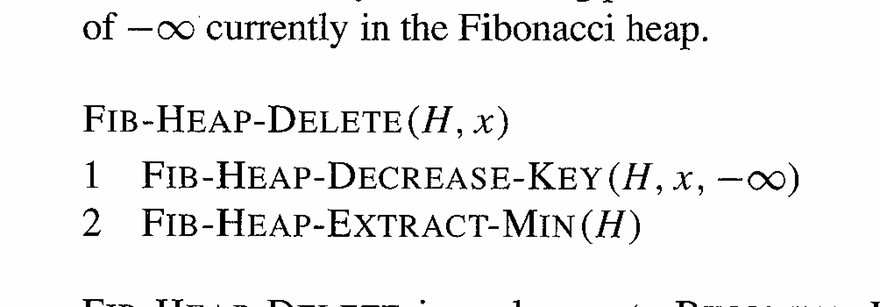
Fibonacci Heap: Delete
The cost is clearly O(lg n), as long as we can show the bound on D(n).

Slide 54
Proof: Lemma 20.1
The bound.Let size(x) be the number of nodes, including x, in a subtree rooted at x.
Lemma 20.1. Let x be any node in Fibonacci Heap, suppose degree[x] = k. let y₁, y₂, …, y_{k} be the children of x in the order in which they were linked to x, from earliest to latest. Then, degree[y₁] ≥ 0 and degree[y_{i}] ≥ i - 2 for i =2, 3, …, k.
Proof.
degree[y₁] ≥ 0. It could not be negative…
For i ≥ 2,
  when y_{i} was linked to x, all of y₁, y₂, …, y_{i-1} were children of x, so, at that time, degree[x] = i-1.
  Node y_{i} is linked to x only if degree[x] = degree[y_{i}], so we must have had degree[y_{i}] = i - 1 at that time.
  Node y_{i} has lost at most one child - it would have been dropped otherwise, hence degree[y_{i}] ≥ i - 2.

Slide 55
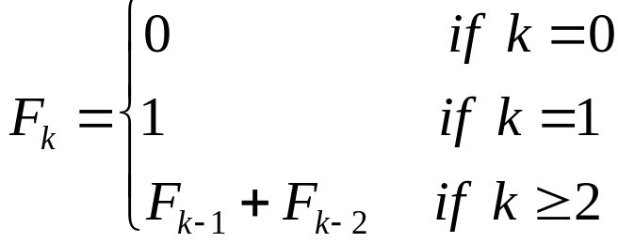
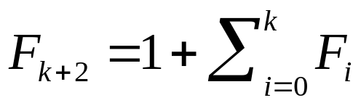
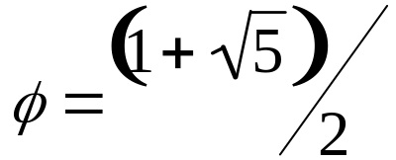

Lemma 20.2: Proof
Recall the definition of Fibonacci Numbers:
Lemma 20.2: for all integers k ≥ 0,
Proof: a simple induction.
Recall: where , the golden ratio.

Slide 56

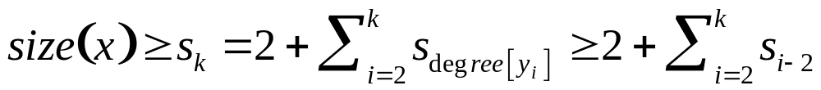
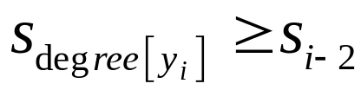
Lemma 20.3: Proof
Lemma 20.3. Let x be any node in a Fibonacci Heap, degree[x] = k. Then size(x) ≥
size(x): the number of nodes, including x, in a subtree rooted at x.
Proof. Define ;
then s₀ = 1, s₁ =2, s₂ = 3. s_{k} ≤ size(x), and s_{k} increases monotonically with k.
Let y₁, y₂, …, y_{k} denote the children of x in the order in which they were linked to x. We now compute a lower bound on size(x): one for x, one for the first child y₁ (size(y₁) ≥ 1), and
where, from Lemma 20.1, .
We now use induction on k to show that s_{k} ≥ F_{k+2} for all k ≥ 0. The bases, k = 0 and k = 1 are trivial. We now have resolve the inductive step.

Slide 57
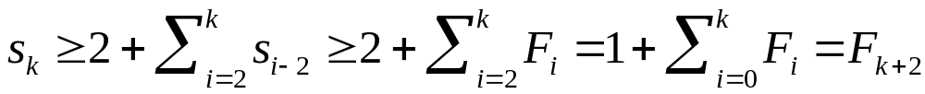


Corollary 20.4: proof
Assume k ≥ 2, and s_{i} ≥ F_{i+2} for i = 0, 1, …, k-1.
We have used Lemma 20.2, and we have completed the proof.
Corollary 20.4. The maximum degree D(n) of any node in an n-node Fibonacci heap is O(lg n).
Proof. Let x be any node, k = degree[x]. By the previous Lemma,
. Taking logarithms, . The maximum degree D(n) is thus O(lg n).

