Slide 1

Maximum Flow (Part 2)

Slide 2
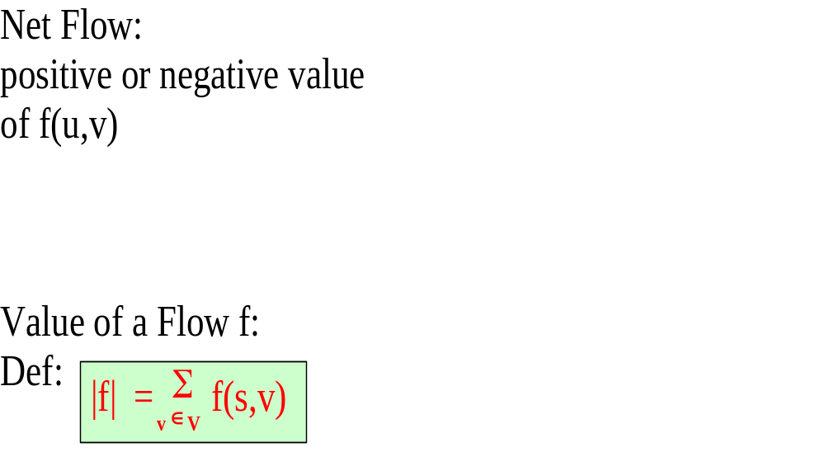
Net flow and value of a flow
u
u
f(u,v) = 5
f(v,u) = -5
8/10
3/4
5/10
4
v
v
3/3
v1
v3
4/6
6/8
3/3
S
t
1/3
6/6
v2
v4
8/8
5/6

Slide 3
Ford Fulkerson – residual networks
The residual network G_{f} of a given flow network G with a valid flow f consists of the same vertices v ∈ V as in G which are linked with residual edges (u,v) ∈ E_{f} that can admit more strictly positive net flow.
The residual capacity c_{f} represents the weight of each edge E_{f} and is the amount of additional net flow f(u,v) before exceeding the capacity c(u,v)
Flow network G = (V,E)
residual network G_{f} = (V,E_{f})
v1
12/12
v3
v1
12
v3
11/16
5
5
15/20
4
11
10
1/4
7/7
11
3
7
15
S
4/9
t
S
5
t
5
4/4
4
8/13
v2
v4
8
v2
3
v4
11/14
11
c_{f}(u,v) = c(u,v) – f(u,v)

Slide 4
Ford Fulkerson – augmenting paths
We define a flow: f_{p}: V x V → R such as:
c_{f}(p) if (u,v) is on p
f_{p}(u,v) = - c_{f}(p) if (v,u) is on p
0 otherwise
Flow network G = (V,E)
residual network G_{f} = (V,E_{f})
v1
12/12
v3
v1
12
v3
11/16
5
4/5
15/20
4/4
11
10
1/4
7/7
11
3
7
-4/15
S
4/9
t
S
-4/5
t
4/5
4/4
4
8/13
v2
v4
-4/8
v2
3
v4
11/14
11
Our virtual flow f_{p} along the augmenting path p in G_{f}

Slide 5
Ford Fulkerson – augmenting the flow
We define a flow: f_{p}: V x V → R such as:
c_{f}(p) if (u,v) is on p
f_{p}(u,v) = - c_{f}(p) if (v,u) is on p
0 otherwise
Flow network G = (V,E)
residual network G_{f} = (V,E_{f})
v1
12/12
v3
v1
12
v3
11/16
5
4/5
19/20
4/4
11
10
1/4
7/7
11
3
7
15
S
0/9
t
S
5
t
4/5
4/4
4
12/13
v2
v4
8
v2
3
v4
11/14
11
New flow:
f´: V x V → R : f´=f + f_{p}
Our virtual flow f_{p} along the augmenting path p in G_{f}

Slide 6
Ford Fulkerson – new valid flow proof of capacity constraint
c_{f}(p) if (u,v) is on p
f_{p}(u,v) = - c_{f}(p) if (v,u) is on p
0 otherwise
Lemma:
f´ : V x V → R : f´ = f + f_{p} in G
c_{f}(p) = min{c_{f} (u,v): (u,v) is on p}
Capacity constraint:
For all u,v ∈ V, we require f(u,v) < c(u,v)
c_{f}(u,v) = c(u,v) – f(u,v)
Proof:
f_{p} (u ,v) < c_{f} (u ,v) = c (u ,v) – f (u ,v)
⇒ (f + f_{p}) (u ,v) = f (u ,v) + f_{p} (u ,v) < c (u ,v)

Slide 7
Ford Fulkerson – new valid flow proof of Skew symmetry
Lemma:
f´ : V x V → R : f´ = f + f_{p} in G
Skew symmetry:
For all u,v ∈ V, we require f(u,v) = - f(v,u)
Proof:
(f + f_{p})(u ,v) = f (u ,v) + f_{p} (u ,v) = - f (v ,u) – f_{p} (v ,u)
= - (f (v ,u) + f_{p} (v ,u)) = - (f + f_{p}) (v ,u)

Slide 8
Ford Fulkerson – new valid flow proof of flow conservation
Lemma:
f´ : V x V → R : f´ = f + f_{p} in G
Flow conservation:
For all u ∈ V - {s,t} : Σ f(u,v) = 0
v ∈ V
Proof:
u ∈ V – {s ,t} ⇒ Σ (f + f_{p}) (u ,v) = Σ (f(u ,v) + f_{p} (u ,v))
= Σ f (u ,v) + Σ f_{p} (u ,v) = 0 + 0 = 0
v ∈ V
v ∈ V
v ∈ V
v ∈ V

Slide 9
Ford Fulkerson – new valid flow
Lemma:
| (f + f_{p}) | = | f | + | f_{p} |
Value of a Flow f:
Def:
|f| = Σ f(s,v)
v ∈ V
Proof:
| (f + f_{p}) | = Σ (f + f_{p}) (s ,v) = Σ (f (s ,v) + f_{p} (s ,v))
= Σ f (s ,v) + Σ f_{p} (s ,v) = | f | + | f_{p} |
v ∈ V
v ∈ V
v ∈ V
v ∈ V

Slide 10
Ford Fulkerson – new valid flow
Lemma:
f´ : V x V → R : f´ = f + f_{p} in G
| (f + f_{p}) | = | f | + | f_{p} | > | f |
Lemma shows:
if an augmenting path can be found then the above flow augmentation will result in a flow improvement.
Question: If we cannot find any more an augmenting path is our flow then maximum?
Idea: The flow in G is maximum ⇔ the residual G_{f} contains no augmenting path.

Slide 11
Ford Fulkerson – cuts of flow networks
Lemma:
the value of a flow in a network is the net flow across any cut of the network
f (S ,T) = | f |
v1
12/12
v3
11/16
19/20
10
1/4
7/7
S
0/9
t
4/4
12/13
v2
v4
11/14

Slide 12
Ford Fulkerson – cuts of flow networks
Assumption:
the value of a flow in a network is the net flow across any cut of the network
Lemma:
f (S ,T) = | f |
Proof:
Working with flows:
X,Y,Z ⊆ V and X ∩ Y = ∅
f (X, Y) = Σ Σ f (x, y)
f (X, X) = 0
f (X, Y) = - f (Y, X)
f (u, V) = 0 for all u ∈ V \ {s, t}
f (X ∪ Y, Z) = f (X, Z) + f (Y, Z)
f (Z, X ∪ Y) = f (Z, X) + f (Z, Y)
f (S, T) = f (S, V-S)
= f (S, V) – f (S, S)
= f (S, V) = f (s ∪ [S-s], V)
= f (s, V) + f (S-s, V)
= f (s, V) = | f |
x ∈ X
y ∈ Y

Slide 13
Ford Fulkerson – cuts of flow networks
Assumption:
The value of any flow f in a flow network G is bounded from above by the capacity of any cut of G
Lemma:
| f | < c (S, T)
| f | = f (S, T)
= Σ Σ f (u, v)
< Σ Σ c (u, v)
= c (S, T)
v1
12/12
v3
11/16
19/20
10
1/4
7/7
u ∈S
S
0/9
t
v ∈T
u ∈S
4/4
v ∈T
12/13
v2
v4
11/14

Slide 14
F. Fulkerson: Max-flow min-cut theorem
If f is a flow in a flow network G = (V,E) with source s and sink t, then the following conditions are equivalent:
f is a maximum flow in G.
The residual network G_{f} contains no augmenting paths.
| f | = c (S, T) for some cut (S, T) of G.
proof:
⇒ (2):
We assume for the sake of contradiction that f is a maximum flow in G but that there still exists an augmenting path p in G_{f}.
Then as we know from above, we can augment the flow in G according to the formula: f´= f + f_{p}. That would create a flow f´that is strictly greater than the former flow f which is in contradiction to our assumption that f is a maximum flow.

Slide 15
F. Fulkerson: Max-flow min-cut theorem
If f is a flow in a flow network G = (V,E) with source s and sink t, then the following conditions are equivalent:
f is a maximum flow in G.
The residual network G_{f} contains no augmenting paths.
| f | = c (S, T) for some cut (S, T) of G.
proof:
(2) ⇒ (3):
original flow network G
residual network G_{f}
3/3
3
v1
v3
v1
v3
4/6
2
6/8
3/3
2
3
6
4
S
t
S
1
t
1/3
2
6/6
6
5
v2
v4
8/8
v2
v4
8
5/6
1

Slide 16
F. Fulkerson: Max-flow min-cut theorem
If f is a flow in a flow network G = (V,E) with source s and sink t, then the following conditions are equivalent:
f is a maximum flow in G.
The residual network G_{f} contains no augmenting paths.
| f | = c (S, T) for some cut (S, T) of G.
proof:
(2) ⇒ (3): Define
S = {v ∈V | ∃ path p from s to v in G_{f} }
T = V \ S (note t ∉ S according to (2))
residual network G_{f}
3
v3
v1
2
2
3
6
4
S
1
t
2
6
5
v2
v4
8
1

Slide 17
F. Fulkerson: Max-flow min-cut theorem
If f is a flow in a flow network G = (V,E) with source s and sink t, then the following conditions are equivalent:
f is a maximum flow in G.
The residual network G_{f} contains no augmenting paths.
| f | = c (S, T) for some cut (S, T) of G.
proof:
(2) ⇒ (3): Define
S = {v ∈V | ∃ path p from s to v in G_{f} }
T = V \ S (note t ∉ S according to (2))
for ∀ u ∈ S, v ∈ T: f (u, v) = c (u, v) (otherwise (u, v) ∈ E_{f} and v ∈ S)
| f | = f (S, T) = c (S, T)
original network G
3/3
v1
v3
4/6
6/8
3/3
S
t
1/3
6/6
v2
v4
8/8
1
5/6

Slide 18
F. Fulkerson: Max-flow min-cut theorem
If f is a fow in a flow network G = (V,E) with source s and sink t, then the following conditions are equivalent:
f is a maximum flow in G.
The residual network G_{f} contains no augmenting paths.
| f | = c (S, T) for some cut (S, T) of G.
proof:
(3) ⇒ (1): as proofed before | f | = f (S, T) < c (S, T)
the statement of (3) : | f | = c (S, T) implies that f is a maximum flow

Slide 19
Reduction to Maximum Flow

Slide 20
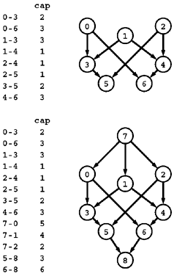
R1: Multiple sources and sinks
Problem:
  What if you have a problem with more than one source and more than one sink?
  The network at the top has three sources (0, 1, and 2) and two sinks (5 and 6).
Reduction: Create a network which
  is a copy of the original network
  with the addition of a new source 7 and
  a new sink 8.
  There is an edge from 7 to each original-network source with capacity equal to the sum of the capacities of that source's outgoing edges,
  an edge from each original-network sink to 8 with capacity equal to the sum of the capacities of that sink's incoming edges.

Slide 21
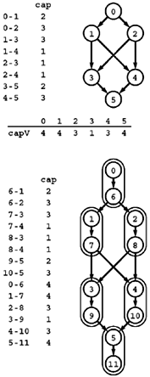
R2: Removing vertex capacities
Problem:
  Given a flow network, find a maxflow satisfying additional constraints specifying that the flow through each vertex must not exceed some fixed capacity.
Reduction: Create a new network
  Associate a new vertex u* (where u* denotes u+V) with each vertex u,
  add an edge u-u* whose capacity is the capacity of u,
  include an edge u*-v for each edge u-v.

Slide 22
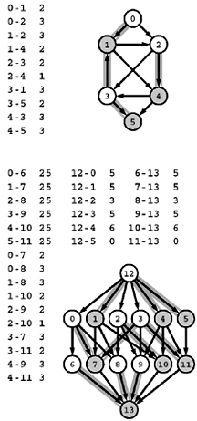
R3: Reduction to acyclic network
Problem:
  Find a maxflow in an acyclic network.
Reduction: Create a new network where
  Each vertex u in the top network corresponds to two vertices u and u* (where u* denotes u+V) in the bottom network,
  each edge u-v in the top network corresponds to an edge u-v* in the bottom network.
  Additionally, the bottom network has uncapacitated edges u-u*
  a source s with an edge to each unstarred vertex,
  a sink t with an edge from each starred vertex.

Slide 23
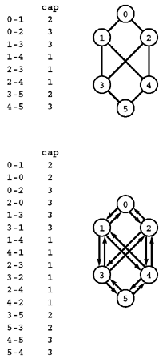
R4: Reduction from undirected networks
Problem:
  Given an undirected weighted graph find the maximum flow
Reduction: Create a network s.t.
  we can consider it to be a directed network with edges in each direction.

Slide 24
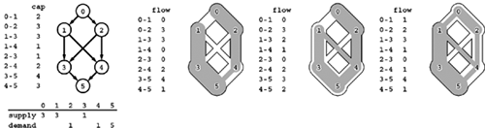
R5: Feasible flow
Problem:
  Suppose that a weight is assigned to each vertex in a flow network and is to be interpreted as supply (if positive) or demand (if negative), with the sum of the vertex weights equal to zero. Define a flow to be feasible if the difference between each vertex's outflow and inflow is equal to that vertex's weight (supply if positive and demand if negative). Given such a network, determine whether or not a feasible flow exists.

Slide 25
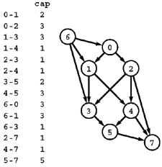
R5: Reduction from feasible solution
Reduction: Create a network
  by adding edges from a new source vertex to the supply vertices (each with capacity equal to the amount of the supply) and
  edges to a new sink vertex from the demand vertices (each with capacity equal to the amount of the demand).
  The network has a feasible flow if and only if this network has a flow (a maxflow) that fills all the edges from the sink and all the edges to the source.

Slide 26
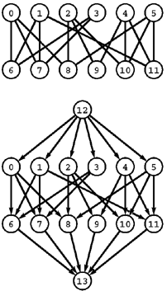
R6: Bipartite matching
Problem:
  Given a bipartite graph, find a set of edges of maximum cardinality such that each vertex is connected to at most one other vertex.
Reduction: Construct an st-network
  by directing all the edges from the top row to the bottom row,
  adding a new source with edges to each vertex on the top row,
  adding a new sink with edges to each vertex on the bottom row, and
  assigning capacity 1 to all edges.
  In any flow, at most one outgoing edge from each vertex on the top row can be filled and at most one incoming edge to each vertex on the bottom row can be filled, so a solution to the maxflow problem on this network gives a maximum matching for the bipartite graph.

Slide 27
Model for Matching Problem
Group1 on leftmost set, Group2 on rightmost set, edges if they are compatible
A
A
X
A
X
X
B
B
B
Y
Y
Y
C
C
C
Z
Z
D
Z
D
D
G1
G2
A matching
Optimal matching

Slide 28
Solution Using Max Flow
Add a supersouce, supersink, make each undirected edge directed with a flow of 1
A
A
X
X
B
B
t
Y
s
Y
C
C
Z
Z
D
D
Since the input is 1, flow conservation prevents multiple matchings

Slide 29
Edge Connectivity
What is the minimum number of edges that need to be removed to separate a given graph into two pieces?
Find a set of edges of minimal cardinality that does this separation.

Slide 30
Edge Connectivity for undirected graph
Theorem:
  The time required to determine the edge connectivity of an undirected graph is O(E²).
Proof:
  We can compute the minimum size of any cut that separates two given vertices by computing the maxflow in the st-network formed from the graph by assigning unit capacity to each edge.
  The edge connectivity is equal to the minimum of these values over all pairs of vertices.
  We do not need to do the computation for all pairs of vertices,
  Let s* be a vertex of minimal degree in the graph.
  Note that the degree of s* can be no greater than 2E/V.
  Consider any minimum cut of the graph.
    By definition, the number of edges in the cut set is equal to the graph's edge connectivity.
    The vertex s* appears in one of the cut's vertex sets, and the other set must have some vertex t,
    so the size of any minimal cut separating s* and t must be equal to the graph's edge connectivity. Therefore, if we solve V-1 maxflow problems (using s* as the source and each other vertex as the sink), the minimum flow value found is the edge connectivity of the network.
  Now, any augmenting-path maxflow algorithm with s* as the source uses at most 2E/V paths;
  so, if we use any method that takes at most E steps to find an augmenting path, we have a total of at most (V – 1)(2 E/V)E steps to find the edge connectivity and that implies the stated result.

Slide 31
Vertex Connectivity
What is the minimum number of vertices that need to be removed to separate a given graph into two pieces?
Assignment

Slide 32
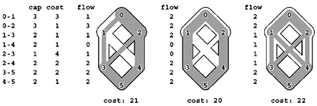
Min Cost Maximum Flow
Flow cost:
  The flow cost of an edge in a flow network with edge costs is the product of that edge's flow and cost. The cost of a flow is the sum of the flow costs of that flow's edges.
Mincost maxflow:
  Given a flow network with edge costs, find a maxflow such that no other maxflow has lower cost.
These flows all have the same (maximal) value, but their costs (the sum of the products of edge flows and edge costs) differ. The maxflow in the center has minimal cost (no maxflow has lower cost).

Slide 33
Extended def: “Residual Network”
Residual network
  Given a flow in a flow network with edge costs, the residual network for the flow has the
    same vertices as the original and
    one or two edges in the residual network for each edge in the original,
    For each edge u-v in the original, let f be the flow, c the capacity, and x the cost.
      If f is positive, include an edge v-u in the residual with capacity f and cost -x;
      if f is less than c, include an edge u-v in the residual with capacity c-f and cost x.

Slide 34
Mincost Maxflo Theorem
Theorem:
  A maxflow is a mincost maxflow if and only if its residual network contains no negative-cost (directed) cycle.

Slide 35
How to solve Mincost Maxflow Problem
Algorithm:
  Find a maxflow.
  Augment the flow along any negative-cost cycle in the residual network, continuing until none remain.
Implementation:
  We use any maxflow implementation to find the initial maxflow and the Bellman–Ford algorithm to find negative cycles

Slide 36
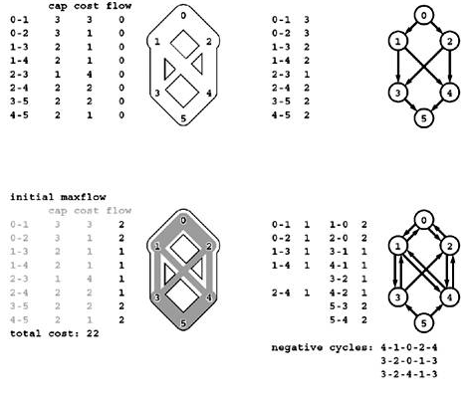

Slide 37
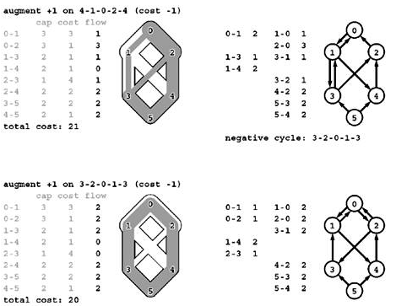

Slide 38
Better algorithm: Cycle cancelling algorithm
Algorithm:
  Initialize:
    Add a dummy edge from source to sink and assigning to it a cost that is higher than the cost of any source–sink path in the network (for example, VC)
    Add a flow that is higher than the maxflow (for example, higher than the source's outflow).
  Apply cycle canceling algorithm which moves as much flow as possible out of the dummy edge, so the resulting flow is a maxflow.
  In the figure, we use an initial flow equal to the maxflow to make plain that the algorithm is simply computing another flow of the same value but lower cost (in general, we do not know the flow value, so there is some flow left in the dummy edge at the end, which we ignore). As is evident from the figure, some augmenting cycles include the dummy edge and increase flow in the network; others do not include the dummy edge and reduce cost. Eventually, we reach a maxflow; at that point, all the augmenting cycles reduce cost without changing the value of the flow, as when we started with a maxflow.

Slide 39
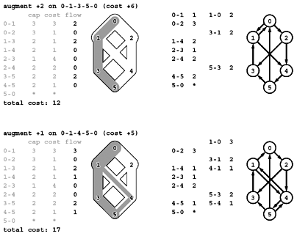
Mincost Maxflow Algorithm –Step 1

Slide 40
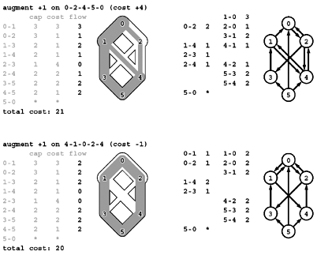
Mincost Maxflow Algorithm –Step 2

Slide 42
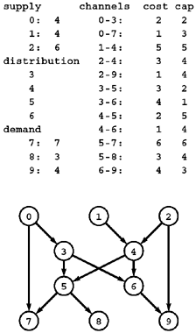
Distribution Problem
Given
  3 supply vertices (0 through 2),
  4 distribution points (3 through 6),
  3 demand vertices (7 through 9),
  12 channels.
  Each supply vertex has a rate of production;
  each demand vertex a rate of consumption;
  each channel a maximum capacity
  a cost per unit distributed.
Problem:
  minimize costs while distributing material through the channels (without exceeding capacity anywhere) such that
    the total rate of material leaving each supply vertex equals its rate of production,
    the total rate at which material arrives at each demand vertex equals its rate of consumption,
    total rate at which material arrives at each distribution point equals the total rate at which material leaves.

Slide 43
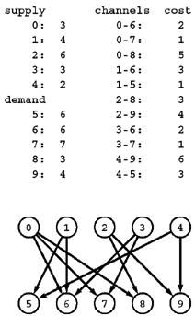
Transportation Problem
Like the distribution problem,
  but with no channel-capacity restrictions and no distribution points.
Given
  5 supply vertices (0 through 4),
  5 demand vertices (5 through 9),
  12 channels.
Problem:
  find the lowest-cost way to distribute material through the channels such that supply exactly meets demand everywhere.
  Specifically, we require an assignment of weights (distribution rates) to the edges such that the sum of weights on outgoing edges equals the supply at each supply vertex, the sum of weights on ingoing edges equals the demand at each demand vertex, and the total cost (sum of weight times cost for all edges) is minimized over all such assignments.

Slide 44
Communication Problem
Given
  A communications network has a set of requests to transmit messages between servers that are connected by channels (abstract wires) that are capable of transferring information at varying rates.
Problem:
  What is the maximum rate at which information can be transferred between two specified servers in the network?
  If there are costs associated with the channels, what is the cheapest way to send the information at a given rate that is less than the maximum?

Slide 45
Traffic Flow
Given:
  A city government needs to formulate a plan for evacuating people from the city in an emergency.
Problem:
  What is the minimum amount of time that it would take to evacuate the city, if we suppose that we can control traffic flow so as to realize the minimum?
  Traffic planners also might formulate questions like this when deciding which new roads, bridges, or tunnels might alleviate rush-hour or vacation-weekend traffic problems.

Slide 46
Job Placement
Given:
  A job-placement service arranges interviews for a set of students with a set of companies; these interviews result in a set of job offers.
Problem:
  Assuming that an interview followed by a job offer represents mutual interest in the student taking a job at the company, it is in everyone's best interests to maximize the number of job placements.

