Slide 1
Line Following Robot
By Team Arduinox-3
Course No : CSE 204L
Semester: Autumn 2022

Slide 2
Equipments used
Arduino UNO
Motor Driver L2098
Battery Holder Li-io (4 cells)
Battery (Li-on 3.7 × 4 = 13.2V) 18650
Buck converter & display
Yellow Body Kit (2 wheels)
Jumper wire male to female
5 array digital IR sensor
Li-ion Charger

Slide 3
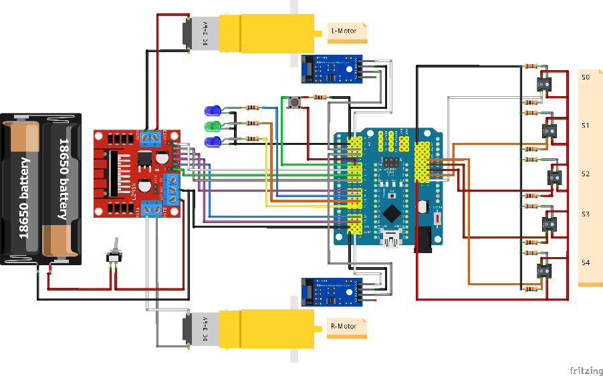
Circuit diagram

Slide 4
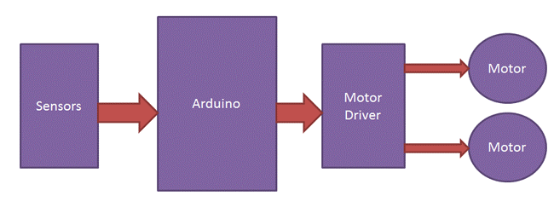
How Does it work?
5 array IR sensor detects the line or any dark surface.
Sensor sends the signal to the arduino about which sensor the line has been detected in.
Arduino sets the h bridge motor driver based in the signals and the code uploaded on the arduino.
Motor driver then drives which ever motor it has been ordered to.

Slide 5
ThanK YOu

