Slide 1
Basic Pentesting 1
ChatGPT said:
Basic Pentesting 1 is a beginner-friendly VulnHub CTF focused on common penetration testing techniques. The goal is to gain root access by enumerating open services, exploiting weak credentials, and leveraging misconfigurations. Typical steps include scanning with tools like nmap, brute-forcing SSH or web login using hydra, exploiting a vulnerable CMS or service, and performing privilege escalation via weak sudo permissions or misconfigured files. It’s a great practice box for learning enumeration, password attacks, and Linux privilege escalation basics.

Slide 2
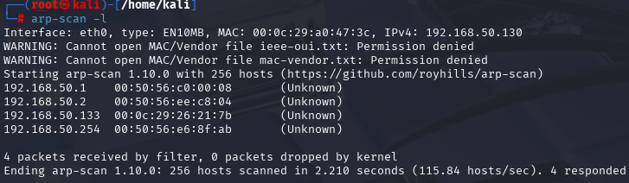

Slide 3
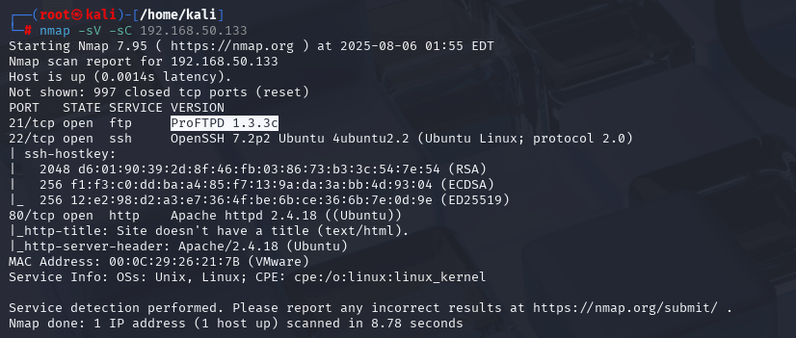

Slide 4
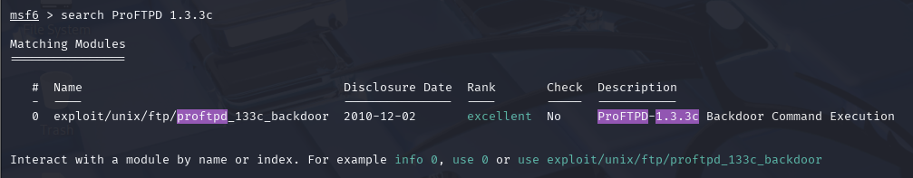

Slide 5
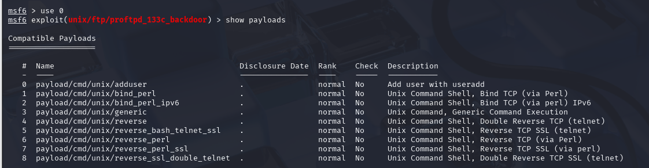

Slide 6
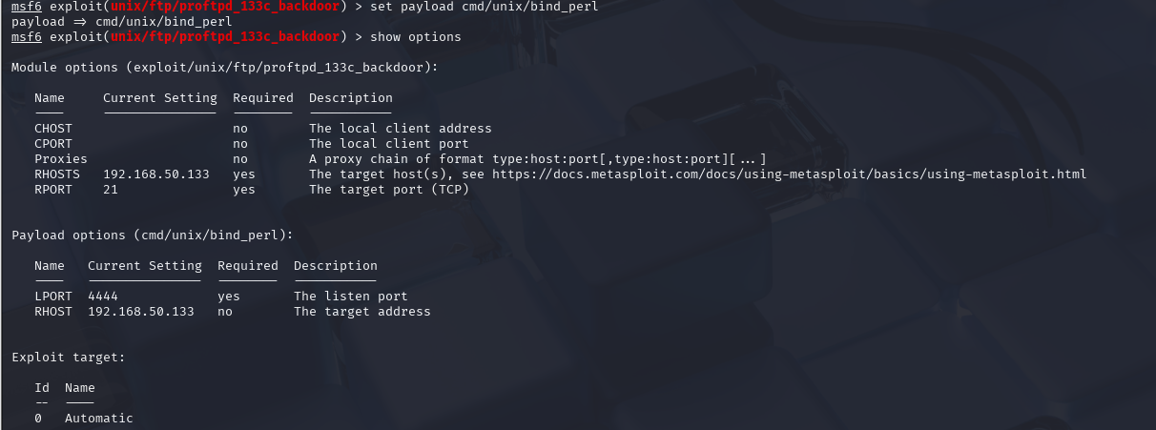

Slide 7
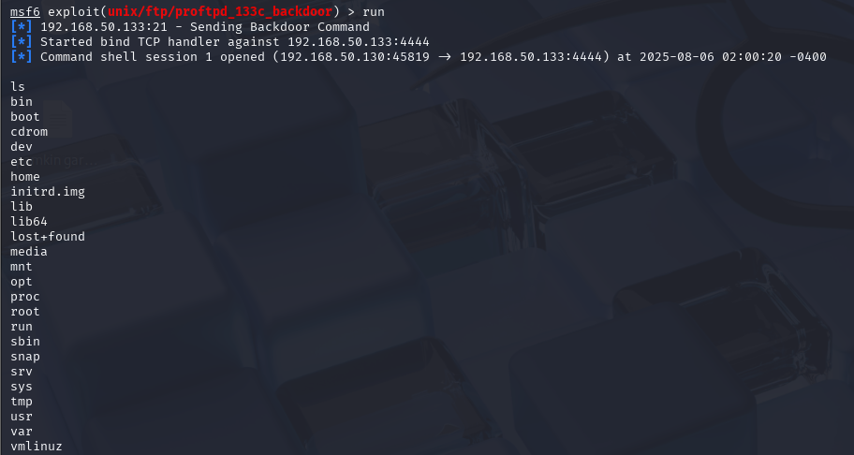

Slide 8
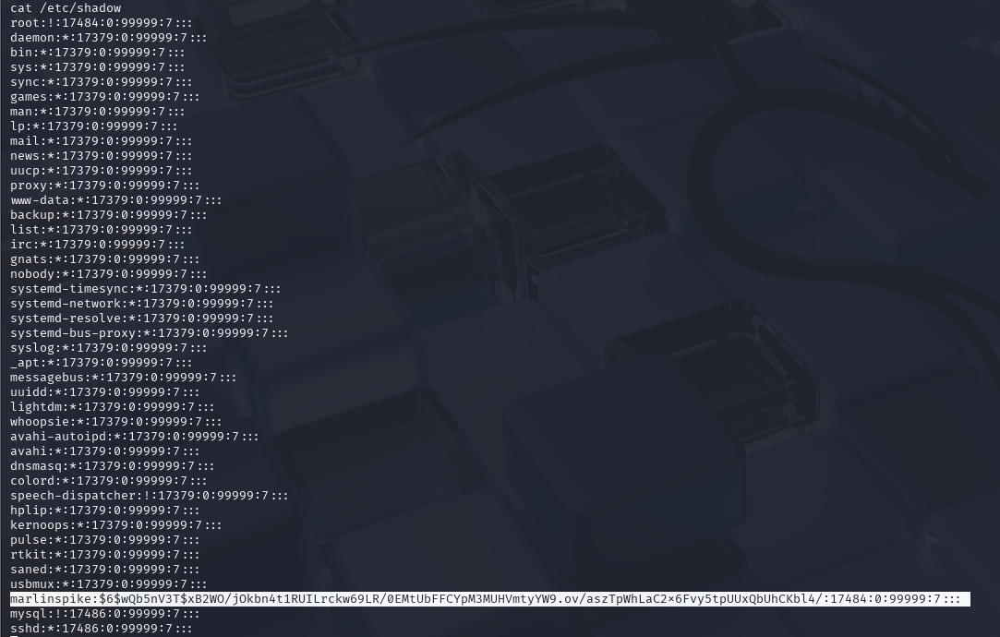

Slide 9
