Slide 1
React JS
an introduction
Saikat Bhattacharya (382029)

Slide 2
“React is, in my opinion, the premier way to build big, fast Web apps with JavaScript.”
- Pete Hunt
https://facebook.github.io/react/docs/thinking-in-react.html

Slide 3








A World of components

Slide 4
A World of components
Angular is a comprehensive
framework
ReactJS is just a library
js into HTML
HTML into js
2 way data binding
Uni-directional data binding
https://medium.freecodecamp.com/angular-2-versus-react-there-will-be-blood-66595faafd51#.y1al5rkkx

Slide 5
React JS: the new features
JSX: Writing markup in Javascript
Virtual DOM: Enhanced performance
Isomorphic Rendering: Renders for all
Unidirectional flow: No two way binding

Slide 6

Flux: unidirectional data flow
A pattern: not a library
Unidirectional: no crossings

Slide 7

Flux: unidirectional data flow
single source of truth

Slide 8





Environmental dependencies

Slide 9



Editor
Atom
Visual Studio
Code
Jetbrains
webstorm
Sublime

Slide 10
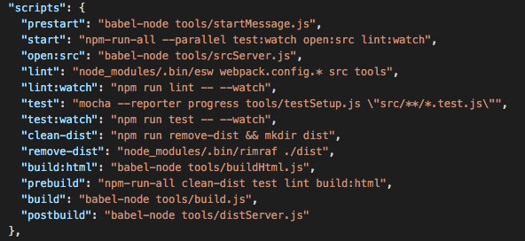
NPM script
package.json

Slide 11
Webpack
a module bundler generates
static assets
It can build and bundle CSS,
preprocessed CSS, compile-to-JS
languages (like CoffeeScript), images

Slide 12
Babel
Browsers does not understand ES6!

Slide 13

ESLint
Pluggable linting utility for JavaScript

Slide 14
Summary
ReactJS - a whole new world!
One directional data flow - Flux
Redux - single source of truth
Webpack - module bundler
Babel - ES6 to ES5 transpiler
ESLint - Error free coding
npm script
Session - 1

