Slide 1
CREDIT EDA CASE STUDY
By
SAIKAT CHOWDHURY
ABHISHEK PAUL

Slide 2
CategIntroduction This case study aims to give you an idea of applying EDA in a real business scenario. In this case study, apart from applying the techniques that you have learnt in the EDA module, you will also develop a basic understanding of risk analytics in banking and financial services and understand how data is used to minimize the risk of losing money while lending to customers. ricalnivariatanalysis for target 0

Slide 3
Business Understanding
The loan providing companies find it hard to give loans to the people due to their insufficient or non-existent credit history. Because of that, some consumers use it as their advantage by becoming a defaulter. Suppose you work for a consumer finance company which specializes in lending various types of loans to urban customers. You have to use EDA to analyze the patterns present in the data. This will ensure that the applicants capable of repaying the loan are not rejected.
When the company receives a loan application, the company has to decide for loan approval based on the applicant’s profile. Two types of risks are associated with the bank’s decision:
If the applicant is likely to repay the loan, then not approving the loan results in a loss of business to the company
If the applicant is not likely to repay the loan, i.e. he/she is likely to default, then approving the loan may lead to a financial loss for the company.

Slide 4
Business Objectives
This case study aims to identify patterns which indicate if a client has difficulty paying their installments which may be used for taking actions such as denying the loan, reducing the amount of loan, lending (to risky applicants) at a higher interest rate, etc. This will ensure that the consumers capable of repaying the loan are not rejected. Identification of such applicants using EDA is the aim of this case study.
In other words, the company wants to understand the driving factors (or driver variables) behind loan default, i.e. the variables which are strong indicators of default. The company can utilize this knowledge for its portfolio and risk assessment.
To develop your understanding of the domain, you are advised to independently research a little about risk analytics - understanding the types of variables and their significance should be enough).

Slide 5

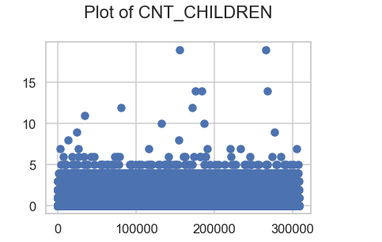
USING SCATTERPLOT FOR OUTLIERS ANALYSIS
CNT_CHILDREN column have outlier values having children more than 10

Slide 6
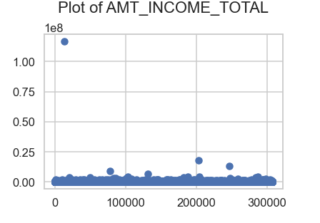
USING SCATTERPLOT FOR OUTLIERS ANALYSIS
AMT_INCOME_TOTAL column have outlier values

Slide 7
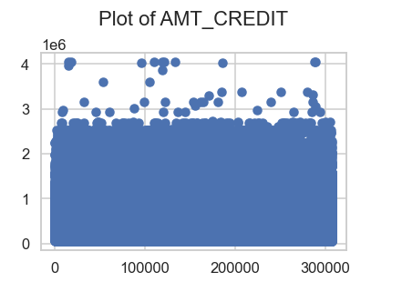
USING SCATTERPLOT FOR OUTLIERS ANALYSIS
AMT_CREDIT column have outlier values

Slide 8
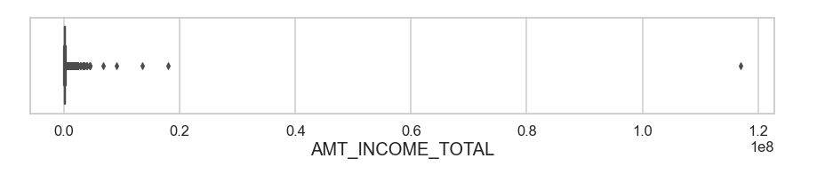
USING BOXPLOT FOR OUTLIERS ANALYSIS
AMT_INCOME_TOTAL column have outlier values

Slide 9
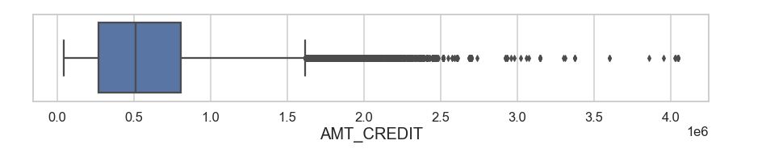
USING BOXPLOT FOR OUTLIERS ANALYSIS
The first quartile is bigger than third quartile for AMT_CREDIT which means most of the credits of clients are present in the first quartile.

Slide 10
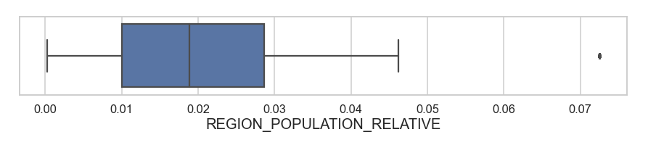
USING BOXPLOT FOR OUTLIERS ANALYSIS
REGION_POPULATION_RELATIVE have outlier values which lies beyond 0.07

Slide 11
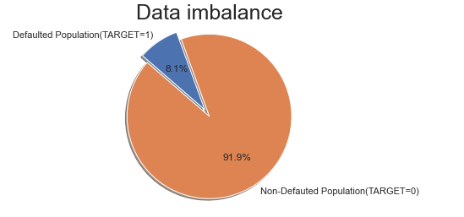
USING PIE-CHART FOR DATA IMBALANCE
We can see that the Application data has high imbalance with Defaulted population at 8.1% as compared to Non-defaulted population at 91.9% Imbalance ratio is 11.3.

Slide 12
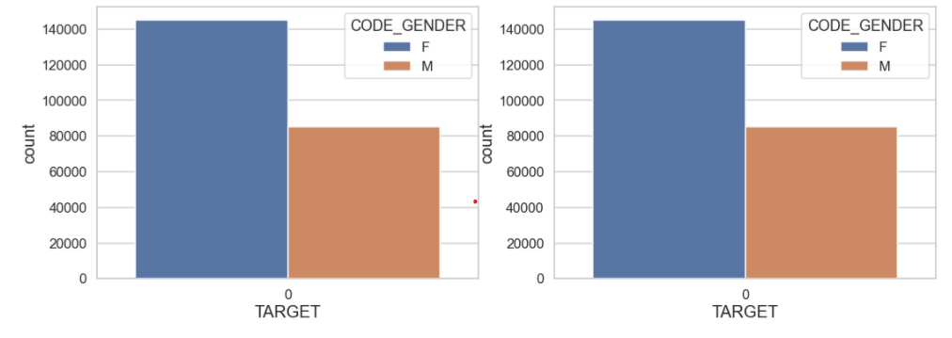
Segmented Analysis Male vs Female
We cannot decide much on basis of gender as defaulters and non defaulters both follow same pattern

Slide 13
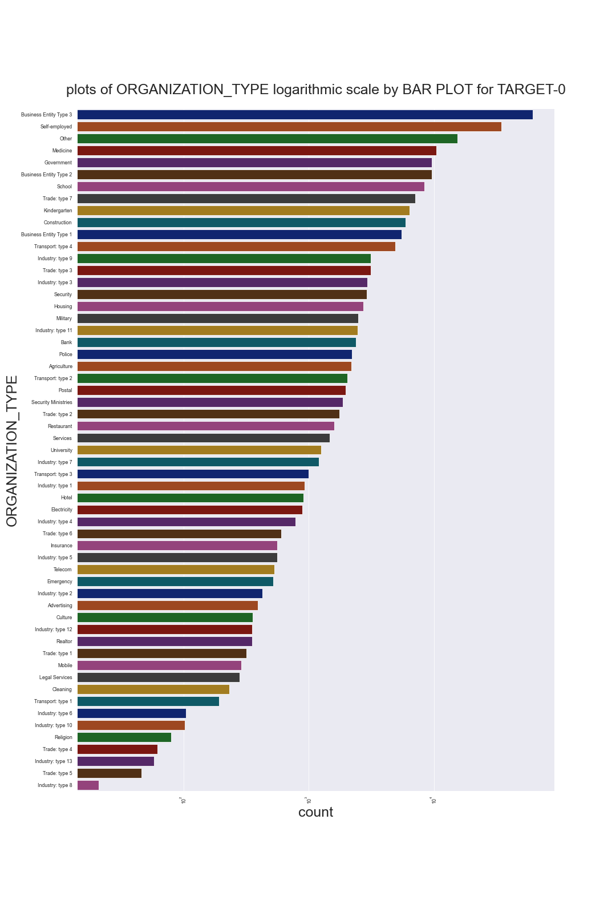
Plots of ORGANIZATION_TYPE logarithmic scale by BAR PLOT for TARGET-0
Points to be concluded from the above graph.
Clients which have applied for credits are from most of the organization type ‘Business entity Type 3’ , ‘Self employed’,‘Other’, ‘Medicine’ and ‘Government’. 2.Less clients are from Industry type 8,type 6, type 10, religion and trade type 5, type 4.

Slide 14
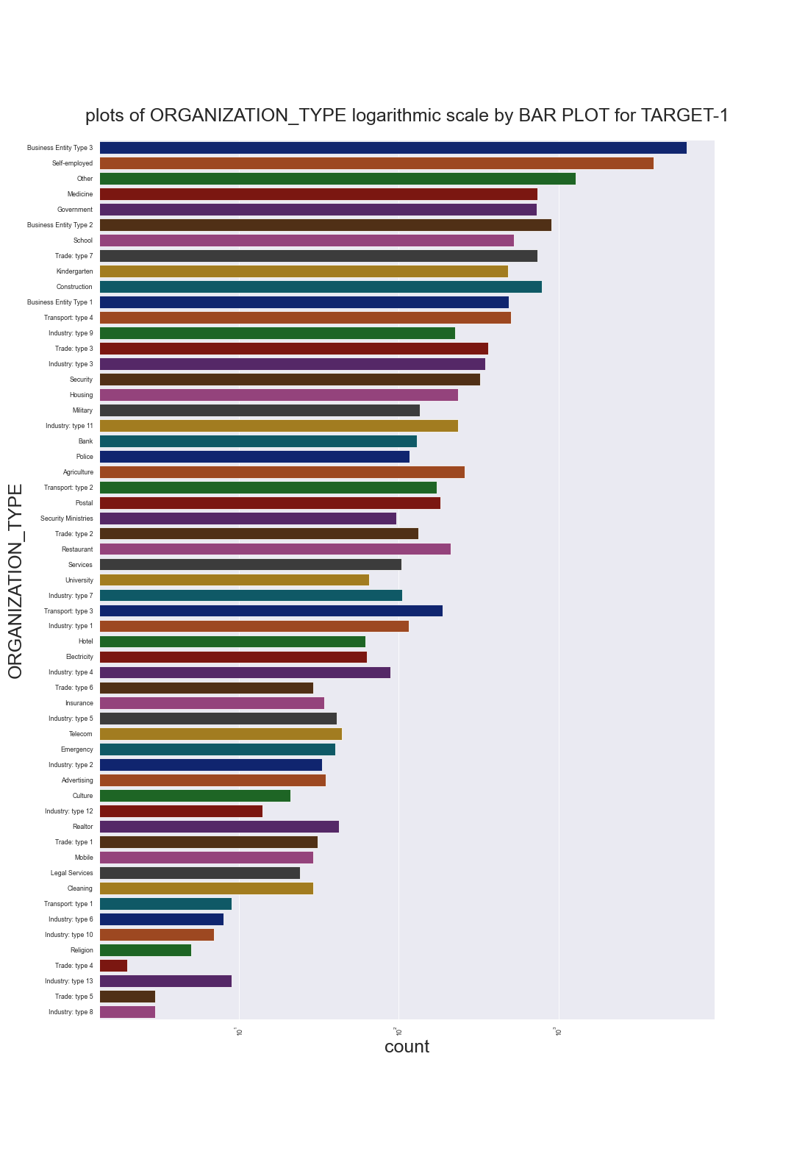
Plots of ORGANIZATION_TYPE logarithmic scale by BAR PLOT for TARGET-1
Points to be concluded from the above graph.
1.Clients which have applied for credits are from most of the organization type ‘Business entity Type 3’ , ‘Self employed’ , ‘Other', 'Medicine’ and ‘Government’. 2.Less clients are from Industry type 8,type 6, type 10, religion and trade type 5, type 4.
3.Same as type 0 in distribution of organization type.

Slide 15
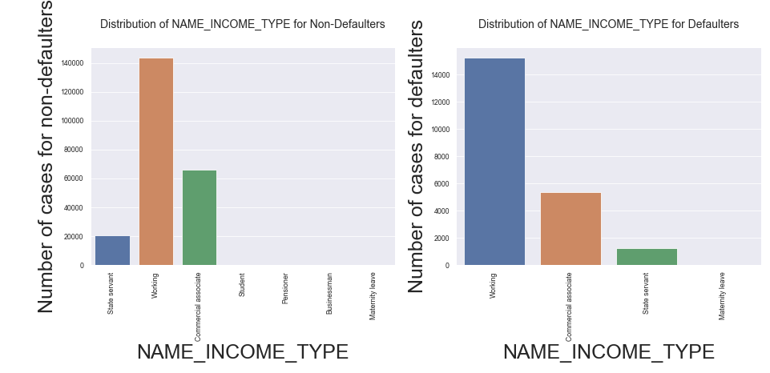
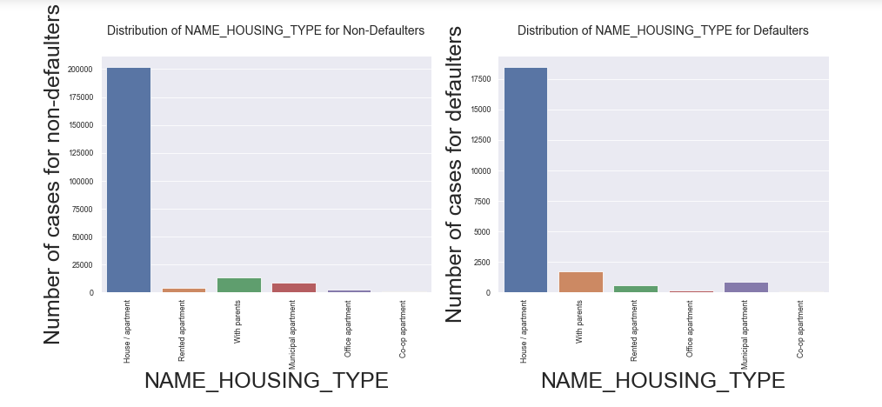
1.In this plot, NAME_INCOME_TYPE,Most of the defaults are from Working population.
2.For NAME_HOUSING_PLOT,Population living in Rented apartments and those living with parents have higher default rate as they have higher proportion in the Defaulted population as compared to non defaulted population. Living in rental apartment means a cash outflow towards rent and thus less cash left for repayment of loan. Living with parents may suggest that the income is not too high and thus difficulty in repayment of loan

Slide 16
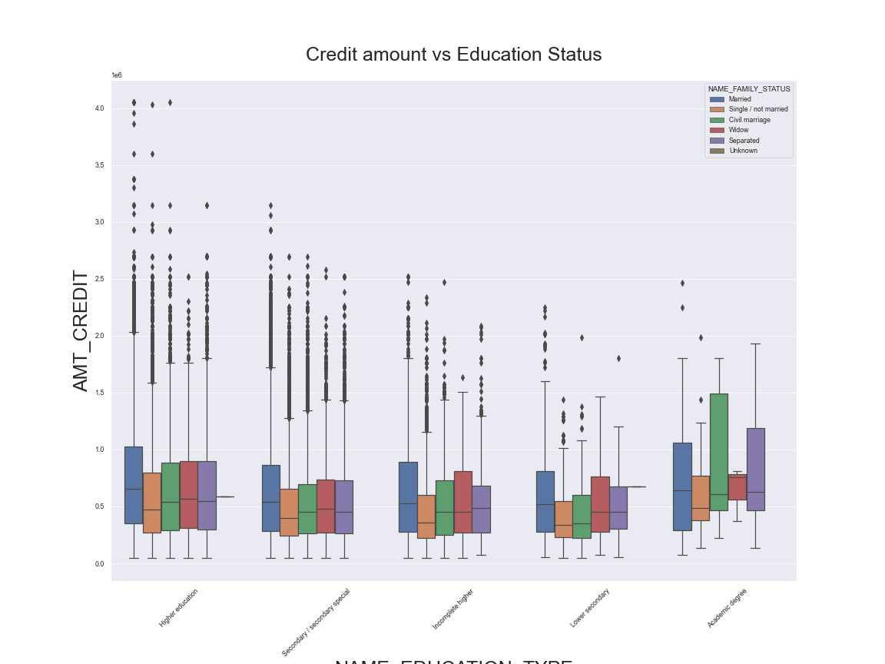
Bivariate analysis by boxplot between NAME_EDUCATION_TYPE and AMT_CREDIT
From the above box plot we can conclude that Family status of 'civil marriage', 'marriage' and 'separated' of Academic degree education are having higher number of credits than others. Also, higher education of family status of 'marriage', 'single' and 'civil marriage' are having more outliers. Civil marriage for Academic degree is having most of the credits in the third quartile.

Slide 17
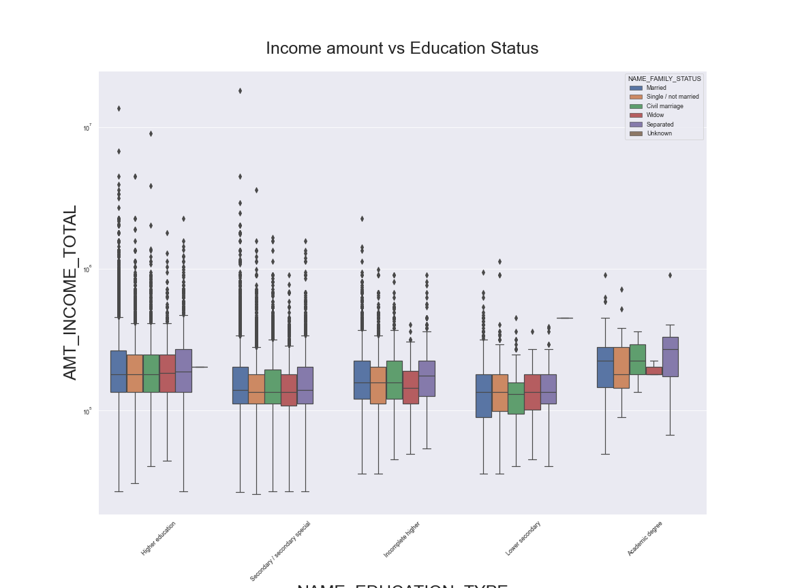
Income amount VS Education Status
From above boxplot for Education type 'Higher education' the income amount is mostly equal with family status. It does contain many outliers. Less outlier are having for Academic degree but there income amount is little higher that Higher education. Lower secondary of civil marriage family status are have less income amount than others.

Slide 18
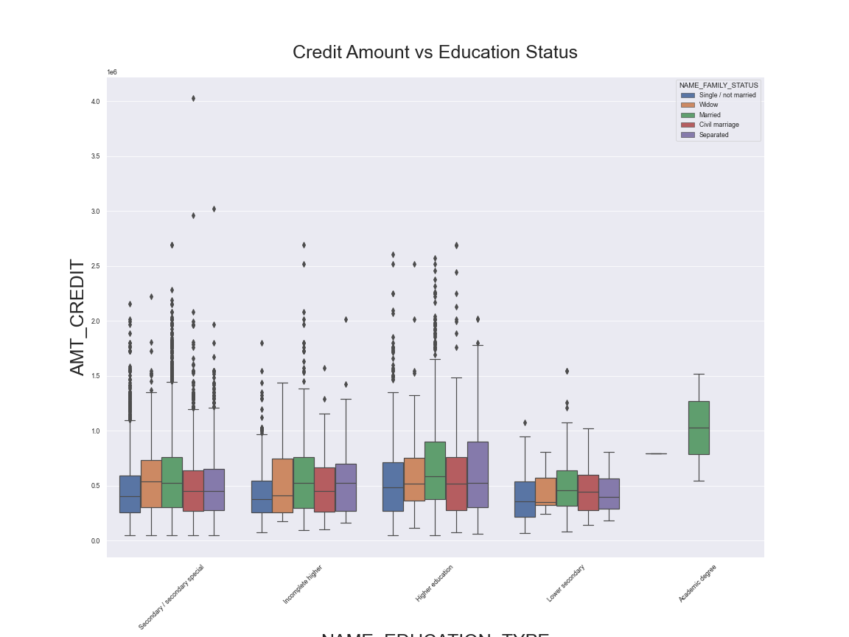
Credit Amount vs Education Status
From the above box plot we can say that Family status of 'civil marriage', 'marriage' and 'separated' of Academic degree education are having higher number of credits than others. Most of the outliers are from Education type 'Higher education' and 'Secondary'. Civil marriage for Academic degree is having most of the credits in the third quartile.

Slide 19
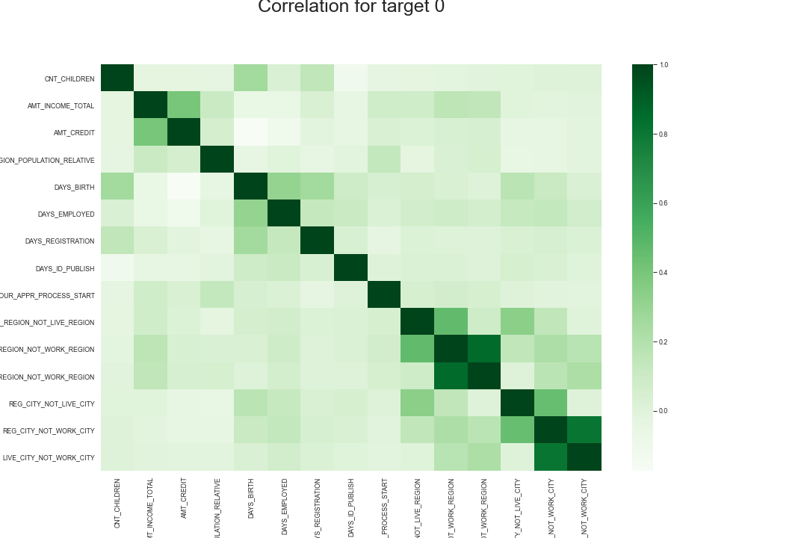
Correlation for Target-0
As we can see from above correlation heat map for TARGET-0, There are number of observation we can point out
1.Credit amount is inversely proportional to the date of birth, which means Credit amount is higher for low age and vice-versa.
2.Credit amount is inversely proportional to the number of children client have, means Credit amount is higher for less 3.children count client have and vice-versa.
4.Income amount is inversely proportional to the number of children client have, means more income for less children client have and vice-versa.
5.less children client have in densely populated area.
6.Credit amount is higher to densely populated area.
7.The income is also higher in densely populated area.

Slide 20
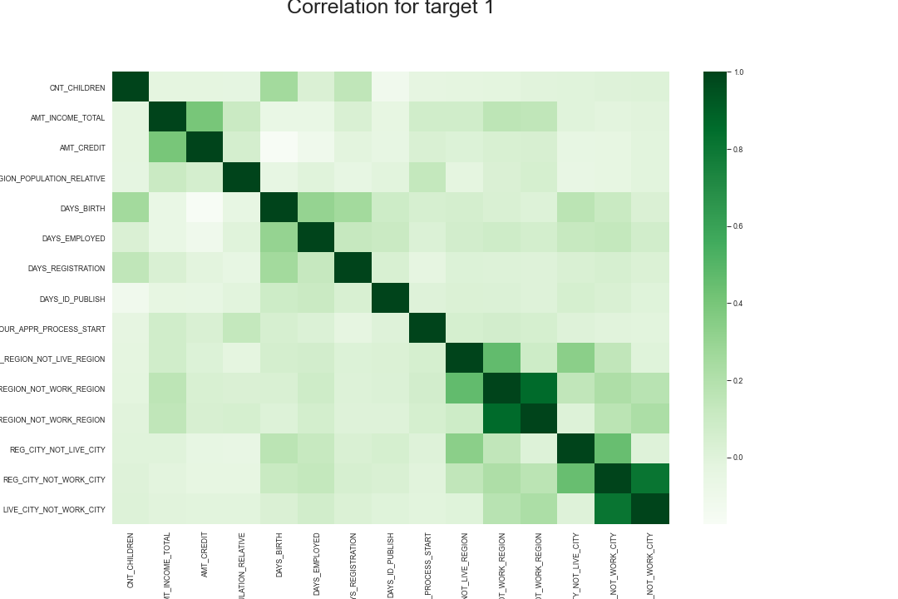
Correlation for Target 1
This heat map for Target 1 is also having quite a same observation just like Target 0. But for few points are different. They are listed below.
1.The client's permanent address does not match contact address are having less children.
2.The client's permanent address does not match work address are having less children.

Slide 21
Correlations Remarks
Top 10 correlations in both the Default and non default population are same:
OBS_30_CNT_SOCIAL_CIRCLE- OBS_60_CNT_SOCIAL_CIRCLE
AMT_GOODS_PRICE- AMT_CREDIT
REGION_RATING_CLIENT_W_CITY- REGION_RATING_CLIENT
CNT_FAM_MEMBERS- CNT_CHILDREN
DEF_60_CNT_SOCIAL_CIRCLE- DEF_30_CNT_SOCIAL_CIRCLE
AMT_CREDIT- AMT_ANNUITY
AMT_ANNUITY- AMT_GOODS_PRICE
EXT_SOURCE_1- AGE
REGION_POPULATION_RELATIVE- REGION_RATING_CLIENT_W_CITY
REGION_RATING_CLIENT- REGION_POPULATION_RELATIVE

Slide 22
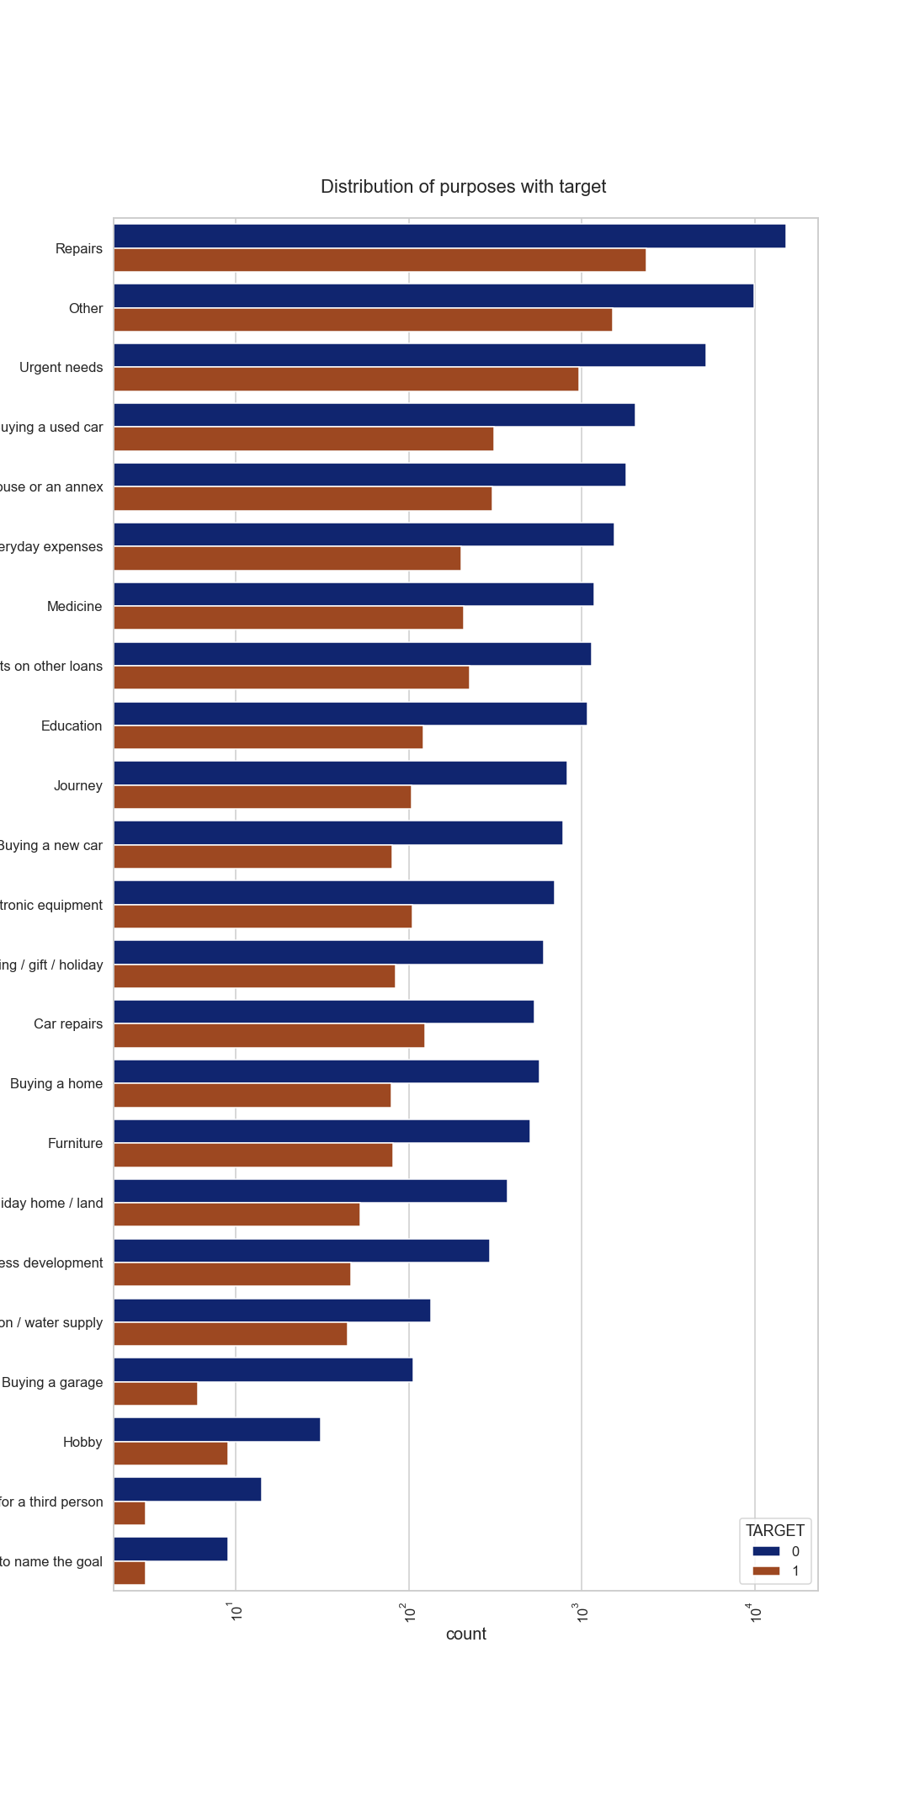
Distribution of purposes with Target

Slide 23
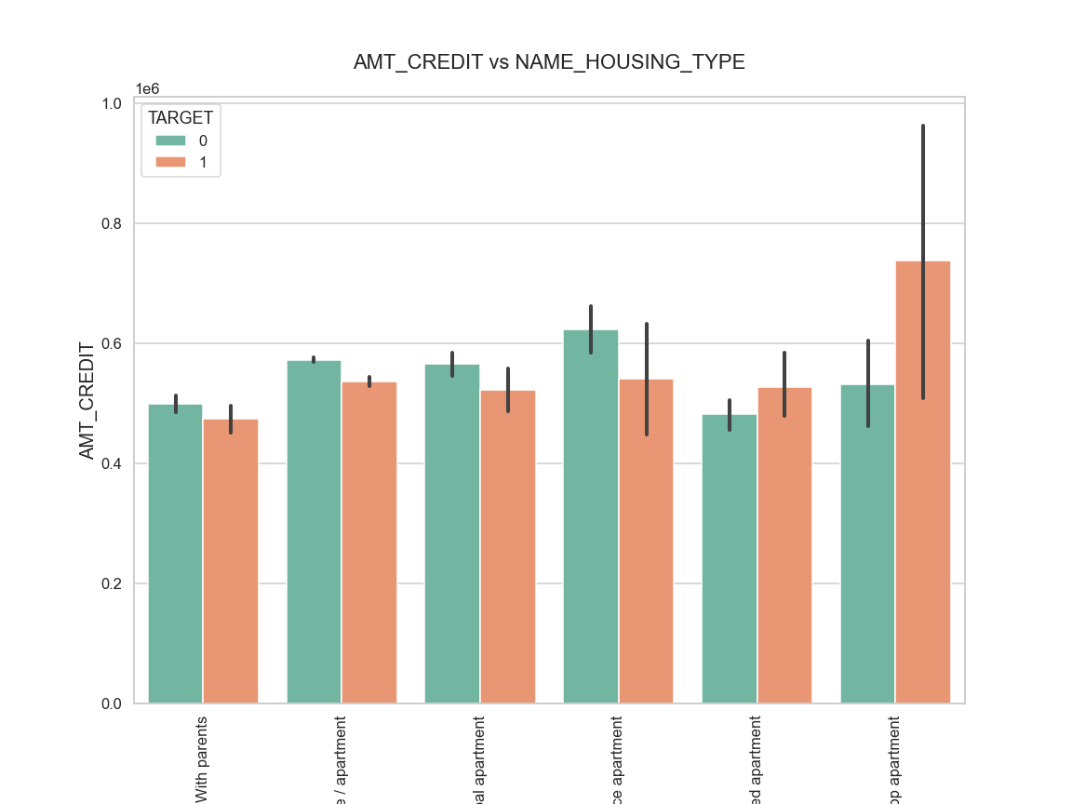
AMT_CREDIT vs NAME_HOUSING_TYPE
Here for Housing type, office apartment is having higher credit of target 0 and co-op apartment is having higher credit of target 1. So, we can conclude that bank should avoid giving loans to the housing type of co-op apartment as they are having difficulties in payment. Bank can focus mostly on housing type with parents or House or municipal apartment for successful payments.

Slide 24
Conclusion
After all these analysis we conculded that
Banks should focus more on contract type Student ,pensioner and Businessman with housing type other than Co-op apartment,Office apartment for successful payments.
Banks should focus less on income type Working as they are having most number of unsuccessful payments.
Also with loan purpose Repair is having higher number of unsuccessful payments on time.
Get as much as clients from housing type With parents as they are having least number of unsuccessful payments.

