Slide 1

SentimentSphere: Sentiment Classification of E-commerce Reviews Using Textual Data Analysis
Ahsanullah University of Science and Technology
Department of Computer Science And Engineering
CSE4114 | Pattern Recognition and Machine Learning Lab
Presented To:
Mr. Ashek Seum
Lecturer, Dept. of CSE, AUST
Mr. Sajib Kumar Saha Joy
Lecturer, Dept. of CSE, AUST
Presented By:
Name: Saikat Das
ID: 2021010158
Section: C2
Group: 08

Slide 2
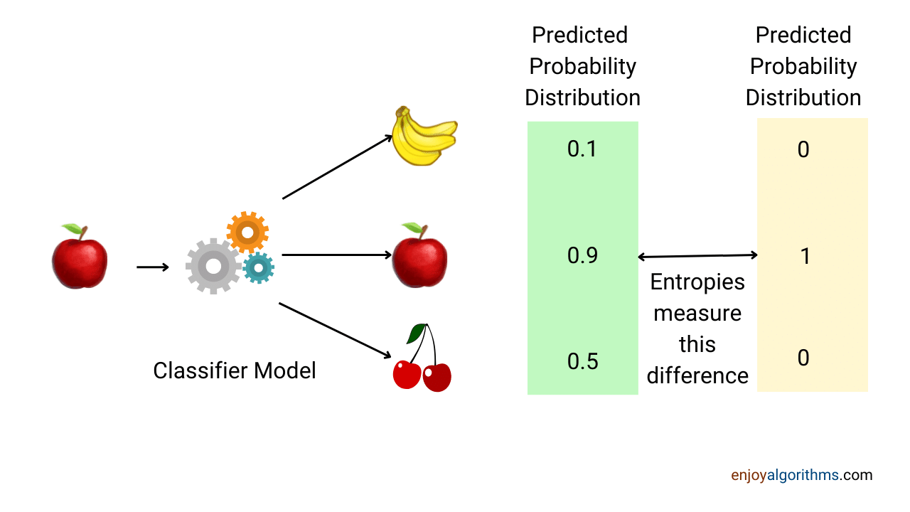

Introduction to Sentiment Analysis
Sentiment analysis is the process of determining the sentiment (positive or negative) expressed in a piece of text.
Classify text into positive or negative sentiments, such as customer reviews or social media comments.
Used in customer feedback, social media monitoring, and e-commerce reviews to understand opinions and improve services/products.

Slide 3


SentimentSphere: Project Summary
Implement a sentiment analysis model using Logistic Regression to classify comments as positive or negative.
Dataset:
3.6 million labeled Amazon customer reviews, each with a sentiment label (1 = negative, 2 = positive).
And 0.4 million labeled test dataset.
Expected Accuracy:
Aim for 88% - 90% accuracy in sentiment classification.
Evaluation Metrics:
• Precision
• Recall
• F1-Score

Slide 4

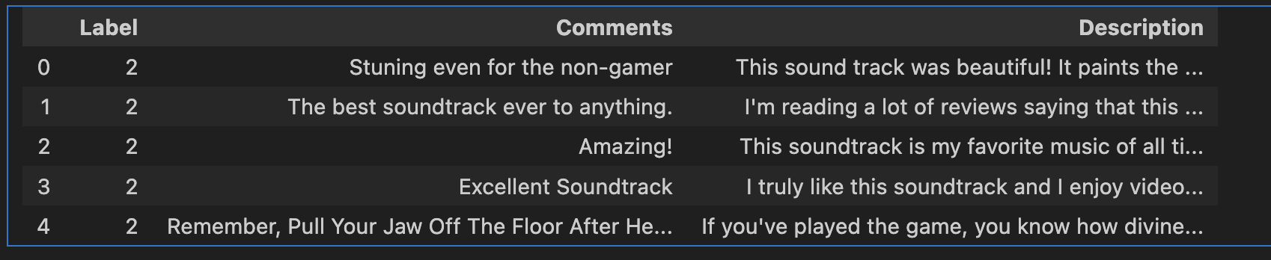
Dataset Overview
Dataset Size:
• Total of 4 million reviews
• 3.6 million reviews for training
• 0.4 million reviews for testing
Format:
• CSV files: train.csv and test.csv
Sentiment Labels:
• 1: Negative sentiment
• 2: Positive sentiment
Source:
• Dataset sourced from Kaggle

Slide 5
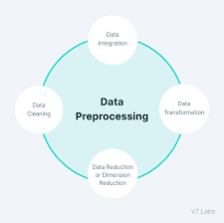
Data Preprocessing
# Fill missing values with empty string
df_train.fillna("", inplace=True)
df_test.fillna("", inplace=True)

Slide 6
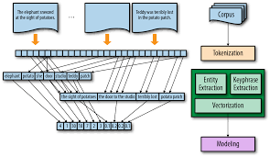
Feature Engineering TF-IDF Vectorization: • Explains Term Frequency-Inverse Document Frequency method. • Importance of weighing words based on frequency and document occurrences. Purpose: Converts text into numerical data suitable for Logistic Regression.

Slide 7

Model Selections
Log Loss: A measure of how well the predicted probabilities match the actual labels.
• Lower Log Loss indicates better model performance.
Models Evaluated:
• Logistic Regression: Measures the probability of each class and calculates the log loss.
• SGD (Stochastic Gradient Descent): Also predicts probabilities for each class.
• Naive Bayes: Provides probabilities for class predictions.
Log Loss Results:
• Logistic Regression: 0.345
• SGD: 0.402
• Naive Bayes: 0.467
Conclusion: Logistic Regression performed the best with the lowest Log Loss.

Slide 8
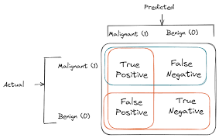
Evaluation Metrics
• Accuracy:
Percentage of correct predictions (Overall performance of the model).
• Precision:
Ratio of correct positive predictions out of all predicted positives.
• Recall:
Ratio of actual positive cases correctly predicted by the model.
• F1-Score:
The harmonic mean of Precision and Recall, providing a balanced measure.
Results:
• Accuracy: 89%
• Precision (positive class): 0.90
• Recall (positive class): 0.88
• F1-Score (positive class): 0.89

Slide 9

Challenges & Limitations
• Imbalanced Dataset: Unequal distribution of positive and negative comments. • Noisy Data: Informal language, slang, spelling errors, typos. • Computational Complexity: Large dataset requiring significant resources. • Possible Solutions: Techniques like oversampling, undersampling, or mini-batch gradient descent.

Slide 10


Future Work & Conclusion
Future Improvements:
• Hyperparameter tuning for better results.
• Use deep learning models (e.g., LSTM, CNN) for better performance.
• Real-time deployment in customer feedback systems.
• Multiclass classification for neutral sentiment.
Conclusion
• Successfully implemented the sentiment analysis model.
• Achieved 89% accuracy and balanced performance in precision and recall.
• Future efforts will focus on enhancing robustness and deploying the model.

Slide 11
Questions?

