Slide 1


Internship Project Presentation
Topic – Flight Management System
Mentor - Sanjeev G
Name – Saikat Moi
Email – saikatmoi2@gmail.com
Java Technology Stack

Slide 2
Technologies Used
Backend – Spring Boot REST , Spring Data JPA , Spring Security, Spring JavaMailSender , Thymeleaf
Database – PostgreSQL
Frontend – HTML, CSS, JavaScript
API Documentation – Swagger
API Testing – Postman
Version Control – GitHub

Slide 3
Registration and Login
Implemented JWT token based authentication and role based authorization.
Admin can add ,modify a flight , schedule flight and also modify/cancel a scheduled flight.
Normal User can search available flights, book tickets, cancel tickets.
All new registrations from frontend are directly assigned normal user permissions , admins can be added from backend only.
Only after verification of the Email Id the account will be activated and can be used for Login .

Slide 4


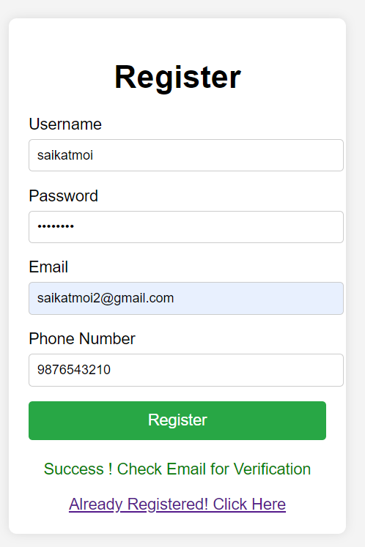
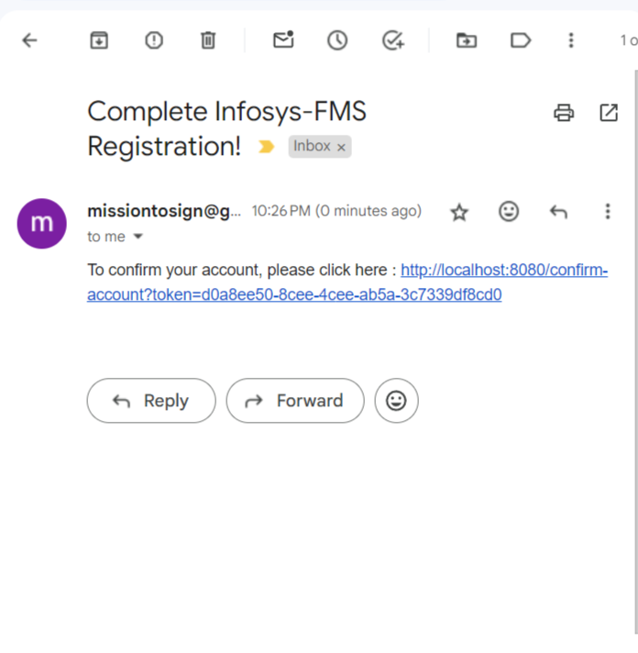
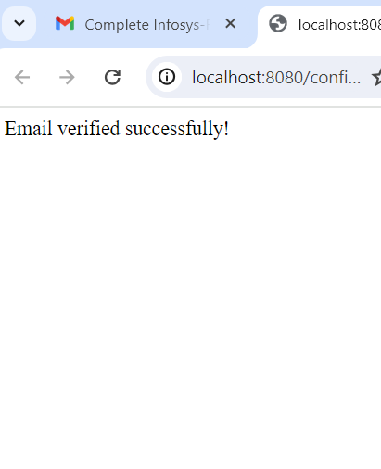

Registration Process Demo

Slide 5

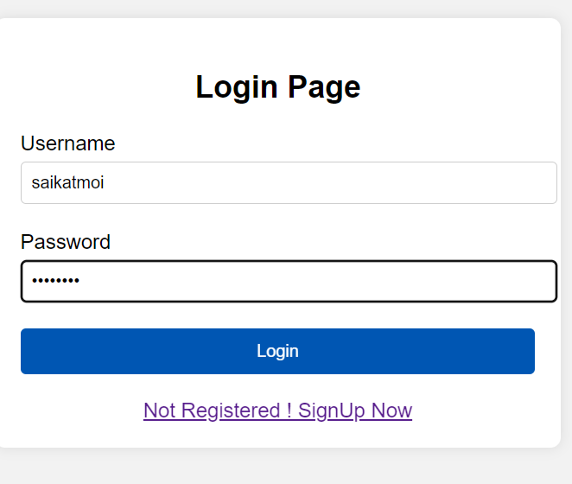
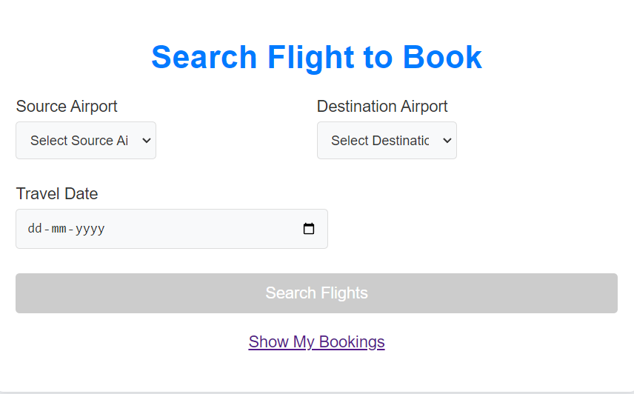
Login Process Demo (USER)
Normal User Login

Slide 6
Booking Process Features
Used Optimistic Locking Strategy to handle the concurrency issue
After successful booking ticket will be send to Email Id and also can be downloaded . Used Thymeleaf to generate ticket .
In case of cancellation of the booking by the user , a email notification will be send .
In case of modification/cancellation of a scheduled flight by the admin , notifications will be send to the affected users.

Slide 7



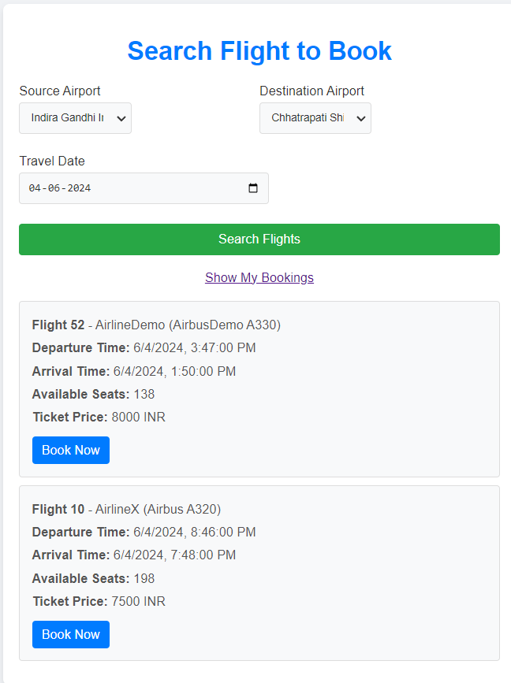
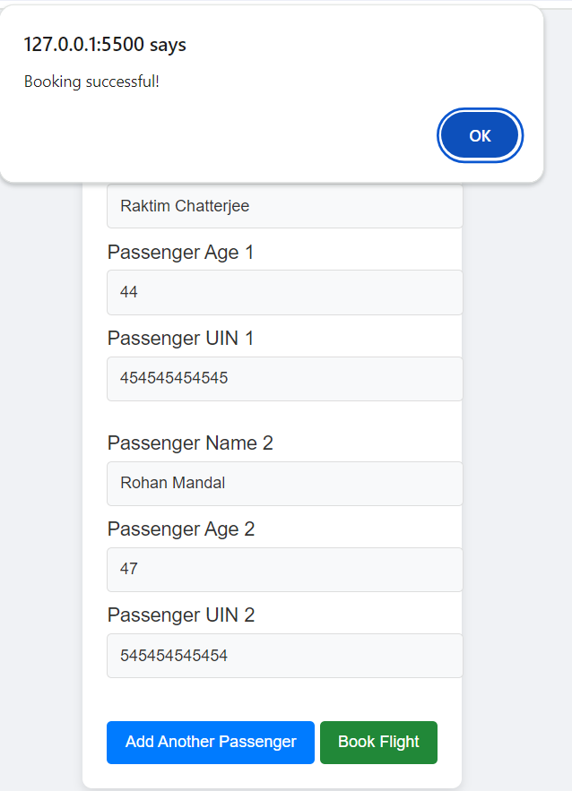
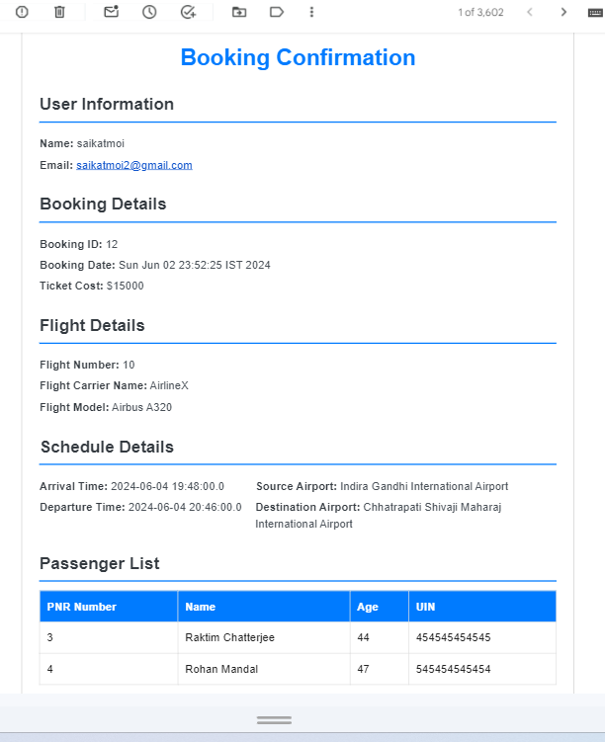
Booking Process Demo

Slide 8

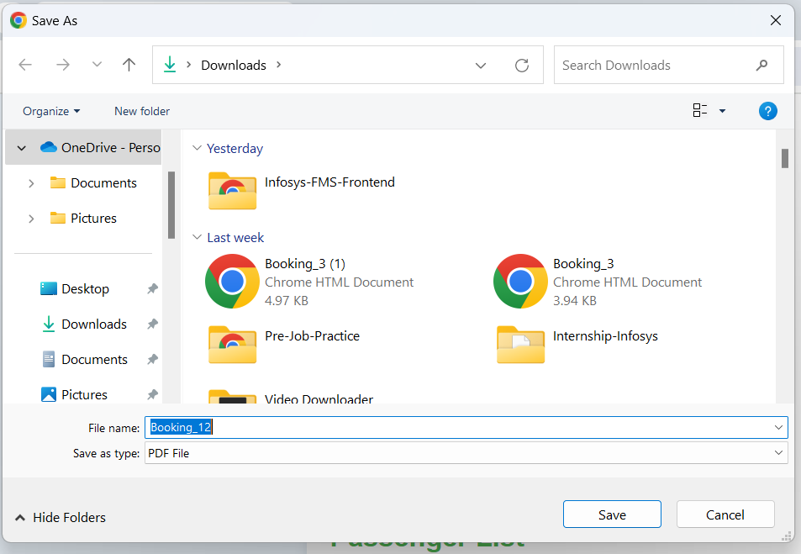

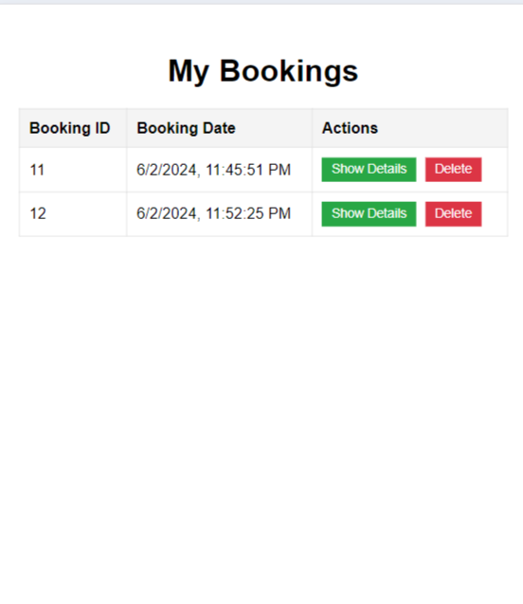
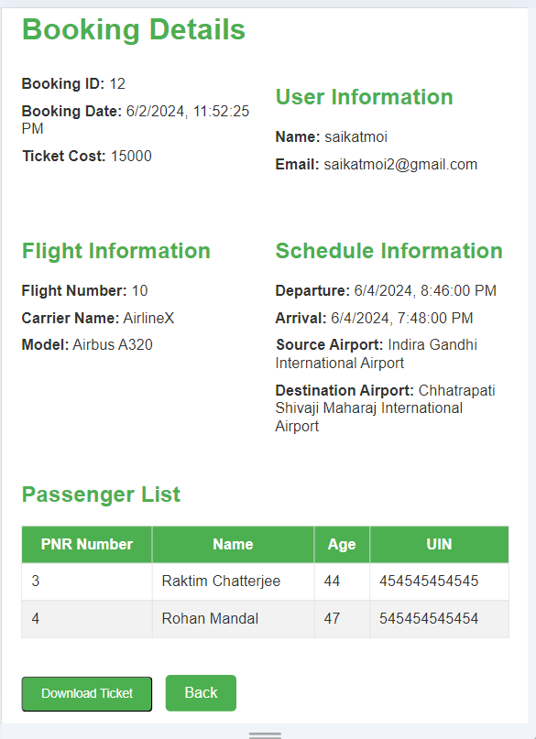
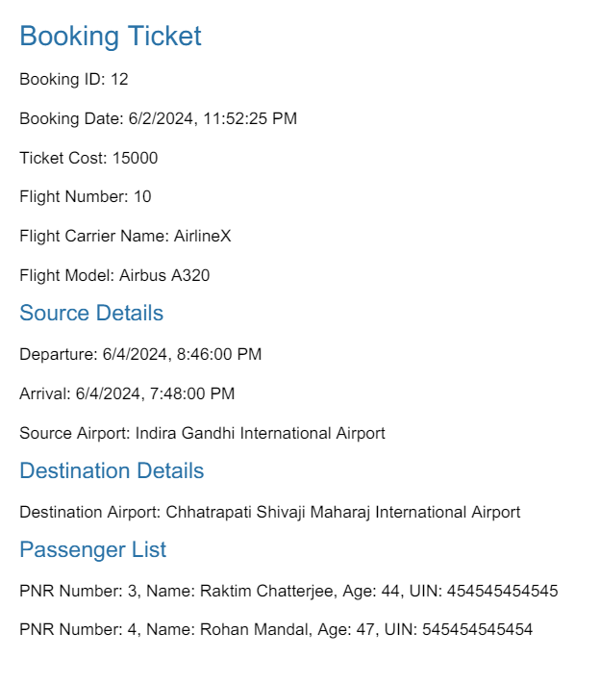
View Bookings

Slide 9

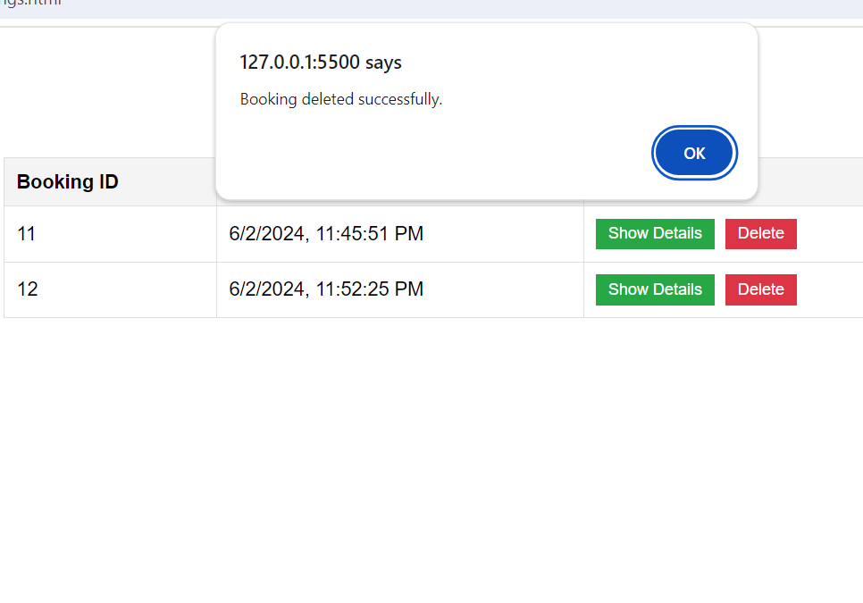
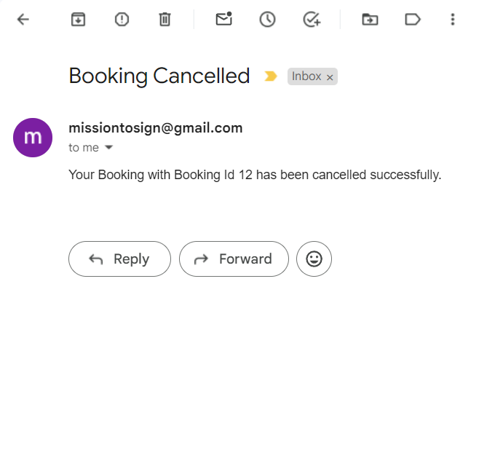
Cancel Bookings

Slide 10
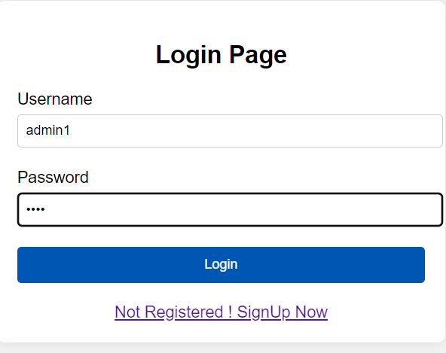
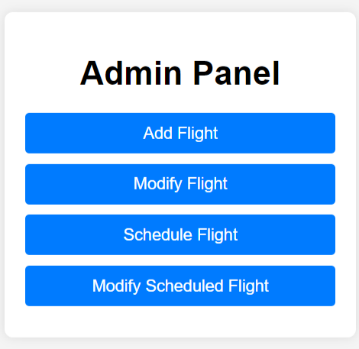
Login Process Demo (ADMIN)
ADMIN Login

Slide 11



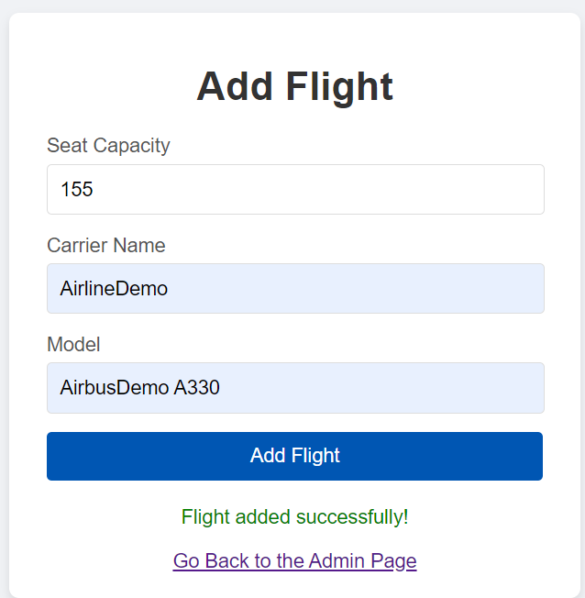
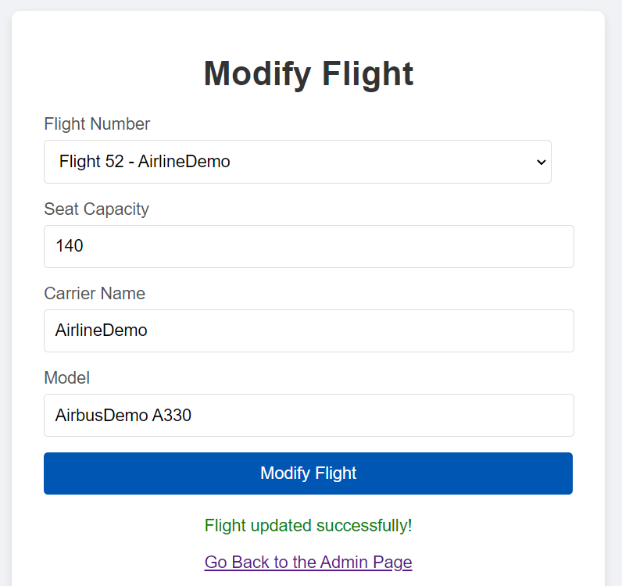
Add and Modify Flight (ADMIN)

Slide 12
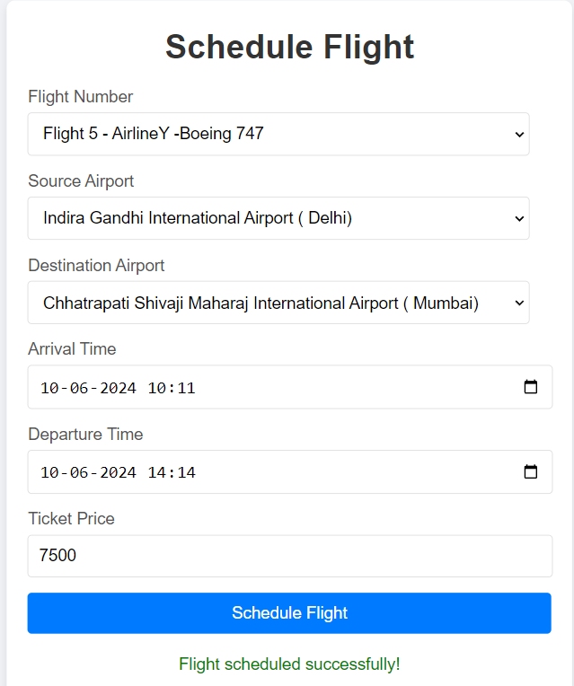


Schedule Flight (ADMIN)

Slide 13

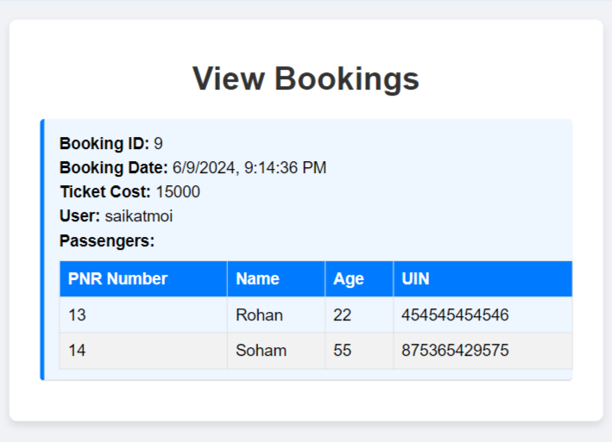
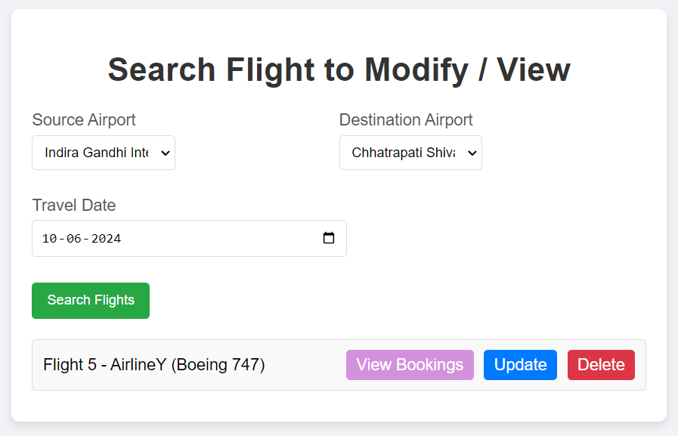
View Bookings of a Scheduled Flight (ADMIN)

Slide 14

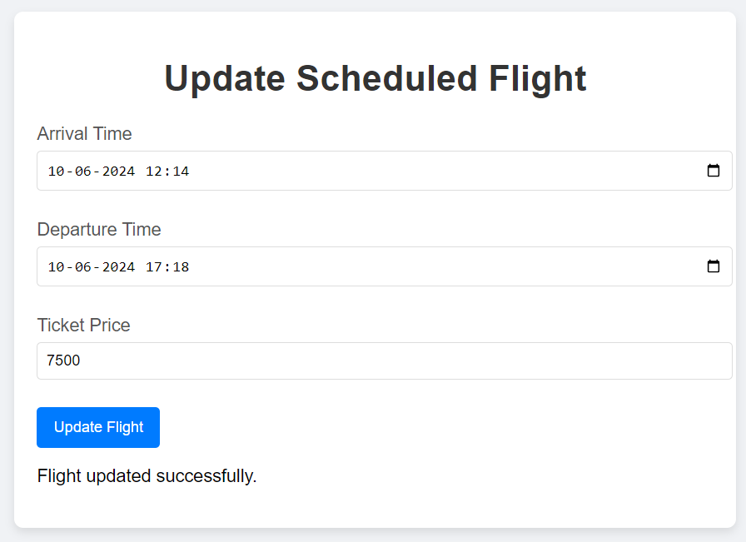
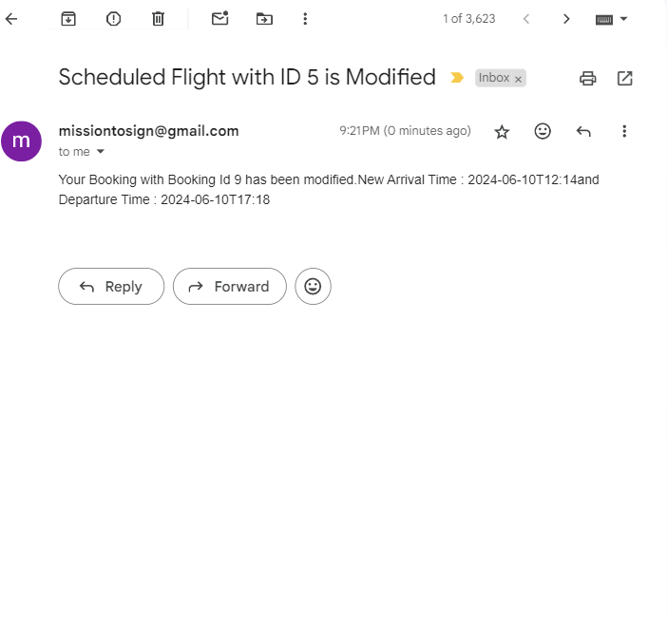
Update Scheduled Flight (ADMIN)

Slide 15
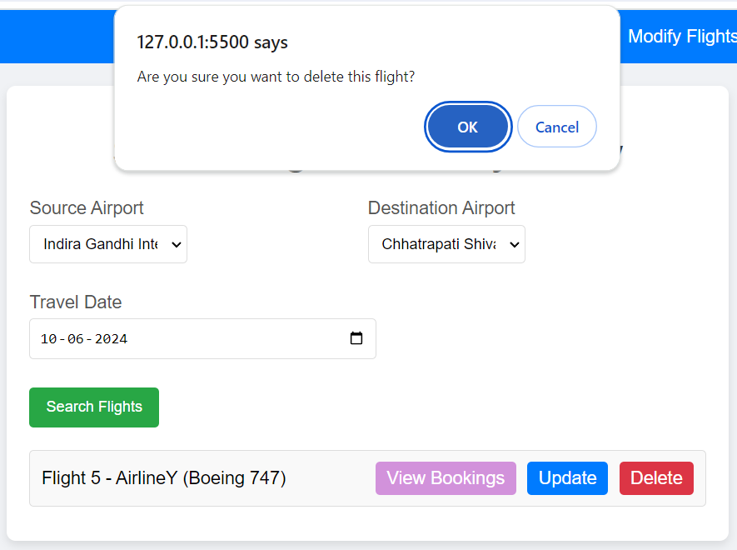
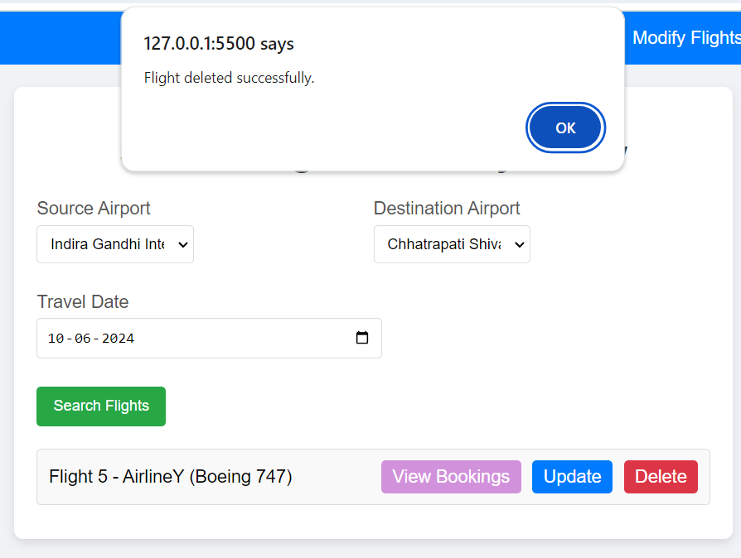
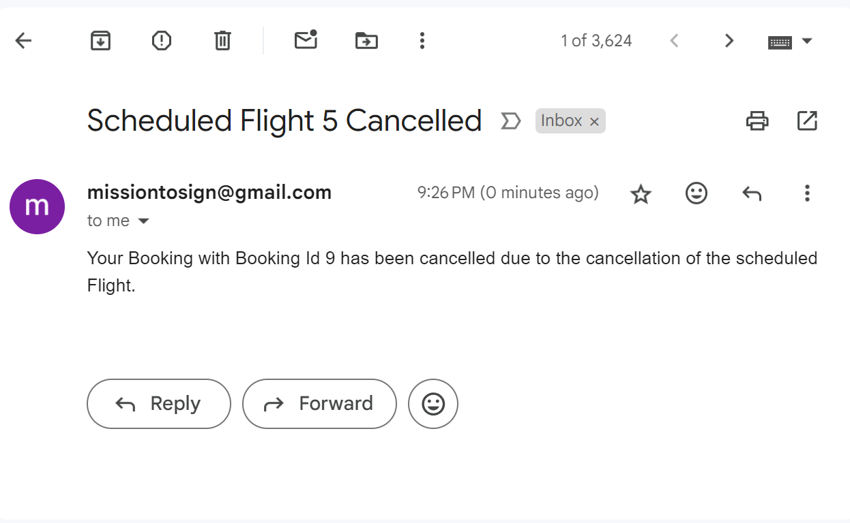
Delete Scheduled Flight (ADMIN)

Slide 16
Opportunities for Improvement
Migrating to microservice architecture to enhance scalability and maintainability
Implementation of OAuth2 for strengthened security and simplified user authentication
Improvement in frontend UI/UX design for better user engagement and performance.
Integration of payment services .

Slide 17
Thank You! Project Link - https://github.com/saikatmoi/Infosys-FMS

