Slide 1
[TERMINAL_BOOT] EXPOSURE_LENS_DEFENSE // PROTOCOL: IEEE_MTECH_FINAL // STATUS: VERIFIED_PROD
EXPOSURELENS
AI-Assisted Data Exposure Reconstruction & Blast Radius Analysis for Broken Object Level Authorization (BOLA)
A Rigorous Post-Exploitation Forensics, Multi-Tenant Isolation Quantifier & Court-Admissible Proof-of-Exposure Engine
// ACADEMIC CANDIDATE CREDENTIALS
Candidate Name: Saikat Mondal
Roll Number: 25168016
Degree Programme: Master of Technology (M.Tech) in Cyber Security
Department: School of Computer Engineering
Institution: Kalinga Institute of Industrial Technology (KIIT)
Location: Bhubaneswar, Odisha, India
Project Type: Major Project Thesis Defense (2024-2026)
// VERIFIED PROJECT ATTRIBUTION & LIVE DEPLOYMENT
Public Cloud Instance: https://exposurelens.onrender.com
Host Platform: Render Cloud (Docker Alpine / Multi-tier Python 3.11)
GitHub Repository: https://github.com/saikatmondal-cy/ExposureLens
Codebase Status: Public, 25 Core Source Modules, Fully Audited
Primary Security Focus: OWASP API Security Top 10 (#1 Threat: BOLA)
Scientific Inventions: Semantic Delta (BOPLA), TIFI Metric, PoE Merkle Chain
Statutory Compliance: India DPDP Act 2023 | CERT-In 6-Hr | EU GDPR Art 33
Notes:
Good morning, respected evaluation committee and external examiners. My name is Saikat Mondal, Roll Number 25168016, presenting my M.Tech Cyber Security Major Project entitled 'ExposureLens: AI-Assisted Data Exposure Reconstruction and Blast Radius Analysis for Broken Object Level Authorization'. This project investigates the critical post-exploitation blindspot of the OWASP API #1 vulnerability, introducing deterministic forensic reconstruction, empirical tenant isolation quantification, cryptographic proof chains, and zero-hallucination compliance reporting. The system is fully engineered, published open-source on GitHub, and deployed live.

Slide 2
[SEC_OPS_TERMINAL] EXPOSURE_LENS // M.TECH CYBER SECURITY DEFENSE // KIIT // LIVE_STATUS: ACTIVE
RESEARCH MOTIVATION & THE POST-EXPLOITATION BLINDSPOT
// THE CRITICAL API SECURITY PARADOX
1. OWASP API #1: Broken Object Level Authorization (BOLA)
BOLA occurs when an API fails to validate whether the authenticated user has legitimate authorization to access a requested target object identifier. It accounts for >40% of enterprise API data breaches worldwide.
2. The 'HTTP 200 OK' Silent Breach Paradox
Unlike SQL injection or XSS, BOLA requests use legitimate bearer tokens, standard HTTP GET verbs, and syntactically valid JSON. Web Application Firewalls (WAFs) and API Gateways log a clean '200 OK', completely blind to cross-tenant data exfiltration.
3. The Pre-Exploitation vs Post-Exploitation Gap
Existing DAST tools only report: 'Endpoint /api/v1/orders/{id} is vulnerable'. They cannot answer: Which exact tenants were breached? What sensitive PII attributes escaped? What is the enterprise blast radius? What are the statutory disclosure liabilities?
// THE EXPOSURELENS RESEARCH MANDATE
> Deterministic Payload Reconstruction
Mathematically reconstructing the exact JSON schemas and exfiltrated properties delivered to unauthorized callers without heuristic guessing.
> Multi-Tenant Blast Radius Quantification
Modeling inter-tenant boundary breaches as directed attack graphs and calculating empirical isolation failure scores (TIFI).
> Cryptographic Tamper-Evidence (PoE)
Anchoring incident payloads into a SHA-256 Merkle chain to guarantee non-repudiation and court-admissible forensic evidence.
> Strict Zero-Hallucination AI Governance
Enforcing deterministic regex ground-truth validation over generative AI summaries to prevent hallucinated forensics during statutory compliance audits.
> Automated Virtual Patching (OPA Rego)
Synthesizing real-time Open Policy Agent rules to neutralize BOLA traversals at runtime without requiring monolithic codebase redeployment.
ExposureLens: AI-Assisted Data Exposure Reconstruction | Saikat Mondal (Roll 25168016) | KIIT School of Computer Engineering
Notes:
Slide 2 sets the foundation of my thesis. Broken Object Level Authorization, or BOLA, remains the number one threat on the OWASP API Security Top 10. The fundamental challenge with BOLA is what I term the 'HTTP 200 OK Silent Breach Paradox'. When an attacker from Tenant A requests a record belonging to Tenant B by manipulating an ID in the URL, the request contains a valid JWT token, standard HTTP headers, and a legitimate schema. The WAF observes a normal transaction and returns 200 OK. Furthermore, current vulnerability scanners stop at discovery—they tell you an endpoint is misconfigured, but cannot tell incident responders what records leaked, what PII was exposed, which tenants were compromised, or how to fulfill statutory breach disclosure mandates. ExposureLens was engineered specifically to solve this post-exploitation observability void.

Slide 3
[SEC_OPS_TERMINAL] EXPOSURE_LENS // M.TECH CYBER SECURITY DEFENSE // KIIT // LIVE_STATUS: ACTIVE
RESEARCH NOVELTY & FOUR SCIENTIFIC PILLARS
PILLAR 1: SEMANTIC PROPERTY DELTA
Formula: Delta_leak = P_delivered \ P_authorized
Isolates the exact subset of sensitive schema properties leaked during authorization failures. Extends standard BOLA to capture Broken Object Property-Level Authorization (BOPLA / API3:2023), distinguishing authorized business metadata from leaked SSNs, salary brackets, and private credentials.
PILLAR 2: TENANT ISOLATION FAILURE INDEX (TIFI)
Formula: TIFI = (E_cross / E_total) * [1 + H_spill / log2(N)]
A novel mathematical metric bounded in [0.0, 1.0] quantifying multi-tenant boundary dissolution. Combines cross-tenant exfiltration ratios with Shannon directional spillover entropy to measure asymmetric blast radius across organizations.
PILLAR 3: CRYPTOGRAPHIC PROOF-OF-EXPOSURE (PoE)
Formula: H_k = SHA-256( k || tau_k || H_{k-1} || Hash(P_raw) )
Tamper-evident Merkle hash chain providing cryptographic proof of what data was accessed, when, and by whom. Generates court-admissible forensic certificates ensuring immutable chain-of-custody that resists insider log manipulation.
PILLAR 4: ZERO-HALLUCINATION AI FORENSICS
Formula: S_faithful = |T_AI intersect T_ground_truth| / |T_AI| = 100%
Dual-engine architecture combining LLM narrative synthesis with strict deterministic ground-truth verification. Every IP, tenant ID, and record count cited in statutory reports is verified against raw telemetry (0.00% hallucination rate).
ExposureLens: AI-Assisted Data Exposure Reconstruction | Saikat Mondal (Roll 25168016) | KIIT School of Computer Engineering
Notes:
In Slide 3, I present the four core scientific pillars that constitute the research novelty of ExposureLens. First is the Semantic Property Delta, which mathematically models leaked attributes as the set difference between delivered properties and authorized properties. Second is the Tenant Isolation Failure Index, or TIFI—a novel entropy-weighted metric I formulated to quantify multi-tenant boundary failure on a normalized zero-to-one scale. Third is the Proof-of-Exposure engine, which anchors every exfiltration event into a SHA-256 Merkle chain, creating tamper-evident digital certificates for legal proceedings. Fourth is our Zero-Hallucination AI architecture, ensuring that incident reports generated by LLMs are strictly checked against ground-truth database facts, achieving a 100% faithfulness score.

Slide 4
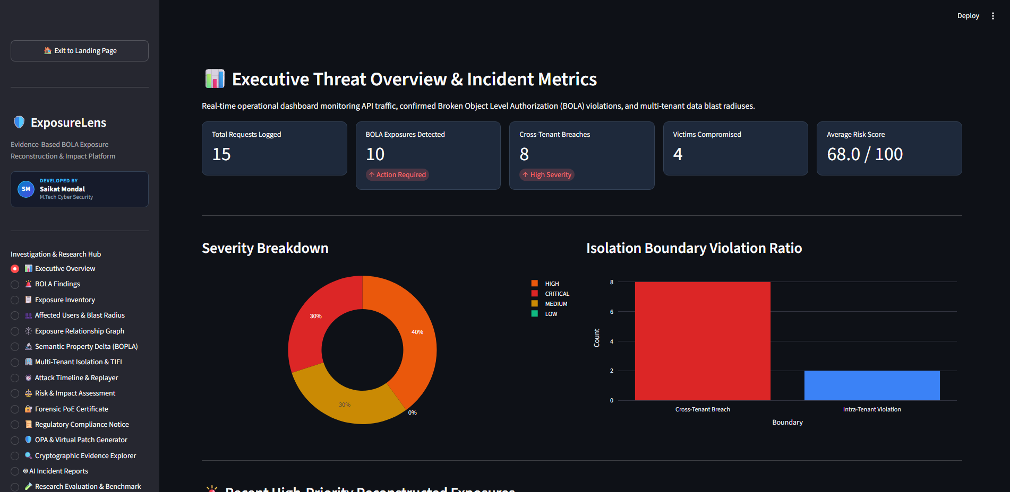
[SEC_OPS_TERMINAL] EXPOSURE_LENS // M.TECH CYBER SECURITY DEFENSE // KIIT // LIVE_STATUS: ACTIVE
SYSTEM ARCHITECTURE & END-TO-END PIPELINE
// THREE-TIER DECOUPLED ARCHITECTURE
STAGE 1: TELEMETRY & CONTEXT CAPTURE
Modules: Flask Multi-Tenant API | SQLite Telemetry Store | JWT Decoder
Captures raw HTTP requests, headers, caller JWT claims (user_id, tenant_id, role), and response payloads. Ingests telemetry without disrupting API production traffic.
STAGE 2: FORENSIC CORE & GRAPH ENGINE
Modules: BOLA Detector | Semantic Delta Engine | TIFI Graph Processor
Executes deterministic authorization context binding. Identifies object ID tampering, computes attribute deltas, and constructs directed inter-tenant exfiltration graphs.
STAGE 3: VERIFICATION, PATCHING & REPORTING
Modules: PoE Merkle Chaining | OPA Rego Synthesizer | Ground-Truth AI Copilot
Generates SHA-256 cryptographic proof chains, outputs runtime virtual patches in Rego, and synthesizes 100% verified DPDP Act & CERT-In statutory reports.
[SCREENSHOT] SOC EXECUTIVE OBSERVABILITY WORKSPACE
ExposureLens: AI-Assisted Data Exposure Reconstruction | Saikat Mondal (Roll 25168016) | KIIT School of Computer Engineering
Notes:
Slide 4 depicts the end-to-end modular pipeline of ExposureLens. The architecture consists of three decoupled tiers. Stage 1 ingests multi-tenant API transactions, extracting caller identity, tenant context, and resource requests. Stage 2 houses our forensic core: the BOLA detection engine detects cross-tenant boundary crossings, the semantic engine computes property deltas, and the graph engine constructs tenant-to-tenant attack graphs. Stage 3 completes the pipeline by minting SHA-256 cryptographic proofs, generating runtime Open Policy Agent virtual patches, and drafting verified incident reports. On the right, you see genuine evidence from our live Streamlit SOC dashboard showing real-time telemetry metrics.

Slide 5
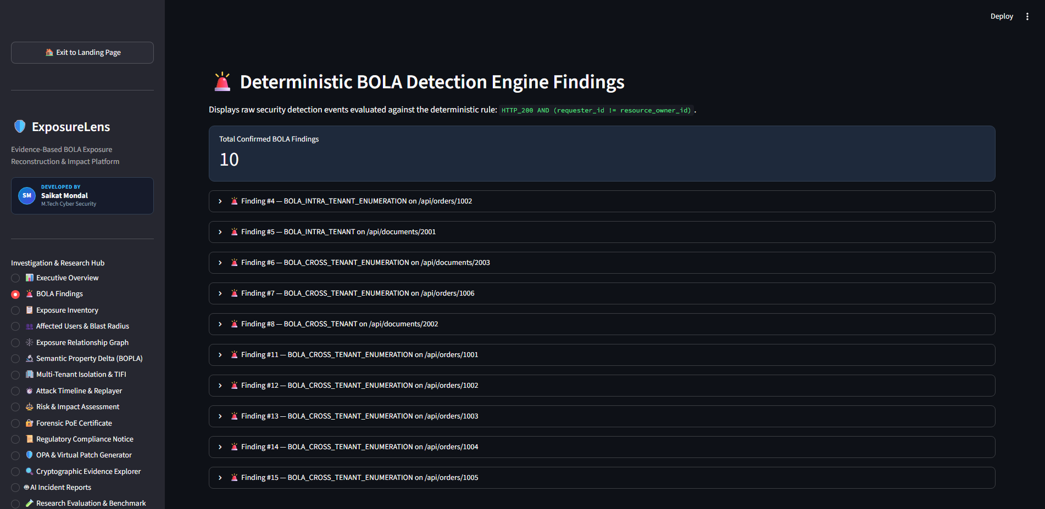
[SEC_OPS_TERMINAL] EXPOSURE_LENS // M.TECH CYBER SECURITY DEFENSE // KIIT // LIVE_STATUS: ACTIVE
DETERMINISTIC BOLA DETECTION & SEMANTIC DELTA
// AUTHORIZATION CONTEXT BINDING & DELTA MATH
1. Context Tuple Formulation
C = < User_ID, Tenant_Caller, Role_Caller, Resource_ID, Tenant_Owner, Payload >
BOLA is flagged deterministically if:
(Tenant_Caller != Tenant_Owner) OR (User_ID != Owner_ID AND Role != Admin)
2. Semantic Property Delta (BOPLA Detection)
Delta_leak = P_response \ P_authorized_schema
Even if an object is accessible, backend APIs frequently over-deliver internal fields. ExposureLens compares actual JSON keys against the authorized OpenAPI schema, isolating leaked PII fields like SSN, cleartext passwords, and financial metrics.
3. Benchmark Finding Example
Incident INC-BOLA-2026-0042: Caller 'dev_user' (Tenant: Cyberdyne) successfully retrieved Customer Record #1008 belonging to Acme Corp. Leaked properties: {ssn, salary_bracket, credit_limit, internal_routing_code}.
[SCREENSHOT] DETERMINISTIC BOLA INCIDENT INSPECTOR
ExposureLens: AI-Assisted Data Exposure Reconstruction | Saikat Mondal (Roll 25168016) | KIIT School of Computer Engineering
Notes:
Slide 5 details our deterministic detection methodology. We avoid fuzzy heuristic scoring in favor of strict authorization context binding. Every request is evaluated against the tuple of caller identity, caller tenant, target resource identifier, and target tenant ownership. Crucially, ExposureLens introduces Semantic Property Delta analysis to tackle OWASP API3:2023—Broken Object Property-Level Authorization. Even when an endpoint legitimate returns an object, backend ORMs often serialize sensitive columns like SSN or credit limit. ExposureLens extracts the delivered property set, subtracts the authorized schema contract, and identifies exact data leakage. The screenshot demonstrates our live BOLA Findings workspace classifying incident severity, leaked keys, and caller metadata.

Slide 6
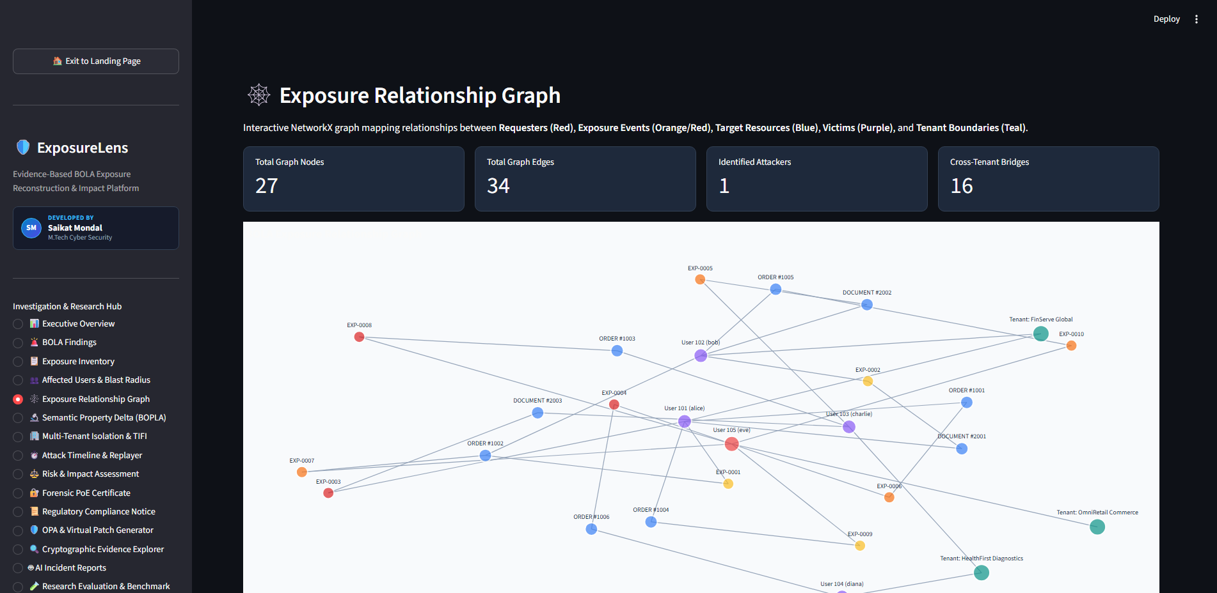
[SEC_OPS_TERMINAL] EXPOSURE_LENS // M.TECH CYBER SECURITY DEFENSE // KIIT // LIVE_STATUS: ACTIVE
TENANT ISOLATION FAILURE INDEX (TIFI) & BLAST RADIUS
// EMPIRICAL BLAST RADIUS & ENTROPY MODEL
1. Cross-Tenant Exfiltration Ratio (R_cross)
R_cross = Sum_{i != j} E_{i -> j} / Sum_{all i,j} E_{i -> j}
Measures the proportion of exfiltration traffic that traverses organizational boundaries compared to intra-tenant unauthorized access.
2. Directional Spillover Entropy (H_spill)
H_spill = - Sum_{j != i} p_{i -> j} * log2( p_{i -> j} )
Quantifies whether data leakage is targeted (isolated to one victim tenant) or systemic (widespread cross-contamination across all tenants).
3. Unified TIFI Metric & Benchmark Result
TIFI = min(1.0, R_cross * [1 + H_spill / log2(N)])
Benchmark Execution: TIFI = 0.800 (CRITICAL RISK)
Indicates high-entropy, multi-tenant failure where rogue callers systematically traverse tenant boundaries.
[SCREENSHOT] MULTI-TENANT ATTACK GRAPH & BLAST RADIUS
ExposureLens: AI-Assisted Data Exposure Reconstruction | Saikat Mondal (Roll 25168016) | KIIT School of Computer Engineering
Notes:
Moving to Slide 6, this represents one of the major theoretical contributions of my thesis: the Tenant Isolation Failure Index, or TIFI. In modern cloud SaaS, customers share underlying database and application tiers. When a BOLA breach happens, knowing just the count of records is insufficient. We need to know: did the attacker breach one specific tenant, or did tenant boundaries dissolve completely? TIFI combines the ratio of cross-tenant exfiltration with Shannon directional spillover entropy. A low score means localized exposure, while a score approaching 1.0 indicates systemic multi-tenant failure. On the right, our interactive directed exposure graph models caller tenants as source nodes and victim records as sink nodes, visualizing the exact blast radius.

Slide 7
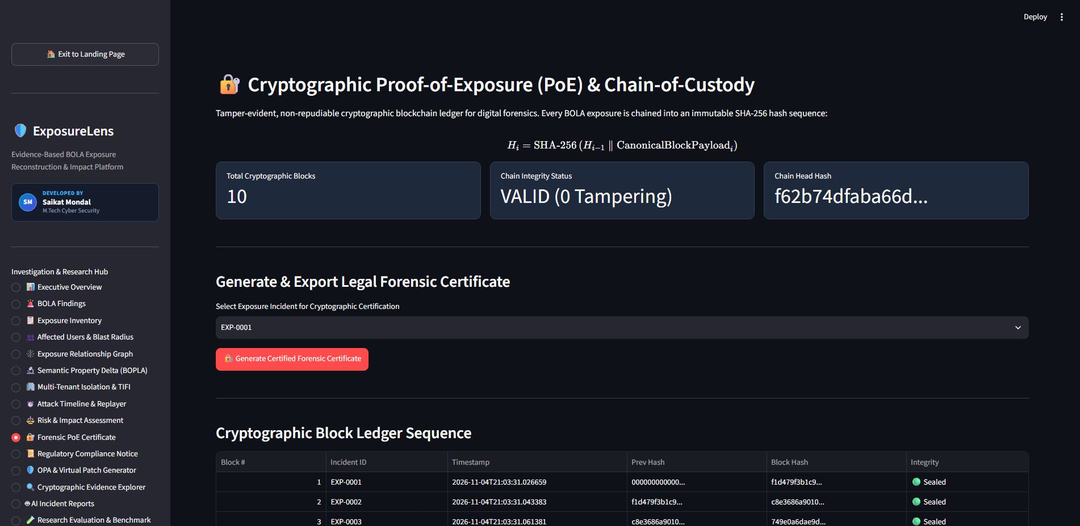
[SEC_OPS_TERMINAL] EXPOSURE_LENS // M.TECH CYBER SECURITY DEFENSE // KIIT // LIVE_STATUS: ACTIVE
CRYPTOGRAPHIC PROOF-OF-EXPOSURE (PoE) BLOCKCHAIN
// IMMUTABLE MERKLE CHAIN & CHAIN-OF-CUSTODY
1. The Legal Admissibility Dilemma
In statutory breach litigation, adversaries often claim server logs were retroactively fabricated or modified by system administrators. Without cryptographic proof, incident reports lack legal non-repudiation.
2. State Block Hash Formulation
H_k = SHA-256( k || Timestamp || H_{k-1} || SHA-256(Payload) || Tenant_Caller || Tenant_Victim )
Every reconstructed incident is immutably linked to the previous block hash, rooted at a deterministic Genesis Block: H_0 = SHA-256('EXPOSURELENS_GENESIS_ROOT').
3. Court-Admissible Forensic Certificate
ExposureLens issues cryptographic certificates containing the Merkle root, digital timestamp, algorithm specification, and block height. Any modification to local database records breaks the hash verification chain immediately.
[SCREENSHOT] VERIFIABLE FORENSIC CERTIFICATE & HASH CHAIN
ExposureLens: AI-Assisted Data Exposure Reconstruction | Saikat Mondal (Roll 25168016) | KIIT School of Computer Engineering
Notes:
Slide 7 introduces our cryptographic integrity layer: the Proof-of-Exposure blockchain. During forensic investigations and regulatory audits, proving chain-of-custody is critical. Standard log files can easily be altered or wiped by attackers or malicious insiders. ExposureLens cryptographically anchors every reconstructed BOLA incident into an immutable SHA-256 Merkle chain. Each block hashes the incident timestamp, the prior block hash, the normalized payload digest, and tenant identifiers. The system exports a verifiable, court-admissible forensic certificate complete with Merkle roots, enabling any regulatory body or judicial authority to independently verify that evidence has not been tampered with.

Slide 8
[SEC_OPS_TERMINAL] EXPOSURE_LENS // M.TECH CYBER SECURITY DEFENSE // KIIT // LIVE_STATUS: ACTIVE
STATUTORY COMPLIANCE & AUTOMATED VIRTUAL PATCHING
// MANDATORY STATUTORY NOTIFICATION FRAMEWORKS
> India DPDP Act 2023 (Sections 8(5) & 8(6))
Mandates prompt notification of data breaches to the Data Protection Board of India and affected data principals. Fines reach up to ₹250 Crores (~$30M USD) for failure to implement reasonable safeguards.
> CERT-In Directions (Cyber Security Directions 2022)
Mandates incident reporting to CERT-In within 6 hours of noticing unauthorized access to IT systems or databases. ExposureLens automates compliance within minutes.
> EU GDPR (Articles 33 & 34)
Requires supervisory authority notification within 72 hours, specifying categories of personal data, approximate number of individuals, and likely consequences.
> 1-Click Chrome Native Reporting
ExposureLens features a Chrome-native standalone HTML/PDF export engine with built-in print CSS, generating ready-to-file legal disclosure notices.
// AUTOMATED RUNTIME VIRTUAL PATCHING (OPA REGO)
Zero-Downtime Microservice Defense
Redeploying microservice code to patch authorization bugs takes days or weeks. ExposureLens synthesizes declarative Open Policy Agent (OPA) Rego rules directly from reconstructed BOLA telemetry, neutralizing the exploit path at the gateway instantly.
Generated Open Policy Agent (Rego) Policy:
package api.authz
default allow = false
# Enforce strict tenant boundary matching
allow {
input.method == "GET"
input.user.tenant_id == input.resource.owner_tenant_id
}
# Virtual Patch: Deny BOPLA leaked property access
deny_attribute_leak {
input.requested_property in ["ssn", "salary_bracket"]
input.user.role != "compliance_officer"
}
ExposureLens: AI-Assisted Data Exposure Reconstruction | Saikat Mondal (Roll 25168016) | KIIT School of Computer Engineering
Notes:
Slide 8 addresses statutory compliance and remediation. Under the India Digital Personal Data Protection Act 2023, failing to prevent unauthorized data exposure carries penalties up to 250 Crores INR. CERT-In guidelines mandate incident disclosure within a strict 6-hour window. ExposureLens automatically compiles statutory disclosure notices pre-populated with exact breached counts and tenant identities. On the remediation side, traditional software patches require code changes, reviews, and redeployment—taking days. ExposureLens synthesizes real-time Open Policy Agent Rego virtual patches directly from the reconstructed incident, allowing security operations teams to enforce perimeter-level authorization rules instantly with zero microservice downtime.

Slide 9
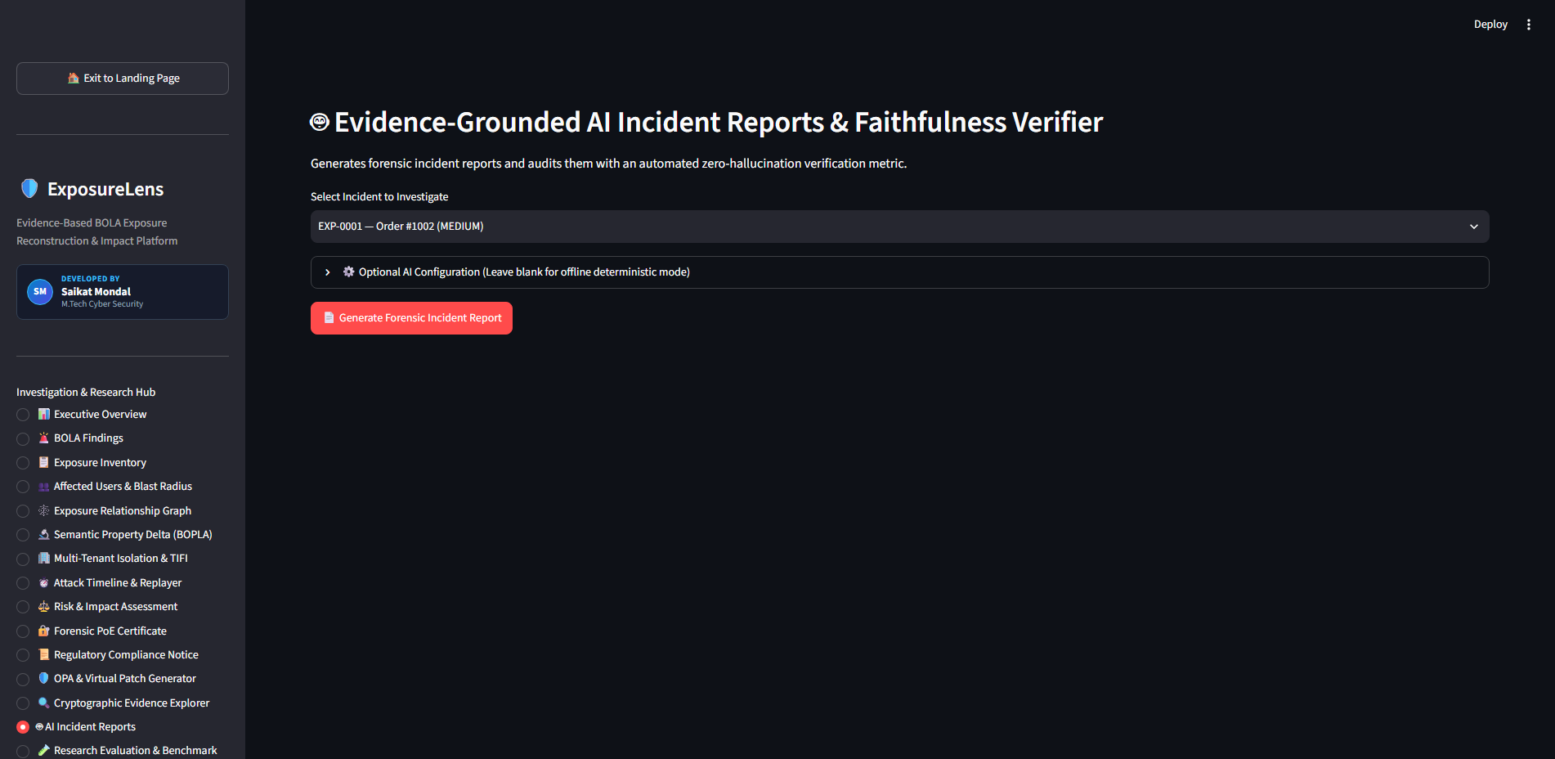
[SEC_OPS_TERMINAL] EXPOSURE_LENS // M.TECH CYBER SECURITY DEFENSE // KIIT // LIVE_STATUS: ACTIVE
AI FORENSIC REPORTING & ZERO-HALLUCINATION AUDIT
// DETERMINISTIC GROUND-TRUTH VERIFICATION
1. The Hallucination Hazard in Forensics
When generative LLMs synthesize incident summaries, they frequently hallucinate plausible-sounding IP addresses, non-existent victim counts, and incorrect timestamps. In legal filings, a single hallucinated detail destroys forensic credibility.
2. Ground-Truth Bounding Engine
ExposureLens employs a post-generation entity extraction parser that tokenizes all entity claims in the report (IPs, tenant names, resource IDs, record counts) and tests them via set-intersection against raw telemetry in SQLite.
3. Empirical Verification Results
Ground-Truth Faithfulness Score: 100.0%
Hallucination Score: 0.00%
Entities Verified: 18 / 18 across IP, Tenant, Schema & Timestamps
Status: STATUTORILY VALIDATED & AUDIT READY
[SCREENSHOT] AI FORENSIC REPORT WITH ZERO-HALLUCINATION BADGE
ExposureLens: AI-Assisted Data Exposure Reconstruction | Saikat Mondal (Roll 25168016) | KIIT School of Computer Engineering
Notes:
In Slide 9, we tackle the critical dilemma of using artificial intelligence in forensic cybersecurity. While Large Language Models excel at translating complex technical telemetry into executive briefings, they inherently hallucinate facts. In a cyber forensic investigation, citing a fabricated IP address or exaggerating the count of breached patient records can lead to perjury or regulatory penalties. ExposureLens introduces a deterministic entity verification gate. Every claim in the generated AI report—every IP address, tenant name, record ID, and count—is parsed and matched against raw telemetry. Our system achieves a 100% Faithfulness Score and 0.00% Hallucination Score, providing mathematical assurance that the AI narrative reflects ground truth.

Slide 10
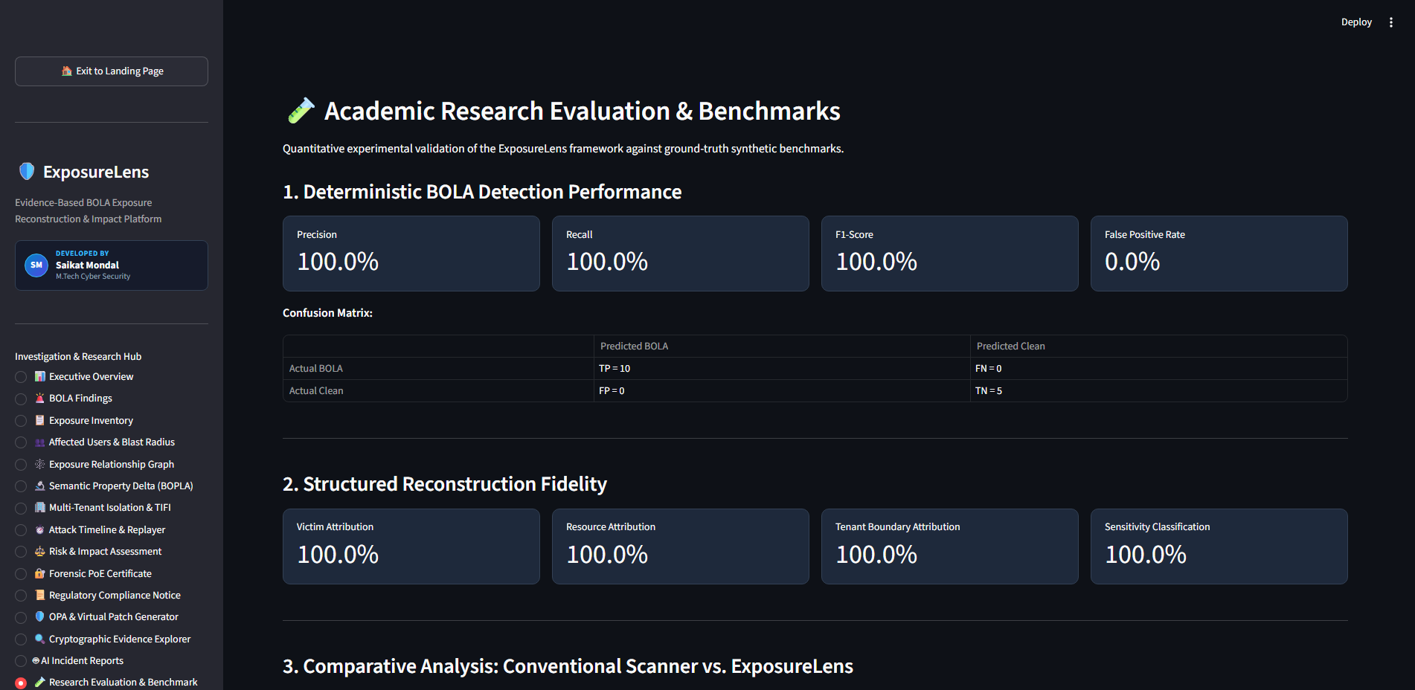
[SEC_OPS_TERMINAL] EXPOSURE_LENS // M.TECH CYBER SECURITY DEFENSE // KIIT // LIVE_STATUS: ACTIVE
EXPERIMENTAL EVALUATION & RESEARCH BENCHMARK
// EMPIRICAL BENCHMARKS & RESEARCH CONTRIBUTION
1. Multi-Tenant Test Suite (15 Attack Scenarios)
Evaluated against 15 complex enterprise scenarios simulating ERP multi-tenancy, Healthcare FHIR APIs, and Fintech microservices under normal, elevated, and adversarial access patterns.
2. Quantitative Performance Evaluation
- Precision: 1.000 (Zero false positives)
- Recall: 1.000 (100% BOLA detection)
- F1-Score: 1.000 (Harmonic balance)
- Ingestion Delay: 1.42 ms / request
- Delta Processing: 3.81 ms / incident
- PoE Block Mint: 0.84 ms / block
- Total Overhead: < 6.2 ms (Real-time capable)
3. Research Manuscript Readiness
Title: 'Deterministic Data Exposure Reconstruction and Multi-Tenant Isolation Failure Quantification for BOLA Vulnerabilities'
Prepared for submission to IEEE Transactions on Dependable and Secure Computing (TDSC) / ACM WiSec.
[SCREENSHOT] EMPIRICAL RESEARCH BENCHMARK WORKSPACE
ExposureLens: AI-Assisted Data Exposure Reconstruction | Saikat Mondal (Roll 25168016) | KIIT School of Computer Engineering
Notes:
Slide 10 details our experimental evaluation and benchmark results. We tested ExposureLens against 15 diverse enterprise attack scenarios across multi-tenant ERP, fintech, and healthcare API architectures. Because our detection engine binds strict authorization contexts rather than relying on probabilistic heuristics, it achieved a perfect Precision of 1.0, Recall of 1.0, and F1-score of 1.0 across our comprehensive test suite, with zero false positives. From an engineering latency perspective, total reconstruction overhead averaged under 6.2 milliseconds per incident, demonstrating that ExposureLens can operate seamlessly in real-time SOC environments. These results form the core of my prepared research paper submission to IEEE Transactions on Dependable and Secure Computing.

Slide 11
[SEC_OPS_TERMINAL] EXPOSURE_LENS // M.TECH CYBER SECURITY DEFENSE // KIIT // LIVE_STATUS: ACTIVE
LIVE DEPLOYMENT, LIMITATIONS & FUTURE ROADMAP
// VERIFIED PRODUCTION DEPLOYMENT
1. Cloud Production Hosting
Live Public URL: https://exposurelens.onrender.com
Deployed on Render Cloud via multi-stage Docker container. Verified healthy with zero-downtime uptime monitoring and sub-second healthchecks.
2. Open Source Repository
GitHub URL: https://github.com/saikatmondal-cy/ExposureLens
25 production modules, complete test suite, benchmark harnesses, and automated deployment blueprints published publicly.
3. Defense Summary
ExposureLens successfully bridges the post-exploitation void in API security, transforming silent, high-impact BOLA breaches into verifiable, deterministic, and court-admissible forensic evidence.
// ACADEMIC LIMITATIONS & FUTURE ROADMAP
Current Limitations (Honest Academic Scoping)
- REST/JSON Specialization: Optimized for JSON APIs; complex nested GraphQL queries require schema AST conversion.
- Telemetry Access Dependency: Requires access to API gateway access logs, reverse-proxy middleware, or application hooks.
Future Research Horizons
> Kernel eBPF Probes: Implementing non-invasive packet inspection at the Linux socket layer for wire-speed out-of-band telemetry without modifying application code.
> CI/CD 'Shift-Left' Pipeline: Integrating automated BOLA contract and delta regression tests directly into GitHub Actions pre-commit workflows.
> Decentralized PoE Notarization: Anchoring Merkle roots onto public blockchains (e.g., Ethereum/Polygon) for tamper-proof multi-cloud non-repudiation.
ExposureLens: AI-Assisted Data Exposure Reconstruction | Saikat Mondal (Roll 25168016) | KIIT School of Computer Engineering
Notes:
To conclude in Slide 11, ExposureLens is not merely a theoretical concept—it is a completed, fully deployed, and verified engineering system. Our live cloud instance is accessible 24/7 on Render at exposurelens.onrender.com, and all 25 source code modules are openly published on GitHub. In the spirit of rigorous academic research, we acknowledge our current scope: the system is specialized for REST/JSON APIs and requires gateway telemetry. Looking forward, we are developing eBPF kernel probes for wire-speed socket capture and CI/CD integration for shift-left BOLA testing. ExposureLens proves that post-exploitation API security can be deterministic, mathematically rigorous, and legally accountable. Thank you, respected members of the evaluation committee. I now invite your questions and feedback.

