Slide 1

MA4240 - Applied Statistics
-Projects Presentation

Slide 2
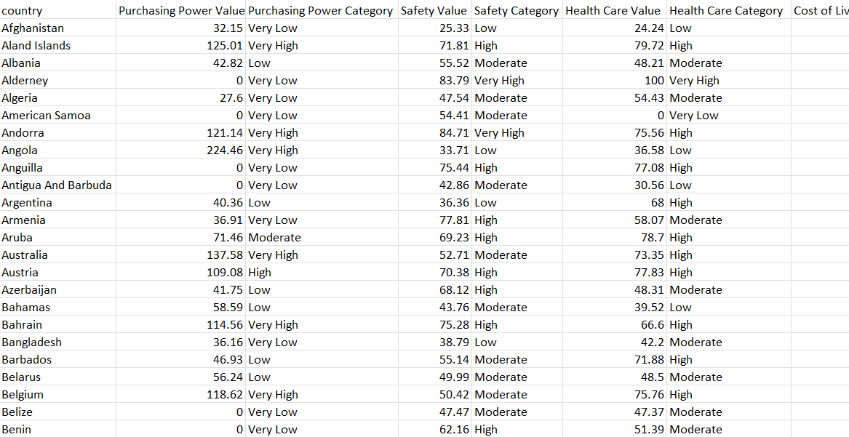
Project - 1 (Data Set Used is given below)
Preview : Dataset-1
Quality of life (Source)

Slide 3
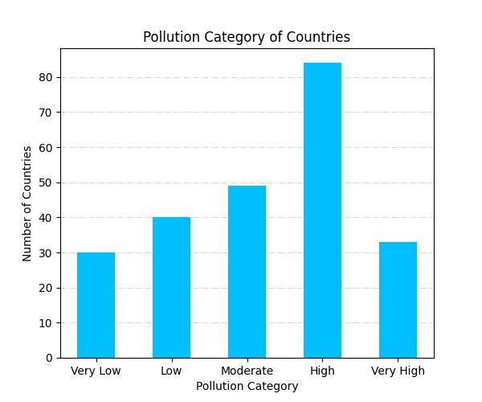
The Plots
Graphs of Pollution Category of Countries:
This bar graph shows the distribution of countries across different pollution categories.
We can see that a significant number of countries experience high levels of pollution.
The pie chart and box plot of the same are shown in the next slide.
Project 1 :Q1
The Bar Graph

Slide 4
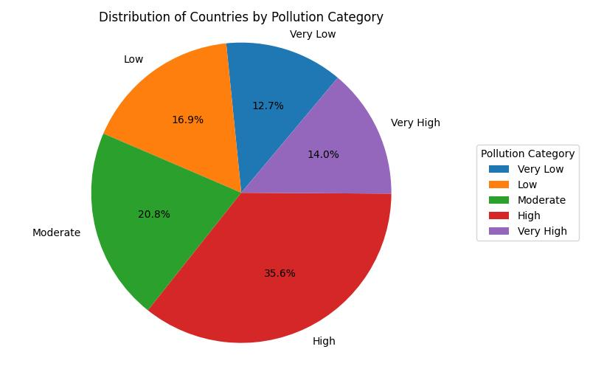
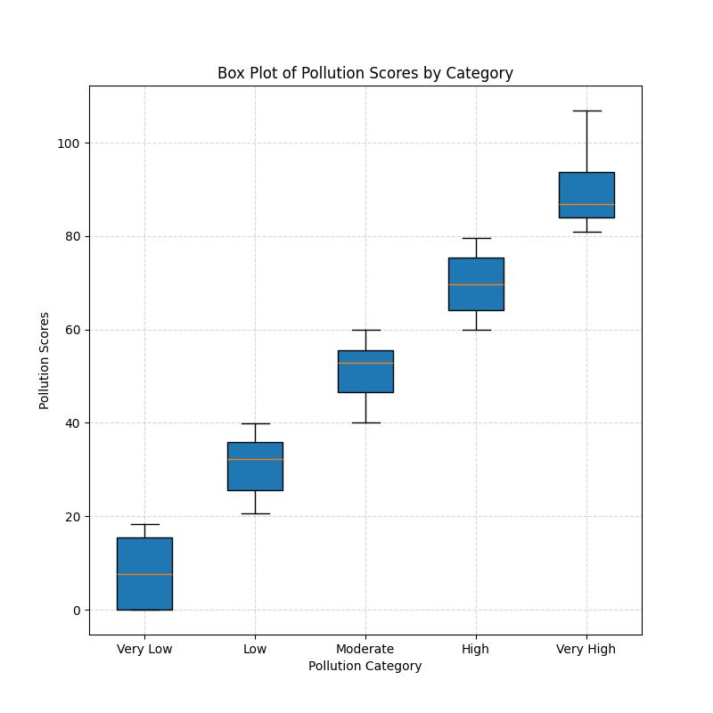
Project 1: Q1
More Plots

Slide 5
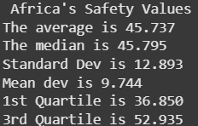
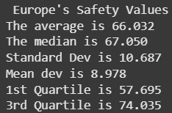
Measures of Central Tendency
Africa vs. Europe
Average Safety Value of Africa is less than that of Europe indicating more safety of European countries than African countries
Even Median Safety value for Europe is more that of Africa indicating that the Safety standards of more than Half of Europe is higher than African countries.
Project 1: Q2
Measures of Central Tendency

Slide 6
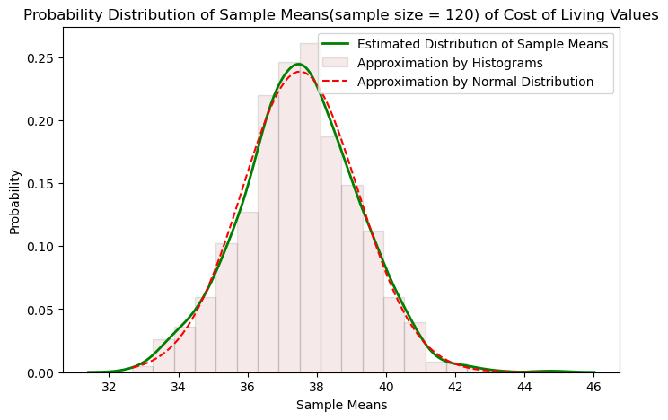
Central Limit Theorem
Taking the Cost of Living as random variable
For this plot we are considering the sample data from the all over the countries.
If we take the random sample n times of size 120, then the data can be approximated as normal dist., with mean around 37.
Project 1 : Q3
Central Limit Theorem

Slide 7
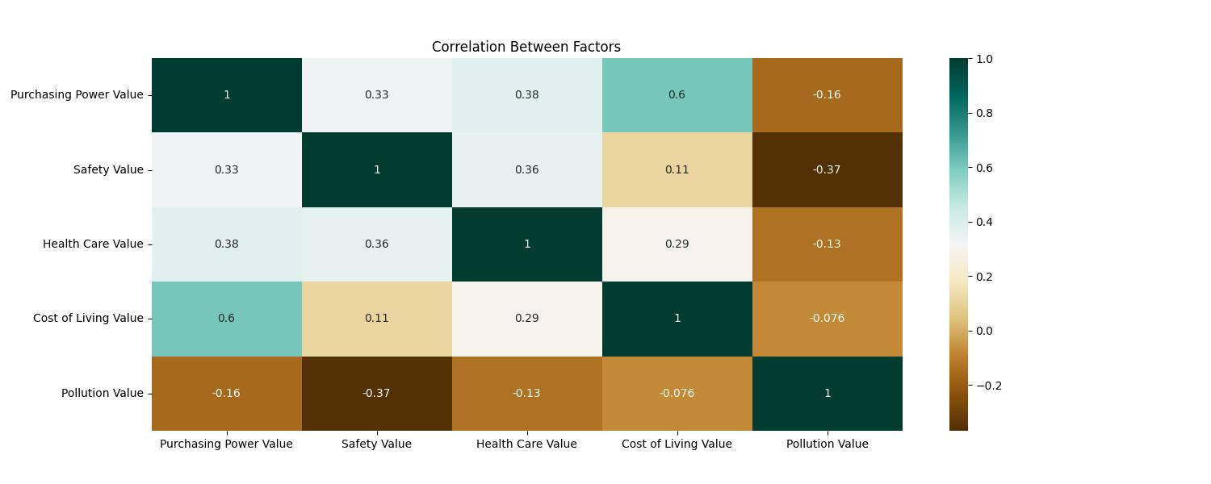
The Correlation Matrix
Project 1
The Correlations

Slide 8
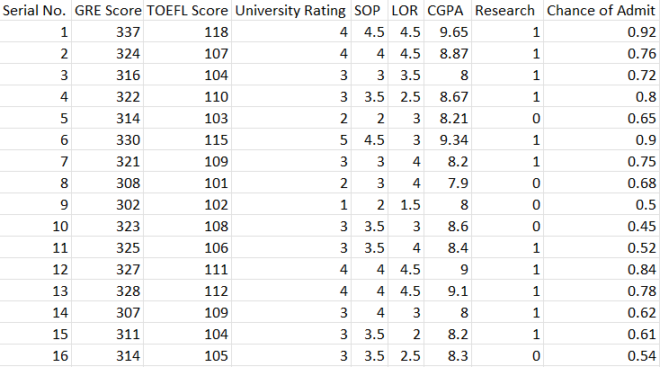
Project - 2 (Data Set Used is given below)
Preview: Dataset-2
Admission_Predict_Ver1.1(Source)

Slide 9
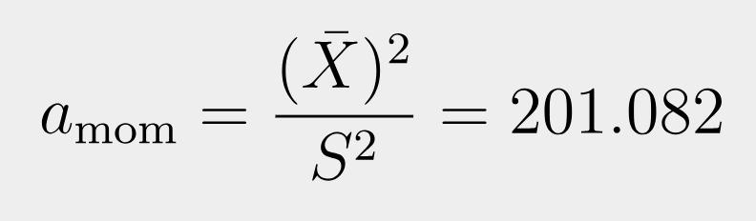
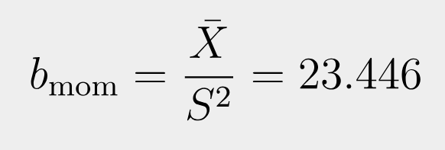
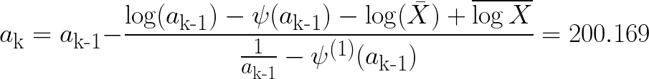
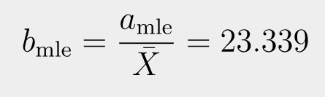
Estimating parameters of Gamma(a,b) for CGPA
MoM estimator for a & b :
MLE estimator for a & b :
Project2 - Q1
Estimating Parameters

Slide 10
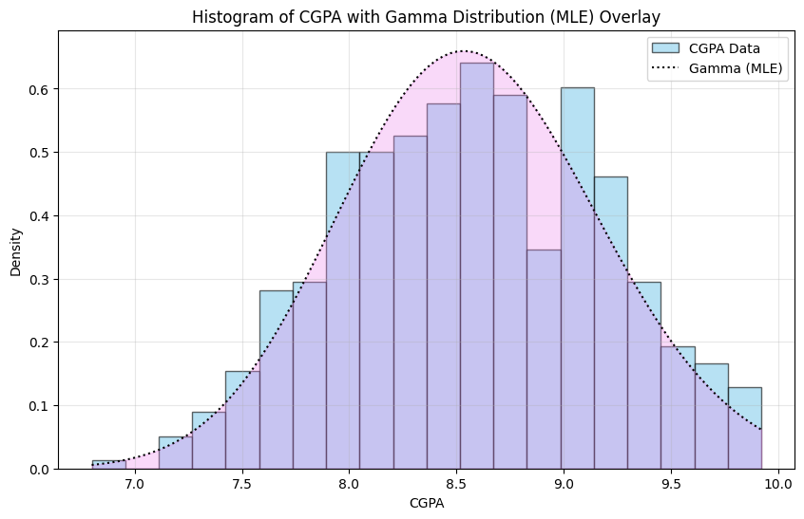
Project2 - Q1
Plotting Gamma(a,b)

Slide 11


CI for Difference of means of GRE & TOEFL scores
Project2 - Q3
Difference in the means

Slide 12
Test Hypothesis for the H₀: p <= 1/2 vs. H₁: p > 1/2
For this Test of Hypothesis we are considering the data of the Research column.
It contains the binary values {0,1} which are required for the bernoulli distribution.
As the data contains 500 tuples ( >30 condition is satisfied for CLT ) we are considering the mean(x) of all the data. As it follows Ɲ ( p , √(p(1-p)/n) ) .
Then, reject the null hypothesis if mean(x) > Z𝛂 * var + 0.5
Else accept the null hypothesis
To compare for the max case we will take the p = 0.5 (one -sided test) . And Level of significance as 𝛂 = 0.05 .
For the data which we have taken from (Research column) the “null hypothesis got Rejected “.
This result simply says that the bernoulli distribution with probability (p) mostly satisfied with the condition p>0.5 .
Project2 - Q4
Test Hypothesis

