Slide 1
EGT 307 Project
Developed by: Sai Keerthan, Xiu Wen, Wei Xuan, Hao Wen

Slide 2
Table of contents
01
02
03
04
Project Objective
System Architecture
Additional Features
Challenges and Solutions
05
Demonstration

Slide 3
01
Project Objective

Slide 4
Project Objective
Objective: Deploy an end-to-end AI Application in Kubernetes
Chosen AI Application: Diabetes Prediction
Requirements:
Modules are containerised and deployed in Kubernetes:
Scaling
Self-healing
Rollout/rollback updates
2) 4 functional modules: UI, Data preprocessing, Model training, Model inference
3) Version control through GitHub

Slide 5
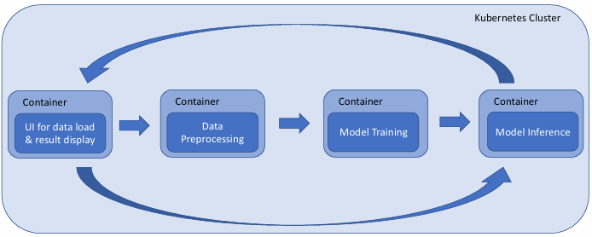
Contribution | Group Member
UI | Xiu Wen
Data Preprocessing | Wei Xuan
Model Training & k8s master | Sai Keerthan
Model Inference | Hao Wen

Slide 6
02
System Architecture

Slide 7
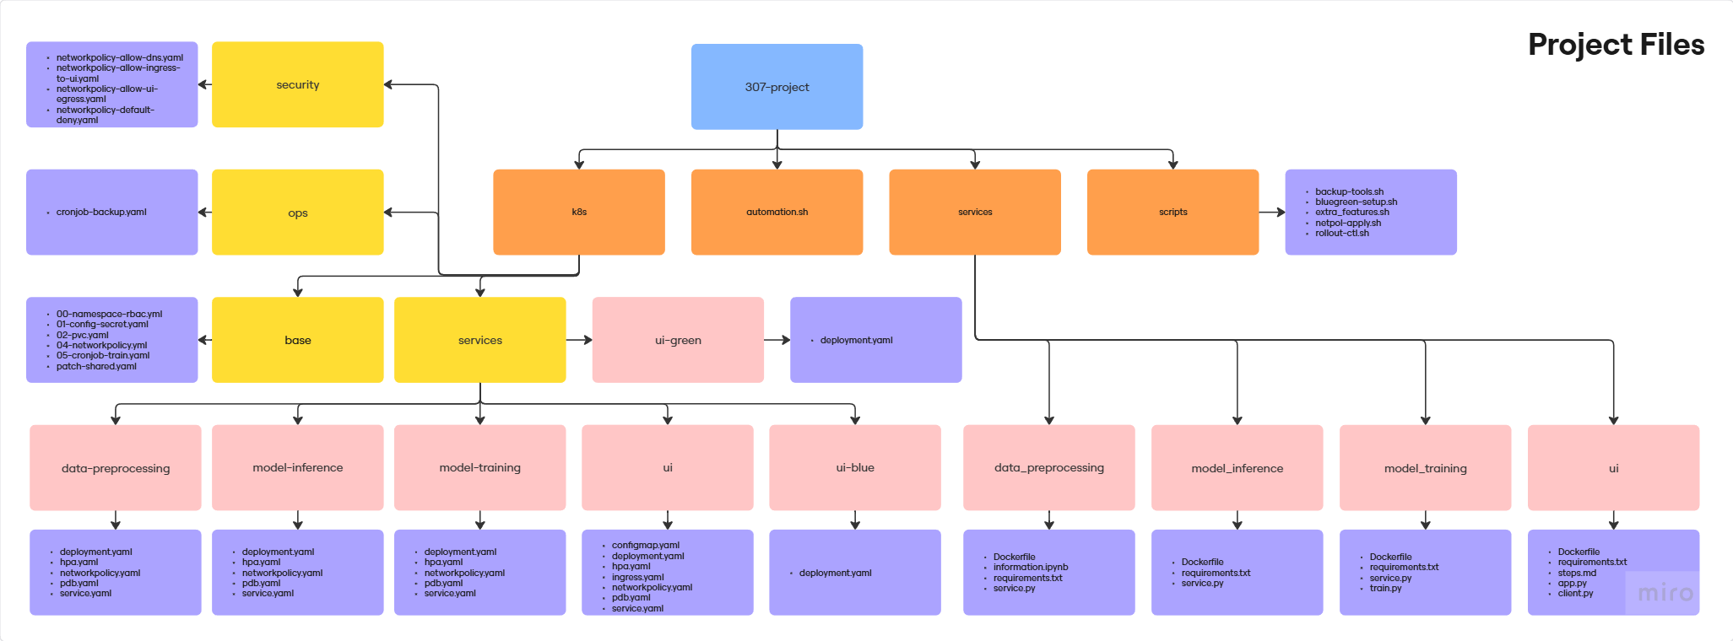
Project Files

Slide 8
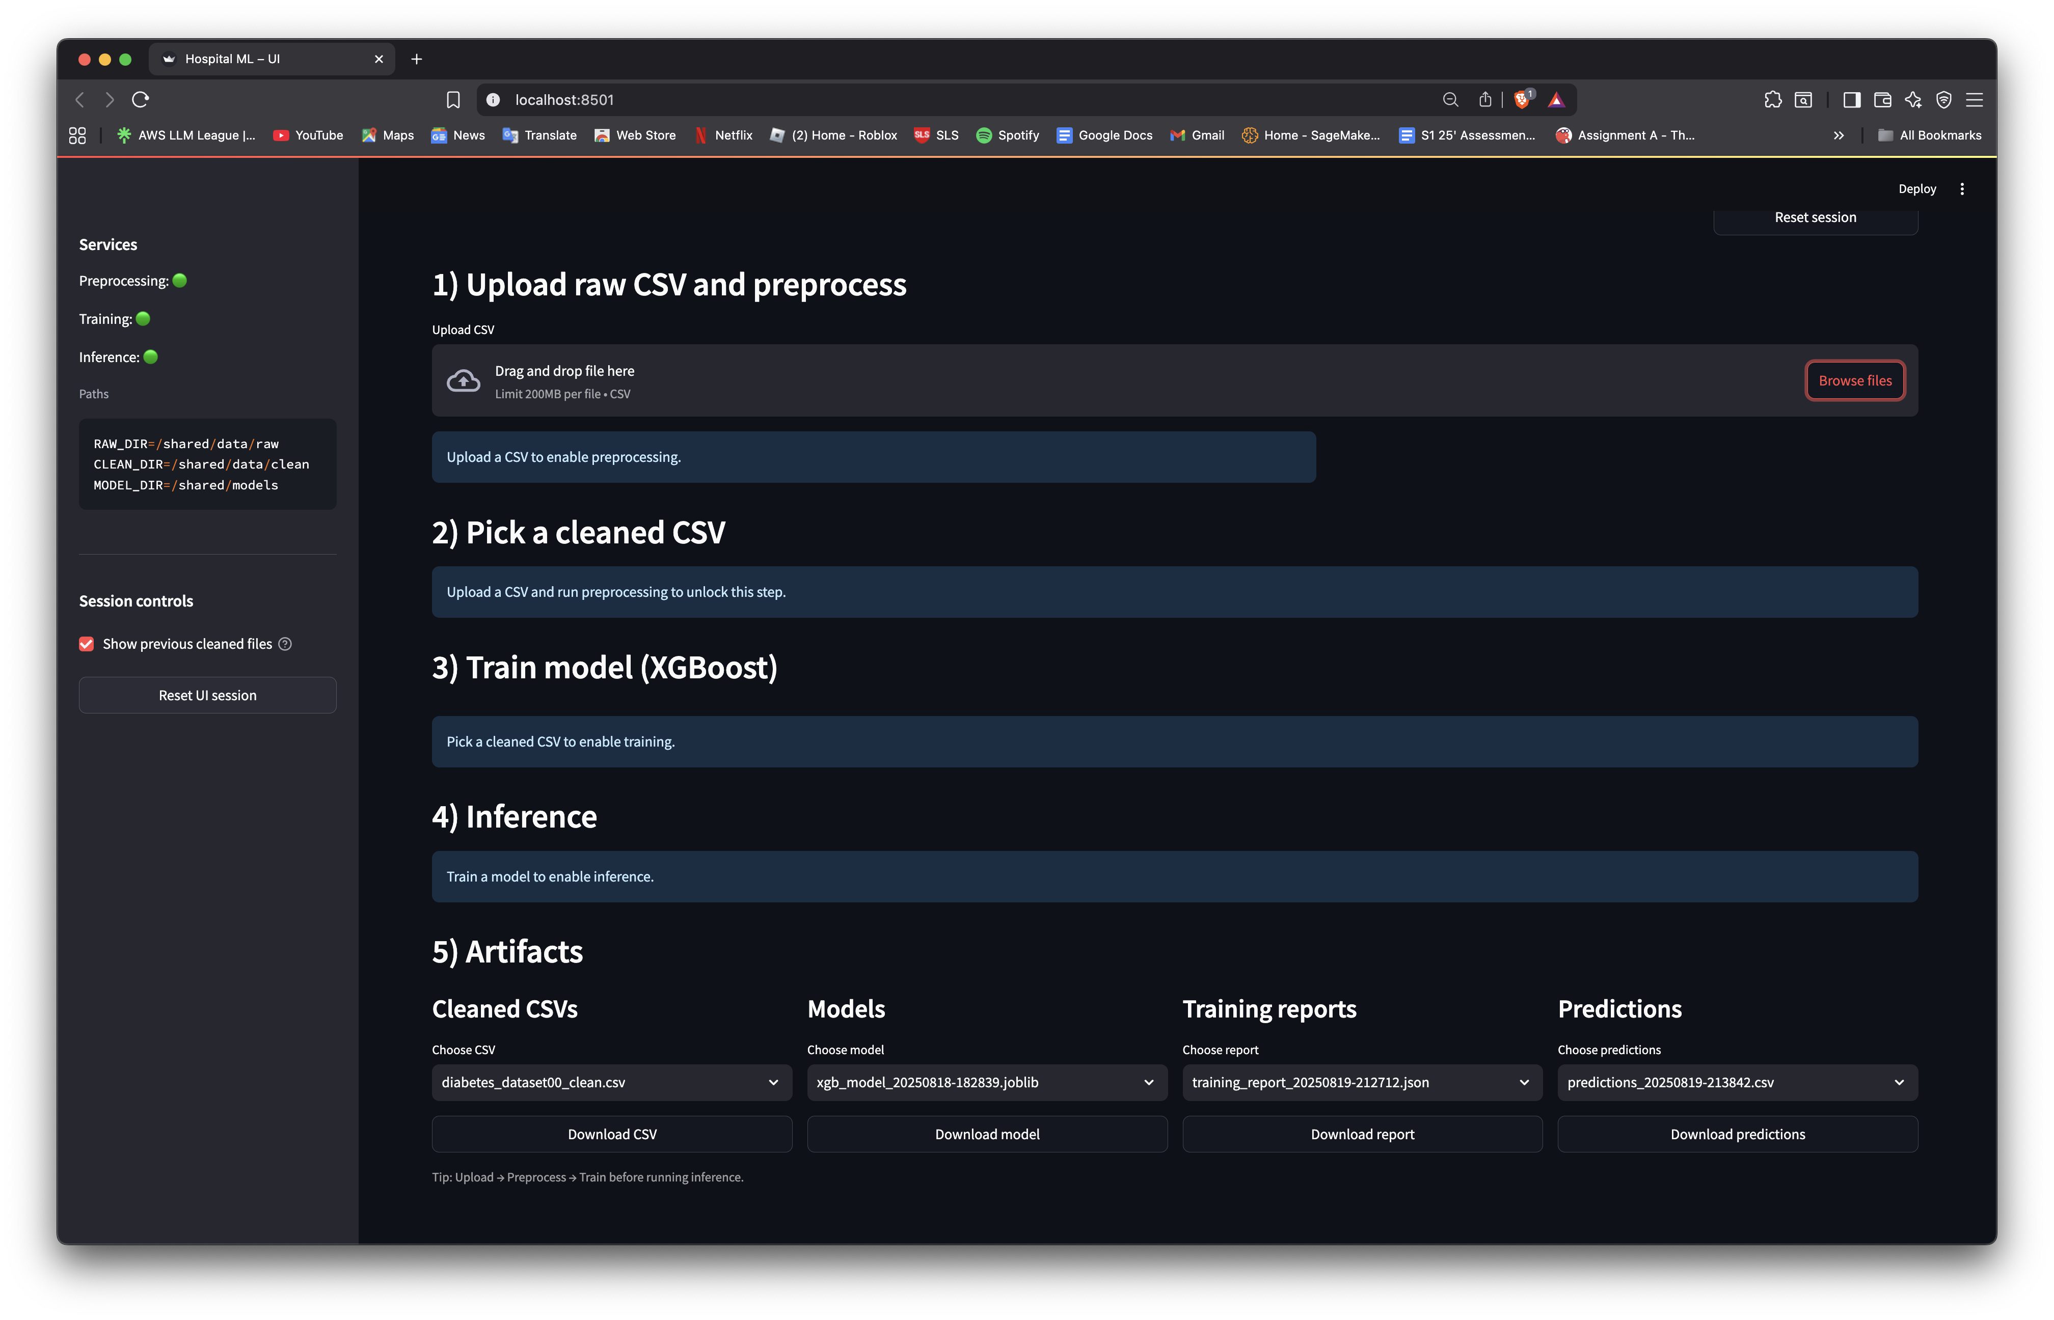
UI
/healthz endpoints
POST /preprocess
POST /train

Slide 9

UI
Services and Endpoints:
Preprocessing at PREPROC_URL
Training at TRAIN_URL
Inference at INFER_URL
Base URLs are configurable by environmental variables.
API wrapper:
UI uses BackendClient class.
Makes UI portable, it gets its config from environment variables instead of hardcoding.
3 Functions:
Upload & Preprocess
Train Model
Predict (Manual)

Slide 10
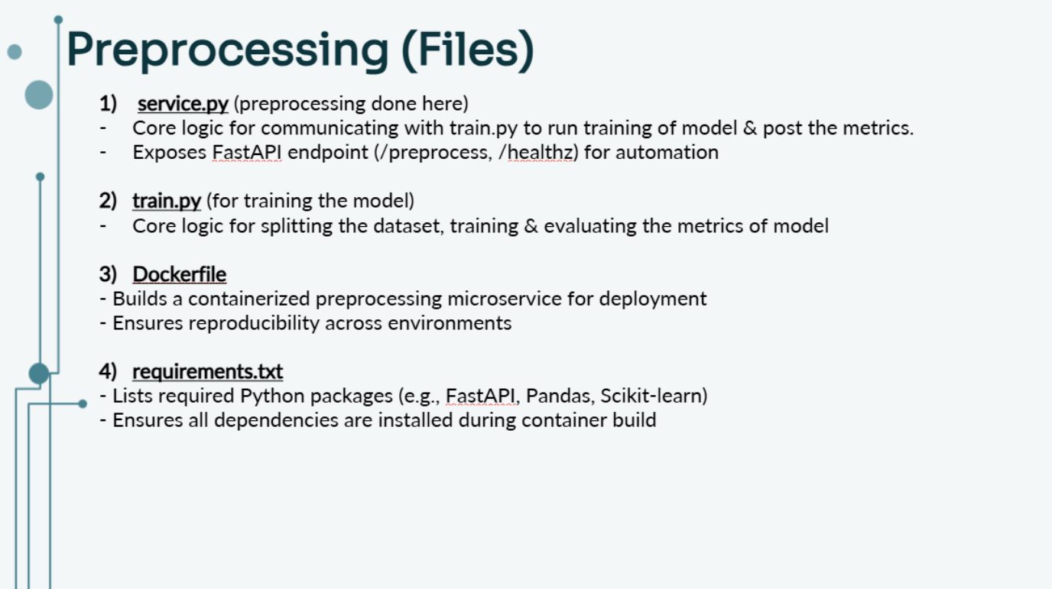

Slide 11
Preprocessing (Overview of Cleaning)
Step 1: Input Handling
Receives a .csv file uploaded from the UI
Stores the raw file into a local folder (RAW_DIR)
Loads into memory for cleaning
Step 2: Cleaning the Data
Removes:
Rows with missing or blank jobId
Duplicates
Normalizes text:
Trims whitespace
Converts to uppercase (e.g. "finance" → "FINANCE")
Step 3: Missing Value Imputation
Categorical → Fill with mode
Numerical → Fill with median
Notes:
service.py
Main script where data preprocessing logic lives.
Handles steps like:
Dropping nulls/duplicates
Encoding categorical variables
Standardizing numerical values
Saving cleaned data to CSV
Exposes API endpoints (/preprocess, /healthz) so this can run as a microservice, not just a script.
Dockerfile
Wraps the code in a container, so it runs the same across any machine or cloud service.
Good for deployment and CI/CD pipelines.
requirements.txt
Ensures all Python packages needed for preprocessing are installed (FastAPI, Scikit-learn, etc.).
No version mismatch headaches when moving between dev and prod.
information.ipynb
Used mainly for manual inspection, testing or debugging.
You can visually verify preprocessing steps worked before automating them.

Slide 12
Preprocessing (Overview of Cleaning)
Step 4: Outlier Removal
Uses IQR (Interquartile Range) to detect and remove extreme values
Mainly for numerical features like salary or experience
Step 5: Feature Engineering
One-hot encoding for categorical columns
MinMax scaling for numerical columns
Step 6: Output
Cleaned data is saved into /shared/data/clean (CLEAN_DIR)
Processing logs include:
Number of rows dropped
Number of missing values filled
Output is ready for model training or prediction
Notes:
service.py
Main script where data preprocessing logic lives.
Handles steps like:
Dropping nulls/duplicates
Encoding categorical variables
Standardizing numerical values
Saving cleaned data to CSV
Exposes API endpoints (/preprocess, /healthz) so this can run as a microservice, not just a script.
Dockerfile
Wraps the code in a container, so it runs the same across any machine or cloud service.
Good for deployment and CI/CD pipelines.
requirements.txt
Ensures all Python packages needed for preprocessing are installed (FastAPI, Scikit-learn, etc.).
No version mismatch headaches when moving between dev and prod.
information.ipynb
Used mainly for manual inspection, testing or debugging.
You can visually verify preprocessing steps worked before automating them.

Slide 13
Model Training
Service.py:
This is the front door to our training service, built with FastAPI.
It exposes a /train endpoint that kicks off training as a background job, so the UI never freezes.
Train.py:
This script handles the actual ML work.
It splits the data into train, validation, and test sets using scikit-learn.
It trains a powerful XGBoost Classifier model.
Finally, it saves the trained model (.joblib file) and a detailed JSON report with performance metrics like accuracy and F1-score.
Dockerfile:
This file packages our entire service into a lightweight and portable Docker container.
It configures the container to run our FastAPI service using the uvicorn server, ready for deployment in Kubernetes.
Requirements.txt:
Programming dependencies.

Slide 14
Model Inference
Files in Services:​
service.py
FastAPI service that reloads our trained model/artifacts, replays the same preprocessing used in training (encoders, optional scaler),aligns features, runs predicts, optionally returns top-k probabilities, and can save a CSV of predictions. Two modes to save: JSON records or cleaned CSV.
2) requirements.txt
Minimal stack for a production-grade ML inference API: FastAPI + Uvicorn for serving; Pandas/Numpy for data; scikit-learn/XGBoost for model + proba support; Joblib for loading; Pydantic for robust request/response validation.
3) Dockerfile
Containerizes the API: installs Python deps, copies code, exposes port 8000, and starts Uvicorn. The image is what the Kubernetes Deployment scales/updates.

Slide 15
Kubernetes (Files)
1) deployment.yaml
​Defines how to run the app (docker image, pods, mounted volume, environment variables)
2) hpa.yaml​
Auto-scales the Deployment between 2 and 6 replicas to keep average CPU near 70%. This is your app’s horizontal scaling policy.
3) networkpolicy.yaml​
Controls which pods are allowed to communicate with yours
Only allows inbound traffic from UI and outbound to DNS
4) pdb.yaml​
Ensures at least 1 pod stays alive during maintenance or scaling
Prevents all pods from being killed at once
5) service.yaml​
Exposes pods internally using a stable name (Type: ClusterIP)
"POST http://data-preprocessing-svc:8000/preprocess"

Slide 16
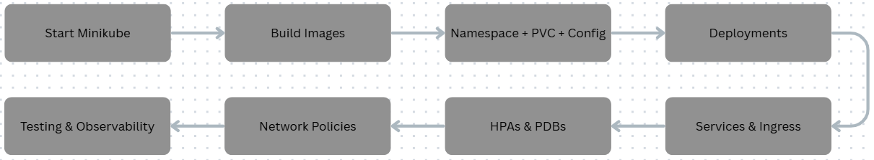
Kubernetes
Testing & Observability:
exposes the UI service to your local machine using a temporary tunnel
"kubectl -n hospital-ml port-forward svc/ui 8501:80"

Slide 17
03
Additional Features

Slide 18
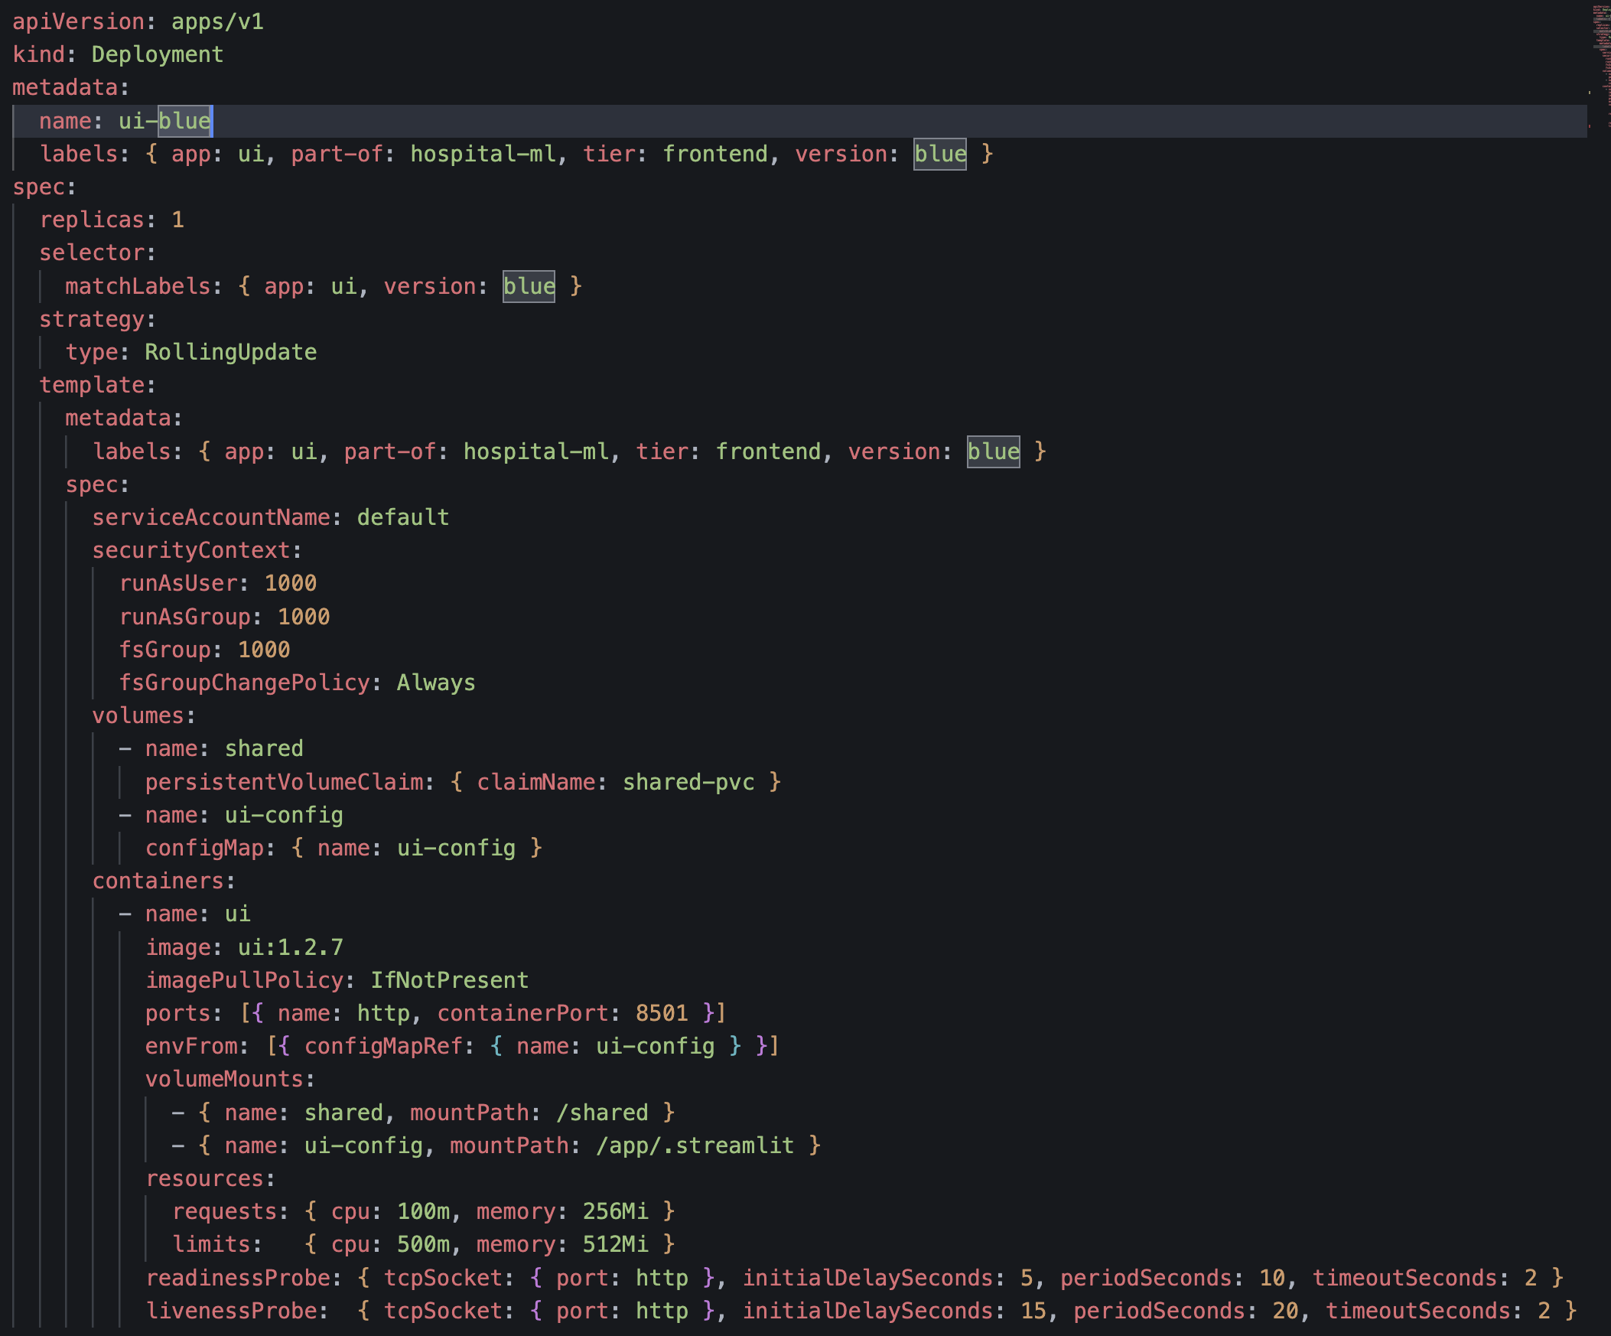
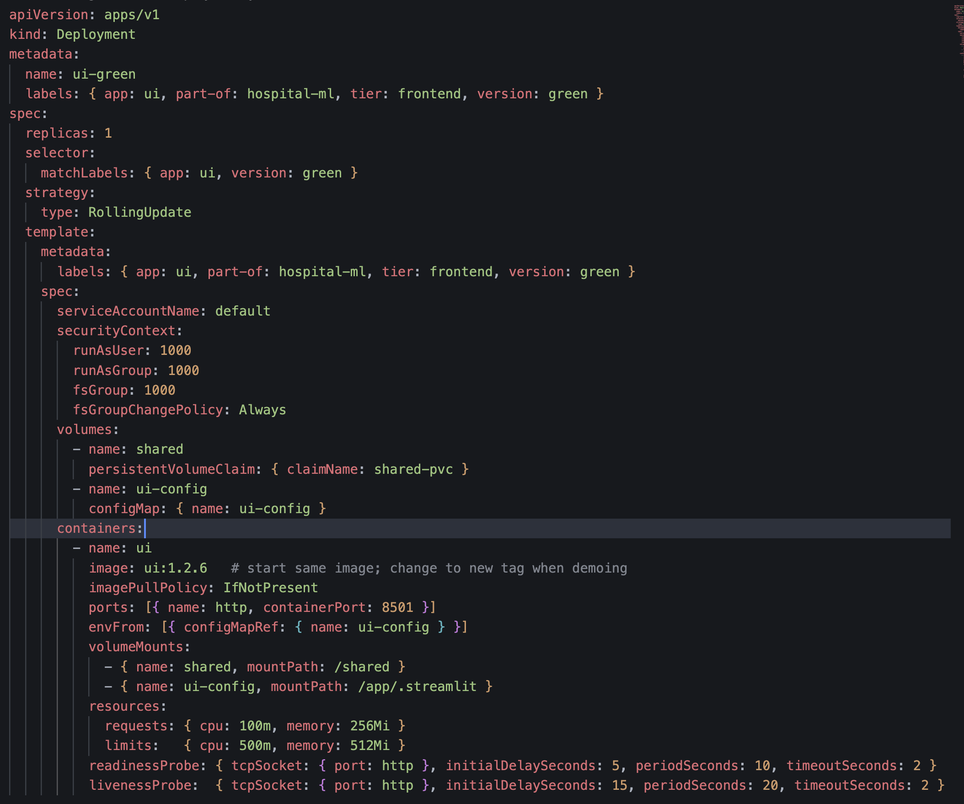
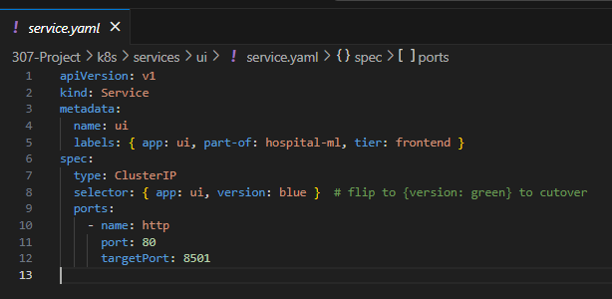
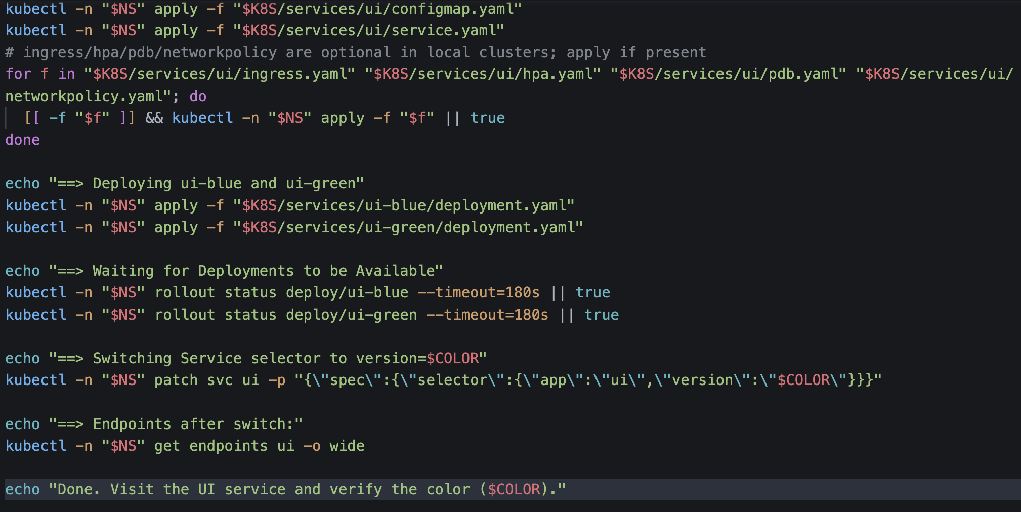
UI – Blue/Green Deployment
Run 2 versions of the same service at once.
Ui-blue: current live version
Ui-green: new version we want to roll out
Benefits:
Zero downtime rollouts
Instant rollback
Safe testing
ui-blue/deployment.yaml
ui-green/deployment.yaml
Cronjob-backup.yaml
Bluegreen-setup.bash

Slide 19
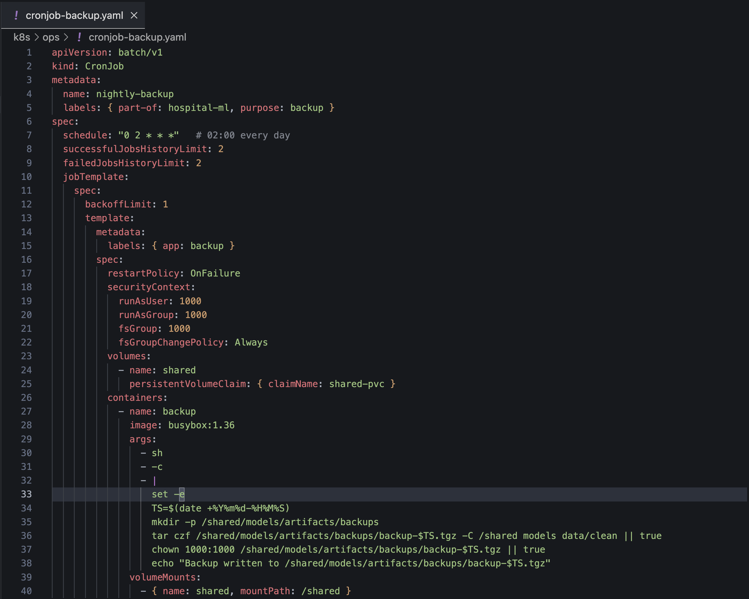
CronJob(Additional Feature)
Automated Backups(Nightly Backups):
This is a Kubernetes CronJob that runs automatically on a schedule.
Nightly Schedule:
The job is scheduled to run every night at 2 AM, ensuring your data is always backed up.
What It Backs Up:
It specifically saves the most important assets: the trained models and the cleaned data files.
How It Works:
It uses a simple tar command to package these directories into a single compressed .tgz file, timestamped for easy identification.
Cronjob-backup.yaml

Slide 20
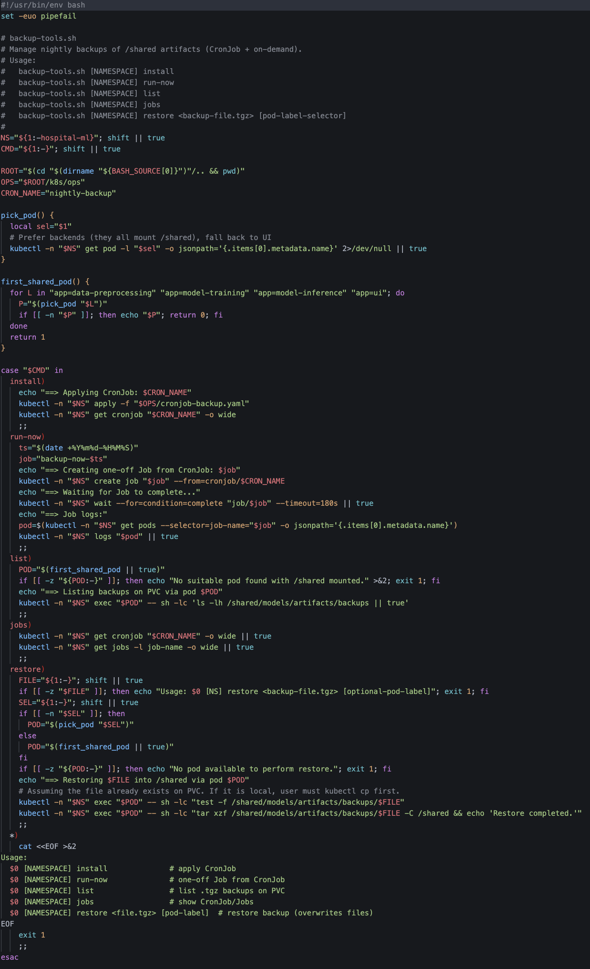
CronJob
Purpose:
Provides tools to create and manage backups inside Kubernetes.
What it does (common tasks):
Creates on-demand backups (manual trigger).
Supports scheduled backups (via CronJobs).
Stores backups in a consistent format for later restore.
Helps with data safety & disaster recovery.
Why it’s useful:
Protects against data loss or corruption.
Automates repetitive backup tasks.
Ensures you can recover quickly in case of failure.
Backup-tools.yaml

Slide 21
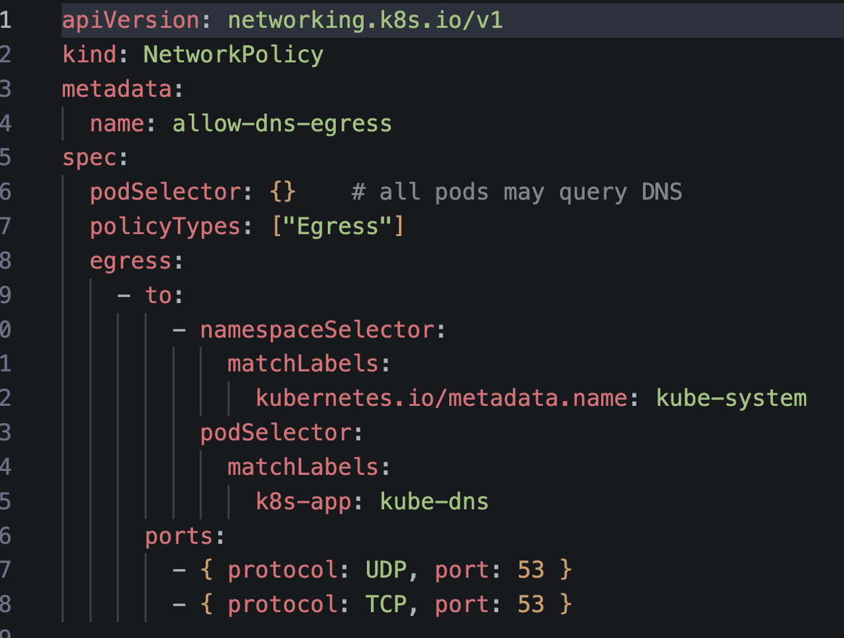
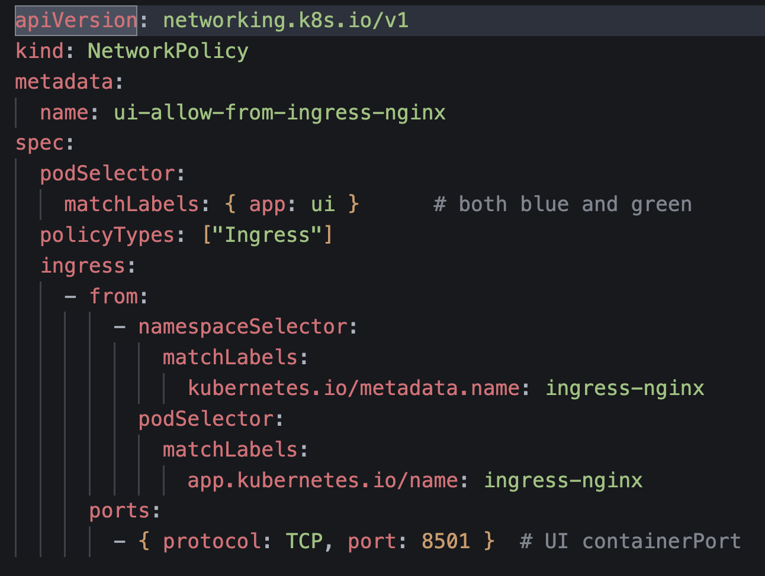
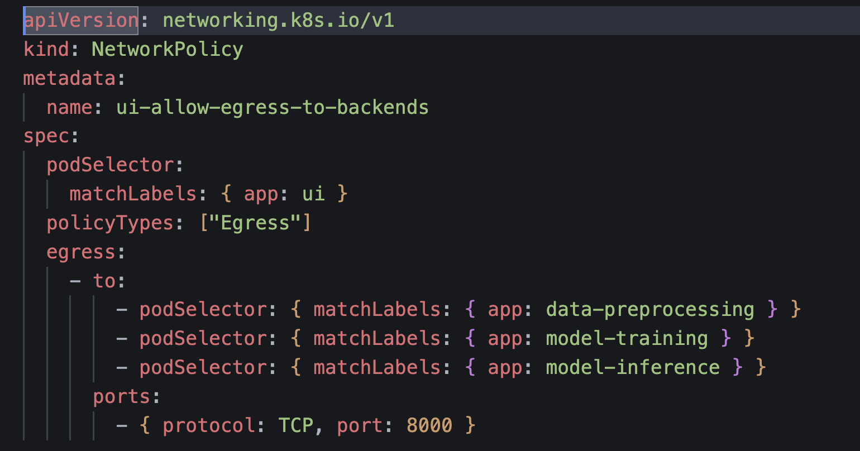
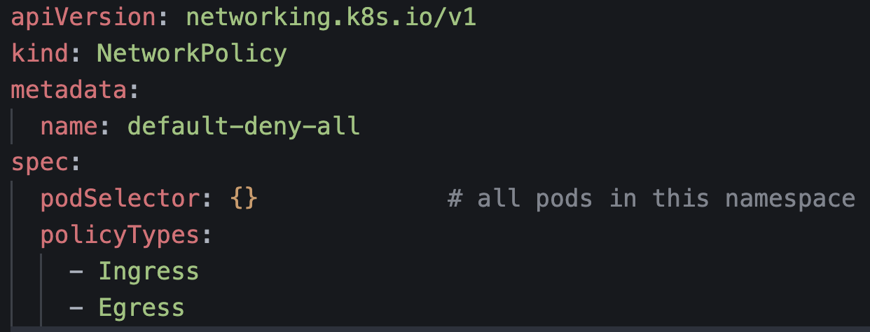
Network(Additional Feature)
Networkpolicy-allow-dns.yaml
Networkpolicy-allow-ingress-to-ui.yaml
Networkpolicy-allow-ui-egress.yaml
Networkpolicy-default-deny.yaml

Slide 22
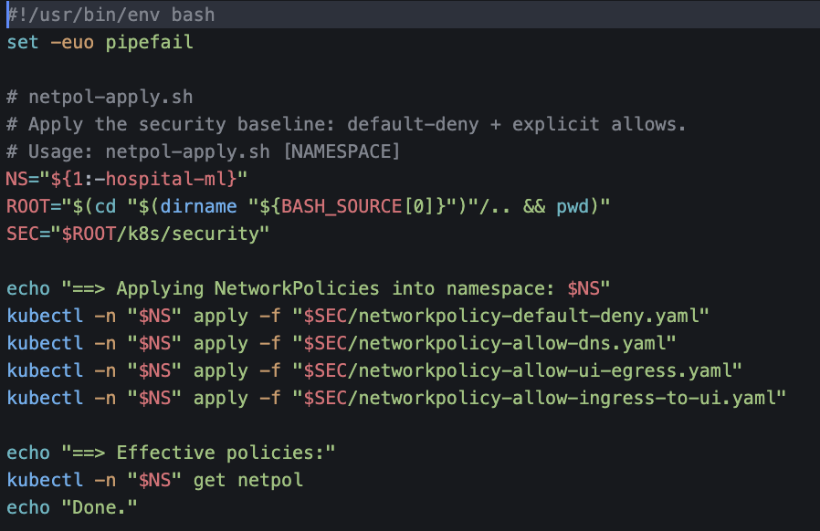
Network(Additional Feature)
Purpose:
Automates the process of applying Kubernetes NetworkPolicies into a namespace for security.
What it does:
Applies a default-deny-all rule (blocks all pod-to-pod traffic by default).
Then applies specific allow rules (DNS, UI-to-backend, ingress traffic, etc.).
Prints out the effective policies so you can verify what’s active.
Why it’s useful:
Enforces zero-trust networking (deny everything, allow only what’s needed).
Protects services from unauthorized pod-to-pod access.
Makes your cluster more secure and production-ready.
Netpol-apply.sh

Slide 23
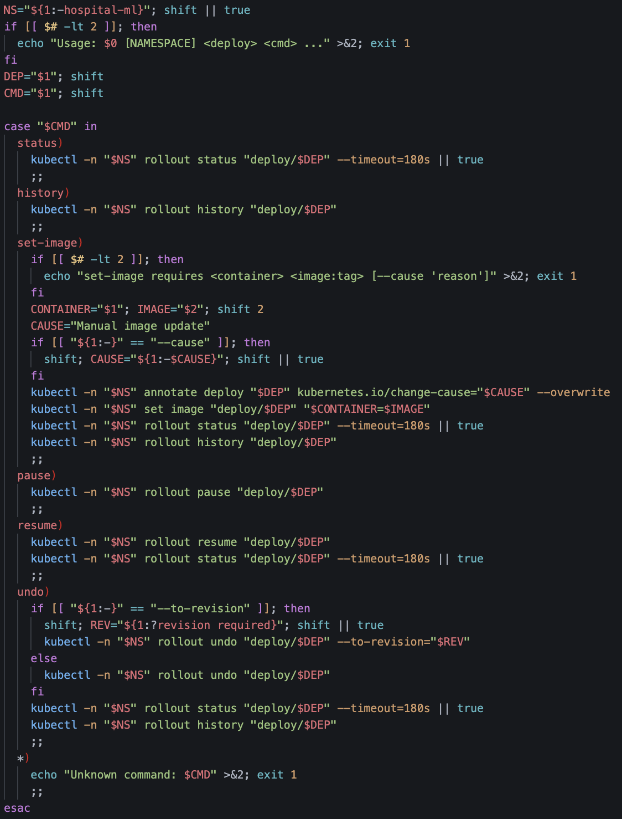
Rollout Control(Additional Feature)
Purpose:
This script is a helper tool to manage Kubernetes rollouts (updates to deployments) without typing long kubectl commands.
What it does (common commands):
status → Shows current rollout progress.
history → Displays past revisions of the deployment.
set-image → Updates the container image (new version).
pause / resume → Temporarily stop/resume a rollout.
undo → Roll back to a previous stable version.
Why it’s useful:
Simplifies rollout management into one-liners.
Helps in safe updates with easy rollback.
Makes the project feel production-ready.
Rollout-ctl.sh

Slide 24
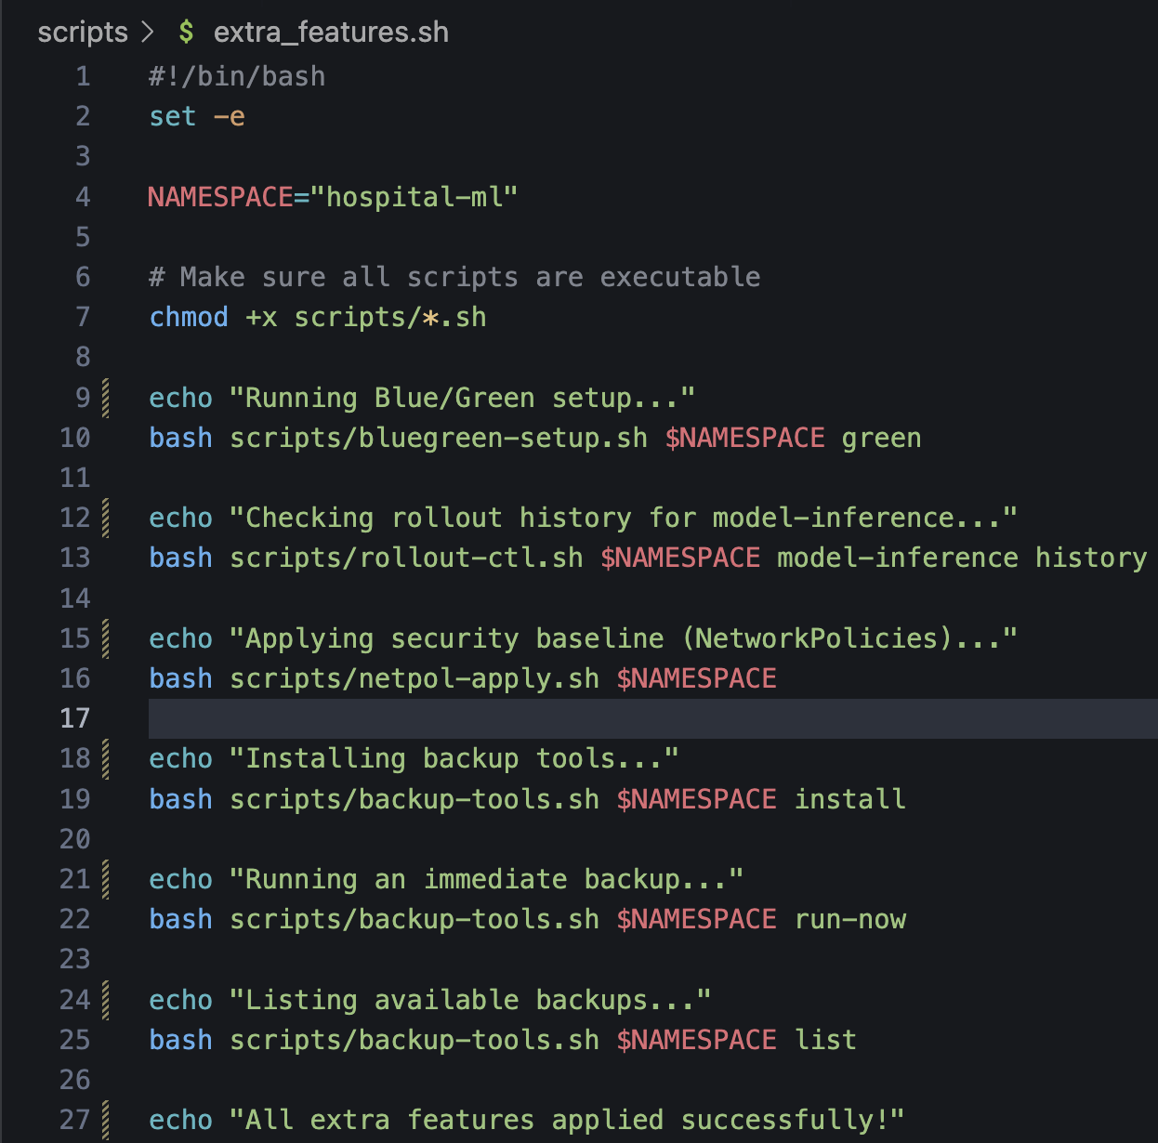
All Additional Features in one .sh
Purpose:
Acts as a companion script to the main automation, enabling advanced Kubernetes features.
What it does (common tasks):
Runs blue/green deployments for zero-downtime updates.
Provides rollout controls (status, history, pause/resume, rollback).
Applies network policies for pod security.
Triggers backup jobs (scheduled or on-demand).
Why it’s useful:
Keeps the base automation (automation.sh) clean and simple.
Lets you add production-grade extras only when needed.
Separates core setup from advanced features, improving flexibility.
Rollout-ctl.sh

Slide 25
04
Challenges and Solutions

Slide 26
Challenges and Solutions
Complicated architecture (integration of k8s)
Solution: visualise diagram so that everyone is on the same page.
Time management
Solution: establish set group meetings and set agendas.
Adding of different new features (unfamiliarity)
Solution: research online and use AI to assist.

Slide 27
05
Demonstration

Slide 28
Thanks!

