Slide 1

EGT305 Assignment Presentation
Developed by: Satini Sai Keerthan (232594T)

Slide 2
Table of contents
01
02
03
04
05
06
Project Objective
Data Cleaning
Data Visualisation
PySpark Workflow
Non-PySpark Workflow
Real Life Scenario

Slide 3

01
Project Objective

Slide 4

Objectives
Objective
Explore The Dataset to know the overall make up of the job market.
Provide findings to government organization & build ML model to predict salary

Slide 5

02
Data Cleaning

Slide 6
Data Cleaning Steps: Part I
Employee_dataset
Employee_salaries
Master_df
Consisted information including JobID, CompID etc.
Did preliminary checks including missing, duplicated
Consisted information about the jobID’s salary
Did preliminary checks and cleaning including missing & duplicated
Cross-Checked with Employee_dataset if it has exactly the same JobId, dropped JobID in Salary dataset if it was not present in Employee_dataset.
Merged cleaned Employee_dataset and Employee_salaries to create master_df using inner join.

Slide 7
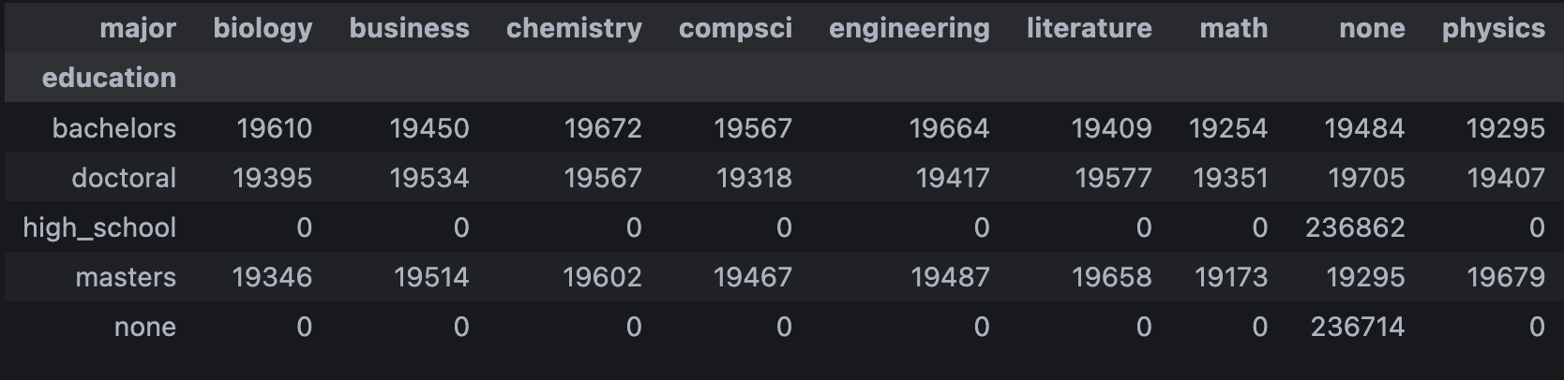
Data Cleaning Steps: Part II
jobRole
education
major
Converted everything to lowercase
Checked value distribution
Removed the president column as it was the only one entry, with no education and no major.
Converted entries to lowercase
Checked value distribution, no sign of outliers
Looked clean
Converted entires to lowercase and checked distribution
Had a lot of none values, but it is plausible as not a lot of people will get a major
Check crosstab between major and education to see if those who are in high school as their education have a major.

Slide 8
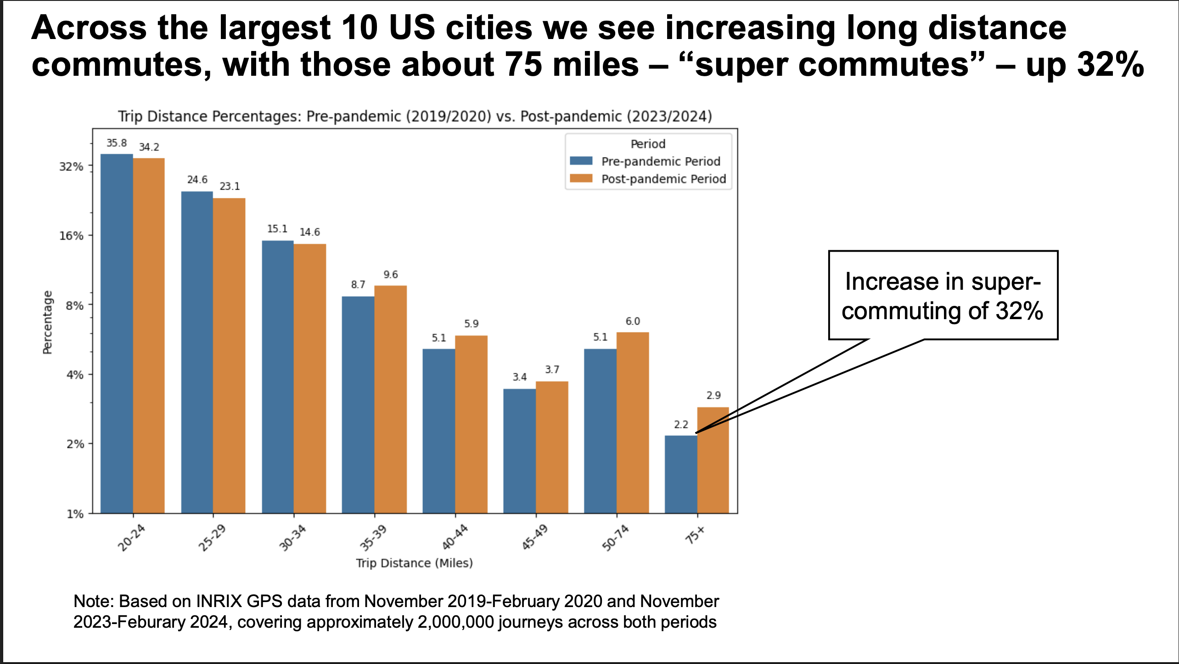
Data Cleaning Steps: Part II
industry
yearsExperience
distanceFromCBD
Converted everything to lowercase
Checked value distribution.
Check the distribution of yearsExperience
Retained entries equal to 0 as they might be new in the field.
Removed extreme outliers of 400 and 500, and retained the remaining as it might be plausible that there are some people travelling a lot for work.

Slide 9
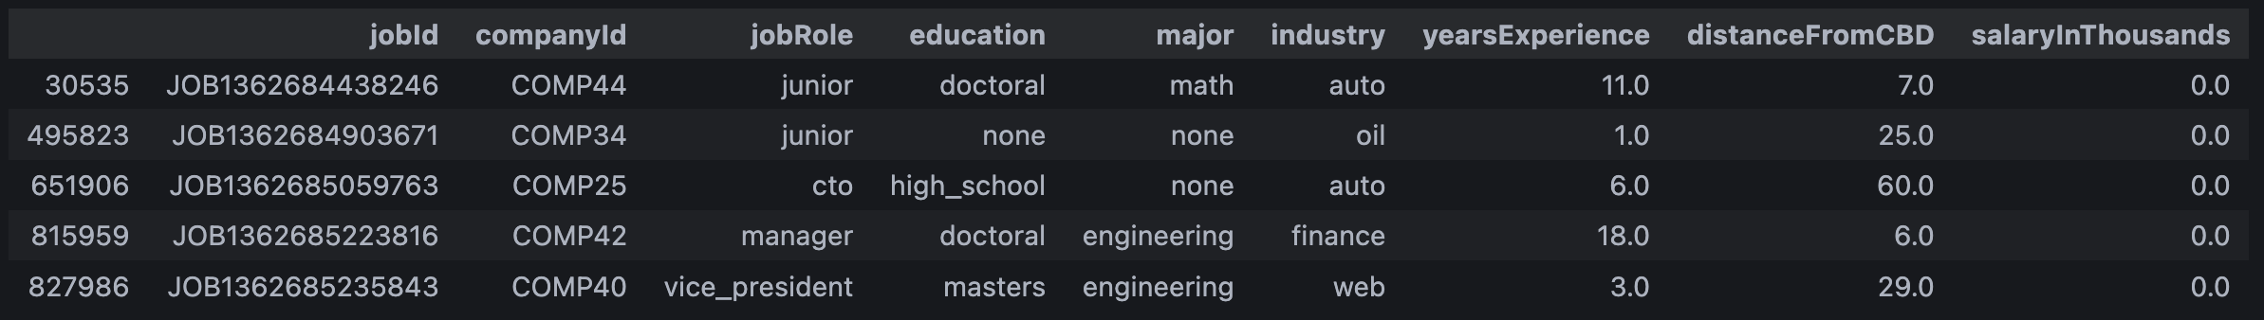
Data Cleaning Steps: Part II
salaryInThousands
Checked value distribution.
Checked for outliers and removed one where it was 1 million thousand.
Checked for no salary and removed the 5 entires as they do not seem plausible.

Slide 10

03
Data Visualisation

Slide 11
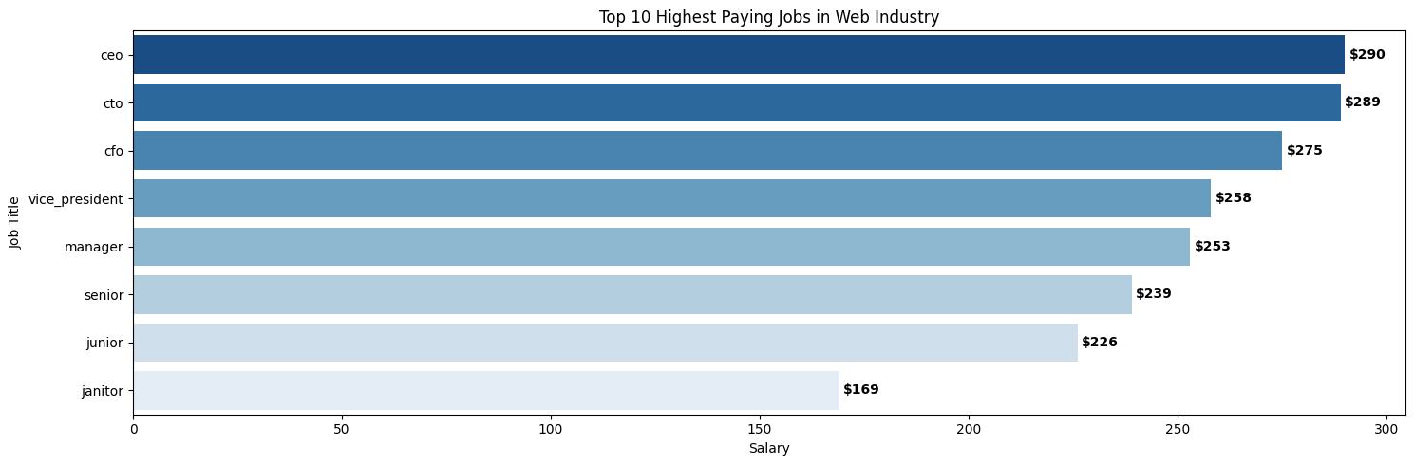
Highest Paying Job For Web Industry
Notes:
**C-suite domination**: CEO ($290k), CTO ($289k), CFO ($275k), followed by VP ($258k), Manager ($253k), Senior ($239k), Junior ($226k). There’s also a “janitor” bar ($169k), which is unusually high for that role—either a data label issue or a small, anomalous subset.
Insights
- Role seniority > almost everything else within web: compensation climbs steeply as you move from junior → senior → manager → VP → C-suite.
- The gap from junior to senior is meaningful (~$13k) and continues to widen as you move into management.
- If “janitor” is truly in the dataset, it’s likely misclassified or represents a tiny sample (e.g., specialist facilities roles at FAANG-scale campuses with night differentials). Worth sanity-checking.
Real-world tie-in: In large consumer-web companies (e.g., Meta, Google), equity lifts senior/manager pay substantially; CTO/VP comp often reflects scarce leadership + strategic impact on product direction and platform bets.

Slide 12
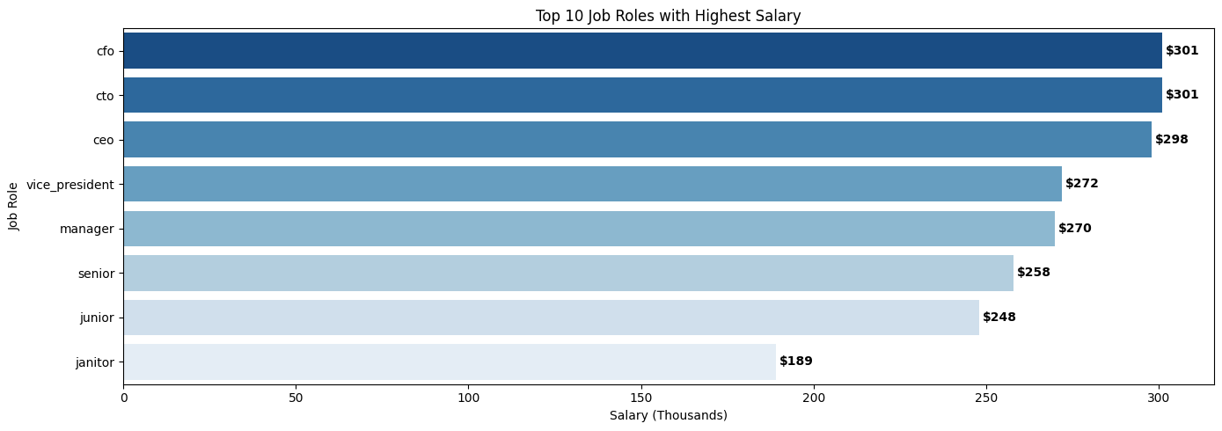
Top 10 Jobs With Highest Salary Across All Industry
Notes:
What it shows: Across all industries, CFO and CTO top out (~$301k), edging CEO ($298k), then VP ($272k), Manager ($270k), Senior ($258k), Junior ($248k), Janitor ($189k).
Insights
- CFO/CTO ≳ CEO (on base/annualized figures) can happen when CEOs take lower base and more equity/bonus. CFO comp spikes in regulated/capital-intensive sectors; CTO comp spikes where deep tech or platform modernization are existential.
- Manager > VP here by a hair could be sample noise or an industry mix effect (e.g., high-pay “manager” titles in finance/tech vs lower-pay “VP” titles in other sectors).
What it shows: Across all industries, CFO and CTO top out (~$301k), edging CEO ($298k), then VP ($272k), Manager ($270k), Senior ($258k), Junior ($248k), Janitor ($189k).
Insights
- CFO/CTO ≳ CEO (on base/annualized figures) can happen when CEOs take lower base and more equity/bonus. CFO comp spikes in regulated/capital-intensive sectors; CTO comp spikes where deep tech or platform modernization are existential.
- Manager > VP here by a hair could be sample noise or an industry mix effect (e.g., high-pay “manager” titles in finance/tech vs lower-pay “VP” titles in other sectors).
Real-world tie-in: In oil & gas or finance, CFOs carry outsized fiduciary risk; in AI-heavy firms, CTO premium reflects talent scarcity in ML/infra leadership.
Real-world tie-in: In oil & gas or finance, CFOs carry outsized fiduciary risk; in AI-heavy firms, CTO premium reflects talent scarcity in ML/infra leadership.

Slide 13
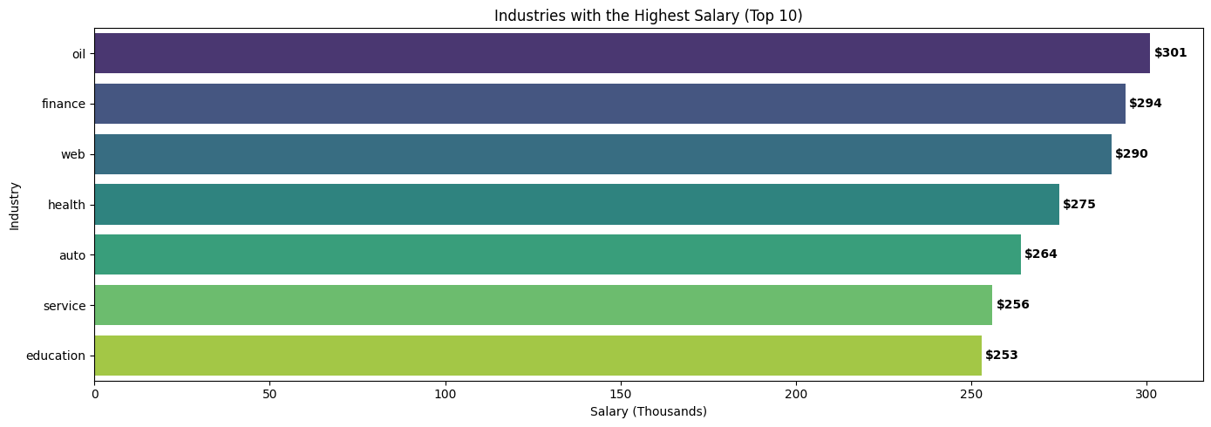
Industries with the Highest Salary
Notes:
What it shows: Across all industries, CFO and CTO top out (~$301k), edging CEO ($298k), then VP ($272k), Manager ($270k), Senior ($258k), Junior ($248k), Janitor ($189k).
Insights
- CFO/CTO ≳ CEO (on base/annualized figures) can happen when CEOs take lower base and more equity/bonus. CFO comp spikes in regulated/capital-intensive sectors; CTO comp spikes where deep tech or platform modernization are existential.
- Manager > VP here by a hair could be sample noise or an industry mix effect (e.g., high-pay “manager” titles in finance/tech vs lower-pay “VP” titles in other sectors).
What it shows: Across all industries, CFO and CTO top out (~$301k), edging CEO ($298k), then VP ($272k), Manager ($270k), Senior ($258k), Junior ($248k), Janitor ($189k).
Insights
- CFO/CTO ≳ CEO (on base/annualized figures) can happen when CEOs take lower base and more equity/bonus. CFO comp spikes in regulated/capital-intensive sectors; CTO comp spikes where deep tech or platform modernization are existential.
- Manager > VP here by a hair could be sample noise or an industry mix effect (e.g., high-pay “manager” titles in finance/tech vs lower-pay “VP” titles in other sectors).
Real-world tie-in: In oil & gas or finance, CFOs carry outsized fiduciary risk; in AI-heavy firms, CTO premium reflects talent scarcity in ML/infra leadership.
Real-world tie-in: In oil & gas or finance, CFOs carry outsized fiduciary risk; in AI-heavy firms, CTO premium reflects talent scarcity in ML/infra leadership.

Slide 14
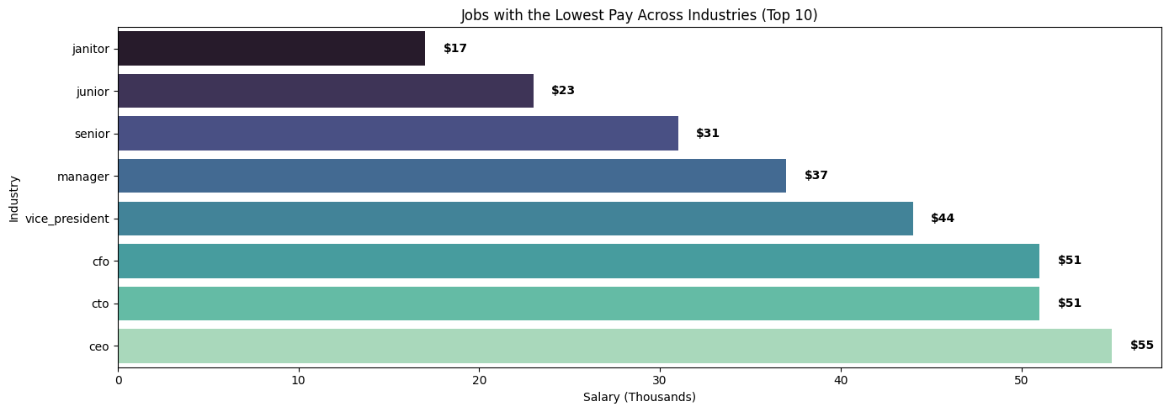
Jobs With Lowest Pay
Notes:
What it shows: Bars are job titles (janitor, junior, senior…CEO) with values ~$17k–$55k—not industries.
Likely interpretation: These look like role-level minimums or lower quantiles rather than industry lows.
Insights
- Even for C-suite roles there exists a long lower tail (e.g., small nonprofits, early startups) with low base comp.
- The presence of very low values for typically well-paid roles implies a wide pay dispersion; titles don’t guarantee pay without industry, company stage, geography, or equity context.
Action: Fix the axis/title to avoid confusion; if these are minima, label as “Lowest observed pay by role” and annotate sample sizes.

Slide 15
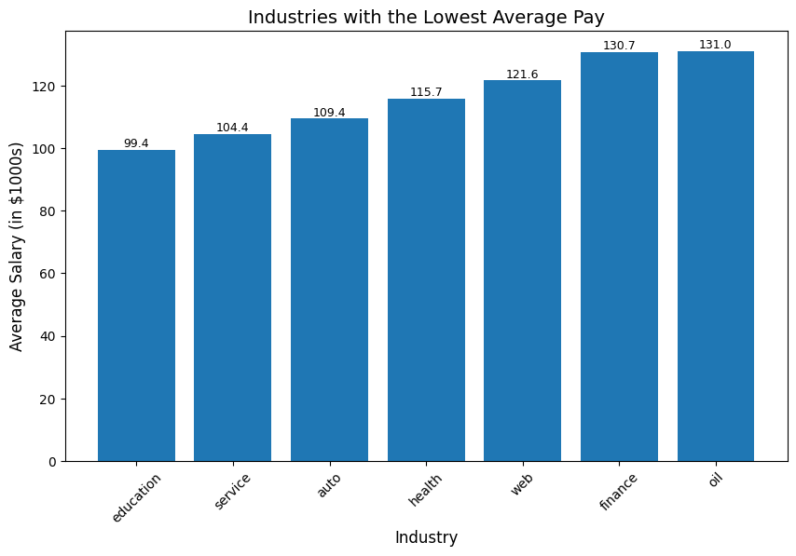
Industries with the Lowest Pay
Notes:
- **Education (~$99k)** is the lowest-paying industry, significantly below all others.
- **Service (~$104k)** and **Auto (~$109k)** follow closely as other low-paying industries.
- **Health (~$116k)** and **Web (~$122k)** sit in the middle, offering better pay but still below the top.
- **Finance (~$131k)** and **Oil (~$131k)** are the highest-paying industries, about 32% higher than Education
*Insights*
- The gap between Education and Finance/Oil highlights a **structural imbalance**: socially critical industries are systematically underpaid compared to profit-driven sectors.
- **Talent attraction risk**: High-paying industries (Oil, Finance, Web) draw top talent, while Education and Service risk shortages.
- **Sustainability concern**: Persistent underpayment in Education/Service threatens the supply of skilled workers in essential areas.
- **Policy implication**: Government may need to raise compensation floors in low-pay but critical industries, while supporting upskilling/reskilling into higher-paying sectors.
The job market is **polarised**: socially essential sectors (Education, Service) remain underpaid, while Finance, Oil, and Web dominate compensation. Sector choice has a major impact on earnings potential, sometimes more than role or education level.

Slide 16
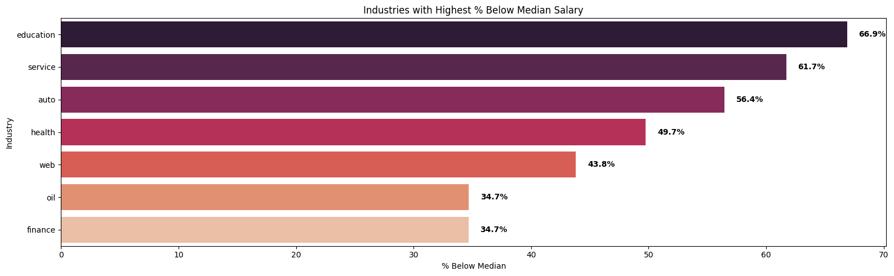
Industries with Highest % of People below Median Salary
Notes:
What it shows: % below median is highest in Education (~66.9%), then Service (~61.7%), Auto (~56.4%), Health (~49.7%), Web (~43.8%), Oil (~34.7%), Finance (~34.7%).
Insights
- Lower-pay sectors push most workers below $114k—particularly Education and Service.
- Oil/Finance have fewer below-median workers (one-third) → compensation in these sectors is right-shifted (higher overall), not just top-heavy.
- Web is mixed: still ~44% below median, indicating bimodality (many below, many far above due to equity/bonus).
Real-world tie-in: Universities (education) have large bases of roles (lecturers, staff) with compressed pay bands, while trading desks (finance) and offshore roles (oil) have high floors and high ceilings.

Slide 17
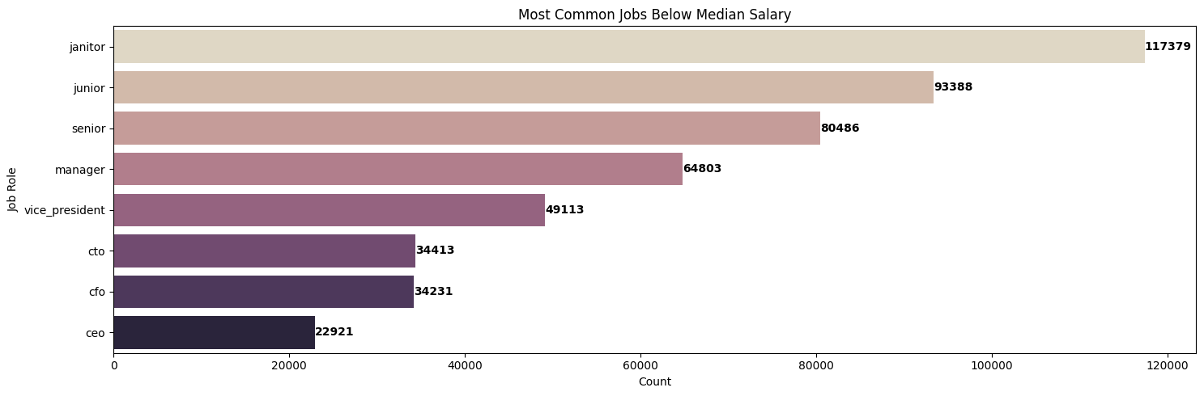
Jobs Below Median Salary
Notes:
What it shows: Below $114k, counts skew to Janitor (~117k), Junior (~93k), Senior (~80k), Manager (~65k), then VP/CTO/CFO/CEO (still non-trivial).
Insights
- Early-career roles dominate sub-median, as expected.
- But a surprising number of “Senior” and “Manager” roles fall below $114k → possible title inflation or location effect (e.g., seniors in lower-cost regions or smaller firms).
- Leadership titles below median likely reflect small-org realities where titles outpace pay, or where equity substitutes for salary.
Real-world tie-in: A “Senior Developer” at a 30-person startup in a Tier-2 city may earn less than a “Software Engineer I” at a FAANG in SF.

Slide 18
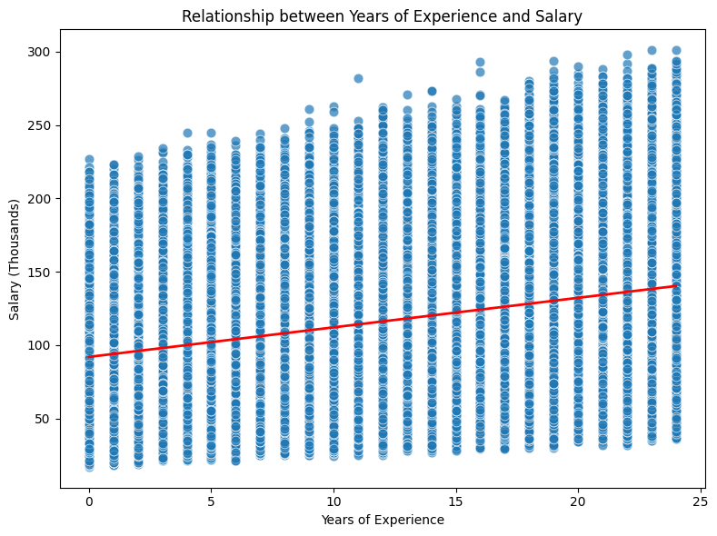
Years Experience Vs Salary
Notes:
What it shows: Clear positive slope, but wide dispersion at every experience level.
Insights
- Experience helps, but it’s not destiny. The R² is likely modest: industry, role, company size, and equity drives a lot of variance.
- You can see early high earners (outliers) at low experience—typical of quant trading, hot startups, or exceptional performers.
- Plateauing is hinted at in the upper range: beyond ~15–20 years, increases are smaller unless you transition into leadership or revenue-critical roles.
Real-world tie-in: A 6-year engineer at a unicorn with pre-IPO equity may out-earn a 15-year engineer in a slow-growth enterprise.

Slide 19
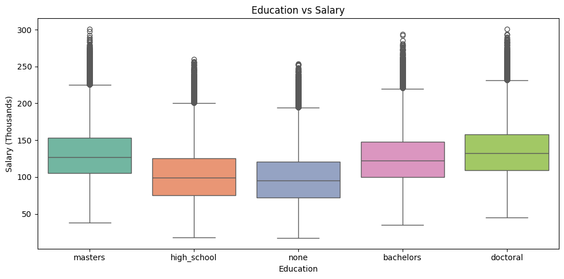
Education vs Salary
Notes:
What it shows: Doctoral has the highest median, then Masters/Bachelors (close), then High School/None. All groups show heavy upper tails (many outliers).
Insights
- Higher education correlates with higher median pay, but the overlap is huge—plenty of bachelors/master’s out-earn doctorate holders.
- The many “outliers” are expected with large n: boxplots flag values >1.5×IQR as points; salaries are right-skewed, so you’ll see lots of points above whiskers.
- Degrees matter most when they unlock industries/roles (e.g., PhD → ML research), but industry/role still dominate the pay outcome.
Real-world tie-in: A non-degree SWE in FAANG with strong portfolio can out-earn a PhD in academia; conversely, PhDs in quant research/biotech can far exceed master’s medians.

Slide 20
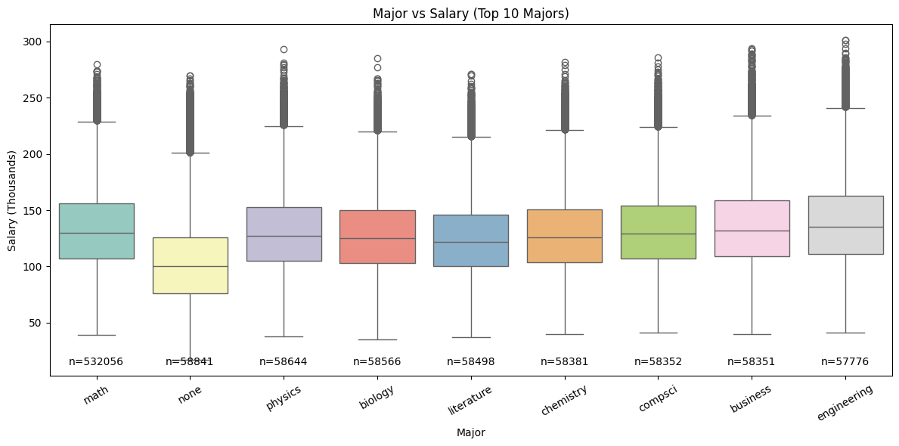
Major Vs Salary
Notes:
What it shows: Doctoral has the highest median, then Masters/Bachelors (close), then High School/None. All groups show heavy upper tails (many outliers)
Insights
- Higher education correlates with higher median pay, but the overlap is huge—plenty of bachelors/master’s out-earn doctorate holders.
- The many “outliers” are expected with large n: boxplots flag values >1.5×IQR as points; salaries are right-skewed, so you’ll see lots of points above whiskers.
- Degrees matter most when they unlock industries/roles (e.g., PhD → ML research), but industry/role still dominate the pay outcome.
Real-world tie-in: A non-degree SWE in FAANG with strong portfolio can out-earn a PhD in academia; conversely, PhDs in quant research/biotech can far exceed master’s medians.

Slide 21

04
Non-PySpark Modelling

Slide 22
Non-PySpark Modelling Phases
Phase 1:
Baseline Model prediction to understand how Models react to dataset
Phase 2:
Add in Log Transformation to prevent skewness on data, along with advanced Encoding & Scaling
Phase 3: Add in RandomSearchCV & Kfolds to squeeze out metrics more

Slide 23
Different ML Models trained
LinearRegression(Ridge)
RandomForest
Fast to Train & easy to understand.
Good with Linearity
Ridge LR used as it has built in L2 Regularisation, penalizing large coefficients to reduce overfitting
Handles Non-Linearity in Dataset better than LR
Captures complex feature interactions.
No need of complicated Scaling as it is not sensitive to outliers.
XGBoost
CatBoost
High Performance as it corrects mistakes of previous trees.
Handles Complicated datasets, good at modelling Non-Linear relationships.
Built in Regularization (L1 & L2) to prevent overfitting.
Highly optimized for speed.
Best for categorical feature handling, without the need for complicated encoding due to built in functionality of the model.
Able to provide excellent performance without significant tuning.

Slide 24
Metrics used to Evaluate Model
MAE (Mean Absolute Error)
RMSE (Root Mean Squared Error)
Averages the absolute difference between the predicted values and the actual values.
A lower MAE translate to predictions being closer to actual on average.
Square Root of MSE, penalising larger errors more than MAE
Robust for detecting models that make large mistakes
MSE (Mean Squared Error)
R² Score
Squared Average of Prediction Errors
Larger errors weight disproportionally, which makes it sensitive to outliers.
Explains how much variance in the target variable is captured by the model
Closer to 1 translates to the ability to have better explanatory power.
Notes:
But we will be focusing more on MAE and R^2 Score.

Slide 25
Phase 1 – NonPySpark Modelling
Model | Dataset | RMSE | MAE | MSE | R² | Training Time (s)
Random Forest | VAL | 20.11 | 16.04 | 404.25 | 0.724 | 37.52
Random Forest | TEST | 20.47 | 16.35 | 419.11 | 0.728
XGBoost | VAL | 19.10 | 15.42 | 364.98 | 0.751 | 0.95
XGBoost | TEST | 19.32 | 15.60 | 373.25 | 0.758
Linear Reg. | VAL | 19.54 | 15.75 | 381.64 | 0.739 | 0.34
Linear Reg. | TEST | 19.76 | 15.94 | 390.64 | 0.747
CatBoost | VAL | 19.10 | 15.42 | 364.98 | 0.751 | 8.85
CatBoost | TEST | 19.32 | 15.60 | 373.25 | 0.758
Notes:
XGBoost and CatBoost gave the best performance overall (lowest RMSE/MAE, highest R²), and XGBoost trained the fastest.
Linear Regression performed surprisingly well compared to Random Forest, with similar error metrics but in a fraction of the time.
Random Forest had the longest training time and slightly worse performance than boosting methods.

Slide 26
Phase 2 – Model Training Information
Log Transformation
LinearRegression(Ridge)
Reduces skewness, stabilizes variances and makes distribution closer to normal
Helps tree-based models to reduce dominance of extreme values, leading to more stable boosting/training.
RobustScalar used on numerical values to scale features using median and IQR. Allowing for balanced coefficients.
OneHot Encoding used on Categorical Columns, prevents any ordinal relationship, allowing for cat features to. Be represented without false ordering.
Tree-Based
CatBoost
Do not need scaling as they split data on thresholds
Target Encoding replace each category with the mean target variable, capturing useful info about relationship between caterogires and targets
No manual Encoding as it applies its own encoding scheme, replacing categories with statistics, permutations to avoid target leakage and overfitting.
Like RF and XGB, split on threshold, so no need for scaling

Slide 27
Phase 2 – NonPySpark Modelling
Model | Dataset | RMSE | MAE | R² | Training Time (s)
LR (Ridge + SparseOHE) | Val | 0.1804 | 0.1475 | 0.7397 | 0.10
LR (Ridge + SparseOHE) | Test | 0.1833 | 0.1501 | 0.7443
Random Forest (RF) | Val | 0.1615 | 0.1345 | 0.7915 | 1.41
Random Forest (RF) | Test | 0.1624 | 0.1360 | 0.7992
XGBoost (XGB) | Val | 0.1643 | 0.1368 | 0.7841 | 3.91
XGBoost (XGB) | Test | 0.1643 | 0.1370 | 0.7946
CatBoost | Val | 0.1564 | 0.1317 | 0.8045 | 10.75
CatBoost | Test | 0.1571 | 0.1327 | 0.8122
Notes:
CatBoost outperformed every one else in terms of Lower MAE and RMSE and higher R^2

Slide 28
Phase 3 – Model Training Information
KFolds
RandomSearchCV
More reliable evaluation
Instead of training and testing on just one train/validation split, K-Folds splits the data into K parts.
The model is trained on (K-1) folds and validated on the remaining fold, repeated K times.
Better hyperparameter tuning
RandomizedSearchCV tries random combinations of hyperparameters instead of exhaustively checking all possibilities.
When combined with K-Fold CV, each set of hyperparameters is tested across multiple folds, ensuring the chosen parameters work well across the dataset and not just by chance on one split.
How Does it Help models?
Tree models can be sensitive to hyperparameters like max_depth, n_estimators, and max_features.
Using K-Fold CV ensures we find hyperparameters that generalize well, rather than ones that just fit a single validation set.
RandomizedSearch makes the process much faster than GridSearch, while still covering a wide range of options.

Slide 29
Phase 3 – NonPySpark Modelling
Model | Dataset | RMSE | MAE | R² | Training Time (s)
Ridge (RS) | Val | 0.1804 | 0.1475 | 0.7398 | 9.97
Ridge (RS) | Test | 0.1833 | 0.1501 | 0.7443
RandomForest | Val | 0.1602 | 0.1339 | 0.7949 | 304.54
RandomForest | Test | 0.1614 | 0.1352 | 0.8017
XGBoost (RS) | Val | 0.1571 | 0.1319 | 0.8027 | 179.08
XGBoost (RS) | Test | 0.1579 | 0.1331 | 0.8103
CatBoost (RS) | Val | 0.1561 | 0.1315 | 0.8053 | 3238.37
CatBoost (RS) | Test | 0.1571 | 0.1328 | 0.8123
Notes:
CatBoost outperformed every one else in terms of Lower MAE and RMSE and higher R^2

Slide 30

05
PySpark Modelling

Slide 31
Non-PySpark Modelling Phases
Phase 1:
Baseline Model prediction to understand how Models react to dataset
Phase 2:
Add in Log Transformation to prevent skewness on data, along with advanced Encoding & Scaling
Phase 3: Add in RandomSearchCV & Kfolds to squeeze out metrics more

Slide 32
Different ML Models trained
LinearRegression
RandomForest
Fast to Train & easy to understand.
Good with Linearity
Ridge LR used as it has built in L2 Regularisation, penalizing large coefficients to reduce overfitting
Handles Non-Linearity in Dataset better than LR
Captures complex feature interactions.
No need of complicated Scaling as it is not sensitive to outliers.
GBTRegressor
Tree-based ensemble model that builds regression trees in sequence, where each new tree corrects the errors of the previous ones.
Able to handle large scale datasets and non-linear relationships

Slide 33
Phase 1 – PySpark Modelling
Model | Dataset | RMSE | MAE | R² | Training Time (s)
Linear Regression | Val | 19.65 | 15.91 | 0.748 | 13.21
Linear Regression | Test | 19.66 | 15.80 | 0.750
Random Forest | Val | 0.23 | 0.19 | 0.602 | 4.61
Random Forest | Test | 0.23 | 0.19 | 0.601
GBT Regressor | Val | 0.17 | 0.14 | 0.771 | 12.92
GBT Regressor | Test | 0.17 | 0.14 | 0.771
Notes:
Model Dataset RMSE MAE R² Training Time (s) Linear Regression Val 0.2784 – 0.4165 12.90 Linear Regression Test 0.2799 – 0.4109 Random Forest Val 0.1975 0.1607 0.7064 8.43 Random Forest Test 0.1999 0.1600 0.6996 GBT Regressor Val 0.1735 0.1400 0.7734 16.05 GBT Regressor Test 0.1723 0.1400 0.7767

Slide 34
Phase 2 – PySpark Modelling
Model | Dataset | RMSE | MAE | R² | Training Time (s)
Linear Regression | Val | 0.2784 | – | 0.4165 | 12.90
Linear Regression | Test | 0.2799 | – | 0.4109
Random Forest | Val | 0.1975 | 0.1607 | 0.7064 | 8.43
Random Forest | Test | 0.1999 | 0.1600 | 0.6996
GBT Regressor | Val | 0.1735 | 0.1400 | 0.7734 | 16.05
GBT Regressor | Test | 0.1723 | 0.1400 | 0.7767
Notes:
By default, when you evaluate with RegressionEvaluator, the metrics are computed on the original target scale (not log space).
So if you trained on log1p(y), but then exponentiate predictions back before evaluation, a small error in log space can become large on the original scale.
Example:
Error of 0.1 in log space → exp(9.31) - exp(9.21) ≈ 10,989 - 9,999 = 990 difference.
Metrics like RMSE and MAE therefore look worse.

Slide 35
Phase 3 – PySpark Modelling
Model | Dataset | RMSE | MAE | R²
Tuned Ridge | Test | 0.1836 | 0.1507 | 0.7466
Tuned RandomForest | Test | 0.1708 | 0.1416 | 0.7807
Tuned GBT | Test | 0.1624 | 0.1360 | 0.8017
Notes:
By default, when you evaluate with RegressionEvaluator, the metrics are computed on the original target scale (not log space).
So if you trained on log1p(y), but then exponentiate predictions back before evaluation, a small error in log space can become large on the original scale.
Example:
Error of 0.1 in log space → exp(9.31) - exp(9.21) ≈ 10,989 - 9,999 = 990 difference.
Metrics like RMSE and MAE therefore look worse.

Slide 36
Phase 3 – PySpark Vs Scikit-Learn
Model | Framework | Test RMSE | Test MAE | Test R²
Ridge (RS) | Scikit-Learn | 0.1833 | 0.1501 | 0.7443
Ridge (RS) | PySpark | 0.1836 | 0.1507 | 0.7466
Random Forest | Scikit-Learn | 0.1614 | 0.1352 | 0.8017
Random Forest | PySpark | 0.1708 | 0.1416 | 0.7807
XGBoost (RS) | Non-PySpark | 0.1579 | 0.1331 | 0.8103
GBT (RS) | PySpark | 0.1624 | 0.1360 | 0.8017
CatBoost (RS) | Non-PySpark | 0.1571 | 0.1328 | 0.8123
Notes:
By default, when you evaluate with RegressionEvaluator, the metrics are computed on the original target scale (not log space).
So if you trained on log1p(y), but then exponentiate predictions back before evaluation, a small error in log space can become large on the original scale.
Example:
Error of 0.1 in log space → exp(9.31) - exp(9.21) ≈ 10,989 - 9,999 = 990 difference.
Metrics like RMSE and MAE therefore look worse.

Slide 37
Overall Comparison Of Sciki-Learn & PySpark
Aspect | scikit-learn (Non-PySpark) | PySpark (MLlib) | Impact on your project
Memory behavior | Single-machine RAM; simple to reason about. | Driver/executor memory plus shuffles; partition/caching config required. | Hit OOM/pressure → had to shrink RandomSearch space and reduce K-folds.
Hyper-parameter search | RandomizedSearchCV, GridSearchCV, Optuna, etc. | CrossValidator/TrainValidationSplit with ParamGridBuilder (grid only; no native random). | Forced to “dumb down” RandomSearch and CV due to runtime/memory.
Cross-validation speed | Fast on small/medium data; parallel via n_jobs. | High overhead from cluster coordination and serialization. | Slower end-to-end for your experiments.
Algorithm coverage | Very broad; easy to add CatBoost, XGBoost, LightGBM. | Smaller built-ins (Linear/GLM, RF, GBT, etc.); 3rd-party libs required for others. | Missed CatBoost natively; fewer model choices in Spark.
GBT / Boosted Trees | Available (GradientBoostingRegressor and external libs). | Available (GBTRegressor) and distributed. | Used Spark GBT; much slower to tune at scale.
CatBoost | Yes (via catboost Python package). | No native CatBoost in MLlib. | Could not run CatBoost in a PySpark pipeline.
XGBoost | Yes (xgboost.sklearn.XGBRegressor). | Not native; needs Spark-specific packages/bridges. | Extra setup/friction compared to scikit-learn.
Iteration speed / ergonomics | Lightweight pipelines; rapid trial-and-error. | More boilerplate (StringIndexer, VectorAssembler, caching, cluster configs). | Slower iteration during EDA/tuning.
Best use case size | Small–medium datasets that fit on one machine. | Very large datasets and distributed training. | Your data/experiments were development-oriented, so scikit-learn fit better.
Training time (practical) | Often faster for your workloads. | Often slower for your workloads due to overhead. | Your runs confirmed longer wall-clock in PySpark.
Notes:
By default, when you evaluate with RegressionEvaluator, the metrics are computed on the original target scale (not log space).
So if you trained on log1p(y), but then exponentiate predictions back before evaluation, a small error in log space can become large on the original scale.
Example:
Error of 0.1 in log space → exp(9.31) - exp(9.21) ≈ 10,989 - 9,999 = 990 difference.
Metrics like RMSE and MAE therefore look worse.

Slide 38
06
Real Life Scenario

Slide 39
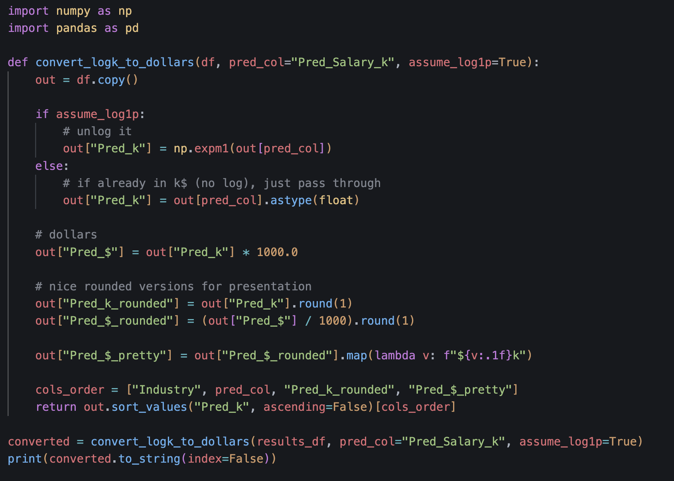
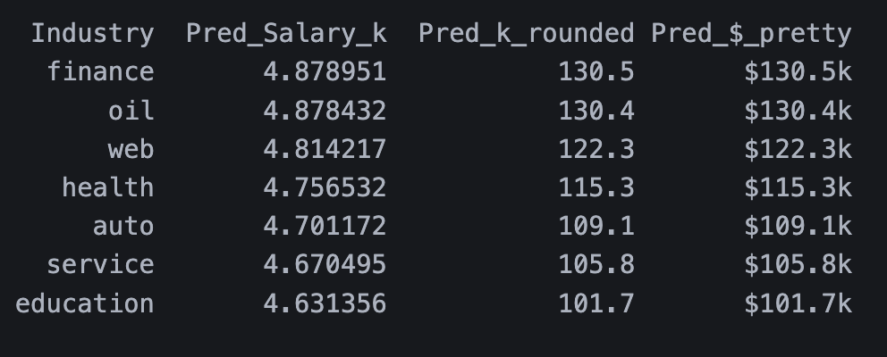
CatBoost Prediction

Slide 40
EDA Recommendation
Finance & Oil
Along with CatBoost’s Prediction, EDA also shows that Finance and Oil are the two highest paid industries.
However he should prioritise Finance First.
Oil can pose risk as it is cyclical, with finance being a more stable and has a broader spread of data roles.

Slide 41
Justification for EDA Recommendation
Better Stability
Finance ranked lowest in Highest % below median salary shows it has better income stability, and skills can be transferred over to AI/Data Roles in Finance Industry.
Growth Path (Holistically too):
A Clear Positive Relationship is showed here, with 8 years spanning in total experience, he can climb the corporate ladder up to Senior/Manager roles, and the fastest way to do that is roles in AI/ML.
Aligns with his interests of board games(strategy) & building things through building robust data pipelines in Finance and model monitoring, along with fraud detection and model monitoring.

Slide 42
Financial Fit
Current expenses: $2,500 mortgage + $4,200 other = $6,700/month (~$80.4k/year before tax).
CatBoost predicts ~$131k in Finance/Oil for this profile: materially higher than the current $88k, leaving more room after tax for obligations and savings.
EDA also mentions that finance is the best industry, and industries like Education & Service pay too less.

Slide 43
Potential Jobs in Finance Industry (Primary)
Roles: Data Engineer, ML Engineer, Analytics Engineer, Fraud/AML Data Scientist, Risk Model Engineer, Quant Ops/Data.
Data platforms: SQL, Python, Spark (your PySpark work is directly relevant), Delta/Parquet, Airflow.
ML & evaluation: Supervised learning (classification/regression), time-series (forecasting, anomaly), model monitoring.
MLOps / production: CI/CD for ML, model registry, feature stores, batch + streaming (Kafka/Kinesis), containerization.
Governance & compliance: Data quality, lineage, PII handling, access control; basic understanding of risk/AML/fraud concepts.
BI & comms: Dashboards (Power BI/Tableau), experiment design, stakeholder reporting.

Slide 44

Thanks!
Do you have any questions?
sai.keerthan01@gmail.com
+65 81838924
Please keep this slide for attribution

Slide 45
Resources | References
Bloom, N., Barrero, J. M., & Davis, S. (2024). The rise in super commuters [PowerPoint slides]. Stanford University. Retrieved from https://nbloom.people.stanford.edu/sites/g/files/sbiybj24291/files/media/file/supercommuters_final.pdf
OpenAI. (2025, August 21). ChatGPT response to questions about developing Models in PySpark & Non-PySpark | Assitsing in Markdown & Powerpoint [Large language model]. https://chat.openai.com/
Gemini. Google, 21 Aug. 2025, Gemini response to EDA Visualisations https://gemini.google.com/

