Slide 1
DATA ANALYTICS
Group Name: Dengue Ops
Group Members: Stephanie, Hao wen, Wei Xuan, Sai

Slide 2
Table of Contents
Index | Title | Overview
01 | Introduction | A brief overview of the project.
02 | Business Understanding | The objective of the project.
03 | Data Understanding | Explaining the trends of selected datasets.
04 | Data Exploration & Preparation | Handling & cleaning of initial data.
05 | Dashboard Understanding | Individual Dashboards & Solutions
06 | Challenges | Challenges faced
07 | Conclusion | Conclusion of our project.
08 | Individual Contributions | Contributions.
09 | References | Citations Used

Slide 3
01
INTRODUCTION TO DENGUEOPS

Slide 4
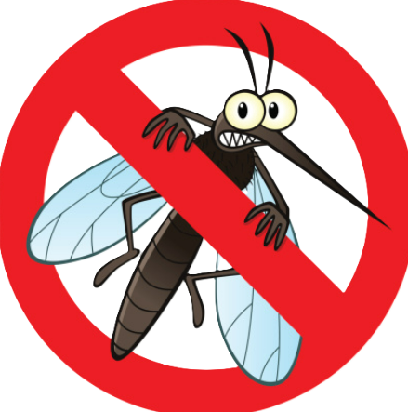
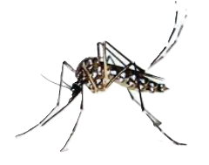
Project Introduction
The basis of this project is to utilize data analytics to suggests improvement towards our target government agencies.
Project Theme
With the growing trend of dengue cases around Singapore, this presentation outlines a framework for understanding and addressing the problem.

Slide 5
02
Business Understanding

Slide 6
Business Understanding
1. Analyse the geographical data to pinpoint dengue hotspots & prioritise resource allocation.
To analyze the historical trend of dengue cases in Singapore and provide insights and recommendations on combating Dengue.
2. Examine data to identify trends & seasonal patterns in dengue cases
3. Assess the input of various policies to mitigate dengue cases.
4. Propose insights to enhance dengue control measures.

Slide 7
03
Data Understanding

Slide 8
Data Understanding
1. Compile Comprehensive Datasets, including Dengue Datasets in Singapore, Climate in Singapore, Dengue in Cuba and Dengue Hospitalisation Rates.
To ensure a thorough & comprehensive analysis of related data, allowing for the derivation of meaningful insights.
2. Conduct a rigorous evaluation of data quality by checking for completeness, accuracy and consistency.
3. Perform detailed data exploration to understand the structure, distribution and relationships within data.
4. Prepare the data for analysis by performing necessary transformation and the data integration

Slide 9
04
Data Exploration & Preparation

Slide 10
Data Exploration & Preparation
These are the steps utilized for Data Exploration & Preparation, before conduction of analysis:
Data Collection:
Data Cleaning:
Collection of important Datasets regarding dengue situation in Singapore.
Collection of Datasets involving potential factors of dengue.
Merging of datasets
Handling of duplicates
Data melting(To transform the data from a wide format(columns) to a long format.(rows))
concatenate of datasets (stacking the data vertically) (concat)
Removing of unnecessary of rows and columns

Slide 11
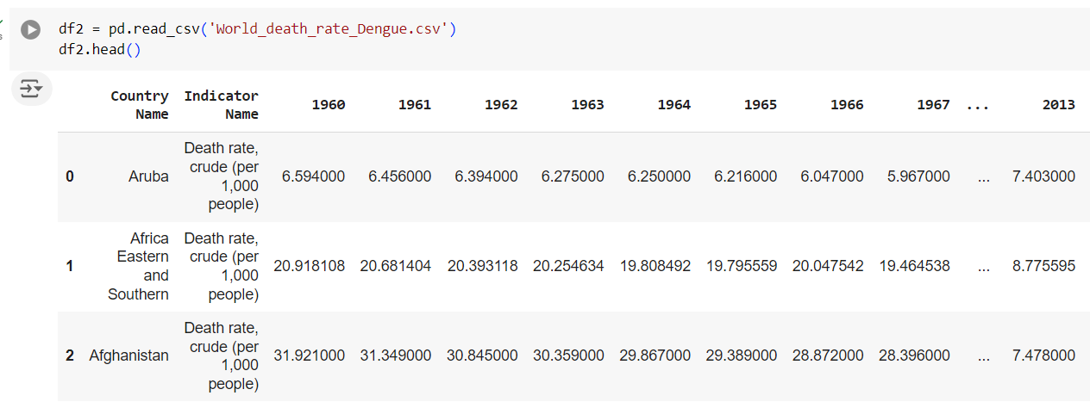
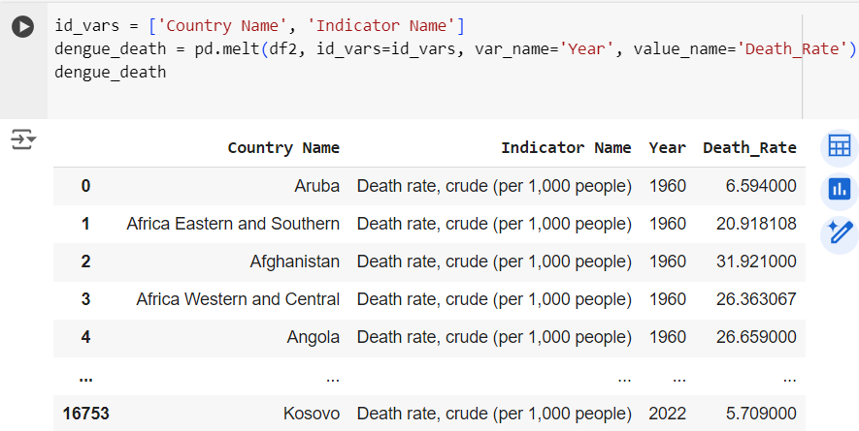
Data Exploration & Preparation
Data Melting
From
To

Slide 12
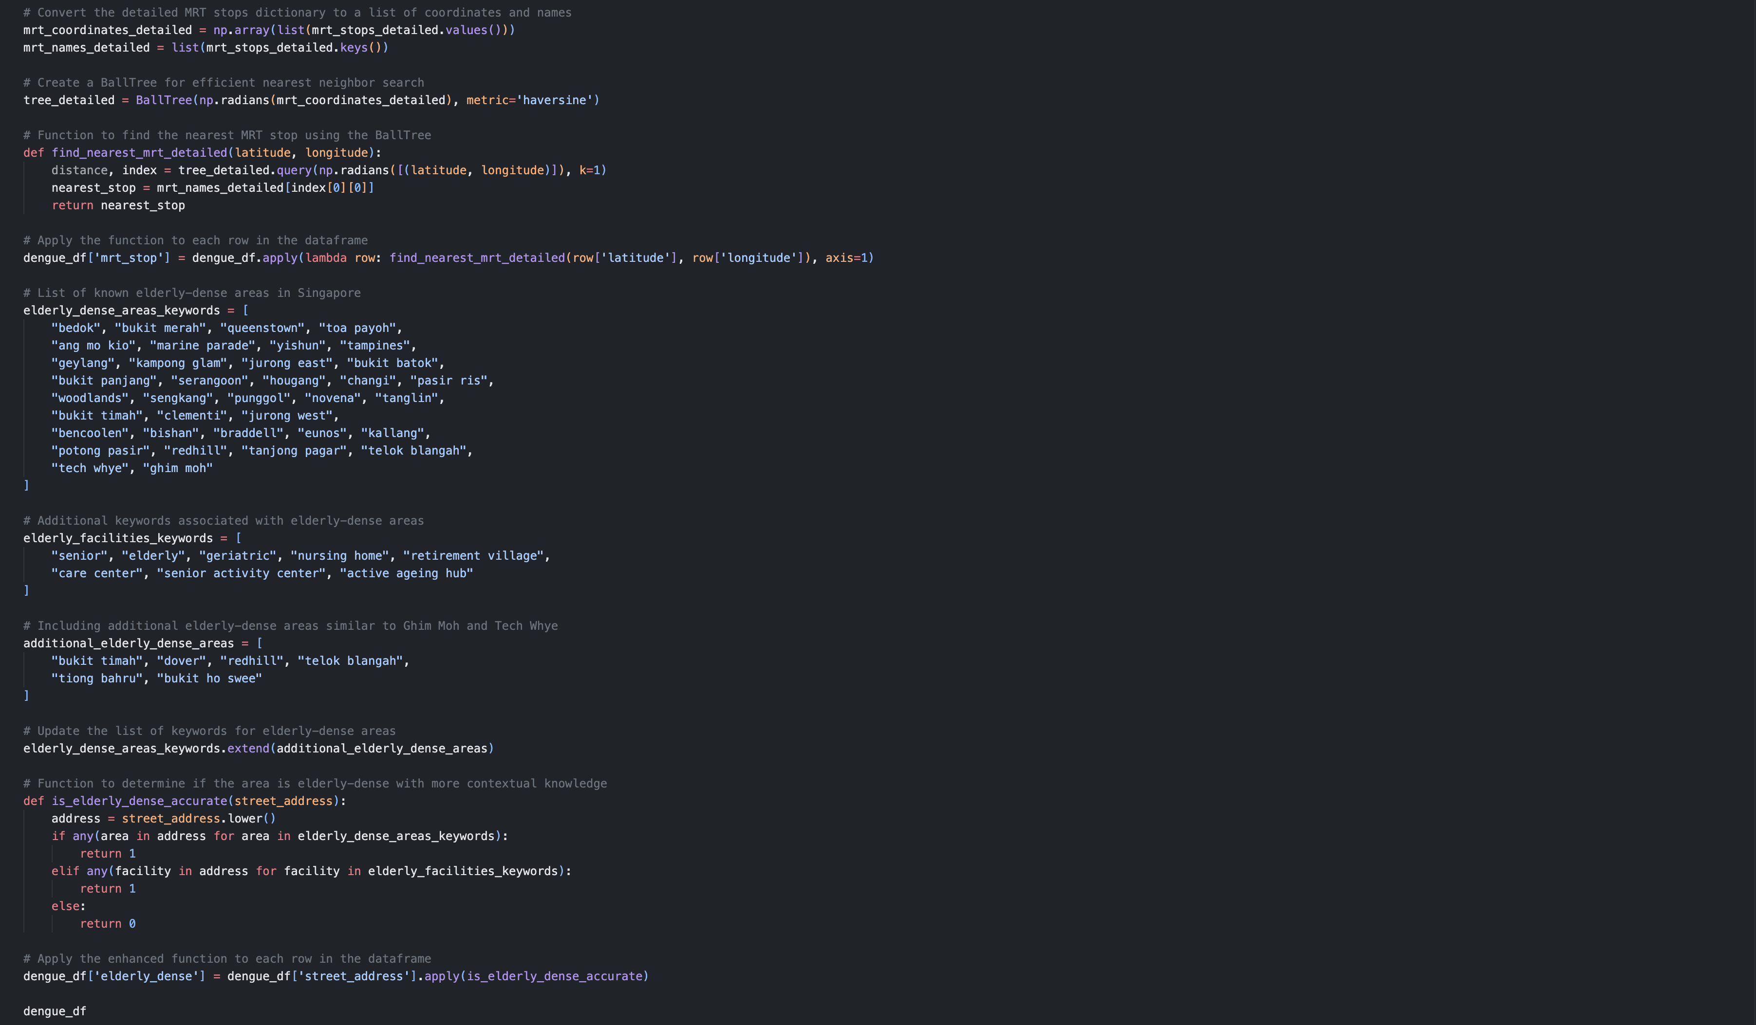
Data Exploration & Preparation
Usage of BallTree from sklearn.neighbours & Geopy Libraries to automatically assign locations based on their longitude and latitude

Slide 13
05
Dashboards
In Order: Hao Wen, Sai, Stephanie, Wei Xuan

Slide 14
Hao Wen's Dashboard
Analysis on Concern of Dengue

Slide 15
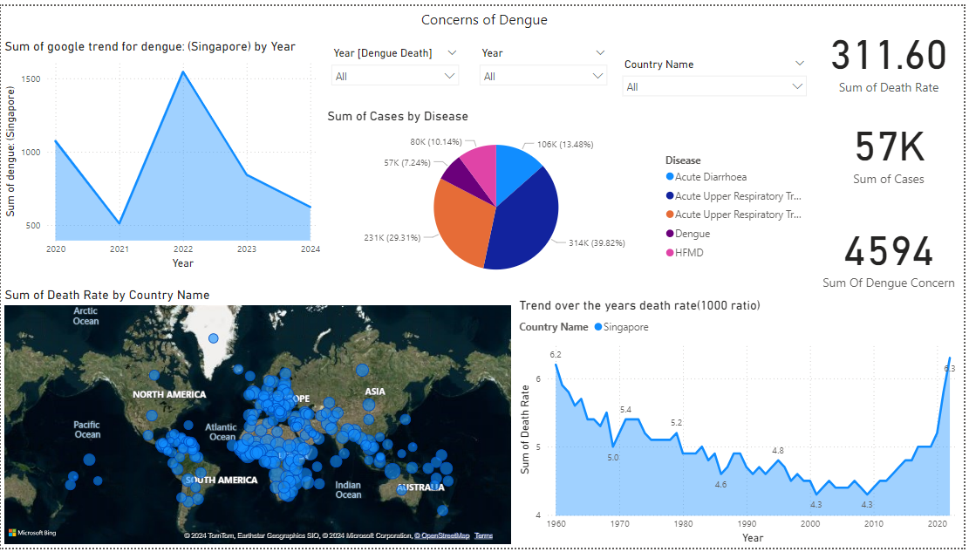
Business insight &Business Understanding

Slide 16
Sai's Dashboard
Analysis on Region-Specific Places & Policies in Singapore

Slide 17
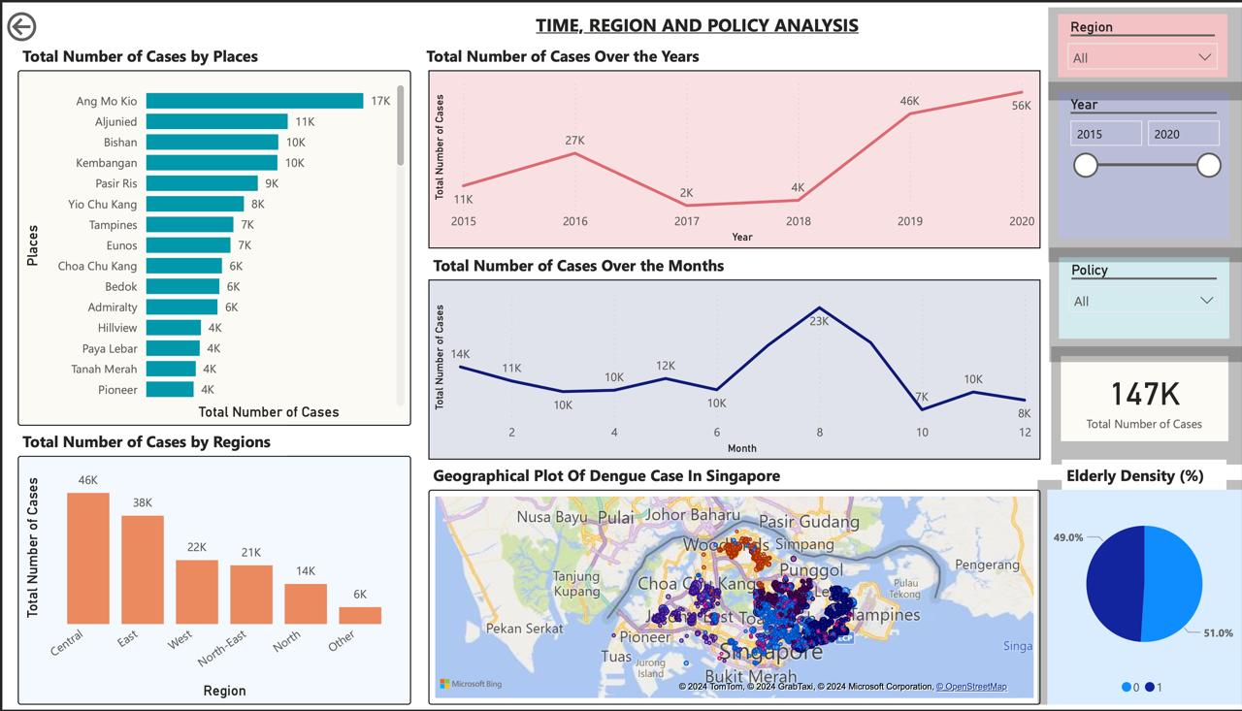

Slide 18
Recommendations
Although a potential biological control technique, Wolbachia has demonstrated variable efficacy throughout the year. Studies show that in terms of year-round performance, Gravitraps—physical traps used to monitor and control mosquito populations—have continuously outperformed Wolbachia. This implies that, even though Wolbachia can be a useful addition to an integrated vector control approach, in order to get the best outcomes, its effectiveness might need to be augmented by other techniques, such as Gravitraps.
When mosquitoes are most active, which is from June to August when the environment is most conducive to their success, Wolbachia has shown to be quite efficient. It usually has less of an effect on decreasing mosquito numbers and dengue transmission outside of these months. Therefore, in order to keep mosquito populations under constant control throughout the off-peak seasons, it is imperative to increase the deployment of complementing measures like Gavitraps and targeted insecticide spraying. We can achieve a more robust and prolonged reduction in dengue transmission by utilizing Wolbachia's advantages at its most effective period and bolstering it with other strategies throughout the year.

Slide 19
Stephanie's Dashboard
Analysis on the relationship between Singapore's Climate and the rising Dengue Cases in Singapore.

Slide 20
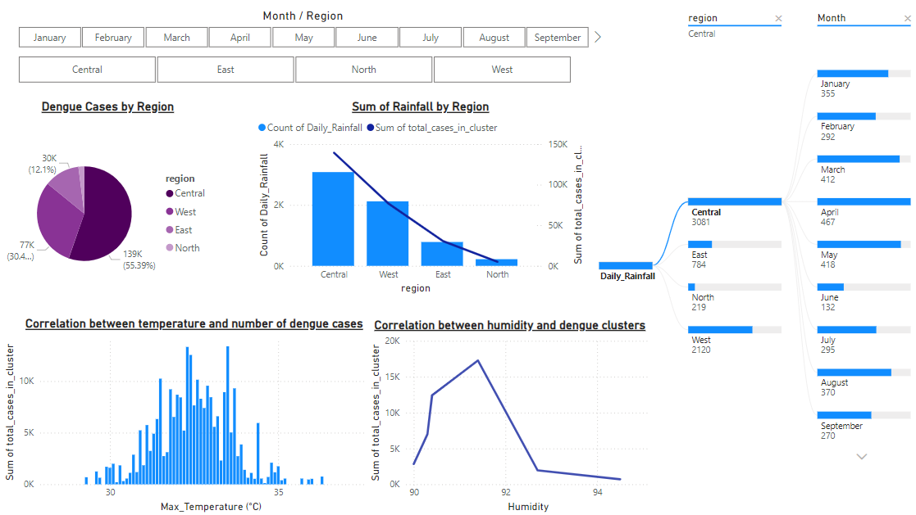
Count of

Slide 21
Recommendations
Heavy, consistent, rainfalls may cause collection of stagnant water in drainage pipes. Stagnant water is a known breeding ground for mosquitoes. Look into regions with high rainfall & dengue rate, and conduct scheduled maintenance checks for blocked drainpipes, gutters, etc.
Increase the use of larvicides in water bodies that cannot be drained and adulticides during peak mosquito activity periods.
Government can invest in improved drainage systems to reduce stagnant water collated from high rainfall.
April is the peak rainfall season within the central region. Such measures should be imposed during this period to make the solutions more effective.

Slide 22


05
Wei Xuan's Dashboard
Analysis on Cuba vs Singapore

Slide 23
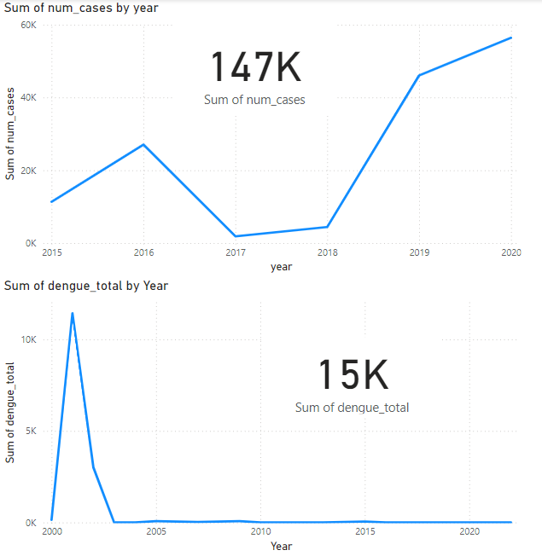
Dashboard about Singapore & Cuba
Singapore:
Cuba:

Slide 24
Methods Used
Similarities:
Bacillus Thuringiensis Israelensis (BTI)
Wolbachia Bacteria
Chemical control
Reduction of stagnant water
Public Education
Surveillance & Monitoring
Regulations & Policies
Differences:
1. Gambusia and Copepod used in Cuba

Slide 25
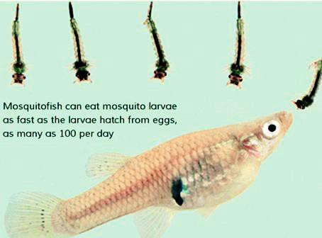
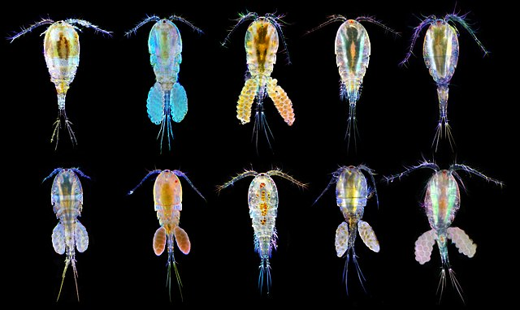
Gambusia vs Copepods
Gambusia:
Lifespan: 1-2 years
Habitat: Ponds, Ditches, Streams, Lakes, Marshes, Slow-moving Rivers
Clean/Unpolluted
Warm
Consume: Larvae, Algae
Advantage:
Highly effective
Thrive in different environment
Disadvantage:
Environmental harm
Reduce biodiversity
High maintenance
Copepods:
Few weeks-months
Habitat: Ponds, Lakes, Streams, Oceans, Estuaries
Various level of cleanliness and pollution depending on species
Moderate temperature
Consumes: Larvae, Microalgae
Advantage:
Low maintenance
Environmentally friendly
Adapt to living conditions
Specifically target mosquitoes
Disadvantage:
Careful management to prevent disruption of ecosystem
Effectiveness varies

Slide 26
06
Challenges

Slide 27
Challenges:
Lack of support from government agencies while attempting to seek out national datasets from them. Main regressor within the project, as government agencies like NEA are the ones with the most information regarding such niche topics like Dengue.
Faced problems finding a suitable topic for the final dashboard, change of Project Topic was considered a week before submission deadline.
Some data we wanted to utilize for analysis did not exist. Though it is a good analysis point, it could not be initiated as no existing dataset was present to support our idea.
Finding Data with proper street addresses and assigned regions and we were having issues integrating APIs to assign street addresses to their locations and regions, forcing us to hard code it out.

Slide 28
07
Conclusion

Slide 29
Conclusion
By analyzing data and trends, we have identified the key influences of rising dengue cases and potential mitigation strategies.
In conclusion, the main suggestion to combat our dengue issue is to make use of copepods, as it is a solution that the Singapore Government has not used before, and it has been proven to be most effective based on the sharp drop of cases within Cuba after this measure was implemented.
Based on our analysis, months August-September is one of the more dengue-ridden months as compared to others. Since it is peak mating-season period, Project Wolbachia should be implemented compared to Gavitrap Deployment as it has been proven to reduce case by a larger percentage compared to Gavitrap Deployment.

Slide 30
08
Contributions

Slide 31
Contributions
Name | Contributions
Sai | Research Singapore
Hao Wen | Research on the concern of dengue
Stephanie | Research of relationship between climate in Singapore & increasing dengue cases.
Wei Xuan | Research on Cuba

Slide 32
09
References

Slide 33
Citations / Links used
rainfall_data
https://www.kaggle.com/datasets/whitecl0ud/weather-data-of-singapore?select=combined_output.csv
humidity_data
https://beta.data.gov.sg/datasets/d_31dbf162e94f76065e1e4c60a80a4264/view
dengue_df
https://outbreak.sgcharts.com/data
cuba dataset
https://opendengue.org
Hospital_2020_2017
https://www.moh.gov.sg/resources-statistics/infectious-disease-statistics/2020/weekly-infectious-diseases-bulletin

Slide 34
THANKS!
Do you have any questions?
dengueops@gmail.com
Please keep this slide for attribution

