Slide 1
JAVA PROGRAMMING PROJECT | CO1–CO6
MONTHLY EXPENSE
& BUDGET ANALYZER
Track spending. Understand your budget. Make smarter decisions.
2620030616 — Sai Keerthana
2620030624 — Sai Praneeth
PSPJ • JAVA PROJECT PRESENTATION

Slide 2
PROJECT OVERVIEW
Abstract & Problem Statement
• A Java console application that records monthly expenses and compares them with a planned budget.
• Inputs: monthly budget, number of expenses, category, description and amount.
• Processing: validate amounts, calculate totals and analyse spending.
• Outputs: average, highest expense, remaining budget, percentage used and budget status.
• Expense records are saved in a text file for later viewing.
PROBLEM TO SOLVE
People can lose track of everyday purchases and exceed their monthly budget. This program makes spending easier to understand.
MONTHLY EXPENSE & BUDGET ANALYZER • JAVA PROJECT
02

Slide 3
INPUT, DATA TYPES & OUTPUT
CO1 — Java Foundations
Scanner sc = new Scanner(System.in);
System.out.print("Enter monthly budget: ₹");
double budget = sc.nextDouble();
System.out.print("Enter number of expenses: ");
int n = sc.nextInt();
sc.nextLine();
System.out.printf("Monthly Budget: ₹%.2f%n", budget);
ONLY THE KEY POINTS
• Scanner reads console input.
• double stores money values; int stores counts.
• printf formats the budget output.
• The program follows input → process → output.
MONTHLY EXPENSE & BUDGET ANALYZER • JAVA PROJECT
03

Slide 4
CONTROL FLOW
CO2 — Conditions & Loops
static String getBudgetStatus(double budget, double total) {
if (total < budget) return "WITHIN BUDGET";
else if (total == budget) return "BUDGET FULLY USED";
else return "OVER BUDGET";
}
for (int i = 0; i < n; i++) {
// read each expense
}
ONLY THE KEY POINTS
• if-else selects a budget status.
• for repeats the input steps for each expense.
• while repeats until a valid amount is entered.
• Conditions also generate budget warning messages.
MONTHLY EXPENSE & BUDGET ANALYZER • JAVA PROJECT
04

Slide 5
REUSABLE CALCULATIONS
CO3 — Methods & Arrays
static double calculateTotal(double[] amounts) {
double total = 0;
for (double amount : amounts) {
total += amount;
}
return total;
}
static double calculateAverage(double[] amounts) {
if (amounts.length == 0) return 0;
return calculateTotal(amounts) / amounts.length;
}
ONLY THE KEY POINTS
• A 1D array stores the expense amounts.
• The loop adds all amounts together.
• Methods keep calculations reusable and organised.
• The empty-array check avoids division by zero.
MONTHLY EXPENSE & BUDGET ANALYZER • JAVA PROJECT
05

Slide 6
OBJECT-ORIENTED PROGRAMMING
CO4 — Classes, Objects & Exceptions
static class Expense {
private String category;
private String description;
private double amount;
Expense(String category, String description,
double amount) {
this.category = category;
this.description = description;
this.amount = amount;
}
}
ONLY THE KEY POINTS
• Expense is a blueprint for one record.
• The constructor initialises each object.
• private fields support encapsulation.
• try-catch handles invalid amount input.
MONTHLY EXPENSE & BUDGET ANALYZER • JAVA PROJECT
06

Slide 7
SAVE AND LOAD EXPENSES
CO5 — Strings & File Handling
String line = e.getCategory() + ","
+ e.getDescription() + ","
+ e.getAmount();
lines.add(line);
Files.write(Path.of("expenses.txt"), lines);
List<String> saved =
Files.readAllLines(Path.of("expenses.txt"));
ONLY THE KEY POINTS
• String concatenation creates a saved record.
• Files.write stores data in expenses.txt.
• Files.readAllLines loads saved lines.
• split(",") separates fields when displaying records.
MONTHLY EXPENSE & BUDGET ANALYZER • JAVA PROJECT
07

Slide 8
CATEGORY-WISE ANALYSIS
CO6 — Collections & Streams
Map<String, Double> categoryTotals =
expenses.stream()
.filter(e -> e.getAmount() > 0)
.collect(Collectors.groupingBy(
Expense::getCategory,
Collectors.summingDouble(
Expense::getAmount)));
categoryTotals.forEach((category, total) ->
System.out.printf("%-15s : ₹%.2f%n",
category, total));
ONLY THE KEY POINTS
• ArrayList stores Expense objects.
• Map stores category names and their totals.
• filter keeps positive expenses.
• groupingBy and summingDouble calculate category totals.
MONTHLY EXPENSE & BUDGET ANALYZER • JAVA PROJECT
08

Slide 9
ILLUSTRATIVE REPORT
Sample Output & Budget Analysis
========== BUDGET ANALYSIS ==========
Monthly Budget : ₹5000.00
Total Spent : ₹3500.00
Average Expense : ₹875.00
Highest Expense : ₹1500.00
Remaining Budget : ₹1500.00
Budget Used : 70.00%
Budget Status : WITHIN BUDGET
--- CATEGORY-WISE ANALYSIS ---
Food : ₹1200.00
Travel : ₹800.00
Shopping : ₹1500.00
KEY RESULTS
• Spending is compared with the budget.
• Remaining money is displayed.
• The category totals show where money goes.
• Sample figures are illustrative; use actual output if available.
MONTHLY EXPENSE & BUDGET ANALYZER • JAVA PROJECT
09

Slide 10
HOW IT WORKS
Workflow & Testing
• 1. Enter the monthly budget and number of expenses.
• 2. Enter category, description and amount for each expense.
• 3. Validate the amount and store the expense.
• 4. Calculate totals, average, highest expense and budget status.
• 5. Analyse categories, save records and display the report.
TEST CASES
• Positive amount: accepted
• Text/zero/negative amount: rejected and requested again
• Total below/equal/above budget: status changes accordingly
• Missing file: friendly message is displayed
MONTHLY EXPENSE & BUDGET ANALYZER • JAVA PROJECT
10

Slide 11
PROJECT OUTCOME
Conclusion
• The project turns monthly expense entries into a clear financial summary.
• It applies the key Java concepts from CO1 to CO6 without lengthy theory.
• Methods and arrays support calculations; classes represent expense records.
• File handling saves data, while collections and streams analyse categories.
• Future improvements could include charts, monthly history and editing records.
KEY BENEFIT
A simple way to understand spending habits, monitor the budget and notice high expenses before they become a problem.
MONTHLY EXPENSE & BUDGET ANALYZER • JAVA PROJECT
11

Slide 12
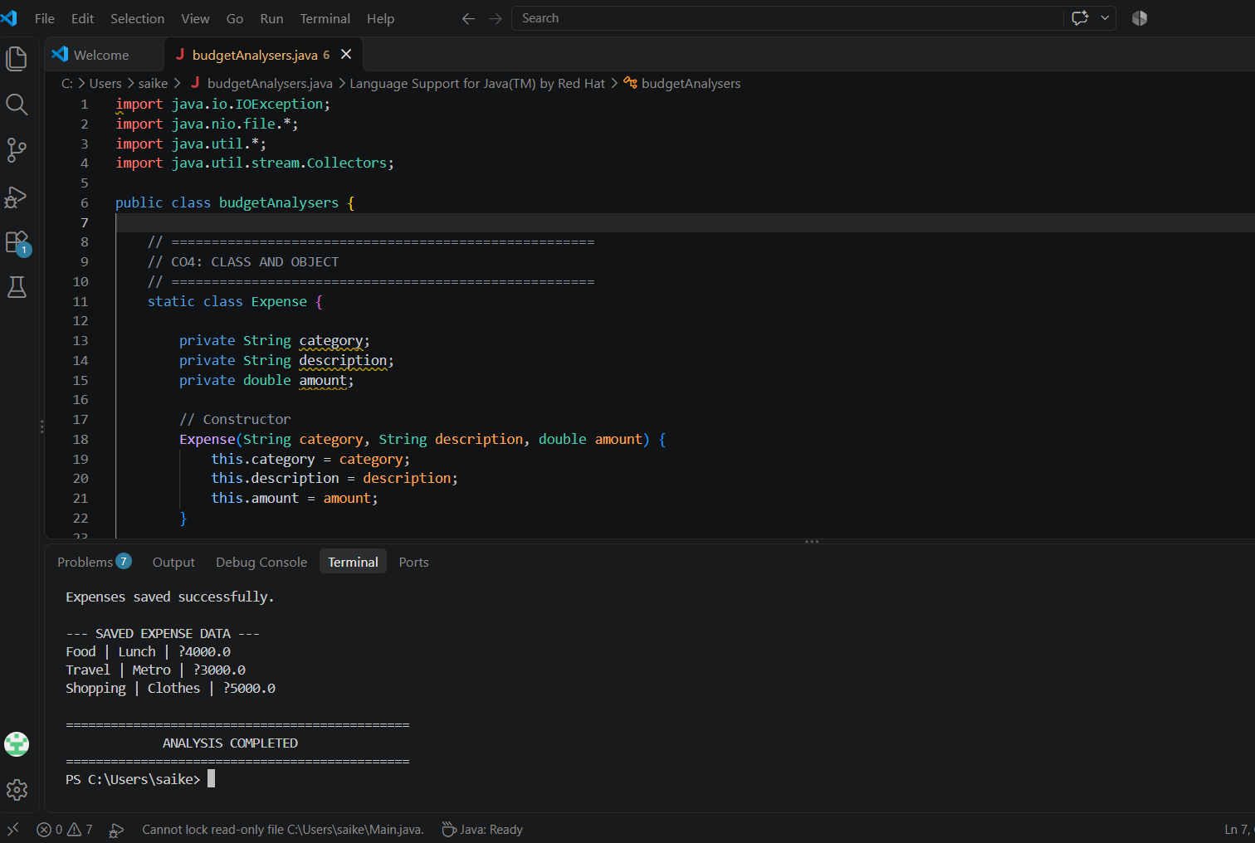

Slide 13
GITHUB URL
https://github.com/saikeerthana-git-c/BudgetAnalyser-Java-Presentation
.
MONTHLY EXPENSE & BUDGET ANALYZER • JAVA PROJECT
11

Slide 14
THANK YOU!
Questions & feedback are welcome.
2620030616 — Sai Keerthana
2620030624 — Sai Praneeth
MONTHLY EXPENSE & BUDGET ANALYZER • JAVA

