Slide 1

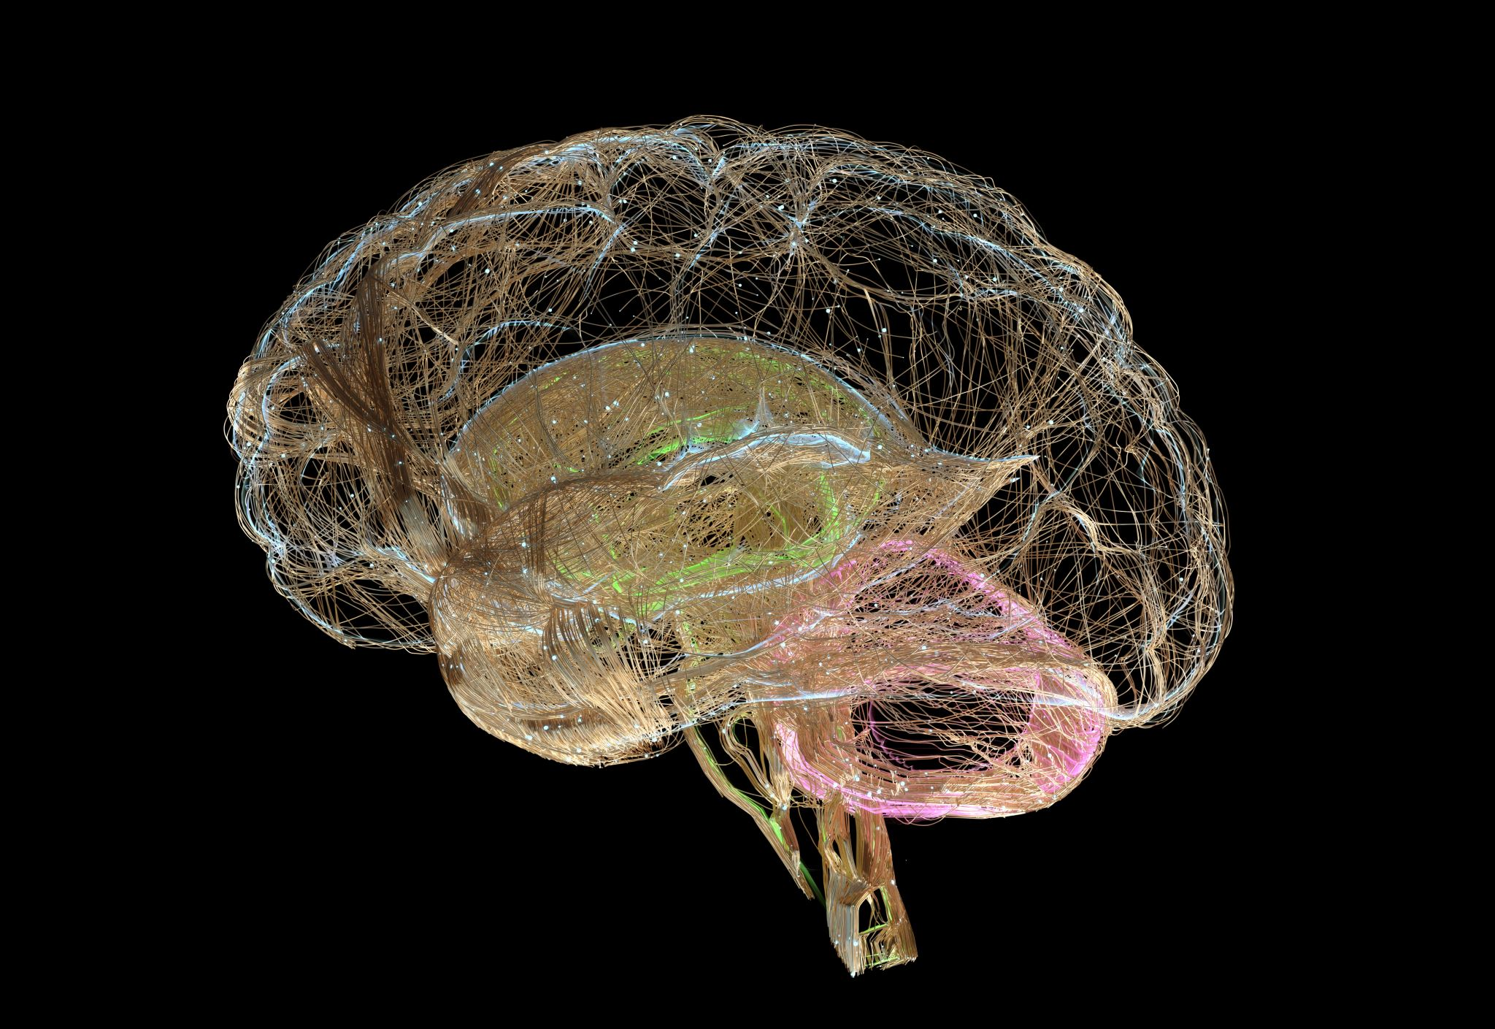


BRAIN TUMOR CLASSIFICATION USING MR IMAGES AND TRANSFER LEARNING
SAI KEERTHI THUNGAPATI - 700763831

Slide 2

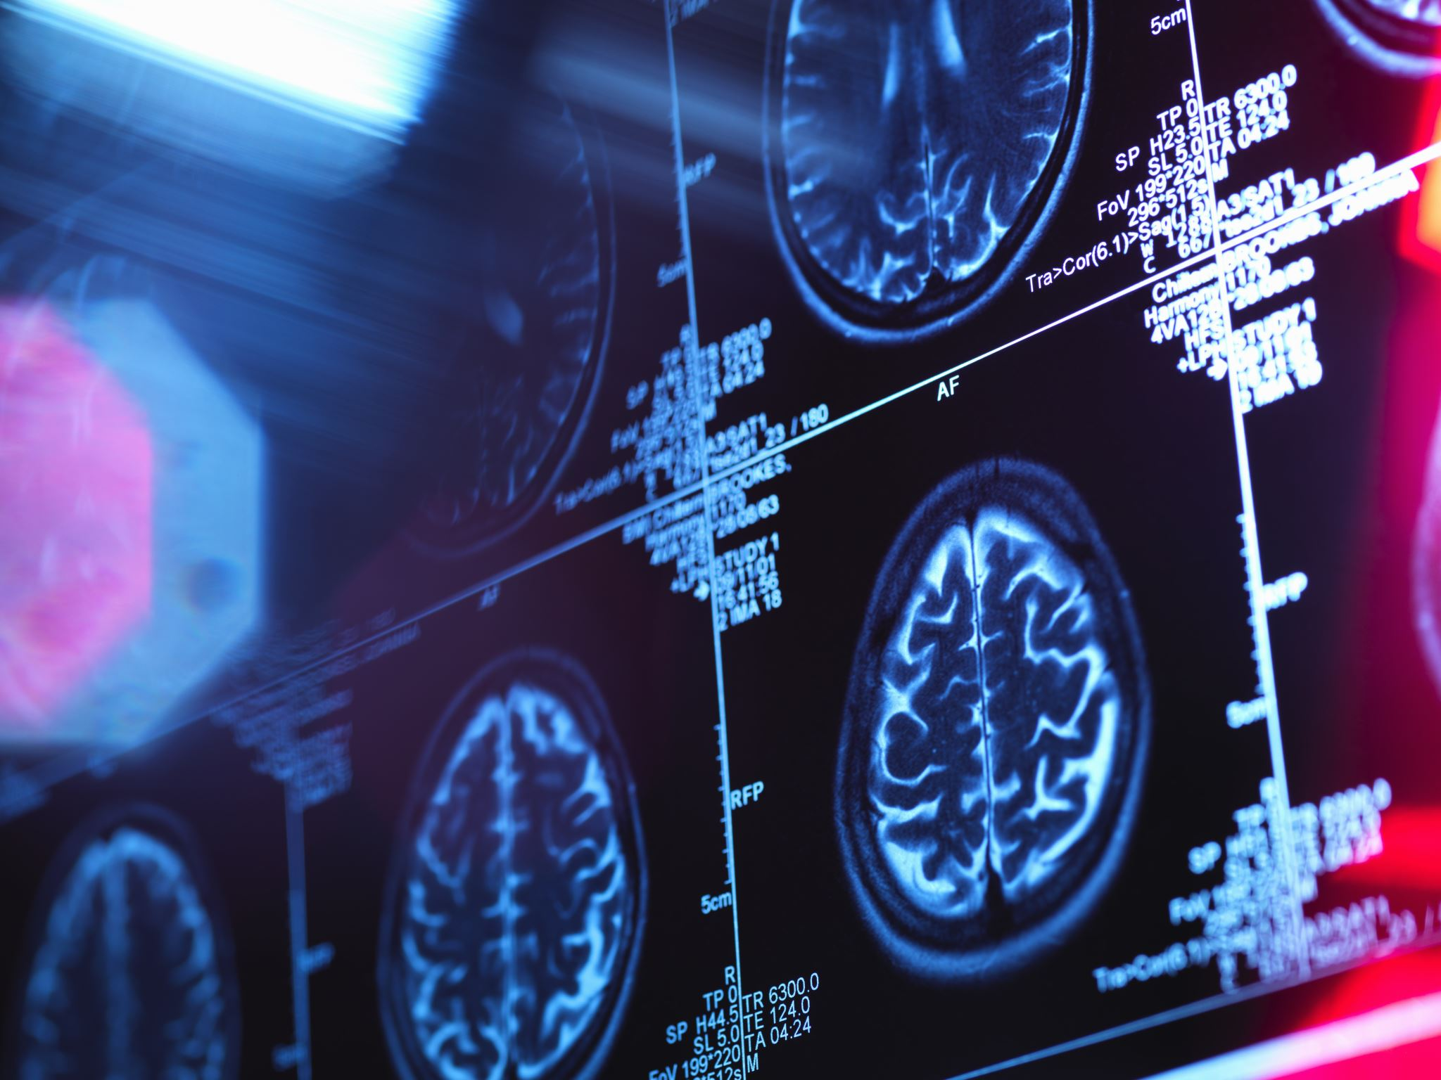
motivation
Detection of brain tumors in real-time can be achieved through various imaging techniques such as magnetic resonance imaging (MRI), computed tomography (CT), and positron emission tomography (PET) scans.
MRI is the most commonly used imaging technique for detecting brain tumors. It uses a magnetic field and radio waves to create detailed images of the brain. CT scans use X-rays to create images of the brain, and PET scans use a radioactive tracer to show how the brain is functioning.
Real-time detection of brain tumors can be helpful for doctors in several ways. It allows them to quickly identify the location and size of the tumor, which can help guide treatment decisions. Real-time imaging can also be used during surgery to help surgeons precisely remove the tumor while minimizing damage to healthy brain tissue.
In addition, real-time monitoring of the tumor during and after treatment can help doctors evaluate the effectiveness of the treatment and make any necessary adjustments. Overall, real-time detection of brain tumors is a valuable tool in the diagnosis and treatment of brain tumors.

Slide 3
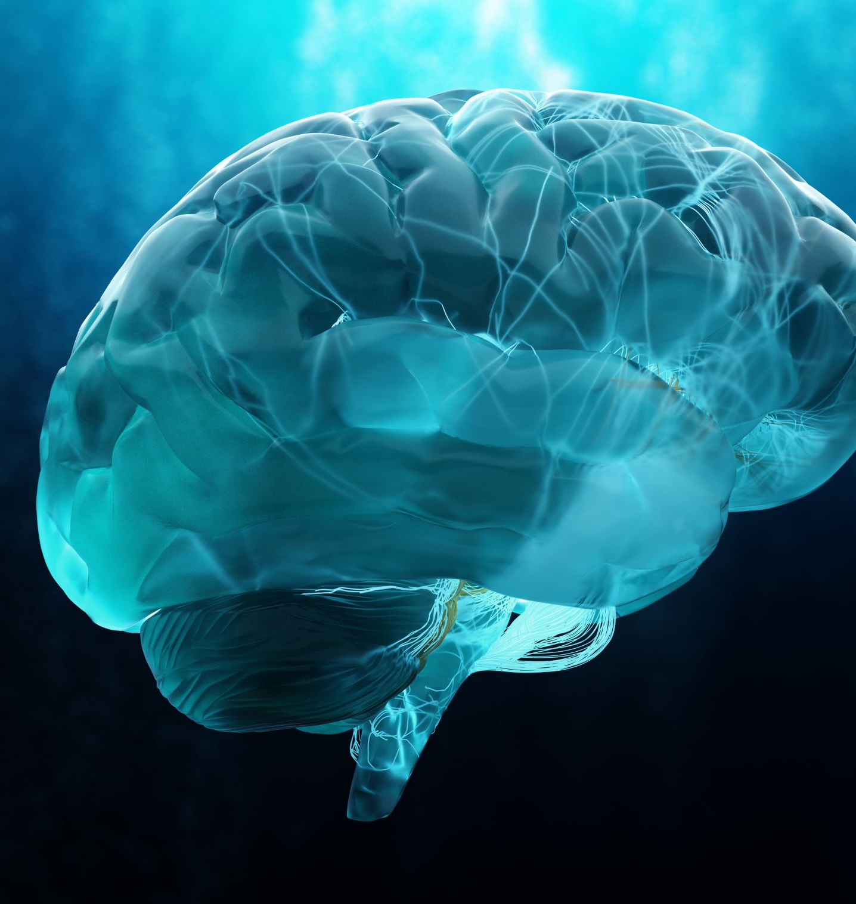
Problem Statement
Brain tumors are one of the most life-threatening conditions, and early diagnosis is crucial for effective treatment. Magnetic Resonance Imaging (MRI) is commonly used for brain tumor detection due to its detailed visualization of soft tissues. However, manual classification of brain tumors from MR images can be time-consuming, subjective, and prone to human error. The challenge is to develop an automated and accurate method for classifying brain tumors based on MR images. Traditional machine learning models require a large amount of labeled data and significant feature engineering, which can be difficult in medical image analysis. Transfer learning, a deep learning approach that utilizes pre-trained models, offers a promising solution by leveraging pre-existing knowledge from large datasets to improve classification performance on smaller, specific medical datasets.

Slide 4

OBJECTIVE
Our objective is to build a system that works with Convolution Neural Network using Transfer Learning Techniques. The model is trained with augmentation methods and generate good accuracy among all the transfer learning and predefined architectures. In transfer learning algorithms based on highly complex neural network that mimic the human brain works to detect patterns in large unstructured data set. Transfer Learning can analyze images, videos, and unstructured data in which machine learning can’t easily do. The model is able to achieve high accuracy on the target dataset, while still being computationally efficient.

Slide 5
contributions
Advances in Medical Imaging Analysis: Transfer learning improves the ability to detect and classify brain tumors from MR images with high accuracy. Reduces the need for manual analysis, helping radiologists make quicker, more reliable decisions.
Improved Tumor Classification: Helps in distinguishing between different types of brain tumors, such as gliomas, meningiomas, and pituitary tumors. Early Detection: Facilitates early diagnosis and treatment planning, potentially improving patient outcomes.
Contribution to Personalized Medicine: Accurate classification aids in developing tailored treatment strategies based on the specific type and grade of the tumor.

Slide 6
EXISTING METHODOLOGY
Traditionally,Convolutional neural network (CNN) model using a large dataset involves a significant level of computational complexity.
Reusing the model weights from previously trained models might therefore streamline this learning process.
Disadvantages:
Poorer output
Significant degree of computational complexity.

Slide 7
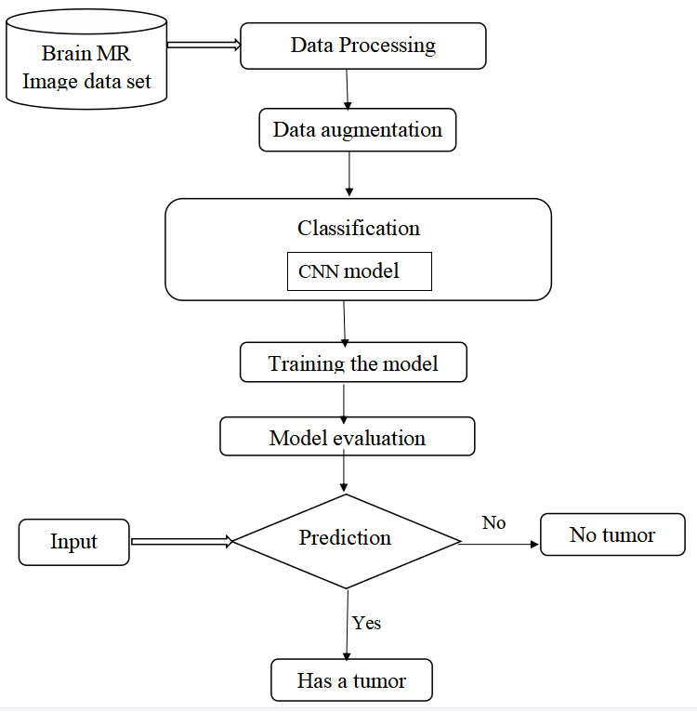
Existing model Block diagram

Slide 8
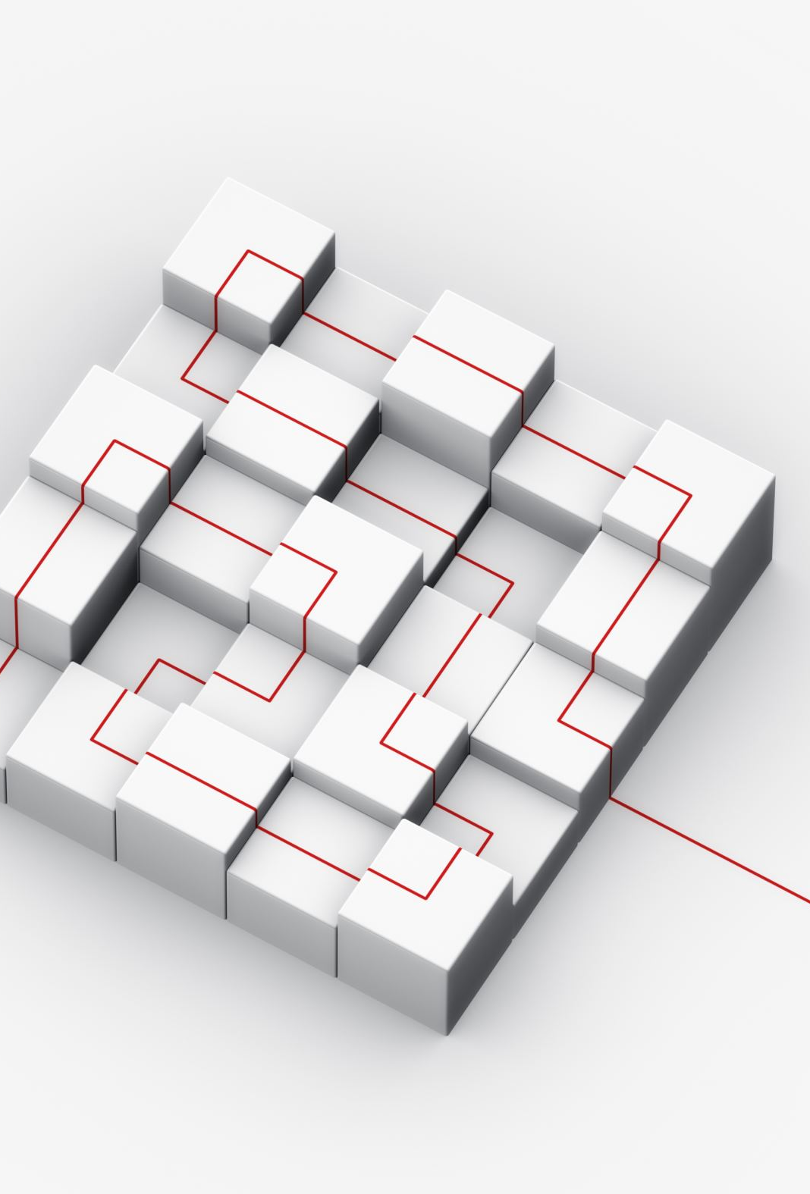
Model Implementation
Loading the dataset: The first step is to load the dataset into memory. This can be done using Python libraries such as NumPy or Pandas. The dataset should be divided into training and test sets.
Augmentation and image pre-procesing: Data augmentation techniques such as and cropping can be used to artificially increase the size of the dataset and reduce overfitting. This step can be done using Python libraries such as Keras or OpenCV.
Feature extraction: Feature extraction involves extracting important features from the images that can help in distinguishing between different types of tumors. This can be done using pre-trained models such as VGG16 or InceptionV3, which have been trained on large datasets of images and can extract meaningful features from the input images.
Classification: Once the features have been extracted, a classification model can be trained to classify the images into different tumor types.
Further classification of tumor type: After the images have been classified into different tumor types, further classification can be done to identify the specific type of tumor.
Overall, this process involves loading the dataset, augmenting the data, extracting important features, classifying the images to identify if there is a tumor or not, and further classifying the specific types of tumor if there is a tumor. This process requires a combination of image processing, machine learning, and deep learning techniques and can be computationally intensive.

Slide 9
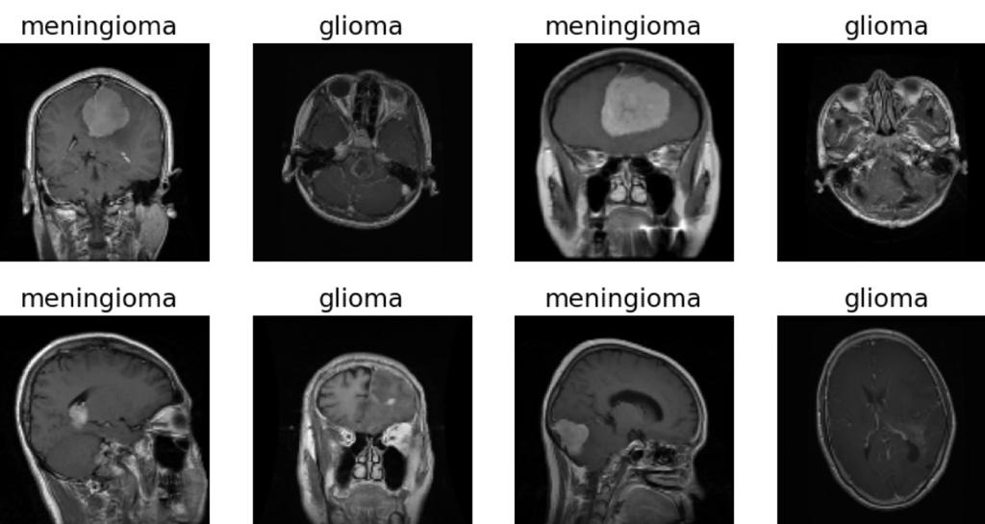
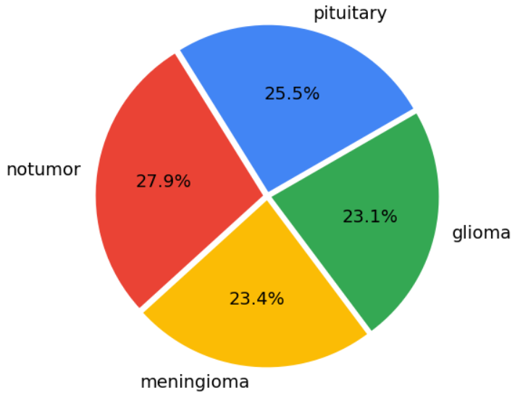
Data Description
There were 4 distinct classes in the dataset — Glioma, Meningioma, Pituitary Tumor, and a baseline case of No Tumor. The dataset consists of 5,712 images in the training set and 1,311 images in the test set.
Sample Images:

Slide 10

Performance metrics
The metrics we have used for the evaluation of our model are:
Accuracy= (TN+TP)/ (TN+FP+FN+TP) (1)
Precision=TP/ (FP+TP) (2)
Recall=TP/ (TP+FN) (3)
F1 score= TP/ (TP+1/2(FP+FN)) (4)
Where,
TP = True-positive,
TN = True-negative,
FP = False- positive,
FN = False-negative

Slide 11
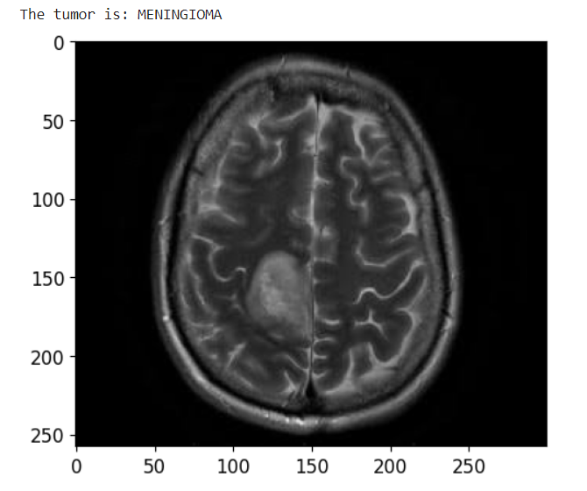
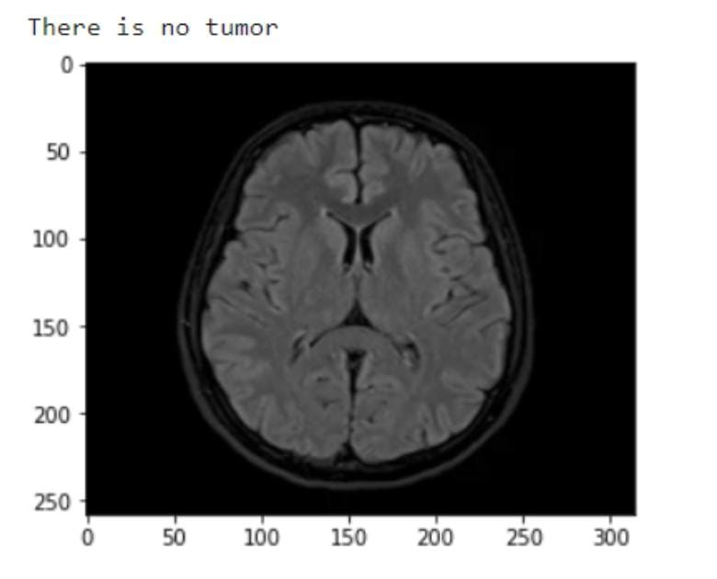
RESULTS
The MR image is predicted correctly as expected. The image is displayed after the prediction with the label on the top of the image as result.

Slide 12
Comparision of Results
Epochs | Three |  | Five |  | Seven |  | Ten
 | Time | Accuracy | Time | Accuracy | Time | Accuracy | Time | Accuracy
CNN | 165 | 75% | 175 | 80% | 179 | 80% | 171 | 86%
VGG-16 | 181 | 90% | 179 | 97% | 181 | 97% | 176 | 98%
InceptionV3 | 184 | 83% | 173 | 87% | 221 | 87% | 183 | 90%

Slide 13
CONCLUSION
Within the proposed work, a model for brain tumor classification is displayed utilizing CNN and transfer learning procedures.
The outcomes proposed that VGG16 model gives way better comes about in comparison to CNN and InceptionV3 with accuracy of 98% on the test dataset.
This show is computationally successful, less time expending and gives strong design for classification of brain tumors.
In future scope, the tumor discovery can be performed utilizing multimodal MRI pictures for moved forward execution.

Slide 14
REFERENCES
[1] A. Çinar and M. Yildirim, ‘‘Detection of tumors on brain MRI images using the hybrid convolutional neural network architecture,’’ Med. Hypotheses, vol. 139, Jun. 2020, Art. no. 109684.
[2] H. M. Rai and K. Chatterjee, ‘‘Detection of brain abnormality by a novel Lu-Net deep neural CNN model from MR images,’’ Mach. Learn. Appl., vol. 2, Dec. 2020, Art. no. 100004.
[3] M. K. Islam, M. S. Ali, M. S. Miah, M. M. Rahman, M. S. Alam, and M. A. Hossain, “Brain tumor detection in MR image using superpixels, principal component analysis and template based K-means clustering algorithm,’’ Mach. Learn. Appl., vol. 5, Sep. 2021, Art. no. 100044
[4] R. Mehrotra, M. A. Ansari, R. Agrawal and R. S.Anand, “A Transfer Learning approach for AIbased classification of brain tumors,” Mach. Learn. Appl. 2020, 2, 10–19.
[5] T. K. Das, P. K. Roy, M. Uddin, K. Srinivasan, C.-Y. Chang, and S. Syed-Abdul, ‘‘Early tumor diagnosis in brain MR images via deep convolutional neural network model,’’ Comput., Mater. Continua, vol. 68, no. 2, pp. 2413–2429, 2021.
[6] M. Toğaçar, B. Ergen, and Z. Cömert, ‘‘BrainMRNet: Brain tumor detection using magnetic resonance images with a novel convolutional neural network model,’’ Med. Hypotheses, vol. 134, Jan. 2020, Art. no. 109531.
[7] Z. Jia and D. Chen, ‘‘Brain tumor identification and classification of MRI images using deep learning techniques,’’ IEEE Access, early access, Aug. 13, 2020, doi: 10.1109/ACCESS.2020.3016319.

