Slide 1

LAB 1: CPU SCHEDULING ALGORITHMS (FCFS)
OCC: 1
GROUP: 8

Slide 2

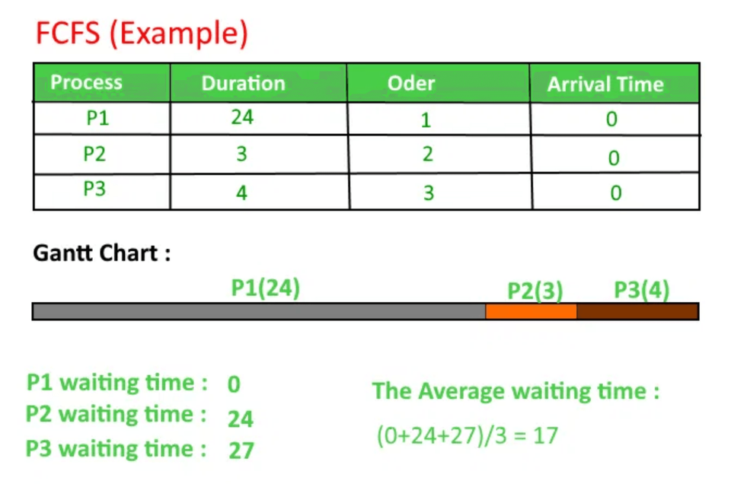
First-Come, First-Served (FCFS)
The simplest CPU scheduling algorithm.
Processes are executed in the exact order they arrive in the ready queue.
Non-preemptive: Once a process starts, it runs until completion.
Drawback: Can cause a "convoy effect" where short processes get stuck waiting for a long process.

Slide 3
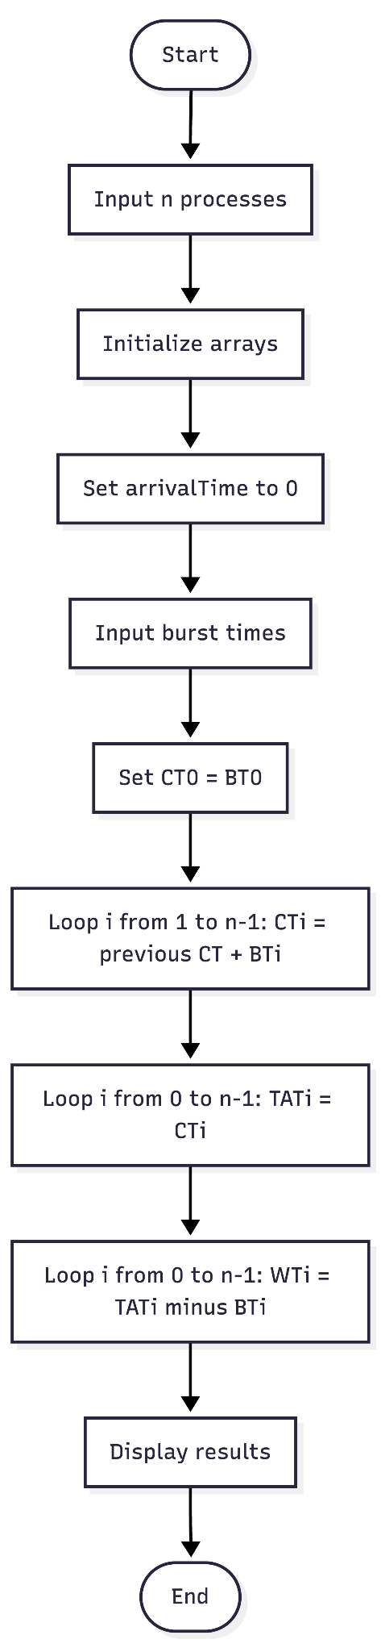
Flowchart & Pseudocode
PSEUDOCODE
1. Input number of processes n and their BurstTime[i].
2. Set all ArrivalTime[i] = 0.
3. CompletionTime[0] = BurstTime[0]
4. For i = 1 to n-1:
CompletionTime[i] = CompletionTime[i-1] + BurstTime[i]
5. For i = 0 to n-1:
TurnAroundTime[i] = CompletionTime[i] - ArrivalTime[i]
6. For i = 0 to n-1:
WaitingTime[i] = TurnAroundTime[i] - BurstTime[i]
7. Display Process, Burst Time, Waiting Time, Turnaround Time.
Figure: FCFS Scheduling Logic Flow

Slide 4


Code Implementation
JAVA FCFS IMPLEMENTATION (CORE LOGIC)
// Calculate Completion Time
completionTime[0] = burstTime[0]; // CT P1 = BT P1
for (int i = 1; i < n; i++) {
// Completion Time = previous Completion Time + Burst Time
completionTime[i] = completionTime[i - 1] + burstTime[i];
}
// Calculate Turnaround Time
for (int i = 0; i < n; i++) {
turnAroundTime[i] = completionTime[i] - arrivalTime[i];
}
// Calculate Waiting Time
for (int i = 0; i < n; i++) {
waitingTime[i] = turnAroundTime[i] - burstTime[i];
}

Slide 5

Program Sample Output
Input scenario: 3 processes. P1=10, P2=5, P3=8.
Process
Burst Time
Waiting Time
Turnaround Time
1
10
0
10
2
5
10
15
3
8
15
23

Slide 6




Code Demonstration
bash — LAB_1.java
ubuntu@sandbox:~$ javac LAB_1.java
ubuntu@sandbox:~$ java LAB_1
Enter number of processes: 3
Enter Burst Time for P1: 10
Enter Burst Time for P2: 5
Enter Burst Time for P3: 8
[ Running FCFS Algorithm... ]
1. Switch to IDE
2. Compile & Run
3. Verify Output

Slide 7

THANK YOU
Any Questions?

