Slide 1

LAB 2: CPU SCHEDULING ALGORITHMS (SJF)
OCC: 1
GROUP: 8

Slide 2

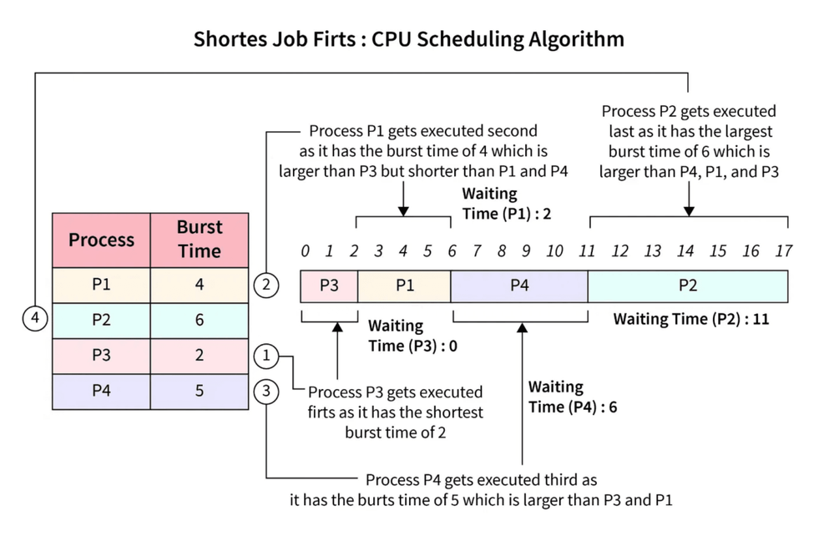
Shortest Job First (SJF)
The CPU is assigned to the process with the smallest burst time next.
Non-preemptive implementation: We sort the list of processes by burst time before assigning wait times.
Benefit: Provides the minimum average waiting time compared to other algorithms.

Slide 3

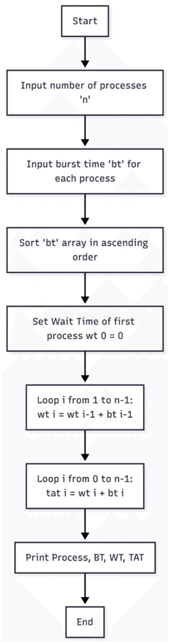
Flowchart & Pseudocode (SJF)
PSEUDOCODE
1. Input number of processes n and their BurstTime[i].
2. Sort processes in ascending order based on BurstTime.
3. Set WaitingTime[0] = 0.
4. For i = 1 to n-1:
WaitingTime[i] = WaitingTime[i-1] + BurstTime[i-1]
5. For i = 0 to n-1:
TurnAroundTime[i] = WaitingTime[i] + BurstTime[i]
6. Display Process, Burst Time, Waiting Time, Turnaround Time.
Figure: SJF Scheduling Logic Flow

Slide 4

Code Implementation (SJF)
JAVA SJF IMPLEMENTATION (CORE LOGIC)
// Sort processes based on burst time (SJF) for (int i = 0; i < n - 1; i++) { for (int j = i + 1; j < n; j++) { if (burstTime[i] > burstTime[j]) { // swap burst time and process id
int temp = burstTime[i]; burstTime[i] = burstTime[j]; burstTime[j] = temp; temp = process[i]; process[i] = process[j]; process[j] = temp; } } } // Calculate waiting time and turnaround time waitingTime[0] = 0; for (int i = 1; i < n; i++) { waitingTime[i] = waitingTime[i - 1] + burstTime[i - 1]; } for (int i = 0; i < n; i++) { turnAroundTime[i] = waitingTime[i] + burstTime[i]; }

Slide 5

Program Sample Output (SJF)
INPUT DATA
P1: 4
P2: 6
P3: 2
P4: 5
Process (Sorted)
Burst Time
Waiting Time
Turnaround Time
P3
2
0
2
P1
4
2
6
P4
5
6
11
P2
6
11
17
Average Waiting Time: 4.75
Average Turnaround Time: 9.00

Slide 6




Live Code Demonstration (SJF)
bash — Lab_2.java
ubuntu@sandbox:~$ javac Lab_2.java
ubuntu@sandbox:~$ java Lab_2
Enter the number of processes: 5
Enter Burst Time for 5 processes:
P1: 6, P2: 2, P3: 10, P4: 8, P5: 4
[ Sorting & Running SJF Algorithm... ]
1. Switch to IDE
2. Compile & Run
3. Verify Output

Slide 7

THANK YOU
Any Questions?

