Slide 1
LAB 6: BANKER'S ALGORITHM FOR
DEADLOCK AVOIDANCE
OCC : 1 GROUP : 8

Slide 2

INTRODUCTION TO BANKER’S ALGORITHM FOR DEADLOCK AVOIDANCE
it is a management technique where the system uses advance information to decide
whether resource requests should be satisfied or delayed.
Safety Check Logic
To decide if a request can be satisfied or must be delayed, the system considers resources currently available, current allocations, and future requests.
Primary use
Simulate the way the operating system avoids deadlocks by deciding whether to satisfy resource requests based on current available, allocated, and future resources.

Slide 3
KEY CHARACTERISTICS
State Tracking
To manage allocations, the system
monitors resources currently available,
resources currently allocated to each
process, and future requests .
Resource Instance Management
The Banker's algorithm is a deadlock
avoidance technique applicable to systems
with multiple instances of each resource type.
Deadlock Avoidance
This strategy ensures that processes do not
enter a permanent waiting state by
ensuring resources are allocated in a deadlock free manner.
Request Evaluation
The operating system uses advance
information to decide whether each request can be safely satisfied or if the process must be delayed.

Slide 4


WORKING PRINCIPLE
Request Evaluation:
When a process requests resources, the operating system uses advance information to determine whether the request can be satisfied immediately or if the process must be delayed.
01
Analysis Logic:
To decide if a current request is safe, the system evaluates the resources currently available, the resources currently allocated to each process, and all future requests .
02
Allocation and Waiting:
03 If the request is granted, resources are allocated to the process; otherwise, the process
enters a waiting state until resources are released to prevent a deadlock.

Slide 5
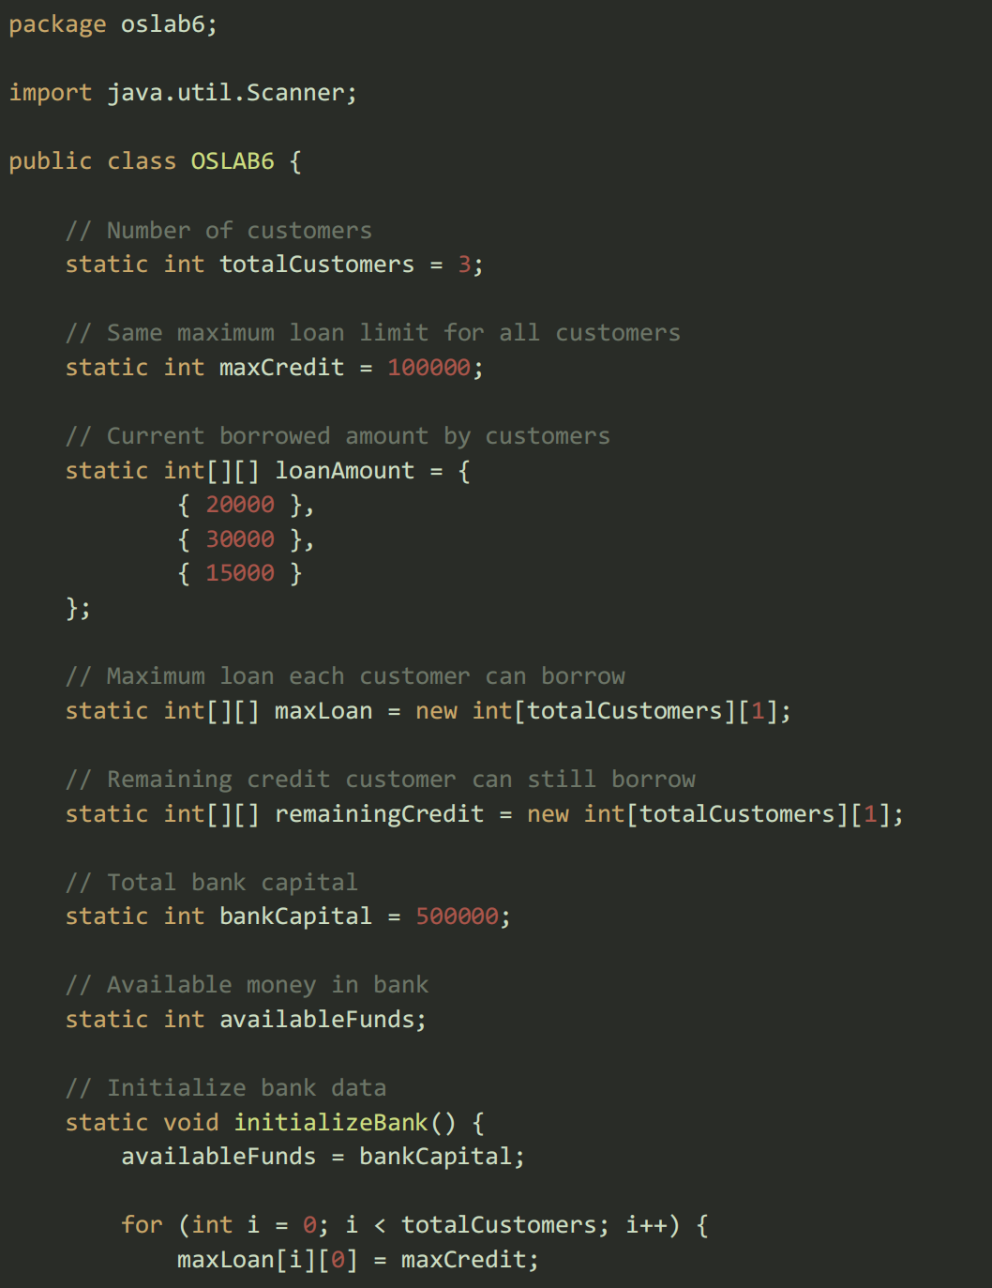
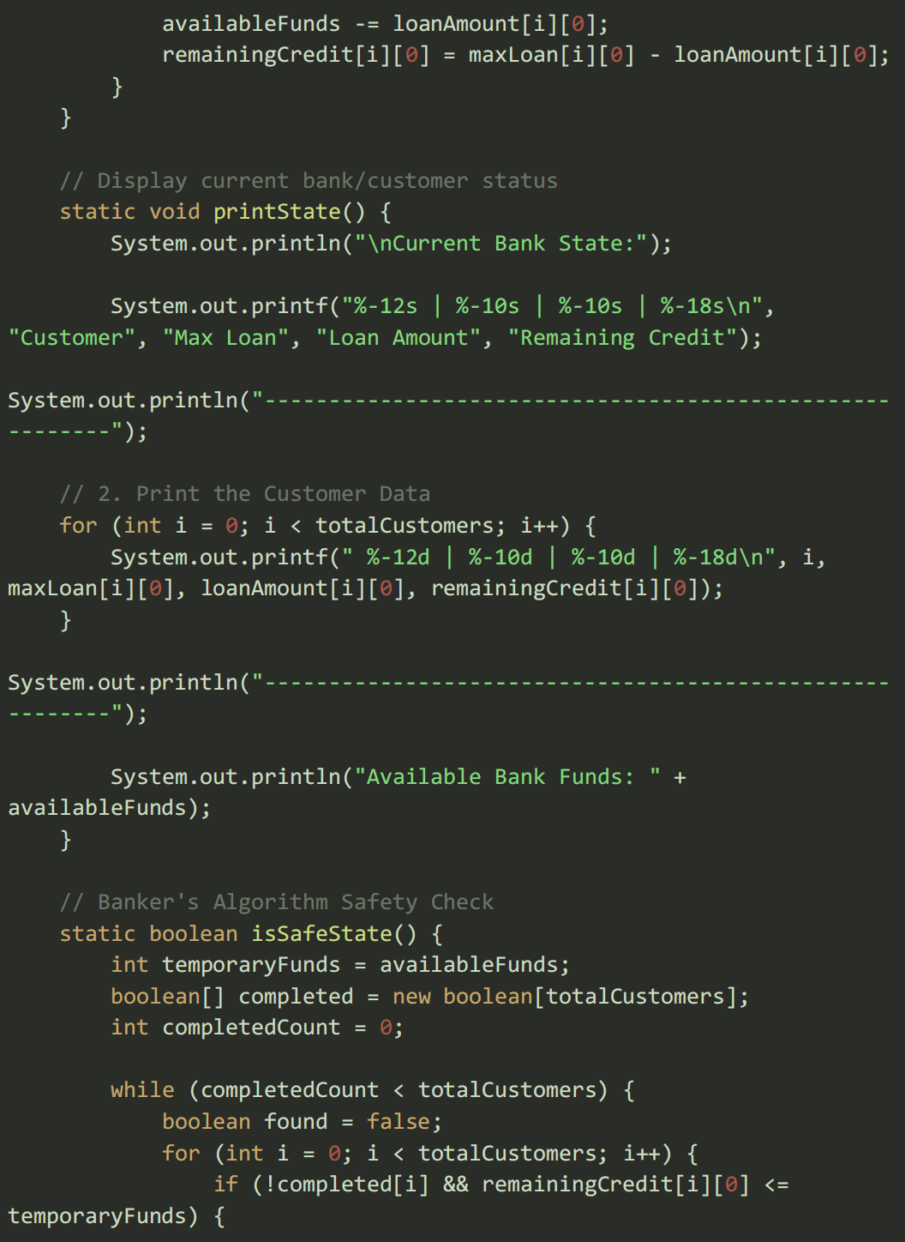
package oslab6;
import java.util.Scanner;
public class OSLAB6 {
// Number of customers
static int totalCustomers = 3;
// Same maximum loan limit for all customers
static int maxCredit = 100000;
// Current borrowed amount by customers
static int[][] loanAmount = {
{ 20000 },
{ 30000 },
{ 15000 }
};
// Maximum loan each customer can borrow
static int[][] maxLoan = new int[totalCustomers][1];
// Remaining credit customer can still borrow
static int[][] remainingCredit = new int[totalCustomers][1];
// Total bank capital
static int bankCapital = 500000;
// Available money in bank
static int availableFunds;
// Initialize bank data
static void initializeBank() {
availableFunds = bankCapital;
for (int i = 0; i < totalCustomers; i++) {
maxLoan[i][0] = maxCredit;
CODE IMPLEMENTATION

Slide 6
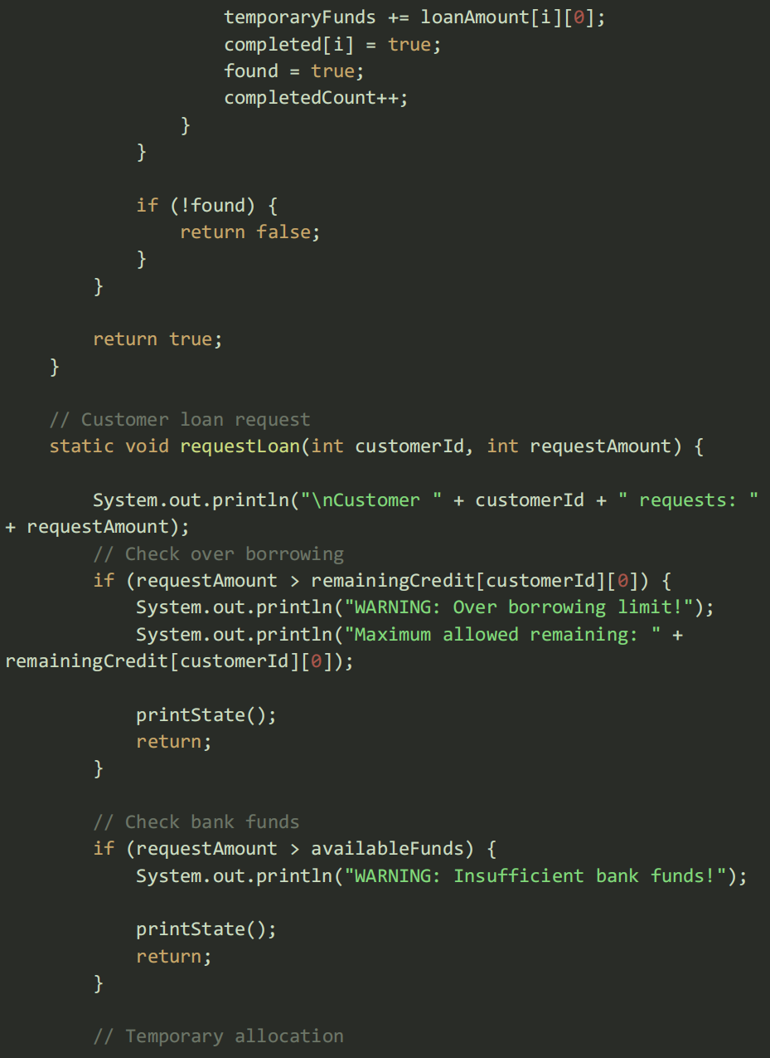
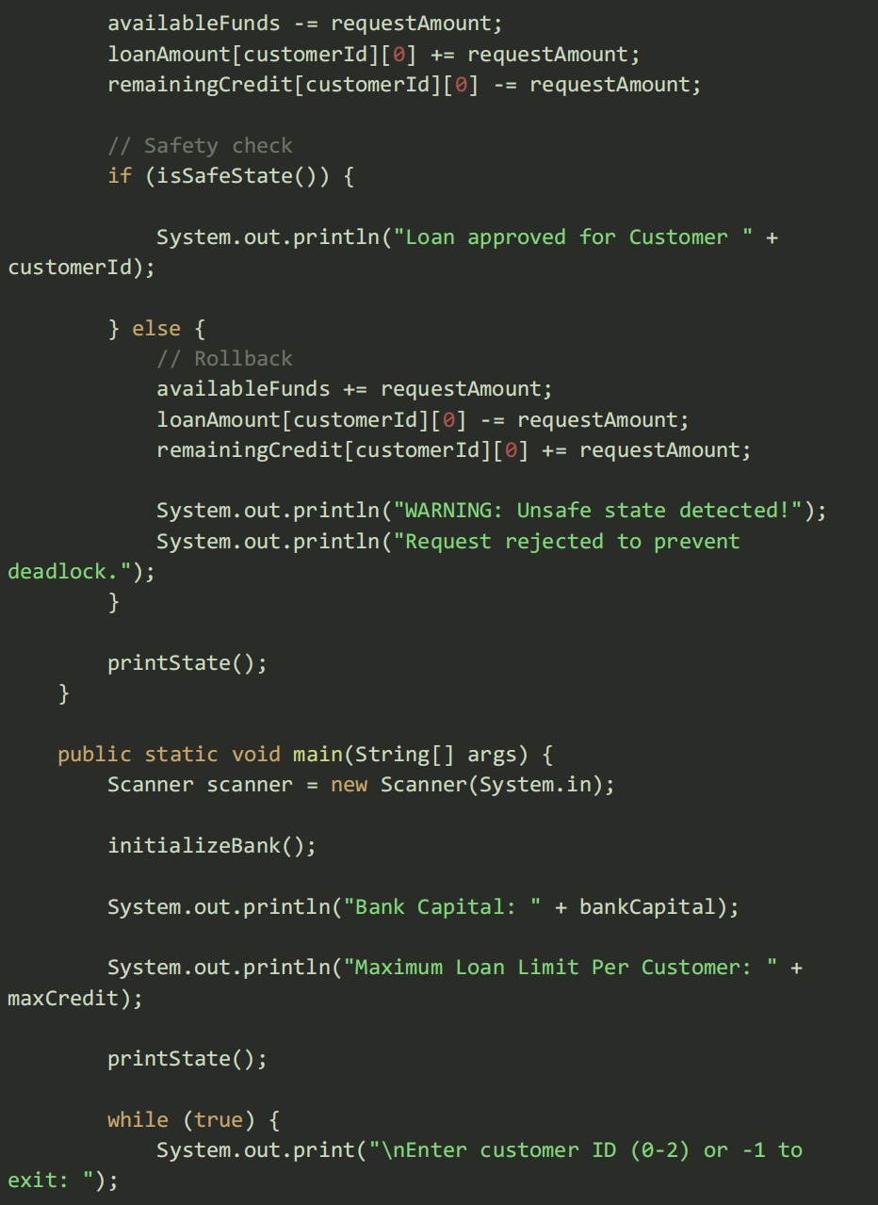
package oslab6;
import java.util.Scanner;
public class OSLAB6 {
// Number of customers
static int totalCustomers = 3;
// Same maximum loan limit for all customers
static int maxCredit = 100000;
// Current borrowed amount by customers
static int[][] loanAmount = {
{ 20000 },
{ 30000 },
{ 15000 }
};
// Maximum loan each customer can borrow
static int[][] maxLoan = new int[totalCustomers][1];
// Remaining credit customer can still borrow
static int[][] remainingCredit = new int[totalCustomers][1];
// Total bank capital
static int bankCapital = 500000;
// Available money in bank
static int availableFunds;
// Initialize bank data
static void initializeBank() {
availableFunds = bankCapital;
for (int i = 0; i < totalCustomers; i++) {
maxLoan[i][0] = maxCredit;
CODE IMPLEMENTATION

Slide 7
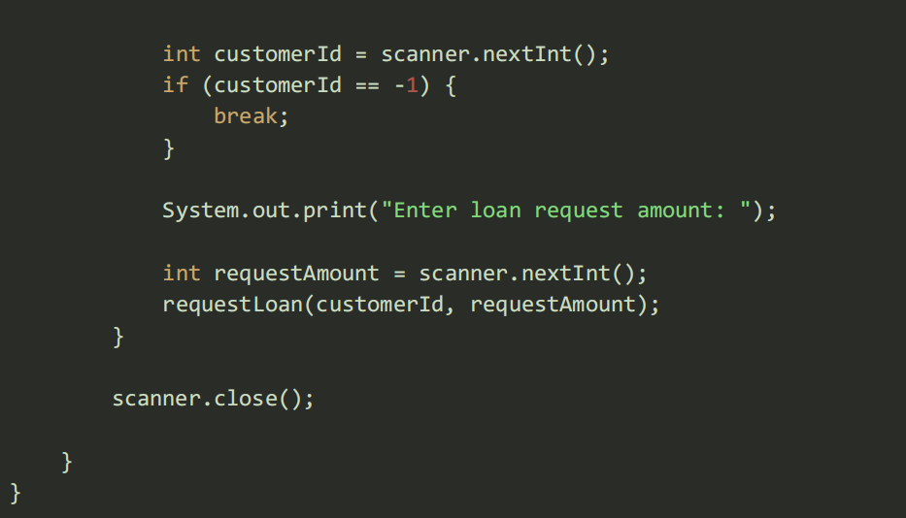
PROGRAM SAMPLE OUTPUT

Slide 8
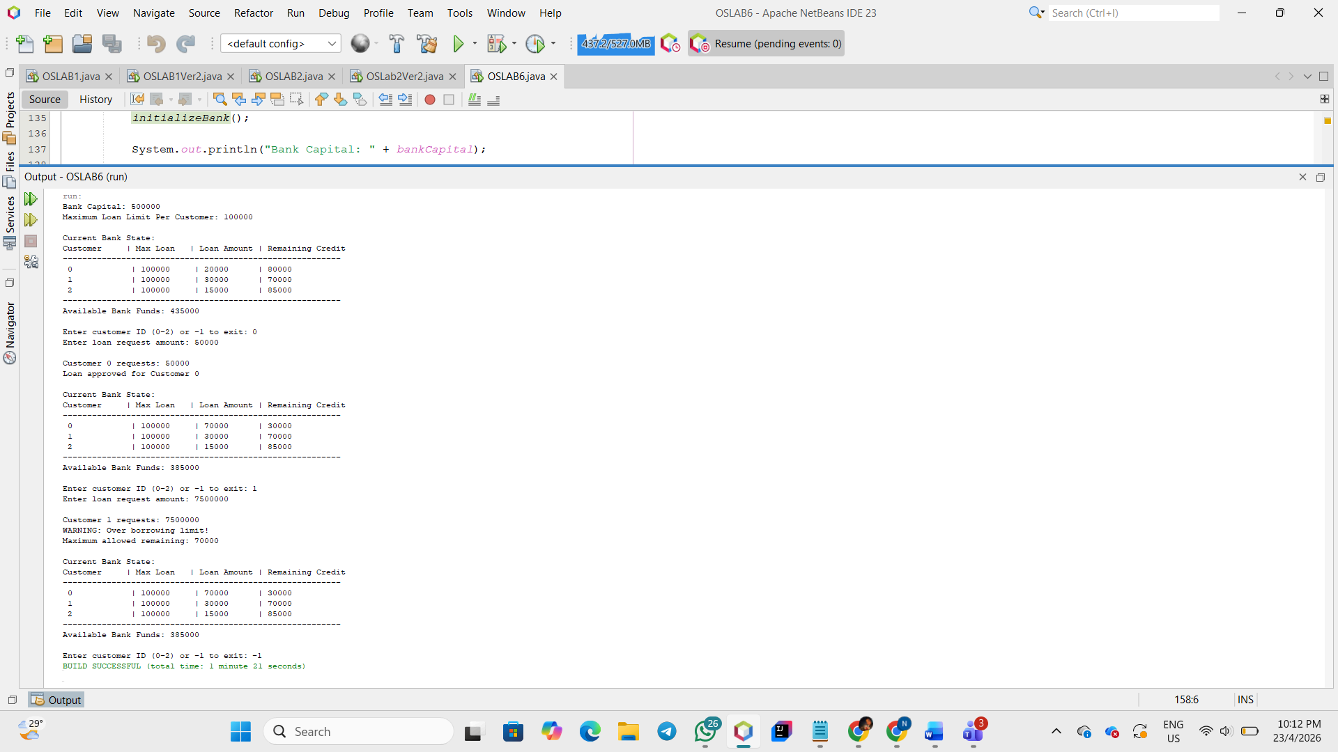
PROGRAM SAMPLE OUTPUT

Slide 9
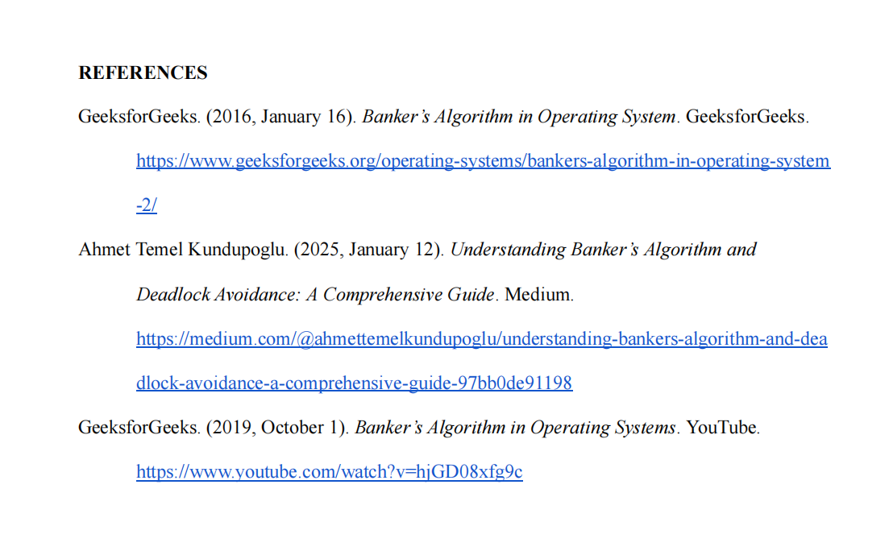

Slide 10
THANKYOU

