Slide 1

PAGE REPLACEMENT ALGORITHMS: FIFO
Operating Systems | Lab 7
Course:
Operating Systems
Lab:
Lab 7
Date:
April 2026

Slide 2



Virtual Memory & Page Replacement
CORE CONCEPTS
THE REPLACEMENT PROBLEM
Physical Memory: Virtual Memory: ├─ Frame 1: Page A ├─ Page A ✓ (in memory) ├─ Frame 2: Page B ├─ Page B ✓ (in memory) ├─ Frame 3: Page C ├─ Page C ✓ (in memory) └─ Frame 4: Full ├─ Page D ✗ (NOT in memory) └─ Page E ✗ (NOT in memory)
Virtual memory separates logical memory from physical memory, giving applications the illusion of contiguous space.
DEMAND PAGING
Page Hit: Requested page is in memory. No disk access required.
When all frames are full and a page fault occurs, which page should be removed?
Page Fault: Requested page not in memory. Must be brought from disk.

Slide 3




FIFO Algorithm Overview
THE FIFO PRINCIPLE
REPLACEMENT DECISION
1. Find the oldest page (first one loaded)
First In, First Out: The page that has been in memory the longest is removed first when replacement is needed.
2. Remove that page from memory
3. Load the new page into the freed frame
4. Update the queue order
QUEUE CONCEPT
Example (3 frames): [ 1 2 3 ] → Request 4 [ 4 2 3 ] (1 was oldest, replaced)
Front
Page
Back
Oldest page at the front is replaced; newest page is added at the back.

Slide 4









Implementation & Data Structures
KEY DATA STRUCTURES (JAVA)
ALGORITHM FLOW
// Pages currently in memory int[] frame = new int[frames]; // Page reference string int[] reference = new int[pages]; // Circular pointer for FIFO int index = 0;
1. Check if page is in any frame.
Hit:
Page found. Do nothing.
Fault:
Page not found.
Replace page at current index.
Increment index circularly.
Record the page fault.
COMPLEXITY ANALYSIS
CIRCULAR INDEX LOGIC
Increment:
index = (index + 1) % frames
Time Complexity: O(n × m)
Behavior:
Ensures oldest page is always replaced first.
Where n is the number of page requests and m is the number of frames. Each request requires a linear search through the frames.
Relevance of Skills in Implementation

Slide 5


FIFO Example Walkthrough
STEP
REQ
F1
F2
F3
RESULT
1
1
1
-
-
Fault
2
2
1
2
-
Fault
3
3
1
2
3
Fault
4
4
4
2
3
Fault (1 replaced)
5
1
4
1
3
Fault (2 replaced)
6
2
4
1
2
Fault (3 replaced)
7
5
5
1
2
Fault (4 replaced)
8
1
5
1
2
Hit
Final Results
9
2
5
1
2
Hit
Total Requests:
12
10
3
5
1
3
Fault (2 replaced)
Page Faults:
10
11
4
4
1
3
Fault (5 replaced)
Page Hits:
2
12
5
4
5
3
Fault (1 replaced)

Slide 6









Algorithm Characteristics
ADVANTAGES
DISADVANTAGES
Simple Implementation:
Easy to understand and implement with minimal code complexity.
Poor Performance:
May replace frequently used pages, ignoring usage patterns.
Predictable Behavior:
Deterministic nature ensures same input yields same output.
Belady's Anomaly:
Theoretical limitation where more frames can lead to more faults.
Low Overhead:
Efficient circular queue requires minimal additional data structures.
Not Optimal:
Does not minimize page faults compared to LRU or Optimal.
Fairness:
Every page gets equal treatment based on arrival time.
No Optimization:
Doesn't learn from access patterns or page utility.
Analyzing algorithm performance through statistical research methods.

Slide 7

Conclusion & Comparison
PERFORMANCE METRICS
EXAMPLE RESULTS (SLIDE 5)
Page Fault Rate = Faults / Total Pages Hit Ratio = Hits / (Hits + Faults) Miss Ratio = Faults / (Hits + Faults)
Fault Rate:
10/12 (83.3%)
Hit Ratio:
2/12 (16.7%)
ALGORITHM COMPARISON
ASPECT
FIFO
OPTIMAL
LRU
LFU
Implementation
Very Simple
Impossible
Complex
Complex
Performance
Moderate
Best
Very Good
Good
Overhead
LOW
HIGH
HIGH
HIGH
Used in Practice
Rarely
Never
Often
Sometimes

Slide 8
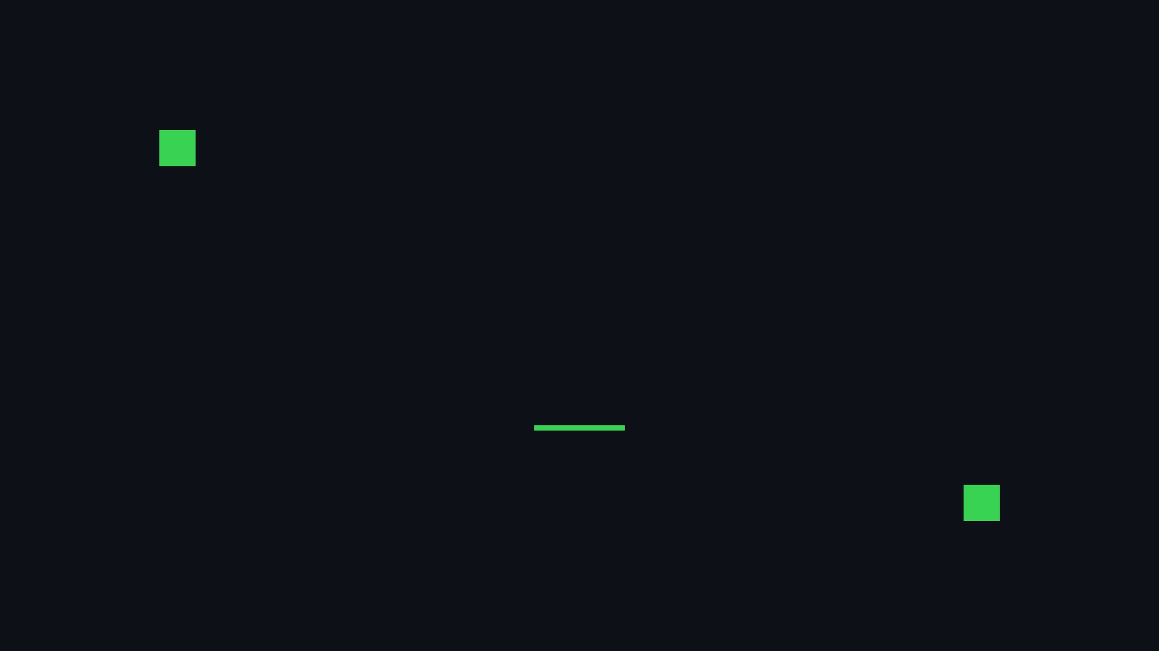
THANK YOU
ANY QUESTIONS?

