Slide 1
LAB 8: DINING-PHILOSOPHERS PROBLEM FOR SYNCHRONIZATION
OCC : 1 GROUP : 8

Slide 2

Problem Overview & System Logic
The Dining Philosophers problem is a classical synchronization challenge that models how systems manage concurrent access to shared resources. It ensures that thread requests are satisfied while strictly preventing system conflicts such as deadlock or starvation.
Synchronization Mechanism
To determine if a philosopher can eat, the system evaluates the real time states of adjacent neighbors and the availability of both required chopsticks. This logic ensures that resources are only granted when both neighbors are not in the EATING state
Primary System Application
This simulation represents how an operating system manages synchronization by making atomic decisions to grant or deny access to shared resources. It utilizes state tracking to prevent circular wait conditions and maintain mutual exclusion.

Slide 3
Thread Synchronization Management
The Dining Philosophers problem provides a synchronization challenge applicable to systems where multiple concurrent threads compete for limited shared resources. Process synchronization ensures these threads coordinate execution to maintain system integrity. Philosopher State Monitoring
To manage resource access, the system monitors the real time status of each philosopher. It specifically tracks whether individuals are currently THINKING, HUNGRY, or EATING to inform allocation decisions. Atomic Request Evaluation
The monitor evaluates state information to decide if a philosopher can pick up chopsticks by ensuring both adjacent neighbors are not in the EATING state. This atomic check ensures resources are only held when they can be fully utilized. Deadlock and Starvation Prevention
This strategy ensures threads do not enter a circular wait condition by requiring atomic acquisition of all resources before proceeding. This management prevents deadlock where processes block indefinitely.
CORE SIMULATION CHARACTERISTICS
Thread Synchronization Management
The Dining Philosophers problem provides a synchronization challenge applicable to systems where multiple concurrent threads compete for limited shared resources. Process synchronization ensures these threads coordinate execution to maintain system integrity.
Philosopher State Monitoring
To manage resource access, the system monitors the real time status of each philosopher. It specifically tracks whether individuals are currently THINKING, HUNGRY, or EATING to inform allocation decisions.
Atomic Request Evaluation
The monitor evaluates state information to decide if a philosopher can pick up chopsticks by ensuring both adjacent neighbors are not in the EATING state. This atomic check ensures resources are only held when they can be fully utilized.
Deadlock and Starvation Prevention
This strategy ensures threads do not enter a circular wait condition by requiring atomic acquisition of all resources before proceeding. This management prevents deadlock where processes block indefinitely.

Slide 4


OPERATIONAL WORKFLOW
Request Evaluation:
Upon entering the HUNGRY state, the synchronization monitor immediately assesses whether the request for resources can be granted based on the current activity of adjacent neighbors.
01
Safety Analysis Logic:
The system evaluates the status of the left and right neighbors to ensure that neither is currently in the EATING state. This atomic verification prevents partial resource acquisition and maintains the integrity of the critical section.
02
Allocation and Blocking:
If the safety check succeeds, the philosopher transitions to the EATING state and acquires both chopsticks simultaneously. If the neighbors are currently eating, the requesting thread is placed in a waiting queue and remains blocked until signaled by the monitor during a neighbor's resource release.
03

Slide 5
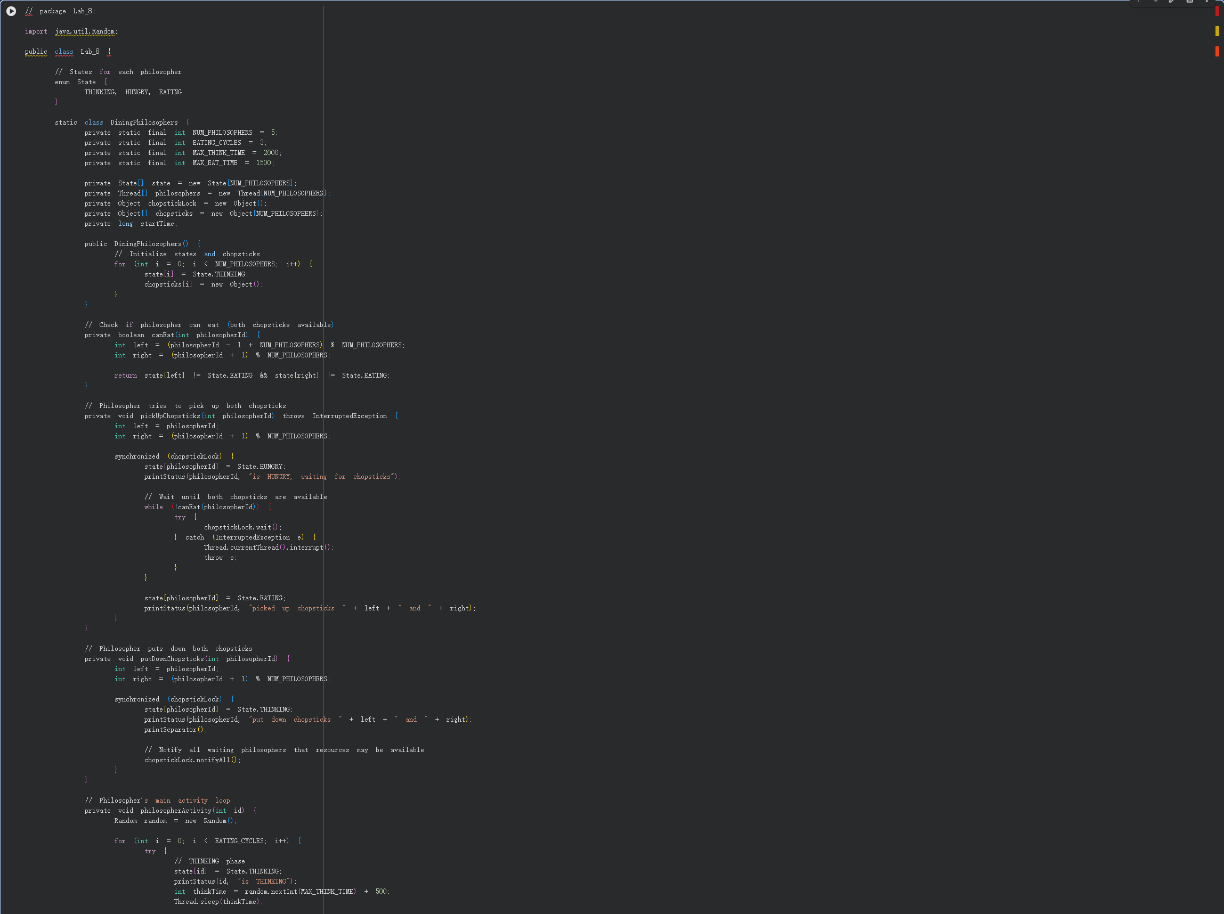
package oslab6;
import java.util.Scanner;
public class OSLAB6 {
// Number of customers
static int totalCustomers = 3;
// Same maximum loan limit for all customers
static int maxCredit = 100000;
// Current borrowed amount by customers
static int[][] loanAmount = {
{ 20000 },
{ 30000 },
{ 15000 }
};
// Maximum loan each customer can borrow
static int[][] maxLoan = new int[totalCustomers][1];
// Remaining credit customer can still borrow
static int[][] remainingCredit = new int[totalCustomers][1];
// Total bank capital
static int bankCapital = 500000;
// Available money in bank
static int availableFunds;
// Initialize bank data
static void initializeBank() {
availableFunds = bankCapital;
for (int i = 0; i < totalCustomers; i++) {
maxLoan[i][0] = maxCredit;
CODE IMPLEMENTATION

Slide 6
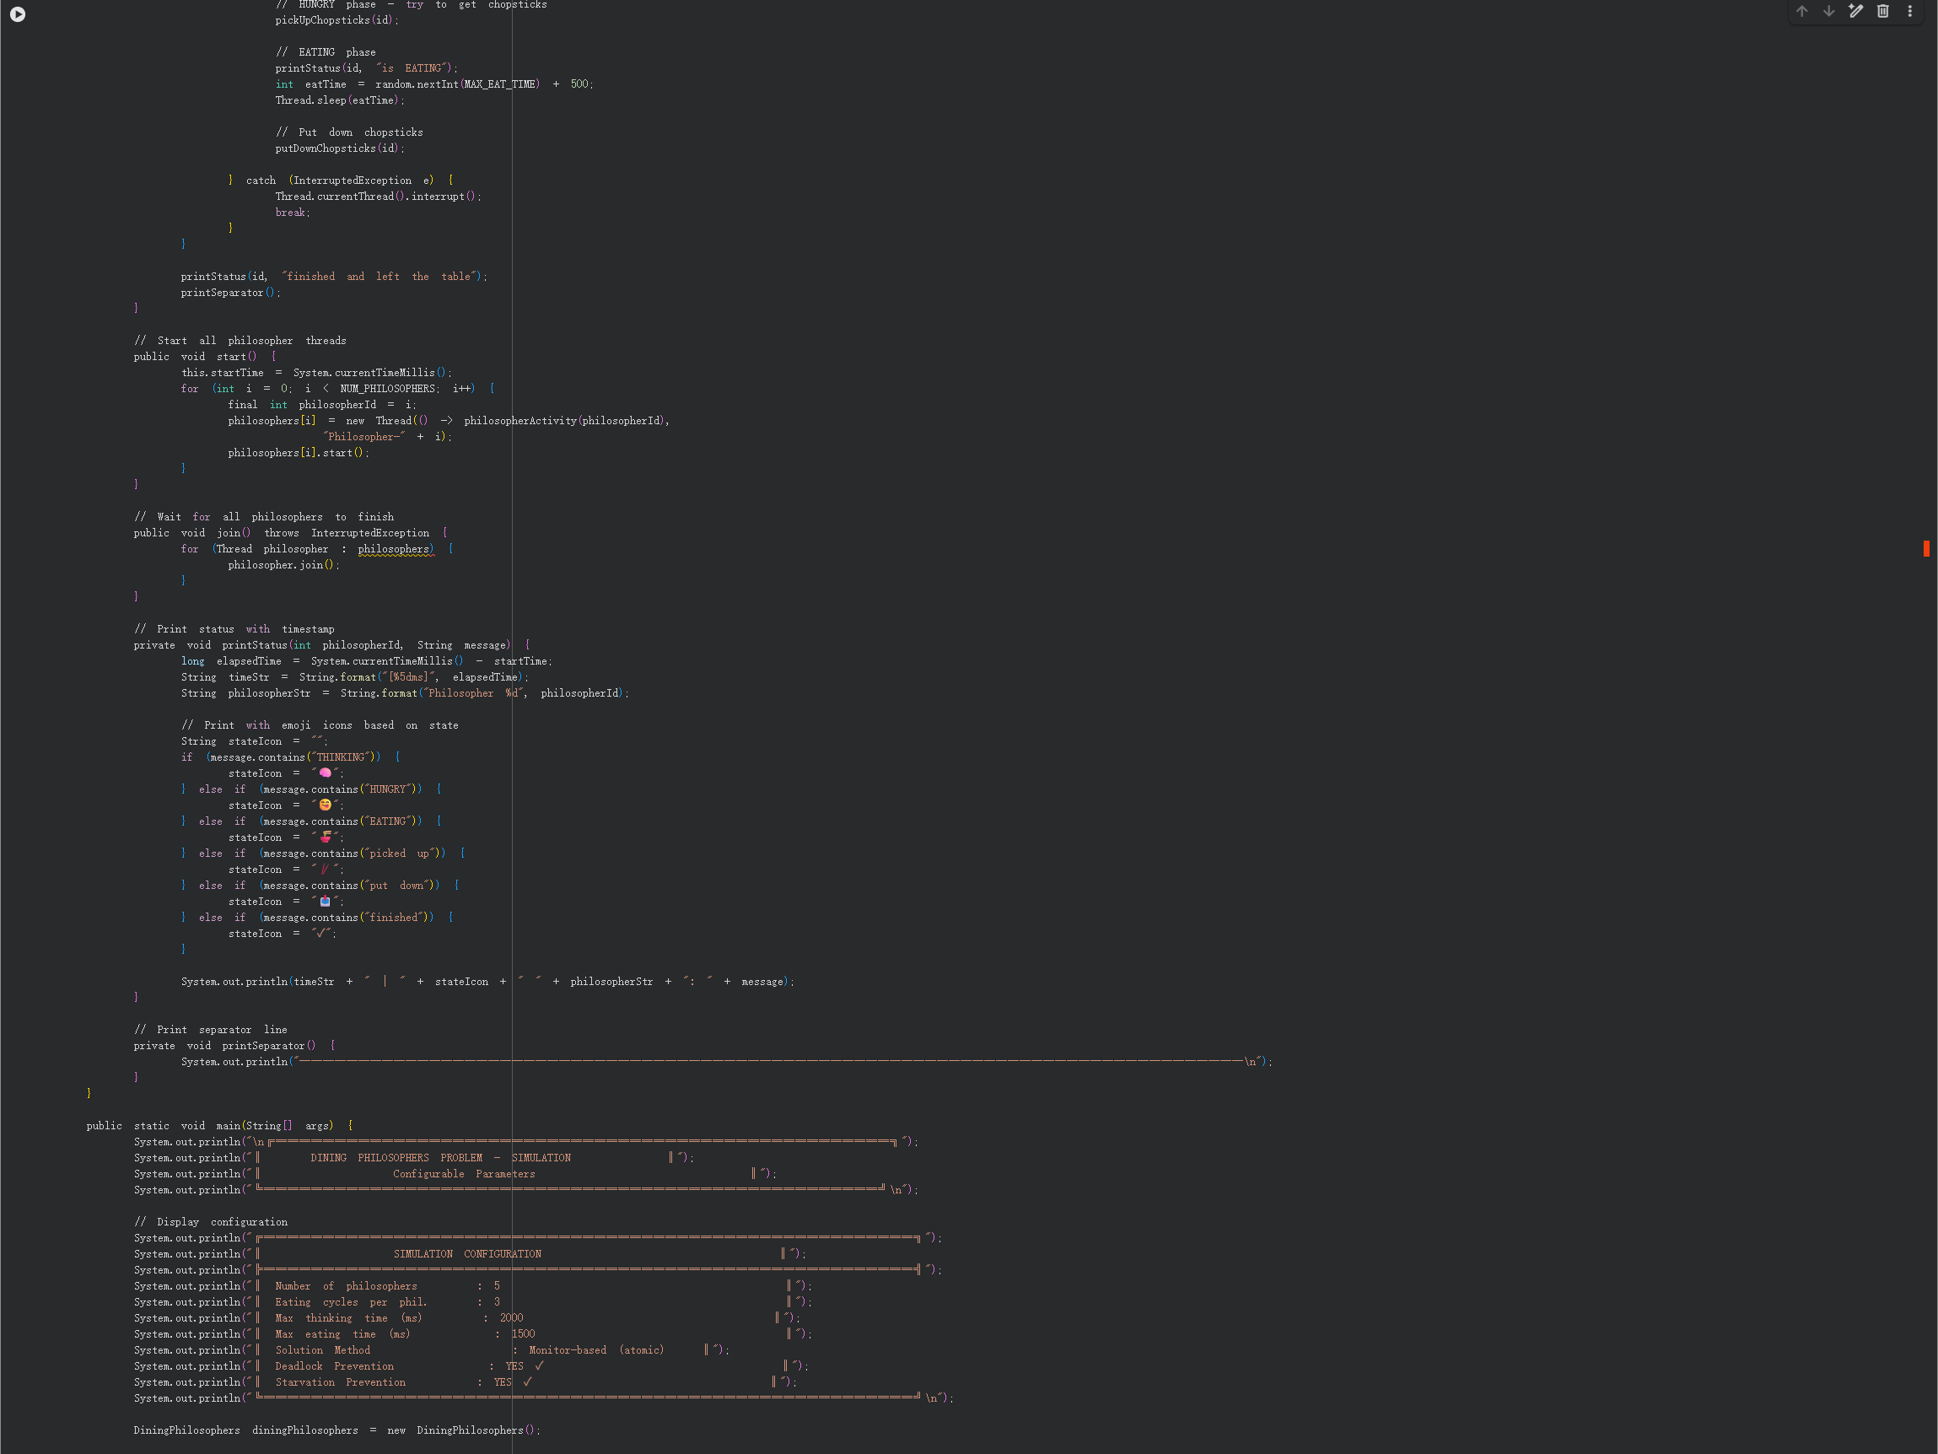
package oslab6;
import java.util.Scanner;
public class OSLAB6 {
// Number of customers
static int totalCustomers = 3;
// Same maximum loan limit for all customers
static int maxCredit = 100000;
// Current borrowed amount by customers
static int[][] loanAmount = {
{ 20000 },
{ 30000 },
{ 15000 }
};
// Maximum loan each customer can borrow
static int[][] maxLoan = new int[totalCustomers][1];
// Remaining credit customer can still borrow
static int[][] remainingCredit = new int[totalCustomers][1];
// Total bank capital
static int bankCapital = 500000;
// Available money in bank
static int availableFunds;
// Initialize bank data
static void initializeBank() {
availableFunds = bankCapital;
for (int i = 0; i < totalCustomers; i++) {
maxLoan[i][0] = maxCredit;
CODE IMPLEMENTATION

Slide 7
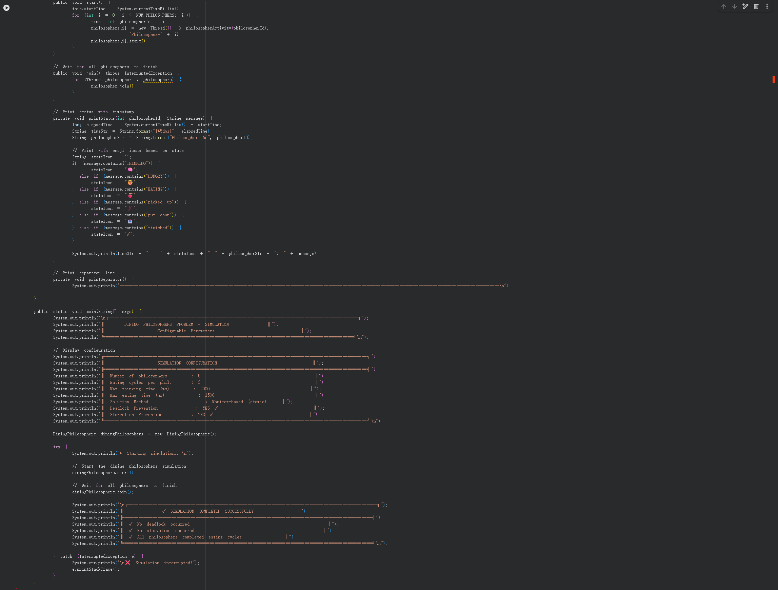
package oslab6;
import java.util.Scanner;
public class OSLAB6 {
// Number of customers
static int totalCustomers = 3;
// Same maximum loan limit for all customers
static int maxCredit = 100000;
// Current borrowed amount by customers
static int[][] loanAmount = {
{ 20000 },
{ 30000 },
{ 15000 }
};
// Maximum loan each customer can borrow
static int[][] maxLoan = new int[totalCustomers][1];
// Remaining credit customer can still borrow
static int[][] remainingCredit = new int[totalCustomers][1];
// Total bank capital
static int bankCapital = 500000;
// Available money in bank
static int availableFunds;
// Initialize bank data
static void initializeBank() {
availableFunds = bankCapital;
for (int i = 0; i < totalCustomers; i++) {
maxLoan[i][0] = maxCredit;
CODE IMPLEMENTATION

Slide 8
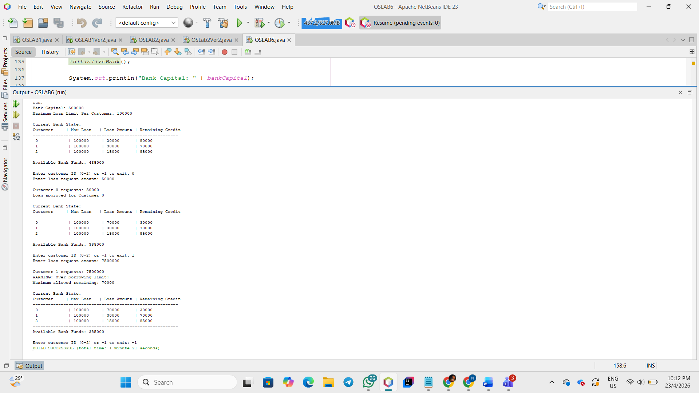
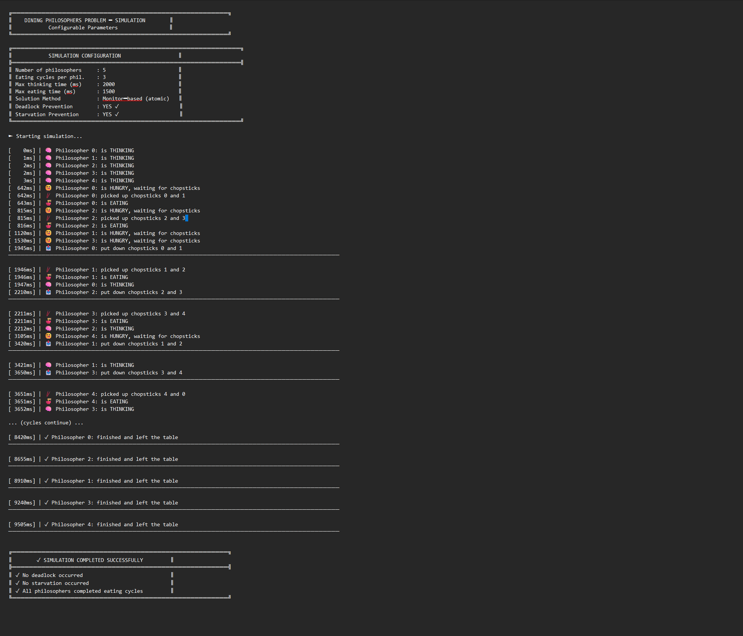
PROGRAM SAMPLE OUTPUT

Slide 9
THANKYOU

