Slide 1
Assignment-Discussion
Named Entity Identification
Teja, 200050020
Saikiran, 200050023
Harshadeep,200050075
30th November, 2023

Slide 2
Problem Statement
Perform Named-Entity Identification using SVM classifier with appropriate feature engineering
Technique to be used: SVM classifier
Dataset: CoNLL NER Data; https://paperswithcode.com/dataset/conll-2003 and
https://huggingface.co/datasets/conll2003 (they are same data, but have common and distinct
information)

Slide 3
Problem Statement
Input: A sentence
Output: Name-No Name tagged for each word in the sentence
Example:
  Input: Delhi is the capital of India.
  Output: Delhi_1 is_0 the_0 capital_0 of_0 India_1 ._0

Slide 4
Data Processing Info (Pre-processing)
CoNLL 2003 dataset contains various sentences each in its tokenized form(in a vector) and corresponding pos_tags vector, chunk_tags vector, ner_tags vector.
We have made use of all these vectors except the chunk_tags vector.
In order for us to know if a token is a named entity, its corresponding NER tag must be non-zero. So we have run through the ner_tags vectors and made its value as 1 whenever it is a non-zero value.

Slide 5
Feature Engineering
The Features that we have used are :
  POS_tagging
  First letter Capital
  All capitals
  Is a Stopword
  Is a Punctuation
  Scaled position in the sentence

Slide 6
Feature Engineering
POS_tag :
  We have used the pos_tags and gave proper nouns(NNP,NNPS) a value 1 and others 0.
First Letter Capital:
  Most of the named entities usually start with a capital letter in the sentences. So we can use this to predict names which are foreign to our dataset.
  Ex: “Harshadeep”,”Teja”,”Saikiran” are not in the dataset and while pos_tagging gives NN. So these are captured by this rule.

Slide 7
Feature Engineering
All letters Capitals :
  This rule helps to identify Acronyms like ‘USA’, ‘UK’
Is a Stopword :
  Using nltk’s english stopword ist, 179 stopwords are eliminated. Stopwords are those which don’t add much meaning to the sentence.
  Ex: “the”, “is”, “and”, “are”, “a”, etc.
Is a Punctuation:
  Punctuation symbols can be eliminated.

Slide 8
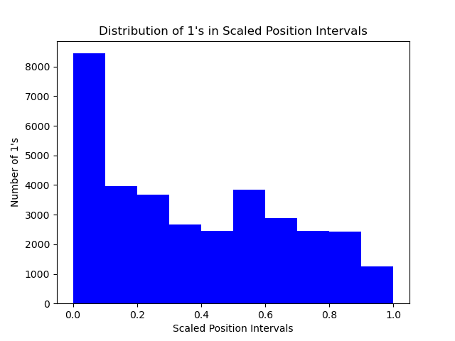
Feature Engineering
Scaled position in a sentence:

Slide 9
SVM Modelling
We have used an SVM model with linear kernel and weights balanced.
  Linear kernel because our data is linearly separable(for all the features)
  Weights balanced because it adjusts the weights of the classes during training.

Slide 10
Overall performance
Precision:
  For Label 0 : 0.99
  For Label 1 : 0.82
Recall:
  For Label 0 : 0.96
  For Label 1 : 0.97
F1-score:
  For Label 0 : 0.98
  For Label 1 : 0.89

Slide 11
Confusion Matrix
Actual Values
Positive(1)
Negative(0)
Positive(1)
8340
1828
Predicted Values
Negative(0)
263
40931

Slide 12
Error analysis
The words which are not named entities but have first letter capital in a sentence gives error.
  Ex: “Thursday” when used in a sentence in that gives an error.
  Ex: Incorrect usage of words may also lead to errors (like using first letter capital when it isn’t necessary)
  Reason: It might be because all the named entities have capital at the start and the fraction of non named entities with capital at the beggining is negligible.
When gibberish is given with all capitals, it gets sorted as a named entity with reasons similar to above.

Slide 13
Learnings
We observe that the CoNLL 2003 dataset is biased because all the named entities have first letter as capital, thus the corresponding feature is very strong compared to others.
From the confusion matrix we observe that false positives(1828) are higher than false negatives(263) because of the above feature where it might identify any entity with first letter as capital as a named entity by mistake.

Slide 14
Evaluation Scheme
Data preprocessing - 20
Features for SVM - 30
Error Analysis - 30
Learnings - 10
Demo - 10

