Slide 1
CS337-PROJECT
Stock Predictions
SaiKiran, Sasank, Varun, Sai Teja

Slide 2
DataSet
We have used TATA stock market dataset, which contains High, Low, Open, Close stock values, we have used the average of High and Low to represent the stock value to a particular date.
We have used four different algorithms for predicting the stock values, Moving Average (MA), Neural Nets(NN’s), Long short term memory (LSTM) , Gated Recurrent Unit(GRU).
Below are the plots of training data fit and the prediction on test data using the above four algorithms.

Slide 3
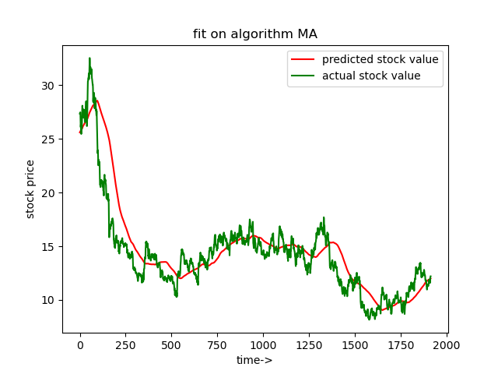
MA_fit

Slide 4
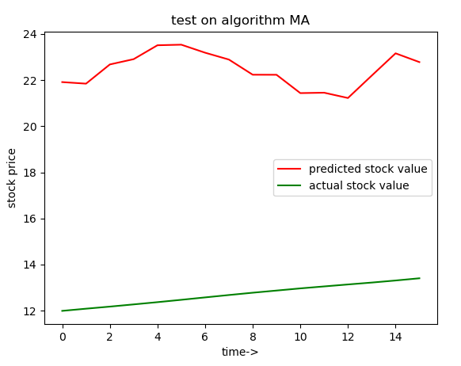
MA_test

Slide 5
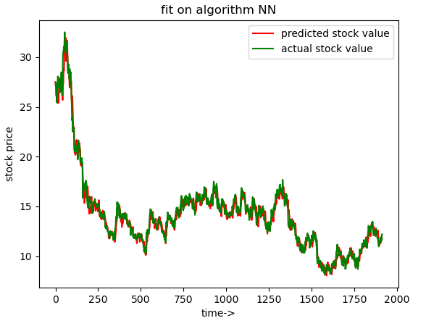
NN_fit

Slide 6
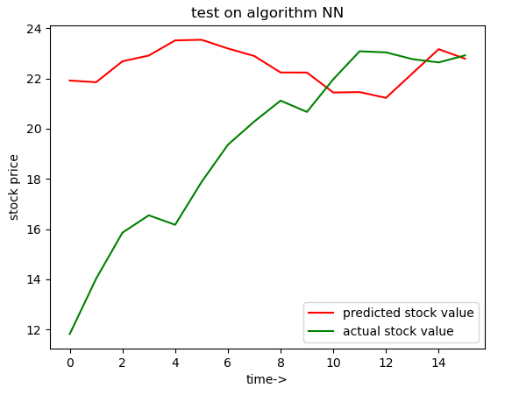
NN_test

Slide 7
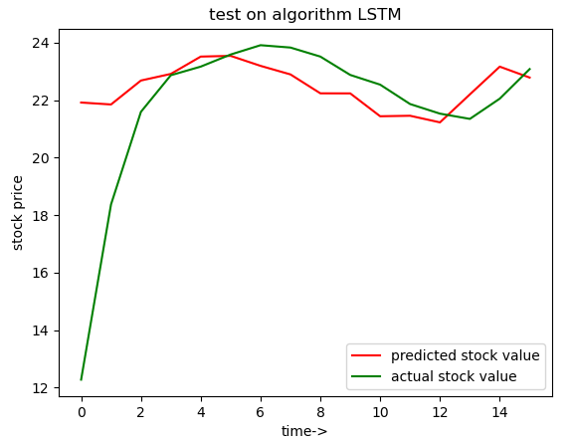
LSTM_test

Slide 8
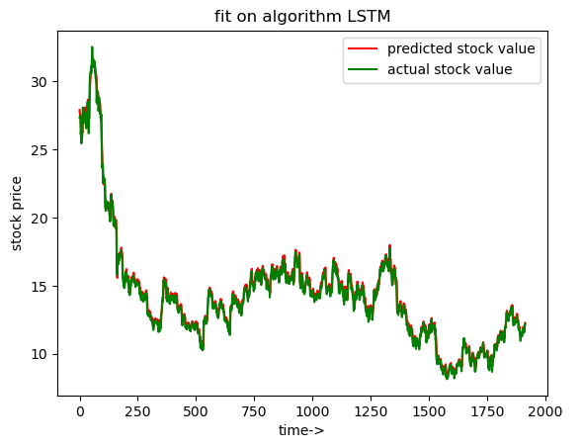
LSTM_fit

Slide 9

GRU_fit

Slide 10
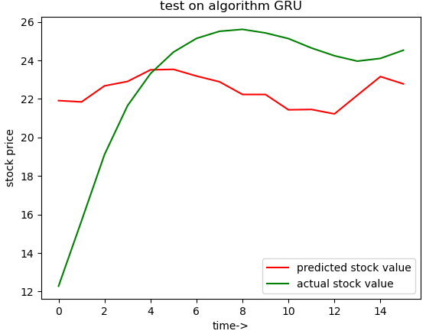
GRU_test

Slide 11
EVALUATION METRICS
Two methods have been used to test the accuracy of the model.
Viewing this task as a REGRESSION TASK.
Viewing this task as a CLASSIFICATION TASK.

Slide 12
REGRESSION TASK
Coefficient of variance(C.V) is used as metric since absolute loss is frame dependent, by which we mean it depends on the scaling factors and selective biases on test.
This model can be used in variety of tasks, ranging from Q-learning methods like DQN,DDPG and other methods which demand us to know the expected value of price.
Time series forecasting techniques used here are pretty naive and the accuracies that are being reported are not state of art but more complex models can be derived upon these basic models.

Slide 13
METRICS:
ALGORITHM | C.V
MA(moving averages) | 1.74
NN(neural network) | 0.21
GRU | 0.16
LSTM | 0.12

Slide 14
Viewing as Classification Task
Here we tried to predict if the stock opening value is higher or lower than the closing value of a day. We tried two methods here.
We used the last 120 days opening and closing values as features.
For the first method we have trained two models for closing and opening separately.
Now we have classified them based on the difference between opening and closing days.
This method gave poor accuracies because the loss function is not exactly trying to improve on the classification task we want but it is trying to predict each closing and opening.
Used Mean Square Loss as loss metric here.
In second method we have directly predicted the type of the day and then used Binary Cross-entropy Loss as loss. Here we achieved an accuracy of 70%.

Slide 15
Thank You

