Slide 1

DATA ANALYTICS PROJECT
CUSTOMER
DATA ANALYSIS
SQL | MICROSOFT POWER BI
Turning retail transactions into customer,
product, revenue and payment insights.
Internship Project • DataMites Institute
Presented by Pulakaram Sai Kiran
01 / 12

Slide 2
01 | PROJECT CONTEXT
02
Project Overview & Objectives
A transaction-level view of shopping behaviour across Istanbul retail malls.
PROJECT OVERVIEW
PROJECT OBJECTIVES
This project analyses 99,457 customer shopping transactions recorded across 10 shopping malls in Istanbul from 2021 to 2023. SQL was used to explore the dataset, assess data quality and analyse customer, product and payment patterns. Power BI was used to present key metrics and interactive visualisations. The goal is to translate transaction data into practical retail insights.
• Compare shopping activity, product quantity and revenue by gender.
• Identify leading product categories and their distribution.
• Examine shopping, quantity and revenue patterns by customer age.
• Understand payment preferences across genders, categories and malls.
• Present key measures through an interactive Power BI dashboard.
CUSTOMER DATA ANALYSIS | SQL + POWER BI
02 / 12

Slide 3
02 | DATA FOUNDATION
03
Dataset Overview & Data Quality
The initial checks established the dataset size, structure and basic completeness.
TOTAL TRANSACTIONS
COLUMNS
SHOPPING MALLS
DATA PERIOD
99,457
10
10
2021–2023
Rows in the customer table
Fields inspected
Istanbul locations
Transaction dates
KEY DATA FIELDS
INITIAL DATA QUALITY RESULTS
• Invoice number and Customer ID
• Gender and Age
• Category, Quantity and Price
• Payment Method and Invoice Date
• Shopping Mall
NULL VALUES
DUPLICATE INVOICE IDS
0
0 found
Across all 10 columns
No matching duplicate rows
Schema inspection: 10 columns; invoice_no is marked as the primary key.
CUSTOMER DATA ANALYSIS | SQL + POWER BI
03 / 12

Slide 4
03 | TECHNICAL APPROACH
04
SQL Analysis Workflow
From database exploration to grouped business metrics.
01
02
03
04
05
Explore
→
Inspect
→
Validate
→
Analyse
→
Interpret
SHOW DATABASES
SHOW TABLES
DESCRIBE customer
Review 10 fields
Count rows and columns
Check NULLs and duplicates
GROUP BY dimensions
COUNT, SUM, comparisons
Compare segments
Summarise business insights
SQL TECHNIQUES USED
Database and table exploration • DESCRIBE • COUNT(*) • COUNT(DISTINCT) • NULL checks • duplicate checks • GROUP BY • aggregate calculations including SUM(quantity × price)
CUSTOMER DATA ANALYSIS | SQL + POWER BI
04 / 12

Slide 5
04 | CUSTOMER INSIGHTS
05
Customer Analysis by Gender
Female customers contributed a larger share of transactions, product quantity and revenue.
FEMALE TRANSACTIONS
FEMALE PRODUCT QUANTITY
FEMALE REVENUE
MALE TRANSACTIONS
59.81%
59.82%
59.72%
40.19%
59,482 transactions
178,659 units
TRY 150.21M
39,975 transactions
Transaction count by gender
Revenue by gender (TRY)
Female
59,482
Female
150.2M
Male
39,975
Male
101.3M
CUSTOMER DATA ANALYSIS | SQL + POWER BI
05 / 12

Slide 6
05 | PRODUCT INSIGHTS
06
Product Category Analysis
Clothing was the leading category by transaction count in the documented SQL results.
CLOTHING TRANSACTIONS
COSMETICS TRANSACTIONS
CATEGORIES
TOTAL TRANSACTIONS
34,487
15,097
8
99,457
34.68% of all transactions
15.18% of all transactions
Product groups
All categories
GENDER COMPARISON
Top reported categories
Female customers recorded more transactions than male customers across all eight product categories. Clothing was the leading category for both genders: 20,652 female transactions and 13,835 male transactions.
Clothing
34,487
Cosmetics
15,097
Other categories in the dataset: Food & Beverage, Toys, Shoes, Souvenir, Technology and Books.
CUSTOMER DATA ANALYSIS | SQL + POWER BI
06 / 12

Slide 7
06 | CUSTOMER INSIGHTS
07
Age-wise Customer Analysis
Transaction activity, product quantity and revenue were compared across ages 18–69.
HIGHEST TRANSACTIONS
HIGHEST PRODUCT QUANTITY
HIGHEST REVENUE
Age 37
Age 37
Age 37
2,057 transactions
6,217 units
TRY 5.58M
AGE-WISE RANGE
REVENUE COMPARISON
Age 18–69
Highest: Age 37
Shopping transactions were relatively evenly distributed across the age range.
TRY 5,578,539.57
Age 54 recorded the lowest transaction count (1,830) and lowest product quantity (5,471).
Lowest: Age 18 | TRY 4,397,720.26
CUSTOMER DATA ANALYSIS | SQL + POWER BI
07 / 12

Slide 8
08 | PAYMENT & LOCATION
09
Payment Method Across Categories & Malls
The SQL analysis compared payment preferences across product categories and shopping malls.
CATEGORY PATTERN
MALL PATTERN
Cash was the most commonly used payment method across all eight product categories. Clothing recorded the highest transactions across payment methods, including 15,456 cash, 12,025 credit card and 7,006 debit card transactions.
Cash was the most preferred payment method across all 10 malls, followed by credit card and debit card. Mall of Istanbul recorded the highest overall transaction count; Emaar Square Mall recorded the lowest.
Overall transactions by selected malls
Mall of Istanbul
19,943
Kanyon
19,823
Metrocity
15,011
Emaar Square Mall
4,811
CUSTOMER DATA ANALYSIS | SQL + POWER BI
09 / 12

Slide 9
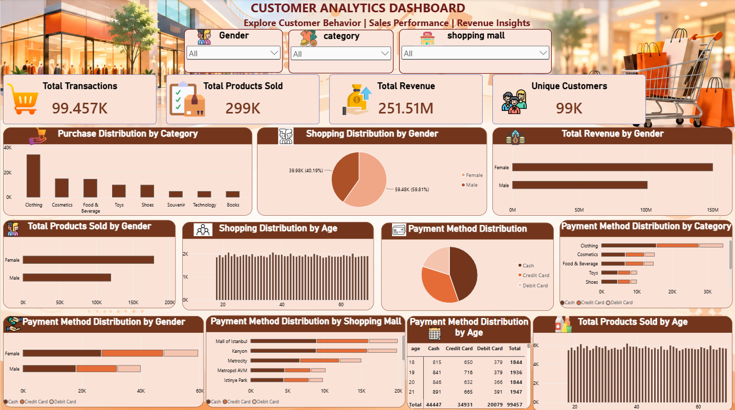
09 | INTERACTIVE REPORTING
10
Power BI Customer Analytics Dashboard
A consolidated view of customer, product, revenue and payment metrics.
Interactive slicers: Gender • Category • Shopping Mall
CUSTOMER DATA ANALYSIS | SQL + POWER BI
10 / 12

Slide 10
10 | BUSINESS IMPACT
11
Key Findings & Business Recommendations
Translate the observed transaction patterns into practical retail actions.
KEY FINDINGS
BUSINESS RECOMMENDATIONS
• Female customers accounted for 59.81% of transactions.
• Female customers contributed 59.82% of product quantity and 59.72% of revenue.
• Clothing was the leading category (34.68% of transactions).
• Cash led payment methods (44.69% of transactions).
• Mall of Istanbul had the highest transaction count (19,943).
• Age-wise shopping activity was relatively evenly distributed.
• Use customer-segment insights to tailor marketing campaigns.
• Review inventory and promotion plans for high-demand categories such as Clothing.
• Maintain convenient cash, credit card and debit card payment options.
• Compare mall-level demand when planning stock and promotional activity.
• Use age-wise patterns to guide broad campaigns rather than assuming one age group dominates.
CUSTOMER DATA ANALYSIS | SQL + POWER BI
11 / 12

Slide 11
PROJECT CONCLUSION
Turning Customer Data into Business Insights
This project analysed 99,457 shopping transactions across 10 shopping malls using SQL and Power BI.
SQL was used to explore customer purchasing patterns, analyse product categories, compare shopping behaviour by gender and age, and evaluate revenue and payment methods.
Power BI was used to transform the analysis results into an interactive dashboard for visualising key business metrics and customer trends.
The analysis revealed that female customers contributed a higher share of transactions, product sales and revenue, while cash was the most frequently used payment method.
THANK YOU
Pulakaram Sai Kiran | MBA – Finance & Business Analytics
12 / 12

