Slide 1

FAKULTÄT FÜR
VERFAHRENS- UND SYSTEMTECHNIK
SURROGATE BASED OPTIMIZATION OF EXTRACTIVE DISTILLATION PROCESSES USING ACTIVE LEARNING
M.Sc.- Chemical and Energy Engineering
Institut für Verfahrenstechnik [ IVT ]
Reviewer
Prof. Kai Sundmacher
Ph.D. Xiang Zhang
Supervisors
M.Sc. Zihao Wang
M.Sc. Edgar Ivan Sanchez Medina
Presentation By
Saikiran Davangam Sreedhar
Matriculation ID: 229971
Magdeburg, 28. March 2023
www.ovgu.de

Slide 2
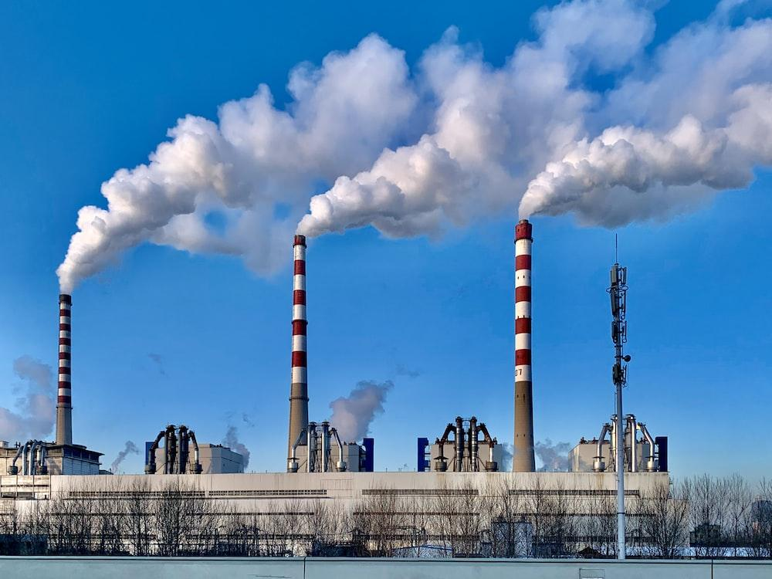
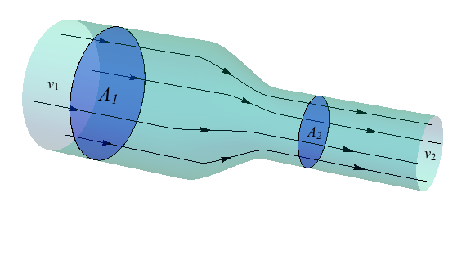
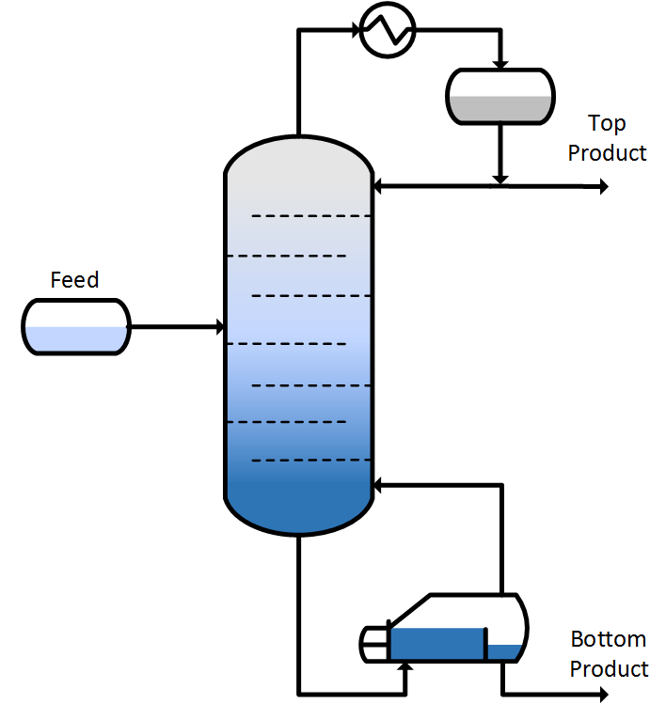
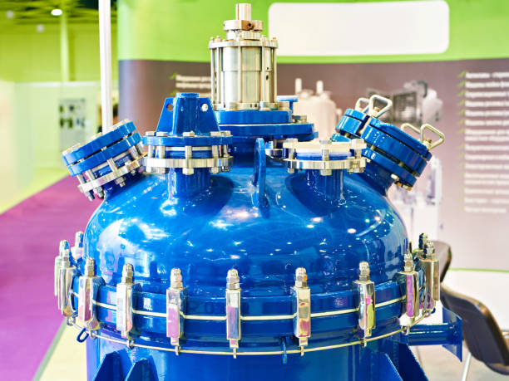
Optimization comes in many different applications
And many many more….

Slide 3
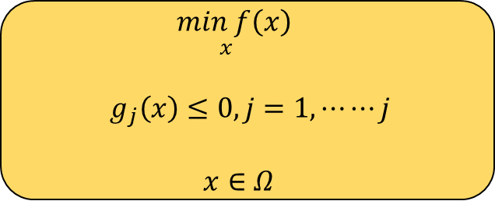
Optimization problems come in a variety of flavours
Constraints
Single box
Linear/non-linear
Cheap to compute
Expensive
“Hidden”
Objective functions
One or multiple
Levels of fidelity
Fast or slow to compute
Analytic or black-box
Uncertainty
Stochasticity in simulation
Noise/heterogeneity in observations
In objective
In constraint
Parameters
Continuous
Integer
Mixed-Integer
Categorical
The problem's characteristics must inform the optimization strategy that is used.

Slide 4
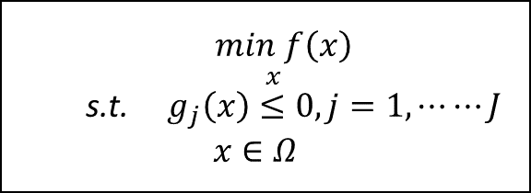


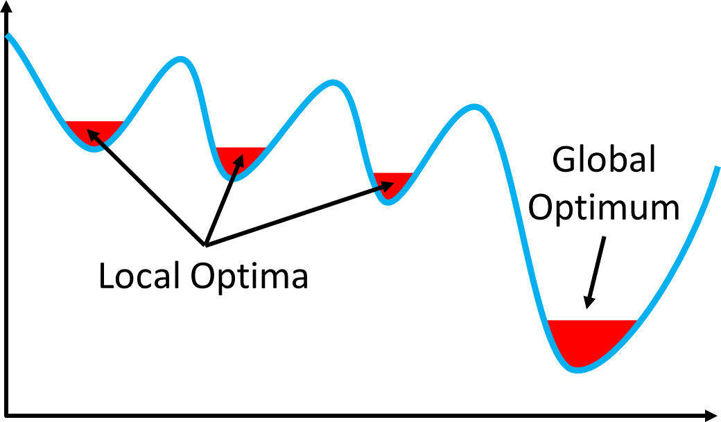

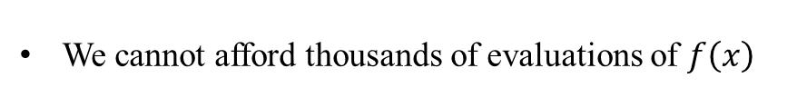
There’s a special class of optimization problems
Black Box
The objective function involves a computer simulation
No analytic description of the objective function(black-box)
No gradient information
Multimodal
The simulation is time-consuming
The objective is to quickly and effectively identify the answer..

Slide 5
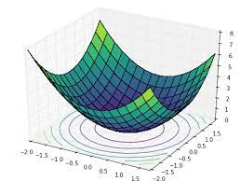
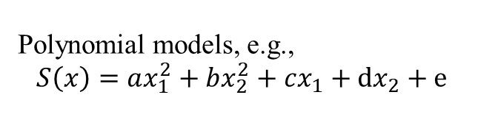
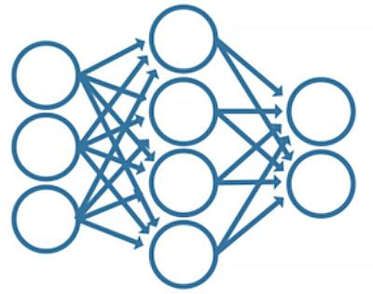
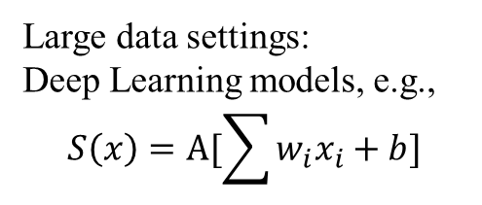
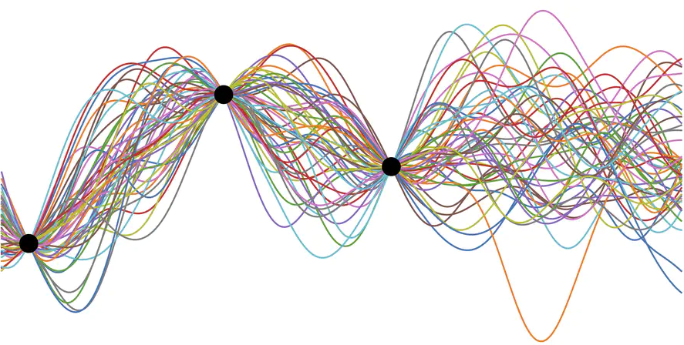
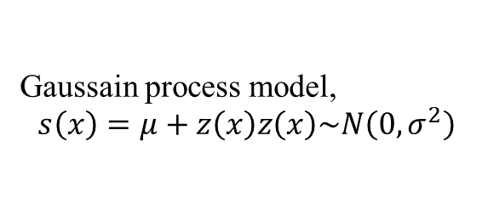
What are those surrogate models?

Slide 6
Flowchart of the surrogate model algorithm
Sampling
Simulation
Model building
Optimization
Add the sample initial dataset
Converged
NO
YES
Finish

Slide 7
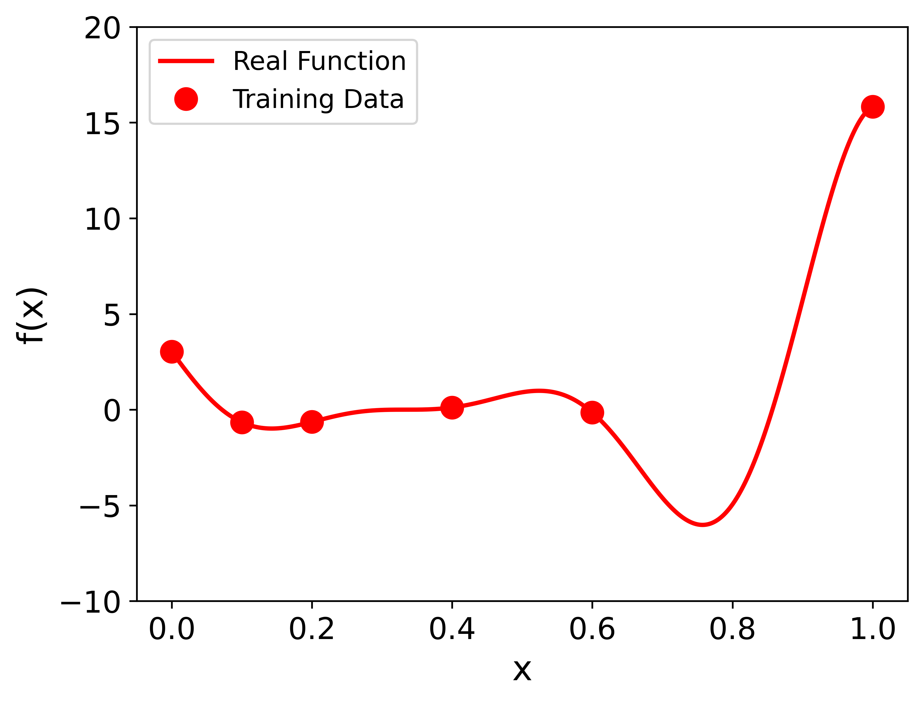
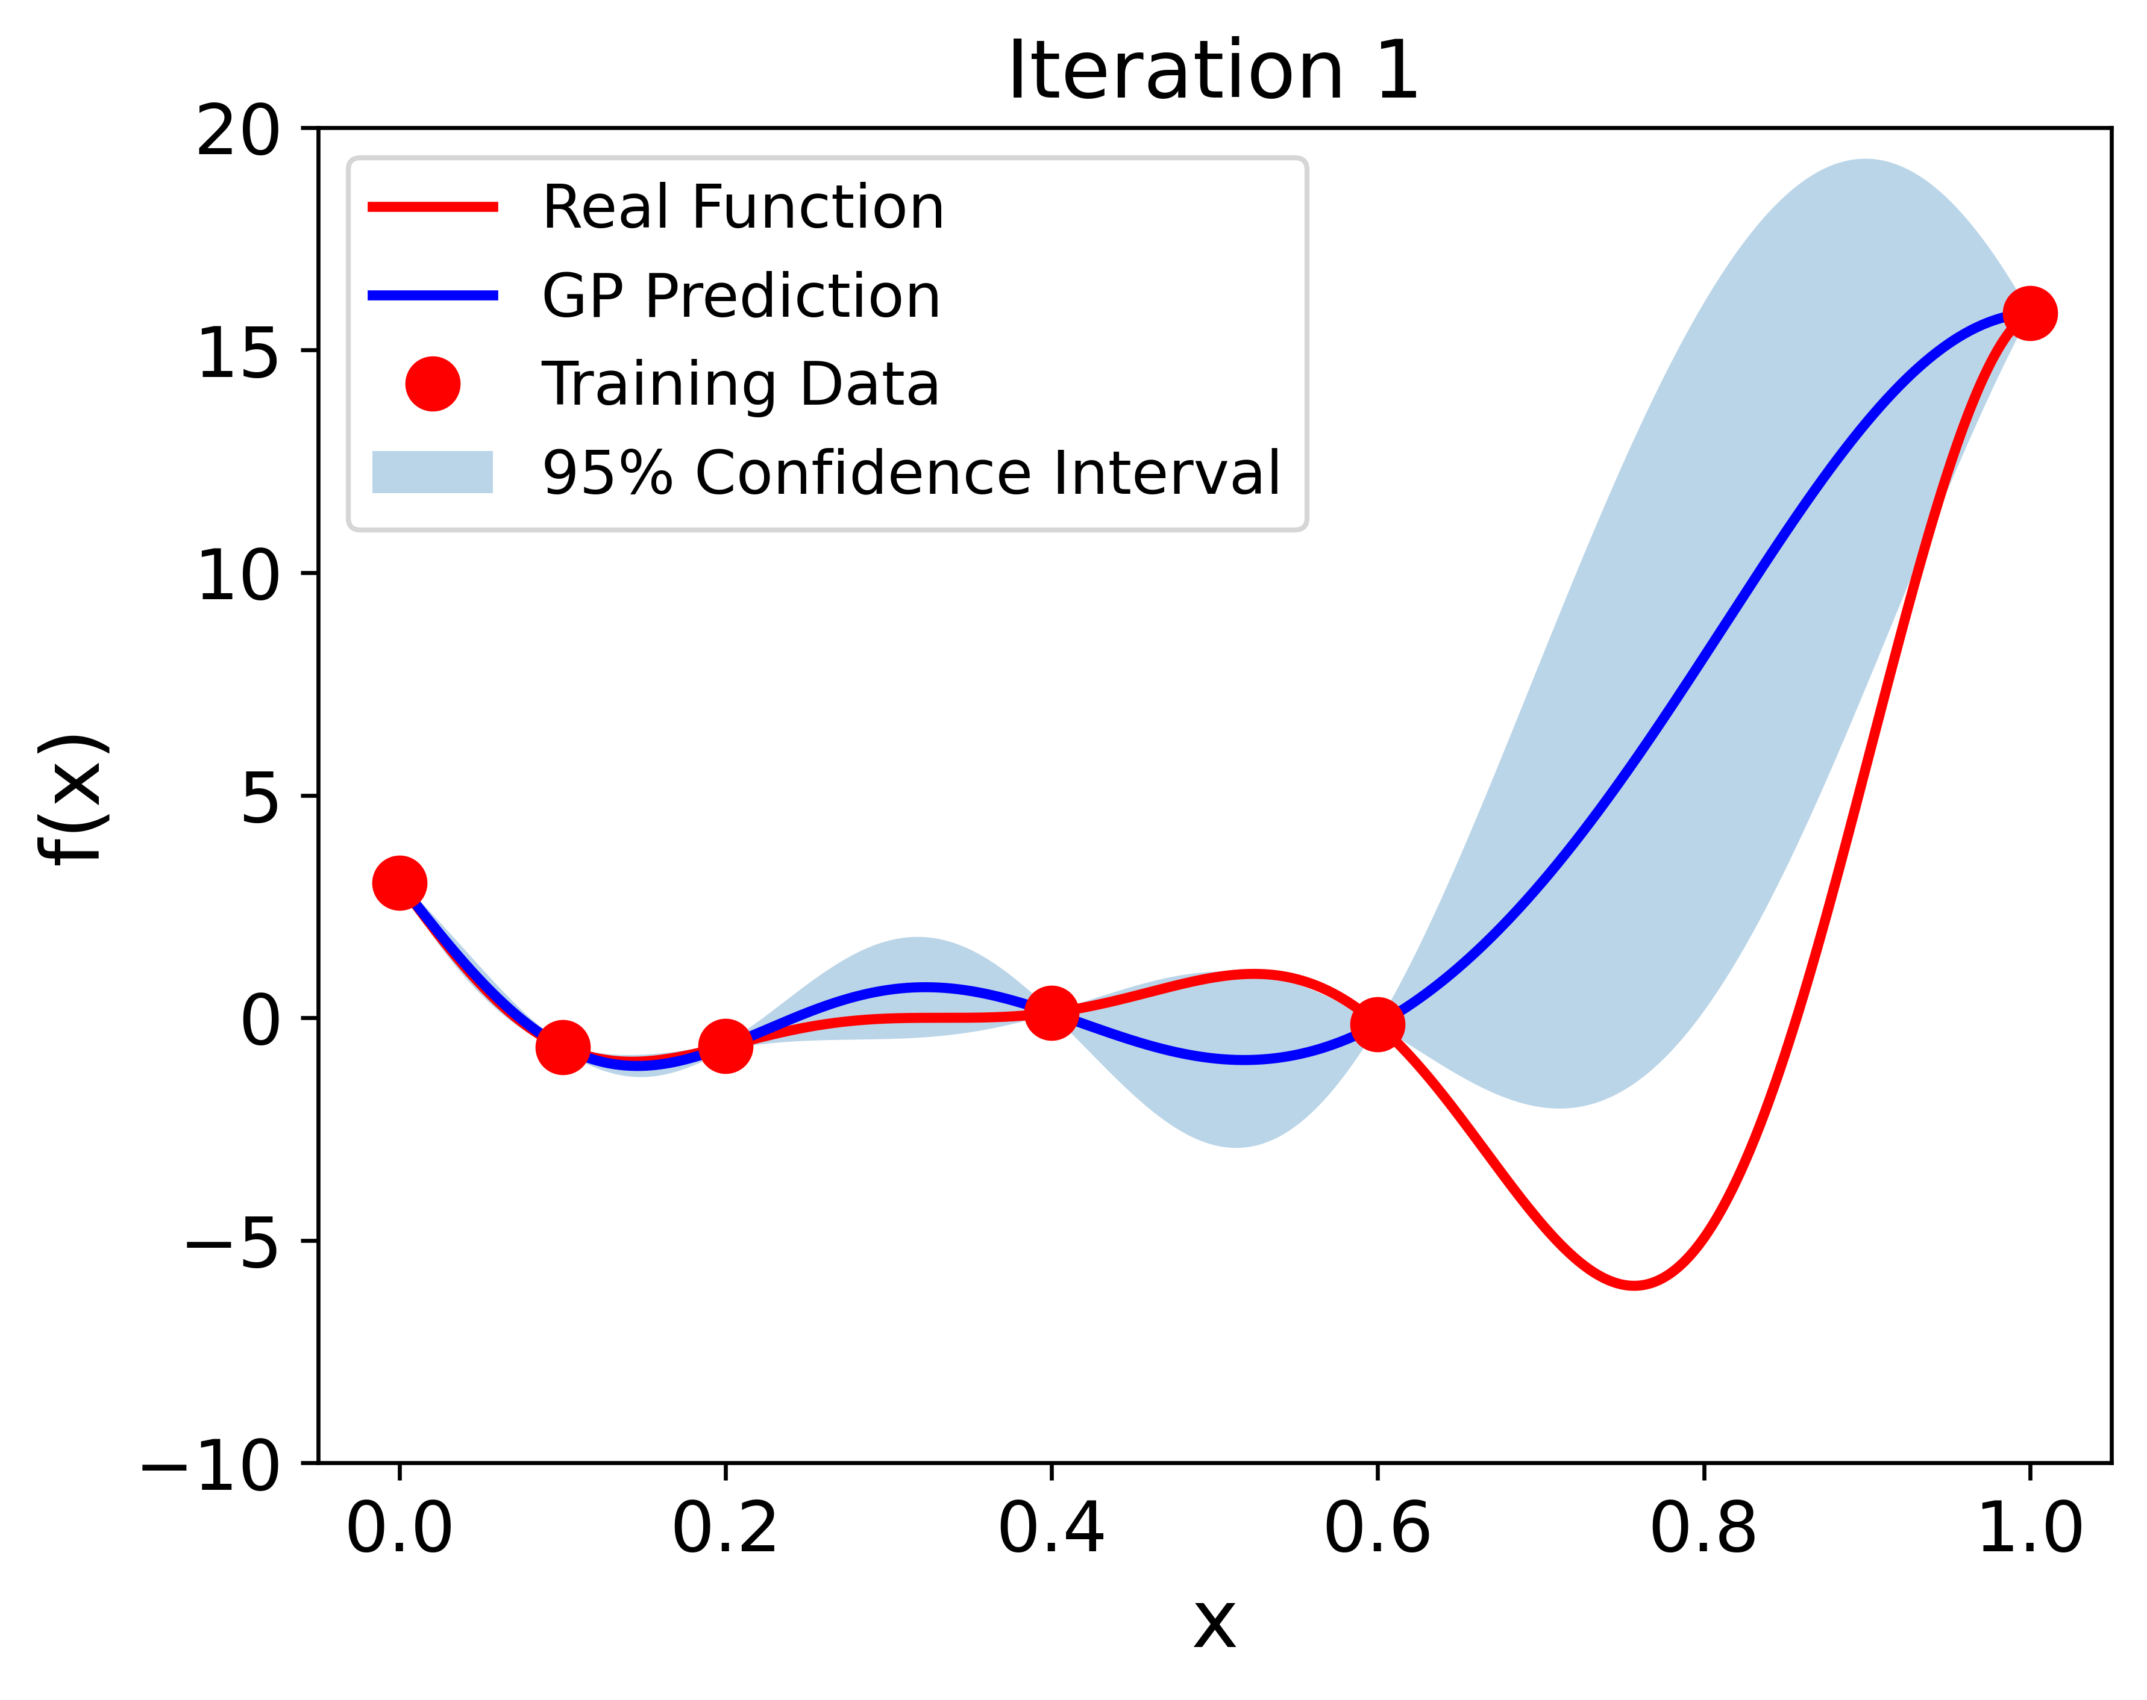
Surrogate models and active learning comes into work.
Function: y = (x * 6 - 2) ** 2 * np.sin(x*12 – 4)
Start with an initial experimental design

Slide 8
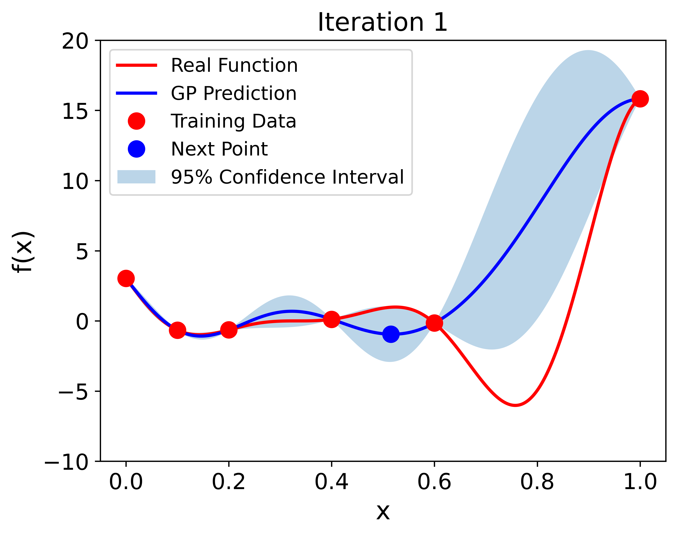
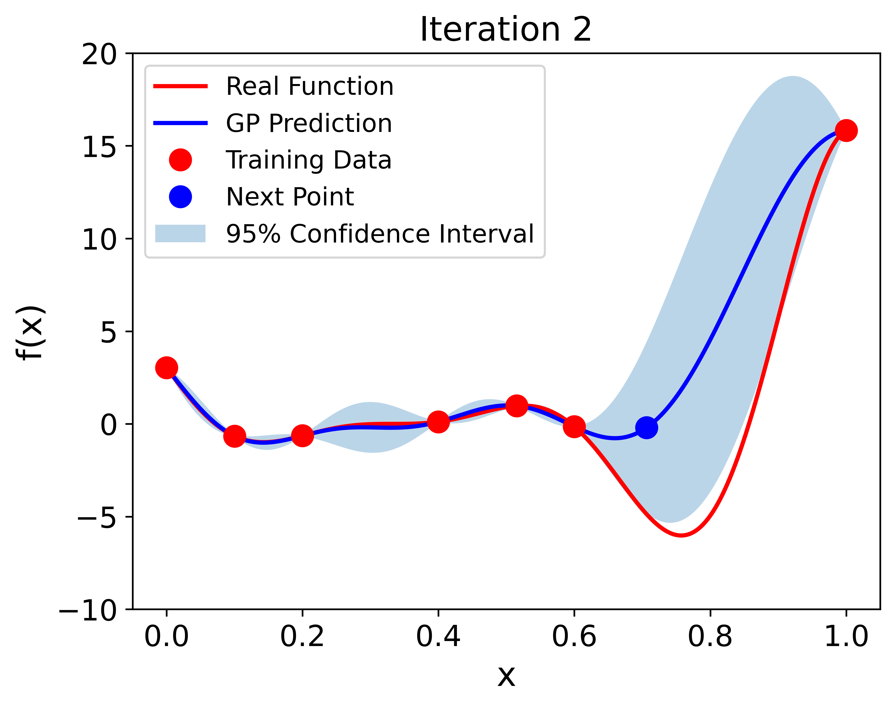
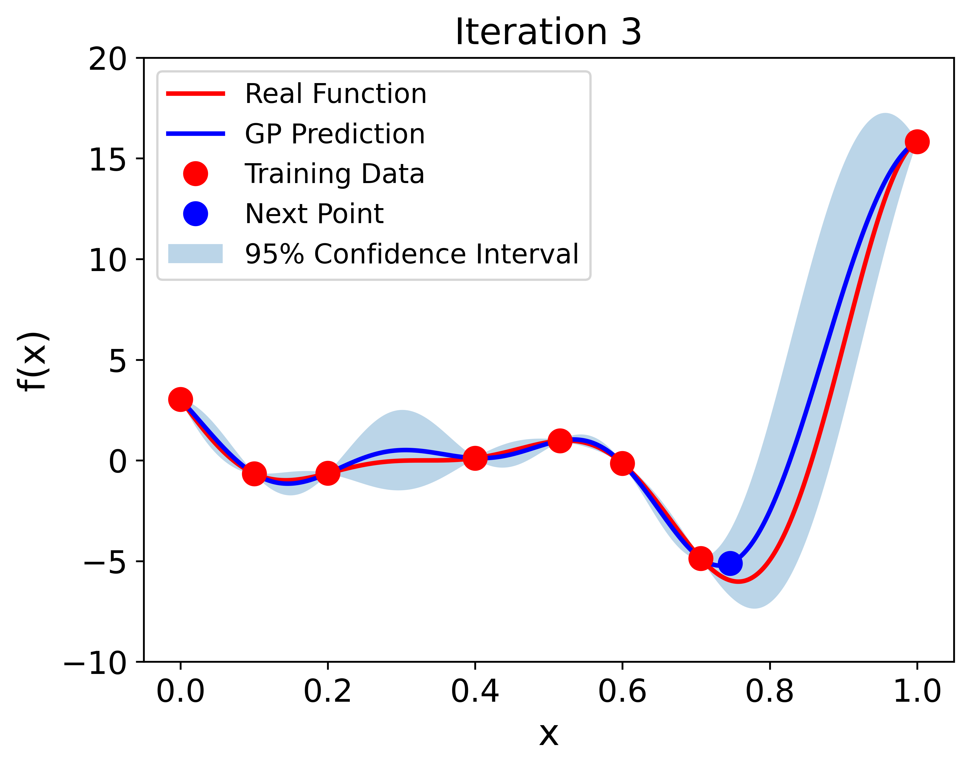
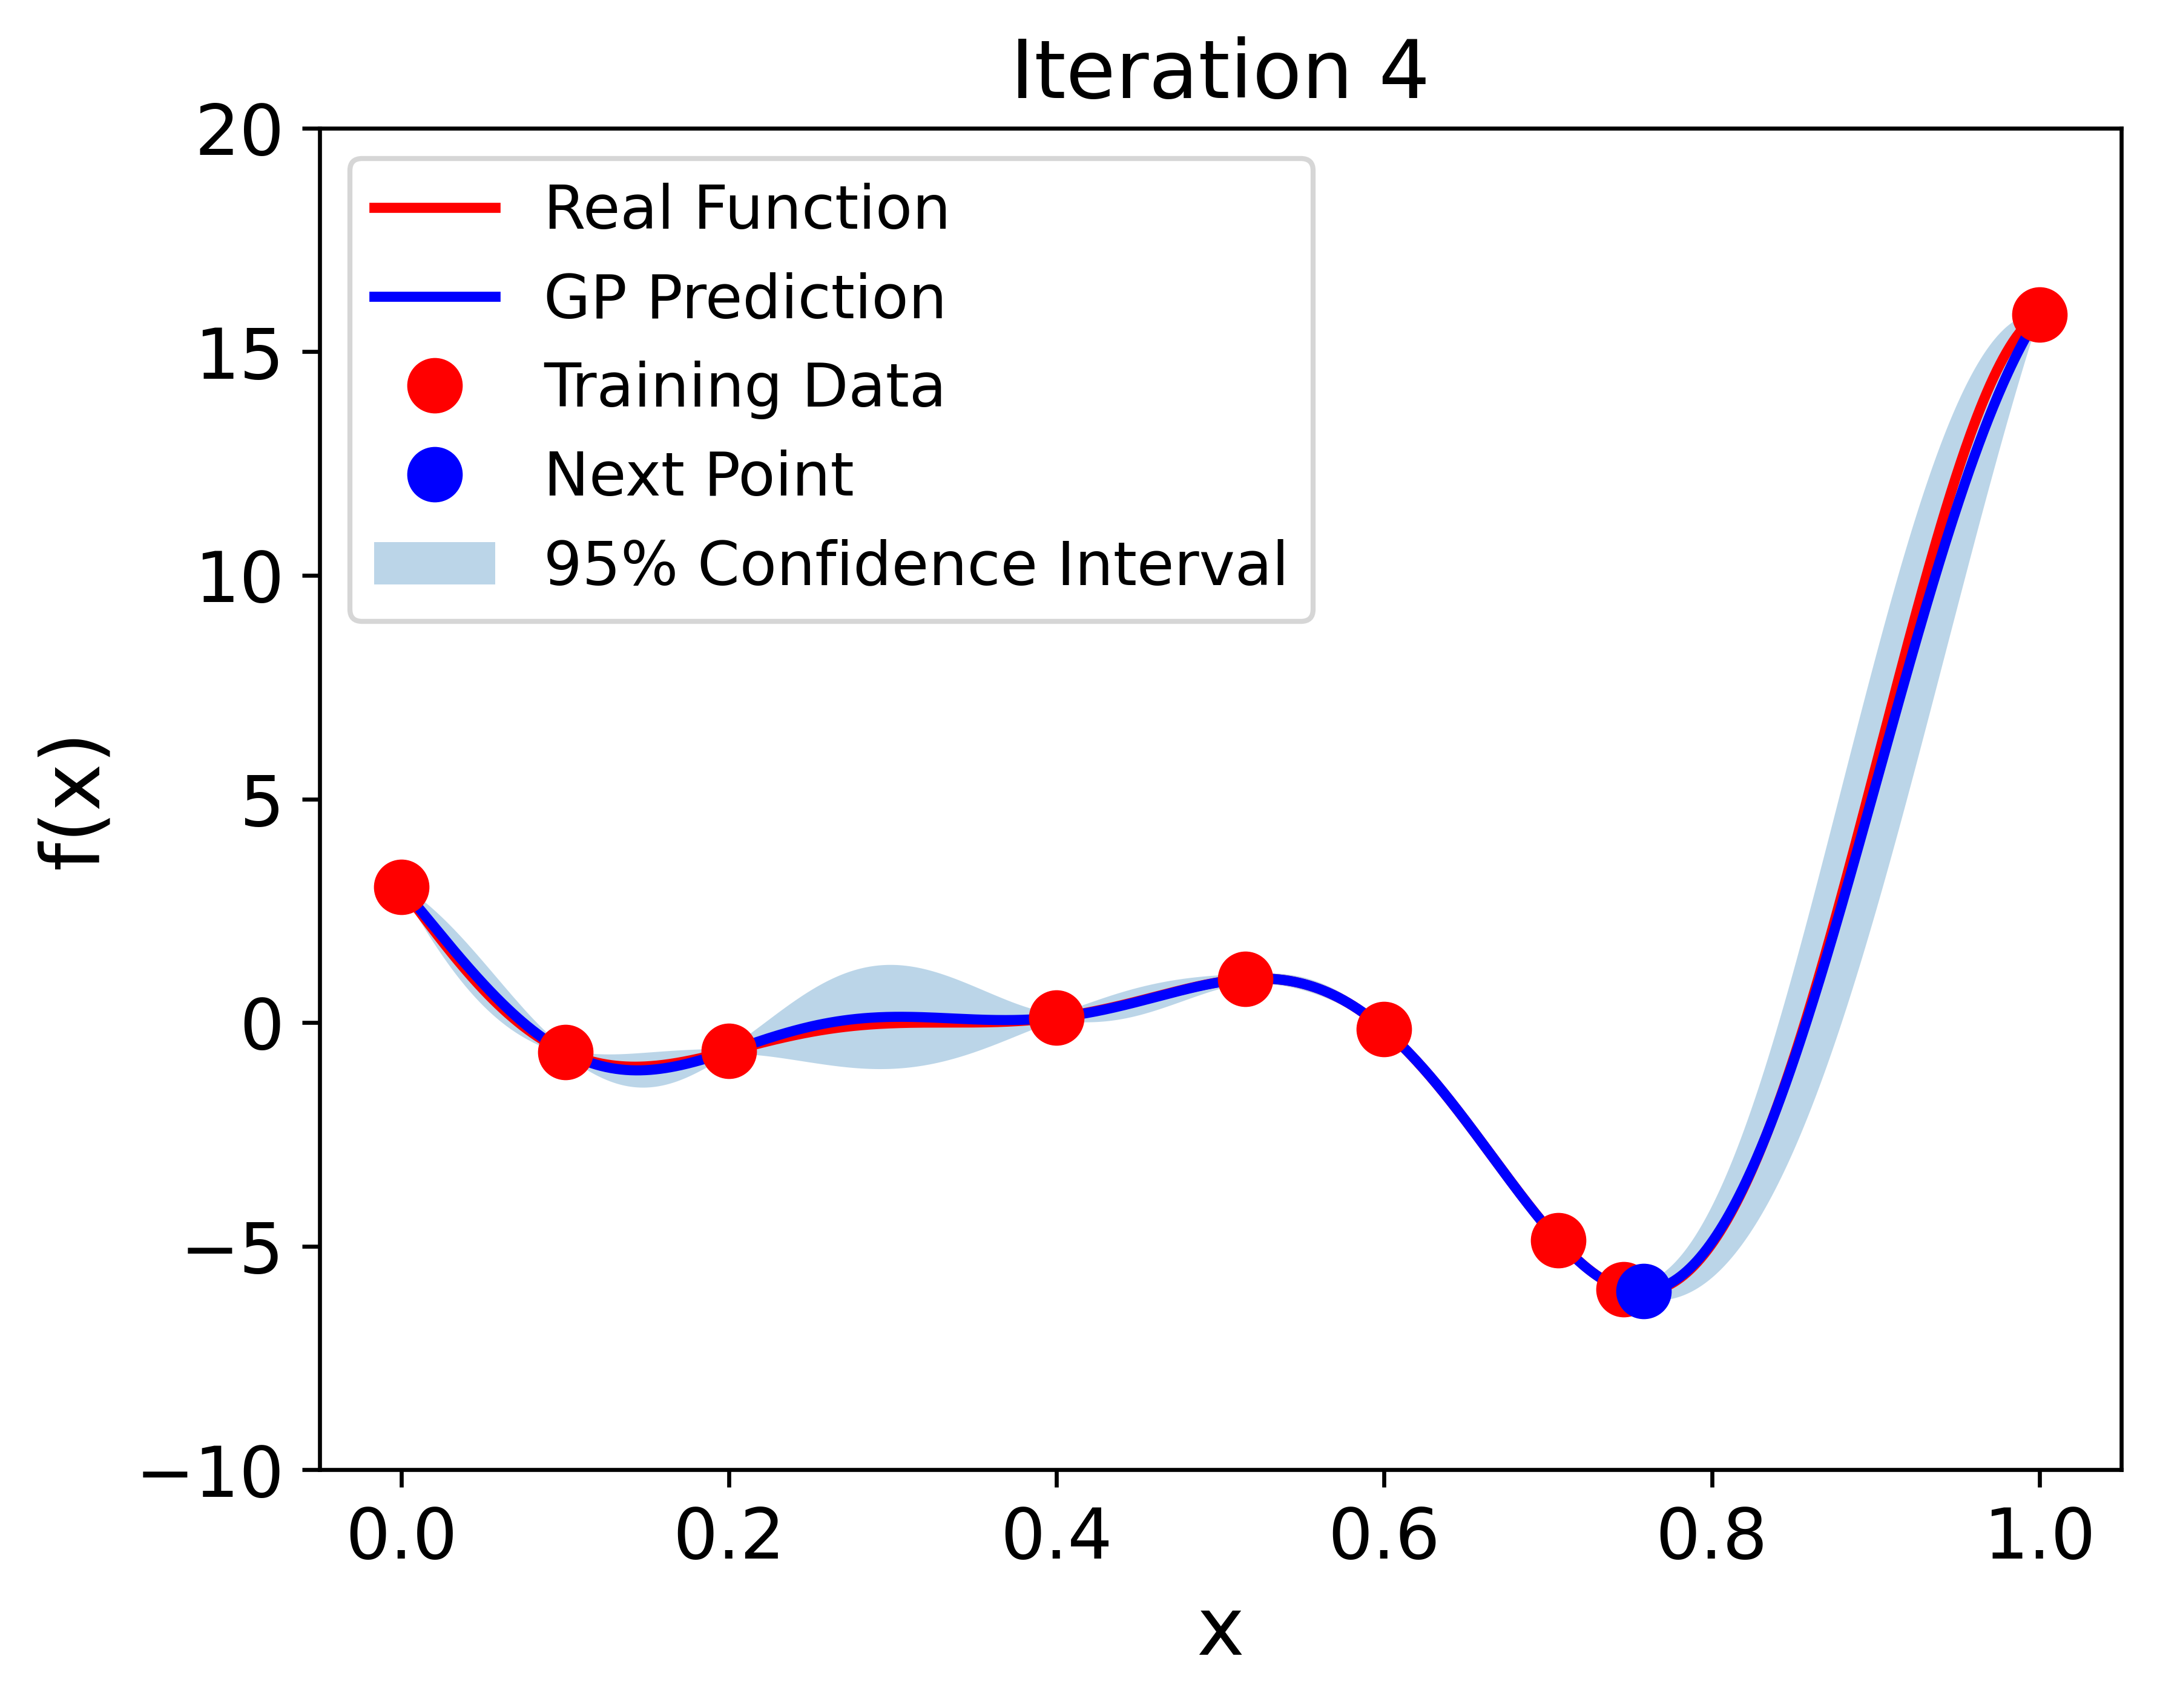
Active learning tells us where to sample next
Select a new evaluation point to run the simulation
Use the new piece of information to update the surrogate model

Slide 9
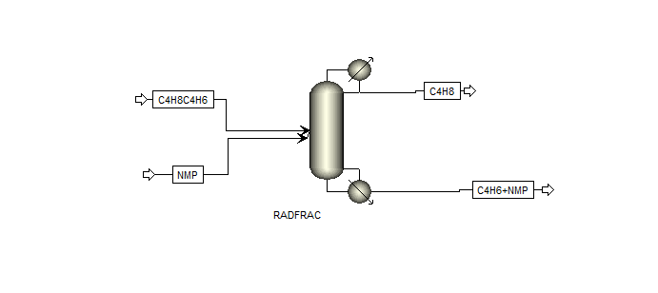
Case Study
Process flow sheet of extractive distillation column
C4H8+C4H6+NMP C4H8 , C4H6 + NMP
Separation of 1-butane/1,3-butadiene using N-methyl-2-pyrrolidone (NMP) as solvent
Input variables
no. of stages: [40, 80]
operating pressure: [1, 10]
reflux ratio: [3.5, 6]
solvent to feed ratio: [1, 8]
Output variables
reboiler heat duty
product purity
Initial samples: 16 data points
Surrogate modeling method: Gaussian process regression
Acquisition function
maximum probability of improvement
upper confidence bound
Optimization algorithm: differential evolution

Slide 10
Case 1: Low-quality data
Low-quality data refers to not considering purity for initial training data.
Convergence for low-quality data occurs at input variables: | No. of stages: 69 Reflux ratio: 4.84 Operating pressure: 3.50 Solvent-to-feed ratio: 2.95
Iterations required for low-quality data: | 10
Heat duty for low-quality data: | 17461.98
Sampling time for low-quality data: | 17.32 seconds

Slide 11
Case 1: Low-quality data

Slide 12
Case 2: High-quality data
High-quality data refers to considering purity >= 0.995 for initial training data.
Convergence for high-quality data occurs at the input variables: | No. of stages:74 Reflux ratio: 4.56 Operating pressure:3.50 Solvent-to-feed ratio: 2.84
Iterations required for high-quality data: | 25
Heat duty for high-quality data: | 16580.85
The sampling time for high-quality data: | 43.40

Slide 13
Case 2: High-quality data

Slide 14
Comparison
Low-quality data
High-quality data
Case | Iteration | Heat duty (kW) | Product purity
Low-quality data | 10 | 17461.98 | 0.995
High-quality data | 25 | 16580.85 | 0.995
With high-quality data, active learning needs more iterations, but achieves better process performance

Slide 15
Conclusion
Active learning offers a cheaper approach for surrogate modeling and process optimization
Better process performance achieved using high-quality data in active learning
Future prospective
Optimization for a complete extractive distillation process
Economic evaluation can be considered

