Slide 1
Title of the project
Smart bp and Stress Detection
TEAM DETAILS
Ch. Harika 2451-19-737-013
M. Shirisha 2451-19-737-015
K. Sai Kiran 2451-19-737-011
GUIDE DETAILS
G. Usha Sri
Asst. Professor , IT Dept
MVSR Engineering College

Slide 2
CONTENTS
CONTENTS
ABSTRACT
INTRODUCTION
PROBLEM STATEMENT
LITERATURE SURVEY
EXISTING SYSTEM
PROPOSED SYSTEM
SYSTEM REQUIREMENTS
ARCHITECTURE
UML DIAGRAMS
MODULES SPLIT-UP
METHODOLOGY
RESULTS
CONCLUSIONS
REFERENCES

Slide 3
ABSTRACT
The effects of stress are causing rigorous damage to the mental as well as physical state of humans. It is very difficult to identify whether a person is in stress. The person may look healthier physically but may not be in a state of good health due to the stress within the body. It is very essential to monitor stress levels regularly which help in diagnosis of any abnormalities in the body that may lead to chronic illness in future. The Wireless networks based on IOT (Internet of Things) provides wide range of opportunities to monitor stress levels regularly and transmit the information to the concerned for immediate action. A model is designed and developed to detect the stress levels using various sensors such as heartbeat rate, blood pressure (BP), body temperature. Further based on the values of these sensors, the levels of stress is calculated and the information is transmitted using IOT.

Slide 4
INTRODUCTION
Stress is the feeling of mental or physical tension, which negatively affects a person’s mind and well-being. It is a normal human reaction that often arises due to challenges or difficulties. Headache, tiredness, disturbed sleep schedule, higher than normal blood pressure, aging, heart illness, obesity, etc., are common symptoms of stress. If a person is under stress for a long time, it can affect the mind and body, causing health issues.
With technology evolving constantly, smartwatches have adopted new stress measurement techniques like Heart rate variability (HRV) and Electro Dermal Activity (EDA) with an easy access to mobile features.
HRV is the measure of the variation of time between each heartbeat. A person who has a low HRV is likely under stress. An EDA sensor, found in some smartwatches, monitors tension by electrically altering the amount of sweat on our skin.

Slide 5
Introduction
It has been suggested that individuals who experience repeated or prolonged stress exhibit blunted biological stress responses when compared to the general population. Thus, when assessing whether a ubiquitous stress response exists, it is important to stratify based on resting levels in the absence of stress.
Research has shown that stress that causes symptomatic responses requires early intervention in order to mitigate possible associated mental health decline and personal risks. Given this, real-time monitoring of stress may provide immediate biofeedback to the individual and allow for early self-intervention.
A normal Systolic Blood Pressure (SBP) is below 120 mmHg and a normal Diastolic Blood Pressure (DBP) is lower than 80 mmHg. Raised Blood Pressure (BP) throughout its range is the most signiﬁcant cause of death and disability in the world.
So design of stress detection and health monitoring technology that could help people to understand their state of mind and body is very essential.

Slide 6
PROBLEM STATEMENT
To build a model that sense heart rate variability, Skin Conductance and temperature using sensors for measuring the stress levels of an individual.

Slide 7
LITERATURE SURVEY
S.No. | Author Name | Title of Project | Method used for stress test | Problem Identified | Limitations
1. | Chalmers.T; Hickey.B.A; Newton.P; Lin, C.-T.; Sibbritt.D; McLachlan, CA.S.; Clifton-Bligh.R; Morley.J; Lal. S | Stress Watch: The Use of Heart Rate and Heart Rate Variability to Detect Stress: A Pilot Study Using Smart Watch Wearables. | 1.AVG BP (Omron IA1B, Japan) 42-item Depression Anxiety Stress Scale (DASS) 3. Trier Social Stress Test (TSST) 4. Kubios HRV Premium software (HRV) | Failure of identifying ubiquitous patterns of HRV and HR changes during stress. | Since medical students are more adapted to lab environments the data collected was effected.
2. | Jharna Agrawal1 , Manish Gupta2 , and Hitendra Garg | Early Stress Detection and Analysis using EEG signals in Machine Learning Framework | stress detection methodology using EEG signals, used FD algorithms viz. Higuchi, Katz and Permutation Entropy for irregularities. Random Forest and Artificial Neural Network for classification. | To find out the best way for detecting stress at an early stage to prevent stress becoming persistent and proposing strategies to stop causing irreversible damages. | Due to Low spatial resolution and elevated noise results are not accurate. It requires further practical validation.

Slide 8
LITERATURE SURVEY
S.No. | Author Name | Title of Project | Method used for stress test | Problem Identified | Limitations
3. | Doma, V. and Pirouz, M., | A comparative analysis of machine learning methods for emotion recognition using EEG and peripheral physiological signals | DEAP dataset,learning techniques [namely Support Vector Machine (SVM), K-nearest neighbor, Linear Discriminant Analysis, Logistic Regression and Decision Trees each of these models] were tested with and without principal component analysis (PCA). | The motivation behind performing the comparative analysis was to check if it is possible to find a correct combination of techniques that can achieve comparable results with more complex techniques | Improvement in accuracy or in efficiency could possibly be achieved with more data
4. | Siirtola, Pekka. | Continuous stress detection using the sensors of commercial smartwatch | WESAD dataset, Firebase Database, SVM classifier | The objective of the project is to help the user with necessary warnings when they are stressed during a task performed. | The stress detected is not accurate enough when compared to laboratory values. more recent algorithms is needed.

Slide 9
LITERATURE SURVEY
S.No. | Author Name | Title of Project | Method used for stress test | Problem Identified | Limitations
5. | Hae Young Lee, Dong-Ju Lee .et.al | Smartphone / smartwatch-based cuffless blood pressure measurement | photoplethysmography-based smartphone algorithm | To recommend optimal BP measurement methods using a smartphone device | The smartwatch-based BP measurement is not yet ready for clinical usage
6. | Zubair M., Yoon C., Kim H. | Smart Wearable Band for Stress Detection. | EDA, Accelerometer, Bluetooth | Using only heart rate to detect stress resulting in misclassification. | It only uses one parameter for the prediction.

Slide 10
EXISTING SYSTEM
IOT based wearable health care devices and fitness bands are available that uses heart rate variability to measure stress level. The heart rate can show variation in most cases. For example, people may have higher heart rate when standing than when sitting. Hence using heart rate as an indicator to detect mental stress may lead to misclassification.

Slide 11
PROPOSED SYSTEM
In the proposed system, a model is designed to monitor the heartbeat rate, temperature and skin conductance using various sensors which will be uploaded to the cloud through ESP WIFI module. Then the data is used for evaluation of stress levels and the details will be sent to the registered mobile number through GSM.

Slide 12
SYSTEM REQUIREMENTS
Software Requirements:
Language Used : Embedded C
Operating System: Windows 10 or above
IDE Used: Arduino UNO
Hardware Requirements:
Processor: Core i3
Hard disk: 250 GB
Ram: 8GB
ESP8266 WIFI Module
LM35 Temperature Sensor
Heart Beat Sensor
16*2 LCD
GSM (Global System for Mobile Communication)
GSR Sensor (Galvanic Skin Response)
Jumper Wires
Project Factory -Server

Slide 13
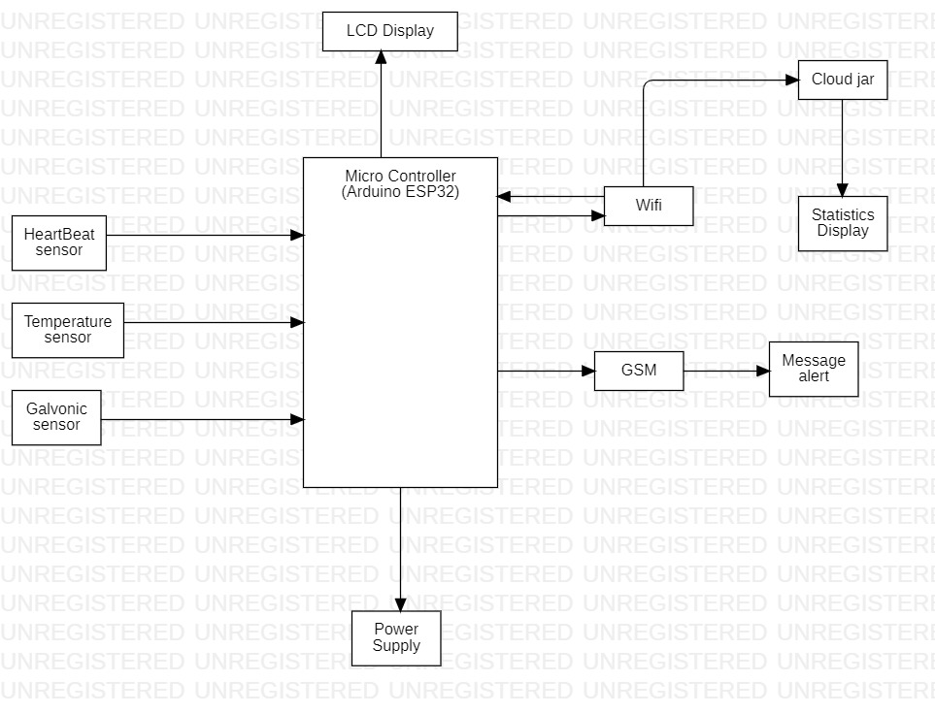
SYSTEM Architecture

Slide 14
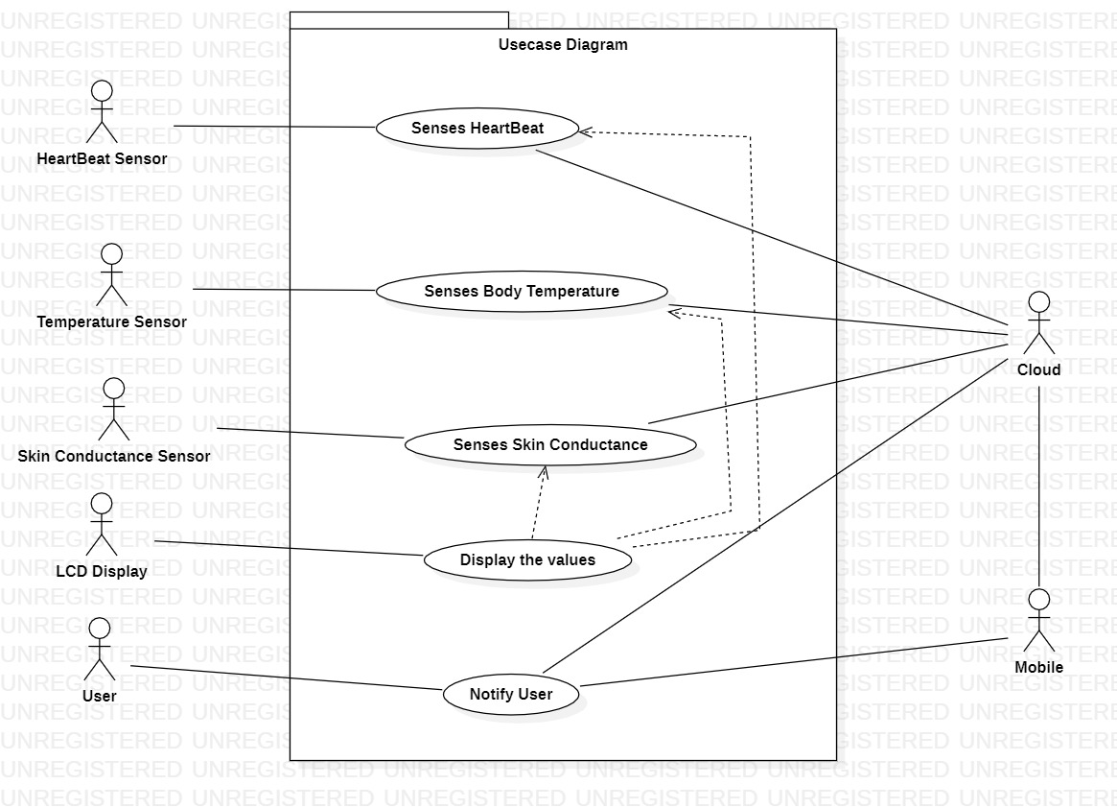
Use case diagram

Slide 15
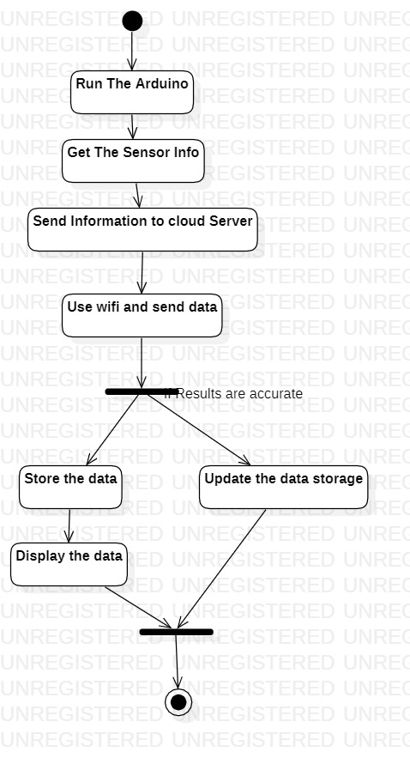
Activity diagram

Slide 16
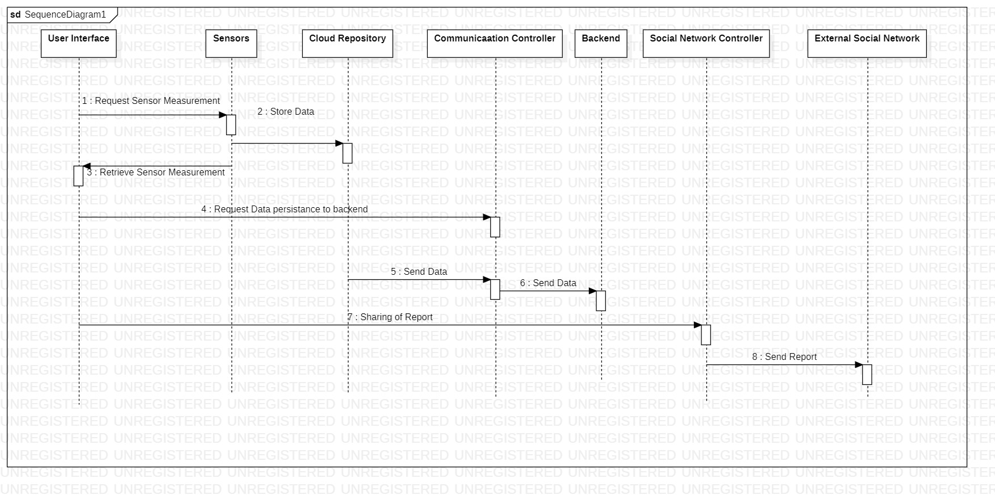
Sequence diagram

Slide 17
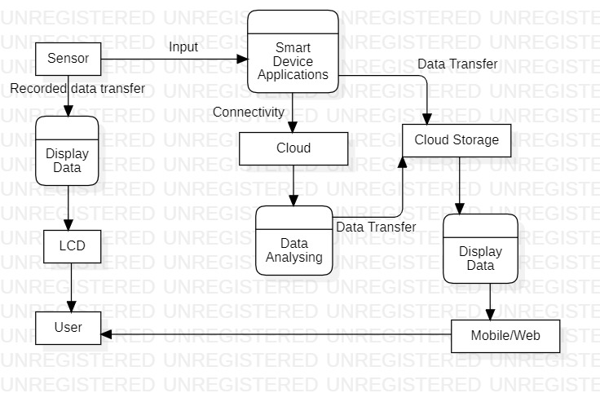
DATA FLOW diagram(DFD)

Slide 18
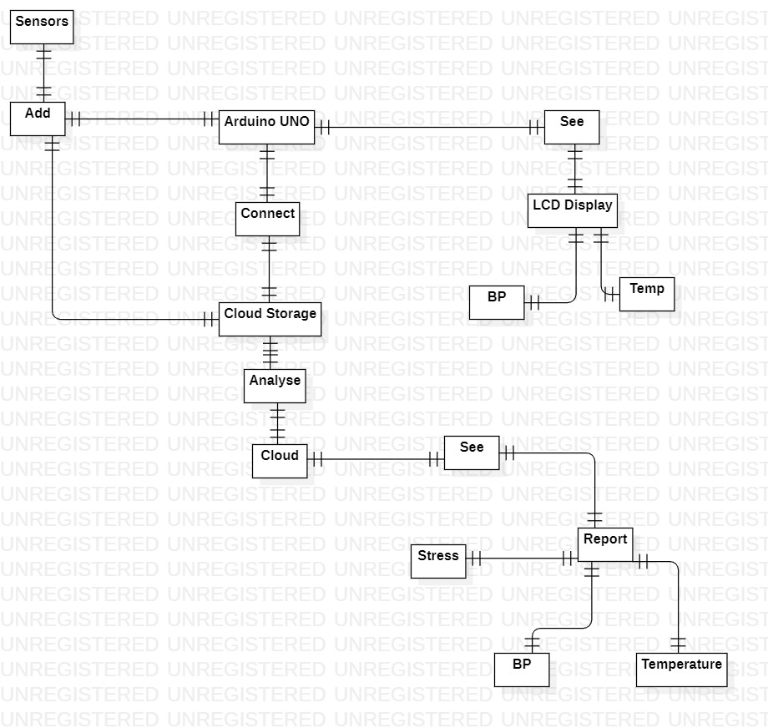
ER DIAGRAM

Slide 19
MODULES SPLIT-UP
Sensing pulse and other vitals using various sensors and display.
A model is designed to detect the heart rate variability, skin conductance and temperature using various sensors.
Uploading to the cloud through WIFI module.
Once we have taken the input from the person through sensors, the information is uploaded and saved to the server through WIFI module.
Analysis of stress levels of the person and delivery.
After data is analysed the results will be displayed to concerned person or to the doctor.

Slide 20
Methodology
Sensing the Vital from an Individual :
A model is designed to detect the heart rate, skin conductance, and the body temperature using the respective sensors. The readings will be taken for every 30 seconds interval of time.
Uploading to the cloud through WIFI module:
Once the reading are taken from the individual , the information is uploaded and saved to the project factory server through WIFI module for every 30 seconds. The uploaded data will be available in the tabular and graphical from for our reference.

Slide 21
3. Analysis of stress levels of the person and delivery.
If gsr(200-500) and temp(32) and hr(72)
then the person has no stress ("normal")
If gsr(<200) and temp(33-40) and hr(73-80)
then the person has low stress ("Stressed")
If gsr(<100) and temp(>40) and hr(>80)
then the person has high stress ("visit doctor")
4. The microcontroller informs the person by sending SMS to the mobile using the GSM module every minute when in contact with sensors.
5. Based on the values from sensors the status of a person will be displayed on the LCD Screen

Slide 22
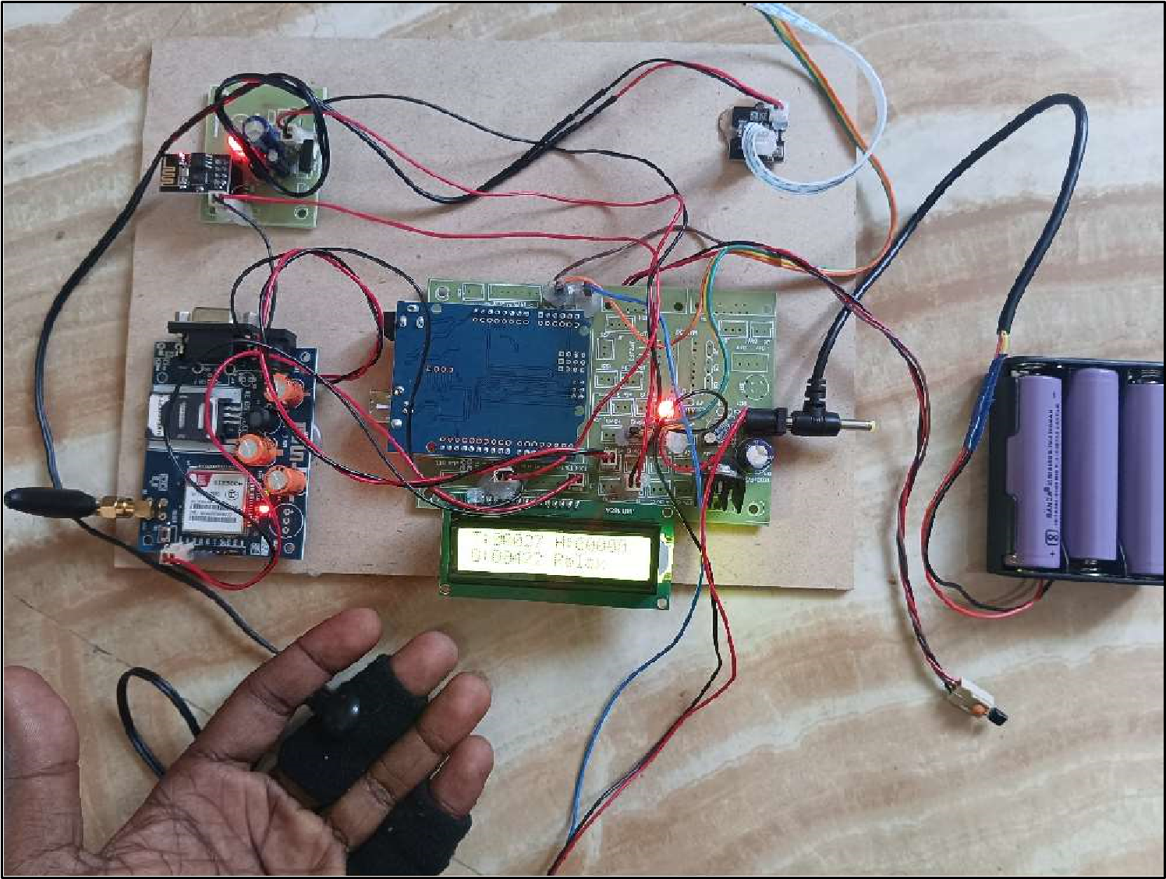
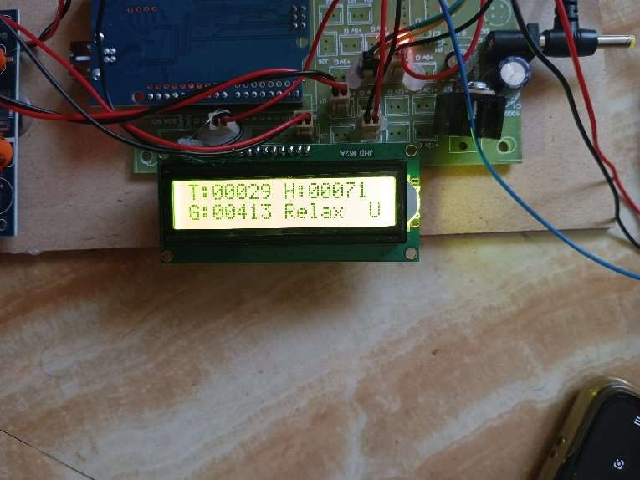
RESULTS
The above images shows the hardware setup of the device and values of a person

Slide 23
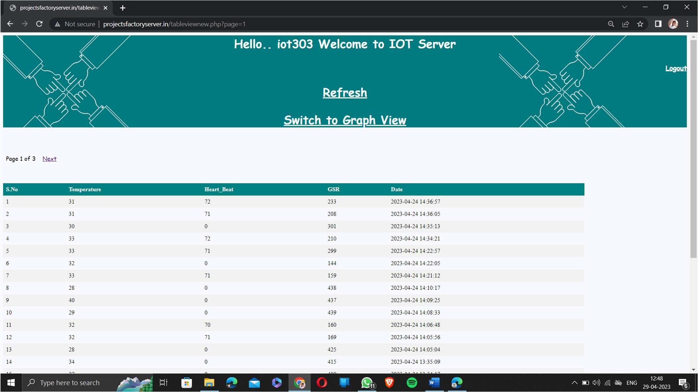
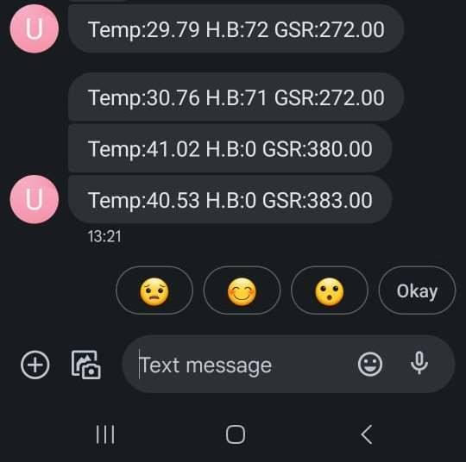
The above images shows the values in the server and the message received to the phone

Slide 24
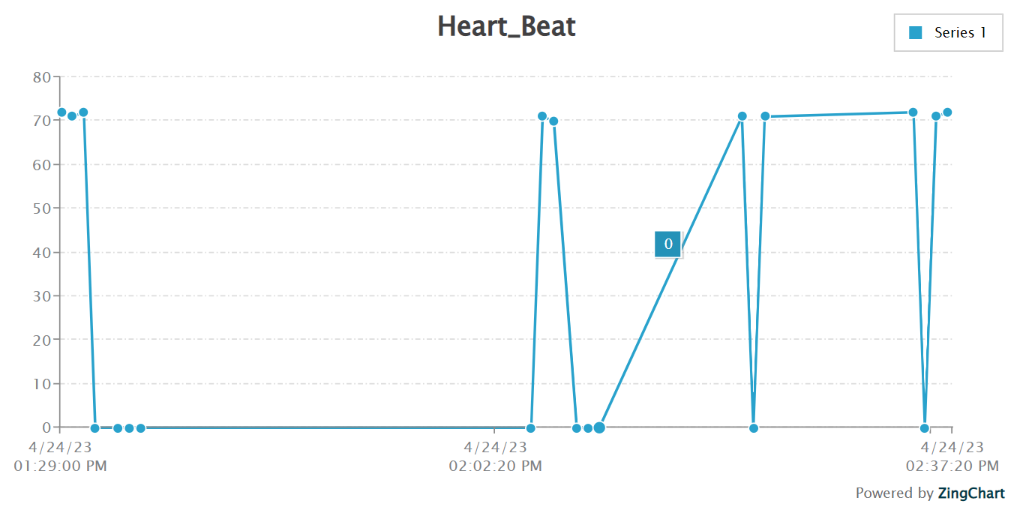
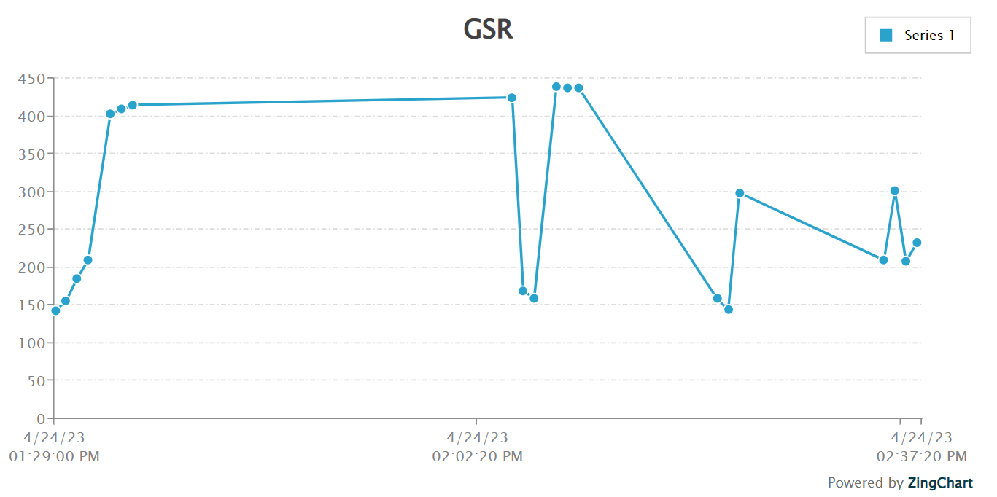
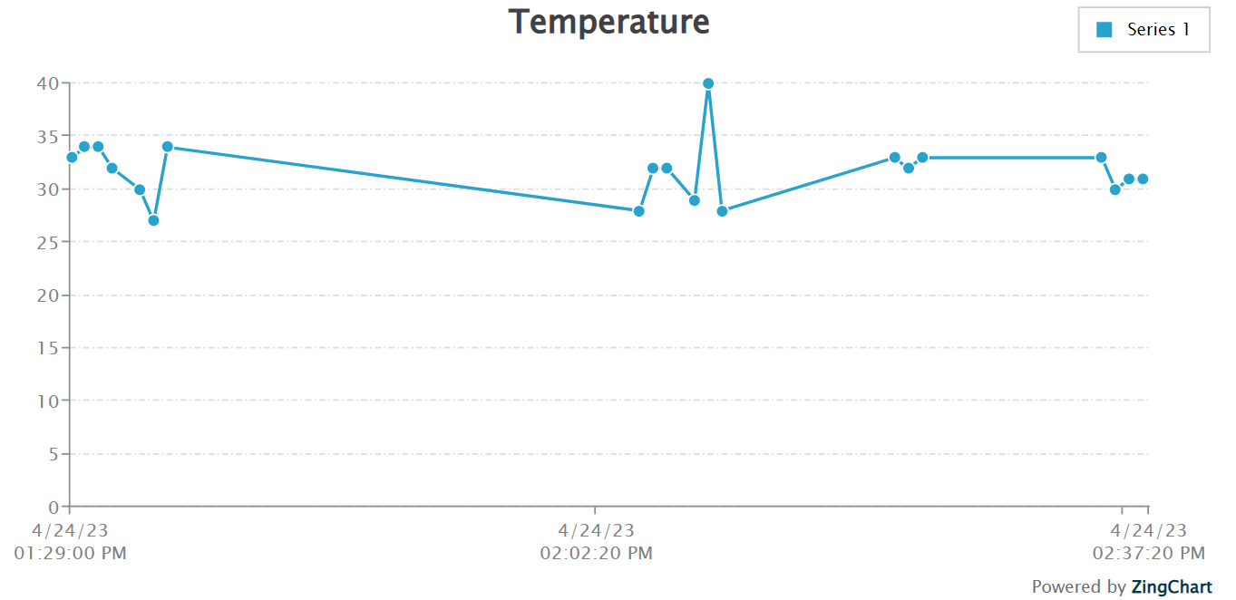
Sensors data shown in the graph format

Slide 25
conclusion
Smart stress detection system is designed and developed using Arduino. The system successfully and accurately detects the stress levels of person using various sensors such as heartbeat rate, body temperature and skin conductance values. Based on the values of these sensors, the levels of stress is calculated and the information is transmitted using IOT to the concerned persons mobile for necessary action. The developed model is more flexible and consuming less power. It is very useful for personal monitoring and is very useful in taking care of disabled persons. This work can be extended by using ECG sensor, EEG sensor, Muscle sensor etc and this model can be built on a SOC device.

Slide 26
REFERENCES
Chalmers, T.; Hickey, B.A.; Newton, P.; Lin, C.-T.; Sibbritt, D.; McLachlan, C.S.; Clifton-Bligh, R.; Morley, J.; Lal, S. Stress Watch: The Use of Heart Rate and Heart Rate Variability to Detect Stress: A Pilot Study Using Smart Watch Wearables. Sensors 2022, 22, 151. https:// doi.org/10.3390/s22010151
Jharna Agrawal1 , Manish Gupta2 , and Hitendra Garg3,2021. Early Stress Detection and Analysis using EEG signals in Machine Learning Framework. 1116 (2021) 012134
Doma, V. and Pirouz, M., 2020. A comparative analysis of machine learning methods for emotion recognition using EEG and peripheral physiological signals.Journal of Big Data, 7(1), pp.1-21.

Slide 27
REFERENCES
Siirtola, Pekka. (2019). “Continuous stress detection using the sensors of commercial smartwatch.” 1198-1201. 10.1145/3341162.3344831.
Hae lee,Dou Ju Lee.et.al,Smartphone / smartwatch-based cuffless blood pressure measurement : a position paper from the Korean Society of Hypertension

Slide 28
THANK YOU

