Slide 1



BankCustomerChurnFinal
View in Power BI

Slide 2
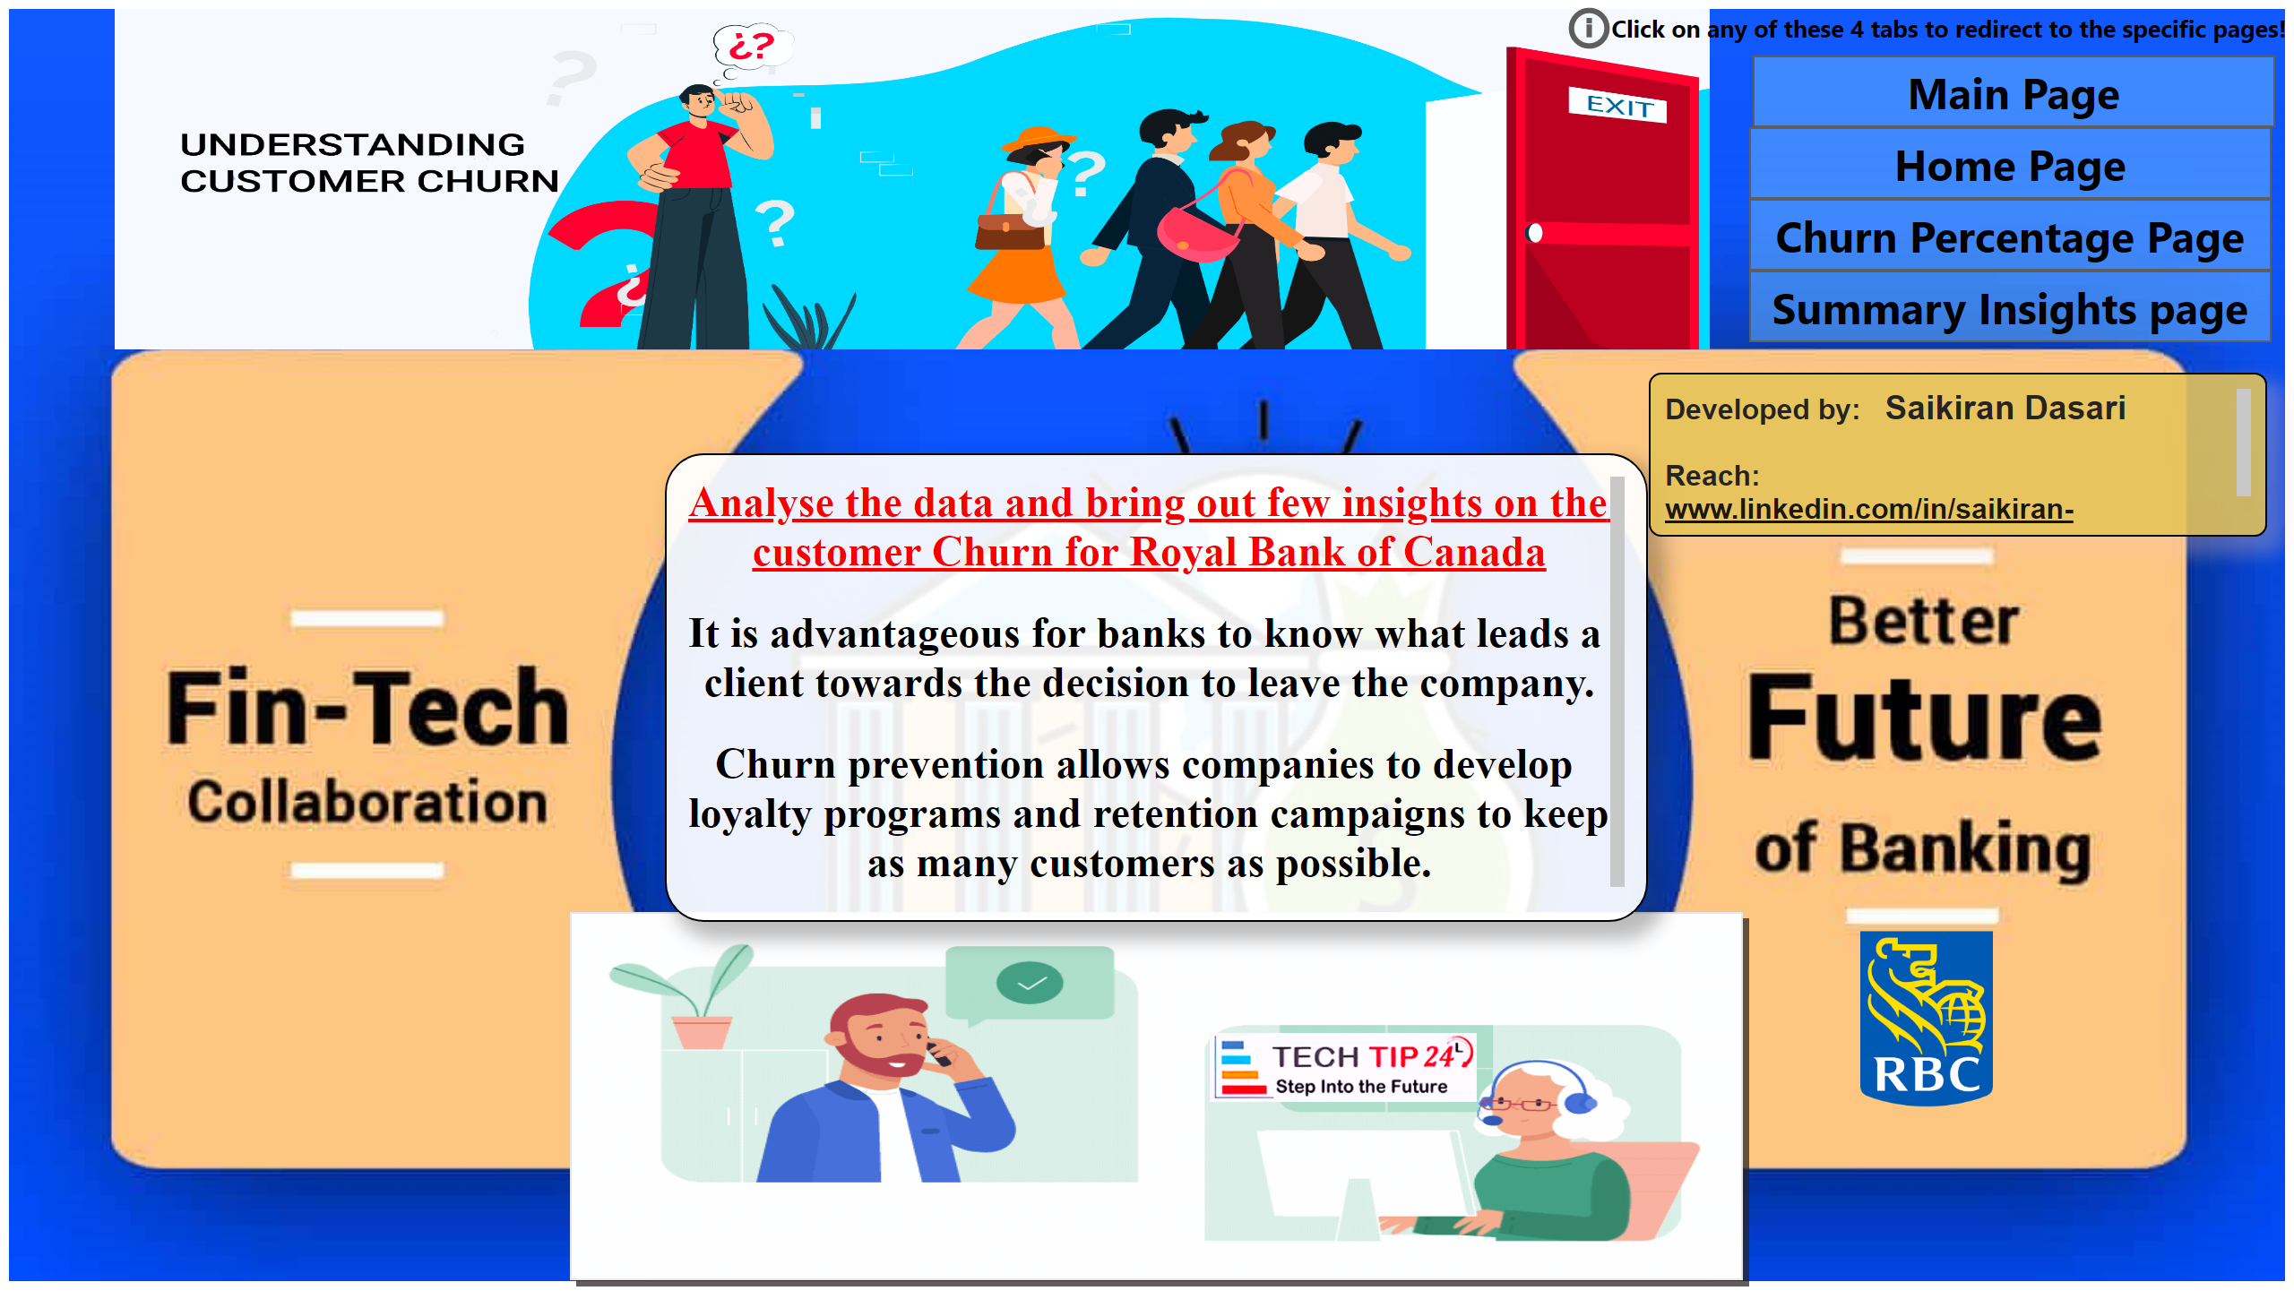
MainPage
Notes:
image
No alt text provided
image
No alt text provided
actionButton
No alt text provided
Main Page
Main Page
actionButton
Main Page
actionButton
Main Page
textbox
No alt text provided
image
No alt text provided
image
No alt text provided
actionButton
Main Page
textbox
No alt text provided
actionButton
No alt text provided

Slide 3
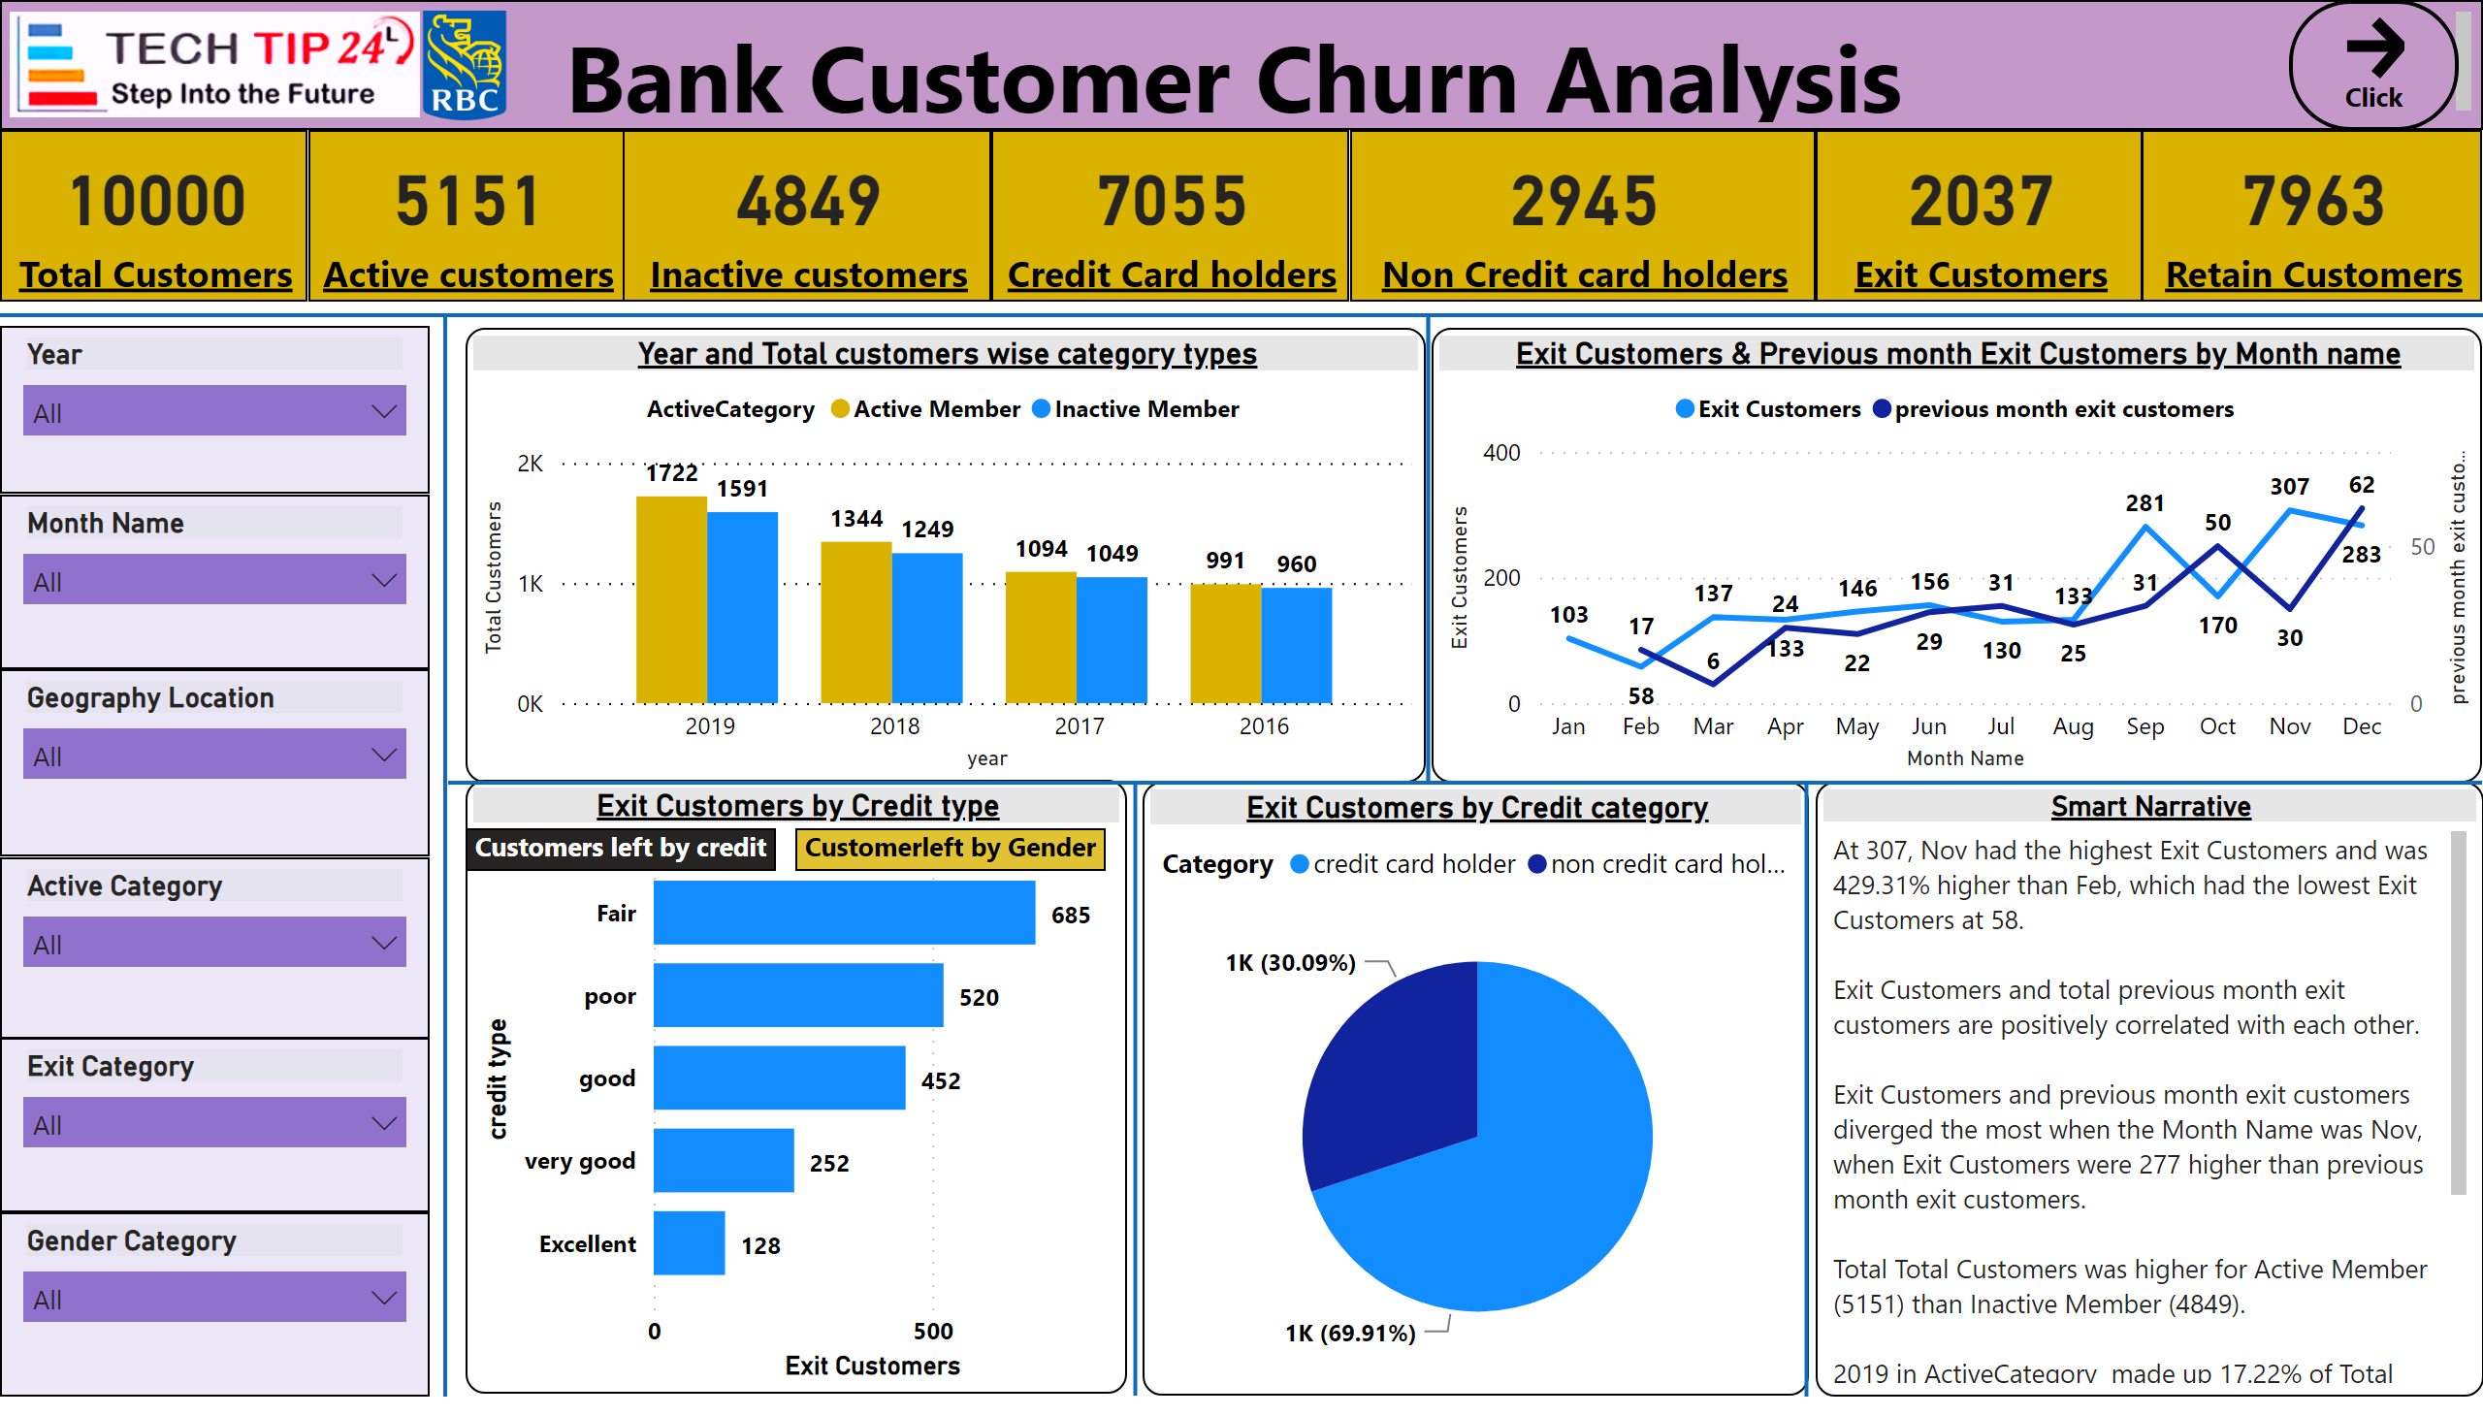
HomePage
Notes:
card
No alt text provided
card
No alt text provided
card
No alt text provided
textbox
No alt text provided
shape
No alt text provided
card
No alt text provided
card
No alt text provided
card
No alt text provided
card
No alt text provided
slicer
No alt text provided
slicer
No alt text provided
slicer
No alt text provided
slicer
No alt text provided
slicer
No alt text provided
slicer
No alt text provided
shape
No alt text provided
Year and Total customers wise category types
No alt text provided
Exit Customers & Previous month Exit Customers by Month name
No alt text provided
donutChart
No alt text provided
Exit Customers by Credit type
No alt text provided
Exit Customers by Credit category
No alt text provided
Smart Narrative
No alt text provided
bookmarkNavigator
No alt text provided
actionButton
No alt text provided
shape
No alt text provided
shape
No alt text provided
shape
No alt text provided
shape
No alt text provided
image
No alt text provided
image
No alt text provided

Slide 4
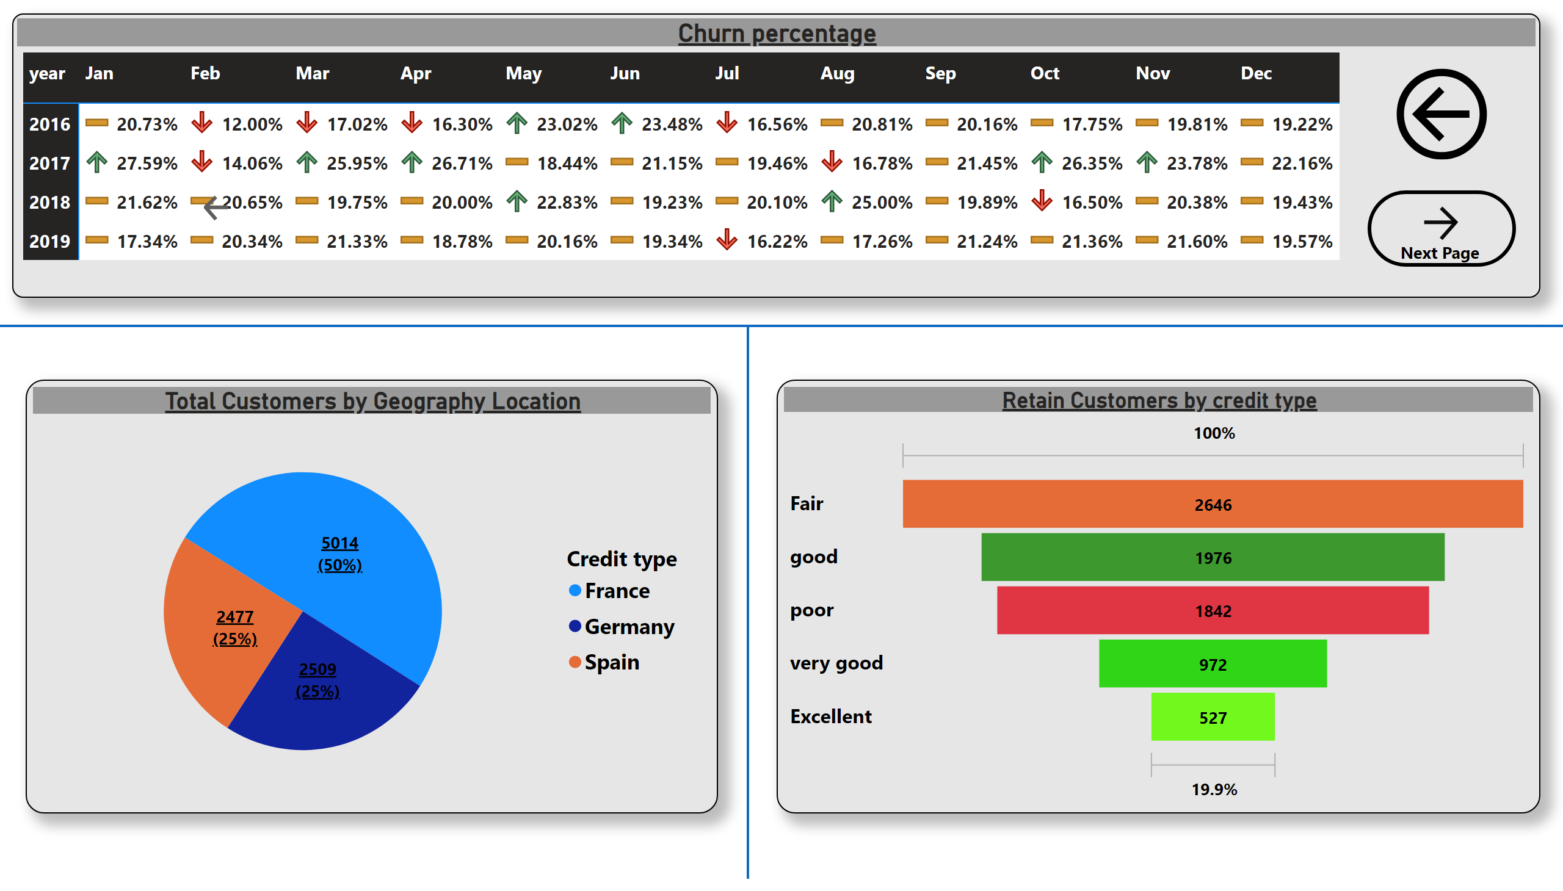
ChurnPercentagePage
Notes:
Churn percentage
No alt text provided
actionButton
No alt text provided
Total Customers by Geography Location
No alt text provided
funnel
No alt text provided
shape
No alt text provided
shape
No alt text provided
actionButton
No alt text provided
actionButton
No alt text provided

Slide 5
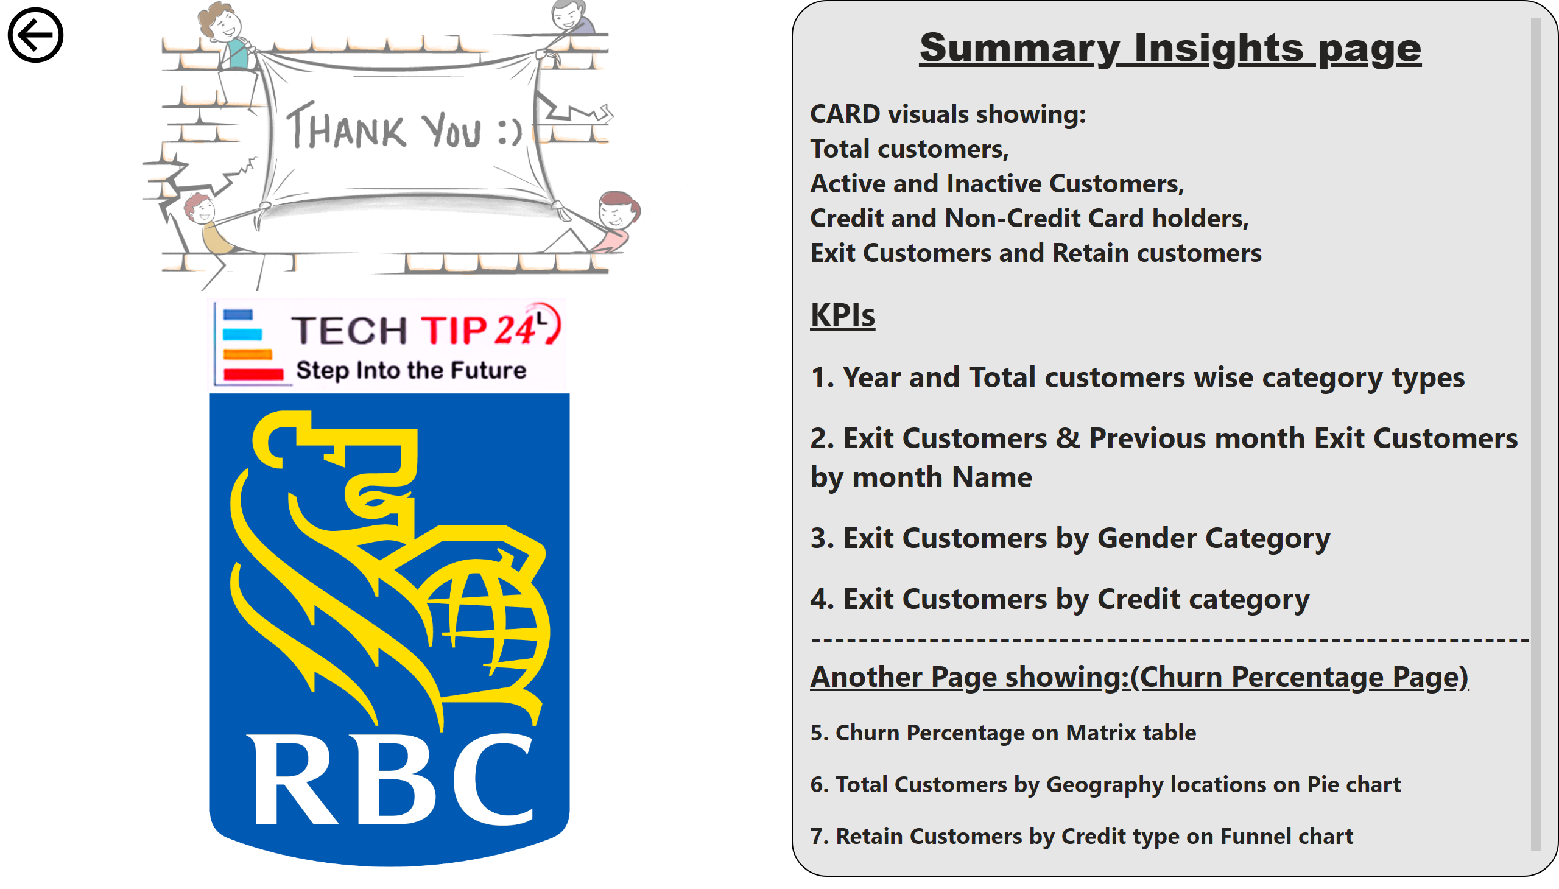
SummaryPage
Notes:
textbox
No alt text provided
image
No alt text provided
actionButton
No alt text provided
actionButton
No alt text provided
image
No alt text provided

