Slide 1
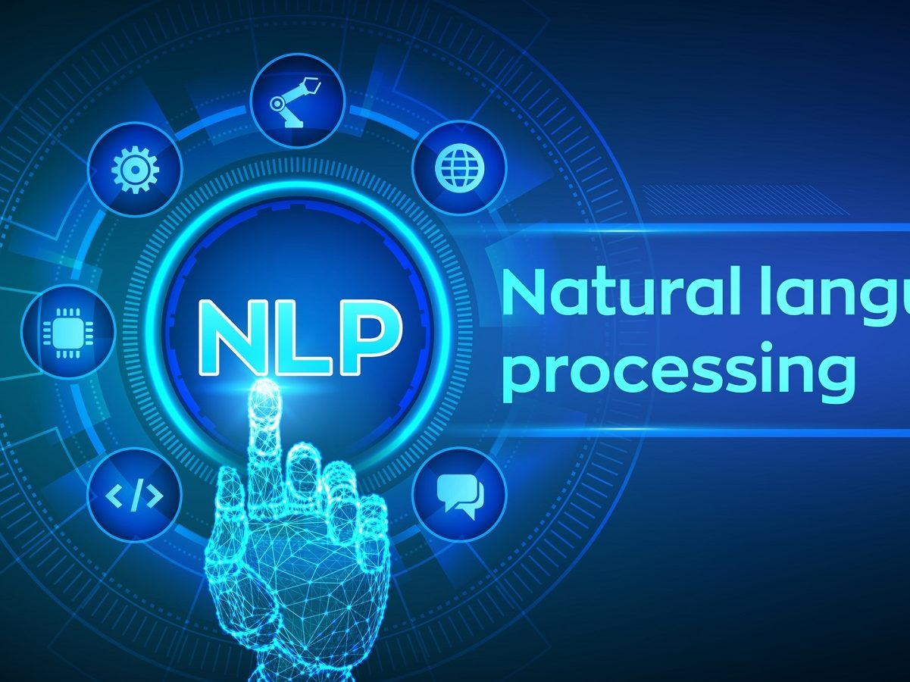
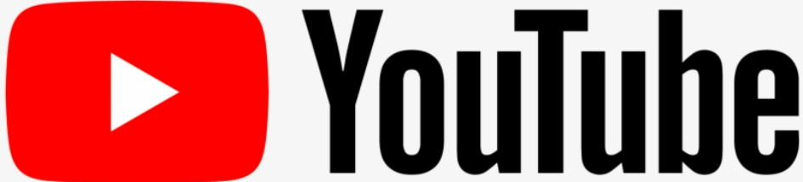
Client Name: Excelr A.I Variant
Mentor: Rajashekar Madishetti
Project coordinator: Pallavi Bapuram
Submitted By:
Saikiran Dasari

Slide 2
Business Objective
As we all know the importance of maintaining consistency in any industry is difficult. And every organisation maintains a certain method of reaching the public to know if the service provided by them is acceptable?
So, in the present generation every company/Organisation holds a social media account. Now we will develop a sort of application which can help different customers to know the customer's interest, which is very important nowadays.
As a Data scientist, we will analyse the data available in YouTube to help our clients in different ways.
Our Objective is to Support a Automotive Industry on which factors they are lagging back while carefully analysing the comments of people about the cars and the Sentiment behind them using NLP techniques and Classifying them Positive, Neutral and Negatives.

Slide 3
Project analysis slide 2
Project Analysis
Business Objective
Data Preprocessing and Feature Engineering
PROJECT
Research and Data Scrapping
Visualizations and NLP Visuals
Exploratory Data Analysis
Deployment

Slide 4
Project analysis slide 3
YouTube Video Comments for Automotive Reviews
Working with APIs is a skill, Why?
APIs is the official way for data extraction and doing other automation stuff allowed by big websites.
If there is an API allowing you to extract the data you need from a website, then you do not need regular web scraping to Automate the Process
TECHNICAL ANALYSIS
Project Objective: Sentiment ANALYSIS
Youtube ANALYSIS
Data Scrapping:
Goggle Cloud Console
Youtube Data API
Beautifulsoup
For Scrapping Data
Helping any YouTube Industries through People Comments and Sentiments on the Business using NLP techniques
Research and Investigation by AGILE Methods
For Entire Project

Slide 5


googleclient
Bokeh plots
Word Cloud
NLTK
Text Blob
Spacy
Streamlit for Application Deployment
LIBRARIES Used In the Project
Google Cloud - YouTube Data API-Key
made the task Quick
The YouTube Data API v3 is an API that provides access to YouTube data, such as videos, playlists, and channels.

Slide 6
Project analysis slide 4
Project Architecture
Channel Analysis and Video Analysis
User Inputs their API-Key
Show the required Visuals on Dashboard
System Product fetches the Data
Preprocess the Data
Along with NLP Visuals
USER INPUTS YOUTUBE VIDEO URL LINK

Slide 7
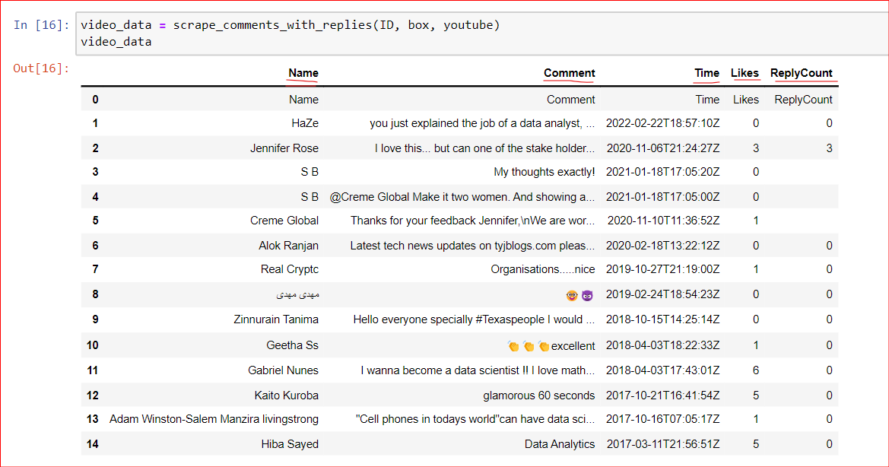
YouTube Video Data Scrapping using:
GOOGLE Cloud Console: YOUTUBE DATA APIv3 service API-Key for fetching “Video” specific data!

Slide 8
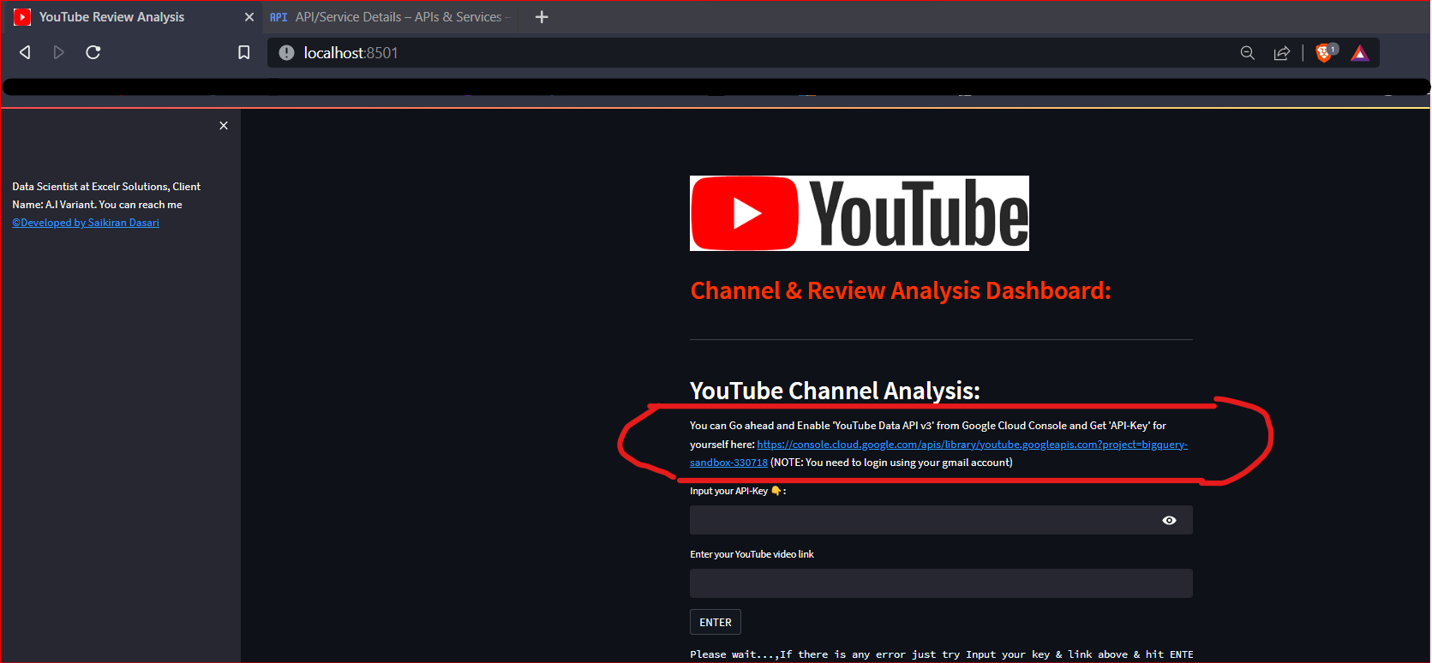
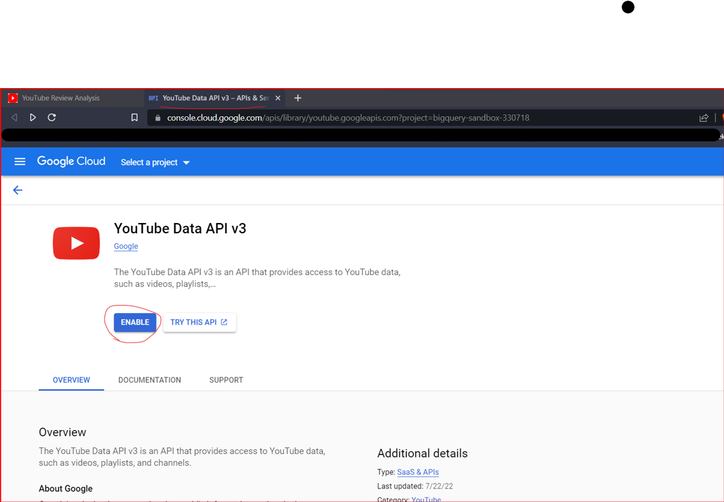
You input your API-KEY and YouTube URL and your are DONE! for your Channel Analysis Insights!!
Steps to Access YouTube Data API v3 Key Service from Google Console
1) Once you Click on the link from application: (See the screen shot circled)
2) Enable it!

Slide 9
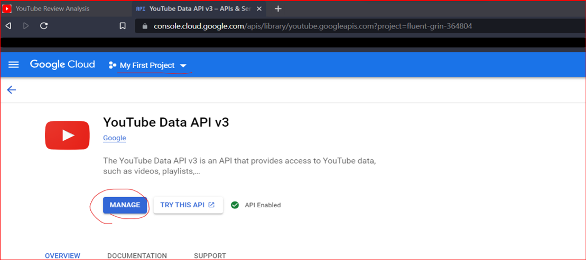
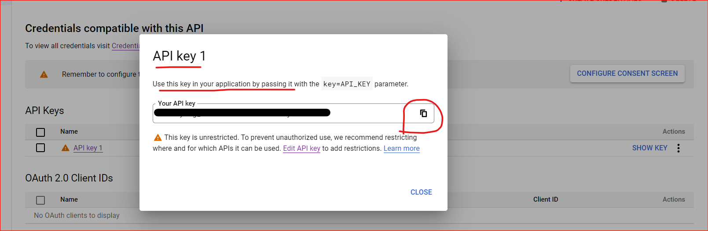
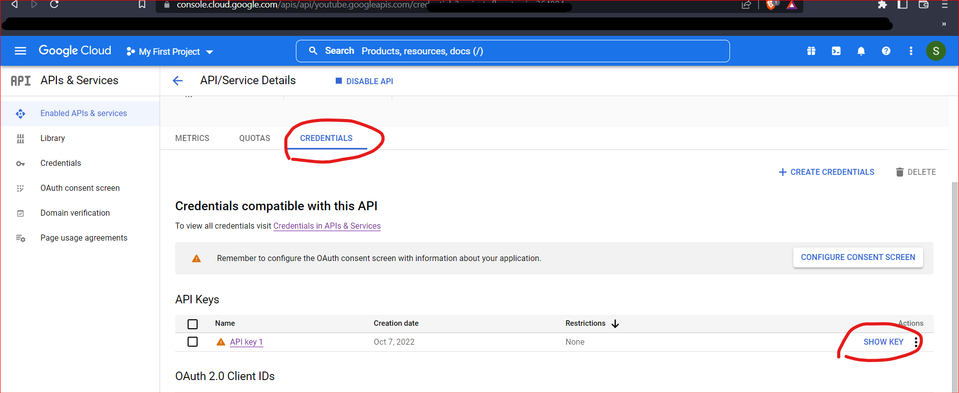
3) Scroll Down and Under ‘Credentials’ tab: you can see your API-Key and click on Show Key
4) Copy by Clicking the icon
5) DONE!! and just paste that in the application and enter

Slide 10
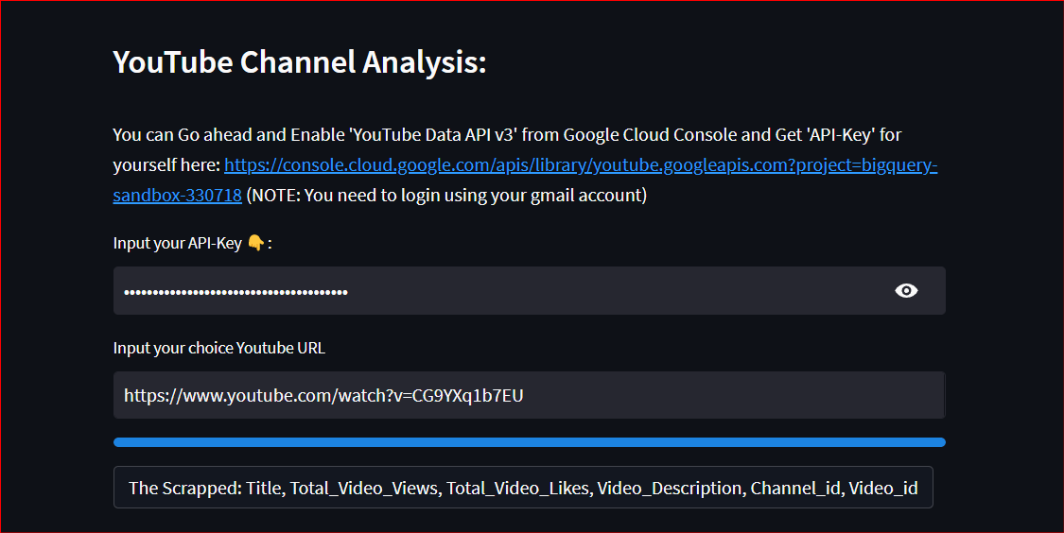
You input your API-KEY and YouTube URL and your are DONE! for your Channel Analysis Insights!!

Slide 11
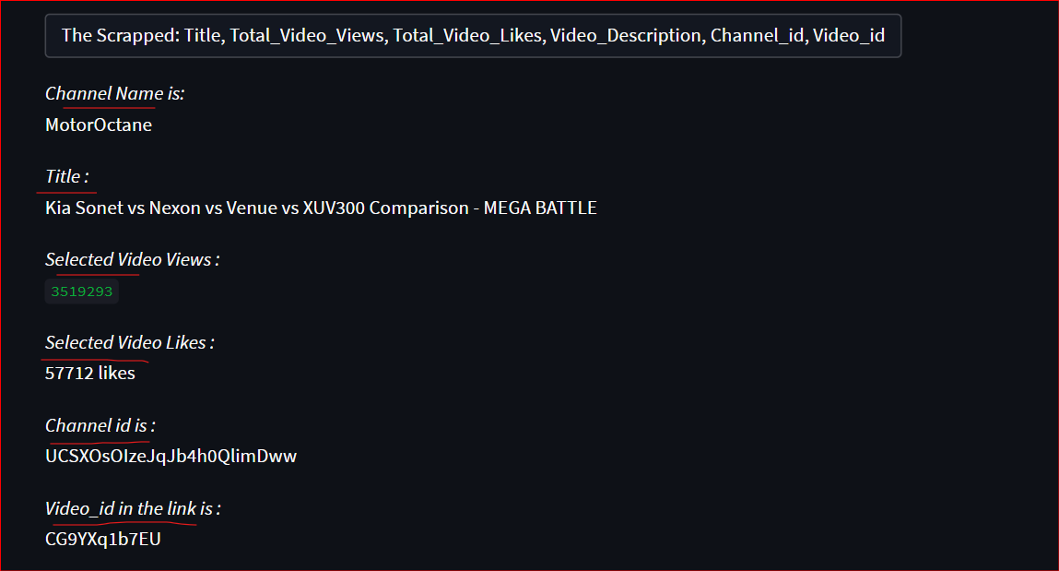
Channel Name
Title of the Video
3) Selected Video Views
4) Selected Video Likes
5) Channel id
6) Video id
From BeautifulSoup4 we get:

Slide 12
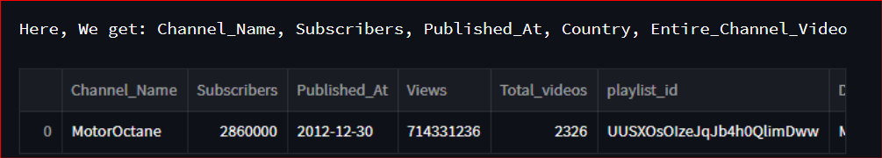
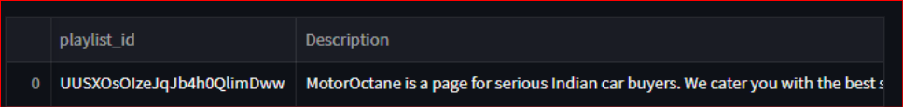
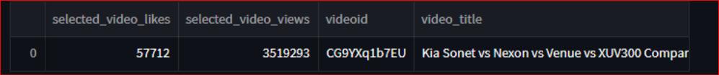
YouTube Video Data Scrapping using:
GOOGLE Cloud Console: YOUTUBE DATA APIv3 service API-Key for fetching Channels and “Video” specific data!

Slide 13
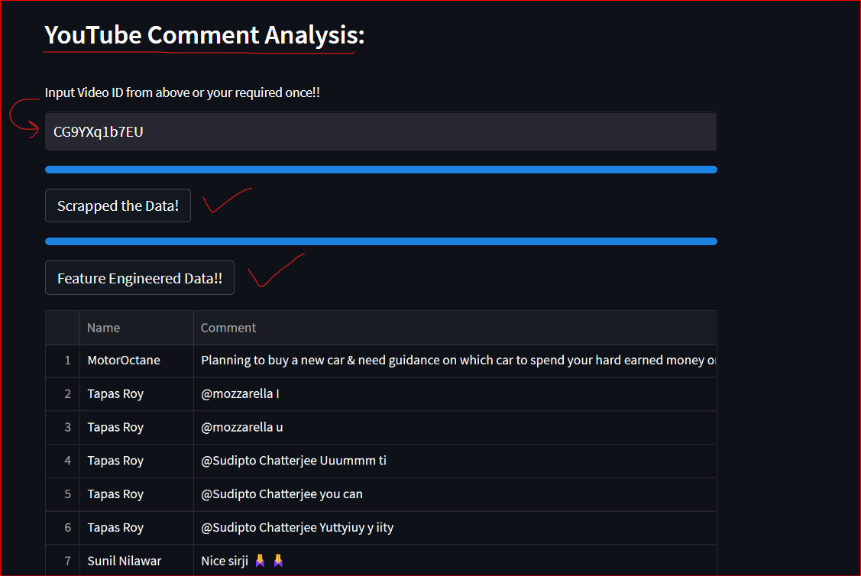
You give your YouTube video_id & DONE! For Entire Insights

Slide 14
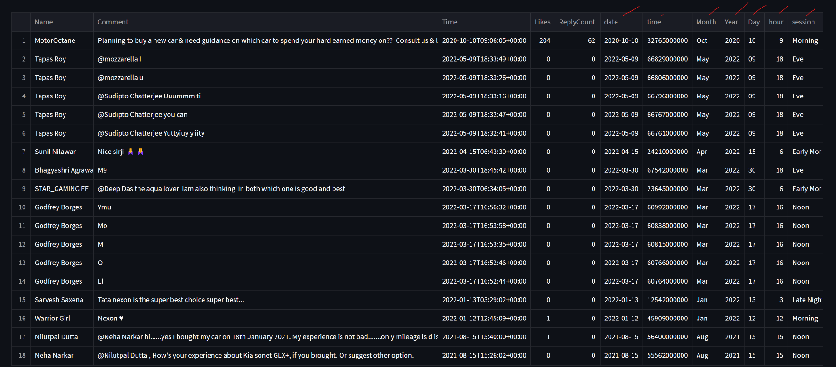
Cleaned and Feature Engineered the Scrapped Data On the Go!!

Slide 15
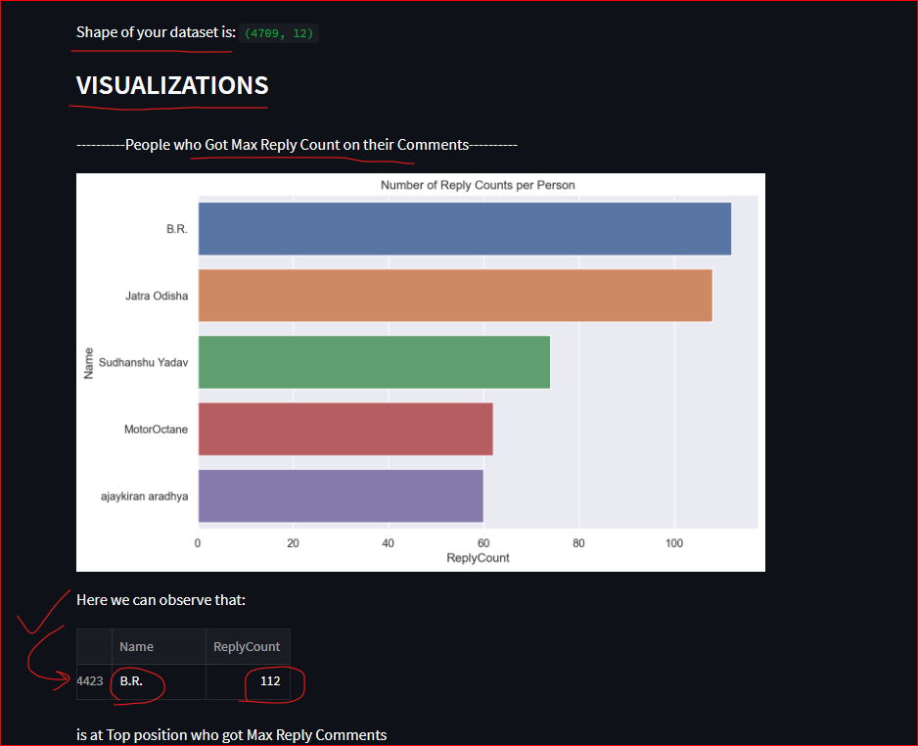

Slide 16
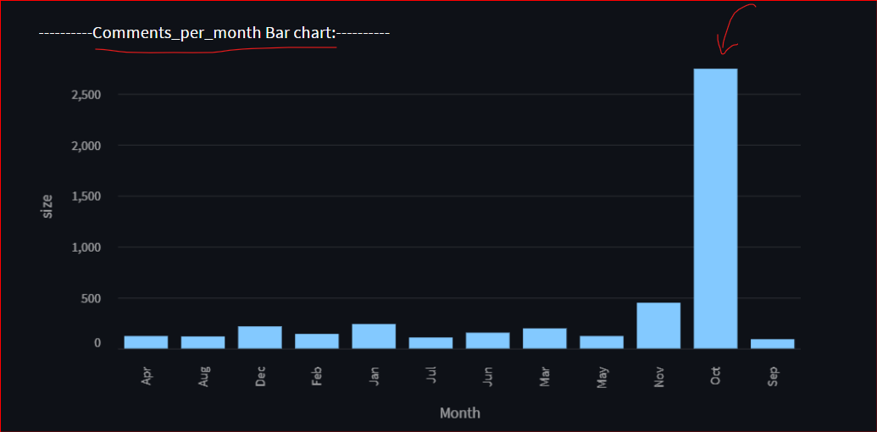
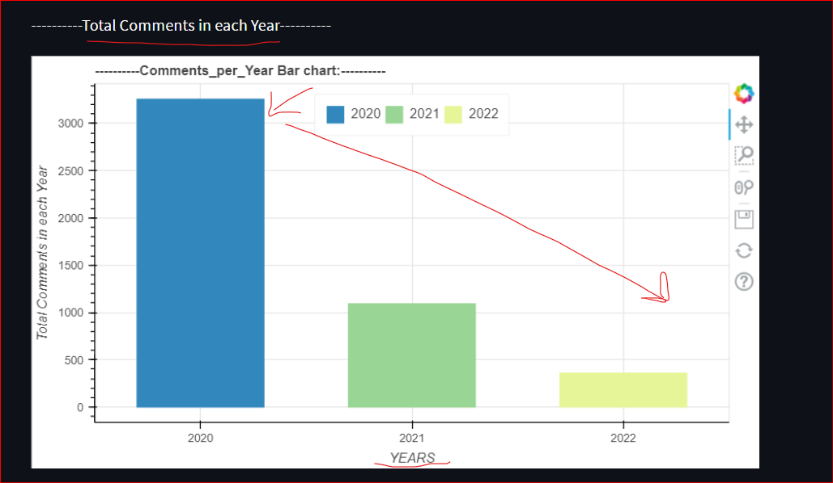

Slide 17
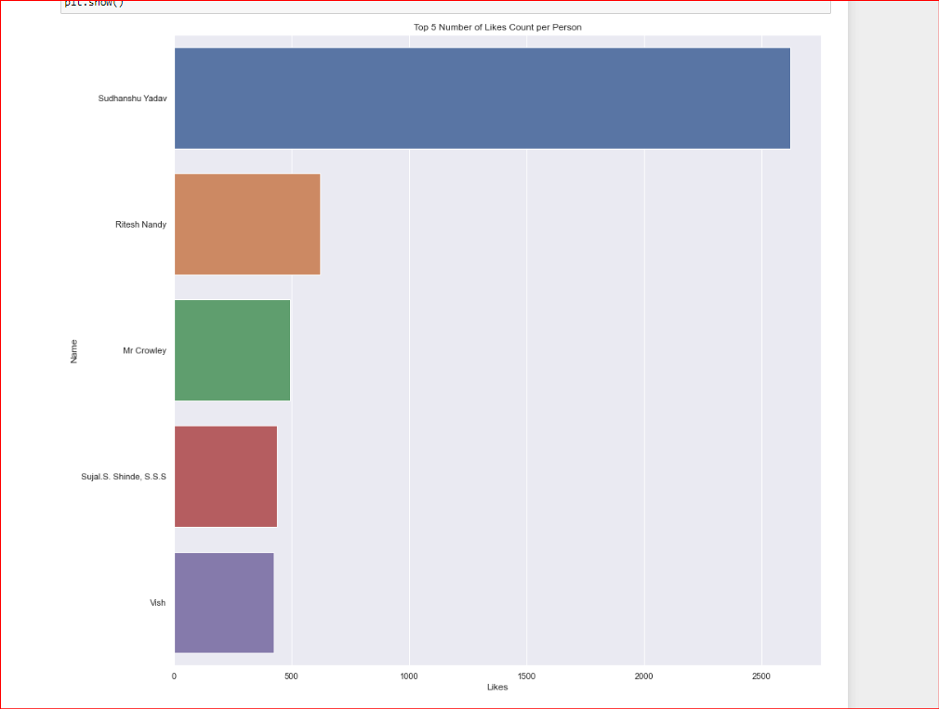

Slide 18
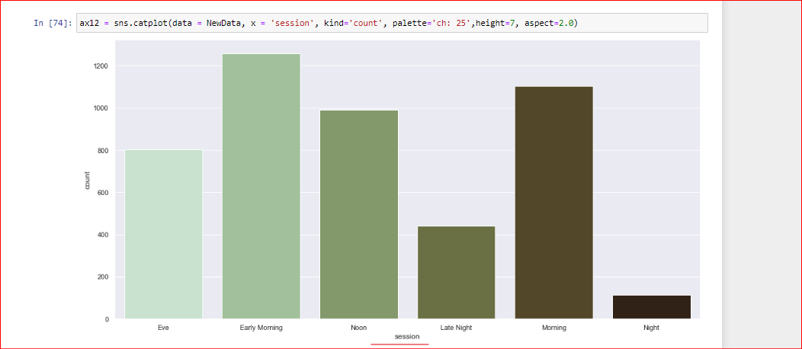
Session wise Comments weightage

Slide 19
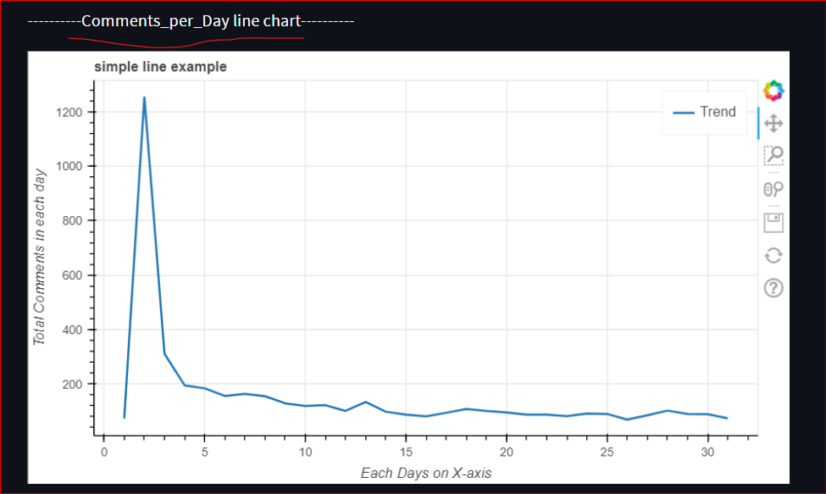
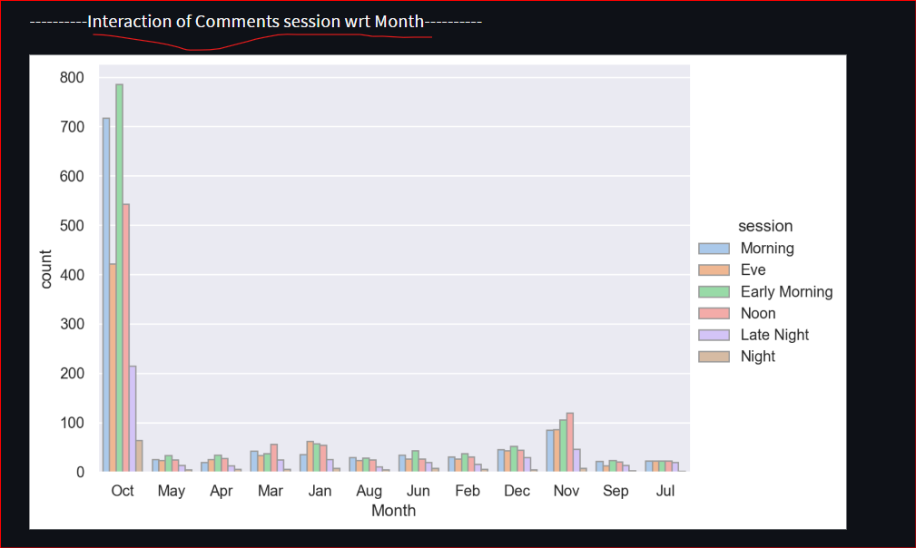

Slide 20
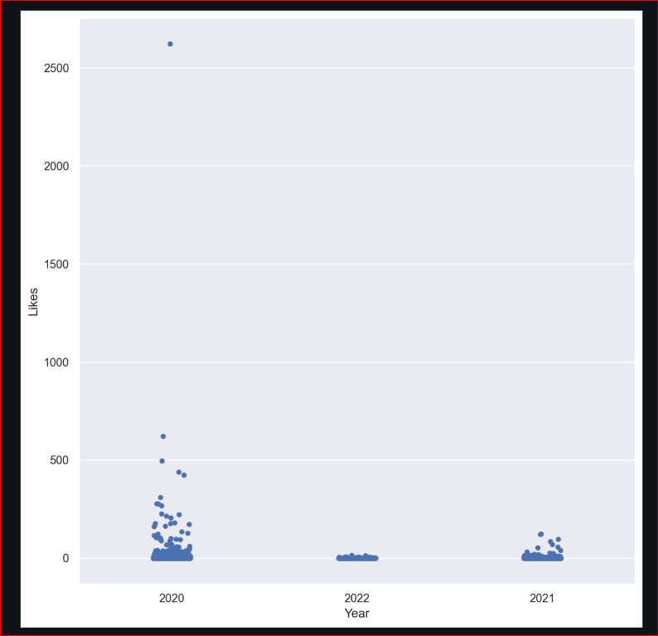
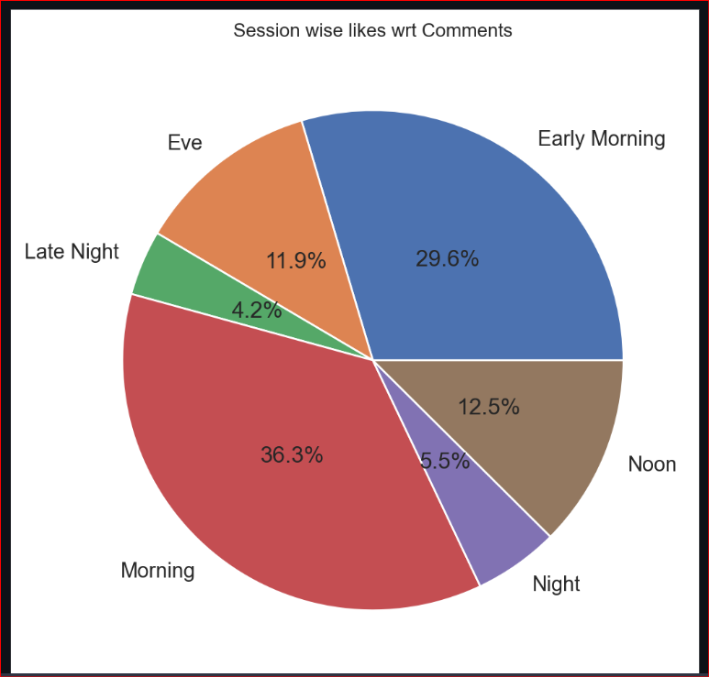
Likes vs Year
Session Wise Like percentage

Slide 21
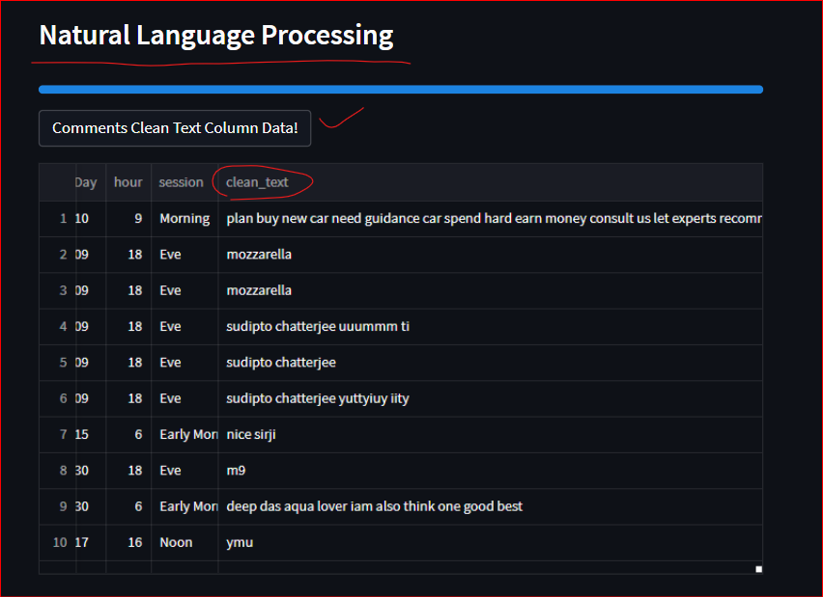
Natural Language Processing
Cleaned the Comment applied various Cleaning functions and using NLTK and Spacy libraries.
Introduced new variable called ‘clean_text’

Slide 22
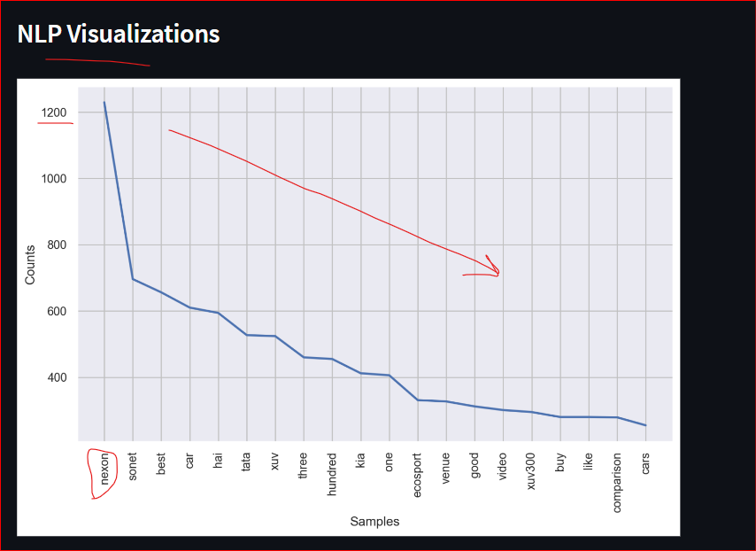
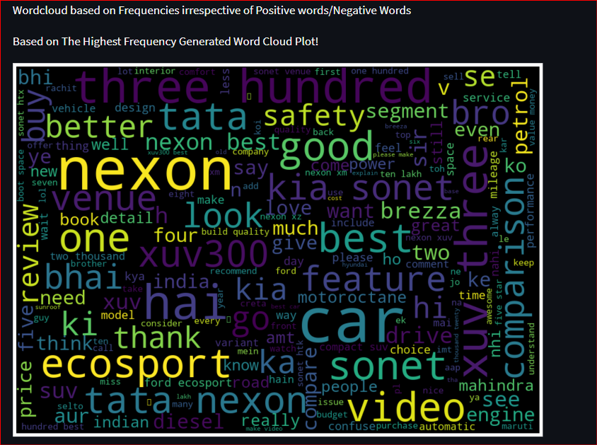

Slide 23
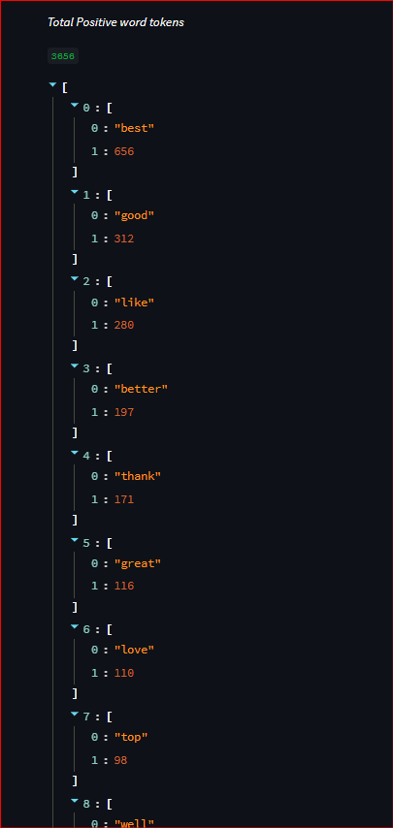
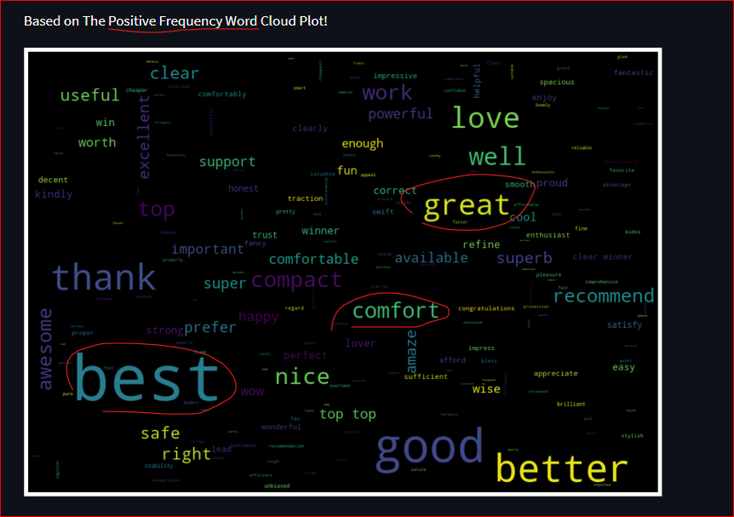
Based on the Positive Frequency Word Cloud Plot!

Slide 24
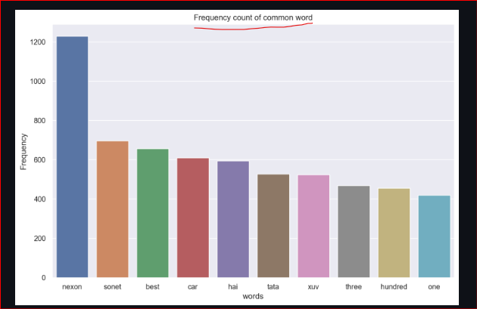
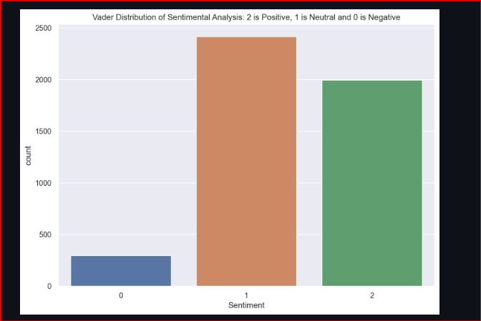
Vader Distribution Scores for Sentiment Analysis (Positive, Neutral and Negative

Slide 25
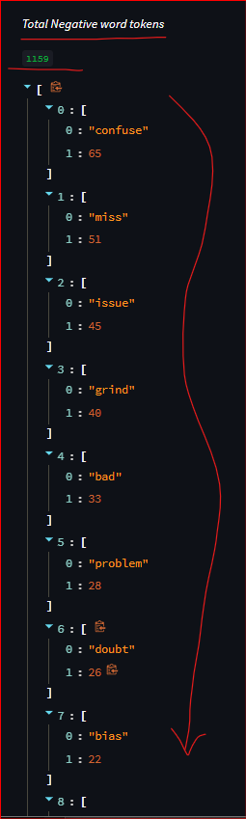
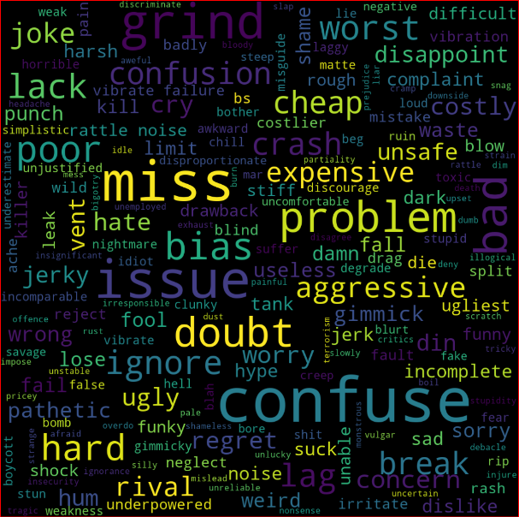
Based on the Negative Frequency Word Cloud Plot!

Slide 26
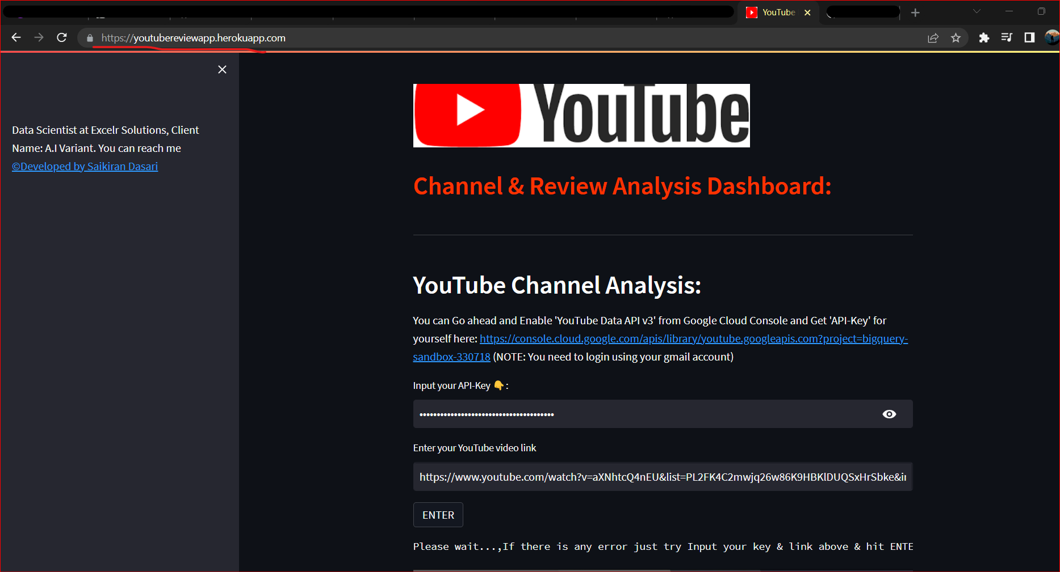
Web App has been Published on HEROKU
Link to access the web app:
https://youtubereviewapp.herokuapp.com/

Slide 27
Researched on Various Other Methods to Scrape the YouTube Data
Other Techniques of Scrapping the Data:
Using ‘Google Sheets’ and Selenium Method
1st Open the Google Sheets, In the 1st Cell Paste the ViedoID
-> and in upper Menu >> Extension >> APPS script and it will open Apps script website
2nd: In Apps scripts we need to Choose YouTube Data API3 service and Paste the Code which I have in Documentation Project Folder{any one as per your requirement}
-> and RUN, and Go to your Google sheets to see the data scrapped!
Drawbacks of Selenium: Time requires to scrape the data is more

Slide 28
Challenges Faced and Overcome Methods:
Since the Project was very Research Intensive(The Scrapping of Data was very tough)
Initially worked on Selenium Automation, but due to large amount of YouTube data it was very difficult to scrape the data quickly.
->Researched on APIs and found way to Scrape the Data Very Quickly On the Go (Open Source) No need to pay anything for APIs
-> Different Types of Visuals needs to be addressed according to the Variables
->The API-Key Security has been enhanced by locking the key in Web App
-> Prototype of the project has been built wherein Number of Clicks were More, by taking Feedback inputs from Mentor
-> Re-Developed the Application with only 3 Clicks the Application able to do all the Work!!
-> Product is very easy to Use, Quick Analysis Visuals and light weight

Slide 29
Thank You

