Slide 1

PROJECT--Tracking_Consumer_Complaints
Project Bootcamp Program
Submitted by: Saikiran Dasari

Slide 2
People Facing Problems in
ACCOUNT OPENING OR CLOSING, DEPOSITS AND WITHDRAWALS, SENDING MONEY.
Dashboard Design Process
To make an analysis of their problems and be taken to resolve them.
To determine what kind of solution which supports solving the problem.
To create a model of the design process of the dashboard, get
feedback, and keep on iterating until the Dashboard is perfect.
To verify the model that meets the goals of the project.

Slide 3

Datasets
The Dataset was provided in Excel File with 172530 Records
Dataset Features:
Domain : Banking Support
Project: Tracking Consumer Complaints
Datasets: US-Complaints_Full-Data.xlsx
Dataset Type: Excel Data
Dataset Size: Excel file has 172k+ records
Company
Company public response
Company response to consumer
Complaint ID
Consumer complaint narrative
Consumer consent provided?
Consumer disputed?
Date received
Date sent to company
Issue
Product
State
Sub-issue
Sub-product
Submitted via
Table Name
Tags
Timely response?
ZIP code
Number of Records

Slide 4
Task List :
Find the total number of customer complaints registered in the whole US.
Find the number of credit card complaints registered by customers.
Find the number of Service complaints registered by customers.
Find out the complaints registered from different states for Top 5 companies.
Find out the responses given to customers.
Find the Timely Response given to Customers.
Complaints registered by customers using Web.
Find the In and Out Responses submitted by Customers.
Find the Percentage of Responses submitted via the web.
Find the types of Issues raised by the Customers.

Slide 5

Most Significant Questions
What are the total complaints received from the consumers?
Which state has the majority of the complaints registered?
What is the status of the Customer Complaints year wise?
Are we able to give timely responses to the customers?
COMPLAINTS DIVIDED INTO CATEGORIES
a. CREDIT CARD COMPLAINTS
b. SERVICE COMPLAINTS.
c. MEANS OF SUBMITTING COMPLAINTS.

Slide 6


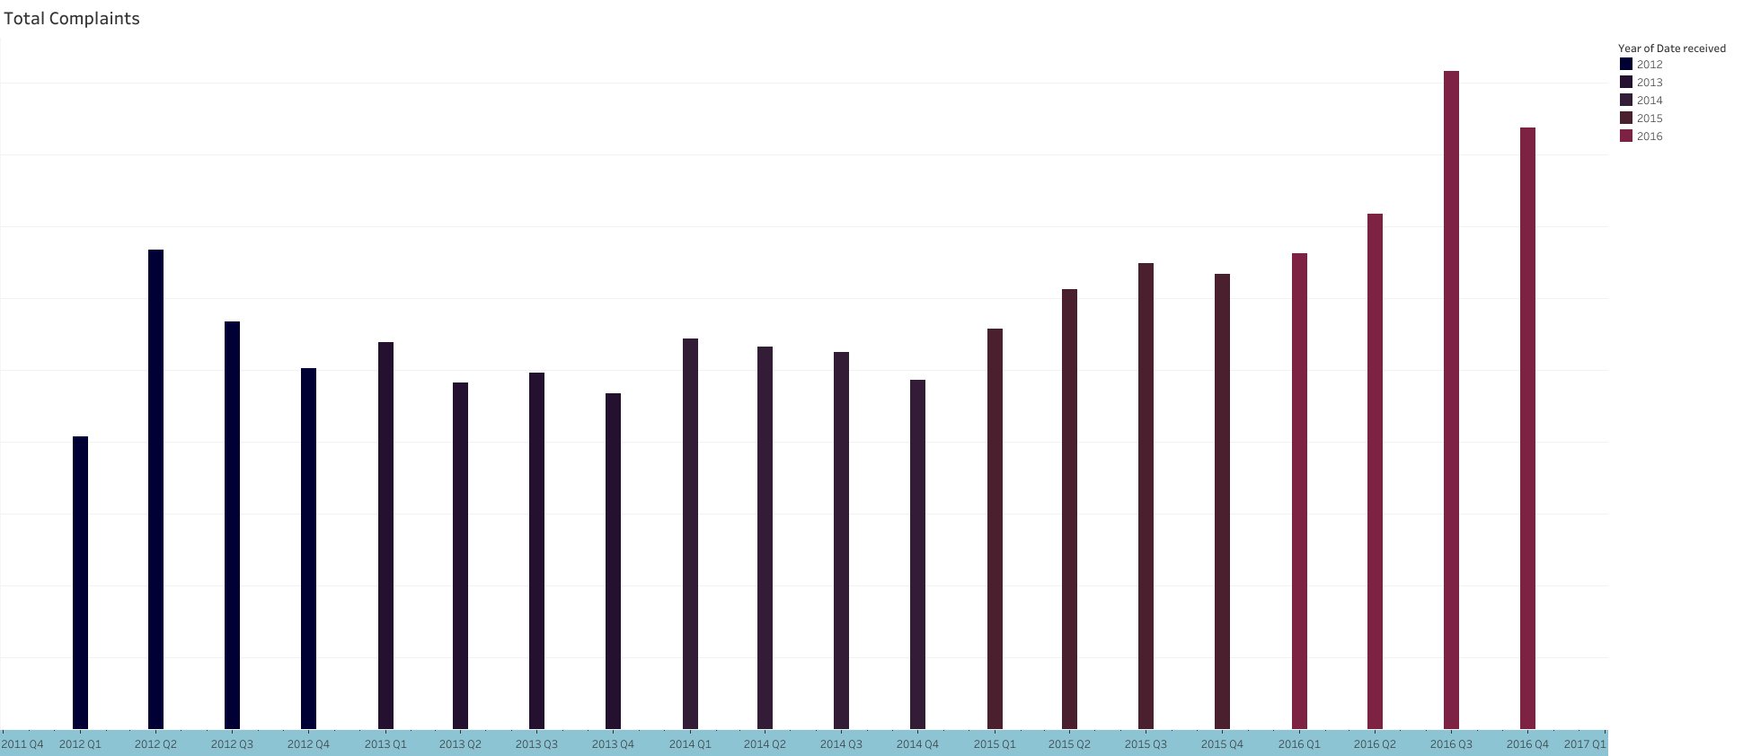

Slide 7




Slide 8


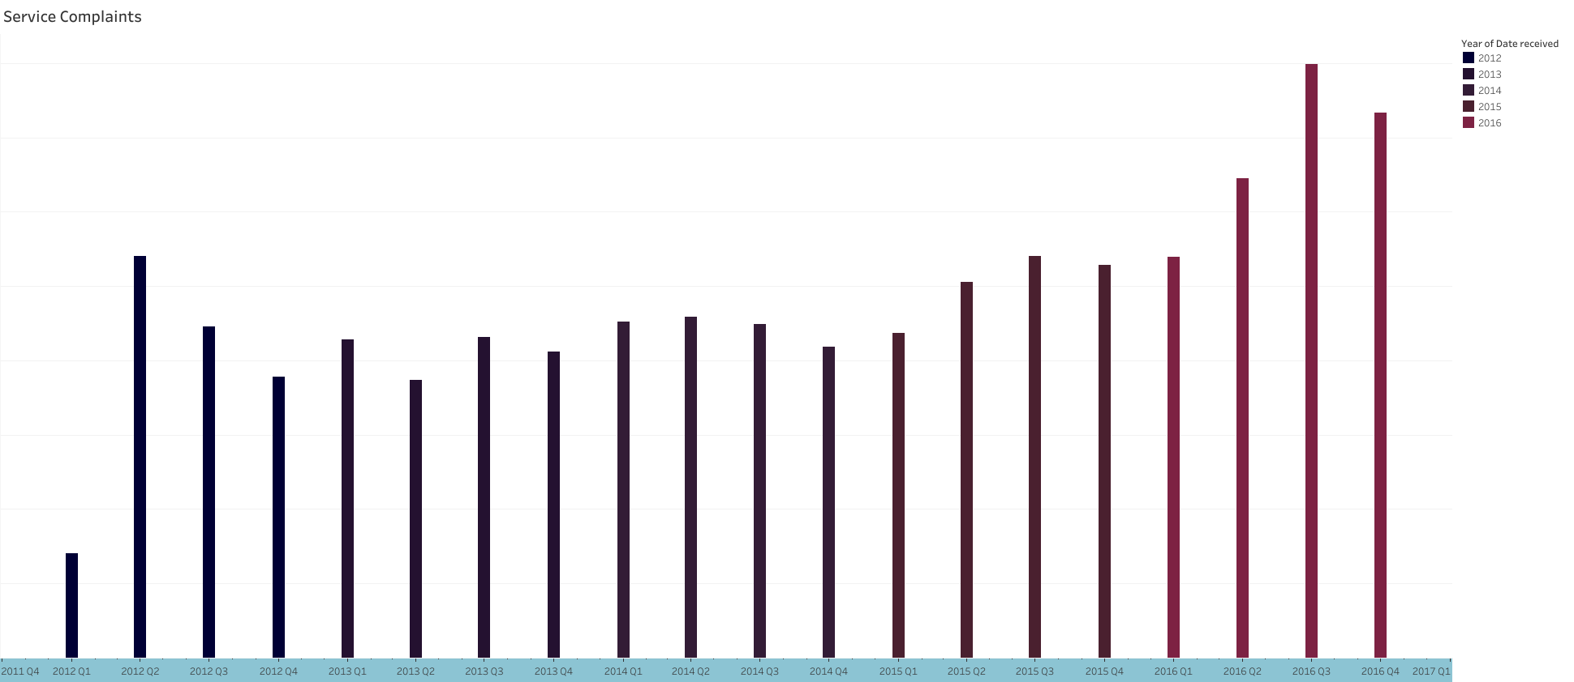

Slide 9

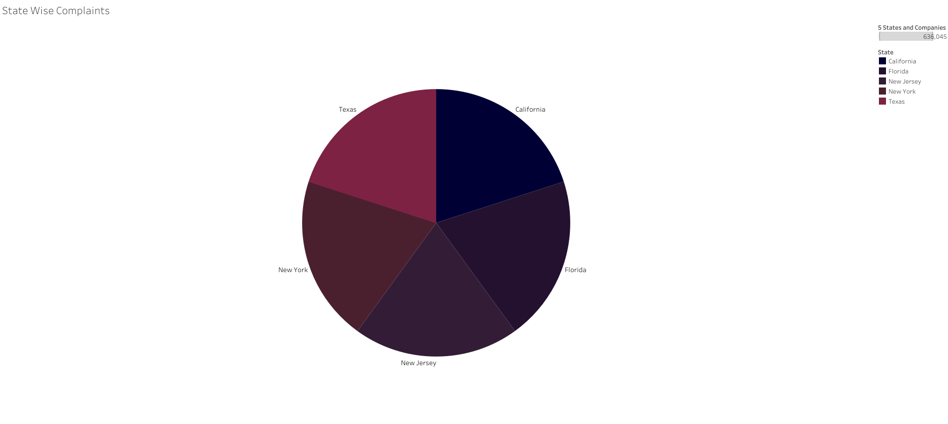

Slide 10

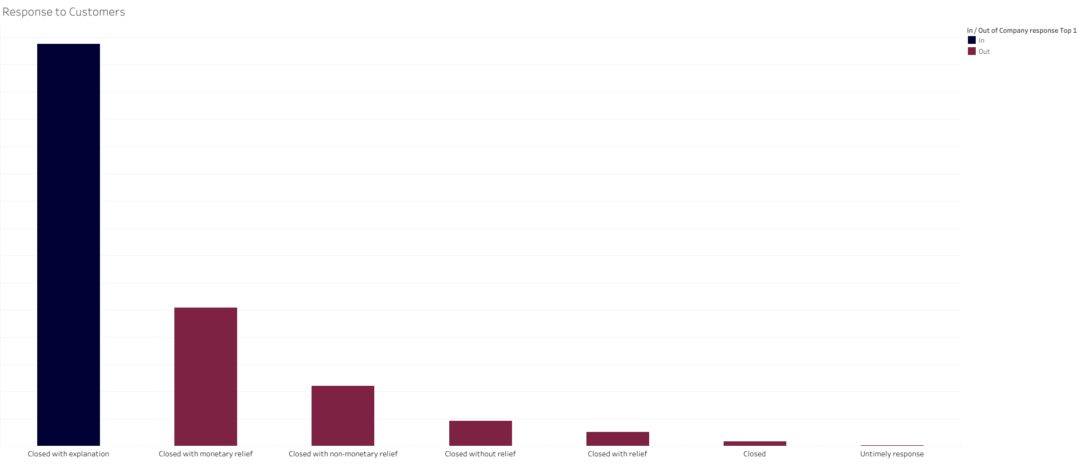
Maximum Companies Responses Closed!

Slide 11

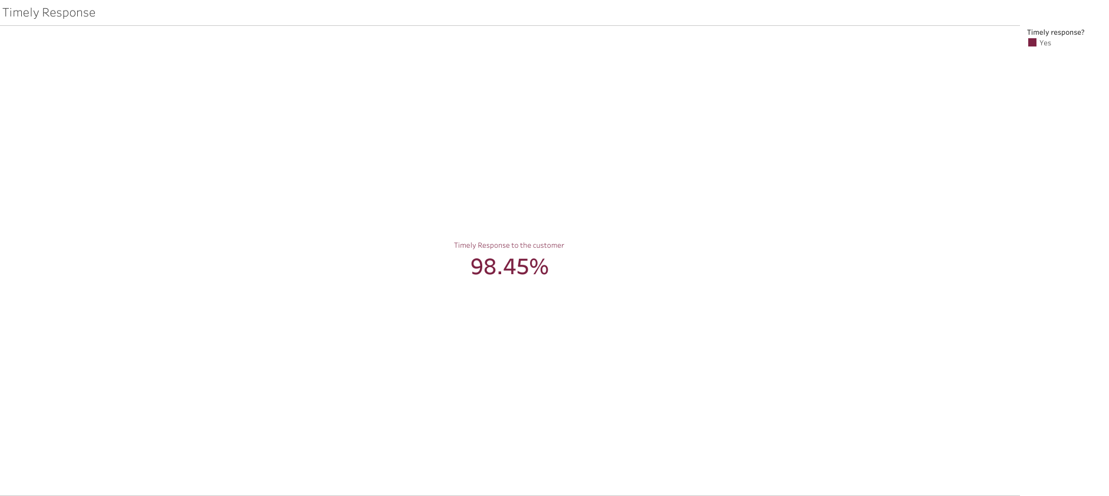
Complaints registered from different states
98% of Timely Responses

Slide 12

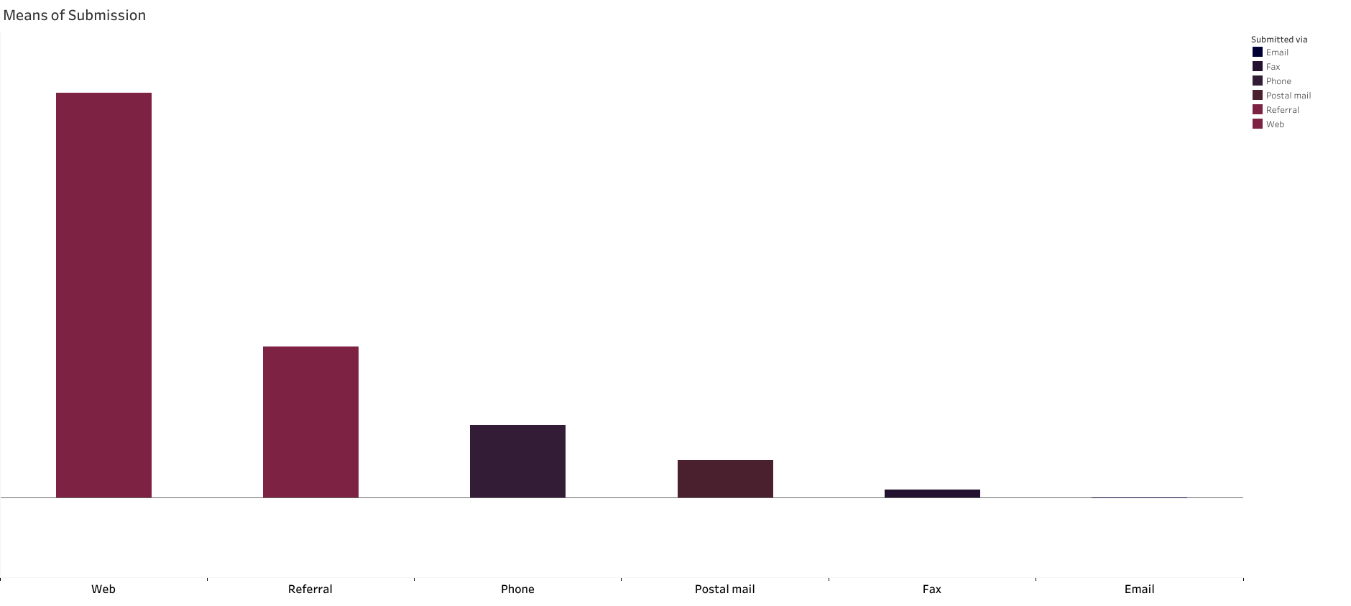
IN and OUT Responses

Slide 13

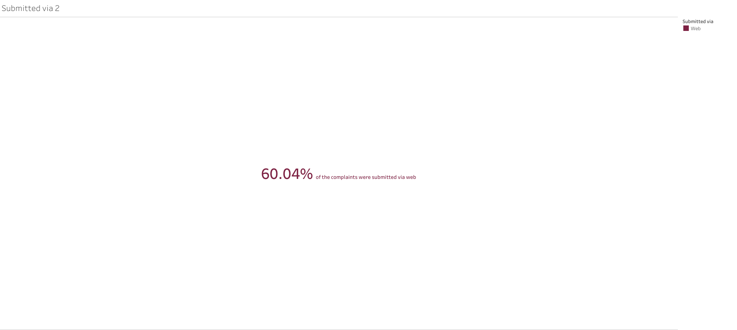
Percentage of responses submitted via WEB

Slide 14

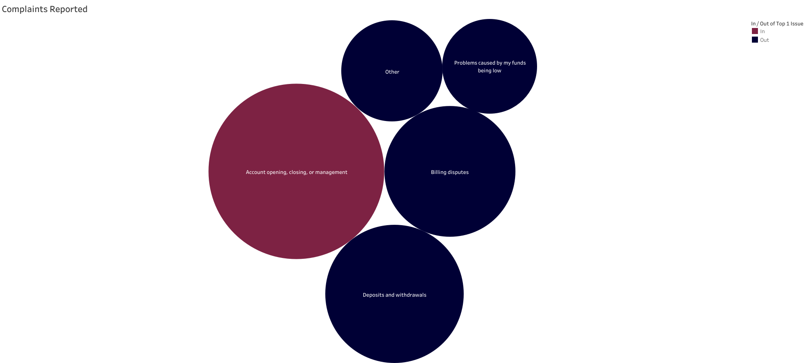
Types of Issues Raised

Slide 15
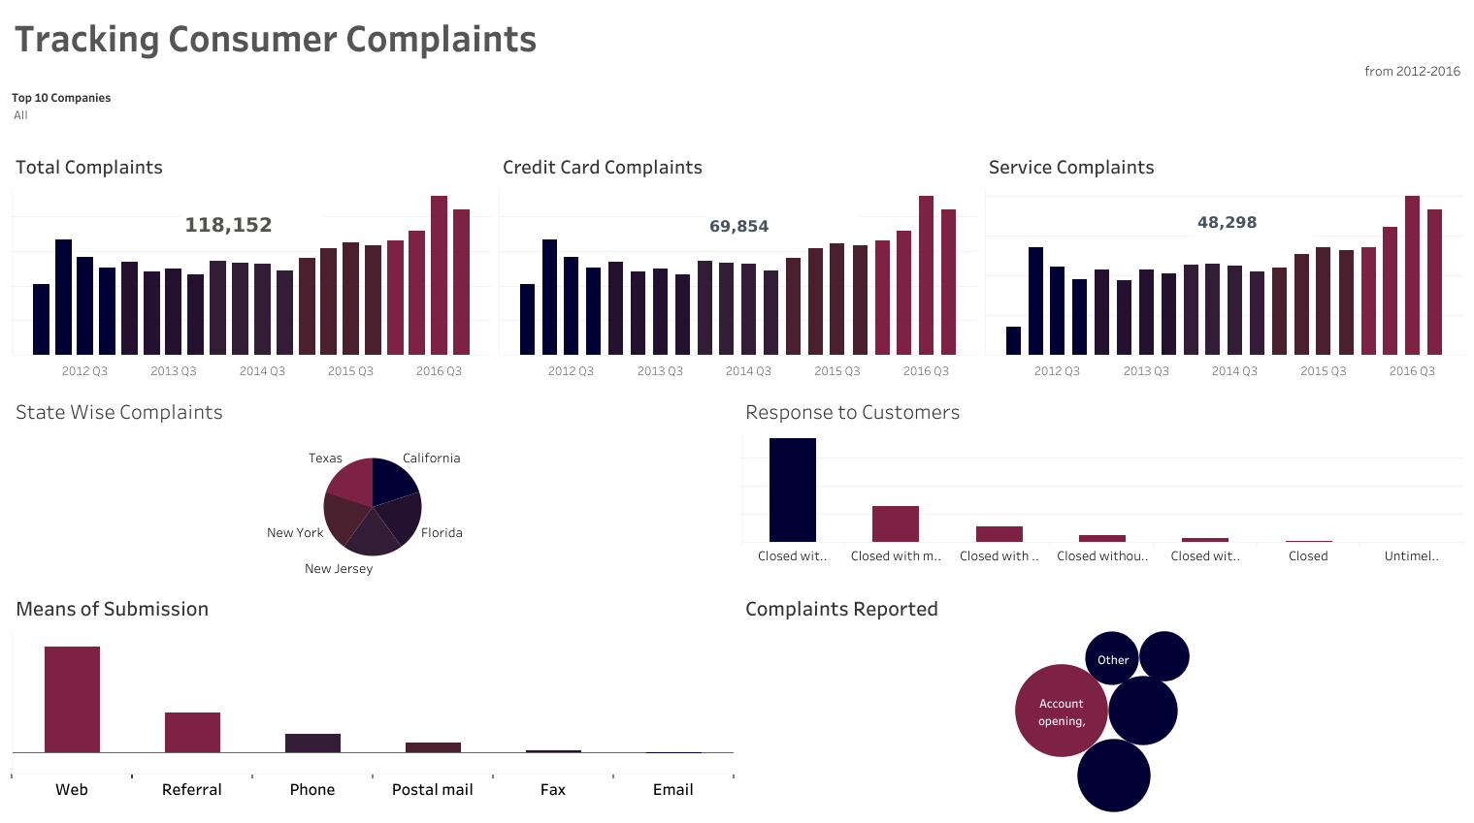


Slide 16
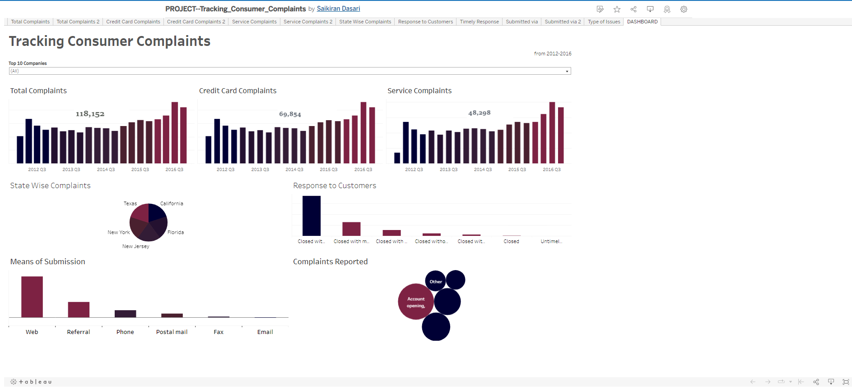
Published the Reports and Dashboard to Tableau Public
https://public.tableau.com/app/profile/saikiran2351/viz/PROJECT--Tracking_Consumer_Complaints/DASHBOARD

Slide 17
THANK YOU

