Slide 1
MINI PROJECT – TESTING EBAY WEBSITE
By Thotakuri Sai Kiran
Under the Guidance of Mrs. Vaishali Sonanis Mam

Slide 2
INTRODUCTION
eBay is a global e-commerce platform that facilitates consumer-to-consumer and business-to-consumer transactions through online auctions and fixed-price listings.
It operates as a dynamic digital marketplace where individuals and enterprises can buy and sell an expansive array of goods—ranging from collectibles, electronics, fashion, and home goods to vehicles and industrial equipment.

Slide 3
RESPONSIBILITIES
Create Test Plan
Create Test Cases
Automate Test Cases for each Module
Create Test Analysis Report
Find Defects and create Defect Report

Slide 4
OVERVIEW
eBay is a global e-commerce platform that facilitates consumer-to-consumer and business-to-consumer transactions through online auctions and fixed-price listings.
Why Use eBay ?
eBay is a trusted marketplace where you can find almost anything—often at great prices—buying new or used items, bidding in auctions, or selling your own products to millions of buyers worldwide.

Slide 5
MODULES
Module 1 : Login Page :Validate username (email) and password fields.
Check error handling for invalid credentials.
If Confirmed successful login then redirect to next page.
Module 2 : Search Multiple Items :Test with various search terms ( "watch," "phone," “headphones").
Verify auto-suggestions and result relevance.
Ensure the search feature returns accurate results.

Slide 6
Module 3 : Add to Cart : Search for a specific item (" Samsung Galaxy S10 5G ").
Add the item to cart and verify cart updates
Validate the cart workflow for a seamless shopping experience.
Module 4: Remove from Cart: Navigate to the cart and remove the added item.
Confirm cart updates and return to homepage.
Ensure users can easily modify their cart.

Slide 7
Module 5 : Update Username :Navigate to account settings and edit the username.
Verify field clearance, new input acceptance, and save confirmation.
Module 6 : Update Address: Edit address fields (street, city, state, postal code).
Confirm submission and error handling for invalid inputs.

Slide 8
Module 7 : Shop by Category :
Perform category-based product browsing. Access any particular category via hover menu.
Verify redirection to category page and subcategory selection.
Module 8: Shop by CategoryAll : Select All Categories
Select any particular category from the dropdown and trigger search.
Confirm results match the chosen category.

Slide 9
Module 9: Footer Link Validation : Test footer navigation links. Click any footer link and verify page load.
Validate return to homepage post-navigation.
Module 10 : Logout : Test secure session termination
Logged out via account flyout menu.
Verify redirection to sign-in page and session clearance.

Slide 10
DEFECTS
While checking the responsiveness of the eBay site on multiple devices , responsiveness in the
mobiles is not working properly which is considered as a defect, so I created a defect report on it.

Slide 11
DEFECT IDENTIFIER: Def_ebay_001
Defect Summary: Responsiveness in mobiles is not working properly
Test ID: TC_001
Test Case Name: TC _responsiveness of mobile
Module Name : Responsiveness
Reproducible: 1.Open eBay on mobile
2. Check responsiveness of the eBay site
Severity: Medium
Priority: Medium
Raised by: Thotakuri Sai Kiran(Tester Name)
Assigned to: Reeva Shah(Team Lead Name)
Date of Assignment: 18-08-2025
Status: opened
Snap Shots:
Fixed by: Shiva Upadhyay(Developer name)
Date of fixing:
Approvals: Nisha Mandot(Manager name)

Slide 12
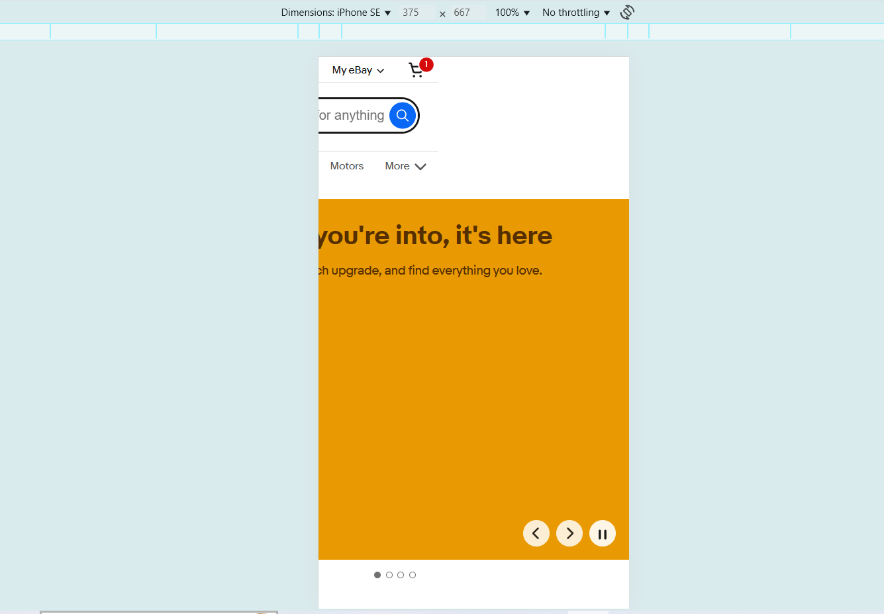

Slide 13
CHALLENGES
Tests failing randomly due to slow page loads
CAPTCHA/verification interrupting automation flow.
Issues Due To Unstable Or Slow Internet

Slide 14
EXPERIENCE
Gained hands-on experience in e-commerce testing by working on eBay
Gained hands-on experience in automating web applications
Using Selenium WebDriver and TestNG
Worked with real-world scenarios like profile updates and address modifications.
Learned to handle test failures.

Slide 15
THANK YOU

